Slide 1
Introduction to Structures:
Definition and Initialization of Structures, Accessing structure members, Nested Structures, Array of Structures, Structures and Functions, Unions, typedef, Enumerated Data types.

Slide 2
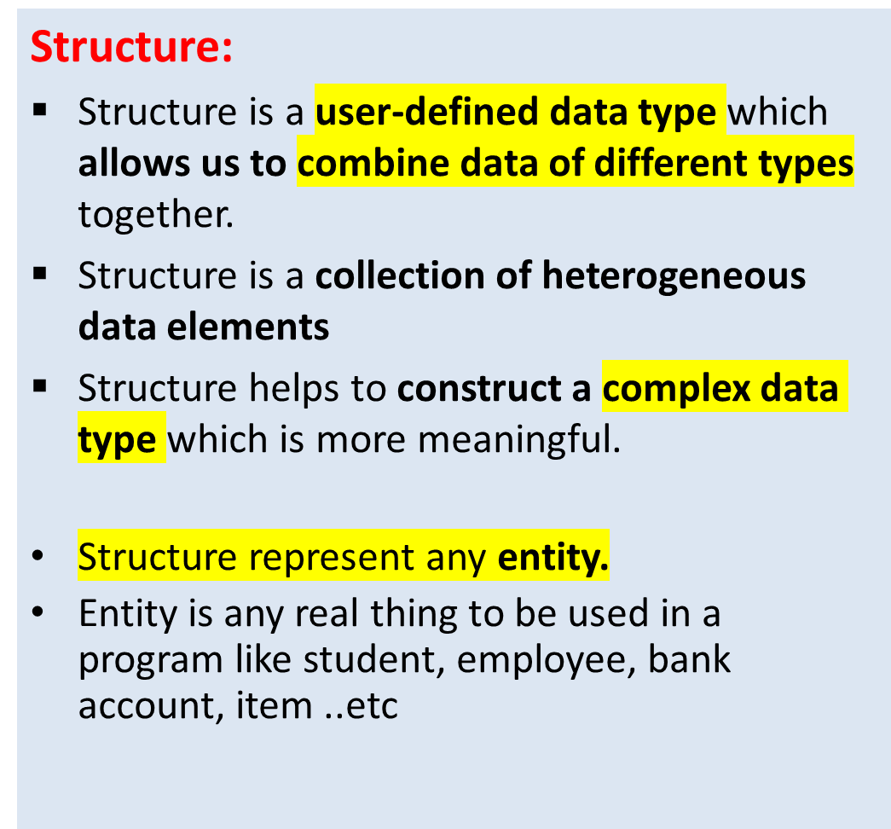
Structures
Example:
If Student is an entity, its properties are
  Roll number
  Name
  Cgpa
If Employee is an entity, its properties are
  Name
  Designation
  Salery ..etc

Slide 3
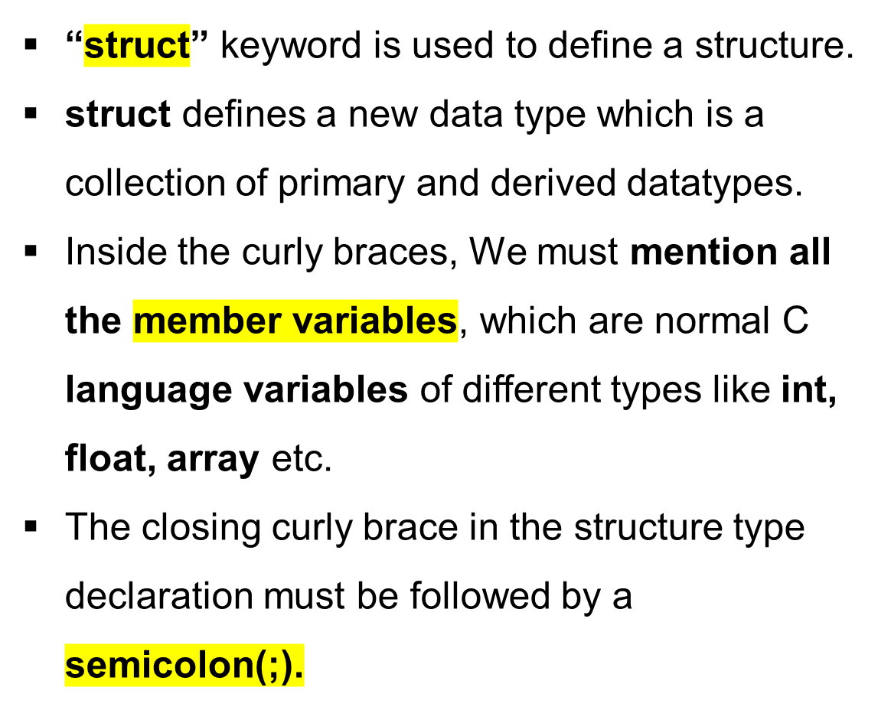
Defining a Structure
Defining a structure
Syntax:
  struct structure_name
  {
  datatype 1 variable 1;
  datatype2 variable 2;
  datatype3 variable 3;
  ...
  };

Slide 4
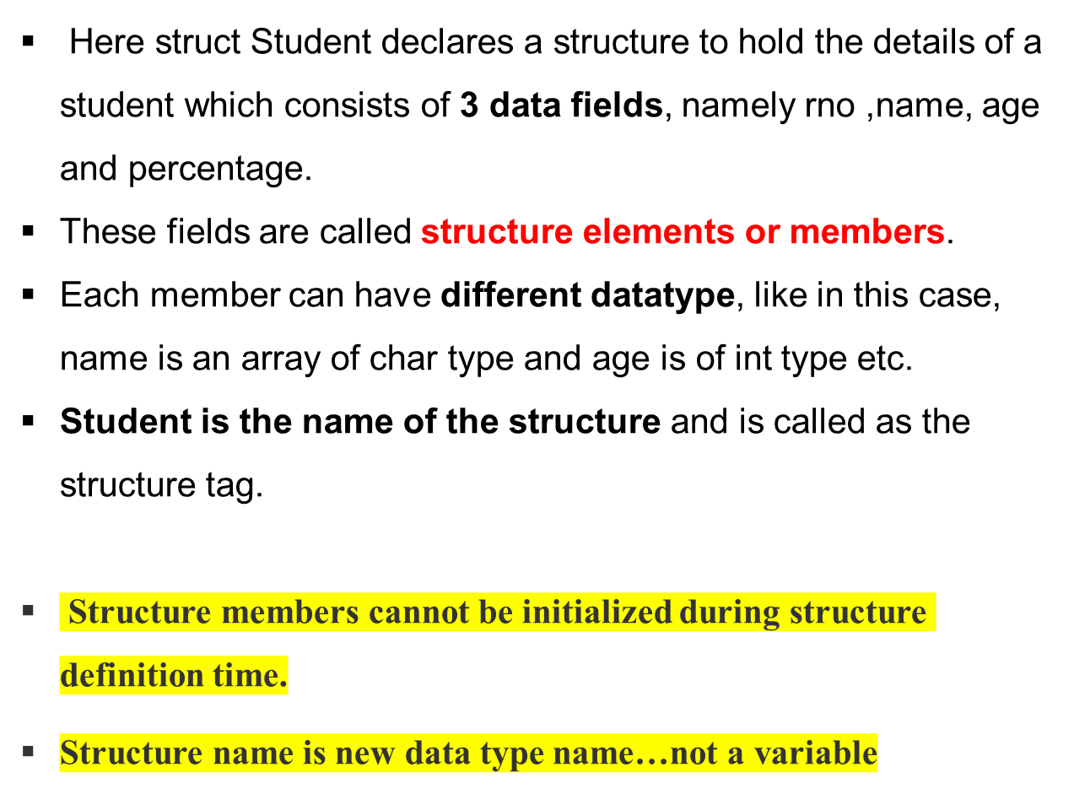
Defining Structure
Example of Structure
struct student
{
int rno;
char name[20];
float percentage;
};
rno, name and percentage are structure memembers

Slide 5
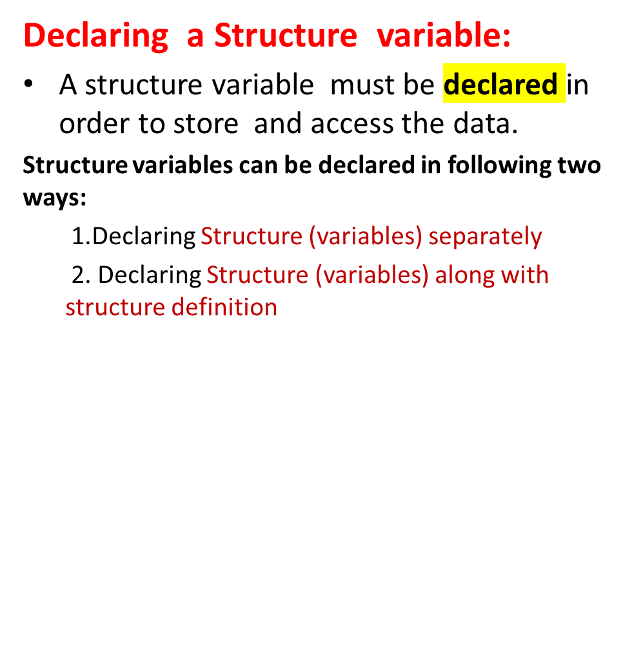
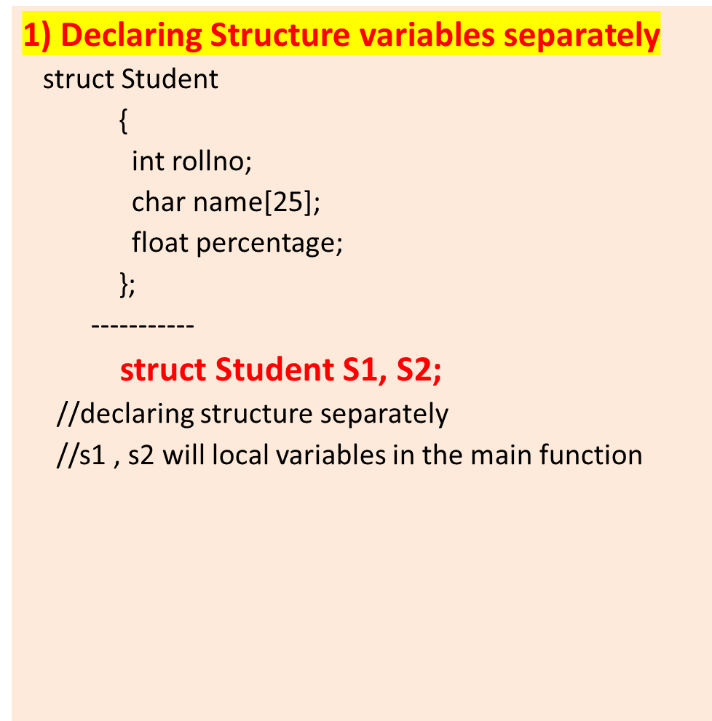
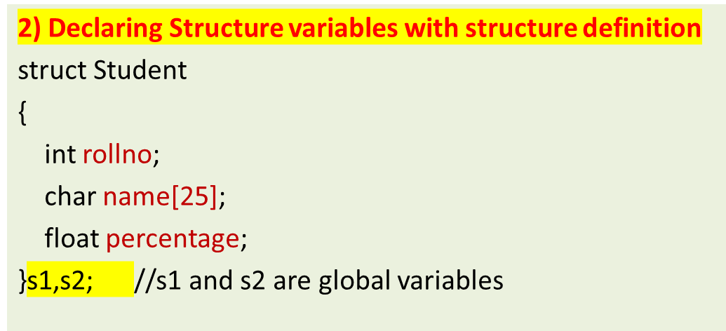
Structure Variable Declaration

Slide 6
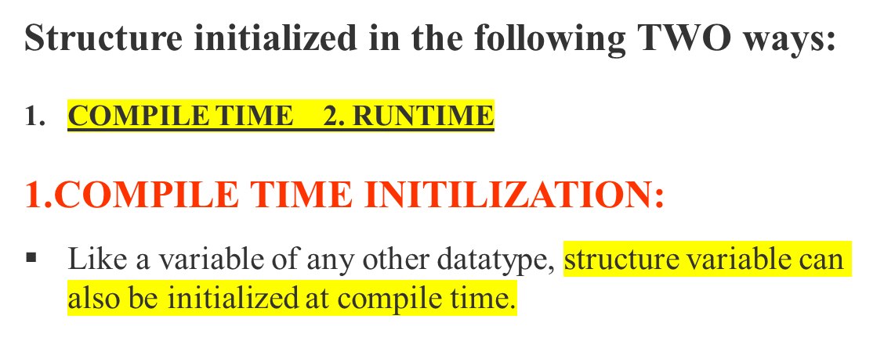
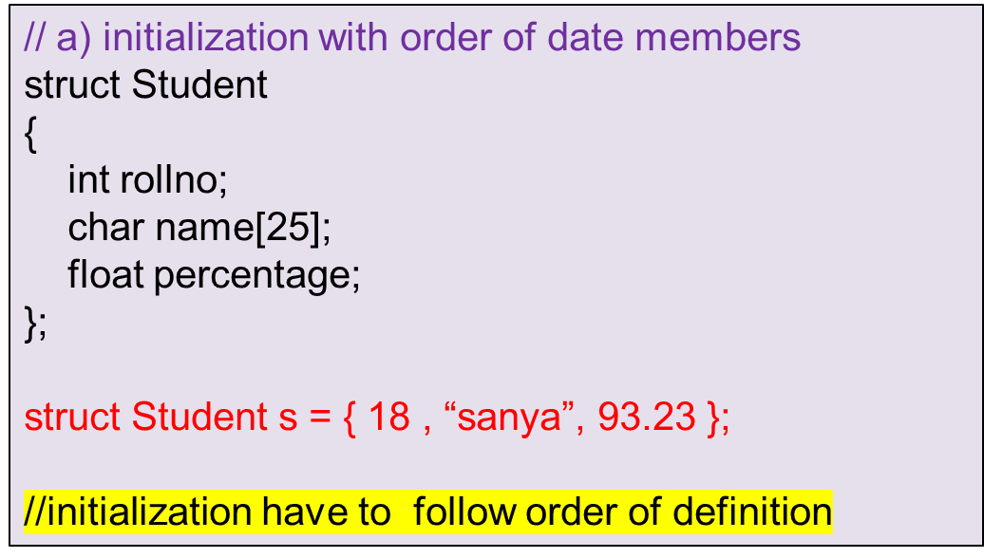
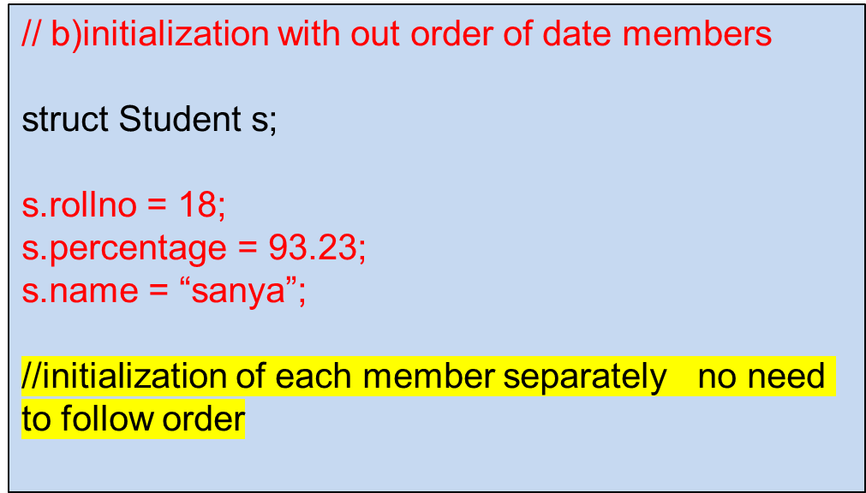
Structure Initialization

Slide 7
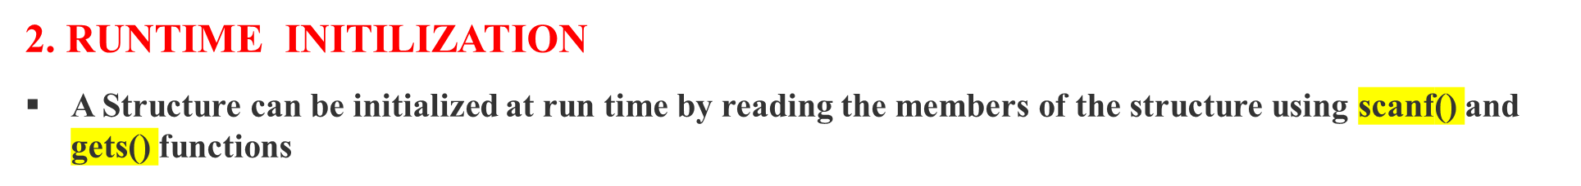
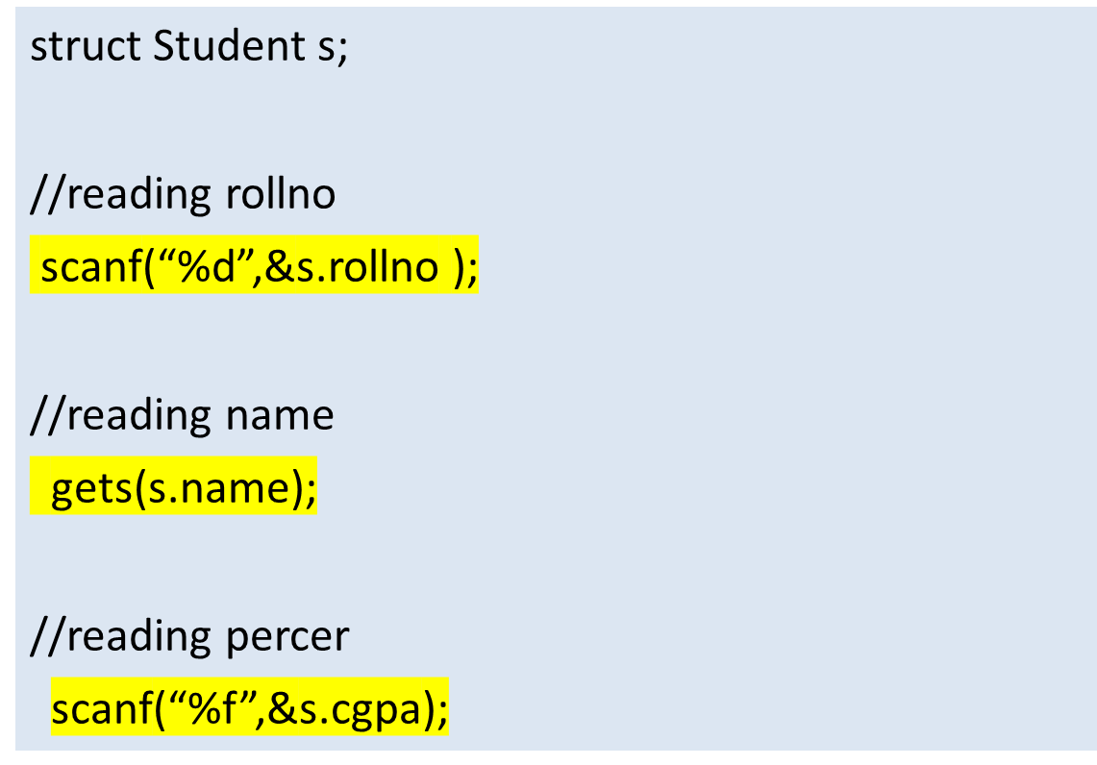
Structure Initialization
Ex.
#include<stdio.h>
#include<string.h>
struct Student
{
int rollno;
char name[25];
float cgpa;
};

Slide 8
Structures
Q) Write a C Program create a student structure with rno, name and cgpa. Read and display the data members of the same
  INPUT:
  Enter Rollno: 856
  Name: Sachin
  cgpa: 9.35
  OUTPUT:
  Rollno is : 856
  Name is : Sachin
  cgpa is : 9.35
    LOGIC:
    Create a structure with data members
    Declare structure variable
    Initialize the structure members
    Display them

Slide 9
Q) Write a C Program create a student structure with rno, name and cgpa. Read and display the data members of the same
#include <stdio.h>
struct Student {
int rno;
char name[100];
float cgpa;
};
int main()
{
struct Student s1;
printf("Enter student rno: ");
scanf("%d", &s1.rno);
printf("Enter student name: ");
getchar();
gets(s1.name);
printf("Enter student CGPA: ");
scanf("%f", &s1.cgpa);
// Display the entered information
printf("Student rno: %d\n", s1.rno);
printf("Student name: %s\n", s1.name);
printf("Student CGPA: %.2f\n", s1cgpa);
return 0;
}

Slide 10
Structures
Logic:
Define a structure called Rectangle with length and width as members.
Prompt the user to enter the dimensions of two rectangles.
calculate the areas of both rectangles ..as area = length * width.
Compare the areas of the two rectangles
If the area of the first rectangle is greater, display “the first rectangle has a larger area”.
If the area of the second rectangle is greater, display “second rectangle has a larger area”
If both rectangles have the same area, display they have equal areas.
Input:
Enter length and width of RECT-1: 5.2 3.7
Enter length and width of RECT-2: 4.8 6.1
Output:
The RECT-2 has a larger area.

Slide 11
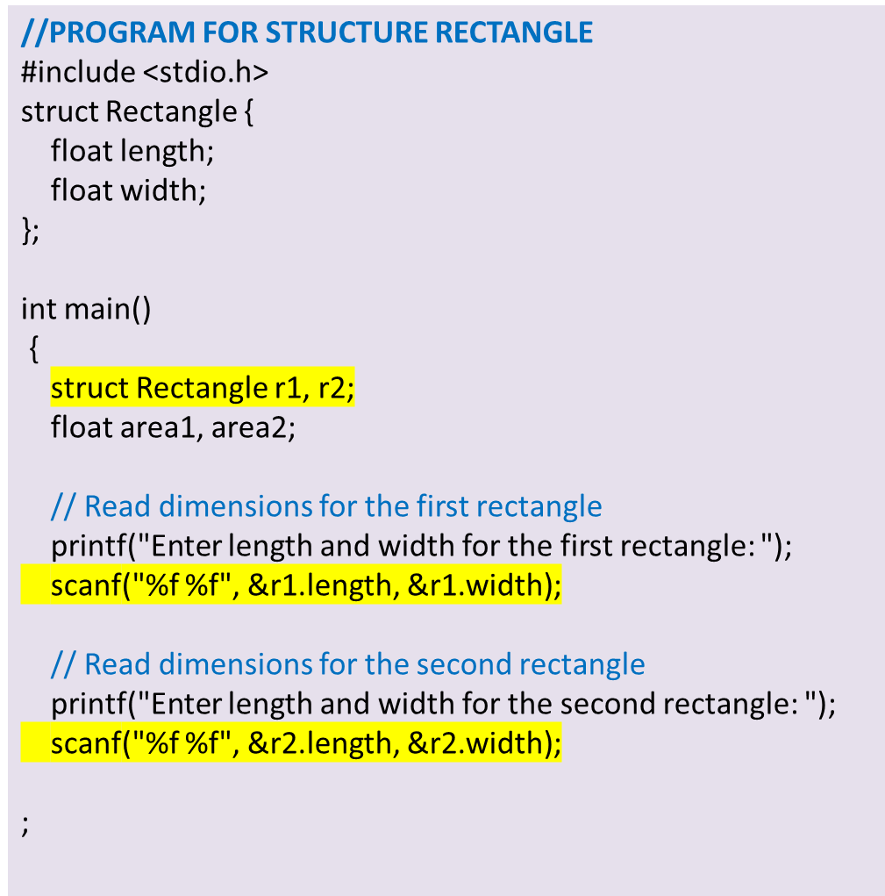
// Calculate areas
area1 = r1.length * r1.width;
area2 = r2.length * r2.width
// Compare areas and display the result
if (area1 > area2) {
printf(“RECT-1 has a larger area.\n");
} else if (area2 > area1) {
printf(“RECT-2 has a larger area.\n");
} else
{
printf("Both rectangles have equal areas.\n");
}
return 0;
}
OUTPUT:
Enter length and width for the first rectangle: 5.2 3.7
Enter length and width for the second rectangle: 4.8 6.1
The second rectangle has a larger area.

Slide 12
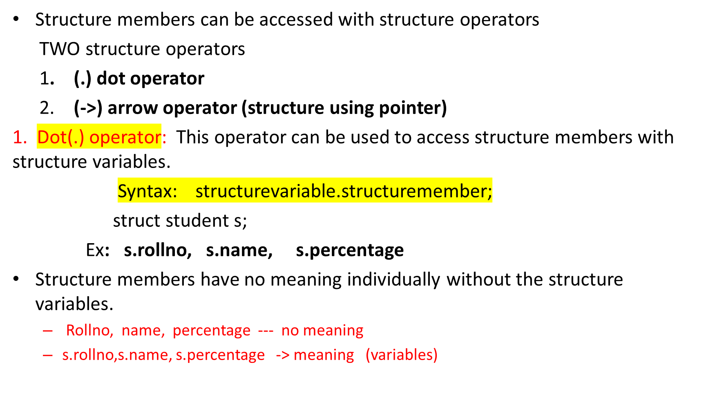
Accessing structure members

Slide 13
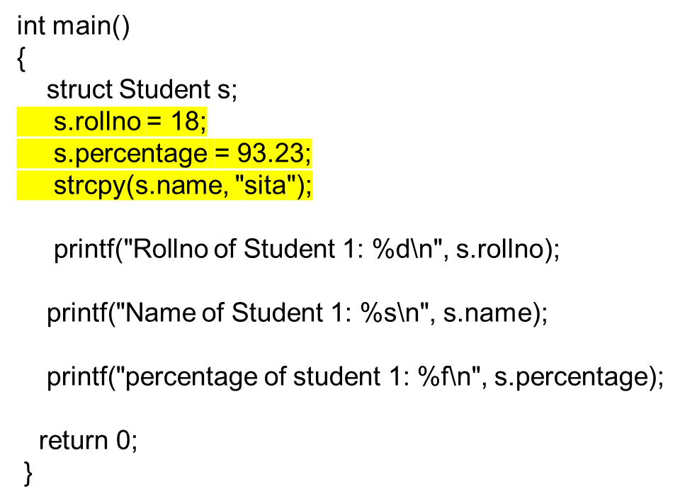
Accessing structure members using .(dot) operator
// C program to access structure members using dot(.) operator
#include<stdio.h>
#include<string.h>
struct Student
{
int rollno ;
char name[25];
float percentage;
};

Slide 14
Structure Pointer /pointer to structure
  The structure pointer points to the address of a memory block where the Structure is being stored.
  we use a structure pointer which tells the address of a structure in memory by pointing pointer variable ptr to the structure variable.
Declare a Structure Pointer
Syntax: struct struct_name *ptrname;
Ex. struct student *p;
Initialization and allocation of memory to the Structure Pointer
//memory should create for pointer variables using malloc
p=(struct student *)malloc(sizeof(struct student));

Slide 15
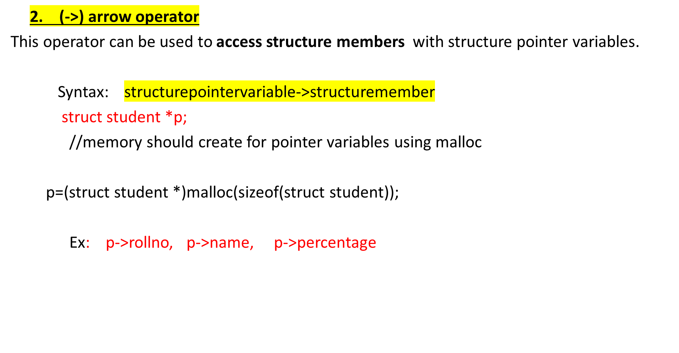
Accessing structure members using -> operator

Slide 16
Accessing structure members using pointer
void main()
{
struct Emp *p;
p=(struct Emp *)malloc(sizeof(struct Emp));
p->eno = 3518;
p->sal = 85000.50;
strcpy(p->name, “samarth");
printf(" Emp number : %d\n", p->eno);
printf("Name : %s\n", p->name);
printf(“Salary : %f\n", p->sal);
}
//Using Arrow operator
#include<stdio.h>
#include<string.h>
struct Emp
{
int eno;
char ename[25];
float sal;
};

Slide 17
Structure pointer
Q) Write a C Program create a student structure pointer with name, rno and cgpa. Read and display the data members of the same
  INPUT:
  Name: Sachin
  Enter rno: 856
  cgpa: 9.35
  OUTPUT:
  Name is : Sachin
  Rollno is : 856
  cgpa is : 9.35
    LOGIC:
    Create a structure with data members
    Declare structure pointer variable
    Initialize the structure members
    Display them

Slide 18
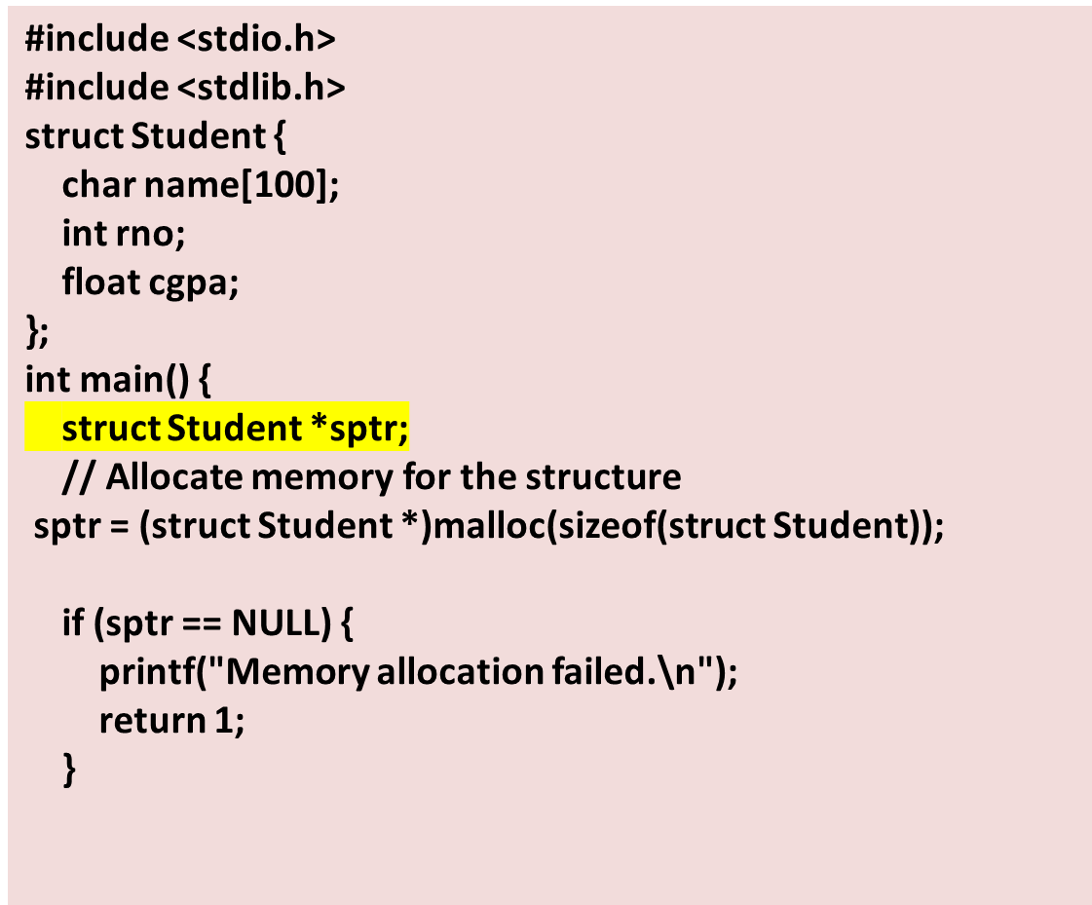
Q) Write a C Program create a student structure pointer with name, age and marks. Read and display the data members of the same
/* Read information using the pointer*/
printf("Enter student name: ")
scanf (" %s", & sptr ->name);
printf("Enter student rno: ");
scanf("%d", &(sptr ->rno));
printf("Enter student marks: ");
scanf("%f", &(sptr ->cgpa));
// Display the entered information
printf("Student name: %s", sptr->name);
printf("Student age: %d\n", sptr->rno);
printf("Student marks: %.2f\n", sptr->cgpa);
// Free the allocated memory
free(sptr);
return 0;
}

Slide 19
Q): Create a structure called Complex that represents a complex number with real and imaginary parts.
Write a program that reads two complex numbers from the user and calculates their sum.
Input:
The user will be prompted to enter the real and imaginary parts of two complex numbers.
Output:
The program will display the sum of the two complex numbers.
Logic
Define a structure called Complex with real and imaginary parts as members.
Prompt the user to enter the real and imaginary parts of two complex numbers.
Read the real and imaginary parts for each complex number.
Calculate the sum of the two complex numbers by adding their corresponding real and imaginary parts.
Display the sum of the two complex numbers.

Slide 20
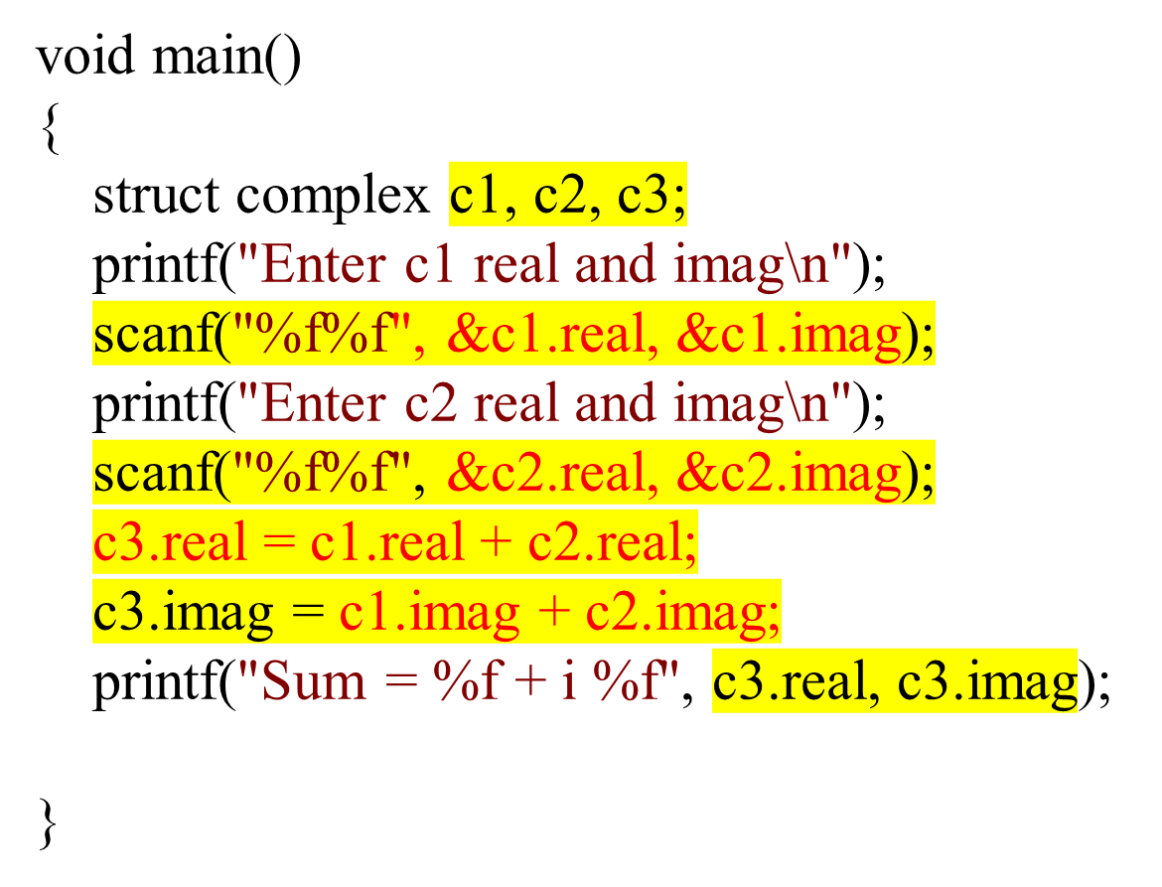
//addition of 2 complex numbers using structures
#include <stdio.h>
struct complex
{
float real;
float imag;
};

Slide 21
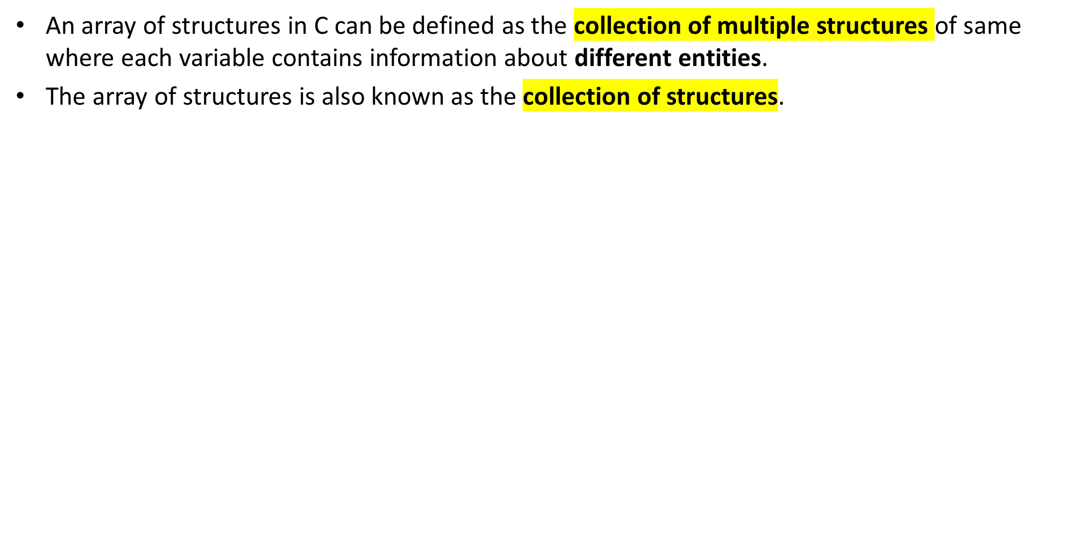
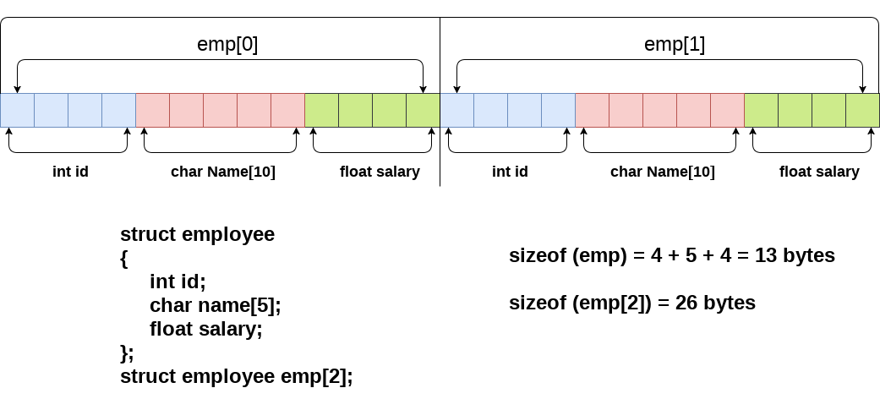
Array of structures

Slide 22
Array of structures
Index—0 Emp[0].id, emp[0].name, emp[0].salary
Index -- 1 Emp[1].id, emp[1].name, emp[1].salary
Index -- i Emp[i].id, emp[i].name, emp[i].salary
//an array of structures that stores information of 5 students and prints it.
int main()
{
int i;
struct student st[5];
printf("Enter Records of 5 students");
for(i=0;i<5;i++){
printf("\nEnter Rollno:");
scanf("%d",&st[i].rollno);
printf("\nEnter Name:");
scanf("%s",&st[i].name);
}
printf("\nStudent Information List:");
for(i=0;i<5;i++){
printf("\nRollno:%d, Name:%s",st[i].rollno,st[i].name);
}
return 0;
}
#include<stdio.h>
#include <string.h>
struct student{
int rollno;
char name[10];
};

Slide 23
Array of structures
Q) Create a structure called Employee that represents an employee with name, id, and salary members. Write a program that reads information for five employees and displays the details of the employee with the highest salary.
Input:
The user will be prompted to enter the information (name, id, and salary) for five employees.
Output:
The program will display the details (name, id, and salary) of the employee with the highest salary.
Logic:
Define a structure called Employee with name, id, and salary as members.
Prompt the user to enter the information for five employees.
Read the information for each employee and store it in an array of Employee structures.
Iterate through the array of employees and find the employee with the highest salary.
Display the details (name, id, and salary) of the employee with the highest salary.

Slide 24
//PROGRAM FOR ARRAY OF STRUCURE
#include <stdio.h>
struct Employee
{
char name[100];
int id;
float salary;
};
int main()
{
struct Employee emp[5];
int i, maxSalaryIndex;
// Read information for five employees
for (i = 0; i < 5; i++) {
printf("Enter name, ID, and salary for emp %d: ", i + 1);
scanf("%s %d %f", emp[i].name, &emp[i].id, &emp[i].salary);
}
// Find the employee with the highest salary
maxSalaryIndex = 0;
for (i = 1; i < 5; i++) {
if (emp[i].salary > emp[maxSalaryIndex].salary)
{
maxSalaryIndex = i;
}
}
// Display the employee with the highest salary
printf("\n Employee with the highest salary:\n");
printf("Name: %s\n", emp[maxSalaryIndex].name);
printf("ID: %d\n", emp[maxSalaryIndex].id);
printf("Salary: %.2f\n", emp[maxSalaryIndex].salary);
return 0;
}
Enter name, ID, and salary for employee 1: John 1234 5000
Enter name, ID, and salary for employee 2: Mary 5678 4500
Enter name, ID, and salary for employee 3: Peter 4321 5500
Enter name, ID, and salary for employee 4: Lisa 9876 4800
Enter name, ID, and salary for employee 5: David 2468 5200
Employee with the highest salary:
Name: Peter
ID: 4321
Salary: 5500.00

Slide 25


Nested Structures
It is structure within structure.
When a structure contains another structure, it is called nested structure
i.e.One structure variable can be declared inside other structure as a structure member.
Syntax:
struct name_1
{
member_1;
member_2;
.
member_n;
struct name_2
{
member_1;
member_2;
.
member_n;
}var1;
} var2;
Outer Structure
Inner strucure

Slide 26
Nested Structures
Structure within structure. –examples
A nested structure variable can be declared in TWO ways:
  Structure within structure using normal variable
  Structure within structure using pointer variable
struct employee
{
char name[20];
struct address
{
char city[20];
int pin;
char phone[14];
};
};
struct address
{
char city[20];
int pin;
char phone[14];
};
struct employee
{
char name[20];
struct address add;
};

Slide 27
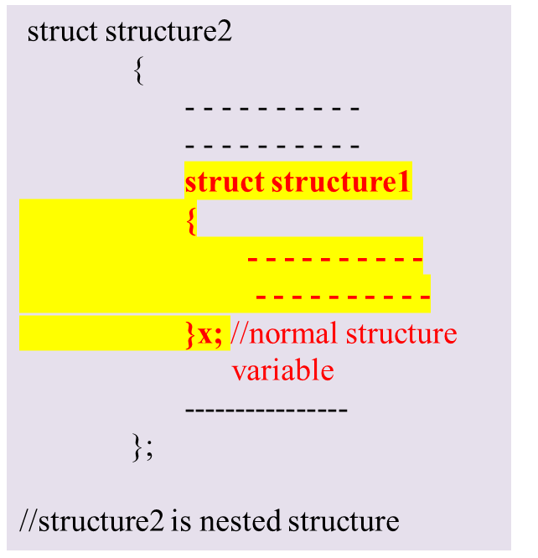
1.Structure within structure using normal variable
One structure can be declared inside other structure as a structure member using normal structure variable
Example:
struct student
{
int rollno;
char name[20];
float percentage;
struct Date
{
int day;
int month;
int year;
}d; //normal structure variable
};
//student is nested structure

Slide 28
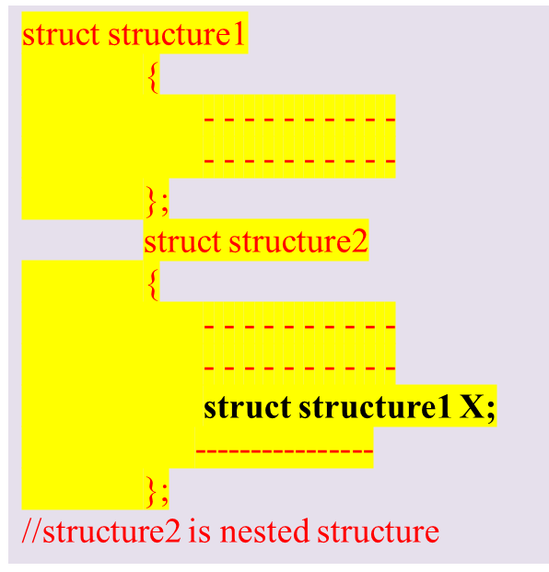
Structure within structure using normal variable
Accessing the nested structure members using normal structure variable:
d is normal variable
s.rollno , s.name, s.d.day, s.d. month ,s.d.year, s.percentagae
program
Example:
struct Date
{
int day;
int month;
int year;
};
struct student
{
int rollno;
char name[20];
struct Date d;
float percentage;
};

Slide 29
2.Structure within structure pointer variable
One structure can be declared inside other structure as a structure member using pointer structure variable
Syntax:
struct structure2
{
- - - - - - - - - -
- - - - - - - - - -
struct structure1
{
- - - - - - - - - -
- - - - - - - - - -
}*X; //x is declared as pointer variable
----------------
};
Example:
struct student
{
int rollno;
char name[20];
struct Date
{
int day;
int month;
int year;
}*d; // d is a pointer variable
float percentage;
};

Slide 30
Structure within structure using pointer variable
Accessing the nested structure members using pointer structure variable:
d is pointer
s.rollno, s.name, s.d->day, s.d->month, s.d->year, s.percentage
program
struct structure1
{
- - - - - - - - - -
- - - - - - - - - -
};
struct structure2
{
- - - - - - - - - -
- - - - - - - - - -
struct structure1 *X;
----------------
};
Example:
struct Date
{
int day;
int month;
int year;
};
struct student
{
int rollno;
char name[20];
struct Date *d;
float percentage;
};

Slide 31
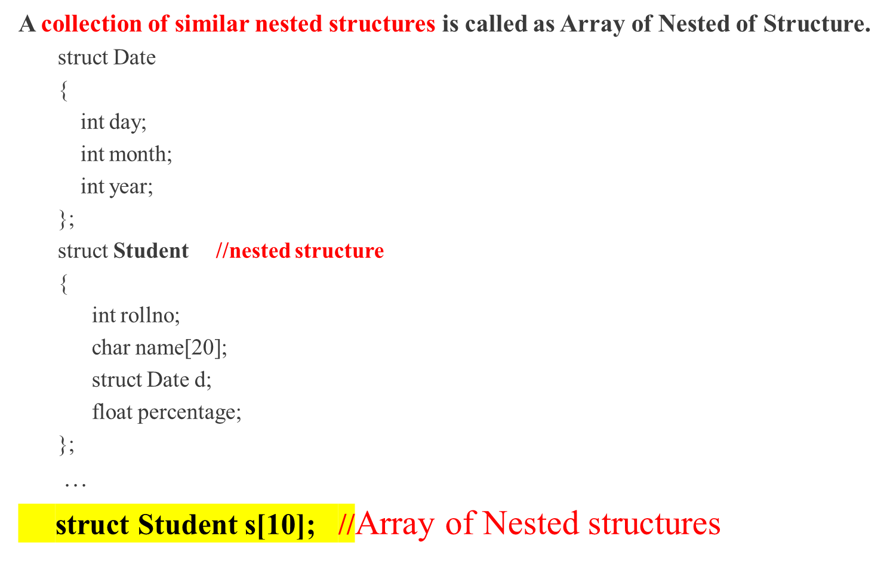
Array of Nested structures

Slide 32
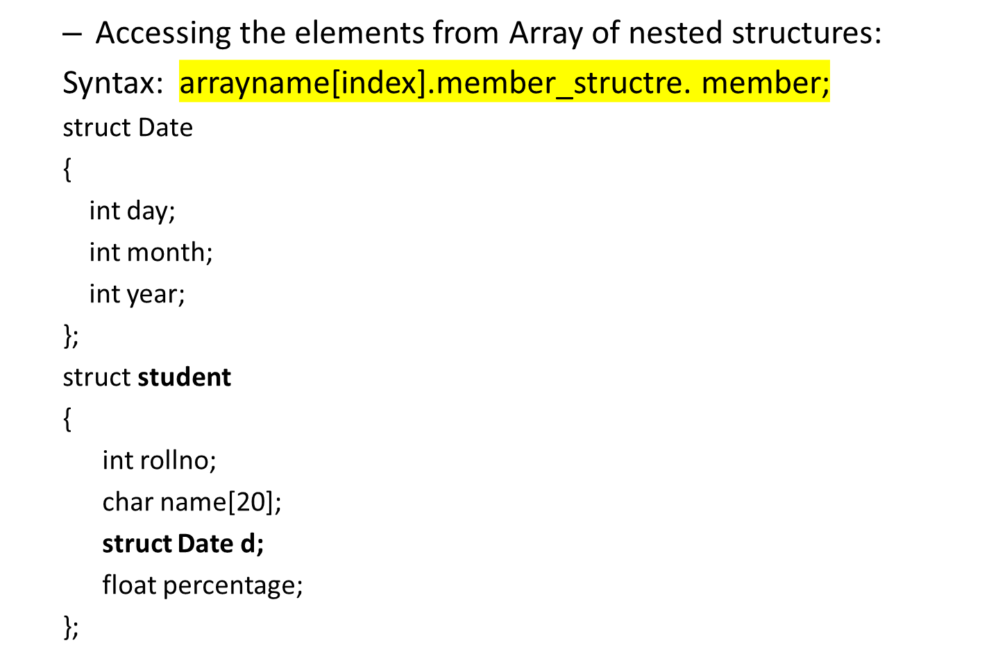
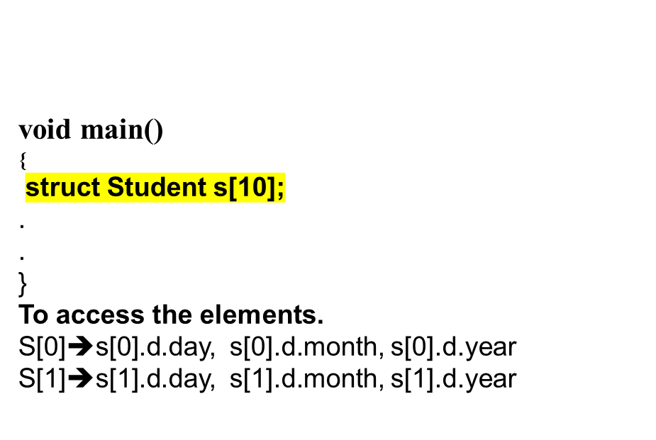
Array of Nested structures

Slide 33
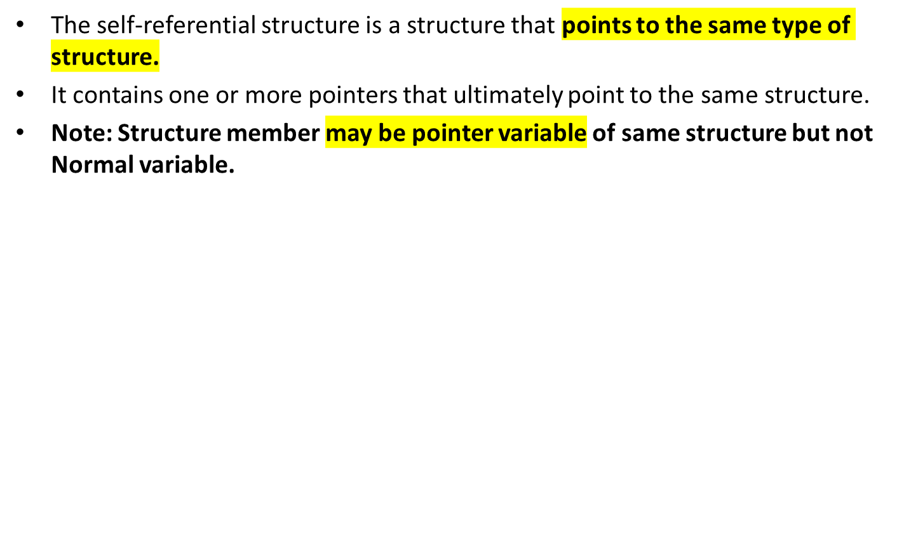
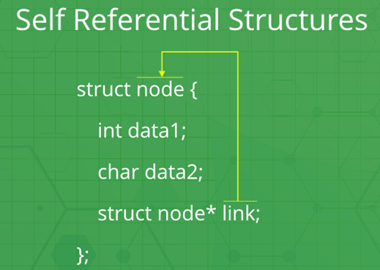
Self-Referential structures

Slide 34
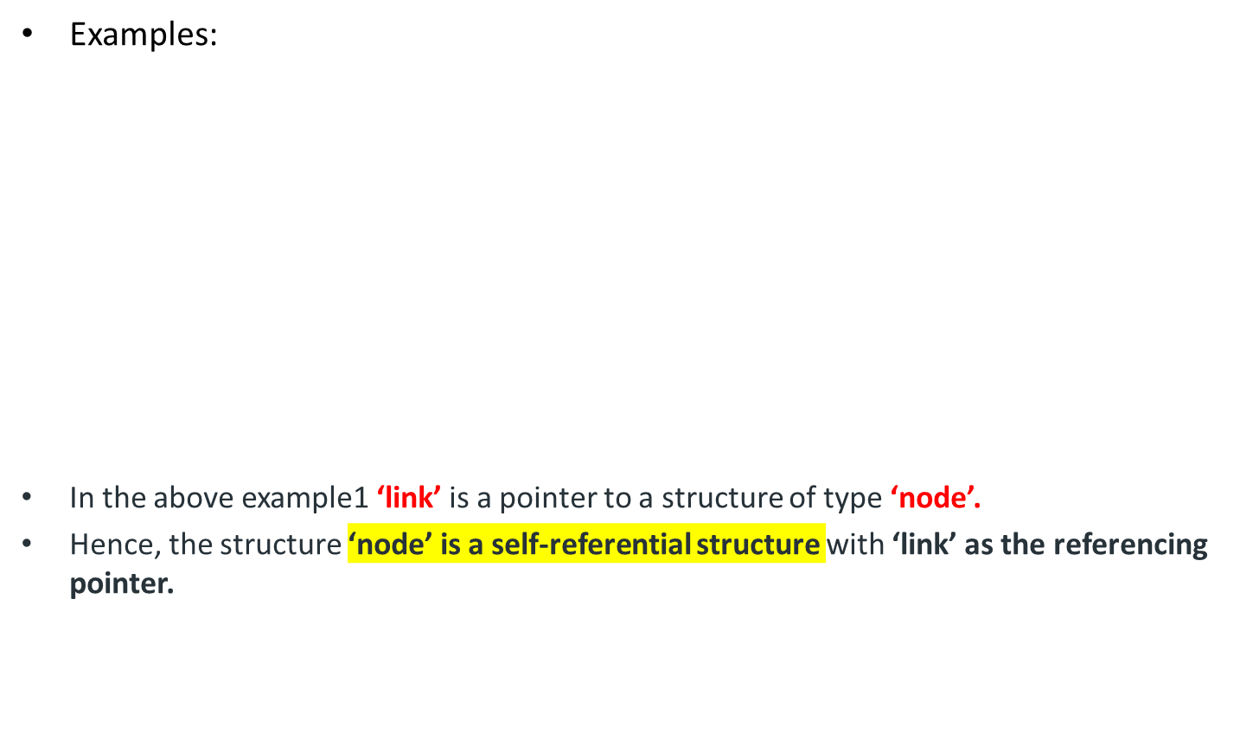
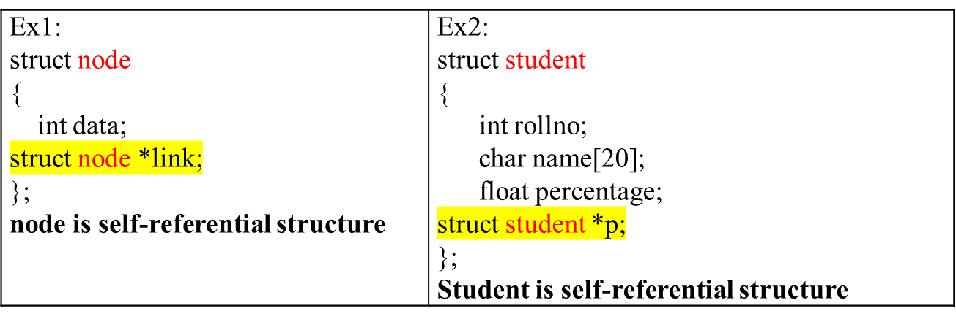
Self-Referential structures

Slide 35
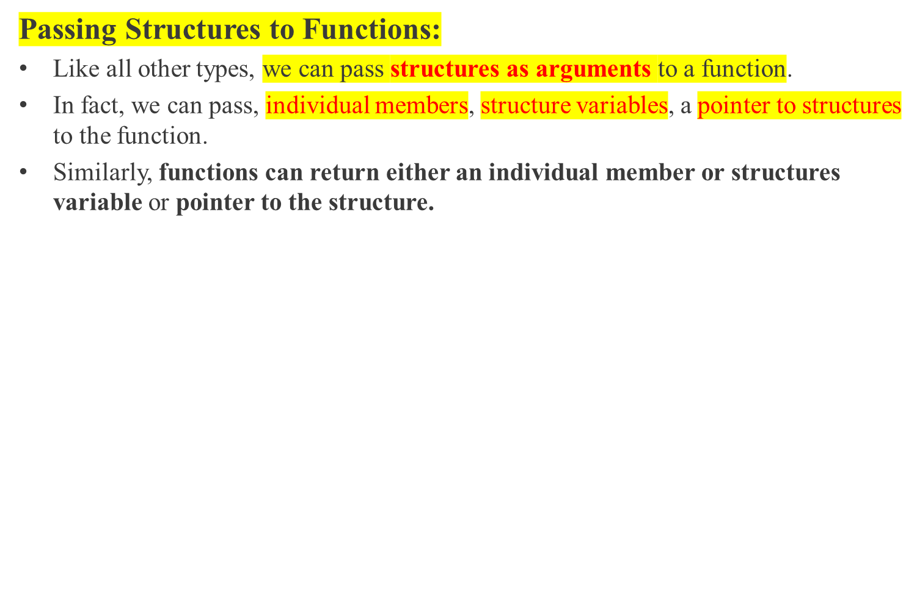
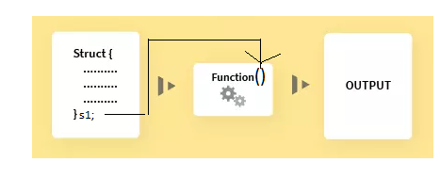
Structures and Functions

Slide 36
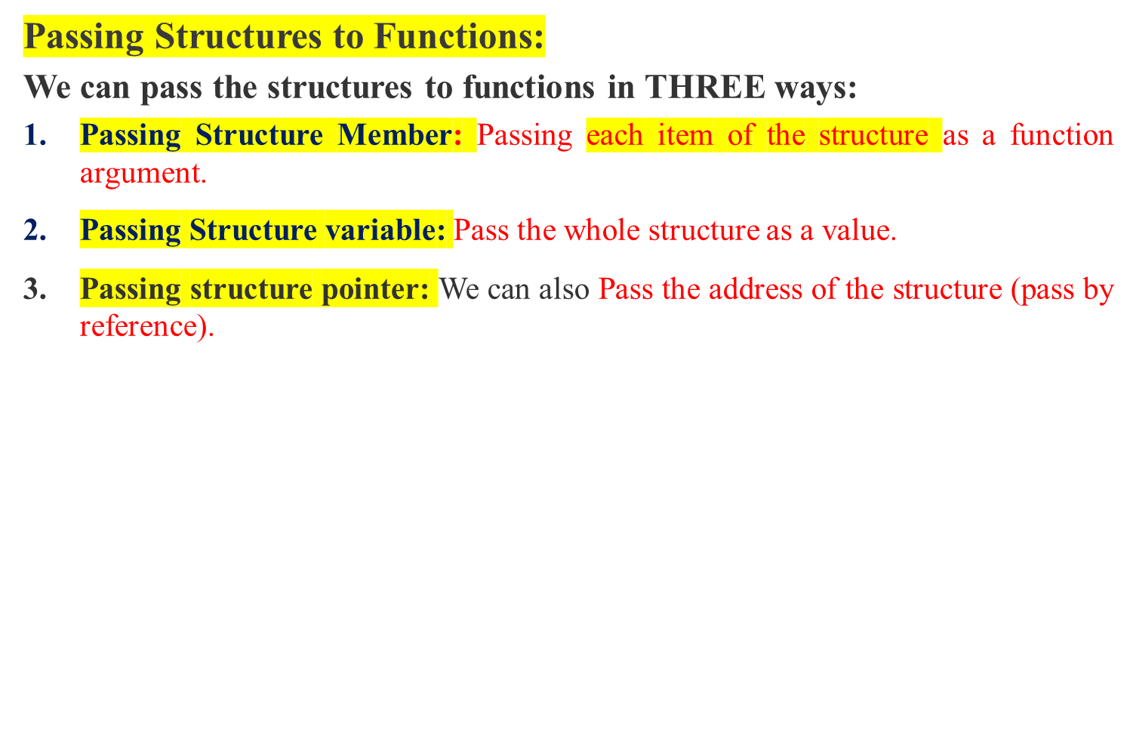
Structures and Functions

Slide 37
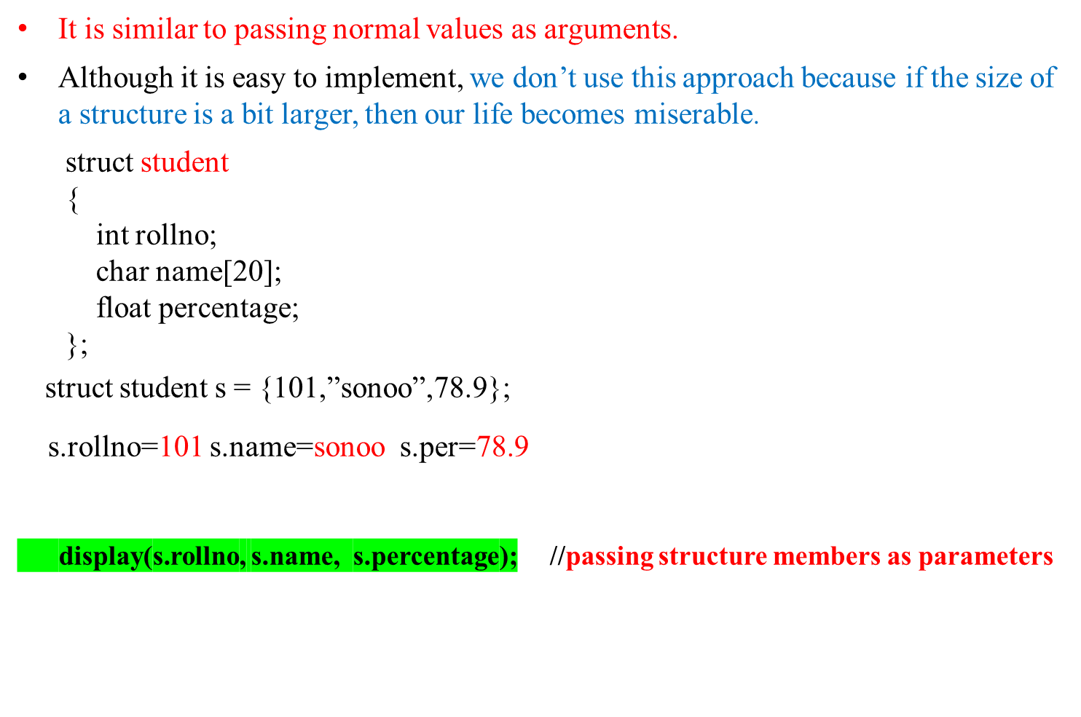
1. Pass structure members as arguments to the function.

Slide 38
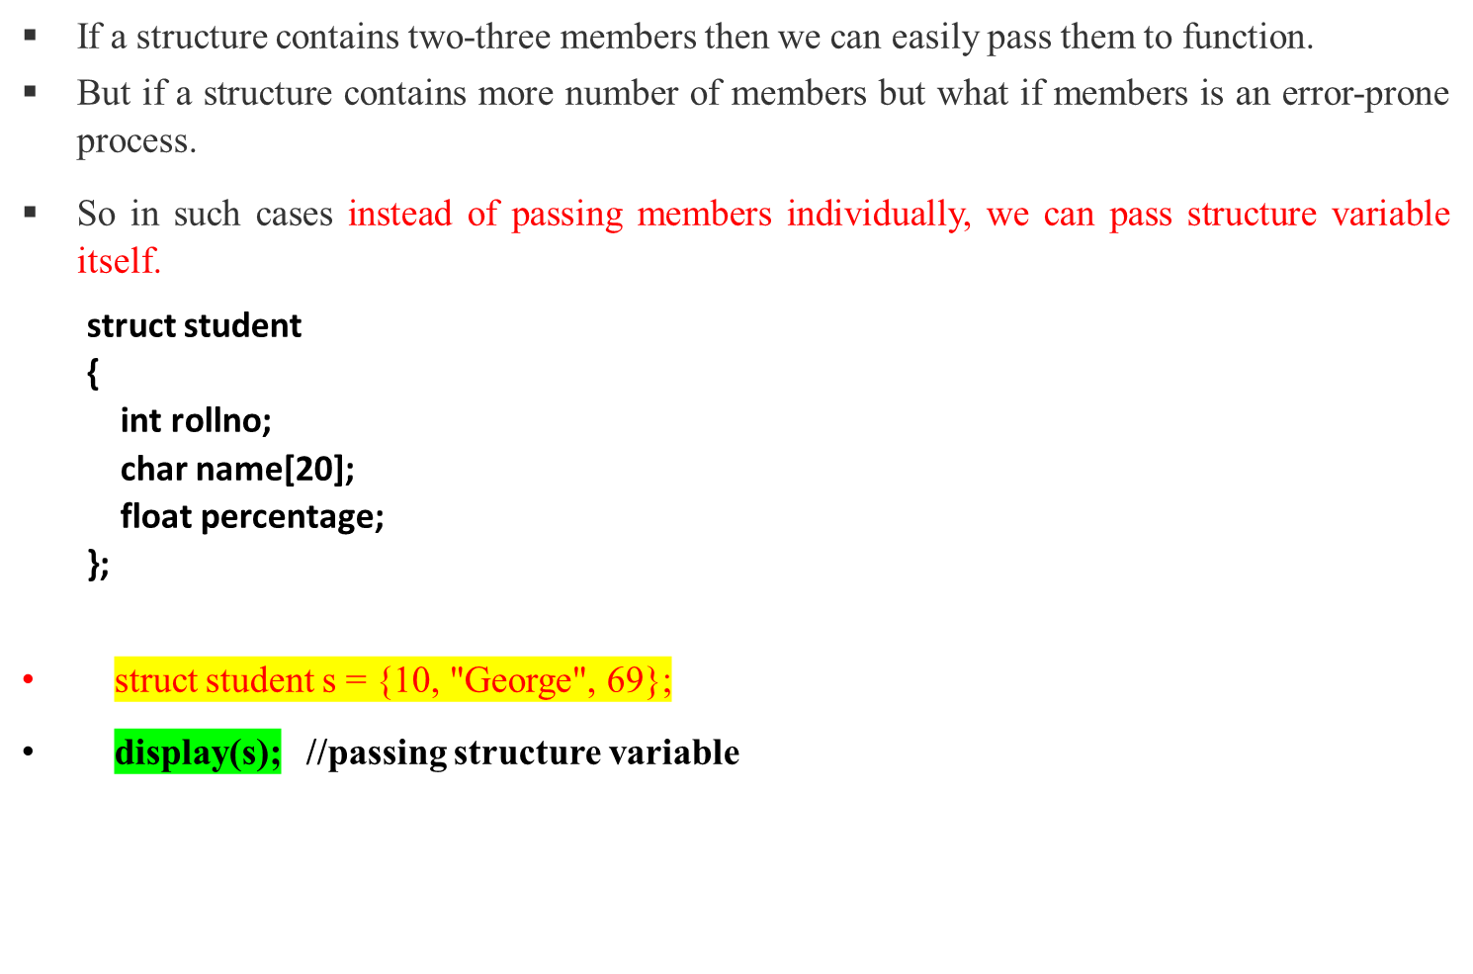
2. Passing Structure Variable as Argument to a Function

Slide 39
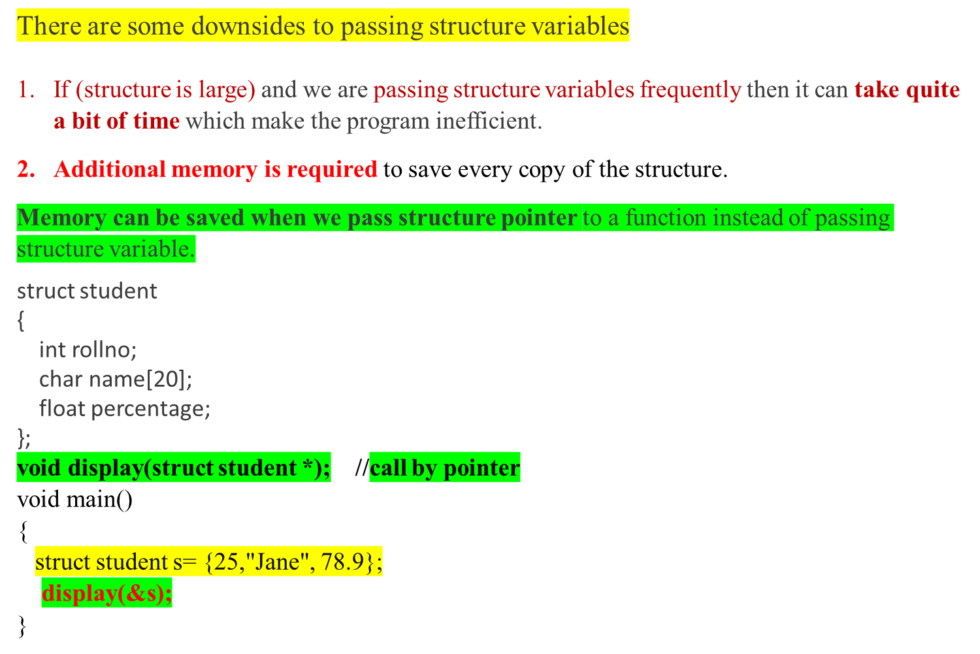
3.Passing Structure Pointers as Argument to a Function

Slide 40
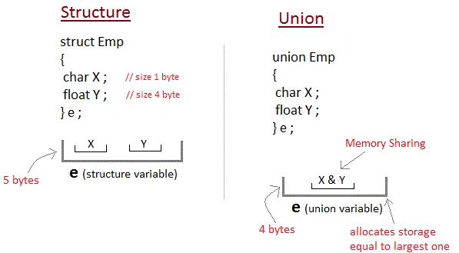
Unions
A union is a special data type that allows to store different data types in the same memory location.
Unions are conceptually similar to structures. The only differences is in terms of storage.
In structure each member has its own storage location, whereas all members of union uses a single shared memory location which is equal to the size of its largest data member.

Slide 41
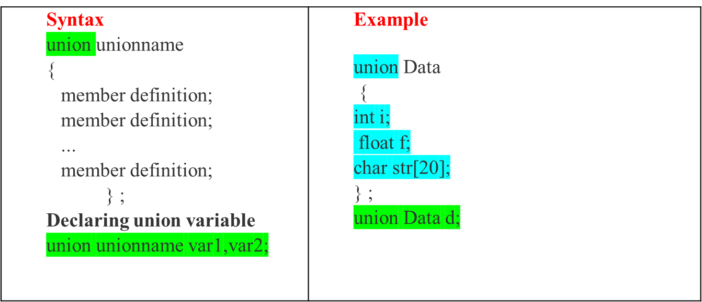
Unions - Defining a Union:
To define a union, you must use the keyword “union“
The union statement defines a new data type with more than one member
In the above example
Now, a variable of Data can store an integer, a floating-point number, or a string of characters.
It means a single variable, i.e., same memory location, can be used to store multiple types of data.

Slide 42
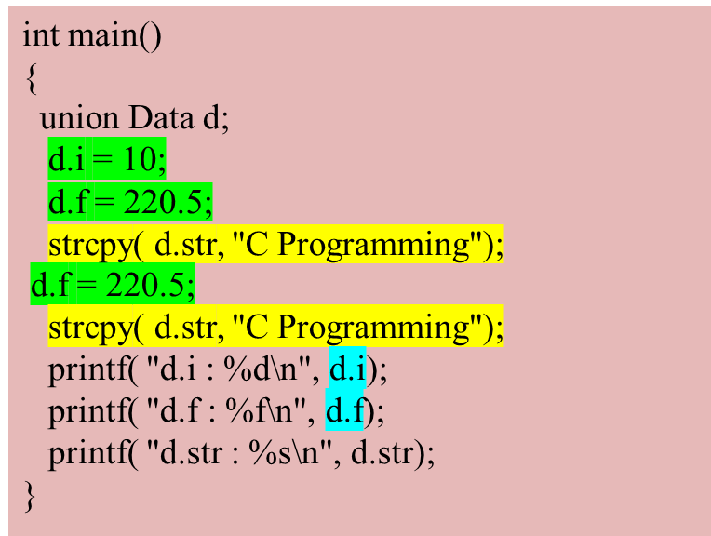

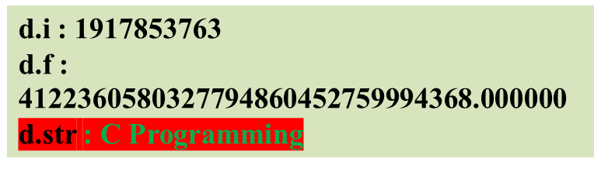
Accessing Union Members
To access any member of a union, we use the member access operator dot (.)
The member access operator is coded as a period between the union variable name and the union member that we wish to access.
You would use the keyword union to define variables of union type.
Example
  #include <stdio.h>
  #include <string.h>
  union Data
  {
  int i;
  float f;
  char str[20];
  };

Slide 43

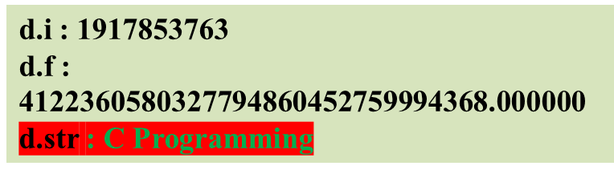
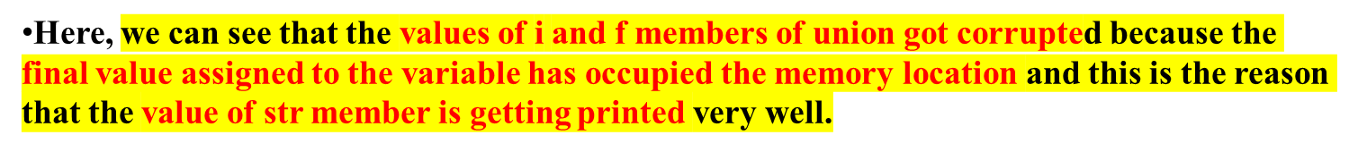
Accessing Union Members
  #include <stdio.h>
  #include <string.h>
  union Data
  {
  int i;
  float f;
  char str[20];
  };

Slide 44
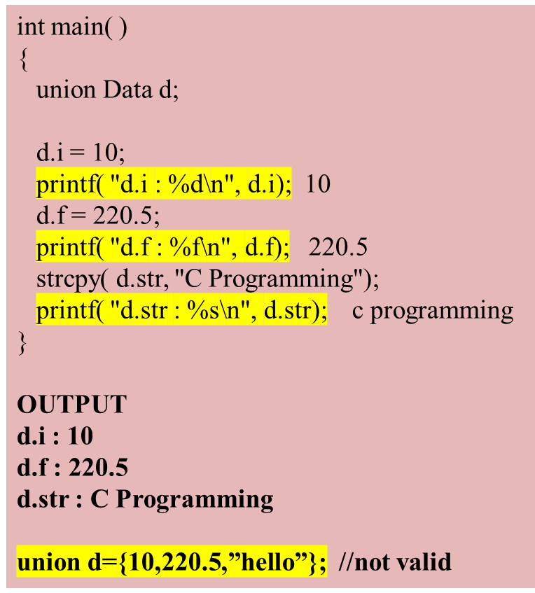
Accessing Union Members

Slide 45
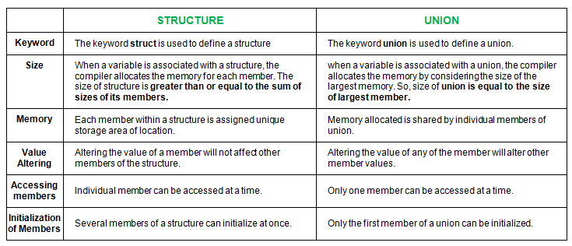
Differences between structures and Unions

Slide 46
User Defined Datatypes
User Defined Datatypes are the new datatypes created by the user.
There are 2 types of user defined datatypes
1. typedef (type definition)
2. enum (enumerated datatype)

Slide 47
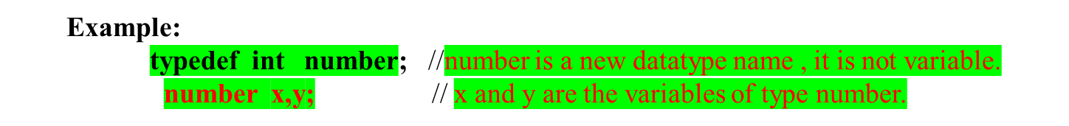
typedef
typedef is a keyword and it is a statement that is used to create a new user defined datatypes.
This is same like defining alias for the commands.
Syntax: typedef datatype newname;
typedef: It is a keyword.
datatype: It is the name of any existing type or user defined type created using structure/union.
newname: alias or new name you want to give to any existing type or user defined type.

Slide 48
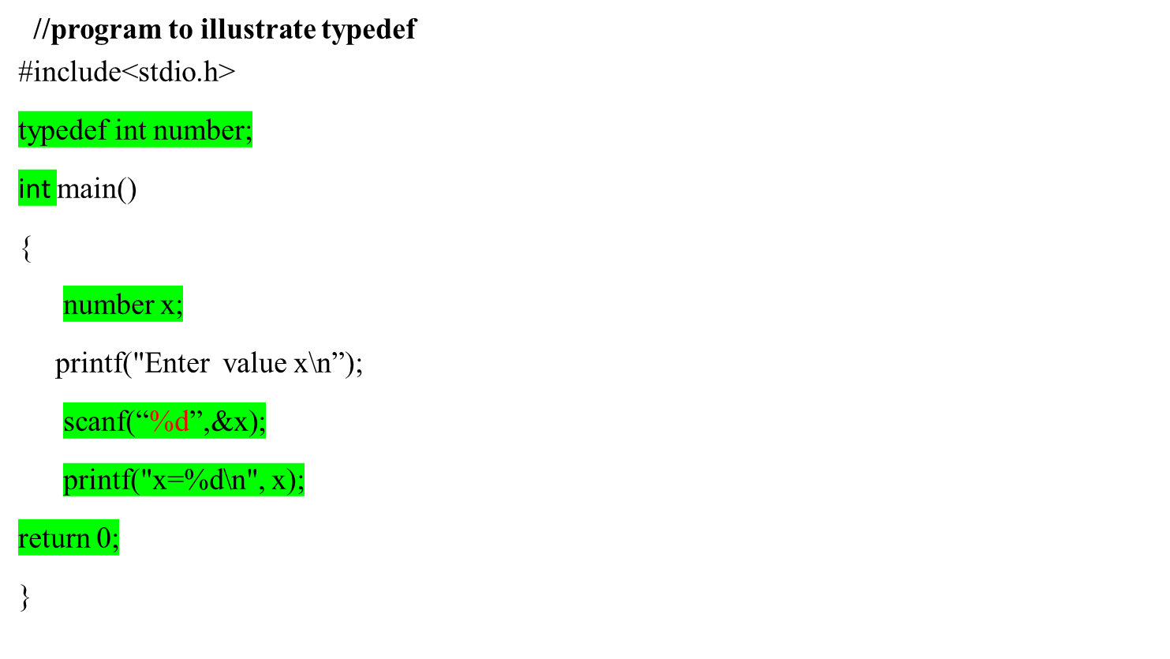
typedef

Slide 49
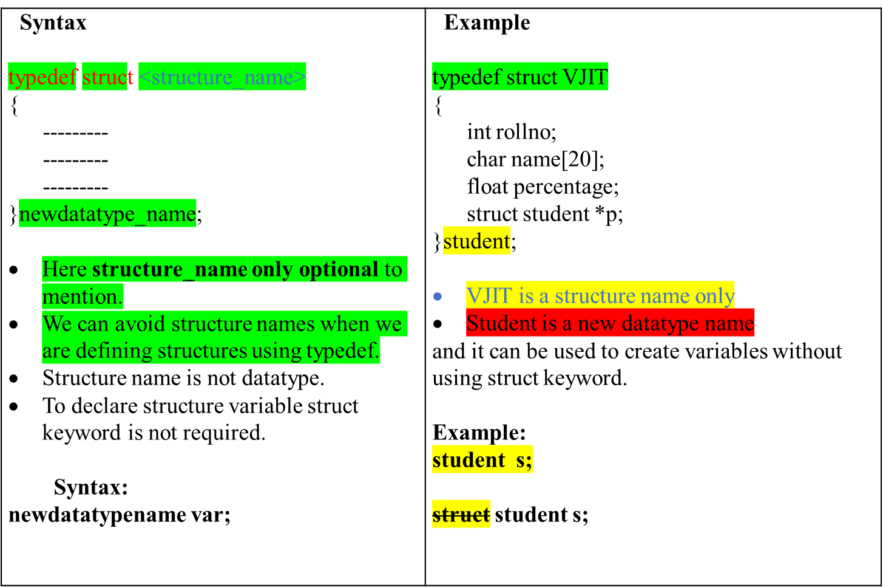
Creating a structure using typedef statement

Slide 50
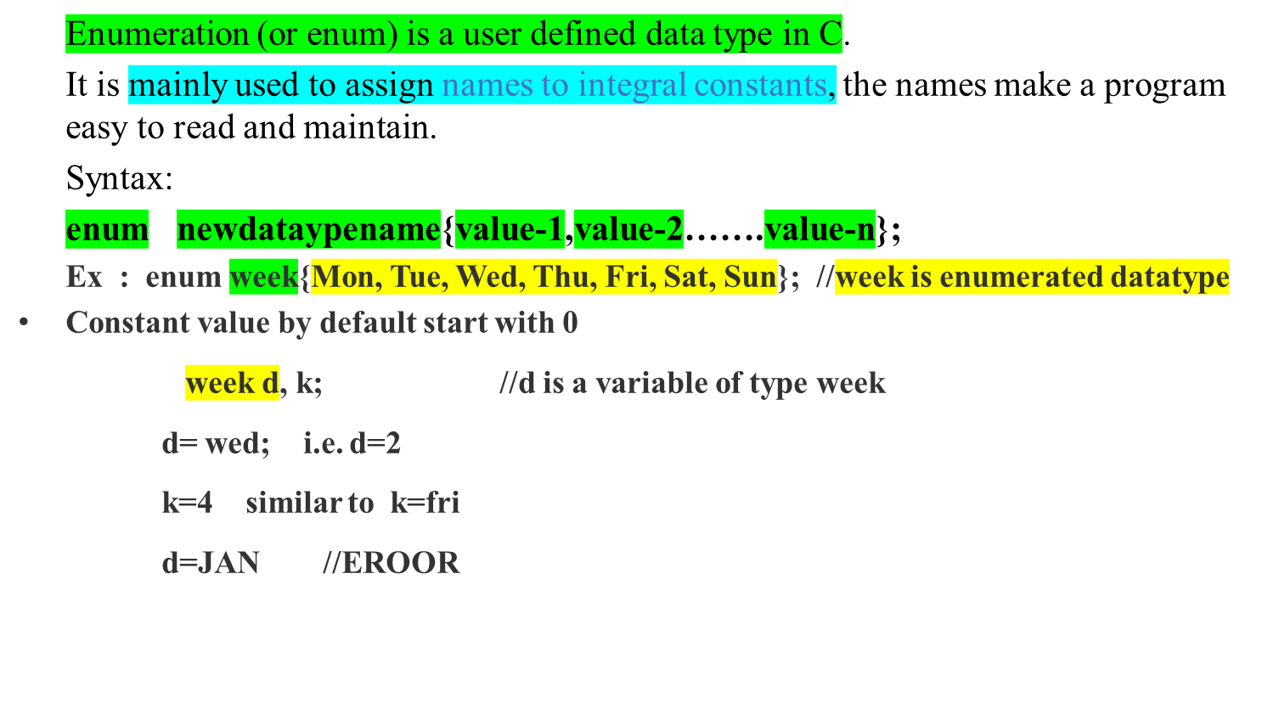
enum: Enumerated datatype

Slide 51
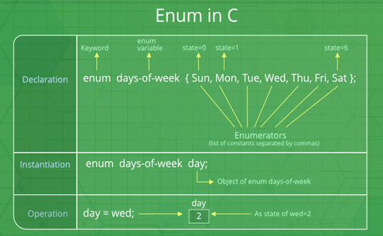
enum: Enumerated datatype

Slide 52
