Slide 1

Coffee Shop Sales
Time Series: EDA & Business Insights
Tools Used :VS-Code Pythone, Excel
Domain : Data Analyst & Data scientist

Slide 2



Project Overview
• Analyze vending machine coffee sales
• Identify sales trends
• Understand customer behavior
• Generate business insights

Slide 3




Dataset Overview
Total Records: 1133
Columns: 10

Slide 4

Missing Values Summary
date | 0
datetime | 0
Cash_type | 0
card | 89
money | 0
coffee_name | 0
Year | 0
Month | 0
Day_Name | 0
Hour | 0
Hour | 0
dtype: | int64

Slide 5
Dataset Information
• Total Records: 1133
• Period: March 2024 – July 2024
• Source: Kaggle
• Format: CSV

Slide 6
Tools Used
• Python (Pandas, Matplotlib)
• Excel (Pivot Tables, Dashboard)
• Machine Learning (Linear Regression)

Slide 7
Data Cleaning Steps
• Removed duplicates
• Converted date columns
• Handled missing values
• Feature engineering applied

Slide 8
Feature Engineering
• Extracted Year
• Extracted Month
• Extracted Day Name
• Extracted Hour

Slide 9
Revenue by Coffee Type
• Latte highest revenue
• Americano with Milk strong performer
• Espresso lowest revenue

Slide 10
Payment Method Distribution
• 92% Card payments
• 8% Cash payments
• Digital adoption very high

Slide 11
Monthly Sales Trend
• Upward trend observed
• Peak in May & June
• Seasonal growth pattern

Slide 12
Sales by Hour
• Peak at 10 AM
• Evening peak at 7 PM
• High morning demand

Slide 13
Weekly Sales Analysis
• Tuesday highest transactions
• Other days relatively stable

Slide 14
Top Performing Products
• Latte
• Americano with Milk
• Cappuccino

Slide 15
Low Performing Products
• Cocoa
• Espresso
• Opportunity for promotion

Slide 16
Customer Behavior Insights
• Strong morning purchase behavior
• Card payment preference
• Repeat product preference pattern

Slide 17
Inventory Planning
• Stock more Latte
• Restock before 10 AM
• Increase stock before peak months

Slide 18
Business Recommendation 1
• Introduce combo offers
• Loyalty rewards for card users

Slide 19
Business Recommendation 2
• Discount on low selling products
• Cross-selling strategies

Slide 20
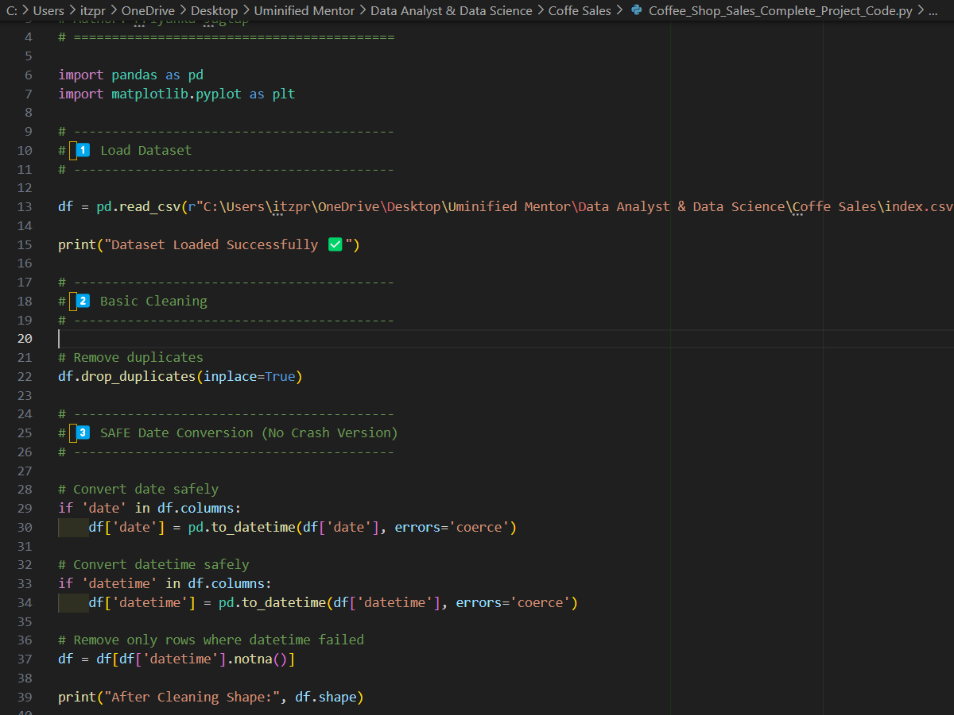
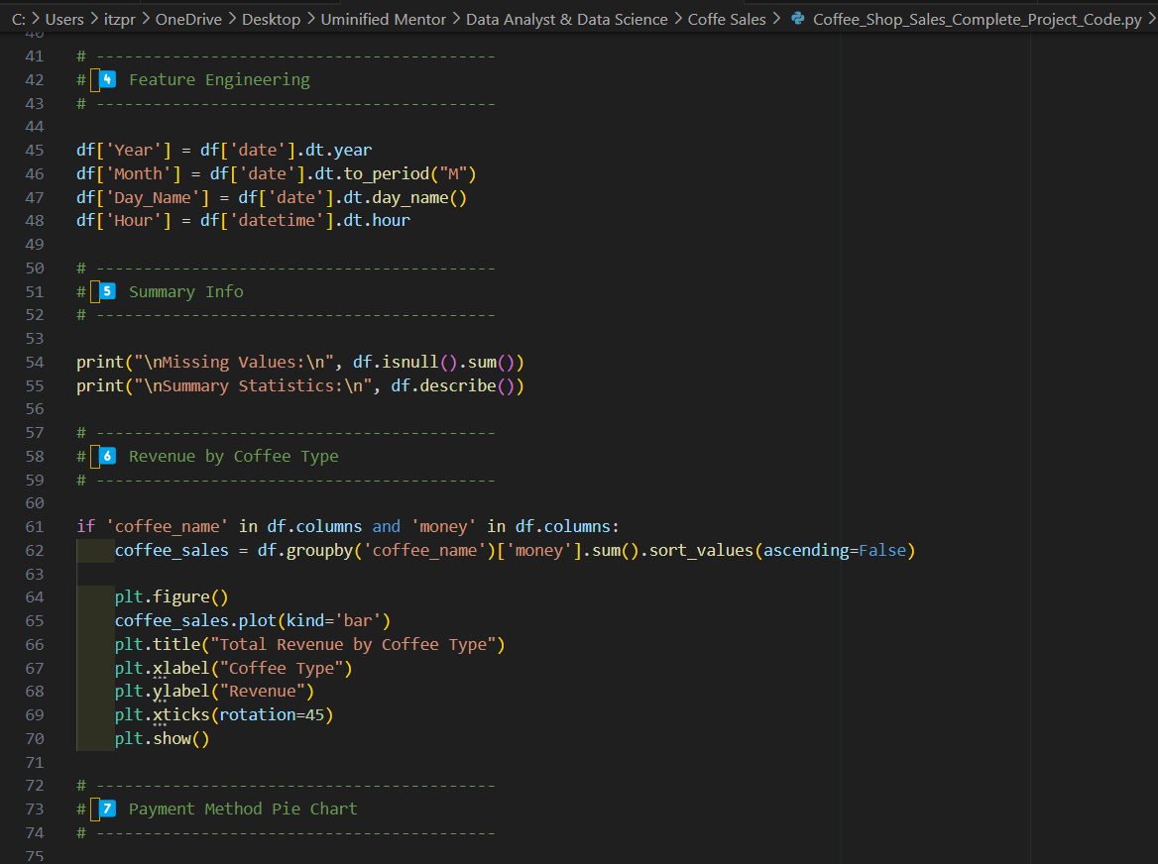

Slide 21
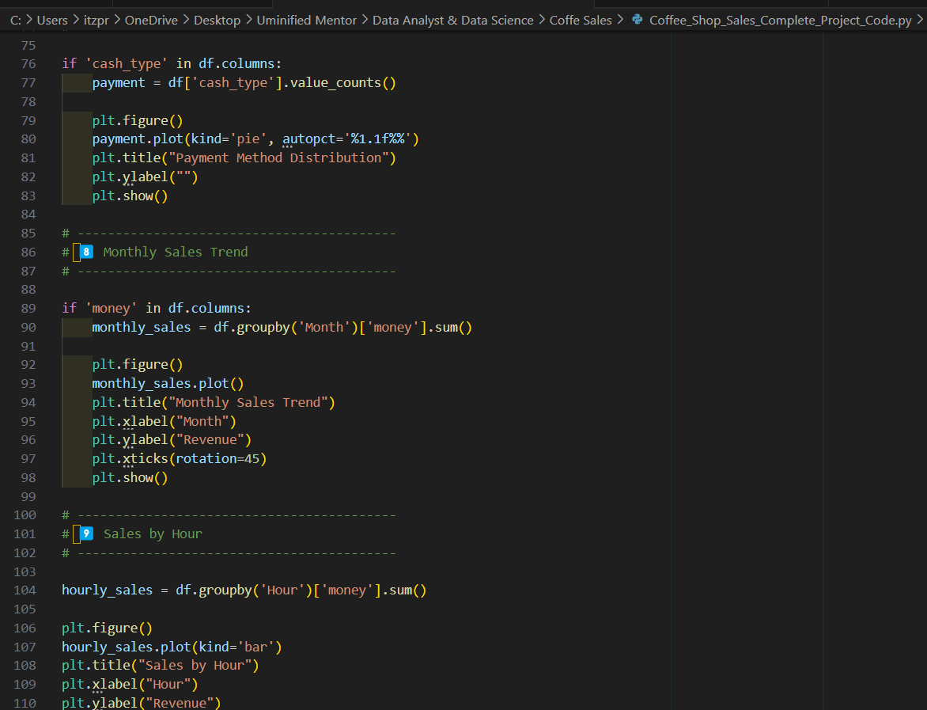
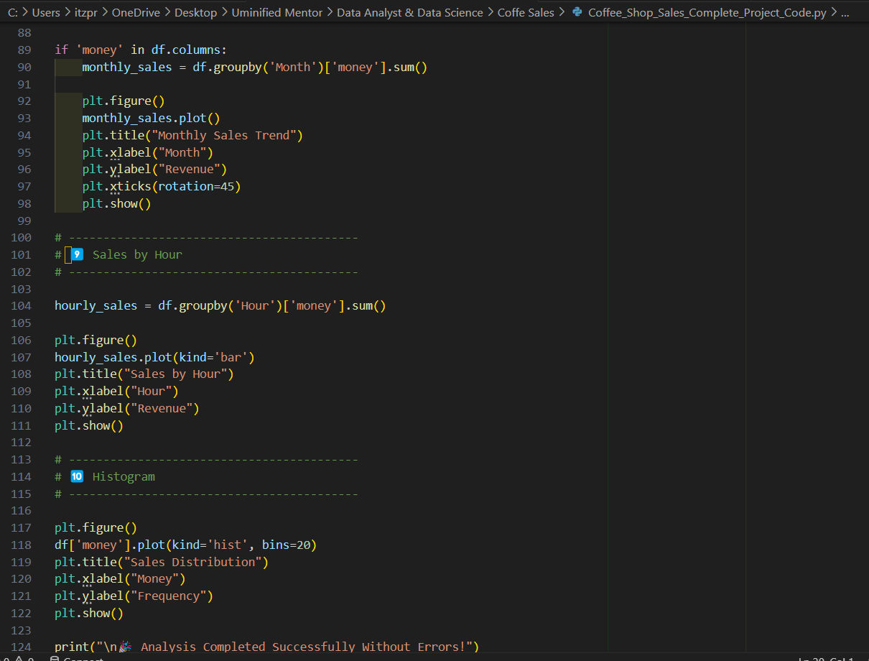

Slide 22
Code
Load Dataset
Basic Cleaning
df = pd.read_csv(r"C:\Users\itzpr\OneDrive\Desktop\Uminified Mentor\Data Analyst & Data Science\Coffe Sales\index.csv")
print("Dataset Loaded Successfully ✅")
# Remove duplicates
df.drop_duplicates(inplace=True)

Slide 23
Code
SAFE Date Conversion (No Crash Version)
Feature Engineering
# Convert date safely
if 'date' in df.columns:
df['date'] = pd.to_datetime(df['date'], errors='coerce')
# Convert datetime safely
if 'datetime' in df.columns:
df['datetime'] = pd.to_datetime(df['datetime'], errors='coerce')
# Remove only rows where datetime failed
df = df[df['datetime'].notna()]
print("After Cleaning Shape:", df.shape)
df['Year'] = df['date'].dt.year
df['Month'] = df['date'].dt.to_period("M")
df['Day_Name'] = df['date'].dt.day_name()
df['Hour'] = df['datetime'].dt.hour

Slide 24
Code
Summary Info
Revenue by Coffee Type
print("\nMissing Values:\n", df.isnull().sum())
print("\nSummary Statistics:\n", df.describe())
if 'coffee_name' in df.columns and 'money' in df.columns:
coffee_sales = df.groupby('coffee_name')['money'].sum().sort_values(ascending=False)
plt.figure()
coffee_sales.plot(kind='bar')
plt.title("Total Revenue by Coffee Type")
plt.xlabel("Coffee Type")
plt.ylabel("Revenue")
plt.xticks(rotation=45)
plt.show()

Slide 25
Code
Payment Method Pie Chart
Monthly Sales Trend
if 'cash_type' in df.columns:
payment = df['cash_type'].value_counts()
plt.figure()
payment.plot(kind='pie', autopct='%1.1f%%')
plt.title("Payment Method Distribution")
plt.ylabel("")
plt.show()
if 'money' in df.columns:
monthly_sales = df.groupby('Month')['money'].sum()
plt.figure()
monthly_sales.plot()
plt.title("Monthly Sales Trend")
plt.xlabel("Month")
plt.ylabel("Revenue")
plt.xticks(rotation=45)
plt.show()

Slide 26
Code
Sales by Hour
Histogram
hourly_sales = df.groupby('Hour')['money'].sum()
plt.figure()
hourly_sales.plot(kind='bar')
plt.title("Sales by Hour")
plt.xlabel("Hour")
plt.ylabel("Revenue")
plt.show()
plt.figure()
df['money'].plot(kind='hist', bins=20)
plt.title("Sales Distribution")
plt.xlabel("Money")
plt.ylabel("Frequency")
plt.show()
print("\n🎉 Analysis Completed Successfully Without Errors!")

Slide 27
Revenue by Coffee Type

Slide 28
Payment Method Distribution

Slide 29
Monthly Sales Trend

Slide 30
Sales by Hour

Slide 31
Sales Distribution

Slide 32
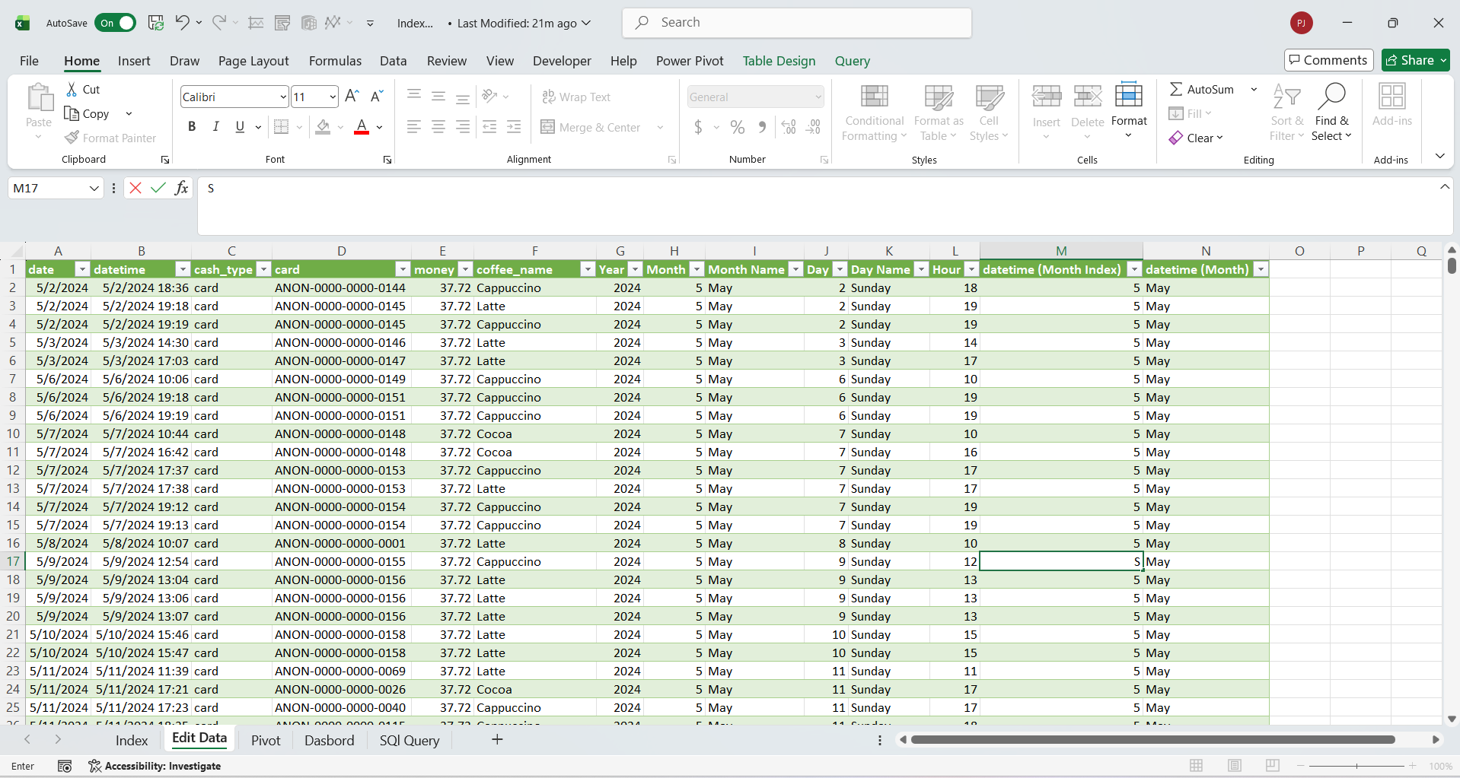
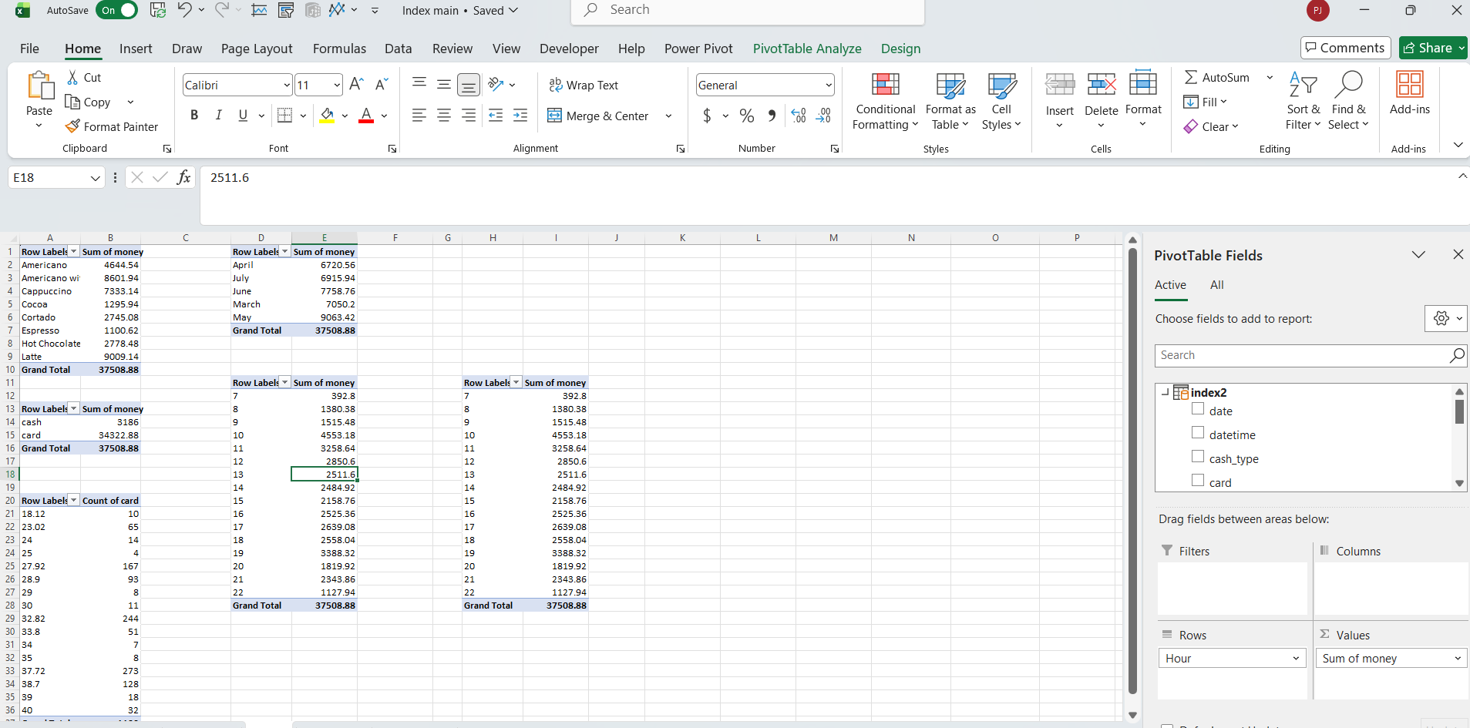

Slide 33
Business Insight
• Sales Trend Analysis
• Peak Hour Insights
• Top Products
• Customer Behavior
• Inventory Planning Recommendation

Slide 34


Machine Learning Model
• Linear Regression used
• Predict next month sales
• Model evaluated using R² score

Slide 35
Business Impact
• Improved inventory control
• Increased profitability
• Data-driven decision making

Slide 36
Future Scope
• Sales Forecasting
• Customer Segmentation
• Advanced ML Models
• Power BI Dashboard

Slide 37
Conclusion
Coffee Shop Sales Analysis helps optimize operations,
improve revenue, and understand customer behavior.

Slide 38

Thank You
Priyanka Jagtap
jagtapriyanka2004@gmail.com

