Slide 1

July, 2020
Rudimentary Cruise Control
1
Notes:
<number>

Slide 2
Agenda
What is Cruise Control?
System Architecture.
Block diagram of Rudimentary Cruise Control.
State flow diagram.
Activity diagram.
Class diagram.
Mathematical calculations.
References.
1
07/30/2020

Slide 3
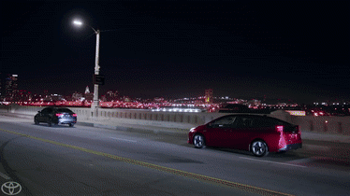
What is Cruise Control?
Cruise control (sometimes known as speed control or auto cruise, or tempomat in some countries) is a system that automatically controls the speed of a motor vehicle. The system is a servomechanism that takes over the throttle of the car to maintain a steady speed as set by the driver.
1
07/30/2020

Slide 4
System Architecture – Cruise Control
Jerk
Stub Node
Desired Acceleration
If Applied Acceleration > Threshold
Algorithm
Node
Calculate Current Velocity based on Desired Acceleration and Applied Acceleration.
Calculates Desired Acceleration based on Input Current Velocity.
Applied Acceleration
Actuator
Cruise Control Algorithm
Calculated based on Mass of car, Gear Ratio, Torque, Wheel diameter etc.
Acceleration
Braking
Current Velocity
1
07/30/2020

Slide 5
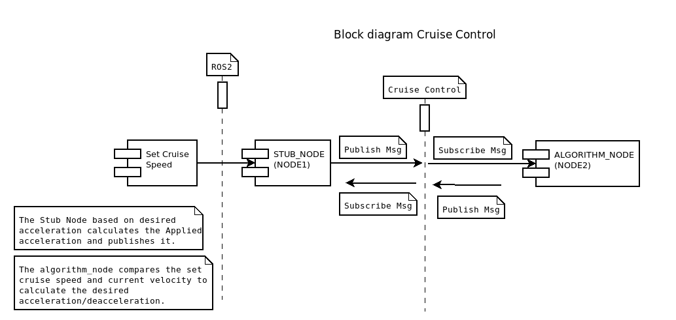
Block diagram – Cruise Control
1
07/30/2020

Slide 6
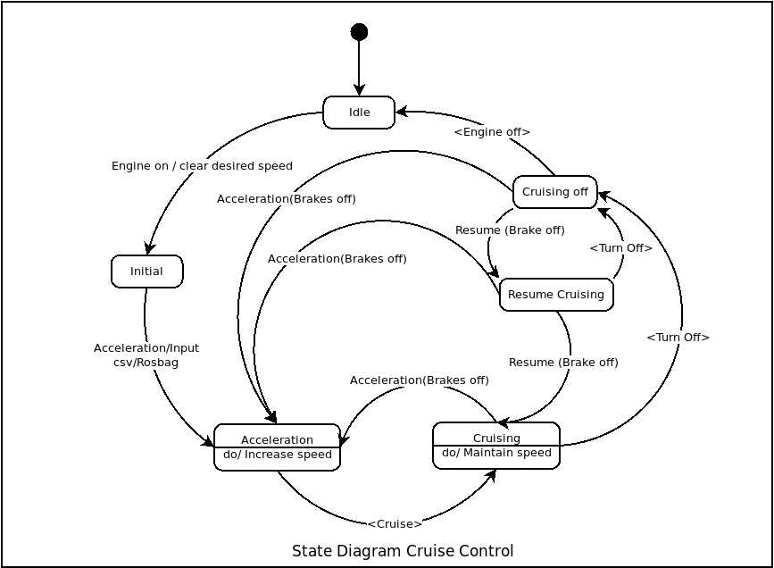
State Diagram – Cruise Control
1
07/30/2020

Slide 7
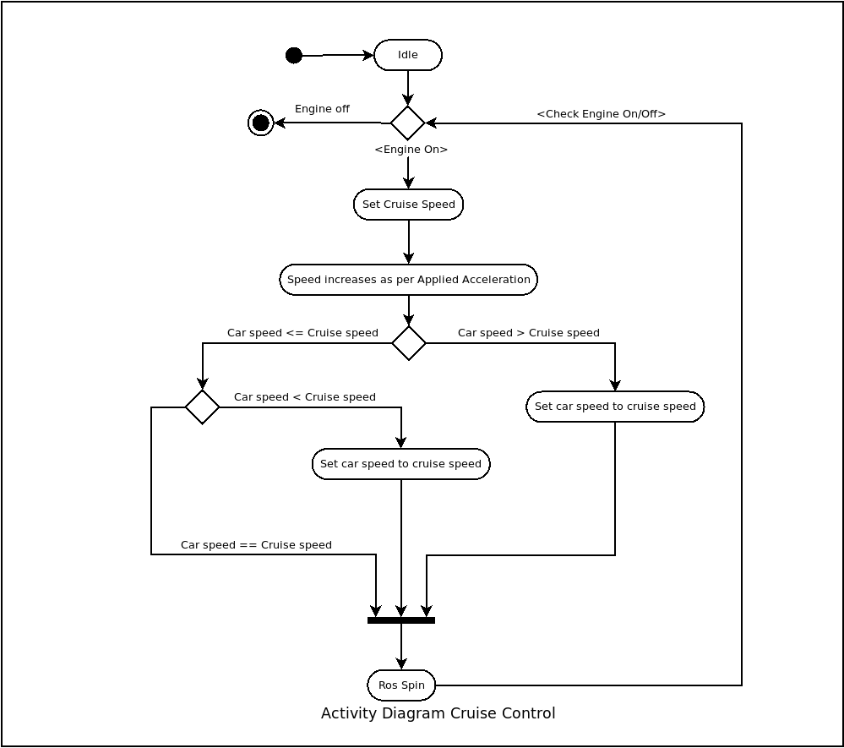
Activity Diagram – Cruise Control
1
07/30/2020

Slide 8
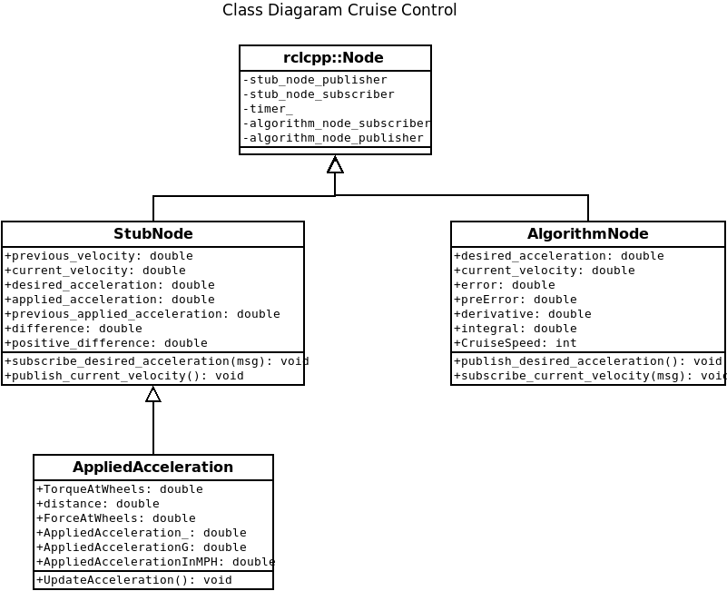
Class Diagram – Cruise Control
1
07/30/2020

Slide 9
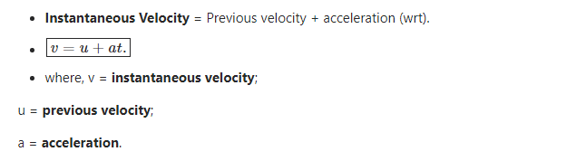
Mathematical calculations – Cruise Control
1
07/30/2020

Slide 10
References
https://en.wikipedia.org/wiki/Cruise_control#:~:text=Cruise%20control%20(sometimes%20known%20as,as%20set%20by%20the%20driver.
https://index.ros.org/doc/ros2/
https://index.ros.org/doc/ros2/Tutorials/
https://hub.docker.com/
07/30/2020
<number>

Slide 11

Reimagining Mobility with YOU
Thank you
07/30/2020
<number>
Notes:
<number>

