Slide 1
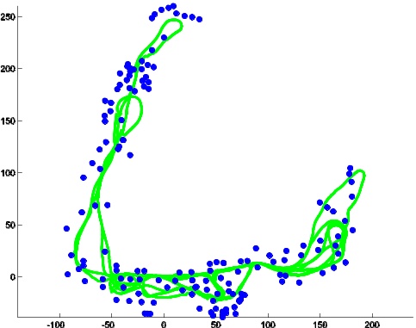
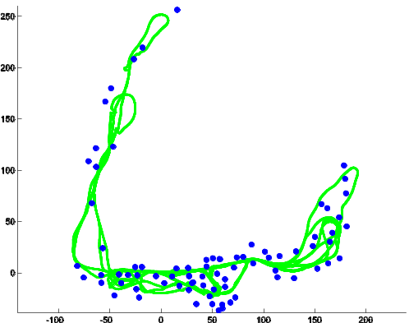
Information based
Reduced Landmark SLAM
Siddharth Choudhary¹, Vadim Indelman²,
Henrik I. Christensen¹ and Frank Dellaert¹
¹Georgia Tech ²Technion
Information theoretic algorithm to efficiently reduce landmarks and poses
Showed a reduction of 40-50% in landmarks and 55% in poses with minimal estimation error as compared to standard SLAM
Relevant to long term autonomy.
Reduction

