Slide 1
Supply Chain & Manufacturing
📦
⚙️
Risk Monitoring
FMN AI Engineer Internship — Technical Assessment
Muhammad Lawal
Two working apps · flagged risk explained by an LLM, grounded in real numbers

Slide 2
Two sponsors, one shared gap: no early warning
Both problems are the same shape: data exists, but nobody turns it into a forward-looking, explained flag.
📦
Supply Chain
⚙️
Manufacturing
“We keep getting caught off guard — some SKUs run out and delay production, others sit overstocked and tie up working capital.”
“Machines go down without warning and it costs us hours of production. I want to know ahead of time which machines are at risk, and why.”
Build: a self-serve tool showing upcoming demand per SKU, flagged in plain language before it becomes a problem.
Build: a tool the plant team can open to see machines at risk, drill into why, and track how that risk is trending.
2 / 7

Slide 3
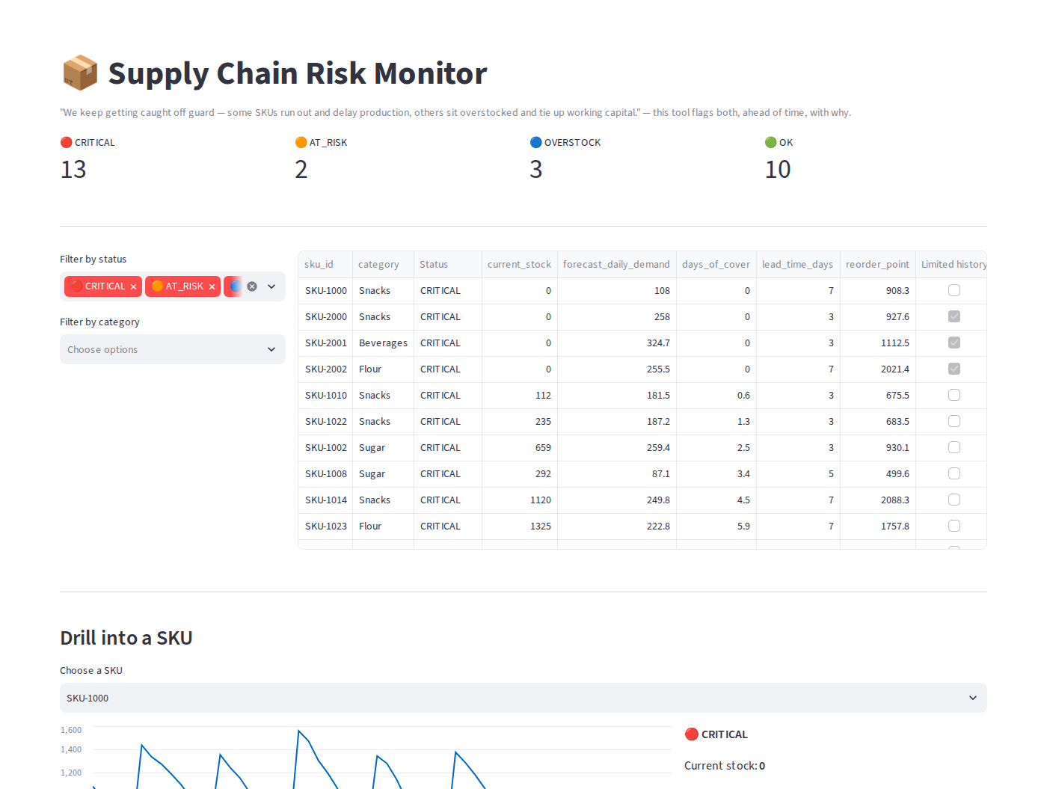
Supply Chain: forecast demand, flag before it's too late
1
Clean
Recovered all 136 missing values using the exact inventory identity — not a blind fill.
2
Forecast
Per-SKU EWMA, span=60 — backtesting showed demand here is close to stationary, so a longer memory window won.
3
Flag
Reorder point = demand over lead time + a volatility-sized safety buffer. Two severity tiers: CRITICAL vs AT_RISK, plus OVERSTOCK.
4
Cold start
3 new SKUs (12 days old) fall back to category averages, always shown with a “limited history” flag.
Live app: 13 CRITICAL · 2 AT_RISK · 3 OVERSTOCK · 10 OK, computed on the real dataset
3 / 7

Slide 4
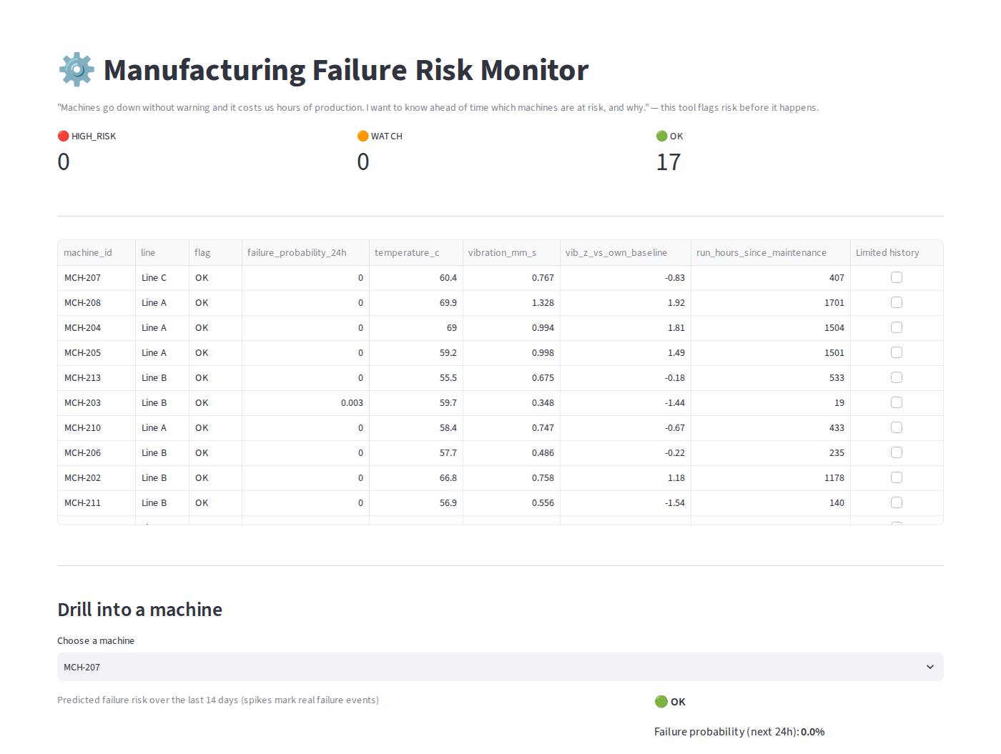
Manufacturing: catch the drift before the failure
1
Clean
Dropped 20 duplicate rows found in EDA; interpolated sensor dropouts per-machine, not globally.
2
Features
24h/72h rolling stats, plus each machine's own baseline z-score — generalizes across very different normal ranges.
3
Label
“Failure in next 24h” turns 17 raw events into ~408 learnable positive hours.
4
Model
RandomForest, class-weight balanced. Evaluated on a true future holdout (train pre-April, test on April).
5
Cold start
Live app: fleet currently healthy (0 HIGH_RISK, 0 WATCH) — an honest true-negative result, not a demo artifact
2 new machines (72h old) compared against established machines' own first 72h — not steady-state.
4 / 7

Slide 5
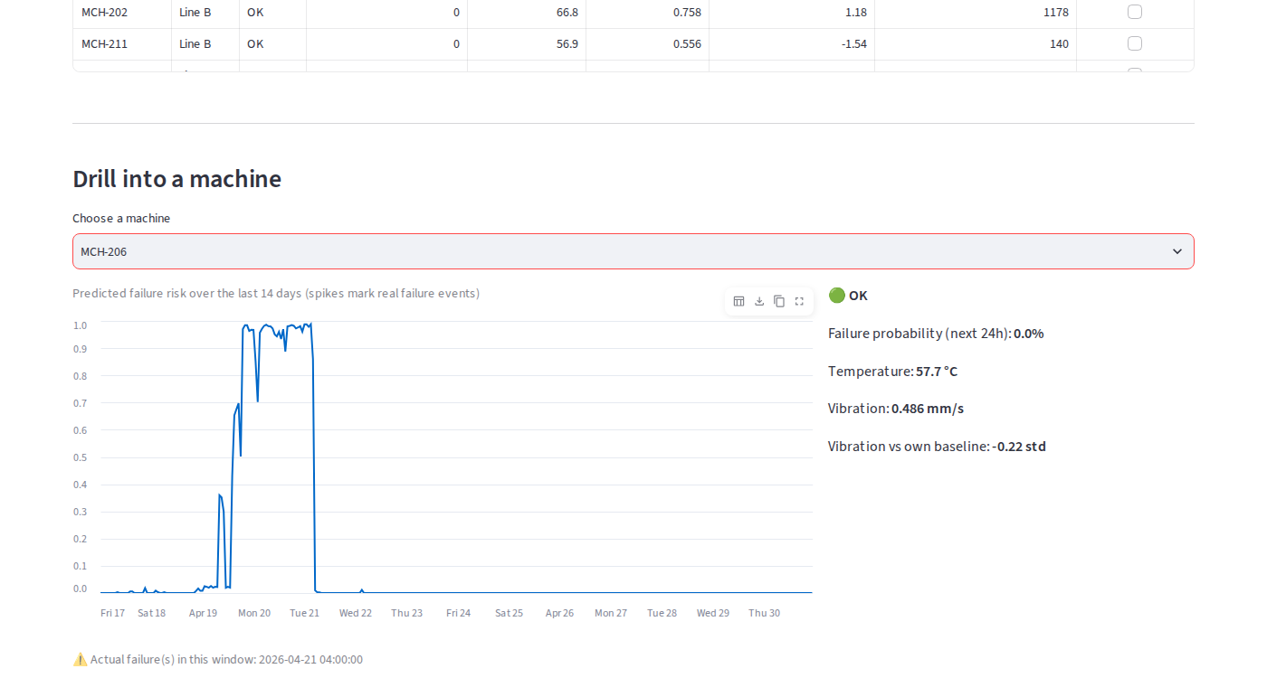
Validated against real held-out data, not assumed
Supply chain — WAPE, backtested on 30 held-out days
EWMA span=60 (ours)
0.204
Naive: 7-day average
0.213
Naive: yesterday's value
0.254
Manufacturing — time-based holdout (trained pre-April, tested on April)
Metric
Our model
Baseline rule
Precision
0.521
0.284
Recall
0.656
0.911
MCH-206, retrospectively scored: predicted risk climbs from ~2% to 90%+ roughly 24-36 hours before both of its real historical failures — the sponsor's exact ask.
F1
0.581
0.433
Baseline catches 91% of failures but 72% of its alerts are false. Our model roughly doubles precision.
⚠ 17 raw failure events fleet-wide is a small base for a classifier — read these numbers as directional, not production-tight.
5 / 7

Slide 6
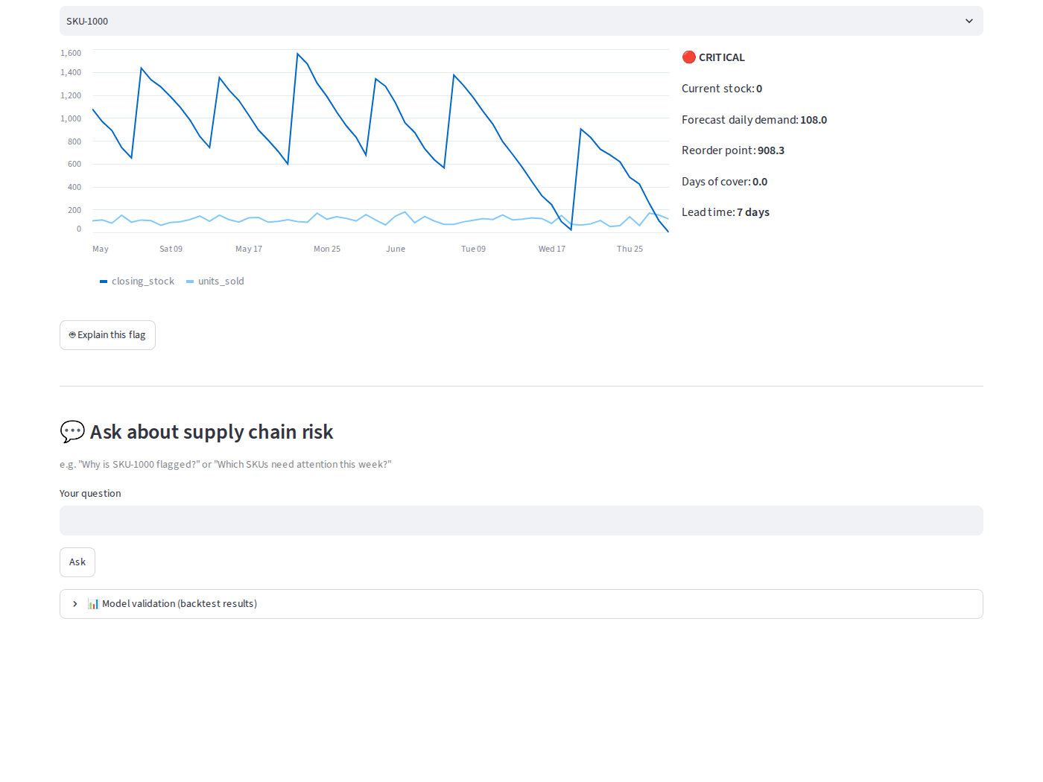
Every flag is explained by an LLM call, grounded in real numbers
💬
No templates
Clicking “Explain this flag” sends that SKU/machine's actual computed numbers (forecast, thresholds, z-scores, top model features) to Claude at runtime.
🔍
Grounded Q&A
The free-text question box passes the entire current snapshot (28 SKU rows / 17 machine rows) into the prompt as JSON — the model answers only from what's there.
⚖️
Why not RAG?
At 28 SKUs / 17 machines, passing the full table is simpler, cheaper, and strictly more accurate than approximate retrieval. It does not scale to a fleet-wide rollout — see Limitations.
Drill-down, “Explain this flag,” and the grounded Q&A box, as built
6 / 7

Slide 7
Limitations & next steps
Small failure count — 17 events is thin for a classifier — survival analysis would use limited data more efficiently as more history accrues.
No open-PO visibility — The supply chain flag assumes nothing is already in transit — feeding real PO data in would remove a source of false positives.
Q&A won't scale as-is — Full-table-in-prompt works at this size; a fleet-wide rollout needs real retrieval (SQL tool-use or pre-aggregation).
Cold-start is a starting point — Category/fleet averages for new SKUs & machines should hand off to their own history within weeks, not stay fixed.
No push alerting yet — Both tools are pull today; closing the sponsors' “caught off guard” loop needs a Slack/email digest for CRITICAL/HIGH_RISK items.
7 / 7

