Slide 1
Principles of Artificial Intelligence
Intelligent Agents

Slide 2






Outline
1
Agents and Environments
2
Rational Agents
3
Task Environments
4
Task-Environment Types
5
Agent Types
6
Environment States

Slide 3





Outline
1
Agents and Environments
2
Rational Agents
3
Task Environments
4
Task-Environment Types
5
Agent Types
6
Environment States

Slide 4
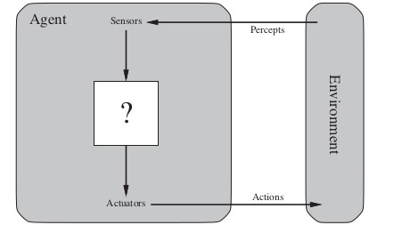
Agents and Environments
Agents
An agent is any entity that can be viewed as: perceiving its environment through sensors, and acting upon that environment through actuators.
(Oc S. Russell & P. Norwig, AIMA)
4 / 52

Slide 5
Agents and Environments
Agents
An agent is any entity that can be viewed as: perceiving its environment through sensors, and acting upon that environment through actuators.
(Oc S. Russell & P. Norwig, AIMA)
4 / 52

Slide 6
Agents and Environments
Agents
An agent is any entity that can be viewed as: perceiving its environment through sensors, and acting upon that environment through actuators.
(Oc S. Russell & P. Norwig, AIMA)
4 / 52

Slide 7
Agents and Environments
Agents
An agent is any entity that can be viewed as: perceiving its environment through sensors, and acting upon that environment through actuators.
(Oc S. Russell & P. Norwig, AIMA)
4 / 52

Slide 8
Agents and Environments [cont.]
Agents
Agents include humans, robots, softbots, thermostats, etc. human:
perceives: with eyes, ears, nose, hands, ..., acts: with voice, hands, arms, legs, ...
robot:
perceives: with video-cameras, infra-red sensors, radar, ... acts: with wheels, motors,
softbot:
perceives: receiving keystrokes, files, network packets, ... acts: displaying on the screen, writing files, sending
network packets
thermostat:
perceives: with heat sensor, ...
acts: electric impulses to valves, devices, ...
5 / 52

Slide 9
Agents and Environments [cont.]
Agents
Agents include humans, robots, softbots, thermostats, etc. human:
perceives: with eyes, ears, nose, hands, ..., acts: with voice, hands, arms, legs, ...
robot:
perceives: with video-cameras, infra-red sensors, radar, ... acts: with wheels, motors,
softbot:
perceives: receiving keystrokes, files, network packets, ... acts: displaying on the screen, writing files, sending
network packets
thermostat:
perceives: with heat sensor, ...
acts: electric impulses to valves, devices, ...
5 / 52

Slide 10
Agents and Environments [cont.]
Agents
Agents include humans, robots, softbots, thermostats, etc. human:
perceives: with eyes, ears, nose, hands, ..., acts: with voice, hands, arms, legs, ...
robot:
perceives: with video-cameras, infra-red sensors, radar, ... acts: with wheels, motors,
softbot:
perceives: receiving keystrokes, files, network packets, ... acts: displaying on the screen, writing files, sending
network packets
thermostat:
perceives: with heat sensor, ...
acts: electric impulses to valves, devices, ...
5 / 52

Slide 11
Agents and Environments [cont.]
Agents
Agents include humans, robots, softbots, thermostats, etc. human:
perceives: with eyes, ears, nose, hands, ..., acts: with voice, hands, arms, legs, ...
robot:
perceives: with video-cameras, infra-red sensors, radar, ... acts: with wheels, motors,
softbot:
perceives: receiving keystrokes, files, network packets, ... acts: displaying on the screen, writing files, sending
network packets
thermostat:
perceives: with heat sensor, ...
acts: electric impulses to valves, devices, ...
5 / 52

Slide 12
Agents and Environments [cont.]
Agents
Agents include humans, robots, softbots, thermostats, etc. human:
perceives: with eyes, ears, nose, hands, ..., acts: with voice, hands, arms, legs, ...
robot:
perceives: with video-cameras, infra-red sensors, radar, ... acts: with wheels, motors,
softbot:
perceives: receiving keystrokes, files, network packets, ... acts: displaying on the screen, writing files, sending
network packets
thermostat:
perceives: with heat sensor, ...
acts: electric impulses to valves, devices, ...
5 / 52

Slide 13
Agents and Environments [cont.]
Agents
Agents include humans, robots, softbots, thermostats, etc. human:
perceives: with eyes, ears, nose, hands, ..., acts: with voice, hands, arms, legs, ...
robot:
perceives: with video-cameras, infra-red sensors, radar, ... acts: with wheels, motors,
softbot:
perceives: receiving keystrokes, files, network packets, ... acts: displaying on the screen, writing files, sending
network packets
thermostat:
perceives: with heat sensor, ...
acts: electric impulses to valves, devices, ...
5 / 52

Slide 14
Agents and Environments [cont.]
Agents
Agents include humans, robots, softbots, thermostats, etc. human:
perceives: with eyes, ears, nose, hands, ..., acts: with voice, hands, arms, legs, ...
robot:
perceives: with video-cameras, infra-red sensors, radar, ... acts: with wheels, motors,
softbot:
perceives: receiving keystrokes, files, network packets, ... acts: displaying on the screen, writing files, sending
network packets
thermostat:
perceives: with heat sensor, ...
acts: electric impulses to valves, devices, ...
5 / 52

Slide 15
Agents and Environments [cont.]
Agents
Agents include humans, robots, softbots, thermostats, etc. human:
perceives: with eyes, ears, nose, hands, ..., acts: with voice, hands, arms, legs, ...
robot:
perceives: with video-cameras, infra-red sensors, radar, ... acts: with wheels, motors,
softbot:
perceives: receiving keystrokes, files, network packets, ... acts: displaying on the screen, writing files, sending
network packets
thermostat:
perceives: with heat sensor, ...
acts: electric impulses to valves, devices, ...
5 / 52

Slide 16
Agents and Environments [cont.]
Agents
Agents include humans, robots, softbots, thermostats, etc. human:
perceives: with eyes, ears, nose, hands, ..., acts: with voice, hands, arms, legs, ...
robot:
perceives: with video-cameras, infra-red sensors, radar, ... acts: with wheels, motors,
softbot:
perceives: receiving keystrokes, files, network packets, ... acts: displaying on the screen, writing files, sending
network packets
thermostat:
perceives: with heat sensor, ...
acts: electric impulses to valves, devices, ...
5 / 52

Slide 17
Agents and Environments [cont.]
Agents
Agents include humans, robots, softbots, thermostats, etc. human:
perceives: with eyes, ears, nose, hands, ..., acts: with voice, hands, arms, legs, ...
robot:
perceives: with video-cameras, infra-red sensors, radar, ... acts: with wheels, motors,
softbot:
perceives: receiving keystrokes, files, network packets, ... acts: displaying on the screen, writing files, sending
network packets
thermostat:
perceives: with heat sensor, ...
acts: electric impulses to valves, devices, ...
5 / 52

Slide 18
Agents and Environments [cont.]
Agents
Agents include humans, robots, softbots, thermostats, etc. human:
perceives: with eyes, ears, nose, hands, ..., acts: with voice, hands, arms, legs, ...
robot:
perceives: with video-cameras, infra-red sensors, radar, ... acts: with wheels, motors,
softbot:
perceives: receiving keystrokes, files, network packets, ... acts: displaying on the screen, writing files, sending
network packets
thermostat:
perceives: with heat sensor, ...
acts: electric impulses to valves, devices, ...
5 / 52

Slide 19
Agents and Environments [cont.]
Agents
Agents include humans, robots, softbots, thermostats, etc. human:
perceives: with eyes, ears, nose, hands, ..., acts: with voice, hands, arms, legs, ...
robot:
perceives: with video-cameras, infra-red sensors, radar, ... acts: with wheels, motors,
softbot:
perceives: receiving keystrokes, files, network packets, ... acts: displaying on the screen, writing files, sending
network packets
thermostat:
perceives: with heat sensor, ...
acts: electric impulses to valves, devices, ...
5 / 52

Slide 20
Agents and Environments [cont.]
Agents
Agents include humans, robots, softbots, thermostats, etc. human:
perceives: with eyes, ears, nose, hands, ..., acts: with voice, hands, arms, legs, ...
robot:
perceives: with video-cameras, infra-red sensors, radar, ... acts: with wheels, motors,
softbot:
perceives: receiving keystrokes, files, network packets, ... acts: displaying on the screen, writing files, sending
network packets
thermostat:
perceives: with heat sensor, ...
acts: electric impulses to valves, devices, ...

Slide 21
Key concepts
Percept and Percept sequences
percept: the collection of agent’s perceptual inputs at any given instant
percept sequence: the complete history of everything the agent has ever perceived
An agent’s choice of action at any given instant
can depend on the entire percept sequence observed to date does not depend on anything it hasn’t perceived
Remark
An agent can perceive its own actions, but not always it effects.

Slide 22
Key concepts
Percept and Percept sequences
percept: the collection of agent’s perceptual inputs at any given instant
percept sequence: the complete history of everything the agent has ever perceived
An agent’s choice of action at any given instant
can depend on the entire percept sequence observed to date does not depend on anything it hasn’t perceived
Remark
An agent can perceive its own actions, but not always it effects.
6 / 52

Slide 23
Key concepts
Percept and Percept sequences
percept: the collection of agent’s perceptual inputs at any given instant
percept sequence: the complete history of everything the agent has ever perceived
An agent’s choice of action at any given instant
can depend on the entire percept sequence observed to date does not depend on anything it hasn’t perceived
Remark
An agent can perceive its own actions, but not always it effects.

Slide 24
Key concepts [cont.]
Agent function
An agent’s behavior is described by the agent function f : P∗ −→ A
which maps any given percept sequence into an action.
ideally, can be seen as a table [percept sequence, action]
Agent program
Internally, the agent function for an artificial agent is implemented by an agent program.
Note: Agent function vs. agent program
The agent function is an abstract mathematical description
possibly-infinite description
The agent program is a concrete implementation of the agent function
finite description
runs on the physical architecture to produce the agent function f

Slide 25
Key concepts [cont.]
Agent function
An agent’s behavior is described by the agent function f : P∗ −→ A
which maps any given percept sequence into an action.
ideally, can be seen as a table [percept sequence, action]
Agent program
Internally, the agent function for an artificial agent is implemented by an agent program.
Note: Agent function vs. agent program
The agent function is an abstract mathematical description
possibly-infinite description
The agent program is a concrete implementation of the agent function
finite description
runs on the physical architecture to produce the agent function f
7 / 52

Slide 26
Key concepts [cont.]
Agent function
An agent’s behavior is described by the agent function f : P∗ −→ A
which maps any given percept sequence into an action.
ideally, can be seen as a table [percept sequence, action]
Agent program
Internally, the agent function for an artificial agent is implemented by an agent program.
Note: Agent function vs. agent program
The agent function is an abstract mathematical description
possibly-infinite description
The agent program is a concrete implementation of the agent function
finite description
runs on the physical architecture to produce the agent function f

Slide 27
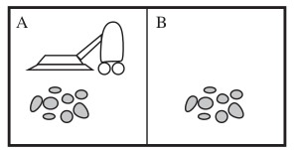
Example
A very-simple vacuum cleaner Environment: squares A and B
Percepts: location ({A, B}) and content ({Dirty, Clean})
e.g. [A, Dirty]
Actions: {left, right, suck, no_op}
(Oc S. Russell & P. Norwig, AIMA)

Slide 28
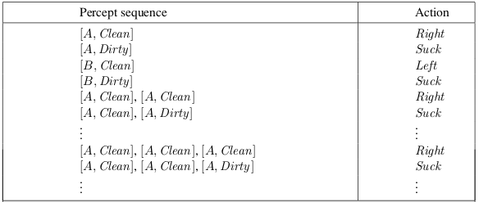
Example [cont.]
A simple agent function
If the current square is dirty, then suck; otherwise, move to the other square.
(Oc S. Russell & P. Norwig, AIMA)
Note: this agent function depends only on the last percept, not on the whole percept sequence.
9 / 52

Slide 29
Example [cont.]
A simple agent function
If the current square is dirty, then suck; otherwise, move to the other square.
(Oc S. Russell & P. Norwig, AIMA)
Note: this agent function depends only on the last percept, not on the whole percept sequence.
9 / 52

Slide 30
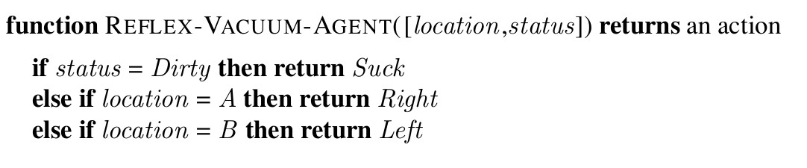
Example [cont.]
Corresponding agent program
(Oc S. Russell & P. Norwig, AIMA)

Slide 31

Outline
1
Agents and Environments
2
Rational Agents
3
Task Environments
4
Task-Environment Types
5
Agent Types
6
Environment States

Slide 32
Main question
What is a rational agent?

Slide 33
Rational Agents
Intuition: a rational agent is one that “does the right thing”
i.e., every entry in the agent function-table is filled out correctly
What is the right thing?
Approximation: the most “succesfull” thing:
In a given environment, according to the percept sequence it receives, an agent generates a sequence of actions, ...
... causing the environment to go through a sequence of states. If such sequence is desirable, then the agent has performed well.
=⇒ need a performance measure to evaluate any sequence of environment states
Performance measure should be objective
Performance measure according to what is wanted in the environment, not to how the agents should behave
e.g. “how clean the floor is” is a better measure than “the amount of dirt cleaned within a certain time”

Slide 34
Rational Agents
Intuition: a rational agent is one that “does the right thing”
i.e., every entry in the agent function-table is filled out correctly
What is the right thing?
Approximation: the most “succesfull” thing:
In a given environment, according to the percept sequence it receives, an agent generates a sequence of actions, ...
... causing the environment to go through a sequence of states. If such sequence is desirable, then the agent has performed well.
=⇒ need a performance measure to evaluate any sequence of environment states
Performance measure should be objective
Performance measure according to what is wanted in the environment, not to how the agents should behave
e.g. “how clean the floor is” is a better measure than “the amount of dirt cleaned within a certain time”
13 / 52

Slide 35
Rational Agents
Intuition: a rational agent is one that “does the right thing”
i.e., every entry in the agent function-table is filled out correctly
What is the right thing?
Approximation: the most “succesfull” thing:
In a given environment, according to the percept sequence it receives, an agent generates a sequence of actions, ...
... causing the environment to go through a sequence of states. If such sequence is desirable, then the agent has performed well.
=⇒ need a performance measure to evaluate any sequence of environment states
Performance measure should be objective
Performance measure according to what is wanted in the environment, not to how the agents should behave
e.g. “how clean the floor is” is a better measure than “the amount of dirt cleaned within a certain time”
13 / 52

Slide 36
Rational Agents
Intuition: a rational agent is one that “does the right thing”
i.e., every entry in the agent function-table is filled out correctly
What is the right thing?
Approximation: the most “succesfull” thing:
In a given environment, according to the percept sequence it receives, an agent generates a sequence of actions, ...
... causing the environment to go through a sequence of states. If such sequence is desirable, then the agent has performed well.
=⇒ need a performance measure to evaluate any sequence of environment states
Performance measure should be objective
Performance measure according to what is wanted in the environment, not to how the agents should behave
e.g. “how clean the floor is” is a better measure than “the amount of dirt cleaned within a certain time”
13 / 52

Slide 37
Rational Agents
Intuition: a rational agent is one that “does the right thing”
i.e., every entry in the agent function-table is filled out correctly
What is the right thing?
Approximation: the most “succesfull” thing:
In a given environment, according to the percept sequence it receives, an agent generates a sequence of actions, ...
... causing the environment to go through a sequence of states. If such sequence is desirable, then the agent has performed well.
=⇒ need a performance measure to evaluate any sequence of environment states
Performance measure should be objective
Performance measure according to what is wanted in the environment, not to how the agents should behave
e.g. “how clean the floor is” is a better measure than “the amount of dirt cleaned within a certain time”
13 / 52

Slide 38
Rational Agents
Intuition: a rational agent is one that “does the right thing”
i.e., every entry in the agent function-table is filled out correctly
What is the right thing?
Approximation: the most “succesfull” thing:
In a given environment, according to the percept sequence it receives, an agent generates a sequence of actions, ...
... causing the environment to go through a sequence of states. If such sequence is desirable, then the agent has performed well.
=⇒ need a performance measure to evaluate any sequence of environment states
Performance measure should be objective
Performance measure according to what is wanted in the environment, not to how the agents should behave
e.g. “how clean the floor is” is a better measure than “the amount of dirt cleaned within a certain time”
13 / 52

Slide 39
Rational Agents
Intuition: a rational agent is one that “does the right thing”
i.e., every entry in the agent function-table is filled out correctly
What is the right thing?
Approximation: the most “succesfull” thing:
In a given environment, according to the percept sequence it receives, an agent generates a sequence of actions, ...
... causing the environment to go through a sequence of states. If such sequence is desirable, then the agent has performed well.
=⇒ need a performance measure to evaluate any sequence of environment states
Performance measure should be objective
Performance measure according to what is wanted in the environment, not to how the agents should behave
e.g. “how clean the floor is” is a better measure than “the amount of dirt cleaned within a certain time”
13 / 52

Slide 40
Rational Agents
Intuition: a rational agent is one that “does the right thing”
i.e., every entry in the agent function-table is filled out correctly
What is the right thing?
Approximation: the most “succesfull” thing:
In a given environment, according to the percept sequence it receives, an agent generates a sequence of actions, ...
... causing the environment to go through a sequence of states. If such sequence is desirable, then the agent has performed well.
=⇒ need a performance measure to evaluate any sequence of environment states
Performance measure should be objective
Performance measure according to what is wanted in the environment, not to how the agents should behave
e.g. “how clean the floor is” is a better measure than “the amount of dirt cleaned within a certain time”
13 / 52

Slide 41
Rational Agents
Intuition: a rational agent is one that “does the right thing”
i.e., every entry in the agent function-table is filled out correctly
What is the right thing?
Approximation: the most “succesfull” thing:
In a given environment, according to the percept sequence it receives, an agent generates a sequence of actions, ...
... causing the environment to go through a sequence of states. If such sequence is desirable, then the agent has performed well.
=⇒ need a performance measure to evaluate any sequence of environment states
Performance measure should be objective
Performance measure according to what is wanted in the environment, not to how the agents should behave
e.g. “how clean the floor is” is a better measure than “the amount of dirt cleaned within a certain time”
13 / 52

Slide 42
Rational Agents
Intuition: a rational agent is one that “does the right thing”
i.e., every entry in the agent function-table is filled out correctly
What is the right thing?
Approximation: the most “succesfull” thing:
In a given environment, according to the percept sequence it receives, an agent generates a sequence of actions, ...
... causing the environment to go through a sequence of states. If such sequence is desirable, then the agent has performed well.
=⇒ need a performance measure to evaluate any sequence of environment states
Performance measure should be objective
Performance measure according to what is wanted in the environment, not to how the agents should behave
e.g. “how clean the floor is” is a better measure than “the amount of dirt cleaned within a certain time”

Slide 43
Rational Agents [cont.]
What is rational at any given time depends on four things:
The performance measure that defines the criterion of success The agent’s prior knowledge of the environment
The actions that the agent can perform
The agent’s percept sequence to date (from sensors)
Definition of a rational agent
For each possible percept sequence, a rational agent should select an action that is expected to maximize its performance measure, given the evidence provided by the percept sequence and whatever built-in knowledge the agent has.

Slide 44
Rational Agents [cont.]
What is rational at any given time depends on four things:
The performance measure that defines the criterion of success The agent’s prior knowledge of the environment
The actions that the agent can perform
The agent’s percept sequence to date (from sensors)
Definition of a rational agent
For each possible percept sequence, a rational agent should select an action that is expected to maximize its performance measure, given the evidence provided by the percept sequence and whatever built-in knowledge the agent has.

Slide 45
Rational Agents: Example
The simple vacuum-cleaner agent Under the following assumptions:
Performance measure: one point for each clean square at each time step, over 1000 time steps
Environment knowledge:
“geography” known a priori,
dirt distribution and agent initial location unknown [clean squares cannot become dirty again ]
Perception: self location, presence of dirt Actions: Left, Right, Suck
Is the agent rational?
=⇒ Yes! (provided the given performence measure)
Beware: if a penalty for each move is given, the agent behaves poorly
=⇒ better agent: do nothing once it is sure all the squares are clean

Slide 46
Rational Agents: Example
The simple vacuum-cleaner agent Under the following assumptions:
Performance measure: one point for each clean square at each time step, over 1000 time steps
Environment knowledge:
“geography” known a priori,
dirt distribution and agent initial location unknown [clean squares cannot become dirty again ]
Perception: self location, presence of dirt Actions: Left, Right, Suck
Is the agent rational?
=⇒ Yes! (provided the given performence measure)
Beware: if a penalty for each move is given, the agent behaves poorly
=⇒ better agent: do nothing once it is sure all the squares are clean
15 / 52

Slide 47
Rational Agents: Example
The simple vacuum-cleaner agent Under the following assumptions:
Performance measure: one point for each clean square at each time step, over 1000 time steps
Environment knowledge:
“geography” known a priori,
dirt distribution and agent initial location unknown [clean squares cannot become dirty again ]
Perception: self location, presence of dirt Actions: Left, Right, Suck
Is the agent rational?
=⇒ Yes! (provided the given performence measure)
Beware: if a penalty for each move is given, the agent behaves poorly
=⇒ better agent: do nothing once it is sure all the squares are clean
15 / 52

Slide 48
Rational Agents: Example
The simple vacuum-cleaner agent Under the following assumptions:
Performance measure: one point for each clean square at each time step, over 1000 time steps
Environment knowledge:
“geography” known a priori,
dirt distribution and agent initial location unknown [clean squares cannot become dirty again ]
Perception: self location, presence of dirt Actions: Left, Right, Suck
Is the agent rational?
=⇒ Yes! (provided the given performence measure)
Beware: if a penalty for each move is given, the agent behaves poorly
=⇒ better agent: do nothing once it is sure all the squares are clean

Slide 49
Rationality vs. Omniscience vs. Perfection
Remark
Rationality /= Omniscience!
An omniscient agent knows for sure the outcome of its actions
=⇒ omniscience impossible in reality
A rational agent may only know “up to a reasonable confidence” (e.g., when crossing a road, what if something falling from a plane flattens you? if so, would you be considered irrational?)
Rational behaviour is not perfect behaviour!
perfection maximizes actual performance
(given uncertainty) rationality maximizes expected performance

Slide 50
Information Gathering, Learning, Autonomy
Rationality requires other important features Information gathering/exploration:
the rational choice depends only on the percept sequence to date
=⇒ actions needed in order to modify future percepts Ex: look both ways before crossing a busy road
Learning:
agent’s prior knowledge of the environment incomplete
=⇒ learning from percept sequences improves & augments it Ex: a baby learns from trial&errors the right movements to walk
Being Autonomous:
prior knowledge may be partial/incorrect or evolving
=⇒ learn to compensate for partial or incorrect prior knowledge Ex: a child learns how to climb a tree
Information gathering, learning, autonomy play an essential role in AI.

Slide 51
Information Gathering, Learning, Autonomy
Rationality requires other important features Information gathering/exploration:
the rational choice depends only on the percept sequence to date
=⇒ actions needed in order to modify future percepts Ex: look both ways before crossing a busy road
Learning:
agent’s prior knowledge of the environment incomplete
=⇒ learning from percept sequences improves & augments it Ex: a baby learns from trial&errors the right movements to walk
Being Autonomous:
prior knowledge may be partial/incorrect or evolving
=⇒ learn to compensate for partial or incorrect prior knowledge Ex: a child learns how to climb a tree
Information gathering, learning, autonomy play an essential role in AI.
17 / 52

Slide 52
Information Gathering, Learning, Autonomy
Rationality requires other important features Information gathering/exploration:
the rational choice depends only on the percept sequence to date
=⇒ actions needed in order to modify future percepts Ex: look both ways before crossing a busy road
Learning:
agent’s prior knowledge of the environment incomplete
=⇒ learning from percept sequences improves & augments it Ex: a baby learns from trial&errors the right movements to walk
Being Autonomous:
prior knowledge may be partial/incorrect or evolving
=⇒ learn to compensate for partial or incorrect prior knowledge Ex: a child learns how to climb a tree
Information gathering, learning, autonomy play an essential role in AI.
17 / 52

Slide 53
Information Gathering, Learning, Autonomy
Rationality requires other important features Information gathering/exploration:
the rational choice depends only on the percept sequence to date
=⇒ actions needed in order to modify future percepts Ex: look both ways before crossing a busy road
Learning:
agent’s prior knowledge of the environment incomplete
=⇒ learning from percept sequences improves & augments it Ex: a baby learns from trial&errors the right movements to walk
Being Autonomous:
prior knowledge may be partial/incorrect or evolving
=⇒ learn to compensate for partial or incorrect prior knowledge Ex: a child learns how to climb a tree
Information gathering, learning, autonomy play an essential role in AI.

Slide 54
Outline
1
Agents and Environments
2
Rational Agents
3
Task Environments
4
Task-Environment Types
5
Agent Types
6
Environment States

Slide 55
Task Environments
PEAS Description of Task Environments
To design a rational agent we must specify its task environment
i.e. the “problems” to which rational agents are the “solutions”
Task environment described in terms of four elements (“PEAS”):
Performance measure Environment Actuators
Sensors
Simple Example: Simple Vacuum Cleaner
Performance measure: 1 point per clean square per time step Environment: squares A and B, possibly dirty
Actuators: move left/right, suck Sensors: self location, presence of dirt

Slide 56
Task Environments
PEAS Description of Task Environments
To design a rational agent we must specify its task environment
i.e. the “problems” to which rational agents are the “solutions”
Task environment described in terms of four elements (“PEAS”):
Performance measure Environment Actuators
Sensors
Simple Example: Simple Vacuum Cleaner
Performance measure: 1 point per clean square per time step Environment: squares A and B, possibly dirty
Actuators: move left/right, suck Sensors: self location, presence of dirt
19 / 52

Slide 57
Task Environments
PEAS Description of Task Environments
To design a rational agent we must specify its task environment
i.e. the “problems” to which rational agents are the “solutions”
Task environment described in terms of four elements (“PEAS”):
Performance measure Environment Actuators
Sensors
Simple Example: Simple Vacuum Cleaner
Performance measure: 1 point per clean square per time step Environment: squares A and B, possibly dirty
Actuators: move left/right, suck Sensors: self location, presence of dirt

Slide 58
Task Environments [cont.]
Complex Example: Autonomous Taxi
Performance measure: safety, destination, profits, comfort, ... Environment: streets/freeways, other traffic, pedestrians, ... Actuators: steering, accelerator, brake, horn, speaker/display, ... Sensors: video, sonar, speedometer, engine sensors, GPS, ...
Remark
Some goals to be measured may conflict!
e.g. profits vs. safety, profits vs. comfort, ...
=⇒ tradeoffs are required

Slide 59
Task Environments [cont.]
Complex Example: Autonomous Taxi
Performance measure: safety, destination, profits, comfort, ... Environment: streets/freeways, other traffic, pedestrians, ... Actuators: steering, accelerator, brake, horn, speaker/display, ... Sensors: video, sonar, speedometer, engine sensors, GPS, ...
Remark
Some goals to be measured may conflict!
e.g. profits vs. safety, profits vs. comfort, ...
=⇒ tradeoffs are required
20 / 52

Slide 60
Task Environments [cont.]
Complex Example: Autonomous Taxi
Performance measure: safety, destination, profits, comfort, ... Environment: streets/freeways, other traffic, pedestrians, ... Actuators: steering, accelerator, brake, horn, speaker/display, ... Sensors: video, sonar, speedometer, engine sensors, GPS, ...
Remark
Some goals to be measured may conflict!
e.g. profits vs. safety, profits vs. comfort, ...
=⇒ tradeoffs are required
20 / 52

Slide 61
Task Environments [cont.]
Complex Example: Autonomous Taxi
Performance measure: safety, destination, profits, comfort, ... Environment: streets/freeways, other traffic, pedestrians, ... Actuators: steering, accelerator, brake, horn, speaker/display, ... Sensors: video, sonar, speedometer, engine sensors, GPS, ...
Remark
Some goals to be measured may conflict!
e.g. profits vs. safety, profits vs. comfort, ...
=⇒ tradeoffs are required
20 / 52

Slide 62
Task Environments [cont.]
Complex Example: Autonomous Taxi
Performance measure: safety, destination, profits, comfort, ... Environment: streets/freeways, other traffic, pedestrians, ... Actuators: steering, accelerator, brake, horn, speaker/display, ... Sensors: video, sonar, speedometer, engine sensors, GPS, ...
Remark
Some goals to be measured may conflict!
e.g. profits vs. safety, profits vs. comfort, ...
=⇒ tradeoffs are required
20 / 52

Slide 63
Task Environments [cont.]
Complex Example: Autonomous Taxi
Performance measure: safety, destination, profits, comfort, ... Environment: streets/freeways, other traffic, pedestrians, ... Actuators: steering, accelerator, brake, horn, speaker/display, ... Sensors: video, sonar, speedometer, engine sensors, GPS, ...
Remark
Some goals to be measured may conflict!
e.g. profits vs. safety, profits vs. comfort, ...
=⇒ tradeoffs are required

Slide 64
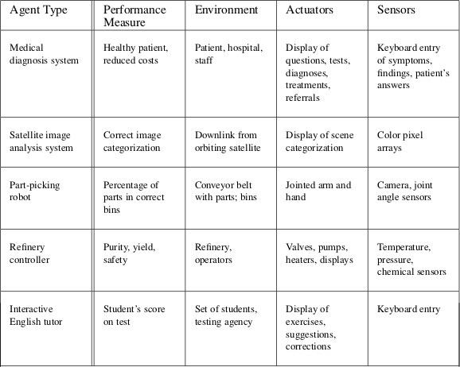
Task Environments: Examples
(Oc S. Russell & P. Norwig, AIMA)

Slide 65
Outline
1
Agents and Environments
2
Rational Agents
3
Task Environments
4
Task-Environment Types
5
Agent Types
6
Environment States

Slide 66
Properties of Task Environments
Task environments can be categorized along six dimensions: Fully observable vs. partially observable
Single-agent vs. multi-agent Deterministic vs. stochastic Episodic vs. sequential Static vs. dynamic
Discrete vs. continuous

Slide 67
Properties of Task Environments [cont.]
Fully observable vs. partially observable
A task environment is (effectively) fully observable iff the sensors detect the complete state of the environment
”relevant” depends on the performance measure
no need to maintain internal state to keep track of the environment
A t.e. may be partially observable (Ex: Taxi driving):
noisy and inaccurate sensors
parts of the state are not accessible for sensors
A t.e. might be even unobservable (no sensors)
e.g. fully-deterministic actions

Slide 68
Properties of Task Environments [cont.]
Fully observable vs. partially observable
A task environment is (effectively) fully observable iff the sensors detect all aspects of the state of the environments that are relevant to the choice of action
”relevant” depends on the performance measure
no need to maintain internal state to keep track of the environment
A t.e. may be partially observable (Ex: Taxi driving):
noisy and inaccurate sensors
parts of the state are not accessible for sensors
A t.e. might be even unobservable (no sensors)
e.g. fully-deterministic actions
24 / 52

Slide 69
Properties of Task Environments [cont.]
Fully observable vs. partially observable
A task environment is (effectively) fully observable iff the sensors detect all aspects of the state of the environments that are relevant to the choice of action
”relevant” depends on the performance measure
no need to maintain internal state to keep track of the environment
A t.e. may be partially observable (Ex: Taxi driving):
noisy and inaccurate sensors
parts of the state are not accessible for sensors
A t.e. might be even unobservable (no sensors)
e.g. fully-deterministic actions
24 / 52

Slide 70
Properties of Task Environments [cont.]
Fully observable vs. partially observable
A task environment is (effectively) fully observable iff the sensors detect all aspects of the state of the environments that are relevant to the choice of action
”relevant” depends on the performance measure
no need to maintain internal state to keep track of the environment
A t.e. may be partially observable (Ex: Taxi driving):
noisy and inaccurate sensors
parts of the state are not accessible for sensors
A t.e. might be even unobservable (no sensors)
e.g. fully-deterministic actions

Slide 71
Properties of Task Environments [cont.]
Single-agent vs. multi-agent
A task environment is multi-agent iff contains other agents who are also maximizing some performance measure that depends on the current agent’s actions
latest condition essential
distinction between single- and multi-agent sometimes subtle
Two important cases
competitive multi-agent environment: other agents’ goals conflict with or oppose to the agent’s goals
Ex: chess, war scenarios, taxi driving (compete for parking lot), ... cooperative multi-agent environment: other agents’ goals coincide in full or in part with the agent’s goals
different design problems for multi-agent wrt. single-agent
competitive: randomized behaviour often rational (unpredictable) collaborative: communication with other agents often rational
25 / 52

Slide 72
Properties of Task Environments [cont.]
Single-agent vs. multi-agent
A task environment is multi-agent iff contains other agents who are also maximizing some performance measure that depends on the current agent’s actions
latest condition essential
distinction between single- and multi-agent sometimes subtle
Two important cases
competitive multi-agent environment: other agents’ goals conflict with or oppose to the agent’s goals
Ex: chess, war scenarios, taxi driving (compete for parking lot), ... cooperative multi-agent environment: other agents’ goals coincide in full or in part with the agent’s goals
Ex: ants’ nest, factory, taxi driving (avoid collisions), ...
different design problems for multi-agent wrt. single-agent
competitive: randomized behaviour often rational (unpredictable) collaborative: communication with other agents often rational
25 / 52

Slide 73
Properties of Task Environments [cont.]
Single-agent vs. multi-agent
A task environment is multi-agent iff contains other agents who are also maximizing some performance measure that depends on the current agent’s actions
latest condition essential
distinction between single- and multi-agent sometimes subtle
Two important cases
competitive multi-agent environment: other agents’ goals conflict with or oppose to the agent’s goals
Ex: chess, war scenarios, taxi driving (compete for parking lot), ... cooperative multi-agent environment: other agents’ goals coincide in full or in part with the agent’s goals
Ex: ants’ nest, factory, taxi driving (avoid collisions), ...
different design problems for multi-agent wrt. single-agent competitive: randomized behaviour often rational (unpredictable) collaborative: communication with other agents often rational
25 / 52

Slide 74
Properties of Task Environments [cont.]
Single-agent vs. multi-agent
A task environment is multi-agent iff contains other agents who are also maximizing some performance measure that depends on the current agent’s actions
latest condition essential
distinction between single- and multi-agent sometimes subtle
Two important cases
competitive multi-agent environment: other agents’ goals conflict with or oppose to the agent’s goals
Ex: chess, war scenarios, taxi driving (compete for parking lot), ... cooperative multi-agent environment: other agents’ goals coincide in full or in part with the agent’s goals
Ex: ants’ nest, factory, taxi driving (avoid collisions), ...
different design problems for multi-agent wrt. single-agent competitive: randomized behaviour often rational (unpredictable) collaborative: communication with other agents often rational
25 / 52

Slide 75
Properties of Task Environments [cont.]
Single-agent vs. multi-agent
A task environment is multi-agent iff contains other agents who are also maximizing some performance measure that depends on the current agent’s actions
latest condition essential
distinction between single- and multi-agent sometimes subtle
Two important cases
competitive multi-agent environment: other agents’ goals conflict with or oppose to the agent’s goals
Ex: chess, war scenarios, taxi driving (compete for parking lot), ... cooperative multi-agent environment: other agents’ goals coincide in full or in part with the agent’s goals
Ex: ants’ nest, factory, taxi driving (avoid collisions), ...
different design problems for multi-agent wrt. single-agent competitive: randomized behaviour often rational (unpredictable) collaborative: communication with other agents often rational
25 / 52

Slide 76
Properties of Task Environments [cont.]
Single-agent vs. multi-agent
A task environment is multi-agent iff contains other agents who are also maximizing some performance measure that depends on the current agent’s actions
latest condition essential
distinction between single- and multi-agent sometimes subtle
Two important cases
competitive multi-agent environment: other agents’ goals conflict with or oppose to the agent’s goals
Ex: chess, war scenarios, taxi driving (compete for parking lot), ... cooperative multi-agent environment: other agents’ goals coincide in full or in part with the agent’s goals
Ex: ants’ nest, factory, taxi driving (avoid collisions), ...
different design problems for multi-agent wrt. single-agent competitive: randomized behaviour often rational (unpredictable) collaborative: communication with other agents often rational
25 / 52

Slide 77
Properties of Task Environments [cont.]
Single-agent vs. multi-agent
A task environment is multi-agent iff contains other agents who are also maximizing some performance measure that depends on the current agent’s actions
latest condition essential
distinction between single- and multi-agent sometimes subtle
Two important cases
competitive multi-agent environment: other agents’ goals conflict with or oppose to the agent’s goals
Ex: chess, war scenarios, taxi driving (compete for parking lot), ... cooperative multi-agent environment: other agents’ goals coincide in full or in part with the agent’s goals
Ex: ants’ nest, factory, taxi driving (avoid collisions), ...
different design problems for multi-agent wrt. single-agent competitive: randomized behaviour often rational (unpredictable) collaborative: communication with other agents often rational
25 / 52

Slide 78
Properties of Task Environments [cont.]
Single-agent vs. multi-agent
A task environment is multi-agent iff contains other agents who are also maximizing some performance measure that depends on the current agent’s actions
latest condition essential
distinction between single- and multi-agent sometimes subtle
Two important cases
competitive multi-agent environment: other agents’ goals conflict with or oppose to the agent’s goals
Ex: chess, war scenarios, taxi driving (compete for parking lot), ... cooperative multi-agent environment: other agents’ goals coincide in full or in part with the agent’s goals
Ex: ants’ nest, factory, taxi driving (avoid collisions), ...
different design problems for multi-agent wrt. single-agent competitive: randomized behaviour often rational (unpredictable) collaborative: communication with other agents often rational

Slide 79
Properties of Task Environments [cont.]
Deterministic vs. stochastic
A task environment is deterministic iff its next state is completely determined by its current state and by the action of the agent. (Ex: a crossword puzzle).
If not so:
A t.e. is stochastic if uncertainty about outcomes is quantified in terms of probabilities (Ex: dice, poker game, component failure,...) A t.e. is nondeterministic iff actions are characterized by their possible outcomes, but no probabilities are attached to them
In a multi-agent environment we ignore uncertainty that arises from the actions of other agents (Ex: chess is deterministic even though each agent is unable to predict the actions of the others).
A partially observable environment could appear to be stochastic.
=⇒ for practical purposes, when it is impossible to keep track of all the unobserved aspects, they must be treated as stochastic.
(Ex: Taxi driving)

Slide 80
Properties of Task Environments [cont.]
Deterministic vs. stochastic
A task environment is deterministic iff its next state is completely determined by its current state and by the action of the agent. (Ex: a crossword puzzle).
If not so:
A t.e. is stochastic if uncertainty about outcomes is quantified in terms of probabilities (Ex: dice, poker game, component failure,...) A t.e. is nondeterministic iff actions are characterized by their possible outcomes, but no probabilities are attached to them
In a multi-agent environment we ignore uncertainty that arises from the actions of other agents (Ex: chess is deterministic even though each agent is unable to predict the actions of the others).
A partially observable environment could appear to be stochastic.
=⇒ for practical purposes, when it is impossible to keep track of all the unobserved aspects, they must be treated as stochastic.
(Ex: Taxi driving)
26 / 52

Slide 81
Properties of Task Environments [cont.]
Deterministic vs. stochastic
A task environment is deterministic iff its next state is completely determined by its current state and by the action of the agent. (Ex: a crossword puzzle).
If not so:
A t.e. is stochastic if uncertainty about outcomes is quantified in terms of probabilities (Ex: dice, poker game, component failure,...) A t.e. is nondeterministic iff actions are characterized by their possible outcomes, but no probabilities are attached to them
In a multi-agent environment we ignore uncertainty that arises from the actions of other agents (Ex: chess is deterministic even though each agent is unable to predict the actions of the others).
A partially observable environment could appear to be stochastic.
=⇒ for practical purposes, when it is impossible to keep track of all the unobserved aspects, they must be treated as stochastic.
(Ex: Taxi driving)
26 / 52

Slide 82
Properties of Task Environments [cont.]
Deterministic vs. stochastic
A task environment is deterministic iff its next state is completely determined by its current state and by the action of the agent. (Ex: a crossword puzzle).
If not so:
A t.e. is stochastic if uncertainty about outcomes is quantified in terms of probabilities (Ex: dice, poker game, component failure,...) A t.e. is nondeterministic iff actions are characterized by their possible outcomes, but no probabilities are attached to them
In a multi-agent environment we ignore uncertainty that arises from the actions of other agents (Ex: chess is deterministic even though each agent is unable to predict the actions of the others).
A partially observable environment could appear to be stochastic.
=⇒ for practical purposes, when it is impossible to keep track of all the unobserved aspects, they must be treated as stochastic.
(Ex: Taxi driving)
26 / 52

Slide 83
Properties of Task Environments [cont.]
Deterministic vs. stochastic
A task environment is deterministic iff its next state is completely determined by its current state and by the action of the agent. (Ex: a crossword puzzle).
If not so:
A t.e. is stochastic if uncertainty about outcomes is quantified in terms of probabilities (Ex: dice, poker game, component failure,...) A t.e. is nondeterministic iff actions are characterized by their possible outcomes, but no probabilities are attached to them
In a multi-agent environment we ignore uncertainty that arises from the actions of other agents (Ex: chess is deterministic even though each agent is unable to predict the actions of the others).
A partially observable environment could appear to be stochastic.
=⇒ for practical purposes, when it is impossible to keep track of all the unobserved aspects, they must be treated as stochastic.
(Ex: Taxi driving)

Slide 84
Properties of Task Environments [cont.]
Episodic vs. sequential
In an episodic task environment
the agent’s experience is divided into atomic episodes
in each episode the agent receives a percept and then performs a single action
=⇒ episodes do not depend on the actions taken in previous
episodes, and they do not influence future episodes
Ex: an agent that has to spot defective parts on an assembly line,
In sequential environments the current decision could affect future decisions =⇒ actions can have long-term consequences
Ex: chess, taxi driving, ...
Episodic environments are much simpler than sequential ones
No need to think ahead!

Slide 85
Properties of Task Environments [cont.]
Episodic vs. sequential
In an episodic task environment
the agent’s experience is divided into atomic episodes
in each episode the agent receives a percept and then performs a single action
=⇒ episodes do not depend on the actions taken in previous
episodes, and they do not influence future episodes
Ex: an agent that has to spot defective parts on an assembly line,
In sequential environments the current decision could affect future decisions =⇒ actions can have long-term consequences
Ex: chess, taxi driving, ...
Episodic environments are much simpler than sequential ones
No need to think ahead!
27 / 52

Slide 86
Properties of Task Environments [cont.]
Episodic vs. sequential
In an episodic task environment
the agent’s experience is divided into atomic episodes
in each episode the agent receives a percept and then performs a single action
=⇒ episodes do not depend on the actions taken in previous
episodes, and they do not influence future episodes
Ex: an agent that has to spot defective parts on an assembly line,
In sequential environments the current decision could affect future decisions =⇒ actions can have long-term consequences
Ex: chess, taxi driving, ...
Episodic environments are much simpler than sequential ones
No need to think ahead!

Slide 87
Properties of Task Environments [cont.]
Static vs. dynamic
The task environment is dynamic iff it can change while the agent is choosing an action, static otherwise
=⇒ agent needs keep looking at the world while deciding an action Ex: crossword puzzles are static, taxi driving is dynamic
The t.e. is semidynamic if the environment itself does not change with time, but the agent’s performance score does
Ex: chess with a clock
Static environments are easier to deal wrt. [semi]dynamic ones
28 / 52

Slide 88
Properties of Task Environments [cont.]
Static vs. dynamic
The task environment is dynamic iff it can change while the agent is choosing an action, static otherwise
=⇒ agent needs keep looking at the world while deciding an action Ex: crossword puzzles are static, taxi driving is dynamic
The t.e. is semidynamic if the environment itself does not change with time, but the agent’s performance score does
Ex: chess with a clock
Static environments are easier to deal wrt. [semi]dynamic ones
28 / 52

Slide 89
Properties of Task Environments [cont.]
Static vs. dynamic
The task environment is dynamic iff it can change while the agent is choosing an action, static otherwise
=⇒ agent needs keep looking at the world while deciding an action Ex: crossword puzzles are static, taxi driving is dynamic
The t.e. is semidynamic if the environment itself does not change with time, but the agent’s performance score does
Ex: chess with a clock
Static environments are easier to deal wrt. [semi]dynamic ones
28 / 52

Slide 90
Properties of Task Environments [cont.]
Static vs. dynamic
The task environment is dynamic iff it can change while the agent is choosing an action, static otherwise
=⇒ agent needs keep looking at the world while deciding an action Ex: crossword puzzles are static, taxi driving is dynamic
The t.e. is semidynamic if the environment itself does not change with time, but the agent’s performance score does
Ex: chess with a clock
Static environments are easier to deal wrt. [semi]dynamic ones
28 / 52

Slide 91
Properties of Task Environments [cont.]
Discrete vs. continuous
The state of the environment, the way time is handled, and agents percepts & actions can be discrete or continuous
Ex: Crossword puzzles: discrete state, time, percepts & actions Ex: Taxi driving: continuous state, time, percepts & actions
...

Slide 92
Properties of Task Environments [cont.]
Note
The simplest environment is fully observable, single-agent, deterministic, episodic, static and discrete.
Ex: simple vacuum cleaner
Most real-world situations are partially observable, multi-agent, stochastic, sequential, dynamic, and continuous.
Ex: taxi driving
30 / 52

Slide 93
Properties of Task Environments [cont.]
Note
The simplest environment is fully observable, single-agent, deterministic, episodic, static and discrete.
Ex: simple vacuum cleaner
Most real-world situations are partially observable, multi-agent, stochastic, sequential, dynamic, and continuous.
Ex: taxi driving
30 / 52

Slide 94
Properties of Task Environments [cont.]
Note
The simplest environment is fully observable, single-agent, deterministic, episodic, static and discrete.
Ex: simple vacuum cleaner
Most real-world situations are partially observable, multi-agent, stochastic, sequential, dynamic, and continuous.
Ex: taxi driving
30 / 52

Slide 95
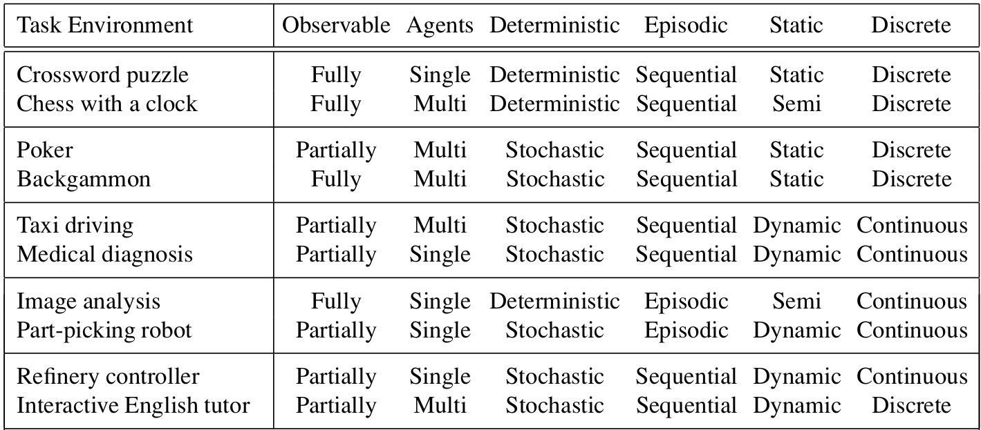
Properties of Task Environments [cont.]
Example properties of task Environments
(Oc S. Russell & P. Norwig, AIMA)
Several of the answers in the table depend on how the task environment is defined.

Slide 96
Properties of the Agent’s State of Knowledge
Known vs. unknown
Describes the agent’s (or designer’s) state of knowledge about the “laws of physics” of the environment
if the environment is known, then the outcomes (or outcome probabilities if stochastic) for all actions are given.
if the environment is unknown, then the agent will have to learn how it works in order to make good decisions
Orthogonal wrt. task-environment properties
Known /= Fully observable
a known environment can be partially observable (Ex: a solitaire card games)
an unknown environment can be fully observable (Ex: a game I don’t know the rules of)

Slide 97
Properties of the Agent’s State of Knowledge
Known vs. unknown
Describes the agent’s (or designer’s) state of knowledge about the “laws of physics” of the environment
if the environment is known, then the outcomes (or outcome probabilities if stochastic) for all actions are given.
if the environment is unknown, then the agent will have to learn how it works in order to make good decisions
Orthogonal wrt. task-environment properties
Known /= Fully observable
a known environment can be partially observable (Ex: a solitaire card games)
an unknown environment can be fully observable (Ex: a game I don’t know the rules of)
32 / 52

Slide 98
Properties of the Agent’s State of Knowledge
Known vs. unknown
Describes the agent’s (or designer’s) state of knowledge about the “laws of physics” of the environment
if the environment is known, then the outcomes (or outcome probabilities if stochastic) for all actions are given.
if the environment is unknown, then the agent will have to learn how it works in order to make good decisions
Orthogonal wrt. task-environment properties
Known /= Fully observable
a known environment can be partially observable (Ex: a solitaire card games)
an unknown environment can be fully observable (Ex: a game I don’t know the rules of)
32 / 52

Slide 99
Properties of the Agent’s State of Knowledge
Known vs. unknown
Describes the agent’s (or designer’s) state of knowledge about the “laws of physics” of the environment
if the environment is known, then the outcomes (or outcome probabilities if stochastic) for all actions are given.
if the environment is unknown, then the agent will have to learn how it works in order to make good decisions
Orthogonal wrt. task-environment properties
Known /= Fully observable
a known environment can be partially observable (Ex: a solitaire card games)
an unknown environment can be fully observable (Ex: a game I don’t know the rules of)

Slide 100
Outline
1
Agents and Environments
2
Rational Agents
3
Task Environments
4
Task-Environment Types
5
Agent Types
6
Environment States

Slide 101
Agents
Agent = Architecture + Program
AI Job: design an agent program implementing the agent function
The agent program runs on some computing device with physical sensors and actuators: the agent architecture All agents have the same skeleton:
Input: current percepts Output: action
Program: manipulates input to produce output
Remark
the agent function takes the entire percept history as input the agent program takes only the current percept as input
=⇒ if the actions need to depend on the entire percept sequence, the agent will have to remember the percepts

Slide 102
Agents
Agent = Architecture + Program
AI Job: design an agent program implementing the agent function
The agent program runs on some computing device with physical sensors and actuators: the agent architecture All agents have the same skeleton:
Input: current percepts Output: action
Program: manipulates input to produce output
Remark
the agent function takes the entire percept history as input the agent program takes only the current percept as input
=⇒ if the actions need to depend on the entire percept sequence, the agent will have to remember the percepts
34 / 52

Slide 103
Agents
Agent = Architecture + Program
AI Job: design an agent program implementing the agent function
The agent program runs on some computing device with physical sensors and actuators: the agent architecture All agents have the same skeleton:
Input: current percepts Output: action
Program: manipulates input to produce output
Remark
the agent function takes the entire percept history as input the agent program takes only the current percept as input
=⇒ if the actions need to depend on the entire percept sequence, the agent will have to remember the percepts
34 / 52

Slide 104
Agents
Agent = Architecture + Program
AI Job: design an agent program implementing the agent function
The agent program runs on some computing device with physical sensors and actuators: the agent architecture All agents have the same skeleton:
Input: current percepts Output: action
Program: manipulates input to produce output
Remark
the agent function takes the entire percept history as input the agent program takes only the current percept as input
=⇒ if the actions need to depend on the entire percept sequence, the agent will have to remember the percepts
34 / 52

Slide 105
Agents
Agent = Architecture + Program
AI Job: design an agent program implementing the agent function
The agent program runs on some computing device with physical sensors and actuators: the agent architecture All agents have the same skeleton:
Input: current percepts Output: action
Program: manipulates input to produce output
Remark
the agent function takes the entire percept history as input the agent program takes only the current percept as input
=⇒ if the actions need to depend on the entire percept sequence, the agent will have to remember the percepts

Slide 106
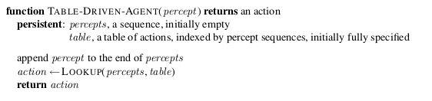
A trivial Agent Program
The Table-Driven Agent
The table represents explicitly the agent function
Ex: the simple vacuum cleaner
(Oc S. Russell & P. Norwig, AIMA)
Blow-up in table size =⇒ doomed to failure
35 / 52

Slide 107
A trivial Agent Program
The Table-Driven Agent
The table represents explicitly the agent function
Ex: the simple vacuum cleaner
(Oc S. Russell & P. Norwig, AIMA)
Blow-up in table size =⇒ doomed to failure
35 / 52

Slide 108
Agent Types
Four basic kinds of agent programs Simple-reflex agents
Model-based reflex agents Goal-based agents
Utility-based agents
All these can be turned into learning agents.
36 / 52

Slide 109
Agent Types
Four basic kinds of agent programs Simple-reflex agents
Model-based reflex agents Goal-based agents
Utility-based agents
All these can be turned into learning agents.
36 / 52

Slide 110
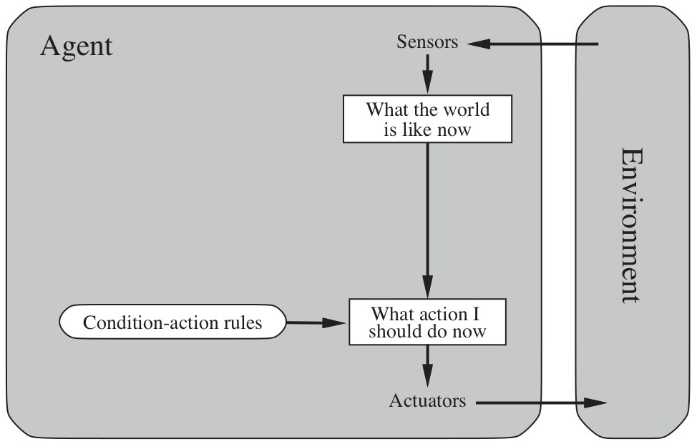
Agent Types: Simple-reflex agent
Select action on the basis of the current percept only
Ex: the simple vacuum-agent
Implemented through condition-action rules
Ex: “if car-in-front-is-braking then initiate-braking” can be implemented, e.g., in a Boolean circuit
Large reduction in possible percept/action situations due to ignoring the percept history
(Oc S. Russell & P. Norwig, AIMA)

Slide 111
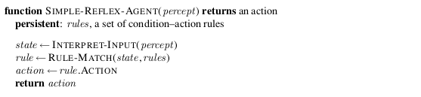
Agent Types: Simple-reflex agent [cont.]
Simple-reflex agent program
(Oc S. Russell & P. Norwig, AIMA)
very simple
may work only if the environment is fully observable
deadlocks or infinite loops may occur otherwise
=⇒ limited applicability

Slide 112
Agent Types: Simple-reflex agent [cont.]
Simple-reflex agent program
(Oc S. Russell & P. Norwig, AIMA)
very simple
may work only if the environment is fully observable
deadlocks or infinite loops may occur otherwise
=⇒ limited applicability

Slide 113
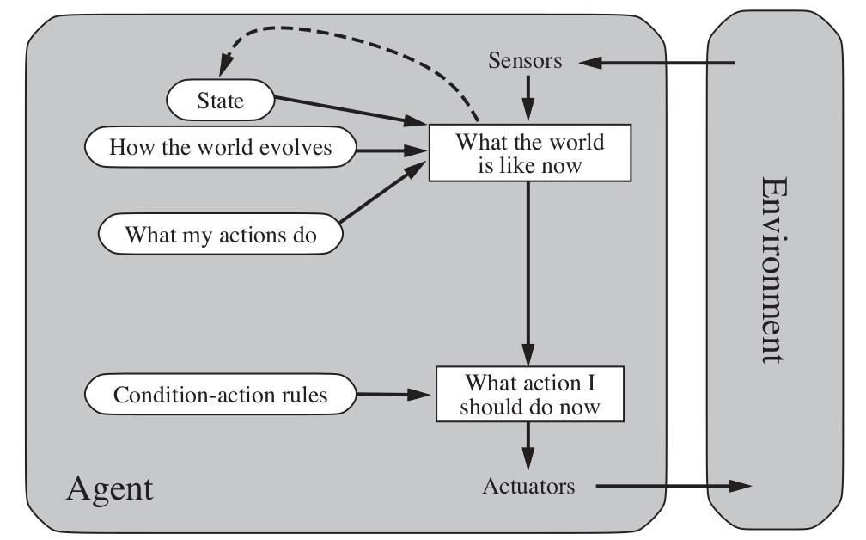
Agent Types: Model-based agent
Idea: To tackle partially-observable environments, keeps track of the part of the world it can’t see now
Maintain internal state depending on the percept history
reflects at least some of the unobserved aspects of current state
To update internal state the agent needs a model of the world:
how the world evolves independently of the agent
Ex: an overtaking car will soon be closer behind than it was before
how the agent’s own actions affect the world
Ex: turn the steering wheel clockwise =⇒ the car turns to the right
(Oc S. Russell & P. Norwig, AIMA)
39 / 52

Slide 114
Agent Types: Model-based agent
Idea: To tackle partially-observable environments, keeps track of the part of the world it can’t see now
Maintain internal state depending on the percept history
reflects at least some of the unobserved aspects of current state
To update internal state the agent needs a model of the world:
how the world evolves independently of the agent
Ex: an overtaking car will soon be closer behind than it was before
how the agent’s own actions affect the world
Ex: turn the steering wheel clockwise =⇒ the car turns to the right
(Oc S. Russell & P. Norwig, AIMA)
39 / 52

Slide 115
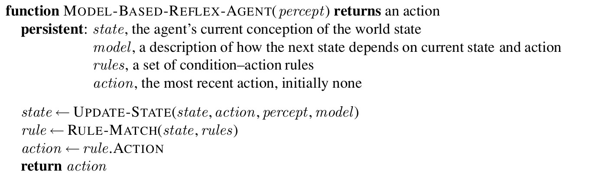
Agent Types: Model-based Agent [cont.]
Model-based Agent program
(Oc S. Russell & P. Norwig, AIMA)

Slide 116
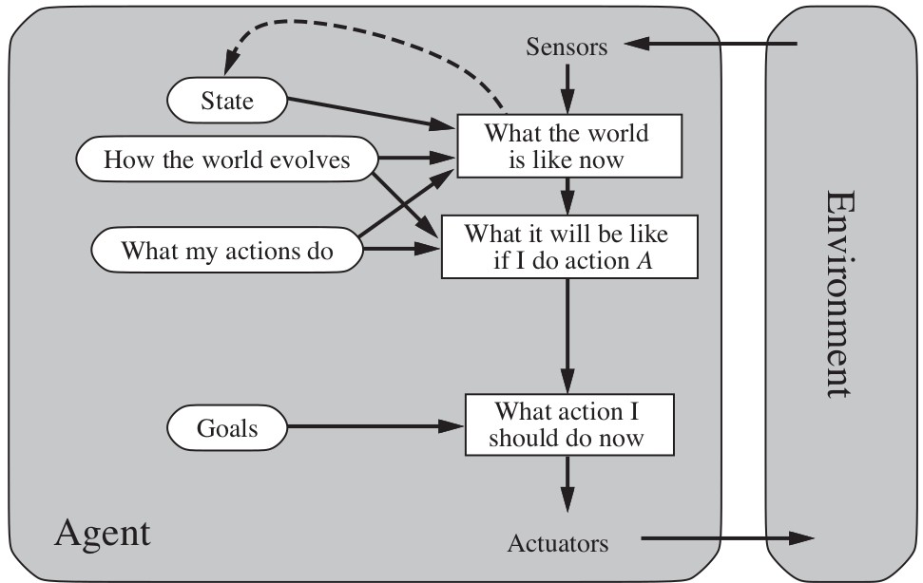
Agent Types: Goal-based agent
The agent needs goal information describing desirable situation
Ex: destination for a Taxi driver
Idea: combine goal with the model to choose actions
Difficult if long action sequences are required to reach the goal
=⇒ Typically investigated in search and planning research.
Major difference: future is taken into account
rules are simple condition-action pairs, do not target a goal
(Oc S. Russell & P. Norwig, AIMA)

Slide 117
Agent Types: Goal-based Agent [cont.]
Goal-based Agents more flexible:
the knowledge that supports its decisions is represented explicitly such knowledge can be modified
=⇒ all of the relevant behaviors to be altered to suit the new conditions Ex: If it rains, the agent can update its knowledge of how effectively its brakes operate
the goal can be modified/updated =⇒ modify its behaviour
no need to rewrite all rules from scratch
more complicate to implement
may require expensive computation (search, planning)

Slide 118
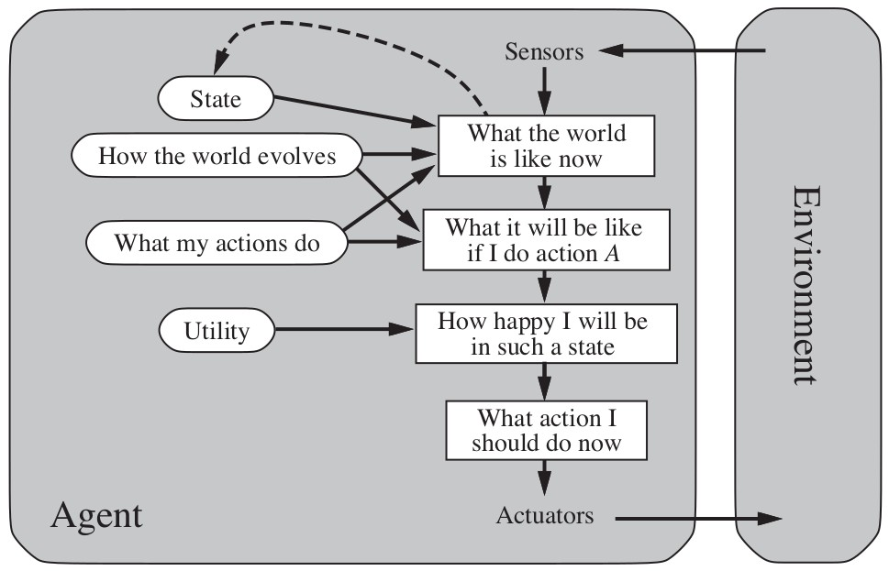
Agent Types: Utility-based agent
Goals alone often not enough to generate high-quality behaviors Certain goals can be reached in different ways, of different quality Ex: some routes are quicker, safer, or cheaper than others
Idea: Add utility function(s) to drive the choice of actions
maps a (sequence of) state(s) onto a real number
=⇒ actions are chosen which maximize the utility function under uncertainty, maximize the expected utility function
=⇒ utility function = internalization of performance measure
(Oc S. Russell & P. Norwig, AIMA)
43 / 52

Slide 119
Agent Types: Utility-based agent
Goals alone often not enough to generate high-quality behaviors Certain goals can be reached in different ways, of different quality Ex: some routes are quicker, safer, or cheaper than others
Idea: Add utility function(s) to drive the choice of actions
maps a (sequence of) state(s) onto a real number
=⇒ actions are chosen which maximize the utility function under uncertainty, maximize the expected utility function
=⇒ utility function = internalization of performance measure
(Oc S. Russell & P. Norwig, AIMA)
43 / 52

Slide 120
Agent Types: Utility-based agent
Goals alone often not enough to generate high-quality behaviors Certain goals can be reached in different ways, of different quality Ex: some routes are quicker, safer, or cheaper than others
Idea: Add utility function(s) to drive the choice of actions
maps a (sequence of) state(s) onto a real number
=⇒ actions are chosen which maximize the utility function under uncertainty, maximize the expected utility function
=⇒ utility function = internalization of performance measure
(Oc S. Russell & P. Norwig, AIMA)
43 / 52

Slide 121
Agent Types: Utility-based agent
Goals alone often not enough to generate high-quality behaviors Certain goals can be reached in different ways, of different quality Ex: some routes are quicker, safer, or cheaper than others
Idea: Add utility function(s) to drive the choice of actions
maps a (sequence of) state(s) onto a real number
=⇒ actions are chosen which maximize the utility function under uncertainty, maximize the expected utility function
=⇒ utility function = internalization of performance measure
(Oc S. Russell & P. Norwig, AIMA)
43 / 52

Slide 122
Agent Types: Utility-based Agent [cont.]
Utility-based Agents
advantages wrt. goal-based:
with conflicting goals, utility specifies and appropriate tradeoff with several goals none of which can be achieved with certainty, utility selects proper tradeoff between importance of goals and likelihood of success
still complicate to implement
require sophisticated perception, reasoning, and learning may require expensive computation

Slide 123
Agent Types: Learning
Problem
Previous agent programs describe methods for selecting actions
How are these agent programs programmed? Programming by hand inefficient and ineffective!
Solution: build learning machines and then teach them (rather than instruct them)
Advantage: robustness of the agent program toward
initially-unknown environments
45 / 52

Slide 124
Agent Types: Learning
Problem
Previous agent programs describe methods for selecting actions
How are these agent programs programmed? Programming by hand inefficient and ineffective!
Solution: build learning machines and then teach them (rather than instruct them)
Advantage: robustness of the agent program toward
initially-unknown environments
45 / 52

Slide 125
Agent Types: Learning
Problem
Previous agent programs describe methods for selecting actions
How are these agent programs programmed? Programming by hand inefficient and ineffective!
Solution: build learning machines and then teach them (rather than instruct them)
Advantage: robustness of the agent program toward
initially-unknown environments
45 / 52

Slide 126
Agent Types: Learning
Problem
Previous agent programs describe methods for selecting actions
How are these agent programs programmed? Programming by hand inefficient and ineffective!
Solution: build learning machines and then teach them (rather than instruct them)
Advantage: robustness of the agent program toward
initially-unknown environments
45 / 52

Slide 127
Agent Types: Learning
Problem
Previous agent programs describe methods for selecting actions
How are these agent programs programmed? Programming by hand inefficient and ineffective!
Solution: build learning machines and then teach them (rather than instruct them)
Advantage: robustness of the agent program toward
initially-unknown environments
45 / 52

Slide 128
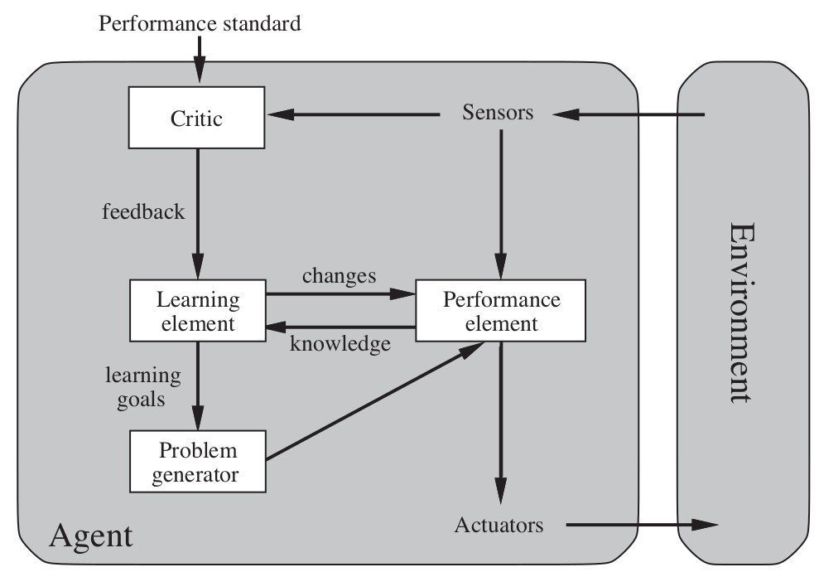
Agent Types: Learning
Learning Agent Types: components
Performance element: selects actions based on percepts Corresponds to the previous agent programs
(Oc S. Russell & P. Norwig, AIMA)
46 / 52

Slide 129
Agent Types: Learning
Learning Agent Types: components Learning element: introduces improvements
uses feedback from the critic on how the agent is doing determines improvements for the performance element
(Oc S. Russell & P. Norwig, AIMA)
46 / 52

Slide 130
Agent Types: Learning
Learning Agent Types: components
Critic tells how the agent is doing wrt. performance standard
(Oc S. Russell & P. Norwig, AIMA)
46 / 52

Slide 131
Agent Types: Learning
Learning Agent Types: components
Problem generator: suggests actions that will lead to new and informative experiences
forces exploration of new stimulating scenarios
(Oc S. Russell & P. Norwig, AIMA)
46 / 52

Slide 132
Learning Agent Types: Example
Taxi Driving
After the taxi makes a quick left turn across three lanes, the critic observes the shocking language used by other drivers.
From this experience, the learning element formulates a rule saying this was a bad action.
The performance element is modified by adding the new rule.
The problem generator might identify certain areas of behavior in need of improvement, and suggest trying out the brakes on different road surfaces under different conditions.
47 / 52

Slide 133
Learning Agent Types: Example
Taxi Driving
After the taxi makes a quick left turn across three lanes, the critic observes the shocking language used by other drivers.
From this experience, the learning element formulates a rule saying this was a bad action.
The performance element is modified by adding the new rule.
The problem generator might identify certain areas of behavior in need of improvement, and suggest trying out the brakes on different road surfaces under different conditions.
47 / 52

Slide 134
Learning Agent Types: Example
Taxi Driving
After the taxi makes a quick left turn across three lanes, the critic observes the shocking language used by other drivers.
From this experience, the learning element formulates a rule saying this was a bad action.
The performance element is modified by adding the new rule.
The problem generator might identify certain areas of behavior in need of improvement, and suggest trying out the brakes on different road surfaces under different conditions.
47 / 52

Slide 135
Learning Agent Types: Example
Taxi Driving
After the taxi makes a quick left turn across three lanes, the critic observes the shocking language used by other drivers.
From this experience, the learning element formulates a rule saying this was a bad action.
The performance element is modified by adding the new rule.
The problem generator might identify certain areas of behavior in need of improvement, and suggest trying out the brakes on different road surfaces under different conditions.
47 / 52

Slide 136
Learning Agent Types: Example
Taxi Driving
After the taxi makes a quick left turn across three lanes, the critic observes the shocking language used by other drivers.
From this experience, the learning element formulates a rule saying this was a bad action.
The performance element is modified by adding the new rule.
The problem generator might identify certain areas of behavior in need of improvement, and suggest trying out the brakes on different road surfaces under different conditions.
47 / 52

Slide 137
Outline
1
Agents and Environments
2
Rational Agents
3
Task Environments
4
Task-Environment Types
5
Agent Types
6
Environment States

Slide 138
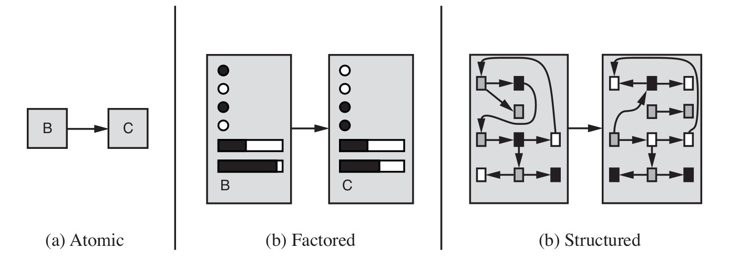
Representations
Representations of states and transitions
Three ways to represent states and transitions between them: atomic: a state is a black box with no internal structure factored: a state consists of a vector of attribute values
structured: a state includes objects, each of which may have attributes of its own as well as relationships to other objects
increasing expressive power and computational complexity reality represented at different levels of abstraction
(Oc S. Russell & P. Norwig, AIMA)
49 / 52

Slide 139
Representations
Representations of states and transitions
Three ways to represent states and transitions between them: atomic: a state is a black box with no internal structure factored: a state consists of a vector of attribute values
structured: a state includes objects, each of which may have attributes of its own as well as relationships to other objects
increasing expressive power and computational complexity reality represented at different levels of abstraction
(Oc S. Russell & P. Norwig, AIMA)
49 / 52

Slide 140
Representations
Representations of states and transitions
Three ways to represent states and transitions between them: atomic: a state is a black box with no internal structure factored: a state consists of a vector of attribute values
structured: a state includes objects, each of which may have attributes of its own as well as relationships to other objects
increasing expressive power and computational complexity reality represented at different levels of abstraction
(Oc S. Russell & P. Norwig, AIMA)
49 / 52

Slide 141
Representations
Representations of states and transitions
Three ways to represent states and transitions between them: atomic: a state is a black box with no internal structure factored: a state consists of a vector of attribute values
structured: a state includes objects, each of which may have attributes of its own as well as relationships to other objects
increasing expressive power and computational complexity reality represented at different levels of abstraction
(Oc S. Russell & P. Norwig, AIMA)
49 / 52

Slide 142
Representations
Representations of states and transitions
Three ways to represent states and transitions between them: atomic: a state is a black box with no internal structure factored: a state consists of a vector of attribute values
structured: a state includes objects, each of which may have attributes of its own as well as relationships to other objects
increasing expressive power and computational complexity reality represented at different levels of abstraction
(Oc S. Russell & P. Norwig, AIMA)
49 / 52

Slide 143
Representations
Representations of states and transitions
Three ways to represent states and transitions between them: atomic: a state is a black box with no internal structure factored: a state consists of a vector of attribute values
structured: a state includes objects, each of which may have attributes of its own as well as relationships to other objects
increasing expressive power and computational complexity reality represented at different levels of abstraction
(Oc S. Russell & P. Norwig, AIMA)
49 / 52

Slide 144
Representations
Representations of states and transitions
Three ways to represent states and transitions between them: atomic: a state is a black box with no internal structure factored: a state consists of a vector of attribute values
structured: a state includes objects, each of which may have attributes of its own as well as relationships to other objects
increasing expressive power and computational complexity reality represented at different levels of abstraction
(Oc S. Russell & P. Norwig, AIMA)
49 / 52

Slide 145
Representations [cont.]
Atomic Representations
each state of the world is indivisible
no internal structure
state: one among a collection of discrete state values
Ex: find driving routes: {Trento, Rovereto, Verona, ...}
=⇒ only property: be identical to or different from another state very high level of abstraction
=⇒ lots of details ignored
The algorithms underlying search and game-playing hidden Markov models Markov decision processes
all work with atomic representations (or treat it as such)

Slide 146
Representations [cont.]
Factored Representation
Each state represented in terms of a vector of attribute values
Ex: (zone, {dirty, clean}), (town, speed)
State: combination of attribute values
Ex: (A, dirty), (Trento, 40kmh)
Distinct states may share the values of some attribute
Ex: (Trento, 40kmh) and (Trento, 47kmh) identical iff all attribute have the same values
=⇒ must differ for at least one value to be different
Can represent uncertainty (e.g., ignorance about the amount of gas in the tank represented by leaving that attribute blank)
Lower level of abstraction =⇒ less details ignored Many areas of Ai based on factored representations
constraint satisfaction and propositional logic planning
Bayesian networks
(most of) machine learning

Slide 147
Representations [cont.]
Structured Representation
States represents in terms of objects and relations over them
Ex ∀x.(Men(x ) → Mortal(x )),
Woman(Maria), Mother ≡ Woman ∩ ∃hasChild.Person
Lowest level of abstraction =⇒ can represent reality in details Many areas of Ai based on factored representations
relational databases first-order logic
first-order probability models knowledge-based learning natural language understanding

