Slide 1
Course Code : | BAD601 | Semester / Year : | VI / III
Course Title : | Big Data Analytics | Academic Year : | 2024-25

Slide 2
Module 4
Introduction to Hive: What is Hive, Hive Architecture, Hive data types, Hive file formats, Hive Query Language (HQL), RC File implementation, User Defined Function (UDF).
Introduction to Pig: What is Pig, Anatomy of Pig, Pig on Hadoop, Pig Philosophy, Use case for Pig, Pig Latin Overview, Data types in Pig, Running Pig, Execution Modes of Pig, HDFS Commands, Relational Operators, Eval Function, Complex Data Types, Piggy Bank, User Defined Function, Pig Vs Hive.

Slide 3
CASE STUDY: RETAIL LOG PROCESSING
TENTOTEN is a Retail Store which has a chain of hypermarkets in India. They have 250+ stores across 95 cities and towns. About 45,000+ people are working in TENTOTEN. TENTOTEN deals in a wide range of products including fashion apparels, food products, books, furniture, etc. Around 1500+ customers visit and/or purchase products every day from each of these stores.
Problem Scenario
The approximate size of TENTOTEN log datasets is 12 TB. Information about the various stores is stored in the form of semi-structured data. Traditional Business Intelligence (BI) tools are good when data is present in pre-defined schema and datasets are just several hundreds of gigabytes. But the TENTOTEN dataset is mostly log dataset, which does not conform to any particular schema. Querying such large dataset is difficult and immensely time consuming.
The challenges are:
Moving the log dataset to HDFS (Hadoop Distributed File System).
Performing analysis on HDFS data.
Hadoop MapReduce can be used to resolve these issues. However we will still have to deal with the below constraints:
Writing complex MapReduce jobs in Java can be tedious and error prone.
Joining across large datasets is quite tricky.
Enter Hive to counter the above challenges.

Slide 4
What is Hive

Slide 5
What is Hive
Hive is a Data Warehousing tool that sits on top of Hadoop. Hive is used to process structured data in Hadoop. The three main tasks performed by Apache Hive are:
Summarization
Querying
Analysis
Facebook initially created Hive component to manage their ever-growing volumes of log data. Later Apache software foundation developed it as open-source and it came to be known as Apache Hive.
Hive makes use of the following:
HDFS for Storage.
MapReduce for execution.
Stores metadata/schemas in an RDBMS.
Hive provides HQL (Hive Query Language) or HiveQL which is similar to SQL. Hive compiles SQL queries into MapReduce jobs and then runs the job in the Hadoop Cluster. It is designed to support OLAP (Online Analytical Processing). Hive provides extensive data type functions and formats for data summarization and analysis.

Slide 6
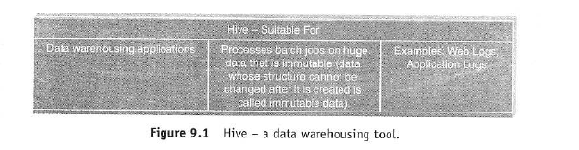
What is Hive
Note:
Hive is not RDBMS.
It is not designed to support OLTP (Online Transaction Processing).
It is not designed for real-time queries.
It is not designed to support row-level updates.

Slide 7
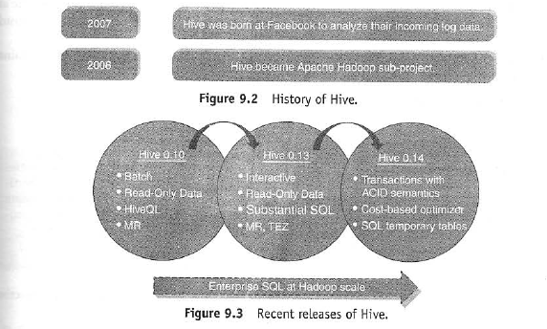
What is Hive
History of Hive and Recent Releases of Hive
Hive Features:
It is similar to SQL.
HQL is easy to code.
Hive supports rich data types such as structs, lists and maps.
Hive supports SQL filters, group-by and order-by clauses.
Custom Types, Custom Functions can be defined.

Slide 8
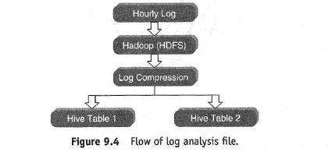
What is Hive
Hive Integration and Work Flow
Explanation of the workflow:
Hourly Log Data can be stored directly into HDFS and then data cleansing is performed on the log file. Finally, Hive table(s) can be created to query the log file.

Slide 9
What is Hive
Hive Data Units
Databases: The namespace for tables.
Tables: Set of records that have similar schema.
Partitions: Logical separations of data based on classification of given information as per specific attributes. Once Hive has partitioned the data based on a specified key, it starts to assemble the records into specific folders as and when the records are inserted.
Buckets (or Clusters): Similar to partitions but uses hash function to segregate data and determines the cluster or bucket into which the record should be placed.
Picture This...
"XYZ Corp" has their customer base spread across 190+ countries. There are 5 million records/entities available. If it is required to fetch the entities pertaining to a particular country, in the absence of partitioning, there is no choice but to go through all of the 5 million entities. This despite the fact our query will eventually result in few thousand entities of the particular country. However, creating partitions based on country will greatly help to alleviate the performance issue by checking the data belonging to the partition for the country in question.

Slide 10
What is Hive
Partitioning tables changes how Hive structures the data storage.
Hive will create subdirectories reflecting the partitioning structure like:
.../customers/country=ABC
Although partitioning helps in enhancing performance and is recommended, having too many partitions may prove detrimental for few queries.
Bucketing is another technique of managing large datasets.
If we partition the dataset based on customer_ID, we would end up with far too many partitions.
Instead, if we bucket the customer table and use customer_id as the bucketing column, the value of this column will be hashed by a user-defined number into buckets.
Records with the same customer_id will always be placed in the same bucket.
Assuming we have far more customer_ids than the number of buckets, each bucket will house many customer_ids.
While creating the table you can specify the number of buckets that you would like your data to be distributed in using the syntax:
CLUSTERED BY (customer_id) INTO XX BUCKETS;
Here, XX is the number of buckets.

Slide 11
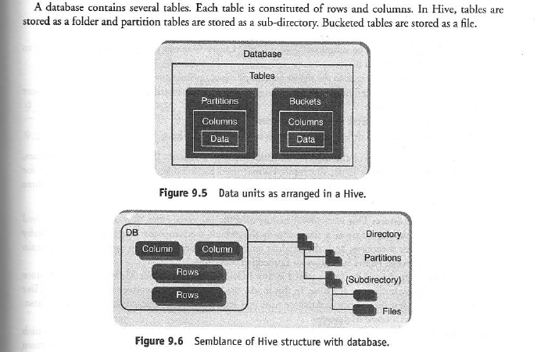
What is Hive
When to Use Partitioning/Bucketing?
Bucketing works well when the field has high cardinality (i.e., many unique values) and data is evenly distributed among buckets.
Partitioning works best when the cardinality of the partitioning field is not too high.
Partitioning can be done on multiple fields with an order (e.g., Year/Month/Day).
Bucketing can be done on only one field.

Slide 12
Hive Architecture

Slide 13
Hive Architecture
HIVE ARCHITECTURE
The various parts are as follows:
Hive Command-Line Interface (Hive CLI):
The most commonly used interface to interact with Hive.
Hive Web Interface:
It is a simple Graphic User Interface to interact with Hive and to execute query.
Hive Server:
This is an optional server. This can be used to submit Hive Jobs from a remote client.
JDBC/ODBC:
Jobs can be submitted from a JDBC Client. One can write a Java code to connect to Hive and submit jobs on it.
Driver:
Hive queries are sent to the driver for compilation, optimization and execution.
Metastore:
Hive table definitions and mappings to the data are stored in a Metastore. A Metastore consists of the following:
  Metastore service: Offers interface to the Hive.
  Database: Stores data definitions, mappings to the data and others.

Slide 14
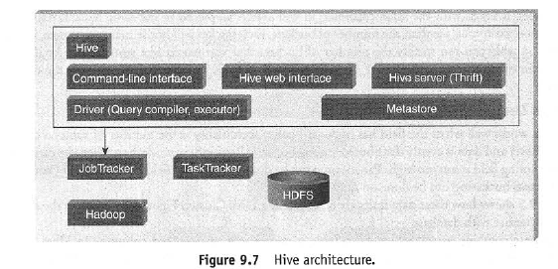
Hive Architecture

Slide 15
Hive Architecture
The metadata which is stored in the metastore includes IDs of Database, IDs of Tables, IDs of Indexes, etc., the time of creation of a Table, the Input Format used for a Table, the Output Format used for a Table, etc. The metastore is updated whenever a table is created or deleted from Hive. There are three kinds of metastore:
Types of Metastore
Embedded Metastore:
This metastore is mainly used for unit tests. Here, only one process is allowed to connect to the metastore at a time. This is the default metastore for Hive. It is Apache Derby Database. In this metastore, both the database and the metastore service run embedded in the main Hive Server process. Figure 9.8 shows an Embedded Metastore.
Local Metastore:
Metadata can be stored in any RDBMS component like MySQL. Local metastore allows multiple connections at a time. In this mode, the Hive metastore service runs in the main Hive Server process, but the metastore database runs in a separate process, and can be on a separate host. Figure 9.9 shows a Local Metastore.
Remote Metastore:
In this, the Hive driver and the metastore interface run on different JVMs (which can run on different machines as well) as in Figure 9.10. This way the database can be fire-walled from the Hive user and also database credentials are completely isolated from the users of Hive.

Slide 16
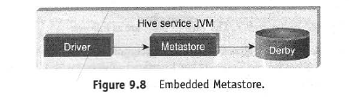
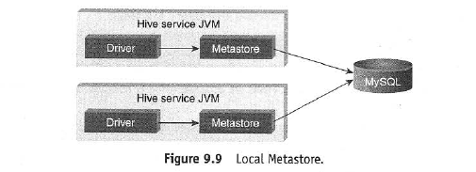
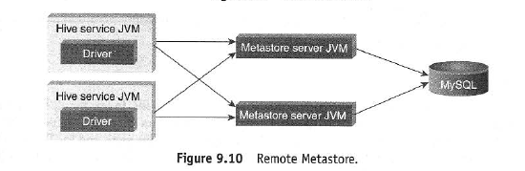
Hive Architecture

Slide 17
Hive data types

Slide 18
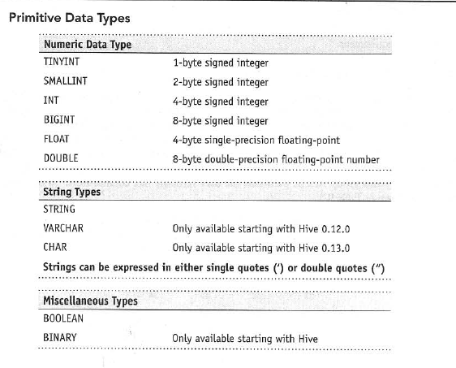
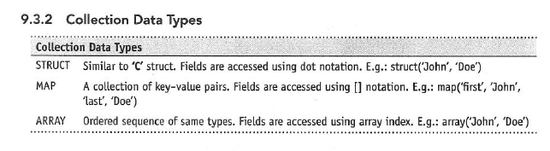
Hive data types

Slide 19
Hive file formats

Slide 20
Hive file formats
The file formats in Hive specify how records are encoded in a file.
Text File
The default file format is text file. In this format, each record is a line in the file. In text file, different control characters are used as delimiters. The delimiters are ^A (octal 001, separates all fields), ^B (octal 002, separates the elements in the array or struct), ^C (octal 003, separates key–value pair), and \n. The term field is used when overriding the default delimiter. The supported text files are CSV and TSV. JSON or XML documents too can be specified as text file.
Sequential File
Sequential files are flat files that store binary key–value pairs. It includes compression support which reduces the CPU, I/O requirement.
RCFile (Record Columnar File)
RCFile stores the data in Column Oriented Manner which ensures that Aggregation operation is not an expensive operation. For example, consider a table which contains four columns.
Instead of only partitioning the table horizontally like the row-oriented DBMS (row-store), RCFile partitions this table first horizontally and then vertically to serialize the data. Based on the user-specified value, first the table is partitioned into multiple row groups horizontally. Next, in every row group RCFile partitions the data vertically like column-store. So the table will be serialized.

Slide 21
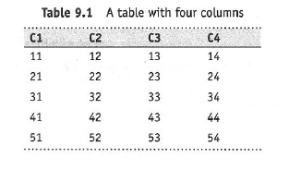
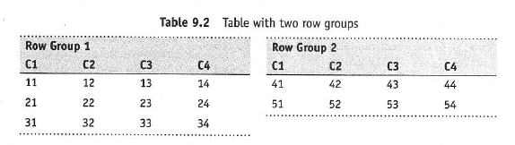
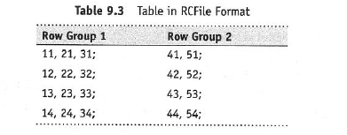
Hive file formats

Slide 22
Hive Query Language

