Slide 1
Course Code : | BAD601 | Semester / Year : | VI / III
Course Title : | Big Data Analytics | Academic Year : | 2024-25

Slide 2
Module 3
Introduction to MongoDB: What is MongoDB, Why MongoDB, Terms used in RDBMS and MongoDB, Data Types in MongoDB, MongoDB Query Language.

Slide 3
What is MongoDB

Slide 4
What is MongoDB
MongoDB is a NoSQL database that stores data in a flexible, document-oriented format using JSON-like BSON (Binary JSON) documents.
Unlike traditional relational databases (SQL-based), MongoDB does not require a fixed schema, making it highly scalable and suitable for handling large volumes of unstructured or semi-structured data.
MongoDB is
  Cross-platform
    MongoDB can run on multiple operating systems like Windows, macOS, and Linux.
    It allows developers to deploy their applications on various environments without compatibility issues.
  Open source.
    MongoDB is an open-source database, meaning its source code is freely available for anyone to use, modify, and distribute.
    It is licensed under the Server Side Public License (SSPL).
  Non-relational.
    Unlike relational databases, MongoDB does not use tables, rows, or fixed schemas.
    Instead, it stores data in JSON-like documents, which makes it flexible and easy to handle unstructured or semi-structured data.

Slide 5
What is MongoDB
  Distributed.
    MongoDB supports horizontal scaling using sharding, meaning data can be distributed across multiple servers.
    This improves performance, reliability, and fault tolerance.
    It also supports replication, ensuring data is available even if a server fails.
  NoSQL.
    MongoDB is classified as a NoSQL (Not Only SQL) database.
    NoSQL databases are designed for big data applications and do not rely on a structured schema like SQL databases.
    It supports flexible data models, making it ideal for applications that handle large, rapidly changing datasets.
  Document-oriented data store.
    MongoDB stores data in documents, where each document is a key-value pair stored in BSON (Binary JSON) format.
    This makes it highly flexible, as fields can vary from document to document within a collection.

Slide 6
What is MongoDB
    Example of a MongoDB document:
      {
      "name": "Alice",
      "age": 25,
      "city": "New York“
      }
    Unlike SQL databases that require predefined schemas, MongoDB allows schema-less storage, making it easier to evolve the database structure over time.

Slide 7
Why MongoDB

Slide 8
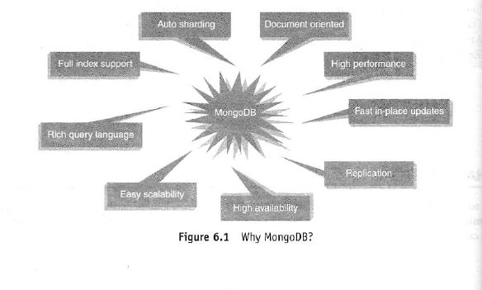
Why MongoDB
Few of the major challenges with traditional RDBMS are dealing with large volumes of data, rich varietyof data—particularly unstructured data, and meeting up to the scale needs of enterprise data.
The need is for a database that can scale out or scale horizontally to meet the scale requirements, has flexibility with respect to schema, is fault-tolerant, is consistent and partition tolerant, and can be easily distributed over a multitude of nodes in a cluster.

Slide 9
Why MongoDB
Using JavaScript Object Notation (JSON)
  JSON is extremely expressive.
  MongoDB actually does not use JSON but BSON (pronounced Bee Son) – it is Binary JSON.
  It is an open standard. It is used to store complex data structures.
  Let us trace the journey from .csv to XML to JSON:
    Let us look at how data is stored in .csv file.
    Assume that this data is about the employees of an organization named “XYZ”.
    As can be seen below, the column values are separated using commas and the rows are separated by a carriage return.
    CSV format:
      John, Mathews, +123 4567 8900
      Andrews, Symmonds, +456 7890 1234
      Mable, Mathews, +789 1234 5678
    This looks good! However, let us make it slightly more legible by adding column headings.

Slide 10
Why MongoDB
Using JavaScript Object Notation (JSON)
    Formatted CSV with headings:
      FirstName, LastName, ContactNo
      John, Mathews, +123 4567 8900
      Andrews, Symmonds, +456 7890 1234
      Mable, Mathews, +789 1234 5678
    Now assume that a few employees have more than one ContactNo.
    It can be neatly classified as OfficeContactNo and HomeContactNo.
    But what if a few employees have more than one OfficeContactNo and more than one HomeContactNo?
    Ok, so this is the first issue we need to address.
    Let us look at just another piece of data that you wish to store about the employees.
    You need to store their email addresses as well.
    Here again, we have the same issues, few employees have two email addresses, three and there are a few employees with more than three email addresses as well.

Slide 11
Why MongoDB
Using JavaScript Object Notation (JSON)
    As we come across these fields or columns, we realize that it gets messy with .csv.
    CSVs are known to store well if it is flat and does not have repeating values.
    The problem becomes even more complex when different departments maintain the details of their employees.
    The formats of .csv (columns, etc.) could vastly differ and it will call for some efforts before we merge the files from the various departments to make a single file.
    This problem can be solved by XML.
    But as the name suggests, XML is highly extensible. It does not call for defining a data format, rather it defines how you define a data format.
    You may be prepared to undertake this cumbersome task for highly complex and structured data; however, for simple data exchange, it might just be too much work.
    Enter JSON! Let us look at how it reacts to the problem at hand.

Slide 12
Why MongoDB
Using JavaScript Object Notation (JSON)
    JSON format example:
      { "FirstName": "John", "LastName": "Mathews", "ContactNo": ["+123 4567 8900", "+123 4444 5555"]}
      { "FirstName": "Andrews", "LastName": "Symmonds", "ContactNo": ["+456 7890 1234", "+456 6666 7777"]}
      { "FirstName": "Mable", "LastName": "Mathews", "ContactNo": ["+789 1234 5678"]}
    As you can see, it is quite easy to read a JSON.
    There is absolutely no confusion now.
    One can have a list of n contact numbers, and they can be stored with ease.

Slide 13
Why MongoDB
Using JavaScript Object Notation (JSON)
    JSON is very expressive.
    It provides the much-needed ease to store and retrieve documents in their real form.
    The binary form of JSON is BSON. BSON is an open standard.
    In most cases, it consumes less space as compared to the text-based JSON. There is yet another advantage with BSON.
    It is much easier and quicker to convert BSON to a programming language’s native data format.
    There are MongoDB drivers available for a number of programming languages such as C, C++, Ruby, PHP, Python, C#, etc., and each works slightly differently.
    Using the basic binary format enables the native data structures to be built quickly for each language without going through the hassle of first processing JSON.

Slide 14

Why MongoDB
Creating or Generating a Unique Key
  Each JSON document should have a unique identifier.
  It is the _id key.
  It is similar to the primary key in relational databases.
  This facilitates search for documents based on the unique identifier.
  An index is automatically built on the unique identifier.
  It is your choice to either provide unique values yourself or have the mongo shell generate the same.

Slide 15
Why MongoDB
Creating or Generating a Unique Key
  Database
    It is a collection of collections.
    In other words, it is like a container for collections.
    It gets created the first time that your collection makes a reference to it.
    This can also be created on demand.
    Each database gets its own set of files on the file system.
    A single MongoDB server can house several databases.
  Collection
    A collection is analogous to a table of RDBMS.
    A collection is created on demand.
    It gets created the first time that you attempt to save a document that references it.
    A collection exists within a single database.
    A collection holds several MongoDB documents.

Slide 16
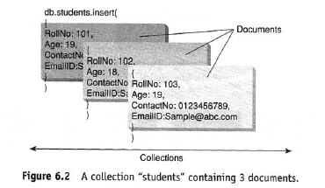
Why MongoDB
Creating or Generating a Unique Key
    A collection does not enforce a schema.
    This implies that documents within a collection can have different fields.
    Even if the documents within a collection have the same fields, the order of the fields can be different.
  Document
    A document is analogous to a row/record/tuple in an RDBMS table.
    A document has a dynamic schema.
    This implies that a document in a collection need not necessarily have the same set of fields/key-value pairs. Shown in Figure 6.2 is a collection by the name "students" containing three documents.

Slide 17
Why MongoDB
Creating or Generating a Unique Key
  Support for Dynamic Queries
    MongoDB has extensive support for dynamic queries.
    This is in keeping with traditional RDBMS wherein we have static data and dynamic queries.
    CouchDB, another document-oriented, schema-less NoSQL database and MongoDB's biggest competitor, works on quite the reverse philosophy.
    It has support for dynamic data and static queries.
  Storing Binary Data
    MongoDB provides GridFS to support the storage of binary data.
    It can store up to 4 MB of data.
    This usually suffices for photographs (such as a profile picture) or small audio clips.
    However, if one wishes to store movie clips, MongoDB has another solution.
    It stores the metadata (data about data along with the context information) in a collection called “file”.
    It then breaks the data into small pieces called chunks and stores it in the “chunks” collection.
    This process takes care about the need for easy scalability.

Slide 18
Why MongoDB
Creating or Generating a Unique Key
  Replication
    Why replication?
    It provides data redundancy and high availability.
    It helps to recover from hardware failure and service interruptions.
    In MongoDB, the replica set has a single primary and several secondaries.
    Each write request from the client is directed to the primary.
    The primary logs all write requests into its Oplog (operations log).
    The Oplog is then used by the secondary replica members to synchronize their data.
    This way there is strict adherence to consistency. Refer Figure 6.3.
    The clients usually read from the primary.
    However, the client can also specify a read preference that will then direct the read operations to the secondary.

Slide 19
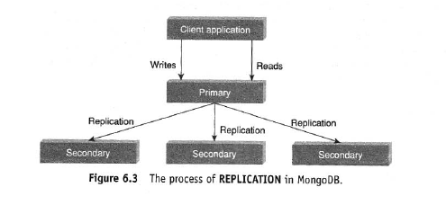
Why MongoDB
Creating or Generating a Unique Key
  Replication

Slide 20
Why MongoDB
Creating or Generating a Unique Key
  Sharding
    Sharding is kin to horizontal scaling.
    It means that the large dataset is divided and distributed over multiple servers or shards.
    Each shard is an independent database and collectively they would constitute a logical database.
    The prime advantages of sharding are as follows:
      Sharding reduces the amount of data that each shard needs to store and manage.
      For example, if the dataset was 1 TB in size and we were to distribute this over four shards, each shard would house just 256 GB of data.
    Refer to Figure 6.4. As the cluster grows, the amount of data that each shard will store and manage will decrease.
    Sharding reduces the number of operations that each shard handles.
    For example, if we were to insert data, the application needs to access only that shard that houses that data.

Slide 21
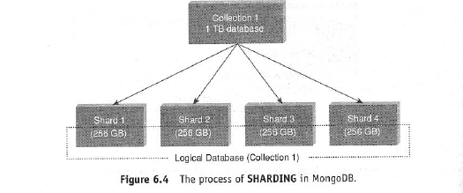
Why MongoDB
Creating or Generating a Unique Key
  Sharding

Slide 22
Why MongoDB
Creating or Generating a Unique Key
  Updating Information In-Place
    MongoDB updates the information in-place.
    This implies that it updates the data wherever it is available.
    It does not allocate separate space and the indexes remain unaltered.
    MongoDB is all for lazy-writes.
    It writes to the disk once every second.
    Reading and writing to disk is a slow operation as compared to reading and writing from memory.
    The fewer the reads and writes that are performed to the disk, the better is the performance.
    This makes MongoDB faster than its other competitors who write almost immediately to the disk.
    However, there is a tradeoff. MongoDB makes no guarantee that data will be stored safely on the disk.

Slide 23
Terms used in RDBMS and MongoDB

Slide 24
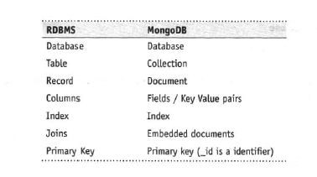
Terms used in RDBMS and MongoDB

Slide 25
Terms used in RDBMS and MongoDB
Create Database
  The syntax for creating a database is as follows:
    use DATABASE_Name
  To create a database by the name “myDB” the syntax is:
  myDB
    > use myDB;
    switched to db myDB
  To confirm the existence of your database, type the command at the MongoDB shell:
  db
    > db;
    myDB

Slide 26
Terms used in RDBMS and MongoDB
Create Database
  To get a list of all databases, type the below command:
  show dbs
    > show dbs;
    admin (empty)
    local 0.078GB
    test 0.078GB
  Notice that the newly created database, “myDB” does not show up in the list above.
  The reason is that the database needs to have at least one document to show up in the list.
  The default database in MongoDB is test.
  If one does not create any database, all collections are by default stored in the test database.

Slide 27
Terms used in RDBMS and MongoDB
Drop Database
  The syntax to drop a database is as follows:
    db.dropDatabase();
  To drop the database, "myDB", first ensure that you are currently placed in “myDB” database and then use the db.dropDatabase(); command to drop the database.
    use myDB;
    db.dropDatabase();
  Confirm if the database "myDB" has been dropped.
    db.dropDatabase();
    { "dropped" : "myDB", "ok" : 1 }
  If no database is selected, the default database "test" is dropped.

Slide 28
Data Types in MongoDB

Slide 29
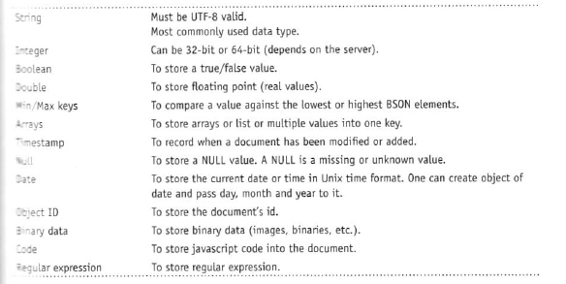
Data Types in MongoDB

Slide 30
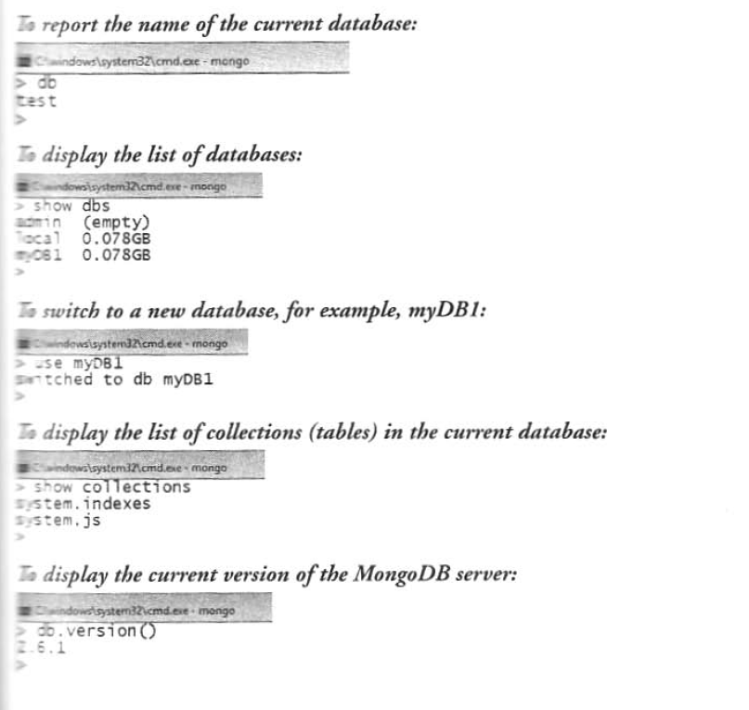
Data Types in MongoDB

Slide 31
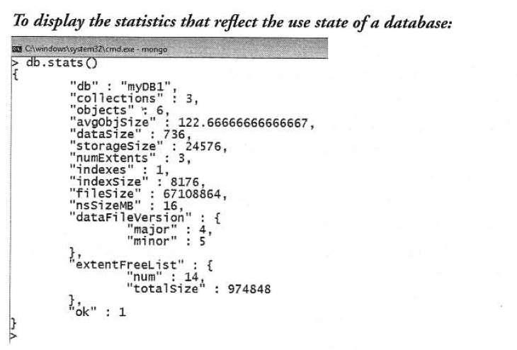
Data Types in MongoDB

Slide 32
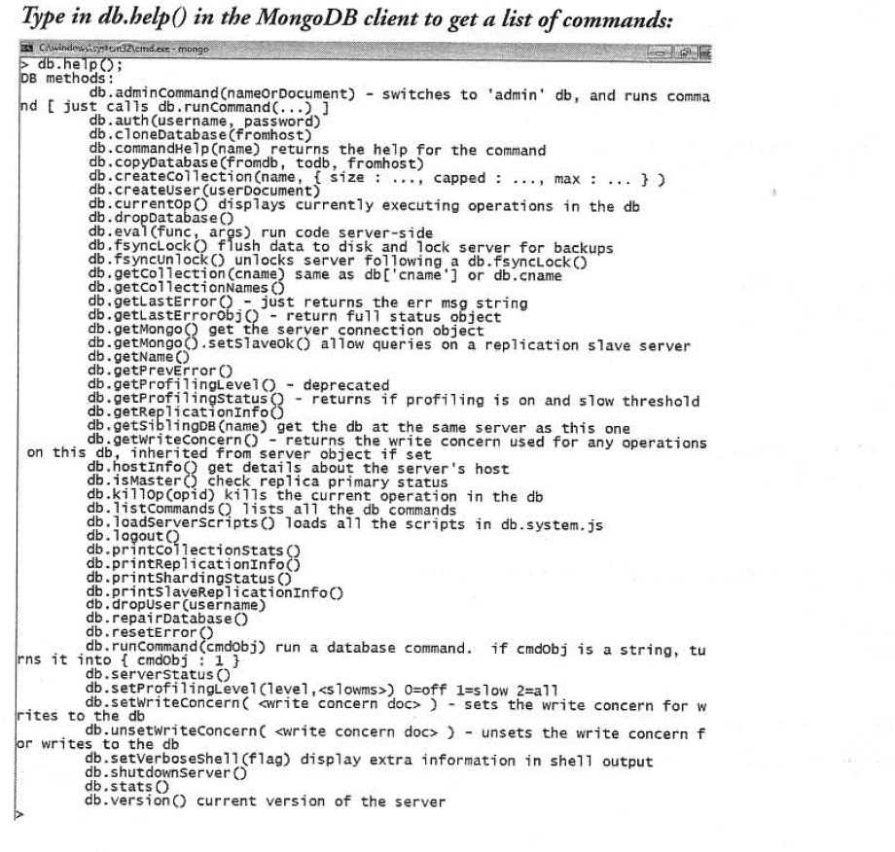
Data Types in MongoDB

Slide 33
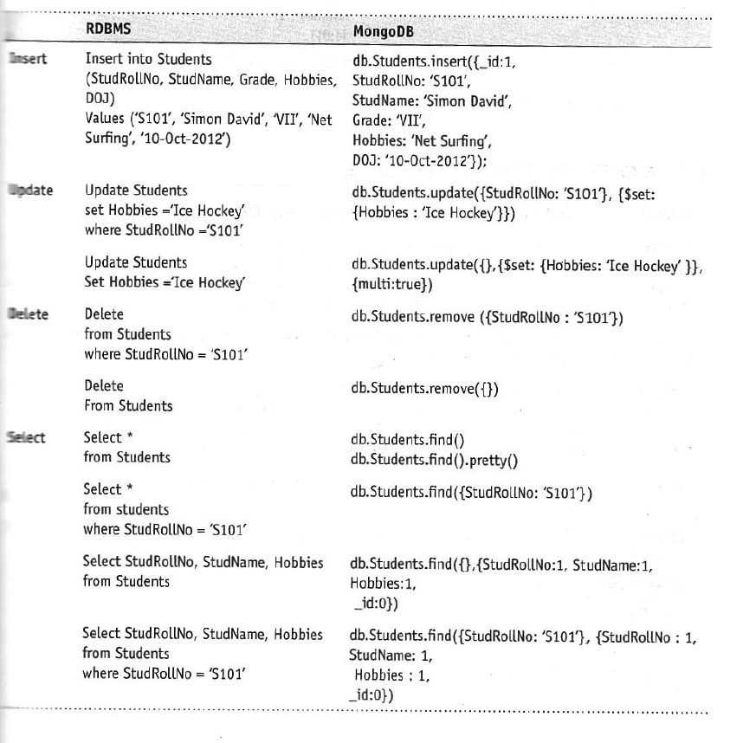
Data Types in MongoDB

Slide 34
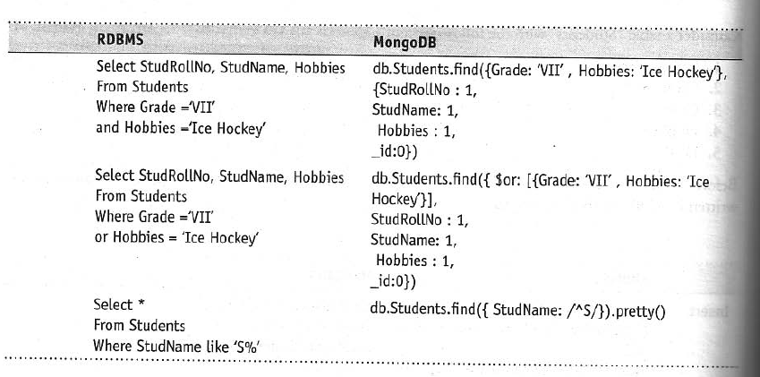
Data Types in MongoDB

Slide 35
MongoDB Query Language

Slide 36
MongoDB Query Language
CRUD (Create, Read, Update, and Delete) operations in MongoDB
  Create → Creation of data is done using insert() or update() or save() method.
  Read → Reading the data is performed using the find() method.
  Update → Update to data is accomplished using the update() method with UPSERT set to false.
  Delete → A document is deleted using the remove() method.
We will present the various methods available in MongoDB shell to deal with data in the next few sections.
The sections have been designed as follows:
  Objective: What is it that we are trying to achieve here?
  Input: What is the input that has been given to us to act upon?
  Act: The actual statement/command to accomplish the task at hand.
  Outcome: The result/output as a consequence of executing the statement.

