Slide 1
Course Code : | BAD601 | Semester / Year : | VI / III
Course Title : | Big Data Analytics | Academic Year : | 2024-25

Slide 2
Module 1
Classification of data, Characteristics, Evolution and definition of Big data, What is Big data, Why Big data, Traditional Business Intelligence Vs Big Data, Typical data warehouse and Hadoop environment.
Big Data Analytics: What is Big data Analytics, Classification of Analytics, Importance of Big Data Analytics, Technologies used in Big data Environments, Few Top Analytical Tools , NoSQL, Hadoop.

Slide 3
Digital Data
Digital data is information that is stored, processed, and transmitted in a binary format (0s and 1s).
It represents text, numbers, images, audio, and video in a form that computers and digital devices can understand and manipulate.
Key Characteristics of Digital Data
  Binary Representation: Digital data is represented using only two values—0 and 1 (bits).
  Storage & Transmission: It can be stored on digital storage devices (hard drives, SSDs, cloud storage) and transmitted over networks (internet, Wi-Fi, Bluetooth).
  Processing by Computers: It can be processed using algorithms, databases, and software applications.
  Non-Degradable: Unlike analog data (e.g., printed photos, cassette tapes), digital data does not degrade in quality over time.
  Easily Reproducible: Digital data can be copied and distributed with no loss of quality.

Slide 4
Digital Data
Types of Digital Data
  Text Data: Emails, documents, books, social media posts.
  Numerical Data: Financial transactions, statistics, sensor data.
  Multimedia Data: Images, videos, audio files.
  Encoded/Binary Data: Executable files, compressed files, encrypted data.
Examples of Digital Data
  A photo taken on a smartphone (JPEG file).
  A song streamed on Spotify (MP3 or AAC file).
  A transaction record in a bank's database.A YouTube video (MP4 file).

Slide 5
Classification of data

Slide 6
Classification of data
Digital data can be classified based on various criteria, including its structure, format, and usage. Here are the main classifications:
Based on Structure
  Structured Data: Organized data stored in fixed formats, such as tables or databases. Example: Relational databases (SQL, MySQL).
  Unstructured Data: Data without a predefined format, such as text files, images, videos, and emails.
  Semi-Structured Data: Data that has some structure but is not as rigid as structured data. Example: JSON, XML, and NoSQL databases.
Based on Format
  Text Data: Documents, emails, social media posts.
  Numeric Data: Financial data, statistics, measurements.
  Multimedia Data: Images, videos, audio files.
  Binary Data: Executable files, encrypted files.
Based on Source
  Machine-Generated Data: Data produced by devices, sensors, or logs.
  Human-Generated Data: Data created by users, such as social media posts, emails, and documents.

Slide 7
Classification of data
Based on Sensitivity
  Public Data: Openly available data, such as government reports and public records.
  Confidential Data: Restricted data, such as business strategies and internal reports.
  Sensitive Data: Personal data, health records, and financial information.
  Critical Data: Highly sensitive data that could cause severe harm if exposed, such as military secrets.
Based on Processing
  ModeBatch Data: Processed in large chunks at scheduled times.
  Real-Time Data: Processed instantly as it is generated.
Based on Storage Type
  Cloud Data: Stored in cloud-based systems (e.g., Google Drive, AWS).
  On-Premises Data: Stored in local servers or data centers.

Slide 8
Classification of data
Structured Data
  Structured data is highly organized and formatted data that is stored in a predefined manner, typically in databases or spreadsheets.
  It follows a clear structure, making it easy to search, retrieve, and process using query languages like SQL (Structured Query Language).
  Key Characteristics of Structured Data
    Predefined Format: Stored in rows and columns like a table.
    Easy to Search & Analyze: Can be queried using SQL and other tools.
    Highly Organized: Stored in relational databases like MySQL, PostgreSQL, Oracle, and Microsoft SQL Server.
    Fixed Data Types: Each field has a specific type (e.g., numbers, text, dates).
    Consistency: Data is structured according to strict rules, reducing errors.

Slide 9
Classification of data
Structured Data
  Source of Structured Data
    Structured data comes from various sources, depending on the context and use case. Here are some key sources:
      Databases
        Relational Databases (SQL): MySQL, PostgreSQL, Oracle, SQL Server
      APIs
        Public APIs: OpenWeatherMap (weather data), Alpha Vantage (stock market data)
        Private/Enterprise APIs: Custom APIs from organizations (e.g., Google Maps API)
      Spreadsheets & CSV Files
        Excel (.xlsx), Google Sheets
        CSV, TSV files used for data storage and exchange

Slide 10
Classification of data
Structured Data
  Source of Structured Data
      Web Scraping & Open Data Portals
        Web Scraping: Extracting structured data from websites (e.g., BeautifulSoup, Scrapy)
        Government & Open Data: Data.gov (USA), Open Data Portal (EU), World Bank Open Data
      Sensor & IoT Data
        Smart devices (e.g., temperature sensors, GPS trackers)
        Industrial IoT (IIoT) platforms like AWS IoT, Google Cloud IoT
      Logs & Event Data
        System Logs: Apache logs, Nginx logs
        Event Data: Clickstream data, user activity logs (Google Analytics, Mixpanel)

Slide 11
Classification of data
Semi- Structured Data
  Semi-structured data is a type of data that does not conform to a strict relational model (tables with fixed schemas) but still has some organizational properties, like tags or markers, to separate elements.
  It falls between structured data (organized in tables) and unstructured data (raw text, images, videos).
  Examples of Semi-Structured Data
    JSON (JavaScript Object Notation)
    XML (eXtensible Markup Language)
    YAML (Yet Another Markup Language)
    NoSQL Databases (MongoDB, CouchDB)
    Email Messages (structured metadata + unstructured text body)
    Sensor Data (logs with timestamps, values, and metadata)

Slide 12
Classification of data
Semi- Structured Data
  Characteristics of Semi-Structured Data
    Lacks a fixed schema but has some level of structure
    Uses tags, keys, and attributes for organization
    More flexible than structured data but still queryable
    Common in web data, IoT, and big data applications
  How is it Used?
    Big Data Processing (Hadoop, Spark)
    Web APIs & Services (REST APIs using JSON/XML)
    Document-Oriented Databases (MongoDB, Elasticsearch)

Slide 13
Classification of data
Unstructured Data
  Unstructured data is information that does not follow a predefined model or schema.
  It lacks a specific format, making it difficult to store and analyze using traditional relational databases.
  Examples of Unstructured Data
    📂 Text Documents – PDFs, Word files, articles
    📧 Emails – Free-form text, attachments
    🖼 Images & Videos – PNG, JPEG, MP4, etc.
    🎵 Audio Files – MP3, WAV, podcasts
    💬 Social Media Content – Tweets, Facebook posts, comments
    📊 Log Files & Sensor Data – System logs, IoT data
  Characteristics of Unstructured Data
    No fixed format or schema
    Difficult to store in relational databases
    Huge volume (Big Data applications)
    Requires AI & NLP techniques for analysis

Slide 14
Classification of data
Unstructured Data
  Issues with Unstructured Data
  Storage & Scalability
    📌 Issue: Unstructured data (videos, images, text, etc.) takes up massive storage space and can be difficult to manage in traditional databases.
    🔹 Example: A company storing thousands of videos needs high-capacity storage solutions like cloud storage (AWS S3, Google Cloud Storage).
  Data Processing & Analysis
    📌 Issue: Unlike structured data, unstructured data cannot be directly queried using SQL. It requires advanced AI/ML techniques for analysis.
    🔹 Example: Sentiment analysis on customer reviews requires Natural Language Processing (NLP) instead of simple database queries.
  Search & Retrieval Complexity
    📌 Issue: Since unstructured data lacks a predefined format, searching for specific information is difficult without metadata or indexing.
    🔹 Example: Finding a specific image in a large database without proper tags or descriptions is time-consuming.

Slide 15
Classification of data
Unstructured Data
  Issues with Unstructured Data
  Data Integration Challenges
    📌 Issue: Combining unstructured data with structured databases is complex because they follow different formats.
    🔹 Example: Merging customer feedback (text) with purchase history (structured data) requires advanced data processing.
  Security & Compliance Risks
    📌 Issue: Unstructured data often contains sensitive information (e.g., emails, documents, social media posts), making compliance and security challenging.
    🔹 Example: Companies must ensure compliance with GDPR, HIPAA when handling sensitive unstructured data.
  High Cost of Management
    📌 Issue: Processing, storing, and analyzing unstructured data requires expensive infrastructure, AI models, and skilled personnel.
    🔹 Example: Running AI-based image recognition on petabytes of images is costly and resource-intensive.

Slide 16
Classification of data
Unstructured Data
  How to deal with unstructured data?
  Storage & Organization
    📌 Problem: Unstructured data is difficult to store in traditional relational databases.
    ✅ Solution: Use scalable storage solutions:
      Cloud Storage: AWS S3, Google Cloud Storage, Azure Blob Storage
      NoSQL Databases: MongoDB, CouchDB, Cassandra
      Data Lakes: Apache Hadoop, Snowflake, Databricks
  Data Processing & Structuring
    📌 Problem: Unstructured data cannot be directly queried using SQL.
    ✅ Solution: Convert data into a structured or semi-structured format using:
      ETL (Extract, Transform, Load)
      Tools: Apache NiFi, Talend
      Data Indexing: Elasticsearch, Solr (for text search)
      Metadata Tagging: Automatically tag images, documents, and videos for better searchability

Slide 17
Classification of data
Unstructured Data
  How to deal with unstructured data?
  Text & Natural Language Processing (NLP)
    📌 Problem: Text-based data (emails, reviews, documents) is difficult to analyze.
    ✅ Solution: Use NLP techniques:
      Text Analytics: NLTK, spaCy, Transformers (for sentiment analysis, topic modeling)
      Speech-to-Text: Google Speech API, AWS Transcribe
      Chatbot/AI Assistants: OpenAI’s GPT models, Dialogflow
  Image & Video Processing
    📌 Problem: Multimedia data is difficult to search and analyze.
    ✅ Solution: Use AI/ML models for recognition and categorization:
      Image Recognition: OpenCV, TensorFlow, Amazon Rekognition
      Video Analysis: OpenAI Whisper, Microsoft Video Indexer
      Metadata Extraction: Tag images and videos with AI-based classification

Slide 18
Classification of data
Unstructured Data
  How to deal with unstructured data?
  Security & Compliance
    📌 Problem: Unstructured data may contain sensitive information, making compliance challenging.
    ✅ Solution: Implement security & compliance frameworks:
      Data Masking & Encryption: AWS KMS, Azure Key Vault
      Access Controls & Monitoring: SIEM tools (Splunk, ELK Stack)
      Compliance Checks: Ensure GDPR, HIPAA compliance using data governance tools.
  Search & Retrieval Optimization
    📌 Problem: Unstructured data is difficult to search and retrieve efficiently.
    ✅ Solution: Use indexing and AI-powered search tools:
      Elasticsearch & Solr: Full-text search for documents, logs, and emails
      Google Cloud Search: AI-powered enterprise search
      Vector Databases (for AI Search): Pinecone, FAISS (for semantic search in text & images)

Slide 19
Classification of data
Unstructured Data
  How to deal with unstructured data?
  Big Data & AI for Large-Scale Processing
    📌 Problem: Large volumes of unstructured data require high computational power.
    ✅ Solution: Use distributed processing frameworks:
      Big Data Processing: Apache Spark, Hadoop
      AI/ML Pipelines: TensorFlow, PyTorch for deep learning
      Streaming Analytics: Apache Kafka, AWS Kinesis for real-time data processing

Slide 20
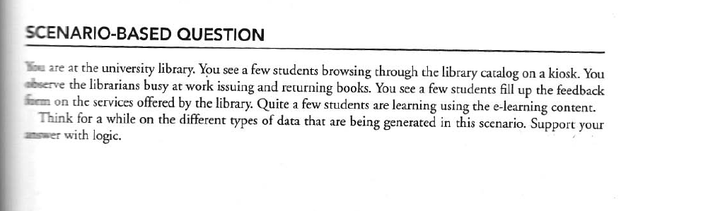
Questions
In which category you will classify the following:
  CCTV footage
  Consumer complaints and feedbacks
  Web page
  Powerpoint presentation
  Web Document

Slide 21
Characteristics of data

Slide 22
Characteristics of data
Data is an essential asset in decision-making and artificial intelligence, and its characteristics define its usability, quality, and reliability.
The three main characteristics of data are Composition, Condition, and Context, each of which influences how data is processed, analyzed, and interpreted.
Why These Characteristics Matter?
  Composition determines how data is processed.
  Condition affects trustworthiness and usability.
  Context ensures correct interpretation and decision-making.

Slide 23
Characteristics of data
Composition (Structure & Type of Data)
  Definition: Composition refers to the fundamental structure, format, and type of data that determines how it can be stored, processed, and analyzed.
  Key Aspects:
    Format: Structured (databases), Semi-structured (JSON, XML), Unstructured (text, images, videos).
    Granularity: Fine-grained (detailed, individual records) vs. Coarse-grained (aggregated data).
    Types: Numeric, categorical, textual, spatial, temporal, multimedia.
  Example:
    A customer database contains structured data (name, age, address).
    A social media feed contains unstructured data (images, text, videos).
    A sensor network collects semi-structured data (JSON with temperature, humidity).

Slide 24
Characteristics of data
Condition (Quality & Reliability of Data)
  Definition: Condition describes the accuracy, completeness, timeliness, and consistency of data, which affects its reliability for analysis and decision-making.
  Key Aspects:
    Accuracy: How correct and free from errors the data is.
    Completeness: Whether all necessary data points are available.
    Timeliness: If the data is up-to-date and relevant.
    Consistency: Whether data across different sources aligns and does not conflict.
  Example:
    High-quality financial records: Accurate, up-to-date, and complete.
    Noisy social media data: May contain inconsistent and redundant information.
    Missing values in medical data: Can lead to incorrect diagnoses.

Slide 25
Characteristics of data
Context (Meaning & Interpretation of Data)
  Definition: Context refers to the circumstances and conditions in which the data was collected, and how it should be interpreted to derive meaningful insights.
  Key Aspects:
    Source: Where the data originates from (e.g., surveys, sensors, transactions).
    Purpose: Why the data was collected (e.g., marketing, healthcare, security).
    Bias & Relevance: Understanding potential biases and whether the data is relevant for the given task.
  Example:
    Temperature data collected from Antarctica cannot be used directly for general climate predictions without considering the location.
    Customer behavior data during the holiday season must be interpreted differently than regular sales trends.
    Medical diagnosis data must consider patient history and demographic factors for meaningful analysis.

Slide 26
Evolution of Big Data

Slide 27
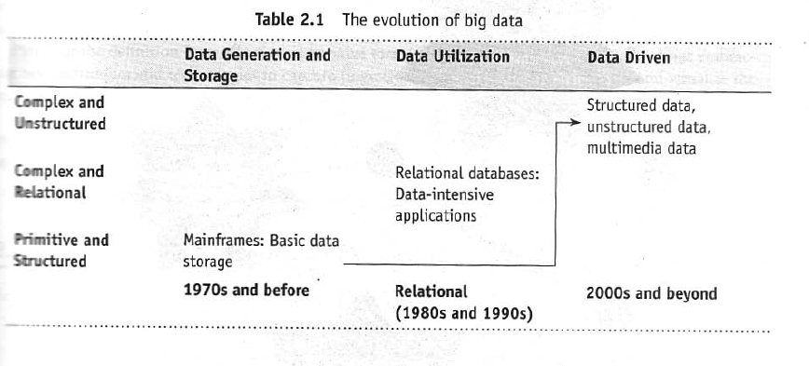
Evolution of Big Data

Slide 28
Definition of Big data

Slide 29
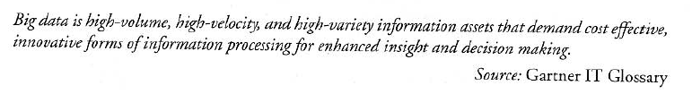
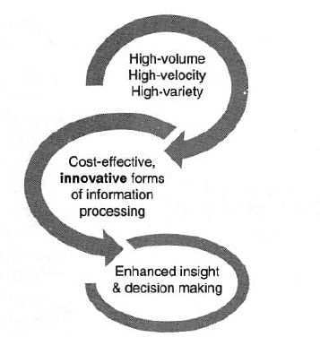
Definition of Big data

Slide 30
Challenges with Big data

Slide 31
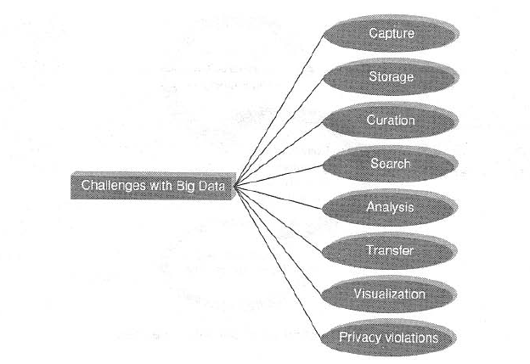
Challenges with Big data

Slide 32
What is Big data?

Slide 33
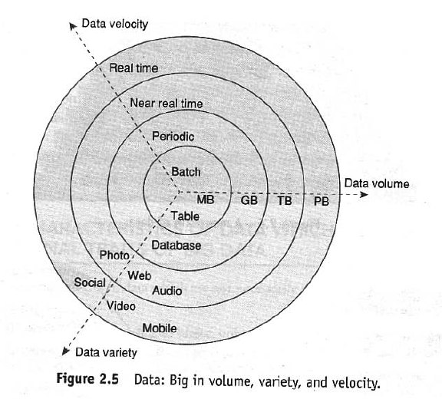
What is Big data
Big Data refers to extremely large, complex, and fast-growing datasets that cannot be efficiently handled using traditional database management systems or processing tools.
It requires specialized technologies and approaches to store, process, and analyze in order to extract meaningful insights.

Slide 34
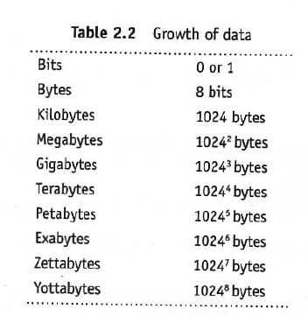
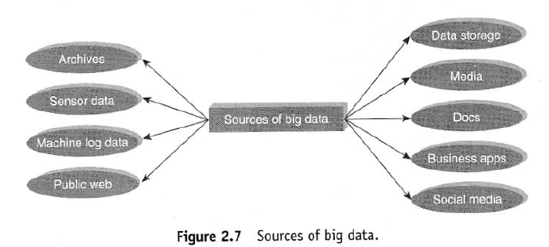
What is Big data
Volume:
  Volume refers to the vast amount of data generated every second from various sources. This data is often too large to be stored or processed using traditional databases.

Slide 35
What is Big data
Velocity:
  Velocity refers to the speed at which data is generated, collected, and processed.
  In many cases, real-time or near-real-time analysis is required to extract value from the data.
Variety:
  Variety refers to the different types and formats of data—structured, semi-structured, and unstructured—that Big Data systems must handle.
Veracity:
  Veracity refers to the accuracy, reliability, and quality of data.
  Since Big Data comes from various sources, some of it may be incomplete, inconsistent, or misleading.
  Poor-quality data can lead to incorrect insights and bad decision-making.

Slide 36
What is Big data
Validity
  Validity refers to whether the data is correct, formatted properly, and useful for the intended purpose.
  Even if data is veracious (truthful), it must also be valid (logically structured and applicable) for meaningful analysis.
Volatility
  Volatility refers to how long data remains relevant and whether it needs to be stored or discarded after a certain period.
  Some data is useful only for a short time, while other data needs to be preserved for years.
Variability
  Variability refers to inconsistencies in data meaning, where the same data might have different interpretations depending on context, time, or source.

Slide 37
Why Big data?

Slide 38
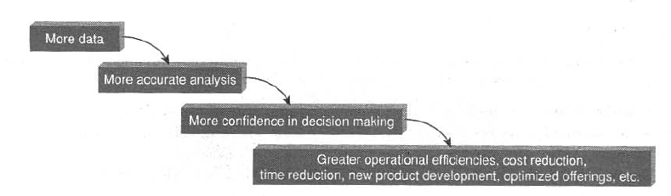
Why Big data?

Slide 39
Traditional Business Intelligence Vs Big Data

Slide 40
Traditional Business Intelligence Vs Big Data
Traditional Business Intelligence (BI) and Big Data are both used for data analysis and decision-making, but they differ in data volume, processing methods, speed, and technologies.
Traditional BI is best for structured data, historical reporting, and predefined analysis.
Big Data is ideal for handling complex, large-scale, and real-time analytics with AI-driven insights.

Slide 41
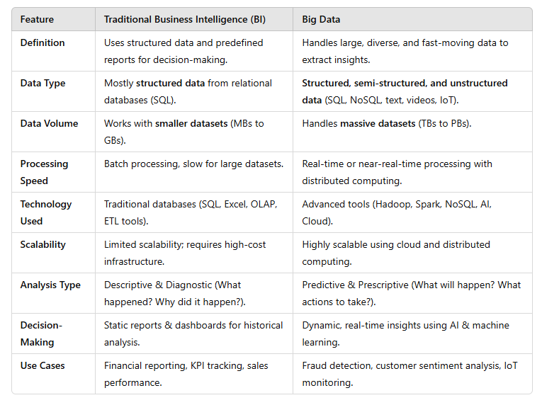
Traditional Business Intelligence Vs Big Data

Slide 42
Typical Data Warehouse environment

Slide 43
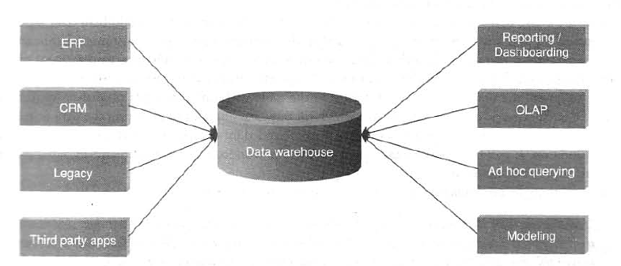
Typical Data Warehouse environment

Slide 44
Typical Hadoop environment.

Slide 45
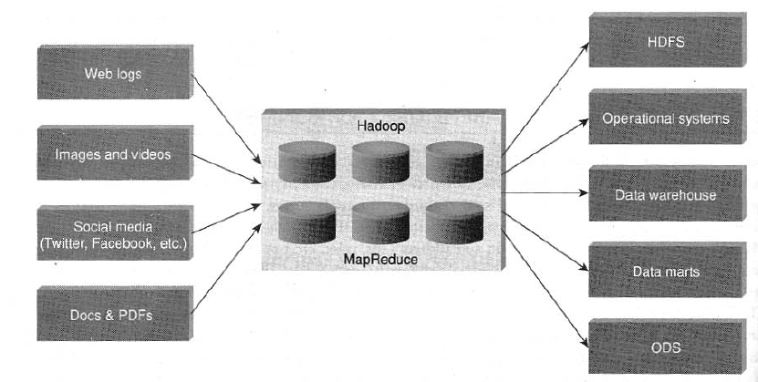
Typical Hadoop environment.

Slide 46
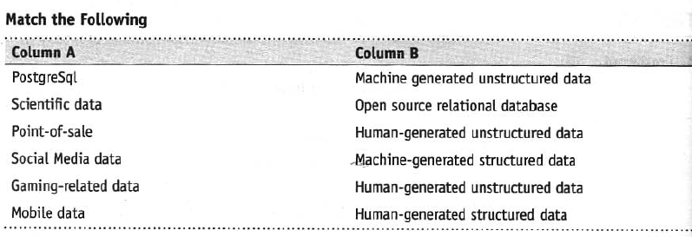
Questions
Share your experience as a customer on an e-commerce site. Comment on the big data that is created on a typical e-commerce site.

Slide 47
What is Big data Analytics

Slide 48
What is Big data Analytics
Big Data Analytics is collecting, organizing, and analyzing large and complex datasets to discover meaningful patterns, correlations, trends, and insights.
It involves using advanced analytical techniques, including machine learning, artificial intelligence (AI), statistical models, and data mining, to extract valuable information from structured, semi-structured, and unstructured data.
This field enables organizations to make data-driven decisions, predict future outcomes, and optimize operations by leveraging high-speed computing, distributed storage, and real-time data processing technologies.
Big Data Analytics indicates its ability to handle massive amounts of data generated at high speed from diverse sources while ensuring accuracy and business relevance.

Slide 49
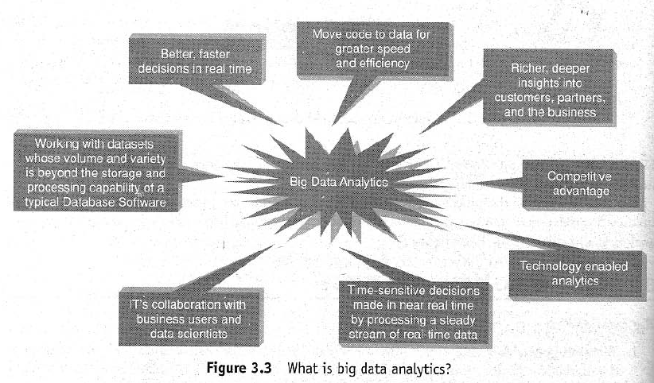
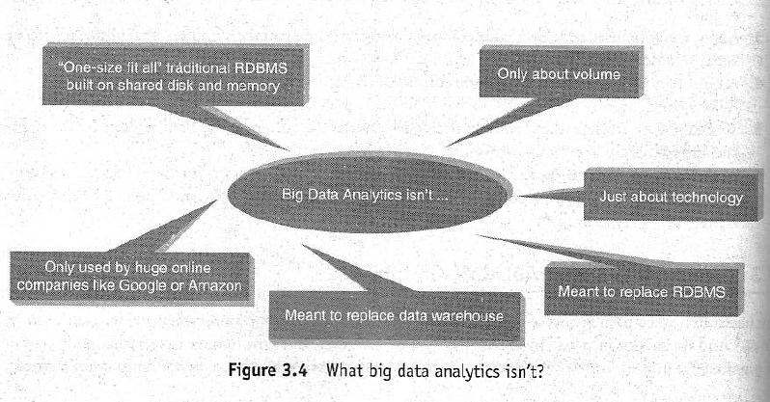
What is Big data Analytics

Slide 50
Classification of Analytics

Slide 51
Classification of Analytics
There are basically two school of thought:
Classification Based on Stages of Analytics
  This school of thought categorizes analytics into four stages:
    Basic Analytics – Simple data reporting and visualization.
    Operationalized Analytics – Embedding analytics into business processes for daily operations.
    Advanced Analytics – Using AI, machine learning, and predictive models for deeper insights.
    Monetized Analytics – Leveraging analytics to create new revenue streams.
  Example:
    E-commerce (Amazon)Basic: Generating sales reports and website traffic data.
    Operationalized: Recommending products to users based on past purchases.
    Advanced: Using AI to predict demand for specific products in different regions.
    Monetized: Selling customer behavior insights to brands for targeted advertising.

Slide 52
Classification of Analytics
There are basically two school of thought:
Classification Based on Analytics Evolution
  This school of thought divides analytics into three generations:
    Analytics 1.0 (Traditional BI) – Relies on structured data, SQL databases, and basic reports.
    Analytics 2.0 (Big Data Era) – Introduces large-scale unstructured data, NoSQL, and Hadoop.
    Analytics 3.0 (AI-Driven Analytics) – Uses real-time, automated decision-making with AI and ML.
  Example: Healthcare Industry
    Analytics 1.0: Hospitals using past patient records to generate reports.
    Analytics 2.0: Wearable devices collecting and analyzing real-time health data.
    Analytics 3.0: AI-powered systems predicting diseases before symptoms appear.

Slide 53
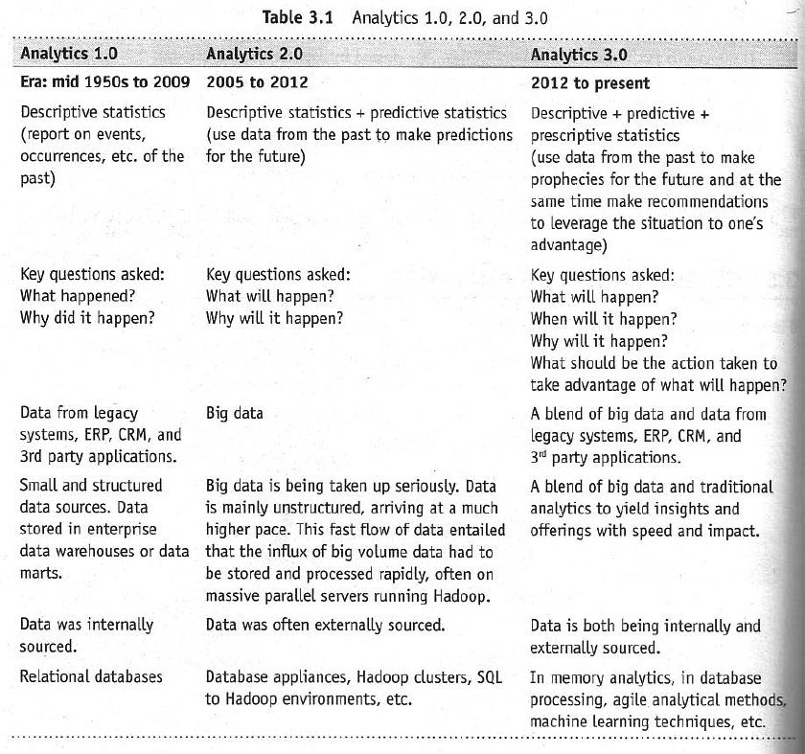
Classification of Analytics

Slide 54
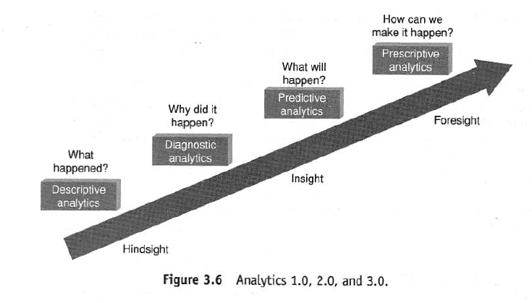
Classification of Analytics

Slide 55
Classification of Analytics
Descriptive Analytics – “What Happened?(helps understand past trends.)”
  Descriptive Analytics focuses on summarizing past data to identify trends, patterns, and insights.
  It does not explain why something happened but presents historical information in a structured manner.
  🔹 Techniques Used:
    Data aggregation, dashboards, reports, data visualization tools (e.g., Tableau, Power BI).
  🔹 Common Use Cases:
    Business reporting, sales tracking, customer segmentation.
  Example: E-commerce (Amazon)
    📌 Scenario: Amazon analyzes last month's sales data to determine which products sold the most.
    📌 Output: A dashboard showing total sales, best-selling products, and peak shopping hours. A report summarizing customer demographics (age, location, gender).
    📌 Impact: Helps businesses understand historical performance and adjust inventory or marketing strategies.

Slide 56
Classification of Analytics
Diagnostic Analytics – “Why Did It Happen?(explains past behaviors.)”
  Diagnostic Analytics digs deeper into past data to identify reasons and causes behind events.
  It answers the "why" question by examining correlations and root causes.
  🔹 Techniques Used:
    Data mining, drill-down analysis, correlation analysis, anomaly detection.
  🔹 Common Use Cases:
    Fraud detection, website traffic analysis, and performance optimization.
  Example: Banking (Credit Card Fraud Detection - Visa & Mastercard)
    📌 Scenario: A bank notices an increase in credit card fraud and wants to determine why.
    📌 Process: The bank analyzes fraudulent transactions over the past three months. It finds that most fraudulent activities occurred in specific locations and involved specific merchants.
    📌 Findings: Fraudsters used compromised accounts for online purchases from foreign countries.
    📌 Impact: The bank strengthens security measures, adds two-factor authentication, and blocks transactions from high-risk regions.

Slide 57
Classification of Analytics
Predictive Analytics – “What Will Happen?(anticipates future outcomes.)”
  Predictive Analytics uses statistical models, machine learning (ML), and AI to forecast future trends.
  It helps businesses anticipate outcomes based on historical data.
  🔹 Techniques Used:
    Regression analysis, time-series forecasting, and machine learning models (e.g., Decision Trees, Neural Networks).
  🔹 Common Use Cases:
    Stock market forecasting, demand prediction, churn analysis.
  Example: Healthcare (Predicting Disease Outbreaks - WHO & CDC)
    📌 Scenario: The World Health Organization (WHO) uses AI to predict flu outbreaks in different regions.
    📌 Process: It analyzes past disease outbreak data, social media trends, and weather conditions. Machine learning models identify patterns that indicate when and where outbreaks are likely to occur.
    📌 Findings: Predicts a high likelihood of a flu outbreak in New York in February.
    📌 Impact: Hospitals stock up on flu vaccines. Governments launch public health awareness campaigns to reduce infections.

Slide 58
Classification of Analytics
Prescriptive Analytics – “What Should We Do?”
  Prescriptive Analytics recommends specific actions based on predictive insights.
  It optimizes decisions by suggesting the best course of action.
  🔹 Techniques Used:
    Optimization algorithms, AI-driven decision support systems, and scenario simulations.
  🔹 Common Use Cases:
    Autonomous vehicles, dynamic pricing, supply chain management.
  Example: Ride-Sharing (Uber’s Surge Pricing Algorithm)
    📌 Scenario: Uber wants to maximize profits while ensuring efficient ride availability.
    📌Process: Predictive analytics forecasts high demand in certain locations (e.g., airports, concerts). Prescriptive analytics adjusts pricing dynamically based on real-time demand and supply.
    📌 Findings: When demand increases, Uber’s algorithm raises prices to encourage more drivers to operate.
    📌 Impact: More drivers are available during peak hours. Customers get faster ride availability, even at a higher price.

Slide 59
Importance of Big Data
Analytics

Slide 60
Importance of Big Data Analytics
Reactive – Business Intelligence (BI)
  Definition:
    Business Intelligence (BI) involves analyzing historical data to generate reports, alerts, and dashboards for better decision-making.
    It helps businesses make data-driven decisions by providing insights at the right time and in the right format.
    The analysis is static and based on past trends rather than real-time or predictive capabilities.
  Example:
    A retail store uses BI tools like Tableau or Power BI to generate sales reports from last quarter.
    The company identifies that winter clothing sales increased in December, helping them plan inventory for next year.

Slide 61
Importance of Big Data Analytics
Reactive – Big Data Analytics
  Definition:
    This approach involves analyzing large datasets (big data) but still follows a reactive model.
    The analysis is based on static data, meaning it does not predict future trends but rather evaluates past data patterns.
  Example:
    A bank analyzes millions of customer transactions to detect past fraudulent activities.
    However, the system does not predict future fraud—it only flags previous suspicious transactions.

Slide 62
Importance of Big Data Analytics
Proactive – Analytics
  Definition:
    This method forecasts future outcomes using predictive modeling, data mining, and machine learning.
    Unlike traditional analytics, it supports decision-making by identifying potential future risks and opportunities.
    It does not work with large-scale big data but applies statistical techniques to structured data.
  Example:
    A healthcare company uses predictive analytics to forecast the likelihood of disease outbreaks based on past data.
    AI models analyze patient records and detect early warning signs of chronic illnesses.

Slide 63
Importance of Big Data Analytics
Proactive – Big Data Analytics
  Definition:
    This is the most advanced form of data analysis, leveraging big data, AI, and high-performance computing.
    It processes terabytes to exabytes of data in real time to extract meaningful insights.
    The goal is to solve complex business problems dynamically, allowing organizations to react in real-time.
  Example:
    Google Maps analyzes real-time traffic data from millions of users to predict congestion and suggest alternate routes.
    Netflix uses AI to dynamically recommend movies based on a user's watching habits and global trends.

Slide 64
Terminologies used in Big data Environments

Slide 65
Terminologies used in Big data Environments
In-Memory Analytics
  In-memory analytics refers to the process of analyzing data by storing it in the system's RAM instead of traditional disk-based storage.
  This approach significantly speeds up query processing and real-time analytics.
  Used in tools like Apache Spark and SAP HANA.
  Advantages: Faster data retrieval, reduced latency, and improved performance for large-scale data analysis.
In-Database Processing
  In-database processing integrates data analytics directly within the database system instead of exporting data to external applications for analysis.
  It enables the execution of complex analytical functions (e.g., machine learning, SQL-based analytics) within the database engine.
  Examples include PostgreSQL with its built-in functions, and Oracle Exadata.
  Benefits: Reduces data movement, enhances security, and speeds up processing.

Slide 66
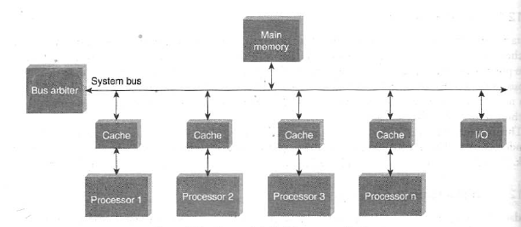
Terminologies used in Big data Environments
Symmetric Multiprocessor (SMP) System
  SMP systems consist of multiple processors sharing a single memory and operating system.
  Each processor has equal access to memory, and tasks are dynamically assigned to any processor.
  Common in enterprise servers and high-performance computing environments.
  Example: IBM Power Systems, Intel Xeon-based servers.
  Advantages: Simple architecture, efficient resource sharing, and better system utilization.

Slide 67
Terminologies used in Big data Environments
Massively Parallel Processing (MPP)
  MPP systems consist of multiple processors with their own memory and operate independently.
  These processors work together to execute a task by dividing it into smaller sub-tasks.
  Used in large-scale data processing applications like data warehouses and cloud computing.
  Examples: Hadoop, Teradata, Google BigQuery.
  Advantages: Scalability, high performance, and efficient handling of big data workloads.

Slide 68
Terminologies used in Big data Environments
Difference Between Parallel and Distributed Systems
Feature | Parallel Computing | Distributed Computing
Definition | Multiple processors work together in a tightly coupled system with shared memory. | Independent computers communicate over a network to perform a task.
Memory | Shared memory or tightly connected nodes. | Each system has its own memory and operates independently.
Communication | Fast, as processors communicate directly through memory. | Slower, as communication happens via network messages.
Fault Tolerance | Low – failure in one processor may affect the entire system. | High – if one node fails, others continue to work.
Scalability | Limited by hardware constraints. | Easily scalable by adding more machines.
Example | Supercomputers, multi-core processors (e.g., GPU clusters). | Cloud computing, Hadoop clusters, the Internet.
Difference Between Parallel and Distributed Systems

Slide 69
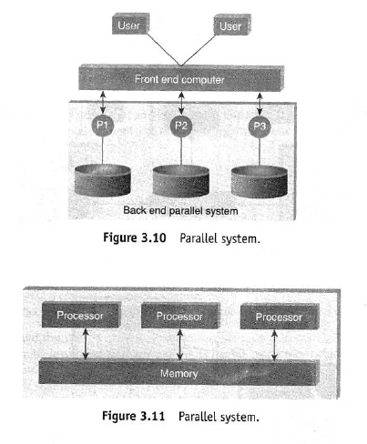
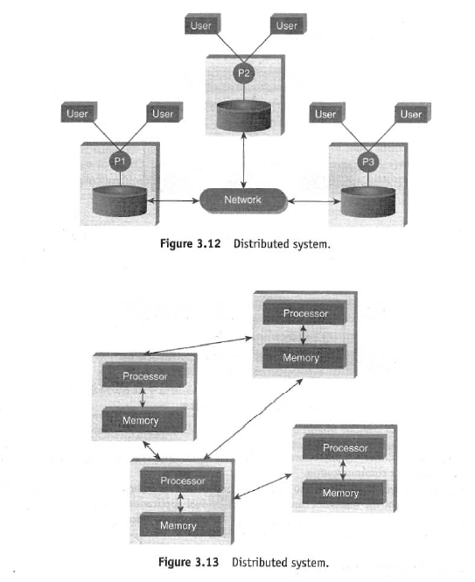
Terminologies used in Big data Environments
Difference Between Parallel and Distributed Systems
Difference Between Parallel and Distributed Systems

Slide 70
Terminologies used in Big data Environments
Shared Nothing (SN) architecture
  Shared Nothing (SN) architecture is a distributed computing architecture where each node (server or processor) is completely independent and does not share memory or disk storage with other nodes.
  Each node has its own CPU, RAM, and storage, and communication between nodes happens via a network.
  The three common architectures for multiprocessor high-transaction rate systems:
    Shared Memory (SM) – Multiple processors share a common central memory.
    Shared Disk (SD) – Processors have private memory but share a collection of disks.
    Shared Nothing (SN) – No memory or disk is shared among processors; each has independent resources.
  The key difference among these architectures lies in how they handle memory and storage sharing in a multiprocessor environment.

Slide 71
Terminologies used in Big data Environments
CAP Theorem (Brewer’s Theorem)
  The CAP theorem states that in a distributed system, it is impossible to achieve all three properties simultaneously. A system can only guarantee two of the three at a time.
  Components of CAP Theorem:
    Consistency (C) → Every read receives the most recent write or an error.
    Availability (A) → Every request gets a response, even if some nodes fail.
    Partition Tolerance (P) → The system continues operating even when network failures occur.
  Trade-offs in CAP Theorem:
    CAP Property Chosen What It Means Example Databases
    CP (Consistency + Partition Tolerance) Guarantees data accuracy but may sacrifice availability during network failures. MongoDB (in strong consistency mode), HBase.
    AP (Availability + Partition Tolerance) Ensures system remains available but may have inconsistent data. DynamoDB, Cassandra.
    CA (Consistency + Availability) Ensures strong consistency and availability but does not tolerate partitions well (only possible in non-distributed systems). Traditional relational databases (e.g., MySQL, PostgreSQL).

Slide 72
Terminologies used in Big data Environments
CAP Theorem (Brewer’s Theorem)
  Real-life analogy:
    A training institute struggles with schedule consistency between two administrators (Amey and Joey), illustrating CAP challenges.
  Resolution Strategy:
    Updates must be reflected in all systems to ensure consistency.
    Systems should always be available when needed.
    When conflicts arise (e.g., two admins not talking), the system must be partition tolerant.
  When to choose consistency over availability?
    If strong data consistency is required (e.g., financial transactions).
  When to choose availability over consistency?
    When temporary inconsistencies are tolerable (e.g., social media feeds).
  These concepts help in designing scalable and fault-tolerant distributed systems.

Slide 73
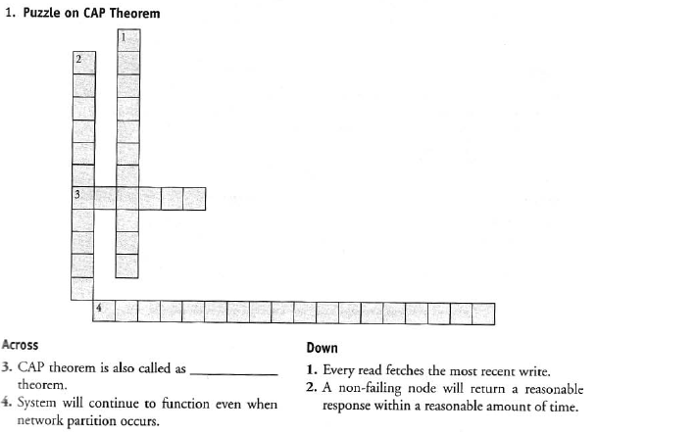

Slide 74
Technologies used in Big data Environments

Slide 75
NOSQL

