Slide 1
PROGRAMMING IN JAVA
By Surbhi Sharma

Slide 2
Files and I/O Streams

Slide 3
Java I/O (Input and Output) is used to process the input and produce the output.
Java uses the concept of stream to make I/O operation fast. The java.io package contains all the classes required for input and output operations.
We can perform file handling in java by Java I/O API.

Slide 4
Stream
A stream is a sequence of data.In Java a stream is composed of bytes. It's called a stream because it is like a stream of water that continues to flow.
In java, 3 streams are created for us automatically. All these streams are attached with console.
1) System.out: standard output stream
2) System.in: standard input stream
3) System.err: standard error stream
Let's see the code to print output and error message to the console.
System.out.println("simple message");
System.err.println("error message");
Let's see the code to get input from console.
int i=System.in.read();//returns ASCII code of 1st character
System.out.println((char)i);//will print the character

Slide 5
Streams
Java implements streams within class hierarchies defined in the java.io package.
A stream is an ordered sequence of data.
A stream is linked to a physical device by the Java I/O system.
All streams behave in the same manner, even if the actual physical devices to which they are linked differ.
An I/O Stream represents an input source or an output destination.

Slide 6
I/O Streams
A stream can represent many different kinds of sources and destinations
– disk files, devices, other programs, a network socket, and memory arrays
Streams support many different kinds of data
– simple bytes, primitive data types, localized characters, and objects
Some streams simply pass on data; others manipulate and transform the data in useful ways.

Slide 7
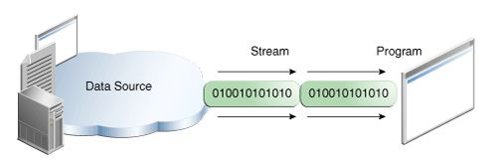
Input Stream
A program uses an input stream to read data from a source, one item at a time.
Reading information into a program.

Slide 8
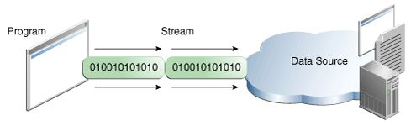
Output Stream
A program uses an output stream to write data to a destination, one item at time:
Writing information from a program.

Slide 9
Types of Streams
Java defines two different types of Streams-
Byte Streams
Character Streams
Byte streams provide a convenient means for handling input and output of bytes.
Byte streams are used, for example, when reading or writing binary data.
Character streams provide a convenient means for handling input and output of characters.
In some cases, character streams are more efficient than byte streams.

Slide 10
Byte Streams
Programs use byte streams to perform input and output of 8-bit bytes.
Byte streams are defined by using two class hierarchies.
At the top, there are two abstract classes: InputStream and OutputStream.
The abstract classes InputStream and OutputStream define several key methods that the other stream classes implement.
Two of the most important methods are read( )and write( ), which, respectively, read and write bytes of data.
Both methods are declared as abstract inside InputStream and OutputStream.

Slide 11
Closing the Streams
Closing a stream when it's no longer needed is very important.
It is so important that we have used a finally block to guarantee that both streams will be closed even if an error occurs. This practice helps avoid serious resource leaks.
When we call the close(), it clears the buffer by performing the write operation to the destination and then closes the stream.

Slide 12
Files

Slide 13
File Class
The File class provides the methods for obtaining the properties of a file/directory and for renaming and deleting a file/directory.
An absolute file name (or full name) contains a file name with its complete path and drive letter.
For example, c:\book\Welcome.java
A relative file name is in relation to the current working directory.
The complete directory path for a relative file name is omitted.
For example, Welcome.java

Slide 14
File Class
The File class is a wrapper class for the file name and its directory path.
For example, new File("c:\\book")
creates a File object for the directory c:\book,
new File("c:\\book\\test.dat")
creates a File object for the file c:\book\test.dat
File class does not contain the methods for reading and writing file contents.

Slide 15
Methods and Constructors
Constructor:
Sr.No. | Method & Description
1 | File(String pathname) This constructor creates a new File instance by converting the given pathname string into an abstract pathname.

Slide 16
Methods of File Class
Methods:
Sr.No. | Method & Description
1 | public String getName() Returns the name of the file or directory denoted by this abstract pathname.
2 | public String getPath() Converts this abstract pathname into a pathname string.
3 | public boolean isAbsolute() Tests whether this abstract pathname is absolute. Returns true if this abstract pathname is absolute, false otherwise.

Slide 17
4 | public String getAbsolutePath() Returns the absolute pathname string of this abstract pathname.
5 | public boolean canRead() Tests whether the application can read the file denoted by this abstract pathname. Returns true if and only if the file specified by this abstract pathname exists and can be read by the application; false otherwise.
6 | public boolean canWrite() Tests whether the application can modify to the file denoted by this abstract pathname. Returns true if and only if the file system actually contains a file denoted by this abstract pathname and the application is allowed to write to the file; false otherwise.
7 | public boolean exists() Tests whether the file or directory denoted by this abstract pathname exists. Returns true if and only if the file or directory denoted by this abstract pathname exists; false otherwise.
8 | public boolean isDirectory() Tests whether the file denoted by this abstract pathname is a directory. Returns true if and only if the file denoted by this abstract pathname exists and is a directory; false otherwise.

Slide 18
9 | public boolean isFile() Tests whether the file denoted by this abstract pathname is a normal file. A file is normal if it is not a directory and, in addition, satisfies other system-dependent criteria. Any non-directory file created by a Java application is guaranteed to be a normal file. Returns true if and only if the file denoted by this abstract pathname exists and is a normal file; false otherwise.
10 | public boolean createNewFile() throws IOException Atomically creates a new, empty file named by this abstract pathname if and only if a file with this name does not yet exist. Returns true if the named file does not exist and was successfully created; false if the named file already exists.

Slide 19
11 | public boolean delete() Deletes the file or directory denoted by this abstract pathname. If this pathname denotes a directory, then the directory must be empty in order to be deleted. Returns true if and only if the file or directory is successfully deleted; false otherwise.
12 | public File[] listFiles() Returns an array of abstract pathnames denoting the files in the directory denoted by this abstract pathname.

Slide 20
import java.io.File;
public class FileDemo {
public static void main(String[] args) {
File f = null;
String[] strs = {"test1.txt", "test2.txt"};
try { // for each string in string array
for(String s:strs ) {
// create new file
f = new File(s);
// true if the file is executable
boolean bool = f.canExecute();
// find the absolute path
String a = f.getAbsolutePath();
// prints absolute path
System.out.print(a);
// prints
System.out.println(" is executable: "+ bool);
} }
catch(Exception e) { // if any I/O error occurs
e.printStackTrace();
} } }

Slide 21
Read and write data from the console

Slide 22
Reading and Writing Files
In Java, all files are byte-oriented, and Java provides methods to read and write bytes from and to a file.
Java allows us to wrap a byte-oriented file stream within a character-based object.
We can use Scanner and PrintWriter class to read and write Files.

Slide 23
PrinterWriter Class
Although using System.out to write to the console is acceptable.
The recommended method of writing to the console when using Java is through a PrintWriter stream.
Using a character-based class for console output makes it easier to internationalize your program.

Slide 24
Class declaration
Let's see the declaration for Java.io.PrintWriter class:
public class PrintWriter extends Writer

Slide 25
Methods of FileWriter class
Method | Description
void println(boolean x) | It is used to print the boolean value.
void println(char[] x) | It is used to print an array of characters.
void println(int x) | It is used to print an integer.
PrintWriter append(char c) | It is used to append the specified character to the writer.
PrintWriter append(CharSequence ch) | It is used to append the specified character sequence to the writer.

Slide 26
boolean checkError() | It is used to flushes the stream and check its error state.
protected void setError() | It is used to indicate that an error occurs.
protected void clearError() | It is used to clear the error state of a stream.
PrintWriter format(String format, Object... args) | It is used to write a formatted string to the writer using specified arguments and format string.
void print(Object obj) | It is used to print an object.
void flush() | It is used to flushes the stream.
void close() | It is used to close the stream.

Slide 27
import java.io.File;
import java.io.PrintWriter;
public class PrintWriterExample {
public static void main(String[] args) throws Exception {
//Data to write on Console using PrintWriter
PrintWriter writer = new PrintWriter(System.out);
writer.write("Java is a language.");
writer.flush();
writer.close();
//Data to write in File using PrintWriter
PrintWriter writer1 =null;
writer1 = new PrintWriter(new File("D:\\testout.txt"));
writer1.write("Like Java, Spring, Hibernate, Android, PHP etc.");
writer1.flush();
writer1.close();
}
}

Slide 28
Using Scanner
The java.util.Scanner class is used to read strings and primitive values from the console.
Scanner breaks the input into tokens delimited by whitespace characters.
To read from the keyboard, we create a Scanner as follows:
Scanner s = new Scanner(System.in);
To read from a file, create a Scanner for a file, as follows:
Scanner s = new Scanner(new File(filename));

Slide 29
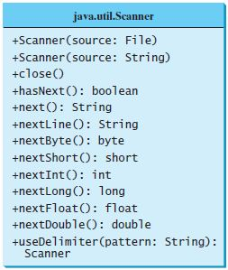
Scanner Methods

Slide 30
import java.io.*;
import java.util.Scanner;
class Scanfile {
public static void main(String [] args) throws IOException{
Scanner s=new Scanner( new BufferedReader( new FileReader("D:\\testout.txt“)));
try{
while(s.hasNext()){
System.out.println(s.next());
}}
finally{
s.close();
}
}}

Slide 31
Binary I/O classes

Slide 32
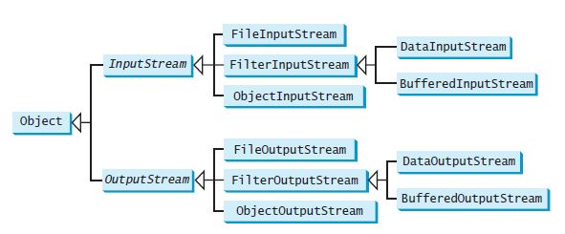
Binary Input/Output Classes

Slide 33
Byte Stream Classes
Stream Class | Meaning / Use
BufferedInputStream | Buffered input stream
BufferedOutputStream | Buffered output stream
DataInputStream | contains methods for reading the Java standard data types
DataOutputStream | contains methods for writing the Java standard data types
FileInputStream | Input stream that reads from a file
FileOutputStream | Output stream that writes to a file
InputStream | Abstract class that describes stream input
OutputStream | Abstract class that describes stream output
PrintStream | Output stream that contains print() and println( )
PipedInputStream | Input Pipe
PipedOutputStream | Output Pipe

Slide 34
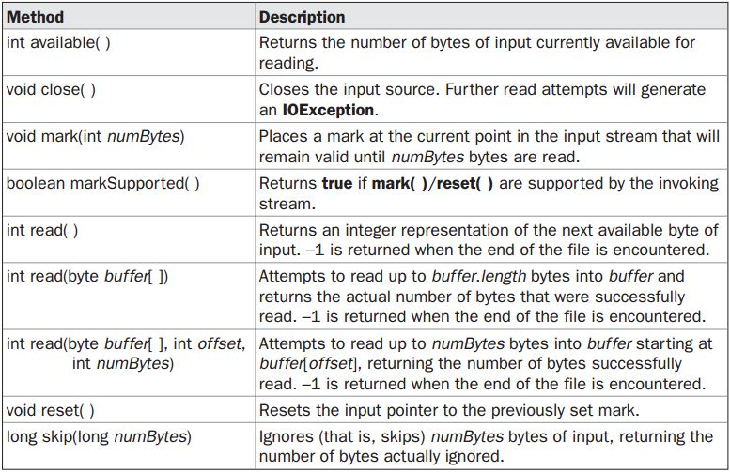
Methods defined by ‘InputStream’

Slide 35
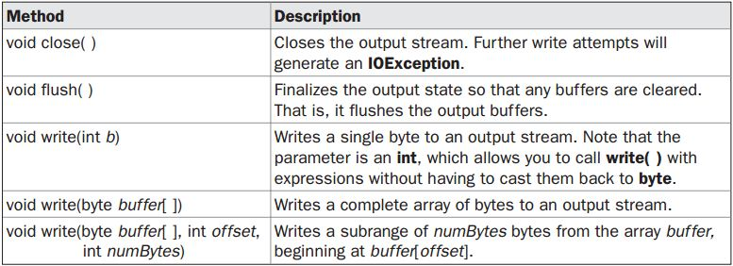
Methods defined by ‘OutputStream’

Slide 36
FileOutputStream Class
Java FileOutputStream is an output stream used for writing data to a file.
If you have to write primitive values into a file, use FileOutputStream class. You can write byte-oriented as well as character-oriented data through FileOutputStream class. But, for character-oriented data, it is preferred to use FileWriter than FileOutStream.
FileOutputStream class declaration
Let's see the declaration for Java.io.FileOutputStream class:
public class FileOutputStream extends OutputStream

Slide 37
FileOutputStream class methods
Method | Description
protected void finalize() | It is sued to clean up the connection with the file output stream.
void write(byte[] ary) | It is used to write ary.length bytes from the byte array to the file output stream.
void write(byte[] ary, int off, int len) | It is used to write len bytes from the byte array starting at offset off to the file output stream.
void write(int b) | It is used to write the specified byte to the file output stream.
void close() | It is used to closes the file output stream.

Slide 38
Java FileOutputStream Example 1: write byte
import java.io.FileOutputStream;
public class FileOutputStreamExample {
public static void main(String args[]){
try{
FileOutputStream fout=new FileOutputStream("D:\\testout.txt");
fout.write(65);
fout.close();
System.out.println("success...");
}catch(Exception e){System.out.println(e);}
}
}

Slide 39
Java FileOutputStream example 2: write string
import java.io.FileOutputStream;
public class FileOutputStreamExample {
public static void main(String args[]){
try{
FileOutputStream fout=new FileOutputStream("D:\\testout.txt");
String s="Welcome to javaTpoint.";
byte b[]=s.getBytes();//converting string into byte array
fout.write(b);
fout.close();
System.out.println("success...");
}catch(Exception e){System.out.println(e);}
}
}

Slide 40
Java FileInputStream Class
Java FileInputStream class obtains input bytes from a file. It is used for reading byte-oriented data (streams of raw bytes) such as image data, audio, video etc. You can also read character-stream data. But, for reading streams of characters, it is recommended to use FileReader class.
Java FileInputStream class declaration
Let's see the declaration for java.io.FileInputStream class:
public class FileInputStream extends InputStream

Slide 41
Java FileInputStream class methods
Method | Description
int read() | It is used to read the byte of data from the input stream.
int read(byte[] b) | It is used to read up to b.length bytes of data from the input stream.
int read(byte[] b, int off, int len) | It is used to read up to len bytes of data from the input stream.
long skip(long x) | It is used to skip over and discards x bytes of data from the input stream.
protected void finalize() | It is used to ensure that the close method is call when there is no more reference to the file input stream.
void close() | It is used to closes the stream.

Slide 42
Java FileInputStream example 1: read single character
import java.io.FileInputStream;
public class DataStreamExample {
public static void main(String args[]){
try{
FileInputStream fin=new FileInputStream("D:\\testout.txt");
int i=fin.read();
System.out.print((char)i);
fin.close();
}catch(Exception e){System.out.println(e);}
}
}

Slide 43
Java FileInputStream example 2: read all characters
import java.io.FileInputStream;
public class DataStreamExample {
public static void main(String args[]){
try{
FileInputStream fin=new FileInputStream("D:\\testout.txt");
int i=0;
while((i=fin.read())!=-1){
System.out.print((char)i);
}
fin.close();
}catch(Exception e){System.out.println(e);}
}
}

Slide 44
import java.io.*;
class CopyFile {
public static void main(String args[])throws IOException{
int i; FileInputStream fin=null; FileOutputStream fout=null;
fin = new FileInputStream(args[0]);
fout = new FileOutputStream(args[1]);
try {
do { i = fin.read();
if(i != -1) fout.write(i);
} while(i != -1);
}
catch(IOException e) {
System.out.println("File Error");
}
fin.close();
fout.close();
}
}

Slide 45
Serialization

Slide 46
ObjectOutputStream class
The ObjectOutputStream class is used to write primitive data types and Java objects to an OutputStream. Only objects that support the java.io.Serializable interface can be written to streams.
Constructor
public ObjectOutputStream(OutputStream out) throws IOException {} | creates an ObjectOutputStream that writes to the specified OutputStream.

Slide 47
Important Methods
Method | Description
1) public final void writeObject(Object obj) throws IOException {} | writes the specified object to the ObjectOutputStream.
2) public void flush() throws IOException {} | flushes the current output stream.
3) public void close() throws IOException {} | closes the current output stream.

Slide 48
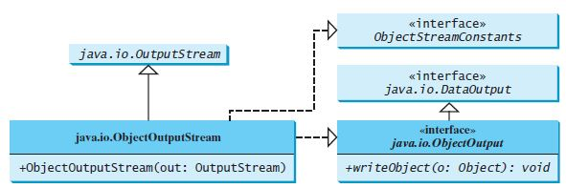
Constructor and Methods of ObjectOutputStream

Slide 49
ObjectInputStream class
An ObjectInputStream deserializes objects and primitive data written using an ObjectOutputStream.
Constructor
public ObjectInputStream(InputStream in) throws IOException {} | creates an ObjectInputStream that reads from the specified InputStream.

Slide 50
Important Methods
Method | Description
1) public final Object readObject() throws IOException, ClassNotFoundException{} | reads an object from the input stream.
2) public void close() throws IOException {} | closes ObjectInputStream.

Slide 51
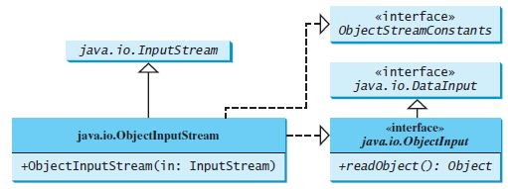
Constructor and Methods of ObjectInputStream

Slide 52
Serialization
Serialization is the process of writing the state of an object to a byte stream.
This is useful when we want to save the state of our program to a persistent storage area, such as a file.
At a later time, we may restore these objects by using the process of de-serialization.
Serialization is also needed to implement Remote Method Invocation (RMI).

Slide 53
An object to be serialized may have references to other objects, which, in turn, have references to still more objects.
If we attempt to serialize an object at the top of an object graph, all of the other referenced objects are recursively located and serialized.

Slide 54
Serializable Interface
Only an object that implements the Serializable interface can be saved and restored by the serialization facilities.
The Serializable interface defines no members.
It is simply used to indicate that a class may be serialized.
If a class is serializable, all of its subclasses are also serializable.

Slide 55
Serialization Example
class MyClass implements Serializable
{
String s;
int i;
double d;
MyClass(String s, int i, double d) {
this.s = s;
this.i = i;
this.d = d;
}
public String toString()
{
return "s=" + s + "; i=" + i + "; d=" + d;
}
}

Slide 56
import java.io.*;
public class SerializationDemo {
public static void main(String args[]) {
try {
MyClass object1 = new MyClass("Hello", -7, 2.7e10);
System.out.println("object1: " + object1);
FileOutputStream fos = new FileOutputStream("serial.txt");
ObjectOutputStream oos = new ObjectOutputStream(fos);
oos.writeObject(object1);
oos.flush();
oos.close();
}
catch(IOException e) {
System.out.println("Exception during serialization: " + e);
System.exit(0);
}

Slide 57
// Object deserialization
try {
MyClass object2;
FileInputStream fis = new FileInputStream("serial.txt");
ObjectInputStream ois = new ObjectInputStream(fis);
object2 = (MyClass)ois.readObject();
ois.close();
System.out.println("object2: " + object2);
}
catch(Exception e) {
System.out.println("Exception during deserialization: " + e);
System.exit(0);
}
}
}

Slide 58
Exercise
Write a program which prompts the user to enter the path of the file to be read (f1) and file to be written(f2).
Append the content of the file f1 at the end of file f2.

