Slide 1
PROGRAMMING IN JAVA
By Surbhi Sharma

Slide 2
What Is a Java Program?

Slide 3
Introduction to Computer Programs
A programming language is a formal constructed language designed to communicate instructions to a machine, particularly a computer. Programming languages can be used to create programs to control the behavior of a machine or to express algorithms.
A vocabulary and set of grammatical rules for instructing a computer to perform specific tasks. The term programming language usually refers to high-level languages, such as BASIC, C, C++, COBOL, FORTRAN, Ada, Java and Pascal.

Slide 4
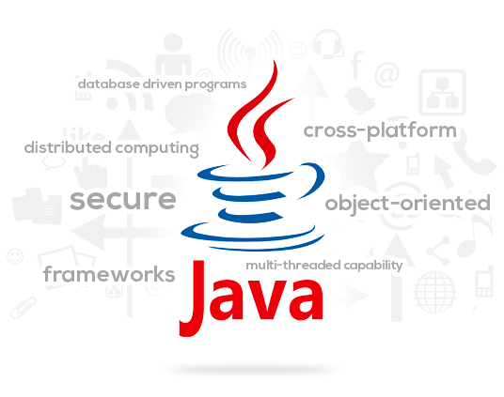
Java Features
Compiled and Interpreted
Simple, Small and Familiar
Platform- Independent and Portable
Object Oriented
Robust and Secure
Distributed
High Performance
Dynamic and Extensible
Scalability and Performance

Slide 5
Types of Java Programs
We can develop two types of java programs:
Stand-alone applications
Web applets
Stand- alone applications are written in java to carry out certain task on a computer. Executing a stand-alone java program involves two steps:
Compiling source code into bytecode using javac compiler.
Executing the bytecode using java interpreter.
Web applets are small java programs developed for internet applications. An applet located on a distant computer can be downloaded via internet and executed on a local computer using java capable browser. The creation and running of applets are more complex than creating an application.

Slide 6
The Java Technology and Development Environment
Java Environment includes a large number of development tools and hundreds of classes and methods.
The development tools are part of the system known as Java Development Kit(JDK) and the classes and methods are part of the Java Standard Library(JSL) or Application Programming Interface(API).
JDK:
JDK comes with a collection of tools that are used for developing and running java program.
They include:-
appletviewer – this tool can be used to run and debug Java applets without a web browser

Slide 7
The Java Technology and Development Environment
javac – the Java compiler, which converts source code into Java bytecode
java – the loader for Java applications. This tool is an interpreter and can interpret the class files generated by the javac compiler.
javap – the class file disassembler
javah – the header files, used to write native methods
javadoc – the documentation generator, which automatically generates documentation from source code comments
jdb – the debugger
The way these tools are applied to build and run application programs is illustrated

Slide 8
The Java Technology and Development Environment
Text Editor
Java Source Code
javadoc
HTML Files
javac
Java Class File
javah
Header Files
java
jdb
Java Program Output

Slide 9
The Java Technology and Development Environment
API:
The JVS(or API) includes hundreds of classes and methods grouped into several functional packages.
Most commonly used are:-
Java Support Packages- For implementing basic features of java
Utilities Package- To provide utility functions
Input/Output Package- For i/o manipulations
Networking Package- For communicating with other computers vis internet
AWT Package- For implementing platform independent graphical user interface
Applet Packages- Allow us to create java applets

Slide 10
The Java Technology and Development Environment
Java Runtime Environment
The Java Runtime Environment (JRE) facilitates the execution of program developed in java.
It Primarily comprises of the following:-
Java Virtual Machine- It is a program that interprets the intermediate java byte code and generate the desired output.
Runtime Class Libraries- Core class libraries for the execution of java programs.
User Interface Toolkits-
Deployment Technologies
Java plug-in- enables execution of java applet
Java Web Start- enables remote-deployment of an application.

Slide 11
Writing, Compiling and Executing Java programs
Write a Java Program
Create a directory to keep your works, e.g., "d:\myProject", or "c:\myProject", or any directory of your choice. The directory name shall not contain blank or special characters. Use meaningful but short name as it is easier to type.
Launch a programming text editor. Begin with a new file and enter the following source code.
Save the file as "Hello.java", under your work directory(e.g., d:\myProject).
/* * First Java program to say Hello */
class Hello
{
public static void main(String[] args)
{
System.out.println("Hello, world!");
}
}

Slide 12
Writing, Compiling and Executing Java programs
In Java, a source file is officially called a compilation unit.
It is a text file that contains one or more class definitions.
The Java compiler requires that a source file use the .java filename extension.
In Java, all code must reside inside a class.
By convention, the name of that class should match the name of the file that holds the program.
You should also make sure that the capitalization of the filename matches the class name.

Slide 13
Writing, Compiling and Executing Java programs
When Java source code is compiled, each individual class is put into its own output file named after the class and using the .class extension.
This is why it is a good idea to give your Java source files the same name as the class they contain—the name of the source file will match the name of the .class file.
When you execute java, you are actually specifying the name of the class that you want to execute.
It will automatically search for a file by that name that has the .class extension.
If it finds the file, it will execute the code contained in the specified class

Slide 14
Writing, Compiling and Executing Java programs
Compile and Run the Java Program
To compile the source code "Hello.java":
Start a CMD Shell (Click the "Start" button ⇒ "run..." ⇒ Enter "cmd").
Set the Current Drive to the drive where you saved your source file "Hello.java".
For example, suppose that your source file is saved in drive "d", enter "d:" as follow:
prompt> d:
d:\xxx>
Set the Current Working Directory to the directory that you saved your source file via the cd (Change Directory) command.
For example, suppose that your source file is saved in directory "d:\myProject".
d:\xxx> cd \myProject
d:\myProject>

Slide 15
Writing, Compiling and Executing Java programs
Invoke the JDK compiler "javac" to compile the source code "Hello.java".
d:\myProject> javac Hello.java
The compilation is successful if the command prompt returns. Otherwise, error messages would be shown. Correct the errors in your source file and re-compile. Check "Common JDK Installation Errors", if you encounter problem compiling your program.
To run the program, invoke the Java Runtime "java":
d:\myProject> java Hello
Hello, world!

Slide 16
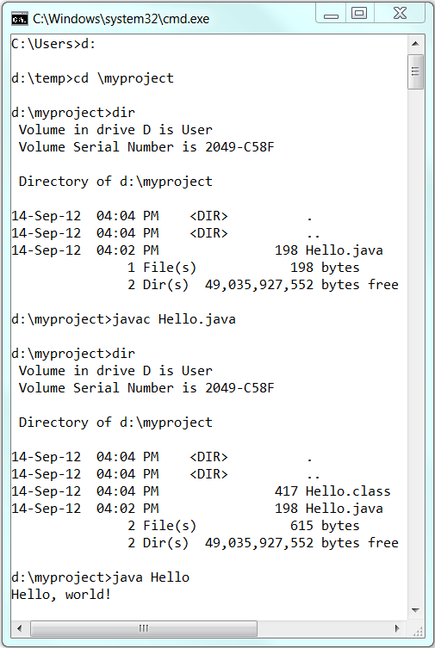
Writing, Compiling and Executing Java programs

Slide 17
Java Program
Class Declaration:
The first line class SampleOne
Declares a class.class is a keyword and declares that a new class defination follows. SampleOne is a java identifier that specifies the name of the class to be defined.
Braces
Every class defination in java begins with a { and ends with a matching closing brace }.
The main line
The third line public static void main(String args[])
defines a method named main. Every java program must include the main () method. This is the starting point for the interpreter to begin the execution of program.

Slide 18
Java Program
The line contains a number of keywords, public , static and void.
Public is an access specifier that declares the main method as unprotected and therefore making it accessible to all other classes.
Static declares this method as one that belongs to the entire class and not a part of any objects of the class. It must be declared static as interpreter uses this method before any objects are created.
Void type modifier states that the main method does not return any values.
String args[] declares a parameter named args, which contins an array of objects of the type String.

Slide 19
Java Program
The Output line
The only executable statement in the program is System.out.println(“Java is better than C++”);
As java is object oriented language, every method must be part of an object.
The println method is a member of the out object, which is a static data member of System class.
The method println always appends a newline character to the end of the string.

Slide 20
Java Program Structure
Package Statement
Import Statement
Interface Statements
Class Definition
Main Method Class
{
Main Method Definition
}

