Slide 1
Study Material
Department of AIML
Course Code : | BCS303 | Semester / Year : | III / II
Course Title : | Operating Systems | Academic Year : | 2024-25

Slide 2
Module 1
Operating System Services: User - Operating System interface; System calls; Types of system calls; System programs; Operating system design and implementation; Operating System structure; Virtual machines; Operating System debugging, Operating System generation; System boot.
2

Slide 3
Operating System Services
Operating Systems Interface
System Calls
Types of System Calls
System Programs
Operating-System Design and Implementation
OS Structure
Virtual Machine
OS Debugging
System Boot
3

Slide 4
Operating System Services

Slide 5
Operating System Services
Operating systems provide an environment for execution of programs and services to programs and users
One set of operating-system services provides functions that are helpful to the user:
User interface - Almost all operating systems have a user interface (UI).
Varies between Command-Line (CLI), Graphics User Interface (GUI), Batch interface
Program execution - The system must be able to load a program into memory and to run that program, end execution, either normally or abnormally (indicating error)
I/O operations - A running program may require I/O, which may involve a file or an I/O device
Notes:
5

Slide 6
Operating System Services (Cont.)
One set of operating-system services provides functions that are helpful to the user (Cont.):
File-system manipulation - The file system is of particular interest. Programs need to read and write files and directories, create and delete them, search them, list file Information, permission management.
Communications – Processes may exchange information, on the same computer or between computers over a network
Communications may be via shared memory or through message passing (packets moved by the OS)
Notes:
6

Slide 7
Operating System Services (Cont.)
Error detection – OS needs to be constantly aware of possible errors
May occur in the CPU and memory hardware, in I/O devices, in user program
For each type of error, OS should take the appropriate action to ensure correct and consistent computing
Debugging facilities can greatly enhance the user’s and programmer’s abilities to efficiently use the system
Notes:
7

Slide 8
Operating System Services (Cont.)
Another set of OS functions exists for ensuring the efficient operation of the system itself via resource sharing
Resource allocation - When multiple users or multiple jobs running concurrently, resources must be allocated to each of them
Many types of resources - CPU cycles, main memory, file storage, I/O devices.
Accounting - To keep track of which users use how much and what kinds of computer resources
Notes:
8

Slide 9
Operating System Services (Cont.)
Protection and security - The owners of information stored in a multiuser or networked computer system may want to control use of that information, concurrent processes should not interfere with each other
Protection involves ensuring that all access to system resources is controlled
Security of the system from outsiders requires user authentication, extends to defending external I/O devices from invalid access attempts
Notes:
9

Slide 10
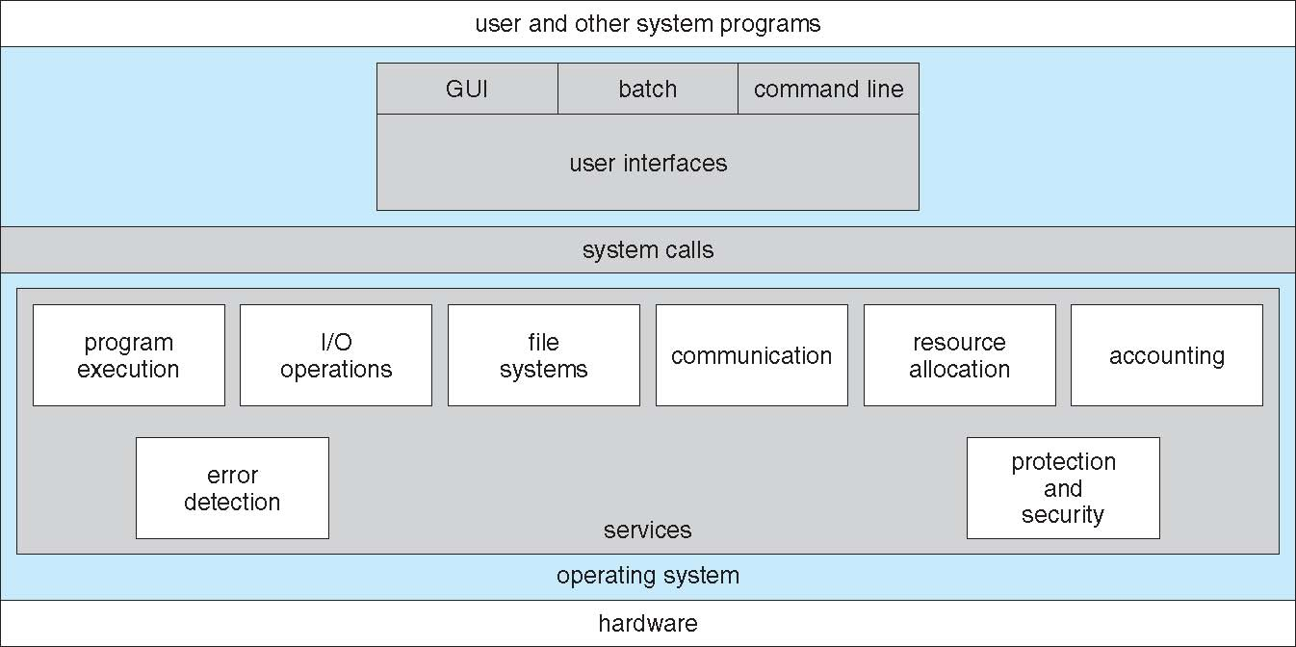
A View of Operating System Services

Slide 11
User Operating System Interface

Slide 12
User Operating System Interface - CLI
CLI or command interpreter allows direct command entry.
Some operating systems include the command interpreter in the kernel. Others treat the command interpreter as a special program that is running when a job is initiated or when a user first logs on.
On systems with multiple command interpreters to choose from, the interpreters are known as shells.
The main function of the command interpreter is to get and execute the next user-specified command.
These commands can be implemented in two general ways.
In one approach, the command interpreter itself contains the code to execute the command. In this case, the number of commands that can be given determines the size of the command interpreter, since each command requires its own implementing code.
An alternative approach implements most commands through system programs. In this case, the command interpreter does not understand the command in any way; it merely uses the command to identify a file to be loaded into memory and executed.
Notes:
12

Slide 13
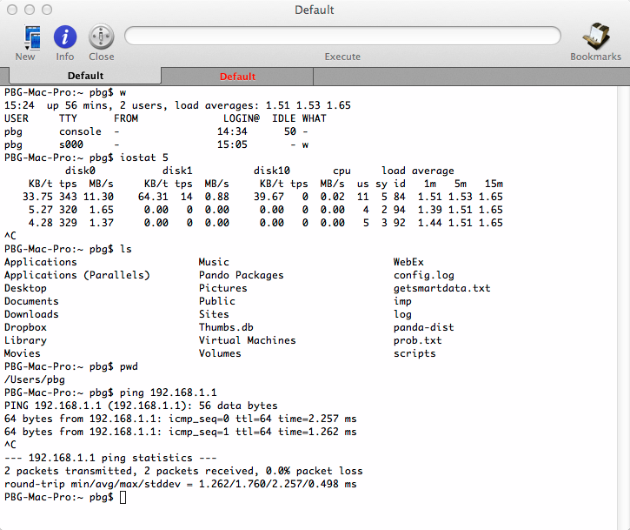
Bourne Shell Command Interpreter

Slide 14
User Operating System Interface - GUI
User-friendly desktop metaphor interface
Usually mouse, keyboard, and monitor
Icons represent files, programs, actions, etc
Various mouse buttons over objects in the interface cause various actions (provide information, options, execute function, open directory (known as a folder)
Invented at Xerox PARC (Research and Development Company)
Notes:
14

Slide 15
User Operating System Interface - GUI
Many systems now include both CLI and GUI interfaces
Microsoft Windows is GUI with CLI “command” shell
Apple Mac OS X is “Aqua” GUI interface with UNIX kernel underneath and shells available
Unix and Linux have CLI with optional GUI interfaces- Common Desktop Environment (CDE) , K-Desktop Environment(KDE), GNU Network Object Model Environment (GNOME)
Notes:
15

Slide 16
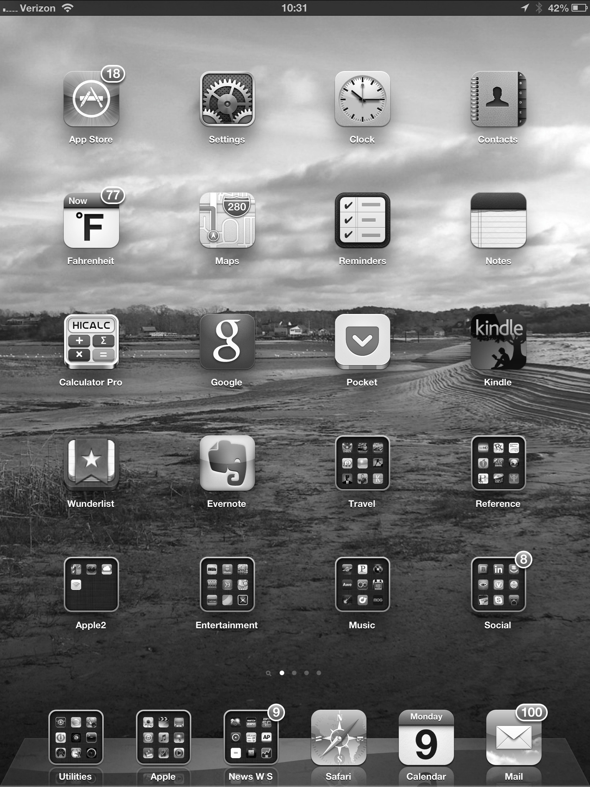
Touchscreen Interfaces
Touchscreen devices require new interfaces
Mouse not possible or not desired
Actions and selection based on gestures
Virtual keyboard for text entry
Voice commands.
Notes:
16

Slide 17
System Calls
Programming interface to the services provided by the OS
These calls are generally available as routines written in C and C++, although certain low-level tasks (for example, tasks where hardware must be accessed directly), may need to be written using assembly-language instructions.
Notes:
17

Slide 18
System Calls
How system calls are used: writing a simple program to read data from one file and copy them to another file.
The first input that the program will need is the names of the two files: the input file and the output file. This sequence requires many I/0 system calls.
Once the two file names are obtained, the program must open the input file and create the output file. Each of these operations requires another system call.
There are also possible error conditions for each operation. In these cases, the program should print a message on the console (another sequence of system calls) and then terminate abnormally (another system call).
If the input file exists, then we must create a new output file. We may find that there is already an output file with the same name. This situation may cause the program to abort (a system call), or we may delete the existing file (another system call) and create a new one (another system call).
Notes:
18

Slide 19
System Calls
Now that both files are set up, we enter a loop that reads from the input file (a system call) and writes to the output file (another system call). Each read and write must return status information regarding various possible error conditions.
On input, the program may find that the end of the file has been reached or that there was a hardware failure in the read (such as a parity error).
The write operation may encounter various errors, depending on the output device (no more disk space, printer out of paper, and so on).
Finally, after the entire file is copied, the program may close both files (another system call), write a message to the console or window (more system calls), and finally terminate normally (the final system call).
Notes:
19

Slide 20
System Calls
Application developers design programs according to an Application Programming Interface.
The API specifies a set of functions application programmer/ including the parameters that are passed to each function and the return values the programmer can expect.
Three of the most common APis available to application programmers are the Win32 API for Windows systems, the POSIX API for POSIX-based systems (which include virtually all versions of UNIX, Linux/ and Mac OS X), and the Java API for designing programs that run on the Java virtual machine.
Behind the scenes/ the functions that make up an API typically invoke the actual system calls on behalf of the application programmer.
Notes:
20

Slide 21
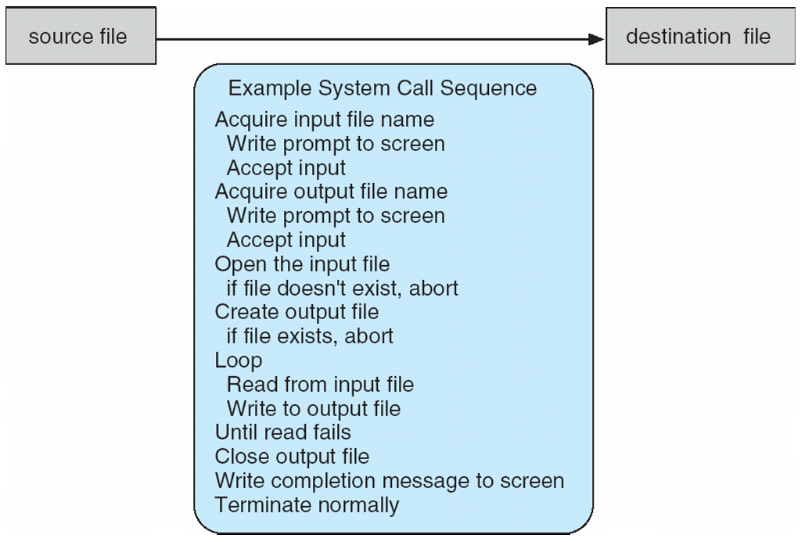
Example of System Calls
System call sequence to copy the contents of one file to another file
Notes:
21

Slide 22
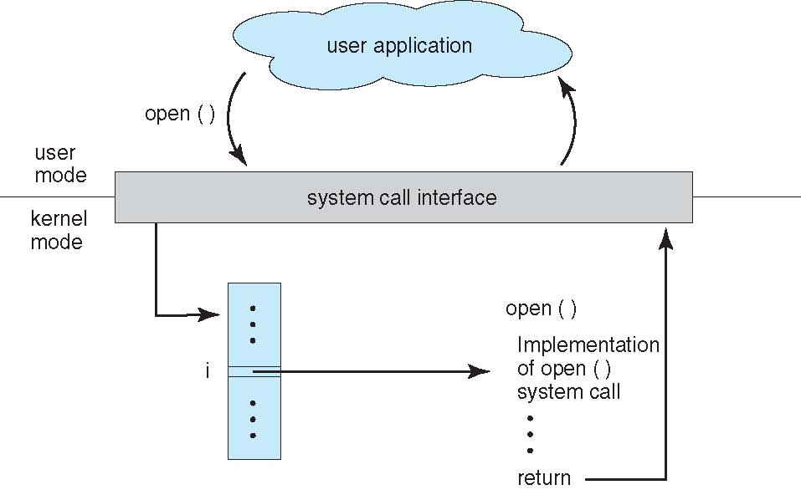
API – System Call – OS Relationship
Notes:
22

Slide 23
Types of System Calls
Process control
create process, terminate process
end, abort
load, execute
get process attributes, set process attributes
wait for time
wait event, signal event
allocate and free memory
Dump memory if error
Debugger for determining bugs, single step execution
Locks for managing access to shared data between processes
Notes:
23

Slide 24
Types of System Calls
File management
create file, delete file
open, close file
read, write, reposition
get and set file attributes
Device management
request device, release device
read, write, reposition
get device attributes, set device attributes
logically attach or detach devices
Notes:
24

Slide 25
Types of System Calls
Information maintenance
get time or date, set time or date
get system data, set system data
get and set process, file, or device attributes
Communications
create, delete communication connection
send, receive messages if message passing model to host name or process name
From client to server
Shared-memory model create and gain access to memory regions
transfer status information
attach and detach remote devices
Notes:
25

Slide 26
Types of System Calls
Protection
Control access to resources
Get and set permissions
Allow and deny user access
Notes:
26

Slide 27
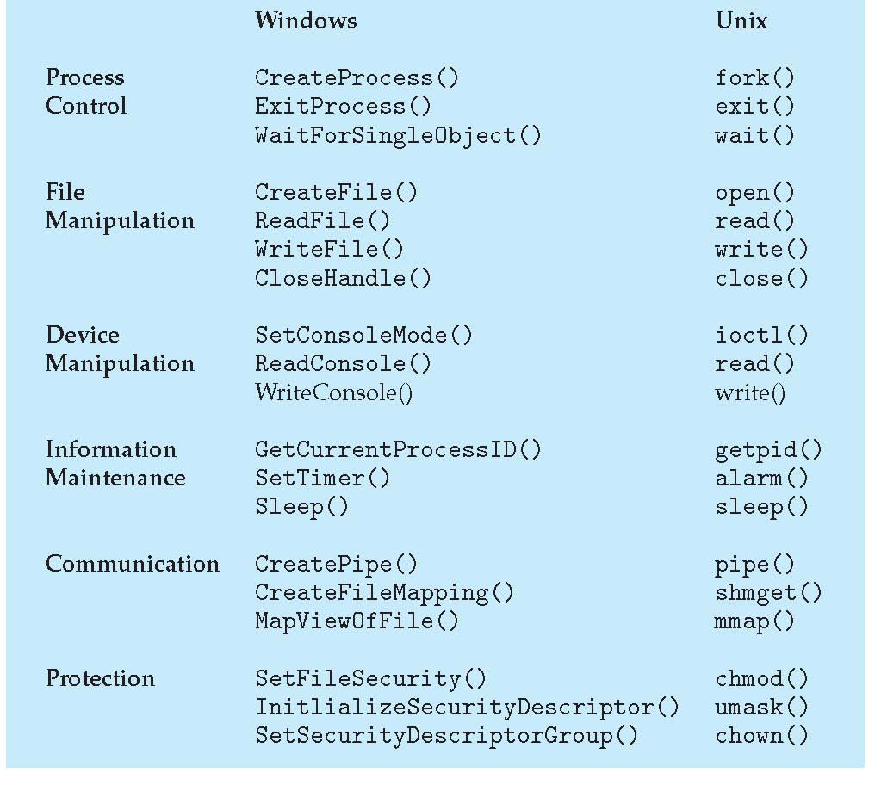
Examples of Windows and UNIX System Calls

Slide 28
System Programs
System programs provide a convenient environment for program development and execution. They can be divided into:
File manipulation
Status information sometimes stored in a File modification
Programming language support
Program loading and execution
Communications
Background services
Application programs
Most users’ view of the operating system is defined by system programs, not the actual system calls
Notes:
28

Slide 29
System Programs
Provide a convenient environment for program development and execution
Some of them are simply user interfaces to system calls; others are considerably more complex
File management - Create, delete, copy, rename, print, list, and generally manipulate files and directories
Status information
Some ask the system for info - date, time, amount of available memory, disk space, number of users
Others provide detailed performance, logging, and debugging information
Typically, these programs format and print the output to the terminal or other output devices
Some systems implement a registry - used to store and retrieve configuration information
Notes:
29

Slide 30
System Programs (Cont.)
File modification
Text editors to create and modify files
Special commands to search contents of files or perform transformations of the text
Programming-language support - Compilers, assemblers, debuggers and interpreters sometimes provided
Program loading and execution- Absolute loaders, relocatable loaders, linkage editors, and overlay-loaders, debugging systems for higher-level and machine language
Communications - Provide the mechanism for creating virtual connections among processes, users, and computer systems
Allow users to send messages to one another’s screens, browse web pages, send electronic-mail messages, log in remotely, transfer files from one machine to another
Notes:
30

Slide 31
System Programs (Cont.)
Background Services
Launch at boot time
Some for system startup, then terminate
Some from system boot to shutdown
Provide facilities like disk checking, process scheduling, error logging, printing
Run in user context not kernel context
Known as services, subsystems, daemons
Application programs
Don’t pertain to system
Run by users
Not typically considered part of OS
Launched by command line, mouse click, finger poke
Notes:
31

Slide 32
Operating System Design and Implementation
Design and Implementation of OS not “solvable”, but some approaches have proven successful
Internal structure of different Operating Systems can vary widely
Start the design by defining goals and specifications
Affected by choice of hardware, type of system
User goals and System goals
User goals – operating system should be convenient to use, easy to learn, reliable, safe, and fast
System goals – operating system should be easy to design, implement, and maintain, as well as flexible, reliable, error-free, and efficient
Notes:
32

Slide 33
Operating System Design and Implementation (Cont.)
Important principle to separate
Policy: What will be done? Mechanism: How to do it?
Mechanisms determine how to do something, policies decide what will be done
The separation of policy from mechanism is a very important principle, it allows maximum flexibility if policy decisions are to be changed later (example – timer)
Specifying and designing an OS is highly creative task of software engineering
Notes:
33

Slide 34
Implementation
Much variation
Early OSes in assembly language
Then system programming languages like Algol, PL/1
Now C, C++
Actually usually a mix of languages
Lowest levels in assembly
Main body in C
Systems programs in C, C++, scripting languages like PERL, Python, shell scripts
More high-level language easier to port to other hardware
But slower
Emulation can allow an OS to run on non-native hardware
Notes:
34

Slide 35
Operating System Structure
General-purpose OS is very large program
Various ways to structure ones
Simple structure – MS-DOS
More complex -- UNIX
Layered – an abstraction
Microkernel -Mach

Slide 36
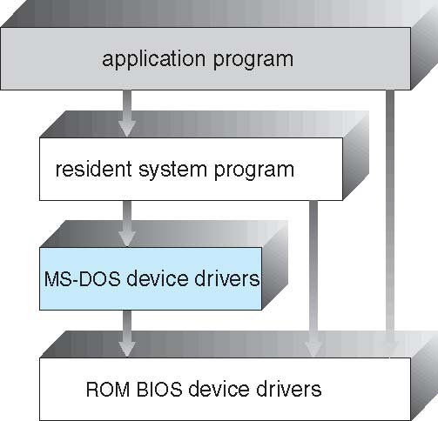
Simple Structure -- MS-DOS
Most commercial OS do not have well defined structure ,frequently such system started as simple ,small and limited system
MS-DOS – was originally designed and implemented by few engineers without having an idea that it will become so popular
MS-DOS – written to provide the most functionality in the least space
Not divided into modules
Notes:
36

Slide 37
Simple Structure -- MS-DOS
Although MS-DOS has some structure, its interfaces and levels of functionality are not well separated
Application program able to access basic I/O routines to write directly to display or disk drive such freedom leaves MSDOS vulnerable to errant programs causing entire system to crash
Notes:
37

Slide 38
Non Simple Structure -- UNIX
UNIX – limited by hardware functionality, the original UNIX operating system had limited structuring. The UNIX OS consists of two separable parts
Systems programs
The kernel
Consists of series of interfaces and physical hardware which can be added and expanded over the years as UNIX has evolved over the years
Provides the file system, CPU scheduling, memory management, and other operating-system functions; a large number of functions for one level
Notes:
38

Slide 39
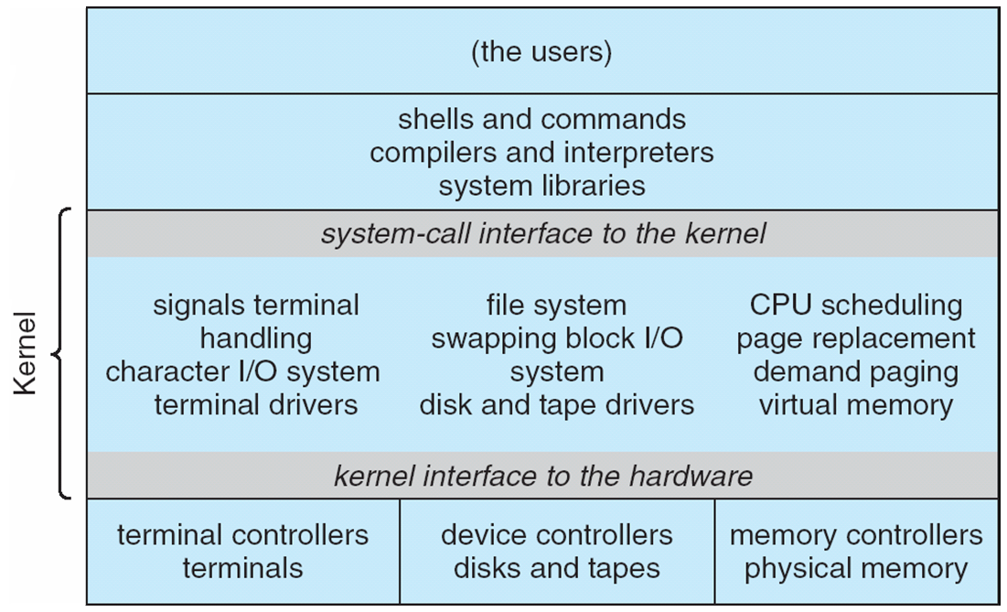
Traditional UNIX System Structure
Fig shows everything below system call interfaces and device drivers
Notes:
39

Slide 40
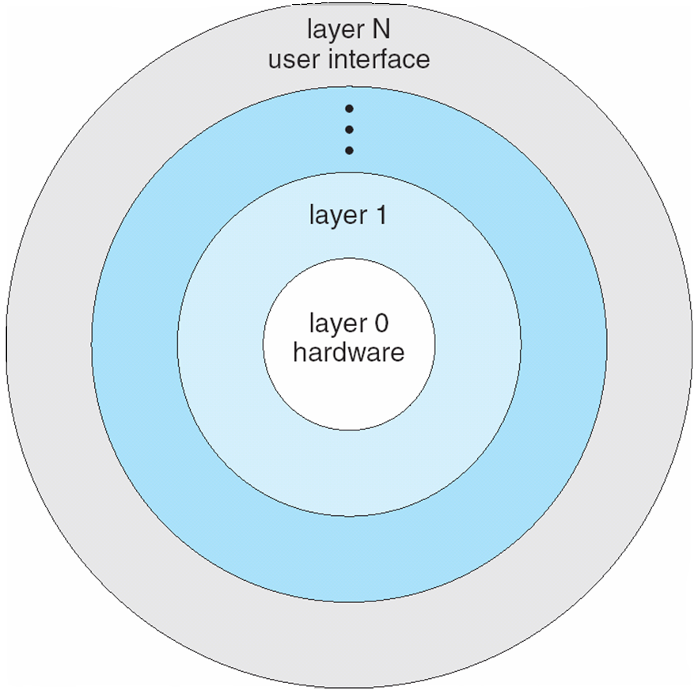
Layered Approach
The operating system can be broken into pieces that are smaller and more appropriate than allowed by the original MS-DOS and UNIX system.
It retains much greater control over the computer and over the applications that make use of that computer.
One approach is layered approach in which operating system is divided into a number of layers (levels), each built on top of lower layers. The bottom layer (layer 0), is the hardware; the highest (layer N) is the user interface.
Notes:
40

Slide 41
Layered Approach
An operating system layer is an implementation of an abstract object made up of data and operations that can manipulate those data.
A typical operating system layer Layer M consists of data structures and set of routines that can be invoked by higher level layers
With modularity,higher level layers uses functions (operations) and services of only lower-level layers
Notes:
41

Slide 42
Microkernel System Structure
As UNIX expanded ,the kernel become large and difficult to manage
Melon university developed an operating system Mach that modularized the kernel using Microkernel Approach
This method structures the operating system by removing all non-essential components from the kernel and implementing them as system and user level programs resulting smaller kernel
Function of microkernel is to provide communication facility between the client program and services that also running in user space
Communication takes place between user modules using message passing
Notes:
42

Slide 43
Microkernel System Structure
Notes:
43

Slide 44
Microkernel System Structure
Benefits:
Easier to extend a microkernel
Easier to port the operating system to new architectures
More reliable (less code is running in kernel mode)
More secure
Demerits:
Performance overhead of user space to kernel space communication
Notes:
44

Slide 45
Modules
The best current methodology for operating-system design involves using object-oriented programming techniques to create a modular kernel.
Here, the kernel has a set of core components and links in additional services either during boot time or during run time.
Such a strategy uses dynamically loadable modules and is common in modern implementations of UNIX, such as Solaris, Linux, and Mac OS X.
Such a design allows the kernel to provide core services yet also allows certain features to be implemented dynamically.
The overall result resembles a layered system in that each kernel section has defined, protected interfaces; but it is more flexible than a layered system in that any module can call any other module.
Furthermore, the approach is like the microkernel approach in that the primary module has only core functions and knowledge of how to load and communicate with other modules; but it is more efficient, because modules do not need to invoke message passing in order to communicate.

Slide 46
Modules

Slide 47
Operating-System Debugging
Debugging is finding and fixing errors, or bugs
OS generate log files containing error information
Failure of an application can generate core dump file capturing memory of the process
Operating system failure can generate crash dump file containing kernel memory
Beyond crashes, performance tuning can optimize system performance
Sometimes using trace listings of activities, recorded for analysis
Profiling is periodic sampling of instruction pointer to look for statistical trends
Kernighan’s Law: “Debugging is twice as hard as writing the code in the first place. Therefore, if you write the code as cleverly as possible, you are, by definition, not smart enough to debug it.”

Slide 48
Operating-System Debugging
Operating system debugging is the process of identifying and fixing errors or bugs in an operating system. Debugging is a crucial step in the development and maintenance of an operating system, as it ensures that the system is stable, secure, and functions as intended.
Types of Debugging:
Kernel Debugging: Kernel debugging involves identifying and fixing errors in the kernel, which is the core part of the operating system.
Device Driver Debugging: Device driver debugging involves identifying and fixing errors in device drivers, which are software components that manage hardware devices.
System Call Debugging: System call debugging involves identifying and fixing errors in system calls, which are interfaces between the operating system and applications.
Memory Debugging: Memory debugging involves identifying and fixing errors related to memory management, such as memory leaks or corruption.

Slide 49
Operating-System Debugging
Debugging Tools:
Print Statements: Print statements are used to print debug messages to the console or a log file.
Debuggers: Debuggers are software tools that allow developers to step through code, set breakpoints, and examine variables.
System Calls Tracing: System calls tracing involves tracing system calls to identify errors or performance issues.
Memory Profilers: Memory profilers are tools that analyze memory usage and identify memory leaks or corruption.
Debugging Techniques:
Divide and Conquer: Divide and conquer involves dividing the code into smaller sections and debugging each section separately.
Print and Analyze: Print and analyze involves printing debug messages and analyzing the output to identify errors.
Use of Debugging Tools: Use of debugging tools involves using tools such as debuggers and memory profilers to identify and fix errors.
Code Review: Code review involves reviewing code to identify errors or potential issues.

Slide 50
Operating-System Debugging
Common Operating System Debugging Issues:
Deadlocks: Deadlocks occur when two or more processes are blocked, waiting for each other to release resources.
Starvation: Starvation occurs when a process is unable to access resources due to other processes holding onto them for an extended period.
Livelocks: Livelocks occur when two or more processes are unable to proceed due to constant retries.
Memory Leaks: Memory leaks occur when memory is allocated but not released, leading to memory exhaustion.
Best Practices for Operating System Debugging:
Use Debugging Tools: Use debugging tools to identify and fix errors.
Write Clean Code: Write clean, modular, and well-documented code to reduce errors.
Test Thoroughly: Test the operating system thoroughly to identify errors.
Code Review: Perform regular code reviews to identify errors or potential issues.

Slide 51
Operating System Generation
Design ,code and implement an operating system specifically for one machine at one site.
Operating systems are designed to run on any of a class of machines at a variety of sites with variety of peripheral configurations
The system must be configured or generated for each specific computer site, a process known as System Generation (SYSGEN)
The operating system is distributed on Disk ,on CD-ROM,DVD-ROM or as an ISO image, which is a file in the format of CD-ROM or DVD-ROM
To generate a system , special program is used
Notes:
51

Slide 52
Operating System Generation
SYSGEN program obtains information concerning the specific configuration of the hardware system
Used to build system-specific compiled kernel or system-tuned
Can general more efficient code than one general kernel
Following kinds of information must be determined
What CPU to be used ? Multiprocessor system
How will the boot disk be formatted ? How many sections or partitions and what information will go to which partitions
How much memory is available ? Some systems determine this value themselves by referencing memory locations untill an illegal address fault is generated .It determine final legal address and hence amount of memory available
Notes:
52

Slide 53
Operating System Generation
What devices are available ? The system need to know to address each device ,the device interrupt number ,the device’s type and model ,and any special device characteristics.
What operating system options are desired or what parameter values are used. These options or values might include how many buffers of which sizes should be used ,what type of CPU-scheduling algorithm is desired ,what the maximum of processes to be supported
Notes:
53

Slide 54
System Boot
When power initialized on system, execution starts at a fixed memory location
Firmware ROM used to hold initial boot code
Operating system must be made available to hardware so hardware can start it
Small piece of code – bootstrap loader, stored in ROM or EEPROM locates the kernel, loads it into memory, and starts it
Sometimes two-step process where boot block at fixed location loaded by ROM code, which loads bootstrap loader from disk
Common bootstrap loader, GRUB, allows selection of kernel from multiple disks, versions, kernel options
Kernel loads and system is then running
Notes:
54

Slide 55
System Boot
System Boot Process:
The system boot process, also known as booting, is the process by which a computer system starts up and loads its operating system and other essential software. The boot process involves a series of steps that occur in a specific order, and it is a critical part of the system's initialization.
Steps in the System Boot Process:
Power-On Self-Test (POST): When the power button is pressed, the system's power supply unit (PSU) sends power to the motherboard, and the system begins to boot. The POST checks the system's hardware components, such as the CPU, memory, and storage devices, to ensure they are functioning properly.
Bootloader: The bootloader is a small program that is stored in the system's firmware, typically in the BIOS (Basic Input/Output System) or UEFI (Unified Extensible Firmware Interface). The bootloader is responsible for loading the operating system into memory.
Boot Device Selection: The bootloader searches for a boot device, such as a hard drive, solid-state drive (SSD), or USB drive, that contains the operating system. The bootloader checks the boot device's partition table to determine which partition contains the operating system.
Operating System Loading: The bootloader loads the operating system into memory, starting with the kernel. The kernel is the core part of the operating system that manages the system's hardware resources and provides services to applications.
Notes:
55

Slide 56
System Boot
Device Initialization: The operating system initializes the system's hardware devices, such as the keyboard, mouse, and network interface card.
System Services: The operating system starts system services, such as the file system, network services, and security services.
User Space: The operating system creates a user space, which is the environment in which applications run. The user space includes the shell, which is the command-line interface to the operating system.
Login: The system prompts the user to log in, and the user enters their credentials. The operating system authenticates the user and grants access to the system.
Types of Boot Processes:
Cold Boot: A cold boot occurs when the system is powered on from a completely powered-off state.
Warm Boot: A warm boot occurs when the system is restarted from a running state, such as when the user clicks the restart button.
Soft Boot: A soft boot occurs when the system is restarted without powering off, such as when the user closes the lid of a laptop.
Notes:
56

Slide 57
System Boot
Boot Process Variations:
UEFI Boot: UEFI boot is a type of boot process that uses the UEFI firmware instead of the traditional BIOS.
Secure Boot: Secure boot is a type of boot process that ensures the system boots only with authorized software.
Network Boot: Network boot is a type of boot process that loads the operating system from a network location instead of a local device.
Notes:
57

