Slide 1
Study Material
Department of Computer Science & Engineering
Course Code : | BCS303 | Semester / Year : | III / II
Course Title : | Operating Systems | Academic Year : | 2024-25

Slide 2
Module 3
PROCESS SYNCHRONIZATION: Synchronization, The critical section problem, Peterson’s solution , Synchronization hardware, Semaphore , Classical problem of Synchronization

Slide 3
Synchronization

Slide 4
Synchronization
Co-operating process is that can affect or be affected by other processes executing in the system
Cooperating processes can either directly share a logical address space (i.e. Both code and data ) or be allowed to share data through files or messages
Processes can execute concurrently
May be interrupted at any time, partially completing execution
Concurrent access to shared data may result in data inconsistency
Maintaining data consistency requires mechanisms to ensure the orderly execution of cooperating processes that share logical address space ,so that data consistency is maintained

Slide 5
Synchronization
Producer-Consumer Problem
Illustration of the problem:
  Suppose that we wanted to provide a solution to the consumer-producer problem that fills all the buffers.
  We can do so by having an integer counter that keeps track of the number of full buffers.
  Initially, counter is set to 0.
  It is incremented by the producer after it produces a new buffer and is decremented by the consumer after it consumes a buffer.

Slide 6
Synchronization
Consumer
  while (true) {
  while (counter == 0)
  ; /* do nothing */
  next_consumed = buffer[out];
  out = (out + 1) % BUFFER_SIZE;
  counter--;
  /* consume the item in next consumed */
  }

Slide 7
Synchronization
Race Condition
  counter++ could be implemented as
    register1 = counter
    register1 = register1 + 1
    counter = register1
  counter-- could be implemented as
    register2 = counter
    register2 = register2 – 1
    counter = register2
  Consider this execution interleaving with “count = 5” initially:
    S0: producer execute register1 = counter {register1 = 5}
    S1: producer execute register1 = register1 + 1 {register1 = 6}
    S2: consumer execute register2 = counter {register2 = 5}
    S3: consumer execute register2 = register2 – 1 {register2 = 4}
    S4: producer execute counter = register1 {counter = 6 }
    S5: consumer execute counter = register2 {counter = 4}

Slide 8
Synchronization
A situation where several processes access and manipulate the same data concurrently and the outcome of the execution depends on the particular order in which the access takes place, is called a race condition.
  To guard against the race condition, we need to ensure that only one process can manipulate the variable counter at a time.
  To make such a guarantee, we require that the processes be synchronized somehow.
Situations such as the one just described occur frequently in operating systems as different parts of the system manipulate resources.
  Furthermore, with the growth of multicore systems, there is an increased emphasis on developing multithreaded applications wherein several threads-which are quite possibly sharing data running in parallel on different processing cores.
  We want any changes that result from such activities not to interfere with one another.
  Because of the importance of this issue, process synchronization and coordination amongst cooperating processes is there.

Slide 9
The Critical Section Problem

Slide 10
The Critical Section Problem
Consider a system consisting of n processes {Po, P1 , ... , P11 _ I}.
Each process has a segment of code, called a critical section, in which the process may be changing common variables, updating a table, writing a file, and so on.
The important feature of the system is that, when one process is executing in its critical section, no other process is to be allowed to execute in its critical section.
That is, no two processes are executing in their critical sections at the same time.
The critical-section problem is to design a protocol that the processes can use to cooperate.
Each process must request permission to enter its critical section.
The section of code implementing this request is the entry section.
The critical section may be followed by an exit section.
The remaining code is the remainder section.
The entry section and exit section are enclosed in boxes to highlight these important segments of code.

Slide 11
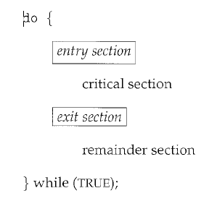
The Critical Section Problem
The general structure of a typical process Pi
A solution to the critical-section problem must satisfy the following three requirements:
  Mutual exclusion. If process Pi is executing in its critical section, then no other processes can be executing in their critical sections.
  Progress. If no process is executing in its critical section and some processes wish to enter their critical sections, then only those processes that are not executing in their remainder sections can participate in deciding which will enter its critical section next, and this selection cannot be postponed indefinitely.
  Bounded waiting. There exists a bound, or limit, on the number of times that other processes are allowed to enter their critical sections after a process has made a request to enter its critical section and before that request is granted.

Slide 12
The Critical Section Problem
We assume that each process is executing at a non zero speed. However, we can make no assumption concerning the relative speed of the n processes.
At a given point in time, many kernel-mode processes may be active in the operating system.
  As a result, the code implementing an operating system (kernel code) is subject to several possible race conditions.
  Consider as an example
    a kernel data structure that maintains a list of all open files in the system.
    This list must be modified when a new file is opened or closed.
    If two processes were to open files simultaneously, the separate updates to this list could result in a race condition.
    Other kernel data structures that are prone to possible race conditions include structures for maintaining memory allocation, for maintaining process lists, and for interrupt handling.
    It is up to kernel developers to ensure that the operating system is free from such race conditions.

Slide 13
The Critical Section Problem
Two general approaches are used to handle critical sections in operating systems:
preemptive kernels:
  A preemptive kernel allows a process to be preempted while it is running in kernel mode.
nonpreemptive kernels:
  A nonpreemptive kernel does not allow a process running in kernel mode to be preempted; a kernel-mode process will run until it exits kernel mode, blocks, or voluntarily yields control of the CPU.
A nonpreemptive kernel is essentially free from race conditions on kernel data structures, as only one process is active in the kernel at a time.
We cannot say the same about preemptive kernels, so they must be carefully designed to ensure that shared kernel data are free from race conditions.
A preemptive kernel is more suitable for real-time programming, as it will allow a real-time process to preempt a process currently running in the kernel.
A preemptive kernel may be more responsive, since there is less risk that a kernel-mode process will run for an arbitrarily long period before relinquishing the processor to waiting processes.

Slide 14
Peterson’s Solution

Slide 15
Peterson’s Solution
A classic software-based solution to the critical-section problem known as Peterson's solution.
There are no guarantees that Peterson's solution will work correctly.
It provides a good algorithmic description of solving the critical-section problem and illustrates some of the complexities involved in designing software that addresses the requirements of mutual exclusion, progress, and bounded waiting.
Peterson's solution is restricted to two processes that alternate execution between their critical sections and remainder sections.
The processes are numbered Po and P1.
When presenting Pi, we use Pj to denote the other process; that is, j equals 1 - i.
Peterson's solution requires the two processes to share two data items:
        int turn;
        boolean flag[2];
The variable turn indicates whose turn it is to enter its critical section. That is, if turn == i, then process Pi is allowed to execute in its critical section. The flag array is used to indicate if a process is ready to enter its critical section.
For example, if flag [i] is true, this value indicates that Pi is ready to enter its critical section.

Slide 16
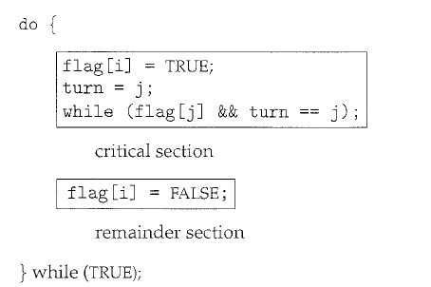
Peterson’s Solution
To enter the critical section, process Pi first sets flag [i] to be true and then sets turn to the value j, thereby asserting that if the other process wishes to enter the critical section, it can do so.
If both processes try to enter at the same time, turn will be set to both i and j at roughly the same time.
Only one of these assignments will last; the other will occur but will be overwritten immediately.
The eventual value of turn determines which of the two processes is allowed to enter its critical section first.

Slide 17
Peterson’s Solution
To prove that this solution is correct. We need to show that:
  Mutual exclusion is preserved.
  The progress requirement is satisfied.
  The bounded-waiting requirement is met.
To prove property 1,
    each P; enters its critical section only if either flag [j] == false or turn == i.
    Also note that, if both processes can be executing in their critical sections at the same time, then flag [0] == flag [1] ==true.
  These imply that P0 and P1 could not have successfully executed their while statements at about the same time, since the value of turn can be either 0 or 1 but cannot be both.
  One of the processes, Pi -must have successfully executed the while statement, whereas Pj; had to execute at least one additional statement ("turn== j").
  At that time, flag [j] == true and turn == j, and this condition will persist as long as Pi is in its critical section; as a result, mutual exclusion is preserved.

Slide 18
Peterson’s Solution
To prove properties 2 and 3,
    a process Pi; can be prevented from entering the critical section only if it is stuck in the while loop with the condition flag [j] ==true and turn=== j; this loop is the only one possible.
  If Pi is not ready to enter the critical section, then flag [j] ==false, and Pj; can enter its critical section.
  If Pj has set flag [j] to true and is also executing in its while statement, then either turn === i or turn === j.
  If turn == i, then P; will enter the critical section.
  If turn== j, then Pi will enter the critical section.
  Once Pi exits its critical section, it will reset flag [j] to false, allowing Pj; to enter its critical section.
  If Pj resets flag [j] to true, it must also set turn to i.
  Thus, since Pi; does not change the value of the variable turn while executing the while statement, Pi; will enter the critical section after at most one entry by Pj.

Slide 19
Synchronization Hardware

Slide 20
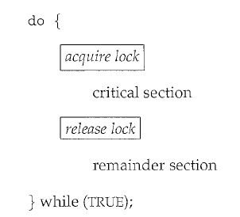
Synchronization Hardware
Any solution to the critical-section problem requires a simple tool-a lock.
Race conditions are prevented by requiring that critical regions be protected by locks.
That is, a process must acquire a lock before entering a critical section; it releases the lock when it exits the critical section.

Slide 21
Synchronization Hardware
Several more solutions to the critical-section problem using techniques ranging from hardware to software based API’s available to application programmers.
All these solutions are based on the premise of locking.
Simple hardware instructions that are available on many systems can be used effectively in solving the critical-section problem.
  Hardware features can make any programming task easier and improve system efficiency.
The critical-section problem could be solved simply in a uniprocessor environment if we could prevent interrupts from occurring while a shared variable was being modified.
  The current sequence of instructions would be allowed to execute in order without preemption.
  No other instructions would be run, so no unexpected modifications could be made to the shared variable.
  This is often the approach taken by non preemptive kernels.
This solution is not as feasible in a multiprocessor environment.
  Disabling interrupts on a multiprocessor can be time consuming, as the message is passed to all the processors.
  This message passing delays entry into each critical section, and system efficiency decreases.
  Also consider the effect on a system's clock if the clock is kept updated by interrupts.

Slide 22
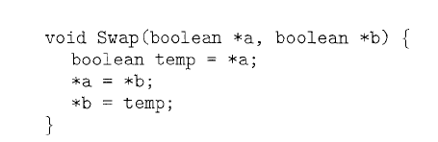
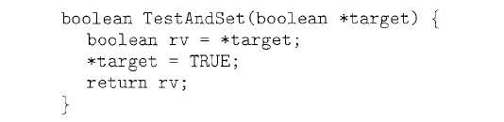
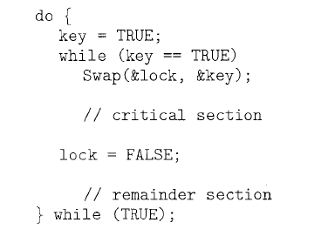
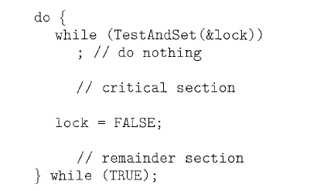
Synchronization Hardware
Many modern computer systems provide special hardware instructions that allow us either to test and modify the content of a word or to swap the contents of two words atomically as one uninterruptible unit.
These special instructions can be used to solve the critical-section problem in a relatively simple manner: the TestAndSet () and Swap() instructions.

Slide 23
Synchronization Hardware
The TestAndSet ()
  The important characteristic of this instruction is that it is executed atomically.
  Thus, if two TestAndSet () instructions are executed simultaneously (each on a different CPU), they will be executed sequentially in some arbitrary order.
  If the machine supports the TestAndSet () instruction, then we can implement mutual exclusion by declaring a Boolean variable lock, initialized to false.
The Swap()
  It operates on the contents of two words.
  It is executed atomically.
  If the machine supports the Swap() instruction, then mutual exclusion can be provided as; A global Boolean variable lock is declared and is initialized to false.
  In addition, each process has a local Boolean variable key.

Slide 24
Semaphores

Slide 25
Semaphores
A semaphore S is an integer variable that, apart from initialization, is accessed only through two standard atomic operations: wait () and signal ().
The wait () operation was originally termed P (from the Dutch proberen, "to test"); signal() was originally called V (from verhogen, "to increment").
The definition of wait () is as follows:
    wait(S) {
    while S <= 0
    ; //no-op
    s--;
    }
The definition of signal() is as follows:
    signal(S) {
    S++;
    }

Slide 26
Semaphores
All modifications to the integer value of the semaphore in the wait () and signal() operations must be executed indivisibly.
  when one process modifies the semaphore value, no other process can simultaneously modify that same semaphore value.
  in the case of wait (S), the testing of the integer value of S (S :S 0), as well as its possible modification (S--), must be executed without interruption.

Slide 27
Usage
Operating systems often distinguish between counting and binary semaphores.
The value of a counting semaphore can range over an unrestricted domain.
  Counting semaphores can be used to control access to a given resource consisting of a finite number o£ instances.
  The semaphore is initialized to the number of resources available.
  Each process that wishes to use a resource performs a wait() operation on the semaphore (thereby decrementing the count).
  When a process releases a resource, it performs a signal() operation (incrementing the count).
  When the count for the semaphore goes to 0, all resources are being used.
  After that, processes that wish to use a resource will block until the count becomes greater than 0.
The value of a binary semaphore can range only between 0 and 1.
  Binary semaphores are known as mutex locks, as they are locks that provide mutual exclusion.
  to deal with the critical-section problem £or multiple processes.
  Then processes share a semaphore, mutex, initialized to 1.
  Each process Pi is organized

Slide 28
Usage
We can also use semaphores to solve various synchronization problems.
  For example,
  consider two concurrently running processes: P1 with a statement S1 and P2 with a statement S2 .
  Suppose we require that S2 be executed only after S1 has completed.
  We can implement this scheme readily by letting P1 and P2 share a common semaphore synch, initialized to 0, and by inserting the statements
        S1;
        signal(synch) ;
  in process P1 and the statements
        wait(synch);
        S2;
  in process P2. Because synch is initialized to 0, P2 will execute S2 only after P1 has invoked signal (synch), which is after statement S1 has been executed.

Slide 29
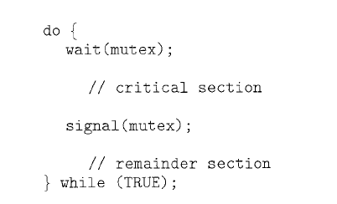
Usage

Slide 30
Classical problem of Synchronization

Slide 31
Bounded-Buffer(Producer-Consumer) Problem
The Producer-Consumer problem is a classic synchronization issue in operating systems. It involves two types of processes: producers, which generate data, and consumers, which process that data. Both share a common buffer. The challenge is to ensure that the producer doesn’t add data to a full buffer and the consumer doesn’t remove data from an empty buffer while avoiding conflicts when accessing the buffer.
Problem : To make sure that the producer won’t try to add data into the buffer if it’s full and that the consumer won’t try to remove data from an empty buffer.
Solution : The producer is to either go to sleep or discard data if the buffer is full. The next time the consumer removes an item from the buffer, it notifies the producer, who starts to fill the buffer again. In the same way, the consumer can go to sleep if it finds the buffer to be empty. The next time the producer puts data into the buffer, it wakes up the sleeping consumer.
An inadequate solution could result in a deadlock where both processes are waiting to be awakened.
We have a buffer of fixed size.
A producer can produce an item and can place it in the buffer.
A consumer can pick items and consume them.
We need to ensure that when a producer is placing an item in the buffer, then at the same time consumer should not consume any item.
In this problem, the buffer is the critical section.

Slide 32
Bounded-Buffer(Producer-Consumer) Problem
To solve this problem, we need two counting semaphores – Full and Empty. “Full” keeps track of some items in the buffer at any given time and “Empty” keeps track of many unoccupied slots.
Initialization of semaphores
  mutex = 1
  Full = 0 // Initially, all slots are empty. Thus full slots are 0
  Empty = n // All slots are empty initially
Solution for Producer
  do{
  //produce an item
  wait(empty);
  wait(mutex);
  //place in buffer
  signal(mutex);
  signal(full);
  }while(true)

Slide 33
Bounded-Buffer(Producer-Consumer) Problem
When producer produces an item then the value of “empty” is reduced by 1 because one slot will be filled now. The value of mutex is also reduced to prevent consumer to access the buffer. Now, the producer has placed the item and thus the value of “full” is increased by 1. The value of mutex is also increased by 1 because the task of producer has been completed and consumer can access the buffer.
Solution for Consumer
  do{
  wait(full);
  wait(mutex);
  // consume item from buffer
  signal(mutex);
  signal(empty);
  }while(true)
As the consumer is removing an item from buffer, therefore the value of “full” is reduced by 1 and the value is mutex is also reduced so that the producer cannot access the buffer at this moment. Now, the consumer has consumed the item, thus increasing the value of “empty” by 1. The value of mutex is also increased so that producer can access the buffer now.

Slide 34
Dining Philosophers problem
Dining Philosophers Problem States that there are 5 Philosophers who are engaged in two activities Thinking and Eating. Meals are taken communally in a table with five plates and five forks in a cyclic manner as shown in the figure.
Constraints and Condition for the problem :
  Every Philosopher needs two forks in order to eat.
  Every Philosopher may pick up the forks on the left or right but only one fork at once.
  Philosophers only eat when they had two forks. We have to design such a protocol i.e. pre and post protocol which ensures that a philosopher only eats if he or she had two forks.
  Each fork is either clean or dirty.
Solution :
  Correctness properties it needs to satisfy are :
    Mutual Exclusion Principle – No two Philosophers can have the two forks simultaneously.
    Free from Deadlock – Each philosopher can get the chance to eat in a certain finite time.
    Free from Starvation – When few Philosophers are waiting then one gets a chance to eat in a while.
    No strict Alternation.
    Proper utilization of time.

Slide 35
Dining Philosophers problem
Semaphore Solution to Dining Philosopher
  Each philosopher is represented by the following pseudocode:
    process P[i]
    while true do
    { THINK;
    PICKUP(CHOPSTICK[i], CHOPSTICK[i+1 mod 5]);
    EAT;
    PUTDOWN(CHOPSTICK[i], CHOPSTICK[i+1 mod 5])
    }
There are three states of the philosopher: THINKING, HUNGRY, and EATING. Here there are two semaphores: Mutex and a semaphore array for the philosophers. Mutex is used such that no two philosophers may access the pickup or put it down at the same time. The array is used to control the behavior of each philosopher. But, semaphores can result in deadlock due to programming errors.

Slide 36
Readers-Writers Problem
The Readers-Writers Problem is a classic synchronization issue in operating systems that involves managing access to shared data by multiple threads or processes. The problem addresses the scenario where:
  Readers: Multiple readers can access the shared data simultaneously without causing any issues because they are only reading and not modifying the data.
  Writers: Only one writer can access the shared data at a time to ensure data integrity, as writers modify the data, and concurrent modifications could lead to data corruption or inconsistencies.
Challenges of the Reader-Writer Problem
  The challenge now becomes how to create a synchronization scheme such that the following is supported:
    Multiple Readers: A number of readers may access simultaneously if no writer is presently writing.
    Exclusion for Writers: If one writer is writing, no other reader or writer may access the common resource.
Solution of the Reader-Writer Problem
  There are two fundamental solutions to the Readers-Writers problem:
    Readers Preference: In this solution, readers are given preference over writers. That means that till readers are reading, writers will have to wait. The Writers can access the resource only when no reader is accessing it.
    Writer’s Preference: Preference is given to the writers. It simply means that, after arrival, the writers can go ahead with their operations; though perhaps there are readers currently accessing the resource.

Slide 37
Readers-Writers Problem
The Readers-Writers Problem is a classic synchronization issue in operating systems that involves managing access to shared data by multiple threads or processes. The problem addresses the scenario where:
  Readers: Multiple readers can access the shared data simultaneously without causing any issues because they are only reading and not modifying the data.
  Writers: Only one writer can access the shared data at a time to ensure data integrity, as writers modify the data, and concurrent modifications could lead to data corruption or inconsistencies.
Challenges of the Reader-Writer Problem
  The challenge now becomes how to create a synchronization scheme such that the following is supported:
    Multiple Readers: A number of readers may access simultaneously if no writer is presently writing.
    Exclusion for Writers: If one writer is writing, no other reader or writer may access the common resource.
Solution of the Reader-Writer Problem
  There are two fundamental solutions to the Readers-Writers problem:
    Readers Preference: In this solution, readers are given preference over writers. That means that till readers are reading, writers will have to wait. The Writers can access the resource only when no reader is accessing it.
    Writer’s Preference: Preference is given to the writers. It simply means that, after arrival, the writers can go ahead with their operations; though perhaps there are readers currently accessing the resource.

