Slide 1
Study Material
Department of Computer Science & Engineering
Course Code : | BCS303 | Semester / Year : | III / II
Course Title : | Operating Systems | Academic Year : | 2024-25

Slide 2
Module 2
Process Scheduling: Basic concepts, Scheduling Algorithms,Thread Scheduling, Multiple-processor scheduling

Slide 3
Basic Concepts

Slide 4
Basic Concepts
In a single-processor system, only one process can run at a time; any others must wait until the CPU is free and can be rescheduled.
The objective of multiprogramming is to have some process running at all times, to maximize CPU utilization.
The idea is relatively simple. A process is executed until it must wait, typically for the completion of some I/O request.
In a simple computer system, the CPU then just sits idle.
All this waiting time is wasted; no useful work is accomplished.
With multiprogramming, we try to use this time productively. Several processes are kept in memory at one time.
When one process has to wait, the operating system takes the CPU away from that process and gives the CPU to another process. This pattern continues.
Every time one process has to wait, another process can take over the use of the CPU.
Scheduling of this kind is a fundamental operating-system function. Almost all computer resources are scheduled before use.
The CPU is, of course, one of the primary computer resources. Thus, its scheduling is central to operating-system design.

Slide 5
CPU-I/O Burst Cycle
The success of CPU scheduling depends on an observed property of processes: process execution consists of a cycle of CPU execution and I/O wait.
Processes alternate between these two states. Process execution begins with a CPU burst. That is followed by an I/O burst, which is followed by another CPU burst, then another I/0 burst, and so on.
Eventually, the final CPU burst ends with a system request to terminate execution.
The durations of CPU bursts have been measured extensively.
Although they vary greatly from process to process and from computer to computer they tend to have a frequency curve
The curve is generally characterized as exponential or hyperexponential, with a large number of short CPU bursts and a small number of long CPU bursts.
An I/O-bound program typically has many short CPU bursts.
A CPU-bound program might have a few long CPU bursts.
This distribution can be important in the selection of an appropriate CPU-scheduling algorithm.

Slide 6

CPU-I/O Burst Cycle

Slide 7
CPU Scheduler
Whenever the CPU becomes idle, the operating system must select one of the processes in the ready queue to be executed.
The selection process is carried out by the short-term scheduler (or CPU scheduler).
The scheduler selects a process from the processes in memory that are ready to execute and allocates the CPU to that process.
Note that the ready queue is not necessarily a first-in, first-out (FIFO) queue.
As we shall see when we consider the various scheduling algorithms, a ready queue can be implemented as a FIFO queue, a priority queue, a tree, or simply an unordered linked list. Conceptually, however, all the processes in the ready queue are lined up waiting for a chance to run on the CPU.
The records in the queues are generally process control blocks (PCBs) of the processes.

Slide 8
Preemptive Scheduling
CPU-scheduling decisions may take place under the following four circumstances:
  When a process switches from the running state to the waiting state (for example, as the result of an I/0 request or an invocation of wait for the termination of one of the child processes)
  When a process switches from the running state to the ready state (for example, when an interrupt occurs)
  When a process switches from the waiting state to the ready state (for example, at completion of I/0)
  When a process terminates
For situations 1 and 4, there is no choice in terms of scheduling.
A new process (if one exists in the ready queue) must be selected for execution.
There is a choice, however, for situations 2 and 3.
When scheduling takes place only under circumstances 1 and 4, we say that the scheduling scheme is non preemptive or cooperative; otherwise, it is preemptive.
Under non-preemptive scheduling,
  once the CPU has been allocated to a process, the process keeps the CPU until it releases the CPU either by terminating or by switching to the waiting state.
  This scheduling method was used by Microsoft Windows 3.x.

Slide 9
Windows 95 introduced preemptive scheduling, and all subsequent versions of Windows operating systems have used preemptive scheduling. The Mac OS X operating system for the Macintosh also uses preemptive scheduling; previous versions of the Macintosh operating system relied on cooperative scheduling.
Cooperative scheduling is the only method that can be used on certain hardware platforms, because it does not require the special hardware (for example, a timer) needed for preemptive scheduling.
Unfortunately, preemptive scheduling incurs a cost associated with access to shared data.
  Consider the case of two processes that share data.
    While one is updating the data, it is preempted so that the second process can run.
    The second process then tries to read the data, which are in an inconsistent state.
Preemption also affects the design of the operating-system kernel.
  During the processing of a system call, the kernel may be busy with an activity on behalf of a process.
  Such activities may involve changing important kernel data (for instance, I/0 queues).
  What happens if the process is preempted in the middle of these changes and the kernel (or the device driver) needs to read or modify the same structure? Chaos ensues.
  Certain operating systems, including most versions of UNIX, deal with this problem by waiting either for a system call to complete or for an I/O block to take place before doing a context switch.
  This scheme ensures that the kernel structure is simple, since the kernel will not preempt a process while the kernel data structures are in an inconsistent state.

Slide 10
Dispatcher
Another component involved in the CPU-scheduling function is the dispatcher.
The dispatcher is the module that gives control of the CPU to the process selected by the short-term scheduler.
This function involves the following:
  Switching context
  Switching to user mode
  Jumping to the proper location in the user program to restart that program
The dispatcher should be as fast as possible, since it is invoked during every process switch.
The time it takes for the dispatcher to stop one process and start another running is known as the dispatch latency.

Slide 11
Scheduling Criteria
Different CPU-scheduling algorithms have different properties, and the choice of a particular algorithm may favor one class of processes over another.
In choosing which algorithm to use in a particular situation, we must consider the properties of the various algorithms.
Many criteria have been suggested for comparing CPU-scheduling algorithms.
Which characteristics are used for comparison can make a substantial difference in which algorithm is judged to be best.
The criteria include the following:
CPU utilization: We want to keep the CPU as busy as possible. Conceptually, CPU utilization can range from 0 to 100 percent. In a real system, it should range from 40 percent (for a lightly loaded system) to 90 percent (for a heavily used system).
Throughput: If the CPU is busy executing processes, then work is being done. One measure of work is the number of processes that are completed per time unit, called throughput. For long processes, this rate may be one process per hour; for short transactions, it may be ten processes per second.

Slide 12
Scheduling Criteria
Turnaround time: From the point of view of a particular process, the important criterion is how long it takes to execute that process. The interval from the time of submission of a process to the time of completion is the turnaround time. Turnaround time is the sum of the periods spent waiting to get into memory, waiting in the ready queue, executing on the CPU, and doing I/O.
Waiting time: The CPU-scheduling algorithm does not affect the amount of time during which a process executes or does I/O; it affects only the amount of time that a process spends waiting in the ready queue. Waiting time is the sum of the periods spent waiting in the ready queue.
Response time: In an interactive system, turnaround time may not be the best criterion. Often, a process can produce some output fairly early and can continue computing new results while previous results are being output to the user. Thus, another measure is the time from the submission of a request until the first response is produced. This measure, called response time, is the time it takes to start responding, not the time it takes to output the response. The turnaround time is generally limited by the speed of the output device.
It is desirable to maximize CPU utilization and throughput and to minimize turnaround time, waiting time, and response time.

Slide 13
Scheduling Algorithms

Slide 14
Scheduling Algorithms
CPU scheduling deals with the problem of deciding which of the processes in the ready queue is to be allocated the CPU.
There are many different CPU-scheduling algorithms.
These are:
  First-Come, First-Served Scheduling
  Shortest-Job-First Scheduling
  Priority Scheduling
  Round-Robin Scheduling
  Multilevel Queue Scheduling
  Multilevel Feedback Queue Scheduling

Slide 15
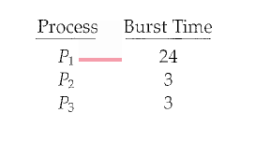
First-Come, First-Served Scheduling
By far the simplest CPU-scheduling algorithm is the first-come, first-served (FCFS) scheduling algorithm.
The process that requests the CPU first is allocated the CPU first.
The implementation of the FCFS policy is easily managed with a FIFO queue.
When a process enters the ready queue, its PCB is linked onto the tail of the queue.
When the CPU is free, it is allocated to the process at the head of the queue.
The running process is then removed from the queue.
On the negative side, the average waiting time under the FCFS policy is often quite long.
Consider the following set of processes that arrive at time 0, with the length of the CPU burst given in milliseconds:

Slide 16
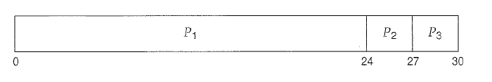
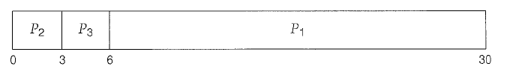
First-Come, First-Served Scheduling
If the processes arrival in the order P1, P2, P3, and are served in FCFS order,
  we get the result shown in the following Gantt chart, which is a bar chart that illustrates a particular schedule, including the start and finish times of each of the participating processes:
The waiting time is 0 milliseconds for process P1, 24 milliseconds for process P2 , and 27 milliseconds for process P3 . Thus, the average waiting time is (0+ 24 + 27)/3 = 17 milliseconds.
If the processes arrive in the order P2, P3 , P1, however, the results will be as shown in the following Gantt chart:
The average waiting time is now (6 + 0 + 3)/3 = 3 milliseconds. This reduction is substantial. Thus, the average waiting time under an FCFS policy is generally not minimal and may vary substantially if the processes CPU burst times vary greatly.

Slide 17
First-Come, First-Served Scheduling
The performance of FCFS scheduling in a dynamic situation.
  Assume we have one CPU-bound process and many I/O-bound processes.
  The CPU-bound process will get and hold the CPU. During this time, all the other processes will finish their I/O and will move into the ready queue, waiting for the CPU. While the processes wait in the ready queue, the I/O devices are idle. Eventually, the CPU-bound process finishes its CPU burst and moves to an I/O device. All the I/O-bound processes, which have short CPU bursts, execute quickly and move back to the I/O queues. At this point, the CPU sits idle. The CPU-bound process will then move back to the ready queue and be allocated the CPU. Again, all the I/O processes end up waiting in the ready queue until the CPU-bound process is done. There is a convoy effect as all the other processes wait for the one big process to get off the CPU. This effect results in lower CPU and device utilization than might be possible if the shorter processes were allowed to go first.
The FCFS scheduling algorithm is nonpreemptive. Once the CPU has been allocated to a process, that process keeps the CPU until it releases the CPU, either by terminating or by requesting I/O.
The FCFS algorithm is thus particularly troublesome for time-sharing systems, where it is important that each user get a share of the CPU at regular intervals.
It would be disastrous to allow one process to keep the CPU for an extended period.

Slide 18
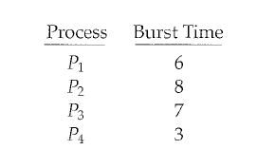
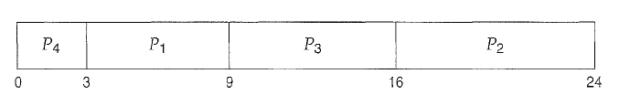
Shortest-Job-First Scheduling
A different approach to CPU scheduling is the shortest-job-first (SJF) scheduling algorithm.
This algorithm associates with each process the length of the process's next CPU burst.
When the CPU is available, it is assigned to the process that has the smallest next CPU burst. If the next CPU bursts of two processes are the same, FCFS scheduling is used to break the tie.
A more appropriate term for this scheduling method would be the shortest-next-CPU-burst algorithm because scheduling depends on the length of the next CPU burst of a process, rather than its total length.
As an example of SJF scheduling, consider the following set of processes, with the length of the CPU burst given in milliseconds:
Using SJF scheduling, we would schedule these processes according to the following Gantt chart:

Slide 19
Shortest-Job-First Scheduling
The waiting time is 3 milliseconds for process P1, 16 milliseconds for process P2, 9 milliseconds for process P3, and 0 milliseconds for process P4. Thus, the average waiting time is (3 + 16 + 9 + 0) I 4 = 7 milliseconds. By comparison, if we were using the FCFS scheduling scheme, the average waiting time would be 10.25 milliseconds.
The SJF scheduling algorithm is provably optimal, in that it gives the minimum average waiting time for a given set of processes.
Moving a short process before a long one decreases the waiting time of the short process more than it increases the waiting time of the long process. Consequently, the average waiting time decreases.
The real difficulty with the SJF algorithm is knowing the length of the next CPU request.
  For long-term (job) scheduling in a batch system, we can use as the length the process time limit that a user specifies when he submits the job.
  Thus, users are motivated to estimate the process time limit accurately, since a lower value may mean faster response.
SJF scheduling is used frequently in long-term scheduling.

Slide 20
Shortest-Job-First Scheduling
Although the SJF algorithm is optimal, it cannot be implemented at the level of short-term CPU scheduling. With short-term scheduling, there is no way to know the length of the next CPU burst.
One approach is to try to approximate SJF scheduling.
  We may not know the length of the next CPU burst, but we may be able to predict its value.
  We expect that the next CPU burst will be similar in length to the previous ones.
  By computing an approximation of the length of the next CPU burst, we can pick the process with the shortest predicted CPU burst.
The next CPU burst is generally predicted as an exponential average of the measured lengths of previous CPU bursts.
The SJF algorithm can be either preemptive or nonpreemptive.
  The choice arises when a new process arrives at the ready queue while a previous process is still executing.
  The next CPU burst of the newly arrived process may be shorter than what is left of the currently executing process.
  A preemptive SJF algorithm will preempt the currently executing process, whereas a nonpreemptive SJF algorithm will allow the currently running process to finish its CPU burst.
  Preemptive SJF scheduling is sometimes called shortest-remaining-time-first scheduling.

Slide 21
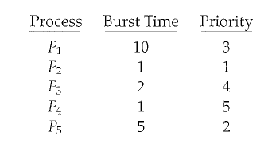
Priority Scheduling
The SJF algorithm is a special case of the general priority scheduling algorithm.
A priority is associated with each process, and the CPU is allocated to the process with the highest priority.
Equal-priority processes are scheduled in FCFS order.
An SJF algorithm is simply a priority algorithm where the priority (p) is the inverse of the (predicted) next CPU burst.
The larger the CPU burst, the lower the priority, and vice versa.
Priorities are generally indicated by some fixed range of numbers, such as 0 to 7 or 0 to 4,095.
However, there is no general agreement on whether 0 is the highest or lowest priority.
As an example, consider the following set of processes, assumed to have arrived at time 0 in the order P1, P2, · · ·, Ps, with the length of the CPU burst given in milliseconds:

Slide 22

Priority Scheduling
Using priority scheduling, we would schedule these processes according to the following Gantt chart:
The average waiting time is 8.2 milliseconds.
Priorities can be defined either internally or externally.
  Internally defined priorities use some measurable quantity or quantities to compute the priority of a process.
    For example, time limits, memory requirements, the number of open files, and the ratio of average I/ burst to average CPU burst have been used in computing priorities.
  External priorities are set by criteria outside the operating system,
    such as the importance of the process, the type and amount of funds being paid for computer use, the department sponsoring the work, and other, often political factors.

Slide 23
Priority Scheduling
Priority scheduling can be either preemptive or nonpreemptive.
  When a process arrives at the ready queue, its priority is compared with the priority of the currently running process.
  A preemptive priority scheduling algorithm will preempt the CPU if the priority of the newly arrived process is higher than the priority of the currently running process.
  A nonpreemptive priority scheduling algorithm will simply put the new process at the head of the ready queue.
A major problem with priority scheduling algorithms is indefinite blocking, or starvation.
  A process that is ready to run but waiting for the CPU can be considered blocked.
  A priority scheduling algorithm can leave some low priority processes waiting indefinitely.
  In a heavily loaded computer system, a steady stream of higher-priority processes can prevent a low-priority process from ever getting the CPU.
  Generally, one of two things will happen.
    Either the process will eventually be run
    or the computer system will eventually crash and lose all unfinished low-priority processes.

Slide 24
Priority Scheduling
A solution to the problem of indefinite blockage of low-priority processes is aging.
  Aging is a technique of gradually increasing the priority of processes that wait in the system for a long time.
    For example:
      if priorities range from 127 (low) to 0 (high), we could increase the priority of a waiting process by 1 every 15 minutes.
      Eventually, even a process with an initial priority of 127 would have the highest priority in the system and would be executed.
      In fact, it would take no more than 32 hours for a priority-127 process to age to a priority-0 process.

Slide 25
Round-Robin Scheduling
The round-robin (RR) scheduling algorithm is designed especially for timesharing systems.
It is similar to FCFS scheduling, but preemption is added to enable the system to switch between processes.
A small unit of time, called a time quantum or time slice, is defined.
A time quantum is generally from 10 to 100 milliseconds in length.
The ready queue is treated as a circular queue.
The CPU scheduler goes around the ready queue, allocating the CPU to each process for a time interval of up to 1 time quantum.
To implement RR scheduling, we keep the ready queue as a FIFO queue of processes.
  New processes are added to the tail of the ready queue.
  The CPU scheduler picks the first process from the ready queue, sets a timer to interrupt after 1 time quantum, and dispatches the process.

Slide 26
Round-Robin Scheduling
One of two things will then happen.
  The process may have a CPU burst of less than 1 time quantum.
    In this case, the process itself will release the CPU voluntarily.
    The scheduler will then proceed to the next process in the ready queue.
Otherwise, if the CPU burst of the currently running process is longer than 1 time quantum,
  the timer will go off and will cause an interrupt to the operating system.
  A context switch will be executed, and the process will be put at the tail o£ the ready queue.
  The CPU scheduler will then select the next process in the ready queue.

Slide 27
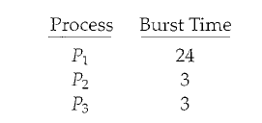
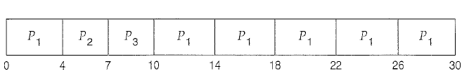
Round-Robin Scheduling
The average waiting time under the RR policy is often long. Consider the following set of processes that arrive at time 0, with the length of the CPU burst given in milliseconds:
If we use a time quantum of 4 milliseconds, then process P1 gets the first 4 milliseconds.
Since it requires another 20 milliseconds, it is preempted after the first time quantum, and the CPU is given to the next process in the queue, process P2 .
Process P2 does not need 4 milliseconds, so it quits before its time quantum expires.
The CPU is then given to the next process, process P3. Once each process has received 1 time quantum, the CPU is returned to process P1 for an additional time quantum.
The resulting RR schedule is as follows:

Slide 28
Round-Robin Scheduling
Let's calculate the average waiting time for the above schedule.
  P1 waits for 6 milliseconds (10- 4), P2 waits for 4 milliseconds, and P3 waits for 7 milliseconds.
  Thus, the average waiting time is 17/3 = 5.66 milliseconds.
In the RR scheduling algorithm, no process is allocated the CPU for more than 1 time quantum in a row.
  If a process's CPU burst exceeds 1 time quantum, that process is preempted and is put back in the ready queue.
  The RR scheduling algorithm is thus preemptive.
If there are n. processes in the ready queue and the time quantum is q, then each process gets 1 In of the CPU time in chunks of at most q time units.
  Each process must wait no longer than (n - 1) x q time units until its next time quantum.
  For example, with five processes and a time quantum of 20 milliseconds, each process will get up to 20 milliseconds every 100 milliseconds.
The performance of the RR algorithm depends heavily on the size of the time quantum.
  At one extreme, if the time quantum is extremely large, the RR policy is the same as the FCFS policy.
  In contrast, if the time quantum is extremely small, the RR approach is called processor sharing and creates the appearance that each of n processes has its own processor running at 1/n the speed of the real processor.

Slide 29
Round-Robin Scheduling
To consider the effect of context switching on the performance of RR scheduling.
  Assume, for example, that we have only one process of 10 time units. If the quantum is 12 time units, the process finishes in. less than 1 time quantum, with no overhead. If the quantum is 6 time units, however, the process requires 2 quanta, resulting in a context switch. If the time quantum is 1 time unit, then nine context switches will occur, slowing the execution of the process accordingly
  The time quantum to be large with respect to the context switch time.
  If the context-switch time is approximately 10 percent of the time quantum, then about 10 percent of the CPU time will be spent in context switching.
  In practice, most modern systems have time quanta ranging from 10 to 100 milliseconds.
Turnaround time also depends on the size of the time quantum.
  The average turnaround time can be improved if most processes finish their next CPU burst in a single time quantum.
  For example, given three processes of 10 time units each and a quantum of 1 time unit, the average turnaround time is 29. If the time quantum is 10, however, the average turnaround time drops to 20.
  If context-switch time is added in, the average turnaround time increases even more for a smaller time quantum, since more context switches are required.

Slide 30
Multilevel Queue Scheduling
Created for situations in which processes are easily classified into different groups.
  For example, a common division is made between foreground (interactive) processes and background (batch) processes.
  These two types of processes have different response-time requirements and so may have different scheduling needs.
  In addition, foreground processes may have priority (externally defined) over background processes.
A multilevel queue scheduling algorithm partitions the ready queue into several separate queues.
  The processes are permanently assigned to one queue, generally based on some property of the process, such as memory size, process priority, or process type.
  Each queue has its own scheduling algorithm.
  For example, separate queues might be used for foreground and background processes.
    The foreground queue might be scheduled by an RR algorithm, while the background queue is scheduled by an FCFS algorithm.
  In addition, there must be scheduling among the queues, which is commonly implemented as fixed-priority preemptive scheduling.
  For example, the foreground queue may have absolute priority over the background queue.

Slide 31
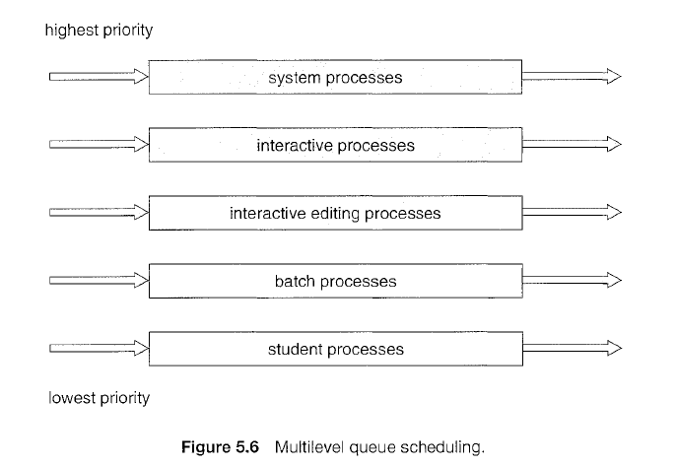
Multilevel Queue Scheduling

Slide 32
Multilevel Queue Scheduling
An example of a multilevel queue scheduling algorithm with five queues, listed below in order of priority:
  System processes
  Interactive processes
  Interactive editing processes
  Batch processes
  Student processes
Each queue has absolute priority over lower-priority queues.
  No process in the batch queue, for example, could run unless the queues for system processes, interactive processes, and interactive editing processes were all empty.
  If an interactive editing process entered the ready queue while a batch process was running, the batch process would be preempted.
Another possibility is to time-slice among the queues.
  Each queue gets a certain portion of the CPU time, which it can then schedule among its various processes.
  For instance, in the foreground-background queue example, the foreground queue can be given 80 percent of the CPU time for RR scheduling among its processes, whereas the background queue receives 20 percent of the CPU to give to its processes on an FCFS basis.

Slide 33
Multilevel Queue Scheduling
An example of a multilevel queue scheduling algorithm with five queues, listed below in order of priority:
  System processes
  Interactive processes
  Interactive editing processes
  Batch processes
  Student processes
Each queue has absolute priority over lower-priority queues.
  No process in the batch queue, for example, could run unless the queues for system processes, interactive processes, and interactive editing processes were all empty.
  If an interactive editing process entered the ready queue while a batch process was running, the batch process would be preempted.
Another possibility is to time-slice among the queues.
  Each queue gets a certain portion of the CPU time, which it can then schedule among its various processes.
  For instance, in the foreground-background queue example, the foreground queue can be given 80 percent of the CPU time for RR scheduling among its processes, whereas the background queue receives 20 percent of the CPU to give to its processes on an FCFS basis.

Slide 34
Multilevel Feedback Queue Scheduling
When the multilevel queue scheduling algorithm is used, processes are permanently assigned to a queue when they enter the system.
  If there are separate queues for foreground and background processes, for example, processes do not move from one queue to the other, since processes do not change their foreground or background nature.
  This setup has the advantage of low scheduling overhead, but it is inflexible.
The multilevel feedback queue scheduling algorithm allows a process to move between queues.
  The idea is to separate processes according to the characteristics of their CPU bursts.
  If a process uses too much CPU time, it will be moved to a lower-priority queue.
  This scheme leaves I/O-bound and interactive processes in the higher-priority queues.
  In addition, a process that waits too long in a lower-priority queue may be moved to a higher-priority queue.
  This form of aging prevents starvation.

Slide 35
Multilevel Feedback Queue Scheduling
For example, consider a multilevel feedback queue scheduler with three queues, numbered from 0 to 2.
  The scheduler first executes all processes in queue 0.
  Only when queue 0 is empty will it execute processes in queue 1.
  Similarly, processes in queue 2 will only be executed if queues 0 and 1 are empty.
  A process that arrives for queue 1 will preempt a process in queue 2.
  A process in queue 1 will in turn be preempted by a process arriving for queue 0.
  A process entering the ready queue is put in queue 0.
  A process in queue 0 is given a time quantum of 8 milliseconds.
  If it does not finish within this time, it is moved to the tail of queue 1.
  If queue 0 is empty, the process at the head of queue 1 is given a quantum of 16 milliseconds.
  If it does not complete, it is preempted and is put into queue 2.
  Processes in queue 2 are run on an FCFS basis but are run only when queues 0 and 1 are empty.

Slide 36
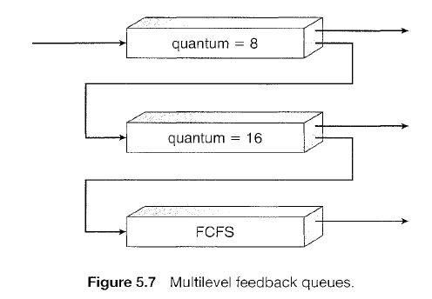
Multilevel Feedback Queue Scheduling
This scheduling algorithm gives highest priority to any process with a CPU burst of 8 milliseconds or less.
Such a process will quickly get the CPU, finish its CPU burst, and go off to its next I/0 burst.
Processes that need more than 8 but less than 24 milliseconds are also served quickly, although with lower priority than shorter processes.
Long processes automatically sink to queue 2 and are served in FCFS order with any CPU cycles left over from queues 0 and 1.

Slide 37
Multilevel Feedback Queue Scheduling
In general, a multilevel feedback queue scheduler is defined by the following parameters:
  The number of queues
  The scheduling algorithm for each queue
  The method used to determine when to upgrade a process to a higher priority queue
  The method used to determine when to demote a process to a lower priority queue
  The method used to determine which queue a process will enter when that process needs service
The definition of a multilevel feedback queue scheduler makes it the most general CPU-scheduling algorithm.
  It can be configured to match a specific system under design.
  Unfortunately, it is also the most complex algorithm, since defining the best scheduler requires some means by which to select values for all the parameters.

Slide 38
Thread Scheduling

Slide 39
Thread Scheduling
Threads are divided as user-level and kernel-level threads.
On operating systems that support them, it is kernel-level threads-not processes-that are being scheduled by the operating system.
User-level threads are managed by a thread library, and the kernel is unaware of them.
To run on a CPU, user-level threads must ultimately be mapped to an associated kernel-level thread, although this mapping may be indirect and may use a lightweight process (LWP).
There are several scheduling issues involving user-level and kernel-level threads and offer specific examples of scheduling for Pthreads.

Slide 40
Contention Scope
One distinction between user-level and kernel-level threads lies in how they are scheduled.
On systems implementing the many-to-one and many-to-many models, the thread library schedules user-level threads to run on an available LWP, a scheme known as process-contention scope (PCS), since competition for the CPU takes place among threads belonging to the same process.
When we say the thread library schedules user threads onto available LWPs, we do not mean that the thread is actually running on a CPU; this would require the operating system to schedule the kernel thread onto a physical CPU.
To decide which kernel thread to schedule onto a CPU, the kernel uses system-contention scope (SCS).
Competition for the CPU with SCS scheduling takes place among all threads in the system.
Systems using the one-to-one model ,such as Windows XP, Solaris, and Linux, schedule threads using only SCS.
Typically, PCS is done according to priority-the scheduler selects the runnable thread with the highest priority to run.
User-level thread priorities are set by the programmer and are not adjusted by the thread library, although some thread libraries may allow the programmer to change the priority of a thread.
It is important to note that PCS will typically preempt the thread currently running in favor of a higher-priority thread; however, there is no guarantee of time slicing among threads of equal priority.

Slide 41
Pthread Scheduling
The POSIX Pthread API allows specifying either PCS or SCS during thread creation.
Pthreads identifies the following contention scope values:
  PTHREAD_SCOPE_PROCESS schedules threads using PCS scheduling.
  PTHREAD_SCOPE_SYSTEM schedules threads using SCS scheduling.
On systems implementing the many-to-many model, the PTHREAD_SCOPE_PROCESS policy schedules user-level threads onto available LWPs.
The number of LWPs is maintained by the thread library, perhaps using scheduler activations.
The PTHREAD_SCOPE_SYSTEM scheduling policy will create and bind an LWP for each user-level thread on many-to-many systems, effectively mapping threads using the one-to-one policy.

Slide 42
Pthread Scheduling
The Pthread IPC provides two functions for getting-and setting-the contention scope policy:
  pthread_attr_setscope(pthread_attr_t *attr, int scope)
  pthread_attr_getscope(pthread_attr_t *attr, int *scope)
The first parameter for both functions contains a pointer to the attribute set for the thread.
The second parameter for the pthread_attr_setscope () function is passed either the PTHREAD_SCOPE_SYSTEM or the PTHREAD_SCOPE_PROCESS value, indicating how the contention scope is to be set.
In the case of pthread_attr_getscope (), this second parameter contains a pointer to an int value that is set to the current value of the contention scope.
If an error occurs, each of these functions returns a non-zero value.

Slide 43
Multiple-processor Scheduling

Slide 44
Multiple-processor Scheduling
If multiple CPUs are available, load sharing becomes possible; however, the scheduling problem becomes correspondingly more complex.
Many possibilities have been tried; and as we saw with single processor CPU scheduling, there is no one best solution.
There are several concerns in multiprocessor scheduling.
We concentrate on systems in which the processors are identical-homogeneous-in terms of their functionality; we can then use any available processor to run any process in the queue.

Slide 45
Approaches to Multiple-Processor Scheduling
One approach to CPU scheduling in a n1.ultiprocessor system has all scheduling decisions, I/O processing, and other system activities handled by a single processor-the master server.
The other processors execute only user code.
This asymmetric multiprocessing is simple because only one processor accesses the system data structures, reducing the need for data sharing.
A second approach uses symmetric multiprocessing (SMP), where each processor is self-scheduling.
All processes may be in a common ready queue, or each processor may have its own private queue of ready processes.
Regardless, scheduling proceeds by having the scheduler for each processor examine the ready queue and select a process to execute.
If we have multiple processors trying to access and update a common data structure, the scheduler must be programmed carefully.
It must be ensured that two processors do not choose the same process and that processes are not lost from the queue.
Virtually all modern operating systems support SMP, including Windows XP, Windows 2000, Solaris, Linux, and Mac OS X.

Slide 46
Processor Affinity
Consider what happens to cache memory when a process has been running on a specific processor.
The data most recently accessed by the process populate the cache for the processor; and as a result, successive memory accesses by the process are often satisfied in cache memory.
Now consider what happens if the process migrates to another processor.
The contents of cache memory must be invalidated for the first processor, and the cache for the second processor must be repopulated.
Because of the high cost of invalidating and repopulating caches, most SMP systems try to avoid migration of processes from one processor to another and instead attempt to keep a process running on the same processor. This is known as processor affinity-that is, a process has an affinity for the processor on which it is currently running.
Processor affinity takes several forms.
  When an operating system has a policy of attempting to keep a process running on the same processor-but not guaranteeing that it will do so-we have a situation known as soft affinity.
  It is also possible for a process to migrate between processors. Some systems also provide system calls that support hard affinity, thereby allowing a process to specify that it is not to migrate to other processors.
  Solaris allows processes to be assigned processor sets to limiting which processes can run on which CPUs. It also implements soft affinity.

Slide 47
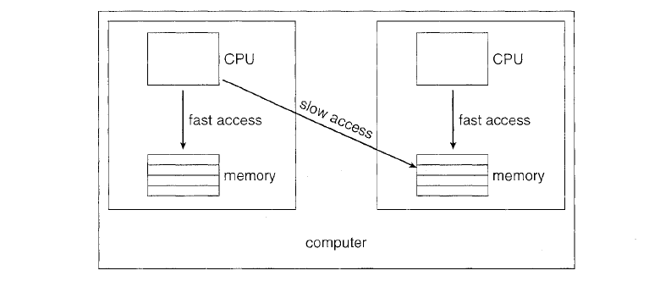
Processor Affinity
The main-memory architecture of a system can affect processor affinity issues. This diagram illustrates an architecture featuring non-uniform memory access (NUMA), in which a CPU has faster access to some parts of main memory than to other parts.
Typically, this occurs in systems containing combined CPU and memory boards.
The CPUs on a board can access the memory on that board with less delay than they can access memory on other boards in the system.
If the operating system's CPU scheduler and memory-placement algorithms work together, then a process that is assigned affinity to a particular CPU can be allocated memory on the board where that CPU resides.

Slide 48
Load Balancing
On SMP systems, it is important to keep the workload balanced among all processors to fully utilize the benefits of having more than one processor.
Otherwise, one or more processors may sit idle while other processors have high workloads, along with lists of processes awaiting the CPU.
Load balancing attempts to keep the workload evenly distributed across all processors in an SMP system.
It is important to note that load balancing is typically only necessary on systems where each processor has its own private queue of eligible processes to execute. Otherwise load balancing is often unnecessary, because once a processor becomes idle, it immediately extracts a runnable process from the common run queue.
It is also important to note, however that in most contemporary operating systems supporting SMP, each processor does have a private queue of eligible processes.
There are two general approaches to load balancing: push migration and pull migration.
  With push migration, a specific task periodically checks the load on each processor and -if it finds an imbalance-evenly distributes the load by moving (or pushing) processes from overloaded to idle or less-busy processors.
  Pull migration occurs when an idle processor pulls a waiting task from a busy processor.
  Push and pull migration need not be mutually exclusive and are in fact often implemented in parallel on load-balancing systems.

Slide 49
Load Balancing
Load balancing often counteracts the benefits of processor affinity.
That is, the benefit of keeping a process running on the same processor is that the process can take advantage of its data being in that processor's cache memory.
Either pulling or pushing a process from one processor to another invalidates this benefit.
As is often the case in systems engineering, there is no absolute rule concerning what policy is best.
Thus, in some systems, an idle processor always pulls a process from a non-idle processor; and in other systems, processes are moved only if the imbalance exceeds a certain threshold.
For example,
  The Linux scheduler and the ULE scheduler available for FreeBSD systems implement both techniques.
  Linux runs its load balancing algorithm every 200 milliseconds (push migration) or whenever the run queue for a processor is empty (pull migration).

Slide 50
Multicore Processors
Traditionally, SMP systems have allowed several threads to run concurrently by providing multiple physical processors.
However, a recent trend in computer hardware has been to place multiple processor cores on the same physical chip, resulting in a Multicore Processor.
Each core has a register set to maintain its architectural state and appears to the operating system to be a separate physical processor.
SMP systems that use multicore processors are faster and consume less power than systems in which each processor has its own physical chip.

Slide 51
Multicore Processors
Multicore processors may complicate scheduling issues.
Let's consider how this can happen.
  When a processor accesses memory, it spends a significant amount of time waiting for the data to become available. This situation, known as memory stall.
  It may occur for various reasons, such as a cache miss (accessing data that is not in cache memory).
In this scenario, the processor can spend up to 50 percent of its time waiting for data to become available from memory.
To remedy this situation, many recent hardware designs have implemented multithreaded processor cores in which two (or more) hardware threads are assigned to each core.
That way, if one thread stalls while waiting for memory, the core can switch to another thread.
From an operating-system perspective, each hardware thread appears as a logical processor that is available to run a software thread.
Thus, on a dual-threaded, dual-core system, four logical processors are presented to the operating system.

Slide 52
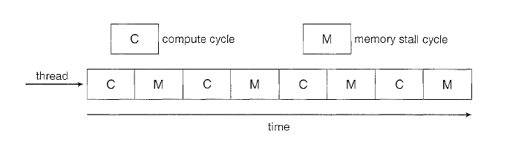
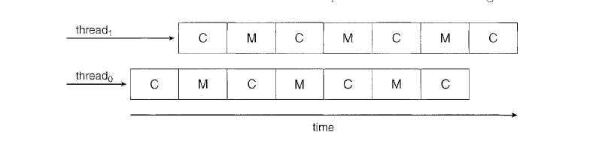
Multicore Processors

Slide 53
Multicore Processors
In general, there are two ways to multithread a processor
  Coarse grained multithreading.
  Fine grained multithreading.
coarse-grained multithreading,
  a thread executes on a processor until a long-latency event such as a memory stall occurs.
  Because of the delay caused by the long-latency event, the processor must switch to another thread to begin execution.
  However, the cost of switching between threads is high, as the instruction pipeline must be flushed before the other thread can begin execution on the processor core.
  Once this new thread begins execution, it begins filling the pipeline with its instructions.
Fine-grained (or interleaved) multithreading
  switches between threads at a much finer level of granularity-typically at the boundary of an instruction cycle.
  However, the architectural design of fine-grained systems includes logic for thread switching.
  As a result, the cost of switching between threads is small.

Slide 54
Multicore Processors
A multithreaded multicore processor actually requires two different levels of scheduling.
  On one level are the scheduling decisions that must be made by the operating system as it chooses which software thread to run on each hardware thread (logical processor).
    For this level of scheduling, the operating system may choose any scheduling algorithm.
  A second level of scheduling specifies how each core decides which hardware thread to run.
    There are several strategies to adopt in this situation.
      The UltraSPARC Tl uses a simple round robin algorithm to schedule the four hardware threads to each core.
      Another example, the Intel Itanium, is a dual-core processor with two hardware managed threads per core.
        Assigned to each hardware thread is a dynamic urgency value ranging from 0 to 7, with 0 representing the lowest urgency, and 7 the highest.
        The Itanium. identifies five different events that may trigger a thread switch.
        When one of these events occurs, the thread-switching logic compares the urgency of the two threads and selects the thread with the highest urgency value to execute on the processor core.

Slide 55
Virtualization and Scheduling
A system with virtualization, even a single-CPU system, frequently acts like a multiprocessor system.
The virtualization software presents one or more virtual CPUs to each of the virtual machines running on the system and then schedules the use of the physical CPUs among the virtual machines.
The significant variations between virtualization technologies make it difficult to summarize the effect of virtualization on scheduling.
  In general, though, most virtualized environments have one host operating system and many guest operating systems.
  The host operating system creates and manages the virtual machines, and each virtual machine has a guest operating system installed and applications running within that guest.
  Each guest operating system may be fine-tuned for specific use cases, applications, and users, including time sharing or even real-time operation.
  Any guest operating-system scheduling algorithm that assumes a certain amount of progress in a given amount of time will be negatively impacted by virtualization.

Slide 56
Virtualization and Scheduling
Consider a time-sharing operating system that tries to allot 100 milliseconds to each time slice to give users a reasonable response time.
  Within a virtual machine, this operating system is at the mercy of the virtualization system as to what CPU resources it actually receives.
  A given 100-millisecond time slice may take much more than 100 milliseconds of virtual CPU time.
  Depending on how busy the system is, the time slice may take a second or more, resulting in very poor response times for users logged into that virtual machine.
The effect on a real-time operating system would be even more catastrophic.
  The net effect of such scheduling layering is that individual virtualized operating systems receive only a portion of the available CPU cycles, even though they believe they are receiving all of the cycles and indeed that they are scheduling all of those cycles.
  Commonly, the time-of-day clocks in virtual machines are incorrect because timers take longer to trigger than they would on dedicated CPUs.
Virtualization can thus undo the good scheduling-algorithm efforts of the operating systems within virtual machines.

