Slide 1
Study Material
Department of Computer Science & Engineering
Course Code : | BCS303 | Semester / Year : | III / II
Course Title : | Operating Systems | Academic Year : | 2024-25

Slide 2
Module 2
Multi threaded Programming: overview , Multithreading models ;Thread Libraries ; Threading issues

Slide 3
Thread Vs Process
Important Terms in Computer Science
Process is the program under action
Thread is the smallest segment of instruction that can be handled independently by schedular

Slide 4
Overview

Slide 5
Overview
Notion of a thread :A fundamental unit of CPU utilization that forms the basis of multithreaded computer systems
Thread : A Basic unit of CPU Utilization that comprises of
      Thread ID
      Program counter
      Register set
      Stack
It shares with other threads belonging to same process its code section , data section and operating system resources such as open files and signals
Heavy weight process has a single thread of control (Single-Threaded)
If process has multiple threads of control ,it can perform more than one task at a time (Multi-threaded)

Slide 6
Motivation
Most modern applications are multithreaded
An application implemented as a separate process with several threads of control
For example.
  A Web browser might have
    one thread display images or text
    another thread retrieves data from the network
  A word processor may have
    a thread for displaying graphics,
    another thread for responding to keystrokes from the user,
    and a third thread for performing spelling and grammar checking in the background.

Slide 7
Motivation
In certain situations, a single application may be required to perform several similar tasks.
For example, a Web server accepts client requests for Web pages, images, sound, and so forth.
  A busy Web server may have several clients concurrently accessing it. If the Web server ran as a traditional single-threaded process, it would be able to service only one client at a time, and a client might have to wait a very long time for its request to be serviced.
  One solution
    The server run as a single process that accepts requests. When the server receives a request, it creates a separate process to service that request. In fact, this process-creation method was in common use before threads became popular. Process creation is time consuming and resource intensive, however. If the new process will perform the same tasks as the existing process, why incur all that overhead?
  Efficient Solution
    Use one process that contains multiple threads. If the Web-server process is multithreaded, the server will create a separate thread that listens for client requests. When a request is made, rather than creating another process, the server will create a new thread to service the request and resume listening for additional requests.

Slide 8

Single and Multithreaded Processes

Slide 9
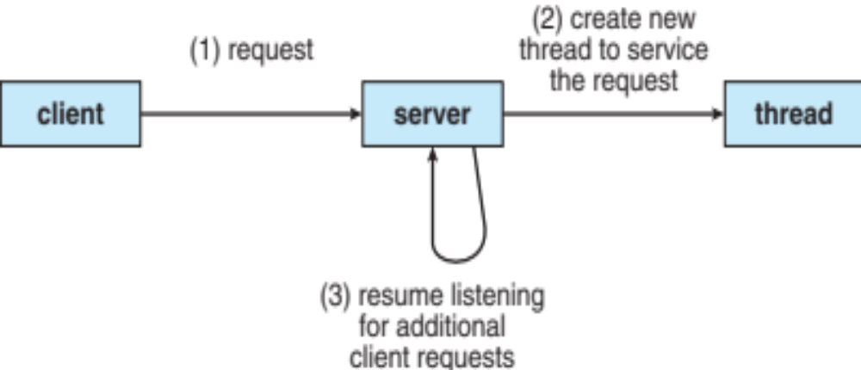
Multi-Threaded Server Architecture

Slide 10
Benefits
Responsiveness –
  Multithreading an interactive application may allow a program to continue running even if part of it is blocked or is performing a lengthy operation, thereby increasing responsiveness to the user.
  For instance a multithreaded Web browser could allow user interaction in one thread while an image was being loaded in another thread.
Resource Sharing –
  Processes may only share resources through techniques such as shared memory or message passing.
  Such techniques must be explicitly arranged by the programmer.
  However, threads share the memory and the resources of the process to which they belong by default.
  The benefit of sharing code and data is that it allows an application to have several different threads of activity within the same address space.

Slide 11
Benefits
Economy –
  Allocating memory and resources for process creation is costly.
  Because threads share the resources of the process to which they belong, it is more economical to create and context-switch threads.
  It is much more time consuming to create and manage processes than threads.
  In Solaris for example, creating a process is about thirty times slower than is creating a thread, and context switching is about five times slower.
Scalability –
  The benefits of multithreading can be greatly increased in a multiprocessor architecture, where threads may be running in parallel on different processors.
  A single-threaded process can only run on one processor, regardless how many are available. Multithreading on a multi CPU machine increases parallelism.

Slide 12
Multicore Programming
A recent trend in system design has been to place multiple computing cores on a single chip, where each core appears as a separate processor to the operating system.
Multithreaded programming provides a mechanism for more efficient use of multiple cores and improved concurrency.
Consider an application with four threads.
  On a system with a single computing core, concurrency merely means that the execution of the threads will be interleaved over time, as the processing core is capable of executing only one thread at a time.
  On a system with multiple cores, however, concurrency means that the threads can run in parallel, as the system can assign a separate thread to each core.
The trend towards multicore systems has placed pressure on system designers as well as application programmers to make better use of the multiple computing cores.
Designers of operating systems must write scheduling algorithms that use multiple processing cores to allow the parallel execution.
For application programmers, the challenge is to modify existing programs as well as design new programs that are multithreaded to take advantage of multicore systems.

Slide 13
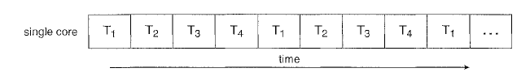
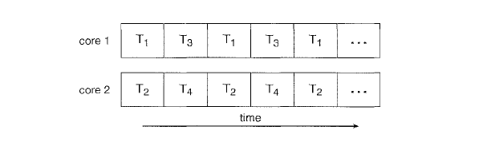
Multicore Programming

Slide 14
Multicore Programming
In general, five areas present challenges in programming for multicore systems:
  Dividing activities
    This involves examining applications to find areas that can be divided into separate, concurrent tasks and thus can run in parallel on individual cores.
  Balance
    While identifying tasks that can run in parallel, programmers must also ensure that the tasks perform equal work of equal value.
    In some instances, a certain task may not contribute as much value to the overall process as other tasks; using a separate execution core to run that task may not be worth the cost.
  Data splitting
    Just as applications are divided into separate tasks, the data accessed and manipulated by the tasks must be divided to run on separate cores.

Slide 15
Multicore Programming
  Data dependency
    The data accessed by the tasks must be examined for dependencies between two or more tasks.
    In instances where one task depends on data from another, programmers must ensure that the execution of the tasks is synchronized to accommodate the data dependency.
  Testing and debugging
    When a program is running in parallel on multiple cores, there are many different execution paths.
    Testing and debugging such concurrent programs is inherently more difficult than testing and debugging single-threaded applications.
Because of these challenges, many software developers argue that the advent of multicore systems will require an entirely new approach to designing software systems in the future.

Slide 16
Multithreading Models

Slide 17
Multithreading Models
Support for threads may be provided either at the user level, for user thread or by the kernel, for kernel threads.
User threads are supported above the kernel and are managed without kernel support, whereas kernel threads are supported and managed directly by the operating system.
Ultimately, a relationship must exist between user threads and kernel threads.
Three common ways of establishing such a relationship.
  Many-to-One
  One-to-One
  Many-to-Many

Slide 18

Many-to-One Model
Many user-level threads mapped to single kernel thread
Thread management is done by the Thread library in user space so it is efficient
One thread blocking system call causes entire process to block
Multiple threads may not run in parallel on mutiprocessor system because only one thread can access the kernel at a time.
This means that all the user-level threads share the same kernel-level thread, and the kernel is not aware of the individual user-level threads.
Example:
The web browser creates multiple user-level threads to perform tasks such as rendering web pages, executing JavaScript code, and handling user input. However, all these user-level threads are mapped to a single kernel-level thread, which is responsible for managing memory, handling I/O operations, and scheduling processes.
Solaris Green Threads, GNU Portable Threads

Slide 19
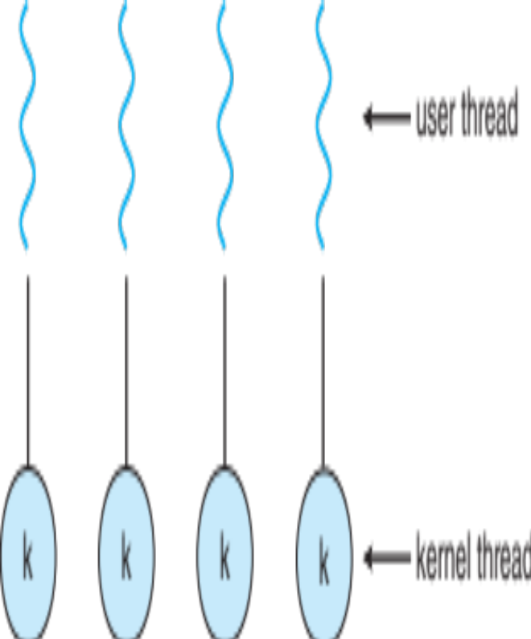
One-to-One Model
Each user-level thread maps to kernel thread. This means that each user-level thread has its own kernel-level thread, and the kernel is aware of each individual user-level thread.
Provide more concurrency than many to one model by allowing another thread to run in parallel on multiprocessors
Drawback is
  creating a user-level thread creates a kernel thread can burden the performance of an application.
  Number of threads per process sometimes restricted due to overhead.
Example:
The database server creates multiple user-level threads to handle different database queries. Each user-level thread is mapped to a separate kernel-level thread, which is responsible for managing memory, handling I/O operations, and scheduling processes.
Windows, Linux

Slide 20

Many-to-Many Model
Allows many user level threads to be mapped to smaller or equal number of kernel threads.
This means that each user-level thread can be mapped to a different kernel-level thread, and the kernel is aware of each individual user-level thread.
The number of kernel threads may be specific to either a particular application or particular machine (An application may be allocated more kernel threads on a multiprocessor than on a uniprocessor)
Developer can create as many user threads as necessary and the corresponding kernel thread can run in parallel on a multiprocessor.
When a thread performs a blocking system call ,the kernel can schedule another thread for execution.
Example:
The web server creates multiple user-level threads to handle different HTTP requests. Each user-level thread is mapped to a different kernel-level thread, which is responsible for managing memory, handling I/O operations, and scheduling processes.

Slide 21

Two-level Model
Variation to many to many model is Two level model
Variation to M:M model which multiplexes many user level threads to a smaller or equal number of kernel threads but also allows a user thread to be bound to kernel thread
Examples
  IRIX
  HP-UX
  Tru64 UNIX
  Solaris 8 and earlier

Slide 22
Thread Libraries

Slide 23
Thread Libraries
Thread library provides programmer with API for creating and managing threads
Two primary ways of implementing
First Way:
  Provide library entirely in user space with no kernel support .
  All code and data structures for library exists in user space
  Invoking a function in library results in a local function call in user space and not a system call
Second Way
  Implement kernel-level library supported by the OS
  Code and data structures for library exist in kernel space
  Invoking a function in the API for library results in a system call to the kernel

Slide 24
Thread Libraries
Three main Thread libraries in use:
  POSIX Pthreads
    the threads extension of the POSIX standard, may be provided as either a user- or kernel-level library
  Win 32
    a kernel-level library available on Windows systems.
  Java
    allows threads to be created and managed directly in Java programs.
    the Java thread API is generally implemented using a thread library available on the host system.

Slide 25
Pthreads
Pthreads refers to POSIX standard (IEEE 1003.1c) defining an API for thread creation and synchronization
Specification for thread behaviour, not implementation
API specifies behavior of the thread library, implementation is up to development of the library
Numerous system implement the Pthread specification including Solaris, Linux, Mac OS X and Tru64UNIX
All Pthreads programs must include the pthread. h header file.
  The statement pthread_t tid declares the identifier for the thread we will create.
  Each thread has a set of attributes, including stack size and scheduling information.
  A separate thread is created with the pthread_create () function call.
  In addition to passing the thread identifier and the attributes for the thread, we also pass the name of the function where the new thread will begin fexecution. Last, we pass the integer parameter that was provided on the command line, argv [1].

Slide 26
Win32 threads
Technique for creating threads using Win32 thread library is similar to Pthread technique.
Include the windows . h header file when using the Win32 API.
  Threads are created in Win32 API using createThread() same as process
  A set of attributes for thread is passed to this function
  These attributes include security information ,size of stack and a flag that can be set to indicate if thread is to start in a suspended state
  Default values used for these attributes which do not initially set to the thread running state by CPU schedular

Slide 27
Java Threads
Threads are the fundamental model of program execution in a Java program, and the Java language and its API provide a rich set of features for the creation and management of threads.
All Java programs comprise at least a single thread of control-even a simple Java program consisting of only a main() method runs as a single thread in the JVM.
Java threads are managed by the JVM
There are two techniques for creating threads in a Java program.
  One approach is to create a new class that is derived from the Thread class and to override its run() method.
  An alternative-and more commonly used technique is to define a class that implements the Runnable interface.

Slide 28

Java Threads
Runnable interface defined as follows :
Whereas a class implements Runnable ,it must define run() method .The code implementing run() method is what runs a separate thread.
Creating a Thread object does not specifically create the new thread; rather, it is the start() method that creates the new thread. Calling the start() method for the new object does two things:
  It allocates memory and initializes a new thread in the JVM.
  It calls the run() method, making the thread eligible to be run by the JVM.

Slide 29
Threading Issues

Slide 30
Threading Issues
The fork() and exec() system calls
Cancellation
Signal Handling
Thread pool
Thread- Specific Data
Scheduler Activations

Slide 31
The fork() and exec() System Calls
fork() system call is used to create a separate duplicate process
Semantics of fork() and exec() call changes in a multithreaded program
If one thread in a program calls fork(), does new process duplicates all threads or is the new process single threaded?
  Some UNIX system have two versions of fork
    That duplicate all threads
    Duplicate only thread that invoked fork() system call
  exec() usually works as normal – replace the running process including all threads.
Which of the two versions of fork() to use depends on the application.
  If exec() is called immediately after forking, then duplicating all threads is unnecessary, as the program specified in the parameters to exec() will replace the process.
  In this instance, duplicating only the calling thread is appropriate.
  If, however, the separate process does not call exec () after forking, the separate process should duplicate all threads.

Slide 32
Cancellation
Task of Terminating a thread before it has completed
  If multiple threads are concurrently searching through a database ,if one thread returns the result remaining threads might be cancelled
Thread to be canceled is target thread
Two general approaches of cancellation
  Asynchronous cancellation one thread immediately terminates the target thread
  Deferred cancellation allows the target thread to periodically check if it should be cancelled ,allowing it an opportunity to terminate itself

Slide 33
Cancellation
Difficulty in cancellation :
  Resources have been allocated to cancelled thread
  Thread cancelled in the middle of updating data it is sharing with other threads .
This becomes especially troublesome with asynchronous cancellation.
  Often, the operating system will reclaim system resources from a canceled thread but will not reclaim all resources.
  Therefore, canceling a thread asynchronously may not free a necessary system-wide resource.
With deferred cancellation, in contrast,
  one thread indicates that a target thread is to be canceled, but cancellation occurs only after the target thread has checked a flag to determine whether or not it should be canceled.
  The thread can perform this check at a at point which it can be canceled safely

Slide 34
Signal Handling
Signals are used in UNIX systems to notify a process that a particular event has occurred.
Signal may be received either synchronously or Asynchronously depending on source of and the reason for the event being signaled
All signals whether synchronous or asynchronous follow the same pattern
  A Signal is generated by the occurrence of a particular event
  A generated Signal is delivered to a process
  Once delivered ,the Signal must be handled.
Synchronous Signal include Illegal memory access and Division by 0.
  If running program performs these actions a signal is generated
  Synchronous signal delivered to same process that performed operation that caused the signal
Signals is generated by event external to running process that process receives signal Asynchronously.
  Examples of such signals include terminating a process with specific keystrokes (such as <control> <C>) and having a timer expire.
  Typically, an asynchronous signal is sent to another process.

Slide 35
Signal Handling
Signal is handled by one of two signal handlers:
    A Default Signal Handler
    A User-defined Signal Handler
Every signal has default handler that is run by kernel when handling that signal.
This default action can be overriden by a user defined handler that is called to handle the signal
Signals are handled in different ways.
  Some signals (such as changing the size of a window) are simply ignored;
  others (such as an illegal memory access) are handled by terminating the program.

Slide 36
Signal Handling
Handling signals in single-threaded programs is straightforward:
  Signals are always delivered to a process.
However, delivering signals is more complicated in multithreaded programs, where a process may have several threads. Where should a signal be delivered for multi-threaded?
    Deliver the signal to the thread to which the signal applies
    Deliver the signal to every thread in the process
    Deliver the signal to certain threads in the process
    Assign a specific thread to receive all signals for the process
Method for delivering a signal depends on type of signal generated

Slide 37
Thread Pools
Creating a separate thread is certainly superior to creating a separate process.
The first issue concerns the amount of time required to create the thread prior to servicing the request, together with the fact that this thread will be discarded once it has completed its work.
The second issue is more troublesome: if we allow all concurrent requests to be serviced in a new thread, we have not placed a bound on the number of threads concurrently active in the system. Unlimited threads could exhaust system resources, such as CPU time or memory.
One solution is to use a Thread Pool.
Thread pool is to create a number of threads at process start up and place them into a pool where they can sit and wait for work.
When a server receives a request ,it awakens a thread from this pool-if one is available and passes it the request for service.
Once thread completes its service ,it returns to the pool and awaits more work
If the pool contains no available thread ,the server waits until one becomes free

Slide 38
Thread Pools
Thread pool offers these Advantages:
  Servicing a request with an existing thread is usually faster than waiting to create a thread
  Thread pool limits that number of threads that exists at any one point . This is particularly important on systems that can not support a large number of concurrent threads.
The number of threads in the pool can be set heuristically based on factors such as
  the number of CPUs in the system,
  the amount of physical memory,
  and the expected number of concurrent client requests.
More sophisticated thread-pool architectures can dynamically adjust the number of threads in the pool according to usage patterns. Such architectures provide the further benefit of having a smaller pool-thereby consuming less memory-when the load on the system is low.

Slide 39
Thread-Specific Data
Threads belonging to a process share the data of the process.
Indeed, this sharing of data provides one of the benefits of multithreaded programming.
However, in some circumstances, each thread might need its own copy of certain data.
We will call such data thread-specific data.
For example, in a transaction-processing system,
  we might service each transaction in a separate thread.
  Furthermore, each transaction might be assigned a unique identifier.
  To associate each thread with its unique identifier, we could use thread-specific data.
Most thread libraries-including Win32 and Pthreads-provide some form of support for thread-specific data. Java provides support as well.

Slide 40

Scheduler Activations
The final issue to be considered with multithreaded programs concerns communication between the kernel and the thread library, which may be required by the many-to-many and two-level models.
Such coordination allows the number of kernel threads to be dynamically adjusted to help ensure the best performance.
Many systems implementing either the many-to-many or the two-level model place an intermediate data structure between the user and kernel threads. This data structure-typically known as a lightweight process, or LWP.
To the user-thread library, the LWP appears to be a virtual processor on which the application can schedule a user thread to run.
Each LWP is attached to a kernel thread, and it is kernel threads that the operating system schedules to run on physical processors.
If a kernel thread blocks (such as while waiting for an I/0 operation to complete), the LWP blocks as well.
Up the chain, the user-level thread attached to the LWP also blocks.

Slide 41
Scheduler Activations
An application may require any number of LWPs to run efficiently.
Consider a CPU-bound application running on a single processor.
  In this scenario, only one thread can run at once, so one LWP is sufficient.
An application that is I/O intensive may require multiple LWPs to execute, however.
Typically, an LWP is required for each concurrent blocking system call.
Suppose, for example, that five different file-read requests occur simultaneously.
  Five LWPs are needed, because all could be waiting for I/0 completion in the kernel.
  If a process has only four LWPs, then the fifth request must wait for one of the LWPs to return from the kernel.
One scheme for communication between the user-thread library and the kernel is known as scheduler activation.

Slide 42
Scheduler Activations
It works as follows:
  The kernel provides an application with a set of virtual processors (LWPs), and the application can schedule user threads onto an available virtual processor.
  Furthermore, the kernel must inform an application about certain events.
  This procedure is known as an Upcalls.
  Upcalls are handled by the thread library with an upcall handler and upcall handlers must run on a virtual processor.
  One event that triggers an upcall occurs when an application thread is about to block.
  In this scenario, the kernel makes an upcall to the application informing it that a thread is about to block and identifying the specific thread.
  The kernel then allocates a new virtual processor to the application.

Slide 43
Scheduler Activations
It works as follows:
  The application runs an upcall handler on this new virtual processor, which saves the state of the blocking thread and relinquishes the virtual processor on which the blocking thread is running.
  The upcall handler then schedules another thread that is eligible to run on the new virtual processor.
  When the event that the blocking thread was waiting for occurs, the kernel makes another upcall to the thread library informing it that the previously blocked thread is now eligible to run.
  The up call handler for this event also requires a virtual processor, and the kernel may allocate a new virtual processor or preempt one of the user threads and run the upcall handler on its virtual processor.
  After marking the unblocked thread as eligible to run, the application schedules an eligible thread to run on an available virtual processor.

