Slide 1

VOTING SYSTEM
Team Members -
1. Anand Raj
2. Umang Jaiswal
3. Shresta Bathula

Slide 2
Introduction
Technologies Used
1 Frontend: HTML, CSS, JavaScript , JSP Pages
2. Backend: Java (Spring Boot)
3.Database: MySQL or any relational database
Admin Roles(1):
1.Admins can log in and create different types of elections:
Rajya Sabha elections
Lok Sabha elections
Municipal Corporation elections
2. Admins can assign sub-admins to manage specific elections.
Sub Admins Roles(2):
1.Sub Admins can manage elections assigned by the Admin.
They can log-in and view a list of candidates for the election.
2. Sub Admins can add new candidates.
3. Sub Admins can modify candidate details but cannot change the candidate's age or vote count.
Voter Roles(3):
1.Voters can register with their details , Only voters who are 18 years or older and Indian citizens can register and they can only vote once.
2. Once a voter casts their vote, they are marked as having voted and cannot vote again.

Slide 3
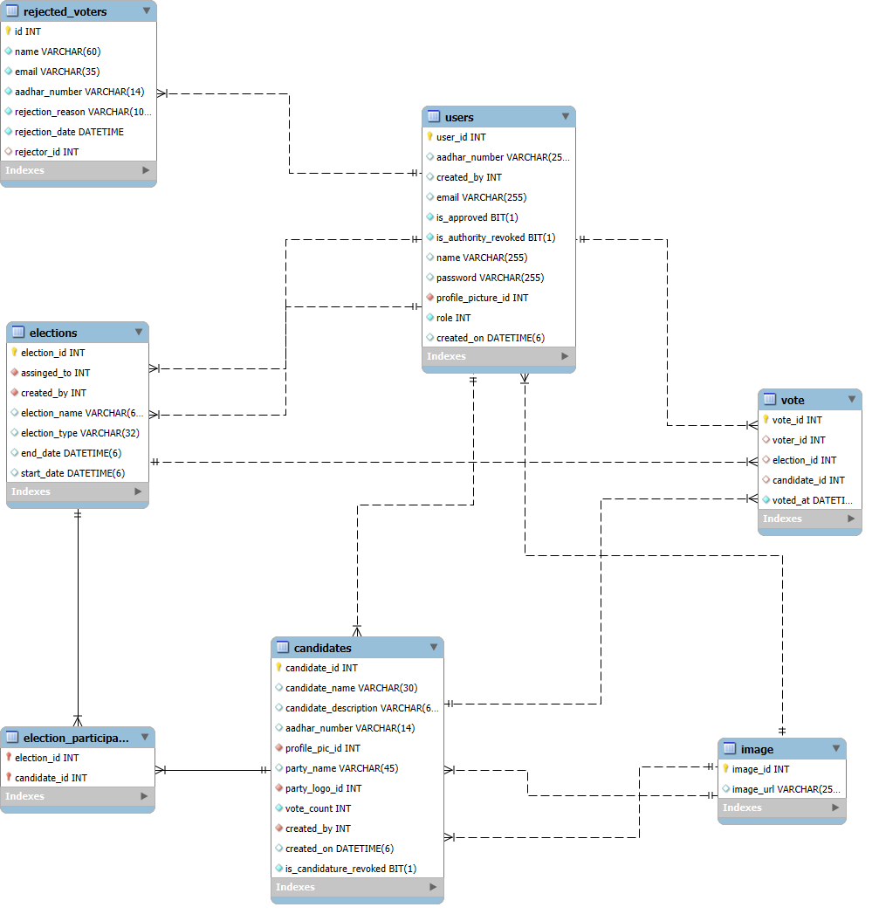
ER Diagram

Slide 4
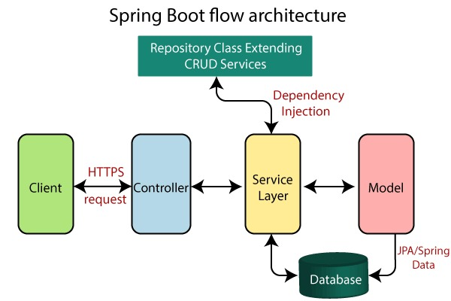

Slide 5

Thank you

