Slide 1
SKYLO REGIONAL HUB
AWS Architecture Design — us-west-2
Staff Cloud Engineer take-home — network, compute, storage, security, and the end-to-end service-time budget
Data ingress from satellite ground stations · containerized 3GPP core processing · single AZ-resilient hub

Slide 2
CONTEXT
What this hub does, and what it must survive
Two functions
Constraints that matter
1
Data ingress
Resilient to single-AZ failure
High-volume, real-time connectivity data from multiple satellite ground stations, arriving over AWS Direct Connect.
Compute scales with traffic
Least-privilege and zero-trust
2
Core network processing
Containerized 3GPP core components managing device sessions, processing data, routing traffic.
SOC 2 already in scope org-wide
Everything provisioned as IaC
Regional hub #1 of many — us-west-2, 3 AZs.
Must connect to Direct Connect and to other Skylo AWS Organization accounts
Skylo Regional Hub — AWS Architecture
2

Slide 3
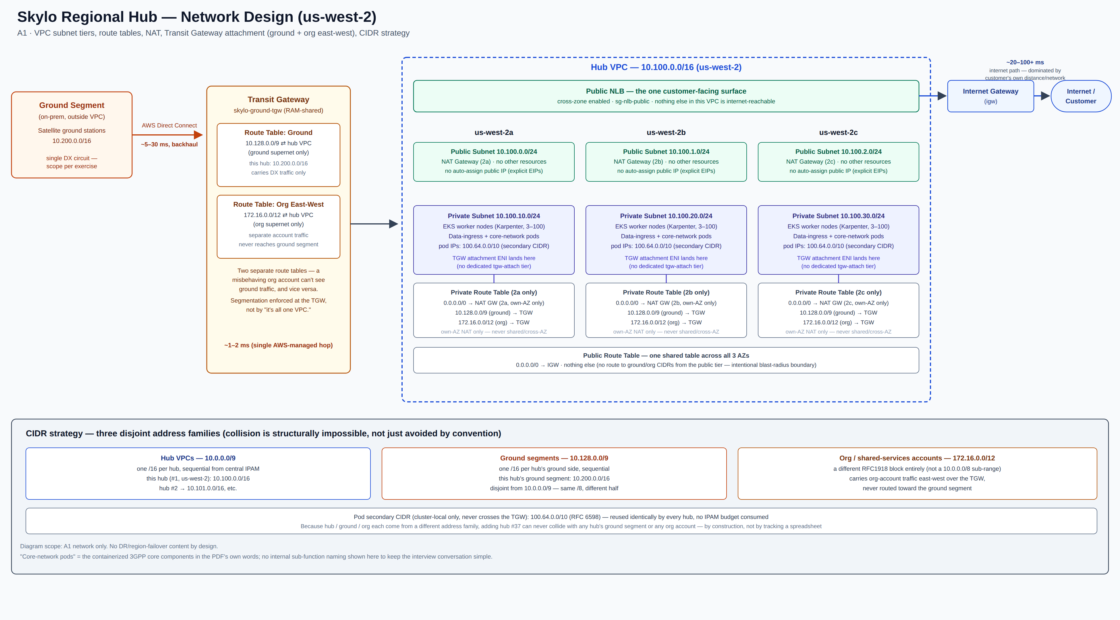
A1 · NETWORK
VPC, subnet tiers, route tables, NAT, TGW attachment
Skylo Regional Hub — AWS Architecture
3

Slide 4
A1 · CIDR STRATEGY
Three disjoint address families — collision is structural, not conventional
Hub VPCs
Ground segments
Org / shared accounts
10.0.0.0/9
10.128.0.0/9
172.16.0.0/12
One /16 per hub, sequential from central IPAM. This hub: 10.100.0.0/16.
One /16 per hub's ground side. This hub: 10.200.0.0/16. Same /8, other half.
A different RFC1918 block entirely — not a sub-range of 10.0.0.0/8 at all.
Why this holds as Skylo scales
Hub VPCs and ground segments are two halves of the same /8 — deliberately chosen so neither can ever grow into the other. Org accounts sit in a different RFC1918 block altogether. That's a structural property, not a naming convention someone has to keep enforcing correctly: adding hub #37 tomorrow cannot collide with any existing hub's ground segment or any org account, by construction.
Pod secondary CIDR (cluster-local, never crosses the TGW): 100.64.0.0/10 — reused identically by every hub, zero IPAM budget consumed.
Skylo Regional Hub — AWS Architecture
4

Slide 5
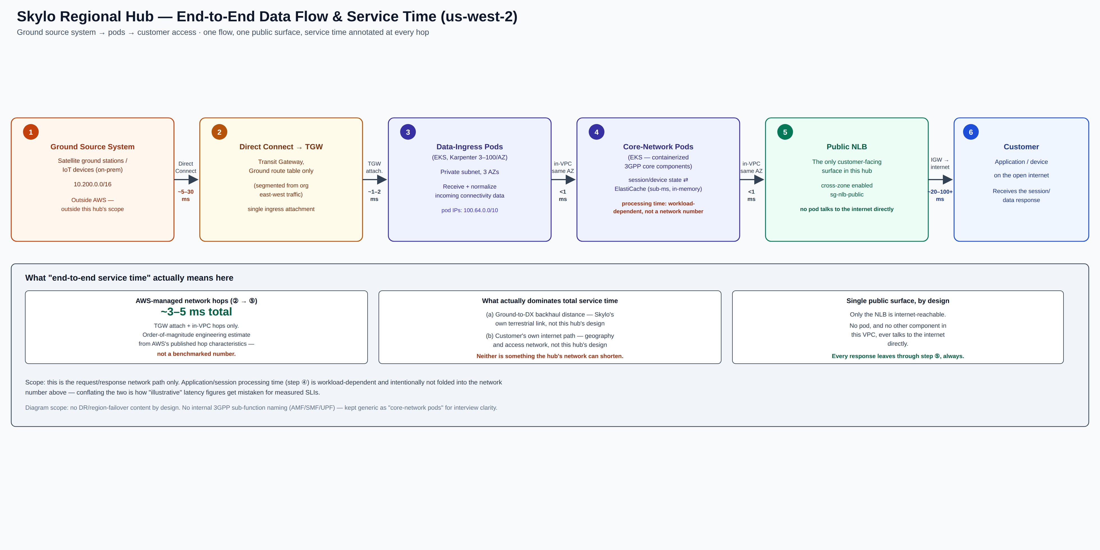
WORKED EXAMPLE
Ground source system → pods → customer access
Skylo Regional Hub — AWS Architecture
5

Slide 6
END-TO-END SERVICE TIME
Ground network to pod API, and pod to customer
~5–30 ms
~3–5 ms
~20–100+ ms
Ground station → Direct Connect → TGW
AWS-managed hops inside the hub
NLB → IGW → internet → customer
Dominated by physical backhaul distance — Skylo's terrestrial link, not this hub's AWS design.
TGW attach + in-VPC hops, pod to pod, pod to NLB. The only segment this design actually controls.
Dominated by the customer's own network distance and access path — outside this hub's control.
Session/application processing time is counted separately — it's workload-dependent, not a network number. And these are order-of-magnitude engineering estimates from AWS's published component characteristics, not benchmarked figures — stated as ranges on purpose rather than a false-precision single number.
Skylo Regional Hub — AWS Architecture
6

Slide 7
A2 · COMPUTE
EKS, chosen against the workload's own networking needs
Why EKS, not ECS
Cost, stated honestly
Core-network pods need low-level networking — custom CNI, multiple NICs, host networking for some components. ECS exposes neither launch type at that layer.
A heavier operational surface — control-plane upgrades, add-on management, a real on-call skill requirement ECS mostly hides. Accepted because the networking need is non-negotiable, not because Kubernetes is fashionable.
Karpenter (not cluster-autoscaler): provisions against actual pending-pod shape — data-ingress and core-processing nodes want different instance types; a fixed ASG per type is the rigidity Karpenter removes.
What would reverse this
Telco-core vendor software ships as Helm charts/Operators with CRDs — not ECS task definitions.
If this hub's scope turns out to be only stateless session/control logic — nothing needing host networking or a custom CNI — ECS/Fargate drops the operational overhead substantially.
Portability: the same core stack can move to the edge or a second cloud later; ECS task definitions don't.
Reversing question: does this hub run the packet-processing workload, or only session/control logic?
Skylo Regional Hub — AWS Architecture
7

Slide 8
A3 · STORAGE
One service per job, picked for the access pattern
Short-term session state
ElastiCache (Redis/Valkey), multi-AZ
In-memory reads for session lookups, native TTL for expiry, multi-AZ replication for failover.
High throughput, low latency
Long-term connection-log archival
S3, Standard → Intelligent-Tiering/Glacier
Durable and cheap at volume; queryable directly (Athena/Glue) for SOC 2 evidence pulls.
Durability + auditability
Nuance worth stating out loud
Multi-AZ gives infrastructure-level failover automatically — but a cluster-mode-enabled client still needs to be cluster-aware (MOVED/ASK redirects) to benefit from it. “No app-level handling” is only fully true with cluster-mode-disabled behind a client-side proxy. Confirm which posture the client library actually supports.
Skylo Regional Hub — AWS Architecture
8

Slide 9
A5 · SECURITY & OBSERVABILITY
Zero-trust by default, not bolted on at the end
IRSA — deliberately withheld
First 3 security services
Logging & monitoring
Any wildcard (*) action or resource
1
AWS Config
Amazon Managed Prometheus + Grafana
the SOC 2 evidence engine + drift detection
Kubernetes-native metrics and dashboards
iam:PassRole / iam:CreateRole
2
GuardDuty
Fluent Bit → OpenSearch
“did something bad happen,” near-zero setup
Container + VPC Flow Logs, SOC 2 audit trail
Rights to modify SGs, route tables, or TGW attachments
3
Security Hub
CloudWatch
aggregates both into one CIS/FSBP view
Cross-account sts:AssumeRole beyond the 1–2 roles actually needed
AWS-service-level signals only (NAT, TGW, ElastiCache) — not forced to carry everything
Top alerting metrics
sg-nlb-public is the only internet-facing SG. sg-eks-private trusts that SG's ID — never 0.0.0.0/0.
Pod crash-loop/OOMKilled · P99 session-processing latency · Scheduling/capacity saturation (watching NAT + ElastiCache limits, not just node count)
Skylo Regional Hub — AWS Architecture
9

Slide 10
SCOPE, AND WHAT I EXPECT TO DEFEND
Ready for the first 30 minutes
Deliberately out of scope here
Trade-offs I'll defend if pushed
Region-loss DR (RTO/RPO target and its cost). Single-AZ resilience is the named constraint and is built into the network/compute design already — that's not DR, it's the baseline. Region failover is a real follow-up question with a verbal answer ready; it's kept out of the written artifact so it stays focused on what's asked.
EKS over ECS — reverses if the workload turns out to be session/control-only.
TGW attachment in private subnets, no dedicated tgw-attach tier — reverses on a security review.
No internal 3GPP sub-function naming (AMF/SMF/UPF) in the diagrams — kept generic as “data-ingress” and “core-network” pods for a simpler conversation.
ElastiCache failover claim depends on the client library being cluster-aware — needs confirming.
Single Direct Connect circuit, as scoped — production hardening would add a second circuit.
Skylo Regional Hub — AWS Architecture
10

Slide 11
Structure, naming, and boundaries should survive contact with the follow-up questions.
NETWORK-DESIGN.md · DESIGN.md · vpc.md · vpc.tf

