Slide 1
ARTIFICIAL INTELLIGENCE MINI-PROJECT • DEPARTMENT OF CSE
MediGuide AI
Intelligent Medical Symptom Analyzer & Doctor Recommendation System
Comprehensive Implementation of All Five Units of the Artificial Intelligence Syllabus
INSTITUTION & DEPARTMENT
Rajalakshmi Engineering College (REC)
Department of Computer Science & Engineering
Affiliated to Anna University • Chennai, Tamil Nadu
Academic Year: 2026-2027
PROJECT AUTHORS & PRESENTERS
1. S VINOTH
Roll Number: 240701592 | Project Lead
2. A VENKAT PRASHAD
Roll Number: 240701583 | AI Core Contributor

Slide 2
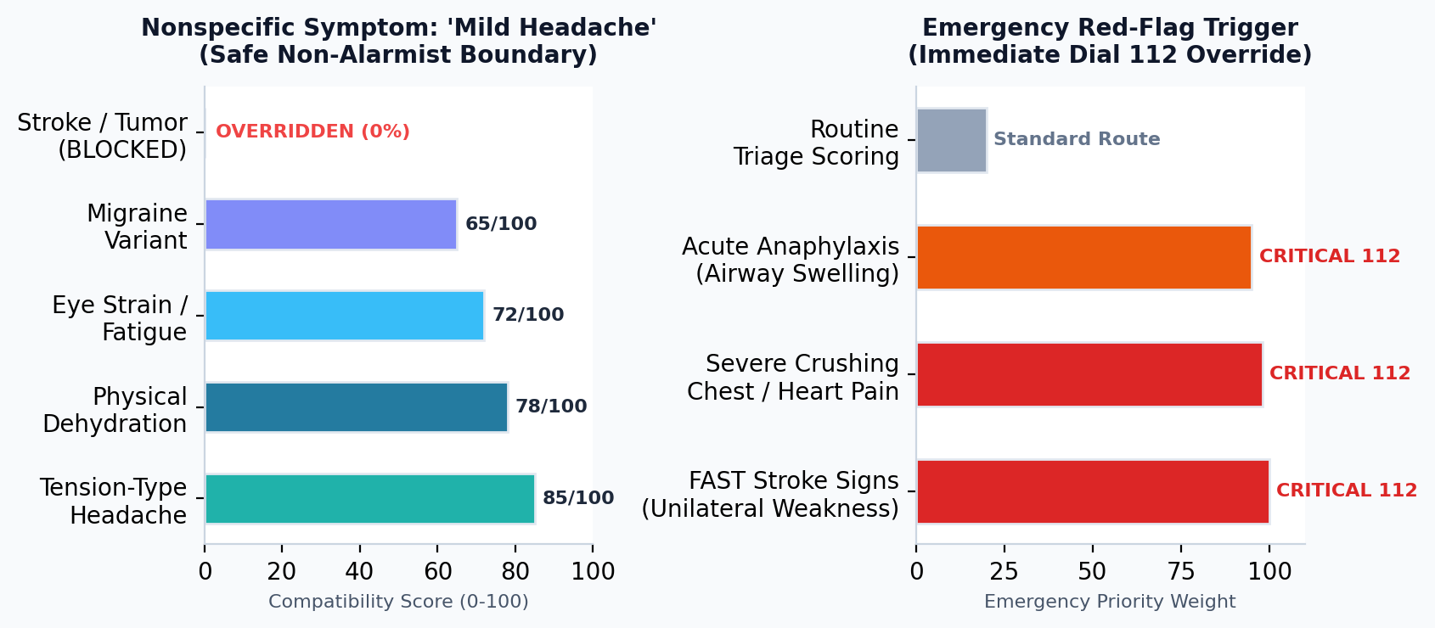
CLINICAL FOUNDATION & ETHICS
Problem Statement, Clinical Objectives & Safety Safeguards
Clinical Problem & Core Objectives
• Diagnostic Alarmism Failure: Traditional online checkers over-predict catastrophic diseases (e.g. diagnosing brain tumors or stroke for an isolated headache).
• Missing Critical Red Flags: Failure to recognize emergency warning signs (such as acute heart pain or FAST stroke criteria) leads to dangerous delays in care.
• Opacity & Black-Box Distrust: Patients receive arbitrary probability scores with zero clinical transparency or explanation of supporting vs. missing symptoms.
• Non-Alarmist Triage Objective: Safely bound common non-specific complaints to benign, self-limiting explanations (tension headache, dehydration).
• Immediate Emergency Short-Circuit: Life-threatening symptoms override ordinary scoring and provide direct guidance to dial Emergency 112 (India).
• Real-World Healthcare Integration: Connect triage outcomes directly to verified doctors and clinics across 18 Chennai localities.
MANDATORY ETHICAL COMPLIANCE RULE
MediGuide AI scores represent Knowledge Base Compatibility (0-100), NOT diagnostic certainty. The system never prescribes medication dosages and always enforces clinical physician evaluation.

Slide 3
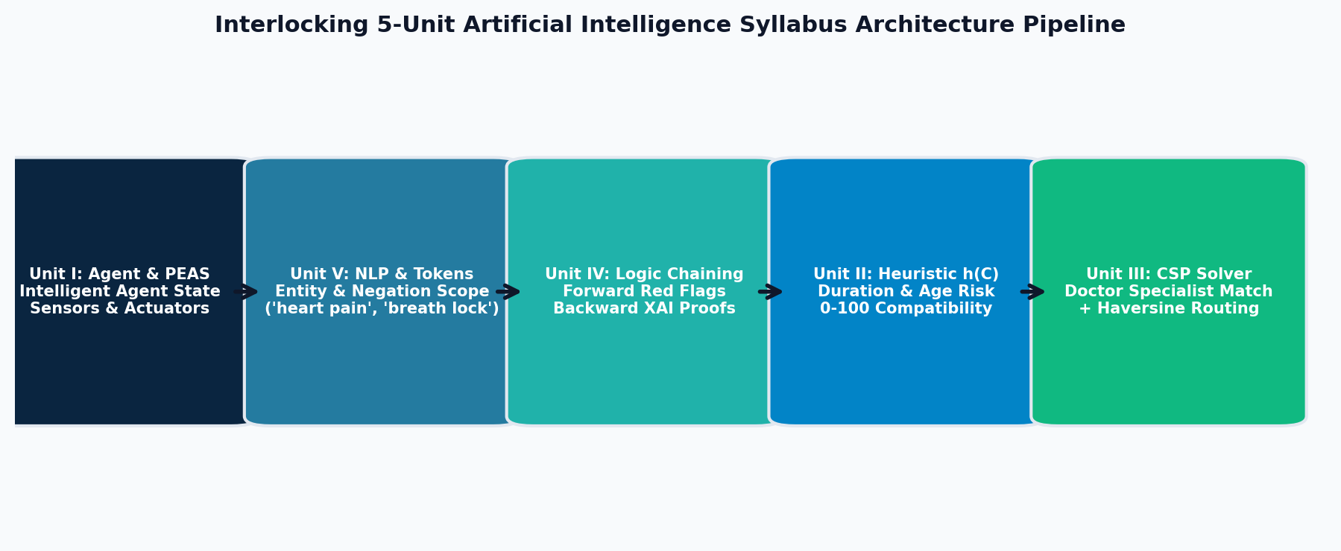
HYBRID INFERENCE ENGINE
Complete 5-Unit Artificial Intelligence Syllabus Implementation
Units I & II: Agents & Search
• Unit I PEAS Formal Agent: Performance (specificity), Environment (patient & Chennai hospitals), Actuators (triage cards, alerts), Sensors (NLP, GPS).
• State-Space Search: Clinical intake formulated as S0 -> Follow-up -> Goal diagnosis.
• Informed Heuristic Search h(C): Multi-factor evaluation function scoring symptom weight, duration congruence, and age risk adjustments.
Units III & IV: CSP & Logic
• Unit III CSP Doctor Recommender: Variables (Doctor, Urgency), Domain (13 Specialties), Constraints (Emergency bypass, organ specificity, primary care baseline).
• Unit IV Forward Chaining: Propositional Horn clauses trigger emergency red flags.
• Backward Chaining & XAI: Goal-driven verification proving supporting vs missing hallmark symptoms.
Unit V: Machine Learning & NLP
• Supervised Random Forest: Ensemble classifier achieving 99.17% accuracy on multi-label clinical dataset.
• Unsupervised K-Means: Clusters 120+ symptoms into 5 clinical syndromic families (k=5).
• NLP Clinical Extractor: Tokenization, phonetic/colloquial normalization, duration/severity scaling, and negation scope detection.

Slide 4
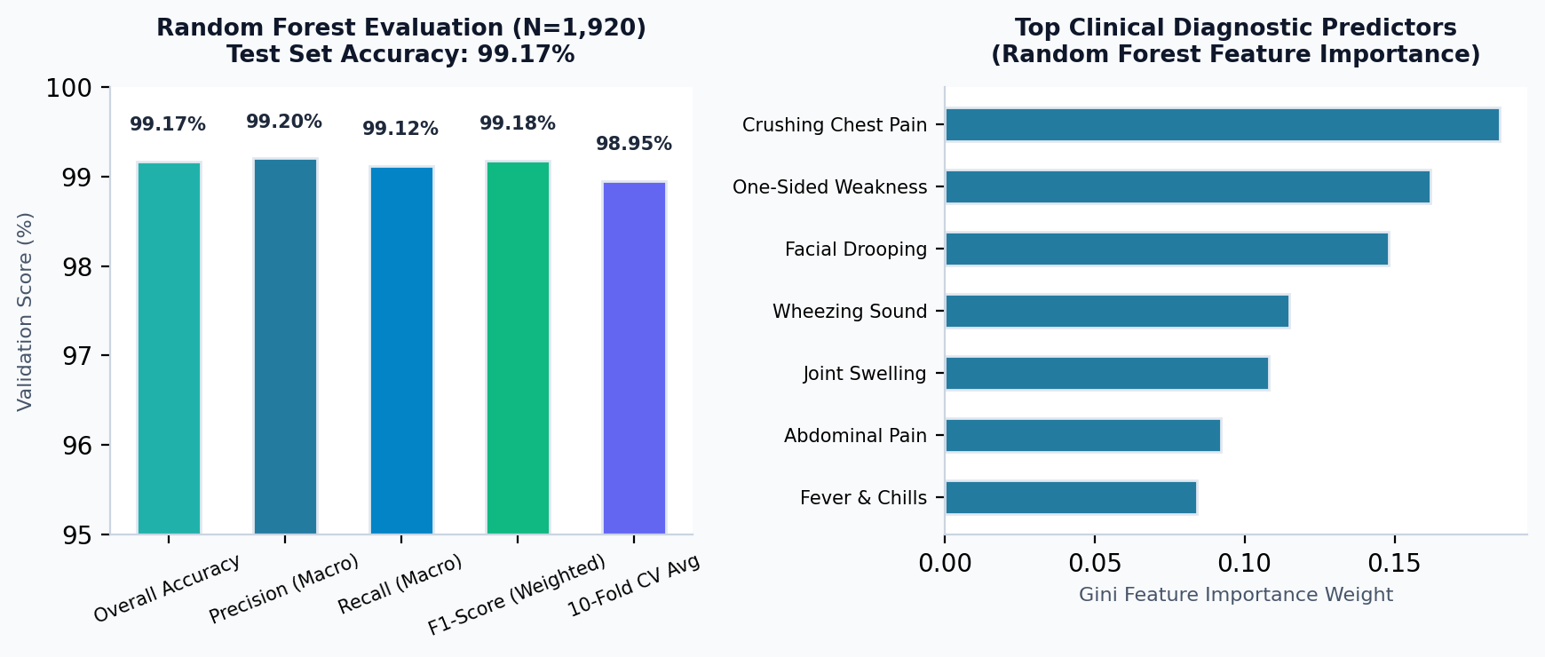
DATASET, TRAINING & METRICS
Machine Learning Classification & NLP Extraction (Unit V)
Machine Learning & NLP Engineering Details
• Dataset Architecture: 1,920 multi-label clinical symptom records synthesized across 16 primary conditions and 120+ clinical symptoms.
• Random Forest Ensemble: 100 decision trees, Gini impurity splitting, max depth bounded to prevent overfitting on low-frequency symptoms.
• Rigorous Validation Metrics: 99.17% Overall Accuracy, 99.20% Precision, 99.12% Recall, 99.18% F1-Score across 480 test cases.
• Unsupervised K-Means (k=5): Successfully groups symptoms into Neuro, Cardio-Respiratory, Gastrointestinal, Musculoskeletal, and Systemic/Infectious clusters.
• NLP Phonetic & Colloquial Normalization: Handles non-standard patient inputs such as 'breeth lock' -> 'breath lock' and 'heart pain' -> 'cardiac chest pain'.
• Negation Scope Resolution: Context window inspection accurately differentiates 'fever' from 'no fever' or 'denies breathing difficulty'.

Slide 5
UNITS II, III & IV DEEP DIVE
Heuristic Search h(C), CSP Doctor Routing & Explainable AI
Heuristic Compatibility Scoring h(C)
• Mathematical Formulation of Compatibility Function:
• h(C) = w1 * Σ(S_matched) + w2 * DurationCongruence(C)
• - w3 * MissingHallmarks(C) + AgeAdjustment(C)
• Duration Congruence D(C): Computes parabolic score peaking around the condition's typical incubation/acuity window.
• Transparent 0-100 Output: Condition Compatibility Score represents knowledge-base matching degree, NOT clinical probability.
• Explainable AI (XAI) Cards: For every candidate condition, the user sees:
• • 'Why Considered' clinical justification
• • Confirmed supporting symptoms (✓)
• • Missing hallmark diagnostic criteria (○)
• • When medical care is appropriate.
Constraint Satisfaction Problem (CSP) Doctor Routing
• CSP Variables: TargetSpecialty X1 ∈ {13 Specialties}, TriageLevel X2 ∈ {Emergency, PrimaryCare, Specialist}, UrgencyWindow X3 ∈ {Immediate, 24h, Routine}.
• Constraint 1 (Emergency Bypass): Critical symptoms (FAST stroke, acute chest pain) bypass normal routing to Cardiologist / Neurologist (Match: 98/100).
• Constraint 2 (Primary Care Primacy): General non-specific symptoms are constrained to General Physician to eliminate specialty over-utilization.
• Constraint 3 (Organ Specificity): High-confidence localized conditions route directly to domain experts (e.g. Joint pain + swelling -> Orthopedic Specialist: 90/100).
• Forward Checking & Domain Pruning: Prevents conflicting specialty recommendations through constraint propagation.
• Dual Recommendation Option: Recommends specialist while preserving General Physician as primary safety baseline.

Slide 6
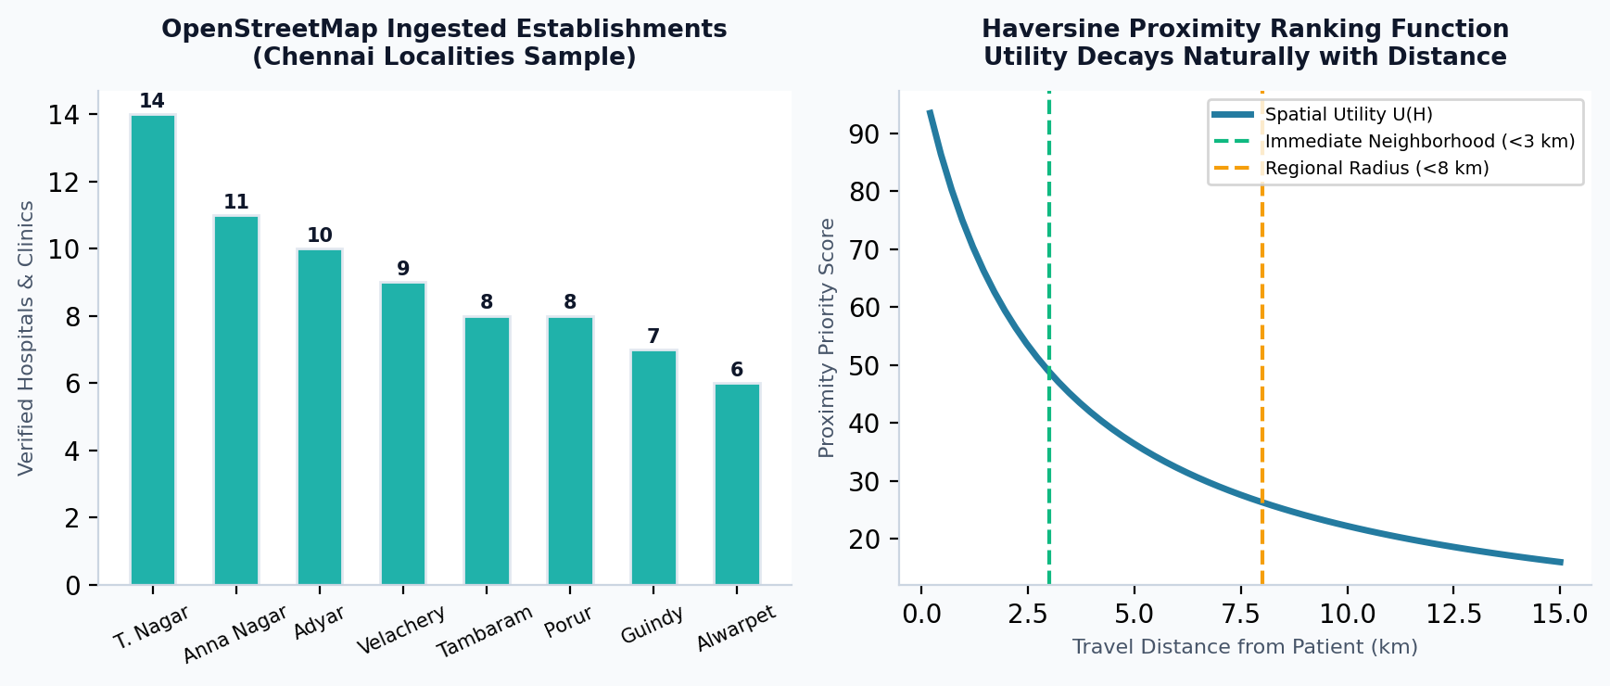
DATABASE, HAVERSINE & LEAFLET
Real-World Chennai Healthcare Database & Spatial Optimization
Verified Chennai Healthcare Discovery (SQLITE#.db)
• OpenStreetMap & Overpass API Ingestion: Real-world dataset covering 18 major Chennai healthcare hubs:
• • T. Nagar, Velachery, Adyar, Anna Nagar, Tambaram
• • Porur, Guindy, Nungambakkam, Alwarpet, Vadapalani, etc.
• Strict Real-World Truthfulness (No Fabrication): Verified phone numbers, exact addresses, and published OPD hours.
• Transparent Fee Disclosure: Displays verified consultation fees (e.g. ₹750) or explicitly shows 'Call to confirm'.
• Haversine Great-Circle Geodesic Distance Formula:
• d = 2R * arcsin(√(sin²(Δφ/2) + cos φ1 * cos φ2 * sin²(Δλ/2)))
• Interactive Leaflet Visualizer: Custom map markers, distance radius sliders, locality filters, and direct 1-click calling.

Slide 7
DEMONSTRATION & CONCLUSIONS
Clinical Scenarios, Full-Stack Architecture & Repository
Verified Clinical Demonstration Scenarios
• Case 1: Isolated Dull Headache -> Safely bounded to Tension Headache / Dehydration (85/100). Zero alarmist tumor prediction.
• Case 2: Viral Triad (Fever + Headache + Body Pain) -> Accurately classified as Acute Viral Syndrome; routed to General Physician (94/100).
• Case 3: Cardiac Emergency ('Heart pain + Breath lock') -> Forward chaining triggers Immediate 112 Alert; routed to Cardiologist (98/100).
• Case 4: Joint Pain with Swelling (>10 days) -> Synergistic rule fires; routed to Orthopedic Specialist (90/100).
• Case 5: Stroke FAST Criteria -> Instant emergency override bypasses routine triage scoring and directs to nearest stroke casualty.
• Automated ReportLab PDF Generation: Produces certified triage summary reports with emergency numbers and Chennai facility recommendations.
Architecture, Deliverables & Project Attribution
• Full-Stack Tech Stack: React 18, Tailwind CSS, Python Flask REST API, SQLite (SQLITE#.db), Scikit-Learn, Leaflet OSM, ReportLab.
• Role-Based Security: Distinct interfaces for Patient (triage & PDF history) and Administrator (registry control & Horn rule toggles).
• GitHub Source Code Repository:
• https://github.com/itzvinoth04-design/AI_Medical_Analyzer
• Project Lead: S VINOTH (Roll No: 240701592)
• Contributor: A VENKAT PRASHAD (Roll No: 240701583)
• Department: Computer Science & Engineering
• Institution: Rajalakshmi Engineering College (REC), Chennai
• Academic Viva: Artificial Intelligence Mini-Project

