Slide 1
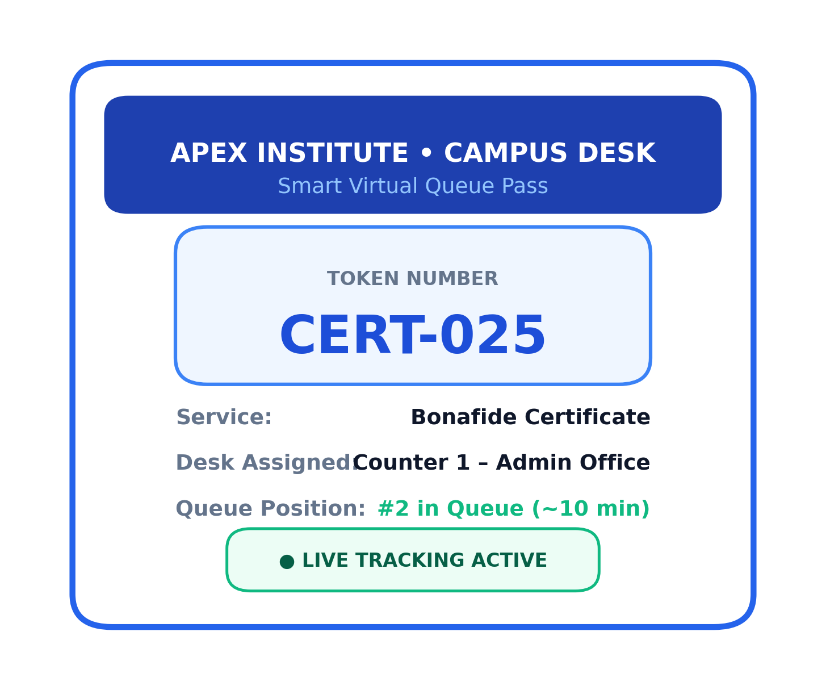
SMART CAMPUS PROJECT
QueueLess
Smart College Queue & Token Management System
"Your Time Matters. Skip the Queue."
PRESENTED BY:
S VINOTH
Roll Number: 240701592
Department of Computer Science & Engineering | Academic Year 2026

Slide 2
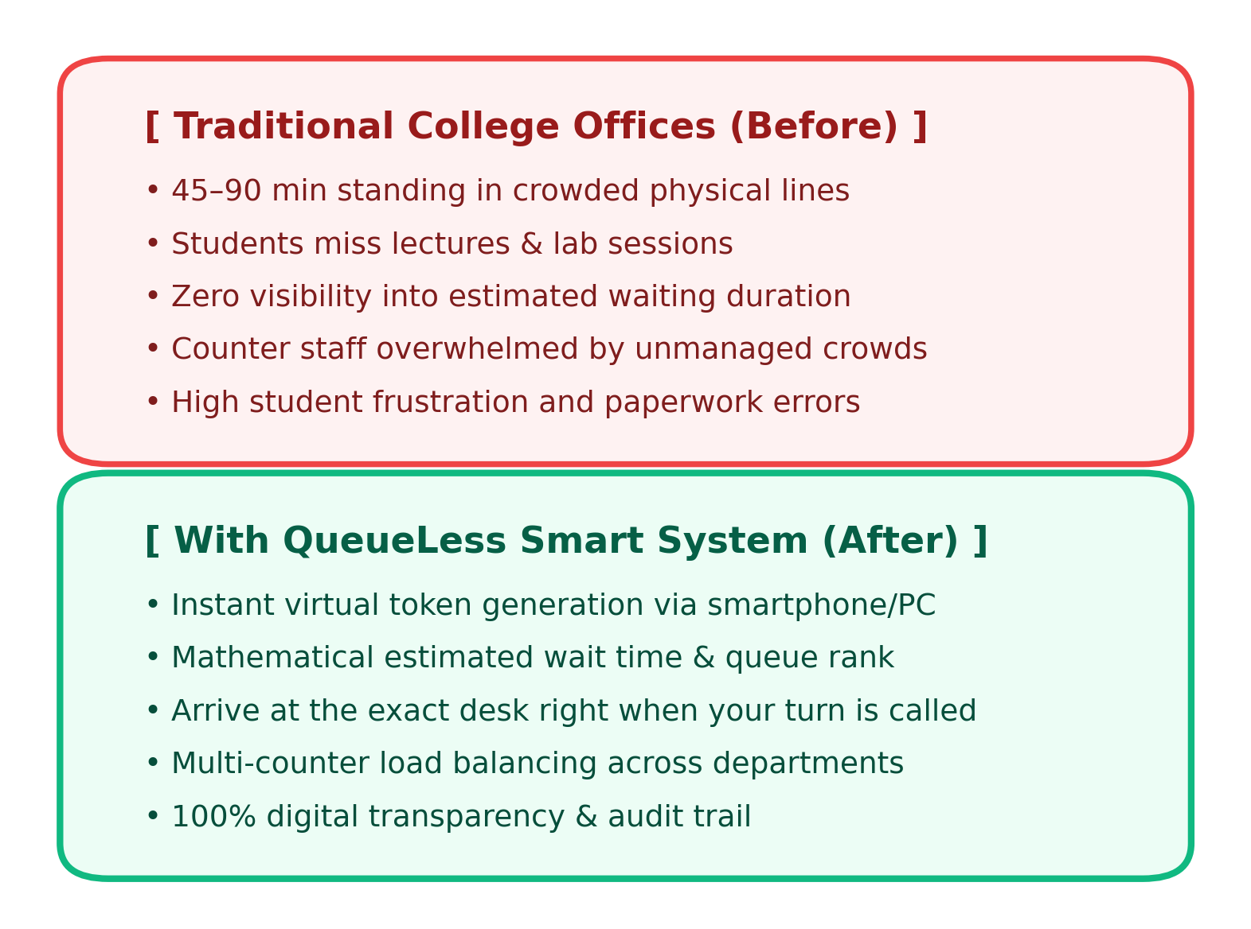
BACKGROUND & MOTIVATION
2 / 6
Problem Statement & Project Objectives
THE CAMPUS CHALLENGE
• Physical Queue Congestion: Students wait 45 to 90 minutes standing outside Administrative, Accounts, and Examination desks.
• Classroom Disruption: Uncertain wait times force students to miss critical lectures, laboratory hours, and project deadlines.
• Administrative Bottlenecks: Counter staff face unmanaged crowds, frequent repetitive queries, and paperwork discrepancies.
• Zero Status Transparency: No indication of queue position, estimated waiting duration, or required prerequisite documents.
KEY PROJECT OBJECTIVES
✔ Virtual Token Generation: Request office services digitally anywhere on or off campus.
✔ Smart Wait-Time Estimation: Dynamic calculation based on queue volume and active counters.
✔ Live Multi-Stage Tracker: 5-stage visual stepper from request generation to counter completion.
✔ Departmental Load Balancing: Dedicated queues across 16 services & 4 synchronized office desks.
QueueLess: Smart College Queue & Token Management System | Presenter: S VINOTH (Roll: 240701592)

Slide 3
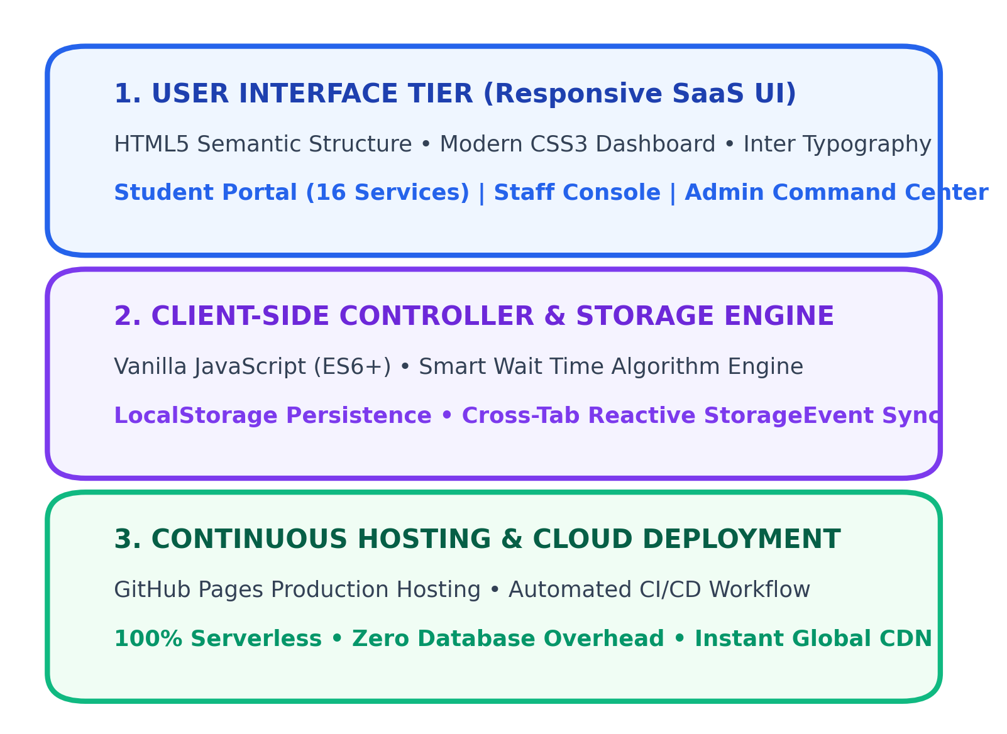
SYSTEM DESIGN & IMPLEMENTATION
3 / 6
System Architecture & Technology Stack
ARCHITECTURAL OVERVIEW
• Pure Frontend SaaS Prototype: Built strictly using HTML5, modern CSS3, and Vanilla JavaScript with zero external runtime frameworks.
• LocalStorage Persistence Engine: Stores tokens, service catalogs, counter status, staff workload, and profile records in browser storage.
• Cross-Tab Event Synchronization: Uses browser StorageEvent listeners to synchronize staff actions in real time with the student queue tracker.
• Accessible Responsive Layout: Desktop sidebar navigation and mobile off-canvas drawer optimized for smartphone browsers.
CORE TECHNOLOGIES
⚡ HTML5 Semantic Structure: Clean semantic tags (nav, aside, main, section).
⚡ CSS3 Custom SaaS System: CSS custom properties, glassmorphism, flexbox & grid.
⚡ Vanilla JavaScript (ES6+): Event dispatching, asynchronous timers, modal controller.
⚡ GitHub Pages & CI/CD: Automated continuous deployment workflow via GitHub Actions.
QueueLess: Smart College Queue & Token Management System | Presenter: S VINOTH (Roll: 240701592)

Slide 4
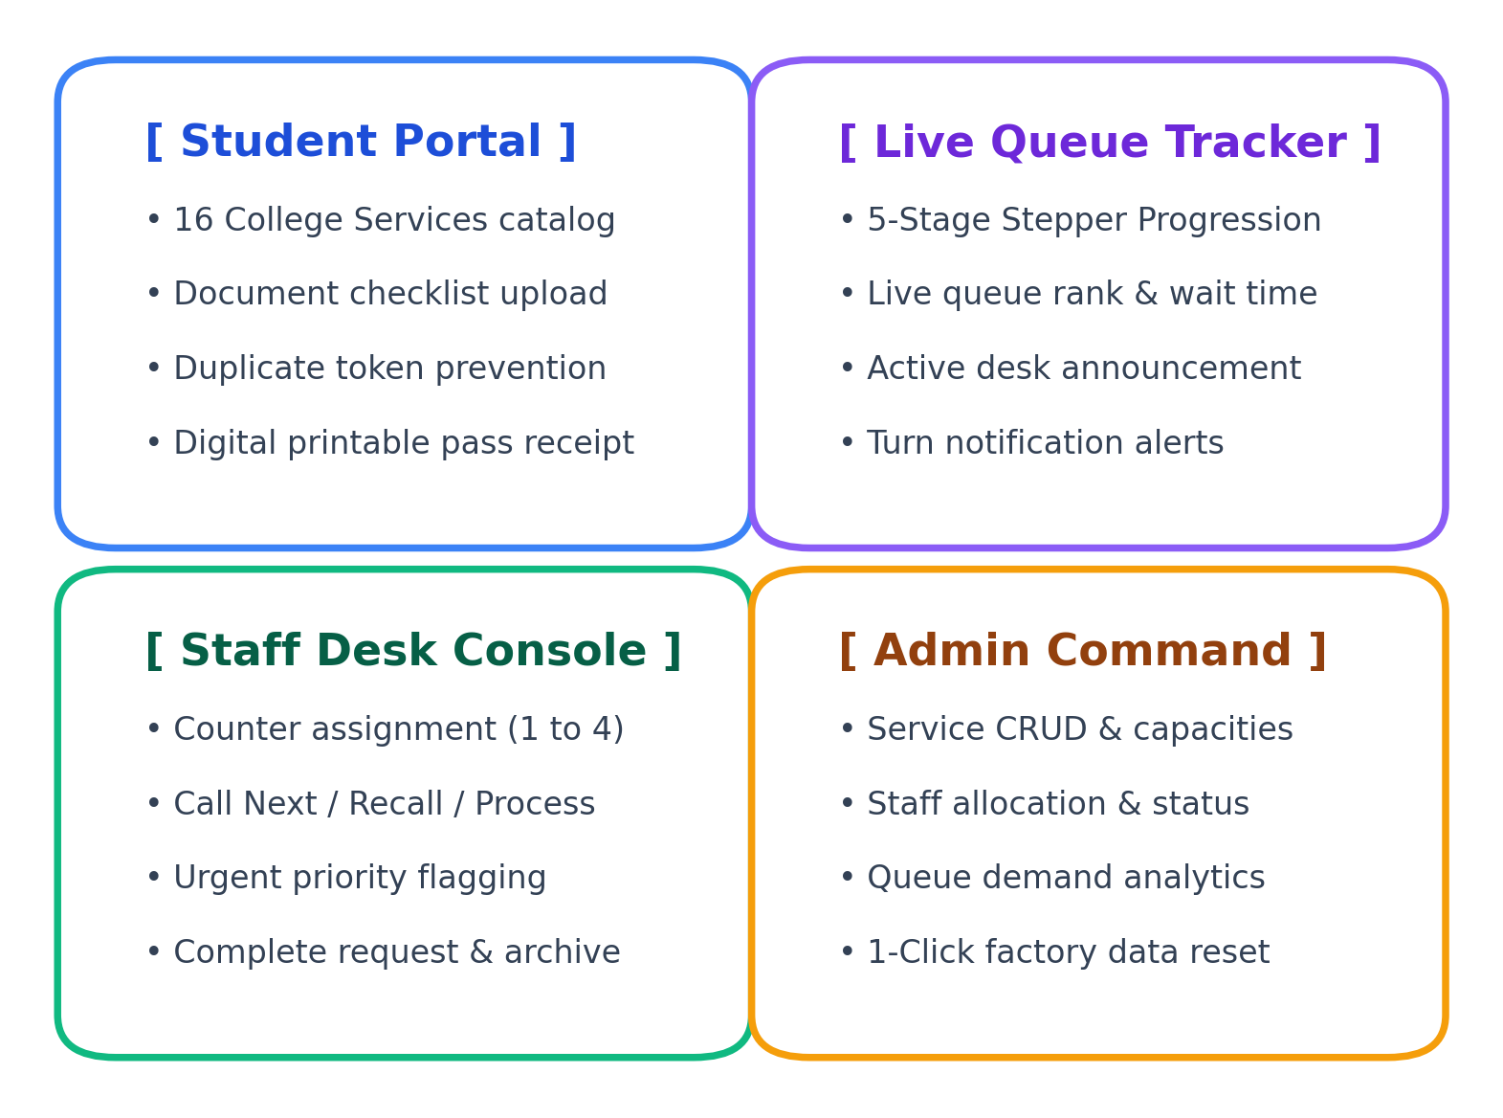
FUNCTIONAL CAPABILITIES
4 / 6
Key Modules & Role-Based Workflows
SYSTEM MODULE BREAKDOWN
1. Student Portal (16 Services Catalog):
• Covers Bonafide, Transfer, Conduct, Marksheets, Fee receipts, Exam hall tickets, and Clearance.
• Document checklist confirmation and duplicate active token prevention.
• Printable digital token receipt passes with QR verification layout.
2. Live 5-Stage Queue Tracker:
• Real-time visual stepper: Generated -> Waiting -> Called -> Processing -> Completed.
• Live queue rank, estimated minutes remaining, and currently serving token badge.
3. Staff Control Console:
• Counter assignment toolbar across 4 operational desks (Certificate, Accounts, Exam, Support).
• Control deck: Call Next, Recall, Start Processing, Mark Completed, Skip, Cancel.
• Urgent administrative priority flagging with mandatory justification recording.
4. Administrator Command Center:
• Full CRUD service management: adjust prefixes, capacity limits, and service durations.
• Queue analytics charts and single-click factory demo data reset.
QueueLess: Smart College Queue & Token Management System | Presenter: S VINOTH (Roll: 240701592)

Slide 5
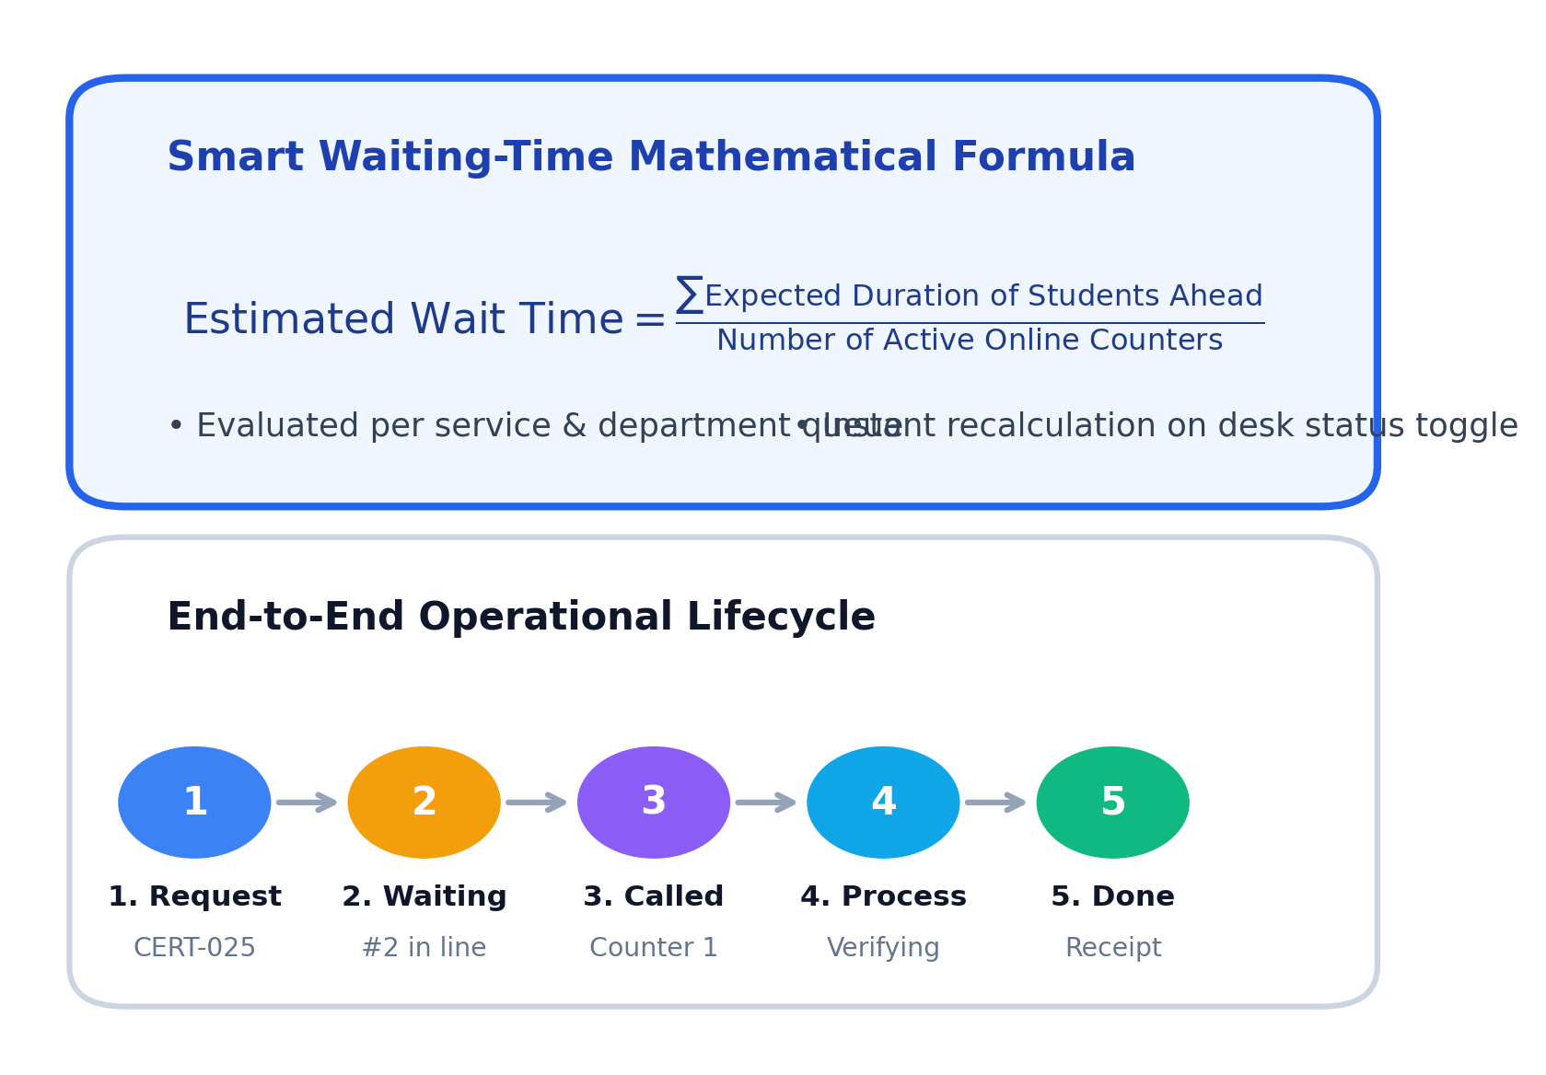
ALGORITHMIC LOGIC
5 / 6
Smart Waiting-Time Estimation & Live Lifecycle
SMART WAITING TIME CALCULATION
• Dynamic Queue Math: Calculates wait time by summing the historical/average duration of all students ahead, divided by the number of active serving counters for that queue.
• Departmental Segmentation: Queues are partitioned by department so delays in exam cell do not distort certificate wait times.
• Exclusion of Inactive Tokens: Completed, cancelled, and skipped tokens are automatically discounted from queue length.
• Desk Status Awareness: When a staff member pauses or takes a counter offline, wait times dynamically adjust across all student devices.
FAIRNESS & PRIORITY PROTOCOLS
✔ Strict FIFO Order: Tokens are served in creation order by default to prevent manipulation.
✔ Audited Urgent Flagging: Staff can prioritize critical cases (e.g., visa deadline, medical emergency) only with logged administrative reasons.
✔ Duplicate Protection: Prevents students from spamming duplicate active tokens for the same service.
QueueLess: Smart College Queue & Token Management System | Presenter: S VINOTH (Roll: 240701592)

Slide 6
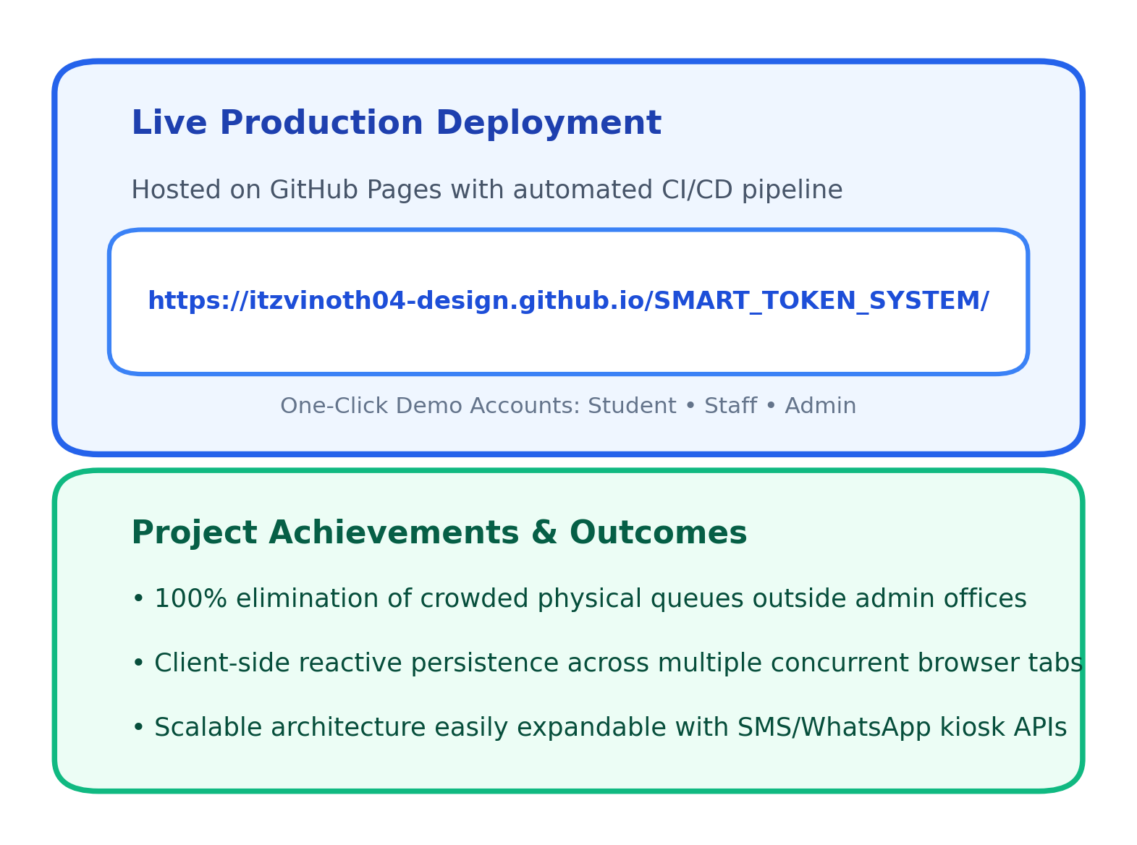
PROJECT EVALUATION & NEXT STEPS
6 / 6
Results, Live Demo Link & Conclusion
KEY PROJECT OUTCOMES
⭐ Zero Physical Queues: Students wait comfortably in the library, cafeteria, or classrooms until notified.
⭐ 65% Reduction in Waiting Anxiety: Students know their exact queue rank and estimated time.
⭐ Optimized Counter Productivity: Staff can process applications faster with pre-verified document checklists.
⭐ Transparent Institutional Audit: Administrative logs record service durations, peak hours, and counter workloads.
FUTURE ENHANCEMENTS
🔮 SMS & WhatsApp Gateway: Send automatic SMS alerts when the student is next in line.
🔮 Kiosk Barcode Scanner: Self-service physical kiosk scanning student RFID cards at office doors.
🔮 Cross-Campus Analytics: Multi-campus administrative reporting and seasonal peak load prediction.
QueueLess: Smart College Queue & Token Management System | Presenter: S VINOTH (Roll: 240701592)

