Slide 1
Presentation
Summary of week: 5, 6, 7

Slide 2
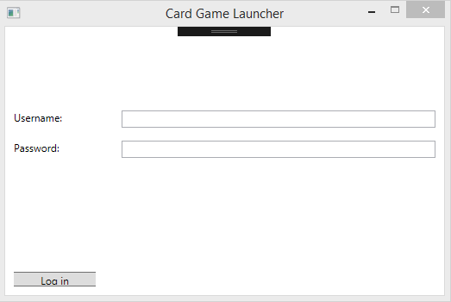
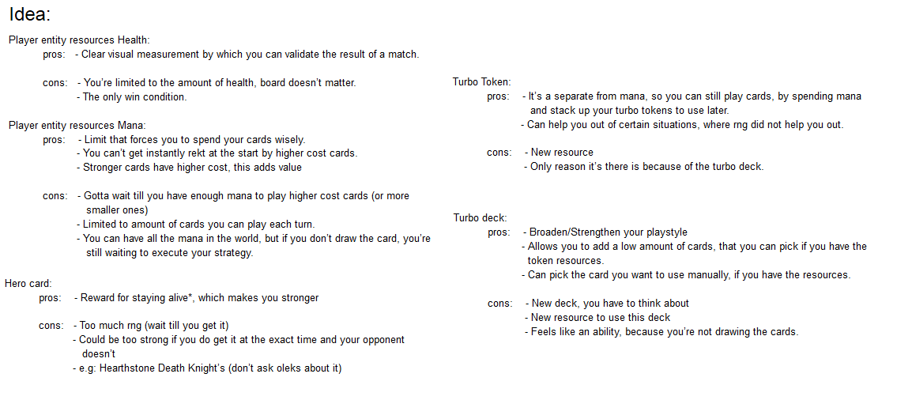
Content
Game Launcher
Game Design

Slide 3
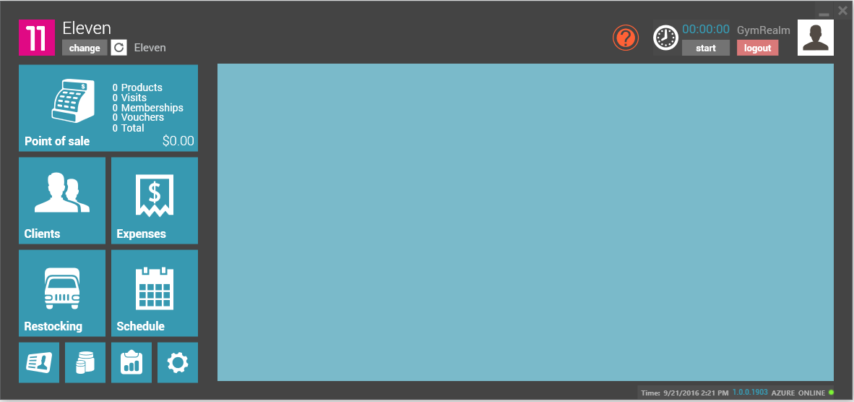
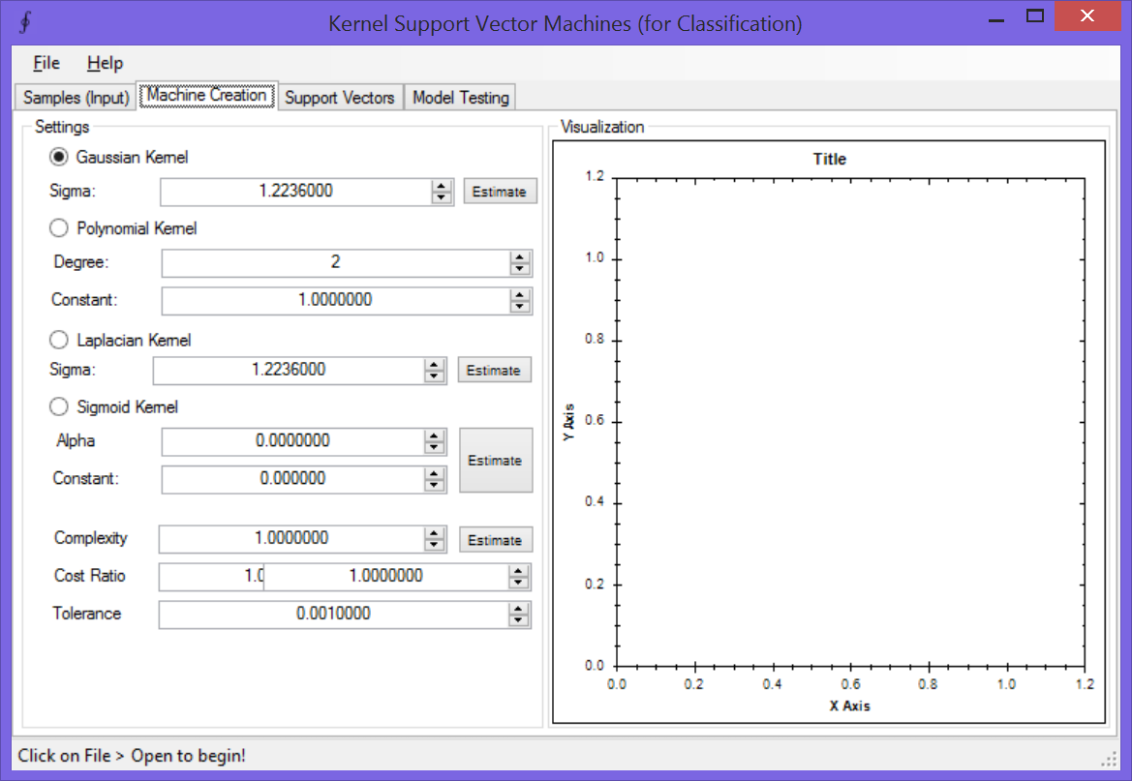
Game Launcher – Tooling
C# WPF
C# Windows Forms

Slide 4
Game Launcher – Tooling
C# WPF
C# Windows Forms
No previous experience
MVVM
(Model, View, View-Model)
Seperates view from model
Model
Back-end (engine)
View
Front-end (visuals)
View-Model
Data binding (events, properties, etc)
More a model than a view
(it functions as an abstraction of the view)
Passes input to model (potentially validate it)
Does not have references to any view!
Previous experience
MVC
(Model, View, Controller)
Seperates view from model
Model
Back-end (engine)
View
Front-end (visuals)
Controller
Responds to user input
Passes input to model (potentially validate it)
Does contain a reference to one or more view(s)

Slide 5
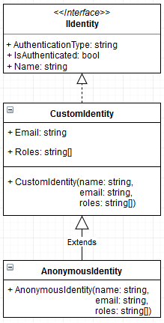
Game Launcher – Auth
Identity
Identity objects encapsulate information about the user or entity being validated

Slide 6
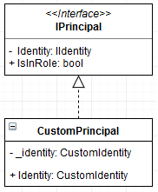
Game Launcher – Auth
Principal
Represents the security context under which code is running
A role-based principal permits users with certain roles to view trusted content in your application, e.g: Logged in identity vs Unauthorized identity.
By default bound to a call context (CallContext) in an application domain
Automatically copied to newly created threads by binding to the thread’s call context.

Slide 7
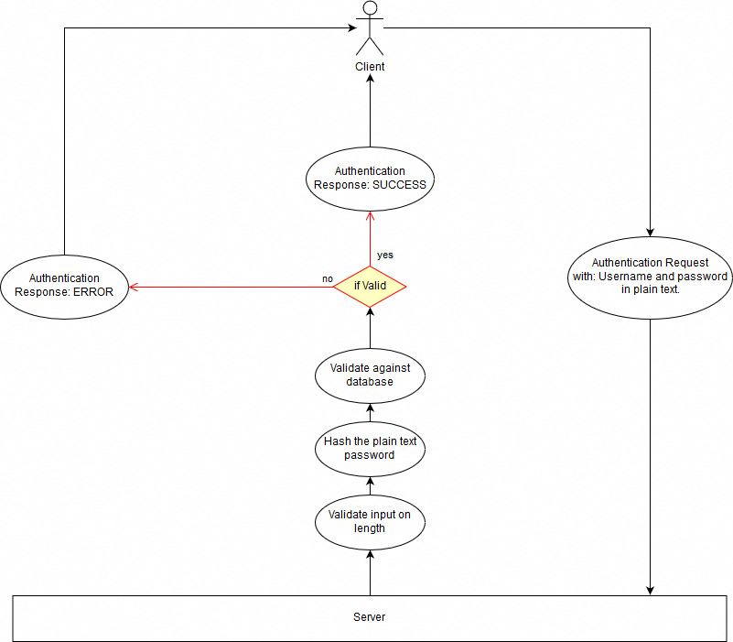
Game Launcher – Auth
Authentication

Slide 8
Game Launcher – Auth
Launcher demo part 1

Slide 9
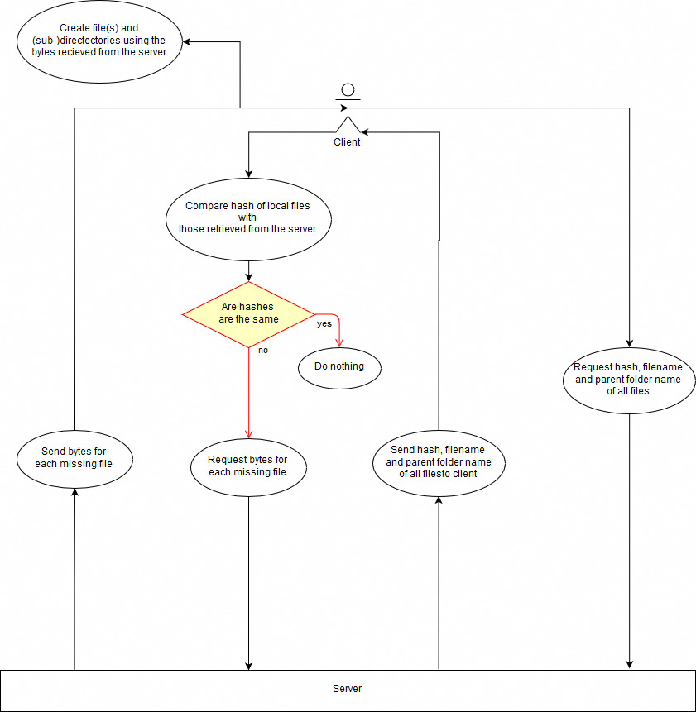
Game Launcher – Downloading

Slide 10
Game Launcher – Auth
Launcher demo part 2

Slide 11
Game Launcher – Game Design
Game design document

Slide 12
Game Launcher – End
The End

