Slide 1

GENESIS
Build apps
from a conversation
An AI workspace for CRM-connected applications
Notes:
Genesis is a prototype AI app builder for CRM-connected workflows.
Source: project README and current implementation, Genesis workspace.

Slide 2
GENESIS
The product
Describe the workflow.
Build with live CRM data.
FOR TEAMS
Explore a workflow visually and iterate in conversation.
Genesis turns a plain-language request into editable web app files and a sandboxed preview.
02
Notes:
The generated application uses a host-provided bridge for supported CRM operations.
Source: project README and current implementation, Genesis workspace.

Slide 3
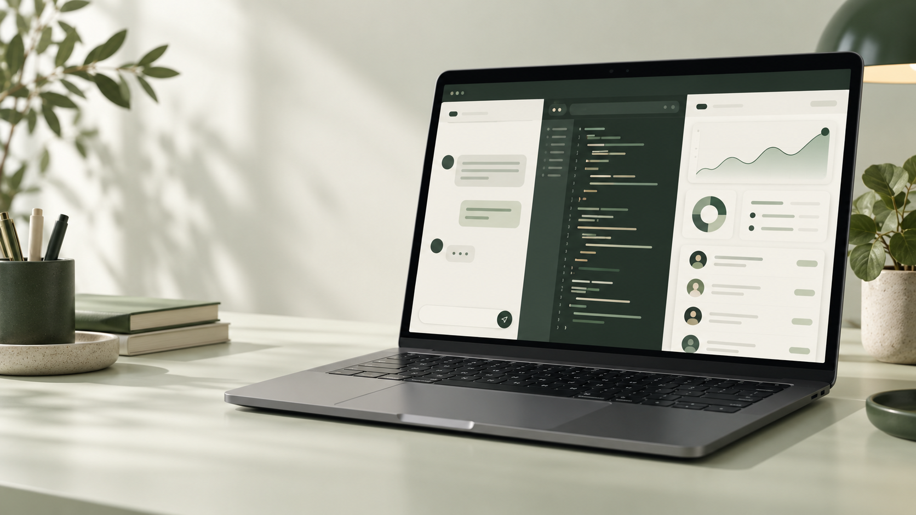
GENESIS
The product experience
A conversation becomes a working starting point
A single workspace keeps the prompt, generated code and live preview together.
Illustrative concept
03
Notes:
This illustration represents the product concept and is not a screenshot.
Source: project README and current implementation, Genesis workspace.

Slide 4
GENESIS
A workflow from prompt to preview
01
02
03
04
Connect
Describe
Review
Refine
Sign in and connect a CRM location.
Ask for an application in plain language.
Watch output arrive and inspect generated files.
Edit code or ask for the next change.
04
Notes:
The generation endpoint supports streamed events. Real-world generation reliability remains under review.
Source: project README and current implementation, Genesis workspace.

Slide 5
GENESIS
One workspace for building
Conversation
Code
Preview
Send requests, follow generation and review the project history.
Inspect and edit project files in a Monaco-based editor.
Run the generated app in an isolated iframe with a CRM bridge.
Saved snapshots support restoring an earlier version.
05
Notes:
The live preview uses an iframe sandbox and a message bridge. Each generation creates a snapshot.
Source: project README and current implementation, Genesis workspace.

Slide 6
GENESIS
Connected CRM workflows
Contacts
Conversations
Calendars
List and search contacts. Create or update a contact after confirmation.
List conversations, read messages and submit an SMS or email.
List calendars, retrieve appointments and check available slots.
Delivery and account permissions depend on the connected CRM environment.
06
Notes:
Some message delivery tests returned account configuration errors. API acceptance does not guarantee delivery. Contact search currently retrieves the first page.
Source: project README and current implementation, Genesis workspace.

Slide 7
GENESIS
Production architecture
Browser
Firebase
External services
Vue workspace
Sandboxed app preview
Hosting and Authentication
Functions and Firestore
Secret Manager
HighLevel OAuth and APIs
AI generation provider
The backend validates requests and keeps CRM credentials on the server.
07
Notes:
The current deployed provider is Groq. The assignment requires OpenAI or Claude.
Source: project README and current implementation, Genesis workspace.

Slide 8
GENESIS
Generation and data flow
Request
Generate
Validate and save
Preview
Natural-language prompt
AI streams a response
Files and snapshots
Run the generated app
CRM requests pass through the host bridge and the backend.
08
Notes:
The server streams tokens, validates generated file records, stores files and snapshots, and mediates CRM requests.
Source: project README and current implementation, Genesis workspace.

Slide 9
GENESIS
Safety and version history
Credentials stay on the server
Changes can be reviewed
OAuth tokens are encrypted before storage. The preview receives a limited API bridge.
CRM writes require confirmation. Snapshots support restore and generation diff.
Access controls and rate limits protect supported endpoints.
09
Notes:
Cloud Functions mediate Firestore access. Rate limits exist for generation and CRM endpoints; they are not universal limits across every endpoint.
Source: project README and current implementation, Genesis workspace.

Slide 10
GENESIS
Deployment and capabilities
Application
AI generation
Firebase-hosted workspace
HighLevel CRM integration
Editable code and version history
Responses stream into the workspace
Generated files are validated
Users can stop a generation
Generation uses the OpenAI SDK with server-side credentials.
10
Notes:
Tests use mocks and do not replace end-to-end validation. A previously observed malformed generation response still needs investigation.
Source: project README and current implementation, Genesis workspace.

