Slide 1
More HTML
Chapter 4

Slide 2

Nesting Tags
How do you write the following in HTML?
The wrong way:
This is <strong>really, <em>REALLY</strong> fun</em>!
Tags must be correctly nested.
  A closing tag must match the most recently opened tag.
The right way:
This is <strong>really,</strong> <em><strong>REALLY</strong> fun</em>!

Slide 3
Spacing And Indentation
Which tag is not closed?
<html><head><title>Can you find it?</title></head> <body><p><ul><li>Not it!</li><li><ol><li>Is it here? </li><li>Or maybe it's this one?</li></ol></li><li> More words here</li><li>This is very hard to read</li></p></body></html>

Slide 4
How About Now?
<html>
<head>
<title>Can you find it?</title>
</head>
<body>
<p>
<ul>
<li>Not it!</li>
<li>
<ol>
<li>Is it here?</li>
<li>Or maybe it's this one?</li>
</ol>
</li>
<li>More words here</li>
<li>This is very hard to read</li>
</p>
</body>
</html>

Slide 5
Spacing And Indentation Guidelines
If the tag's content fits on one line, open and close the tag on the same line.
Otherwise, the tag's content should be indented more than the starting and closing tags.
If the starting and closing tags are on separate lines, they should line up vertically, like above.
<li>Is it here</li>
<ol>
<li>Is it here?</li>
<li>Or maybe this tag is not closed?</li>
</ol>

Slide 6
Spacing And Indentation Guidelines
Use newlines to structure the HTML.
The wrong way:
The right way:
<ol>
<li>Item 1</li><li>Item 2</li><li>Item 3</li>
</ol>
<ol>
<li>Item 1</li>
<li>Item 2</li>
<li>Item 3</li>
</ol>

Slide 7
Extensible HTML: XHTML
Newer version of HTML, standardized in 2000
XHTML tags must always be …
  … in lowercase
  … closed
  … nested properly
XHTML 1.0 Strict is the standard we will be using.
  Reference: http://www.december.com/html/x1/

Slide 8
Why Use Standards?
Ensure interoperability across different browsers
Can easily verify if standards-compliant
  XHTML Validation Service: http://validator.w3.org/
Alas, not all web browsers (particularly Internet Explorer) adhere to the standards
  http://www.webdevout.net/browser-support-summary

Slide 9
Basic XHTML Template
<?xml version="1.0" encoding="utf-8" ?>
<!DOCTYPE html PUBLIC "-//W3C//DTD XHTML 1.0 Strict//EN" "http://www.w3.org/TR/xhtml1/DTD/xhtml1-strict.dtd">
<html xmlns="http://www.w3.org/1999/xhtml">
<head>
<title>page title goes here</title>
</head>
<body>
page content goes here
</body>
</html>

Slide 10
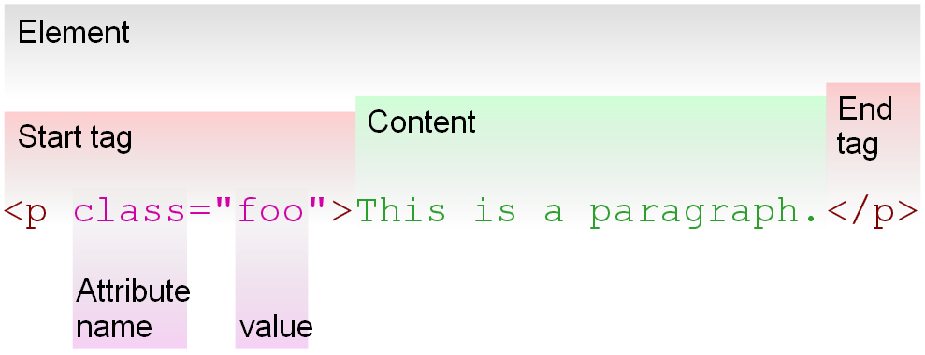
HTML Element

Slide 11
Block vs. Inline Elements
Block elements create "larger" structures than inline elements.
In general,
  block elements may contain text, inline elements, and other block elements.
  inline elements may contain only text and other inline elements.
Block elements begin on new lines, inline elements do not.

Slide 12
Block or Inline?
Block
  h1, h2, ..., h6
  p
  ul, ol
  hr
Inline
  br
  em
  strong
  a
  img

Slide 13
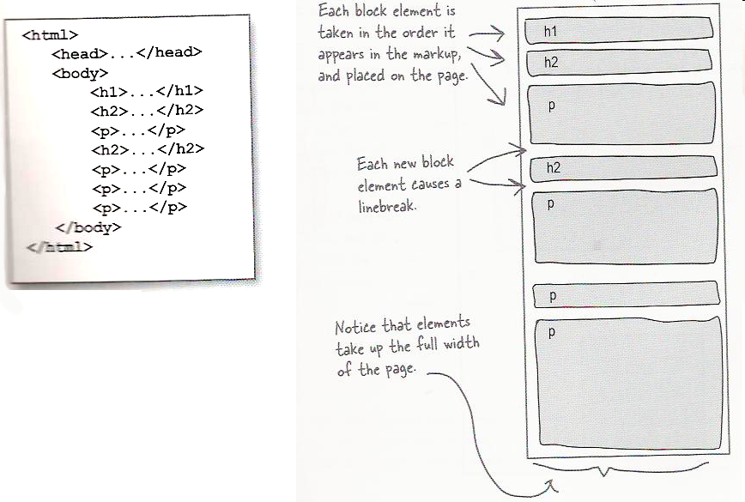
Document Flow: Block Elements

Slide 14
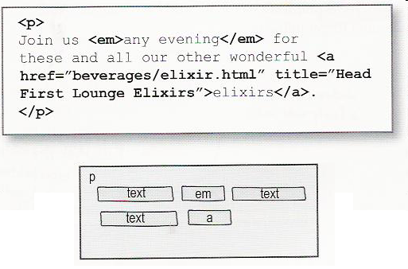
Document Flow: Inline Elements

Slide 15
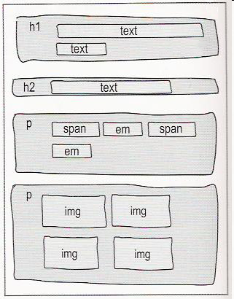
Document Flow Example

Slide 16
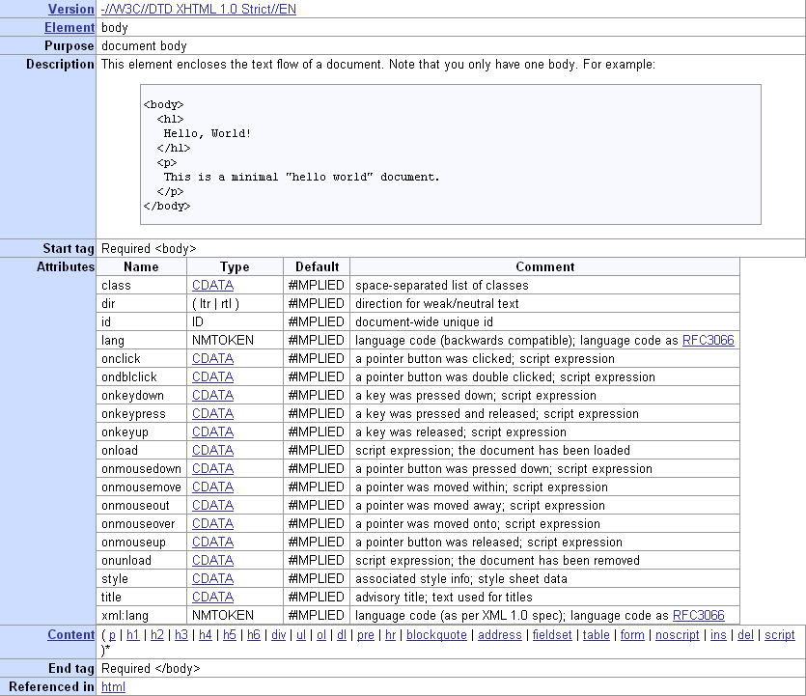
Why Important?
Only block elements are directly allowed inside the body element.
Elements allowed in body element
Image snapshot from XHTML 1.0 Strict Reference http://www.december.com/html/x1/element/body.html

Slide 17
What About Links?
No a!
Allowable content for body:
Illegal:
How can a web page have links?
  One solution is to put the link in a block element.
<body>
<a href="http://www.yahoo.com">Yahoo!</a>
</body>
<body>
<p><a href="http://www.yahoo.com">Yahoo!</a></p>
</body>

Slide 18


Images In XHTML
Requires an alt attribute describing the image
<p>
<img src="hamster.jpg" alt="Hamster eating carrot" />
</p>
Image present:
Image missing:

Slide 19
XHTML Validation
Make sure your files validate!
  XHTML Validation Service: http://validator.w3.org/
When fixing errors, fix the first error and then try validating again.
  For example, a single missing closing tag might be confused for several errors.
Validation does not check for proper indentation.

Slide 20

Web 2.0

Slide 21
HTML/XHTML Resources
W3Schools HTML Tutorial
  http://www.w3schools.com/html/default.asp
W3Schools XHTML Tutorial
  http://www.w3schools.com/xhtml/default.asp
Complete list of HTML tags
  http://www.w3schools.com/tags/default.asp
XHTML 1.0 Strict Reference
  http://www.december.com/html/x1/

Slide 22
Cascading Style Sheets (CSS)
Describe the appearance, layout, and presentation of information on a web page
Describe how information is to be displayed, not what is being displayed

Slide 23
Basic CSS Rule
A CSS file contains one or more rules.
Rule syntax:
selector: HTML element you wish to style
property: attribute you wish to change
selector {
property: value;
property: value;
...
property: value;
}

Slide 24
Example
CSS:
HTML:
p {
font-family: sans-serif;
background-color: yellow;
}
<p>Can you see me now?</p>

Slide 25
Color Properties
color: color of the element's text
background-color: color that will appear behind the element

Slide 26
Colors
Colors are defined by three numbers (from 0 to 255) representing the amount of red, green, and blue (RGB)
Can specify colors by:
  Pre-defined name
    aqua, black, blue, fuchsia, gray, green, lime, maroon, navy, olive, purple, red, silver, teal, white, yellow
  RGB triplet
    rgb(R,G,B) where R, G, and B are each numbers from 0 to 255
  RGB triplet in hexadecimal format*
    #RRGGBB where RR, GG, BB are the red, green, and blue values in hexadecimal
ColorSchemer: http://www.colorschemer.com/online.html
*You do not need to understand hexadecimal.

Slide 27
Colors Example
Ways to specify teal
h1 {
color: teal;
}
h1 {
color: rgb(0,128,128);
}
h1 {
color: #008080;
}

Slide 28
More Properties: Font
font-family: which font will be used
font-size: how large the letters will be drawn
font-style: used to enable/disable italic style
font-weight: used to enable/disable bold style
For examples on how to set these and other properties, see:
  http://www.w3schools.com/css/css_reference.asp
  http://www.tizag.com/cssT/reference.php

Slide 29
Attaching a CSS File: <link />
<head>
<title>...</title>
<link rel="stylesheet" type="text/css" href="style.css" />
</head>
Copy the rel and type attributes and their corresponding values verbatim
Use the href attribute to specify the location of a stylesheet file
  Path location may be absolute or relative

Slide 30
CSS Resources
CSS property references:
  http://www.w3schools.com/css/css_reference.asp
  http://www.tizag.com/cssT/reference.php
CSS tutorial:
  http://www.tizag.com/cssT/
CSE 190 M (Web Programming) lecture notes:
  http://www.cs.washington.edu/education/courses/cse190m/CurrentQtr/lectures/slides/lecture03-basic_css.html

