Slide 1
AI Powered Attendance Capturing System
Submitted by: Team ID: 257829
Guided by: Vatsal Patel
Name of Students | Enrolment No.:
Ayush Saxena | 181230107002
Bherwani Bhavyesh J. | 181230107005
Donda Preet T. | 181230107011
Karmakar Sudip S. | 181230107017
Masrani Jay H. | 181230107018

Slide 2
Content
Introduction
Existing Product/System
Problem Identification
Summary of Prior Art Search
Problem Definition
Canvases Summary
Proposed Feature & Specifications
References

Slide 3
Introduction
AI Powered Attendance Capturing System will be used to capture and recognize the faces of students/office-workers which are known to the model and will store and sort the data accordingly which can then be used.
This system will make the work easy to take attendance of students in class or workers working in the office.
AI Powered Attendance Capturing System is a offline platform to store the student’s/worker’s data and to manipulate the fetched data.

Slide 4
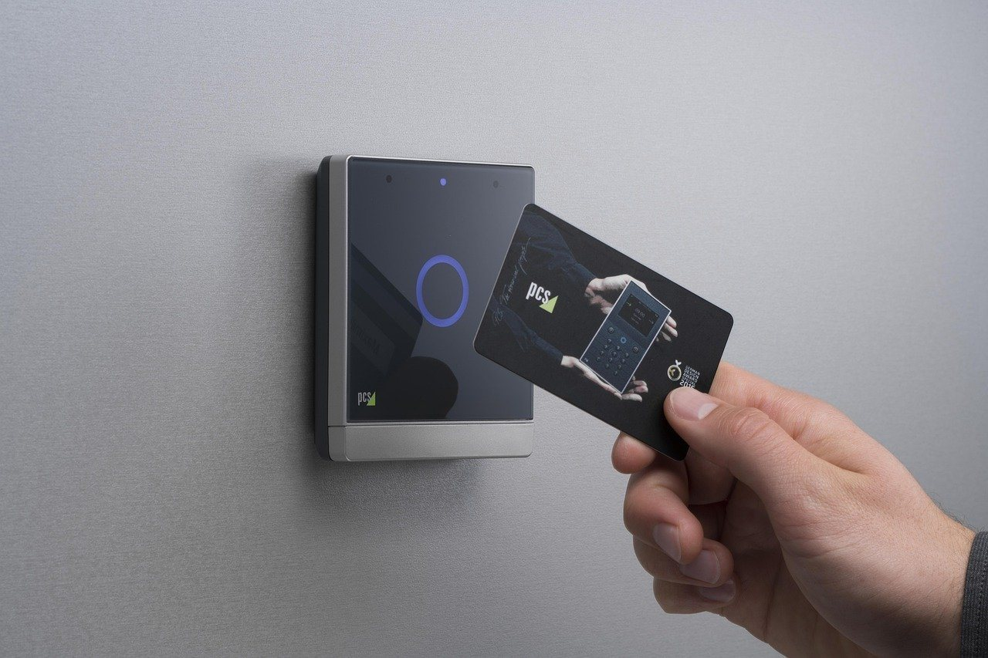

Existing Product/System
RFID (Radio-Frequency Identification)
Biometric Identification

Slide 5
Problem Identification
Problem with Biometric Scan:
Biometric fails if the finger is ruptured/wet.
Significant investment needed in biometrics for security.
Biometric databases can still be hacked.

Slide 6
Problem Identification
Problems with RFID (Radio-Frequency Identification):
Materials like metal & liquid can impact signal
Sometimes not as accurate or reliable.
Implementation can be difficult & time consuming.
Anyone can misuse it by using someone else’s card.

Slide 7
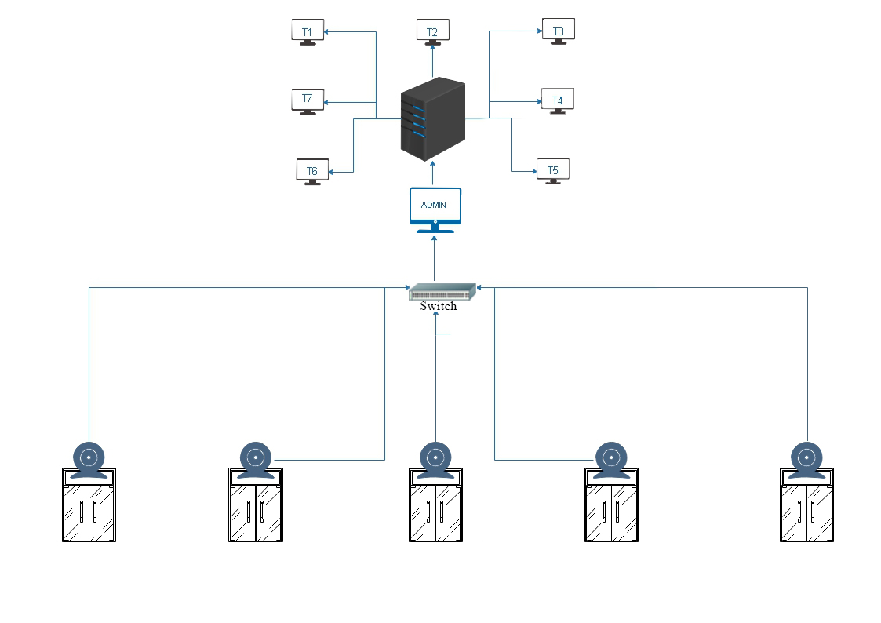
System Design

Slide 8
Summary of Prior Art Search
Biometric Authentication: A Review by Debnath Bhattacharyya, Rahul Ranjan, Farkhod Alisherov A, Minkyu Choi presents a review on the biometric authentication techniques and some future possibilities in field.
Face detection & face recognition using open computer vision classifiers by Lahiru Dinalankara.

Slide 9
Summary of Prior Art Search
It explains the technologies used in the project and the methodology used. Finally, it shows the results, discuss the challenges and how they were resolved followed by a discussion. Using Haar-cascade for face detection worked extremely well even when subjects wore spectacles. Real time video speed was satisfactory as well devoid of noticeable frame lag. Considering all factors, LBPH combined with Haar-cascade can be implemented as a cost eﬀective face recognition platform. An example is a system to identify known troublemakers in a mall or a supermarket to provide the owner a warning to keep him alert or for automatic attendance taking in a college or school.

Slide 10
Summary of Prior Art Search
There are many free source project available on GitHub, many other platform for face capturing attendance storing system and 70% are CLI(command Line Interface), 20% are web based and 10% are GUI(Graphical user interface).
CLI's are very not user friendly, GUI system are having very less functionalities, web based system are not safe as the data of institute is stored on server which can be anywhere in city and can be hacked easily.
AI powered attendance capturing system is software built in python using Tkinter tool and database; MySQL, and system is connected with institute's server via LAN.

Slide 11
Summary of Prior Art Search
How our system is different from other system on internet?
GUI is user friendly, user don't need any technical knowledge to access the feature.
As compared to system on internet many more functions are given for admin and user.
The data security is maintained, data can be changed only by admin and read-only access is given to user.

Slide 12
Problem Definition
RFID (Radio-Frequency Identification):
RFID can be time consuming.
Any problem in the card will not register the attendance of student/worker.
If the card gets lost anyone can misuse it without anyone knowing. Which can result in leak of confidential data of the company, miscellaneous leak. Any if such activities can result in huge loss of company.

Slide 13
Problem Definition
Biometric Scan with Finger:
It can also be time consuming.
In season like winter the skin on the finger starts to peel off due to which the scanner won’t be able to recognise the person.
The biometric machine can be hacked which can result in the hacker having the data of staff or student in the office/school.

Slide 14
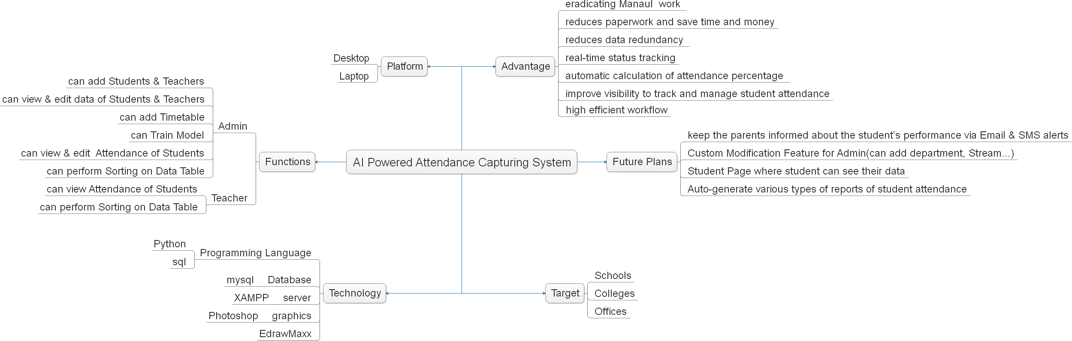
Canvas Summary (Mind Map)

Slide 15
Canvas Summary (AEIOU)
Activities:
Capturing photo
Recognizing faces
Add new student/user
Delete new student/user
Filling Attendance

Slide 16
Canvas Summary (AEIOU)
Environment:
Noisy
Crowdy
Warm
Cool

Slide 17
Canvas Summary (AEIOU)
Interaction:
Camera – Student’s Face
Computer – Camera
Computer – Database
Administrator - Software

Slide 18
Canvas Summary (AEIOU)
Objects:
Camera
Computer
Internet
Images

Slide 19
Canvas Summary (AEIOU)
Users:
Students
Admin
Professor
Teachers
Manager
Office Staff

Slide 20
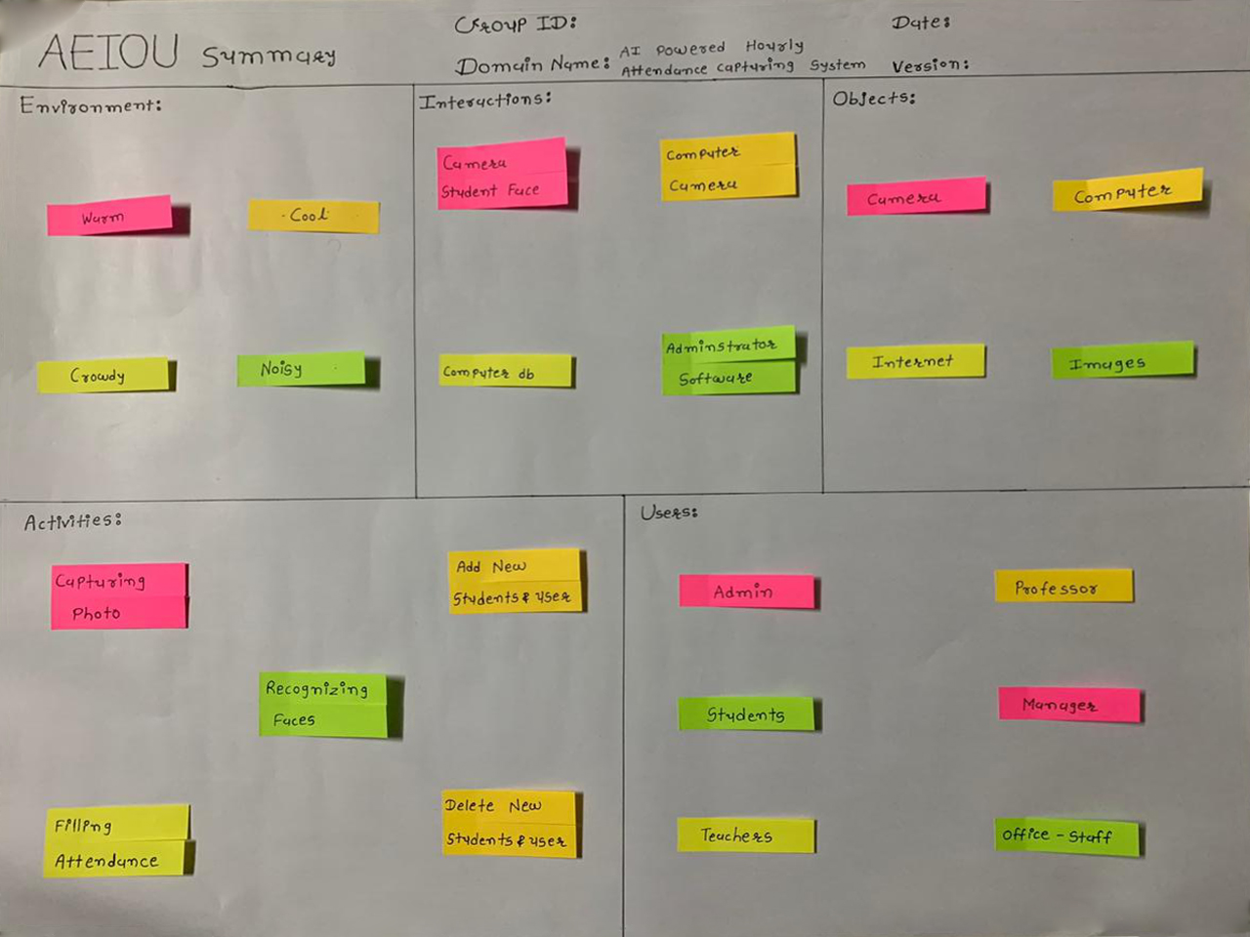
Canvas Summary (AEIOU)

Slide 21
Canvas Summary (Empathy Canvas)
Users:
Students
Professors
Teachers
Managers
Office Staffs

Slide 22
Canvas Summary (Empathy Canvas)
Stakeholders:
Students
Office Staffs
Activities:
Scanning Card
Scanning Fingers
Checking Attendance

Slide 23
Canvas Summary (Empathy Canvas)
Story Boarding:
HAPPY:
Before implementing biometric scanning, system user's company was using RFID card system where user have to had RFID card and if he forgets to bring the RFID card he had to run back home to grab the RFID card but After implementing biometric scanning system there was no need of any card, just finger was required.
SAD:
In winter season the skin on the finger starts peeling off due to which the biometric scanner won’t recognize the person and thus he/she won't able to get the attendance for the whole day. In monsoon season when finger get wet the biometric scanner won't recognize the finger. And Because of this all other students or staff have to wait for their chance as there is only one or two Biometric system available.

Slide 24
Canvas Summary (Empathy Canvas)
Story Boarding:
Happy:
In monsoon season a user was waiting for bus in bus stand and the user's phone rang so the user reached his pocket to get phone but the user was unaware that he kept RFID card in same pocket with his phone as soon as he took his phone out of the pocket his RFID card fell in a puddle of water but as the RFID card was water proof so there was no damage on it, and it didn't cost user's time to replace it.
Sad:
When the RFID card get lost students or office worker won't get the attendance for whole day and he or she had to meet the admin of RFID card system for generation and deactivation of previous RFID card which require more time and if the card gets in the hand of an unknown person then he/she can misuse the RFID card for unethical purpose.

Slide 25
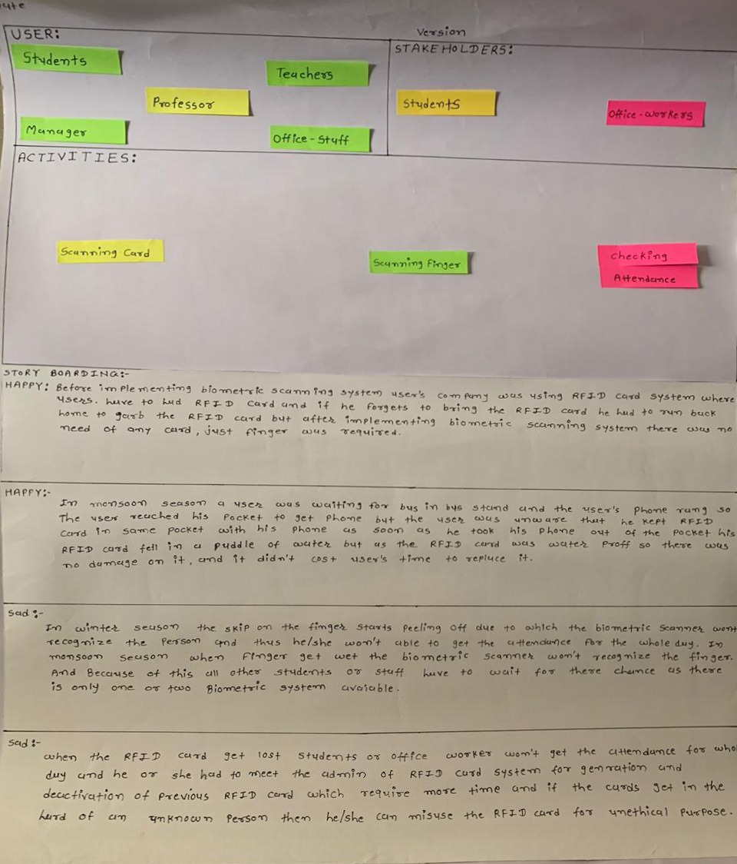
Canvas Summary (Empathy Canvas)

Slide 26
Canvas Summary (Ideation Canvas)
People:
Professors
Teachers
Students
Staffs
Activity:
Manually Taking Attendance
Attendance Through Biometric Method
Attendance Through RFID Method

Slide 27
Canvas Summary (Ideation Canvas)
Situation/Context/Location:
During Lectures - Attendance - college
RFID card lost
Injury in finger - Biometric method fail
Rainy - Biometric method fail
Props/Possible Solution:
Computer + ML + Camera = Automated Attendance Capturing System

Slide 28
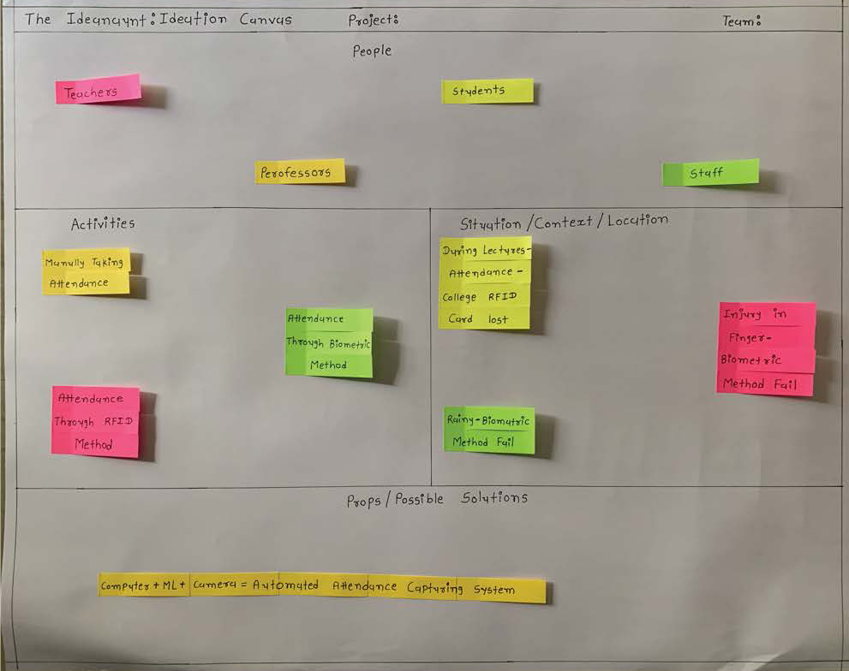
Canvas Summary (Ideation Canvas)

Slide 29
Canvas Summary (Product Development Canvas)
Purpose:
Store attendance in database
Generate attendance report
Save time
Reduce manual error
People:
Student
Professor
Teacher
Admin
Office-staff

Slide 30
Canvas Summary (Product Development Canvas)
Product Function:
Train Model
Face Recognition
Add Users
Add Students
Can Sort Data
Can View Attendance of Students
Product Feature:
OpenCV
Machine-Learning

Slide 31
Canvas Summary (Product Development Canvas)
Components:
Database
Camera
Server

Slide 32
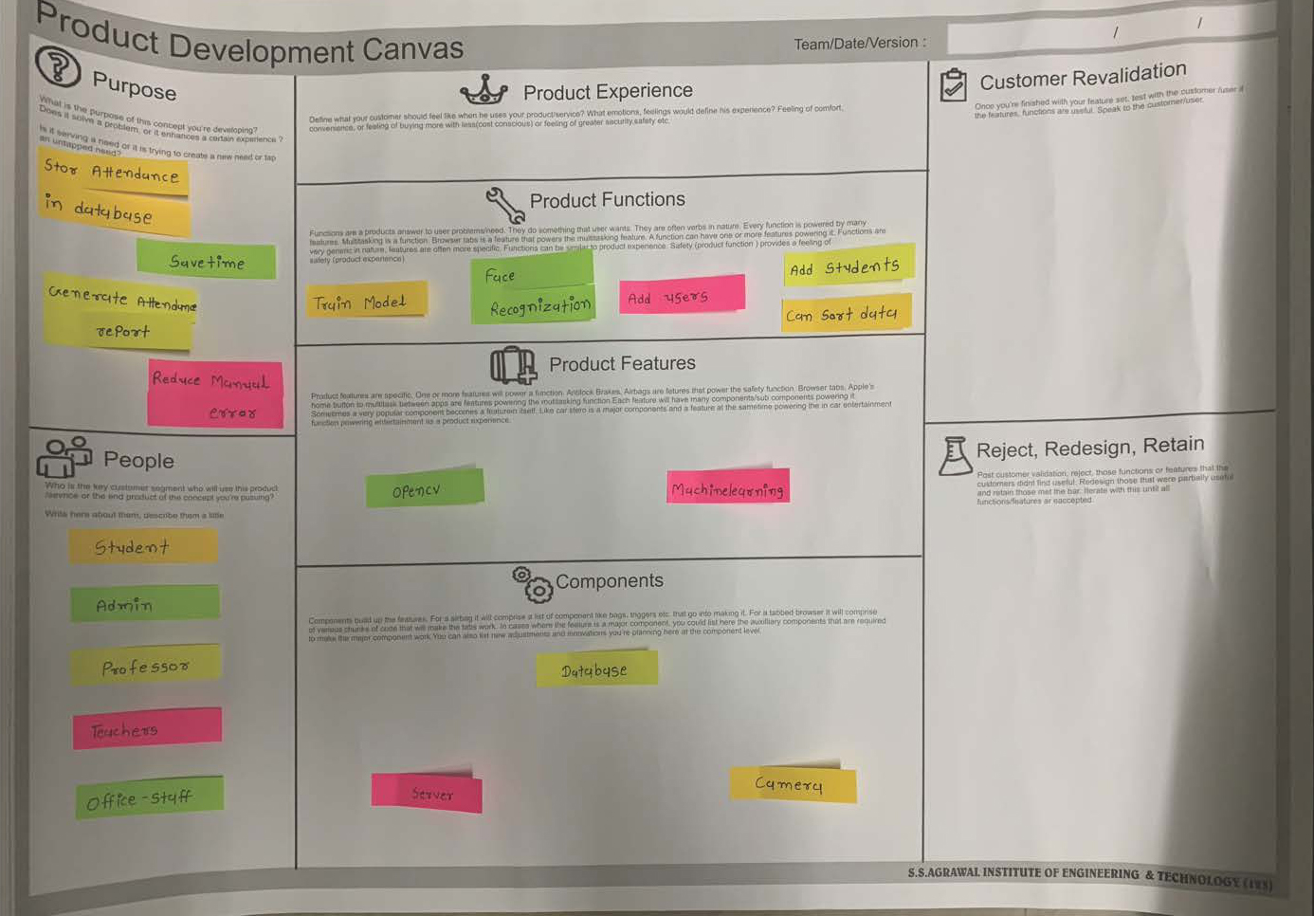
Canvas Summary (Product Development Canvas)

Slide 33
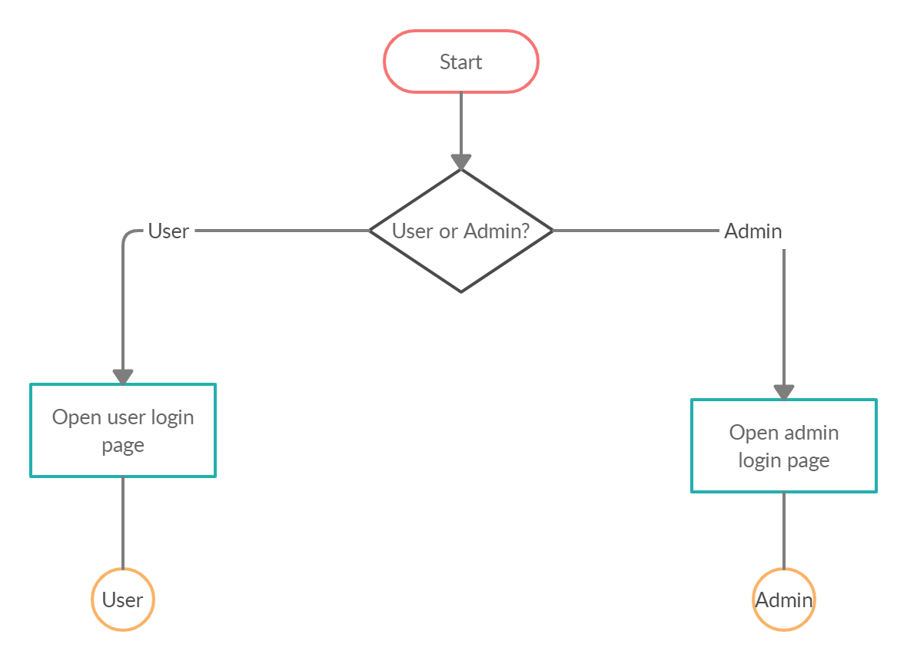
Canvas Summary (Prototype)

Slide 34
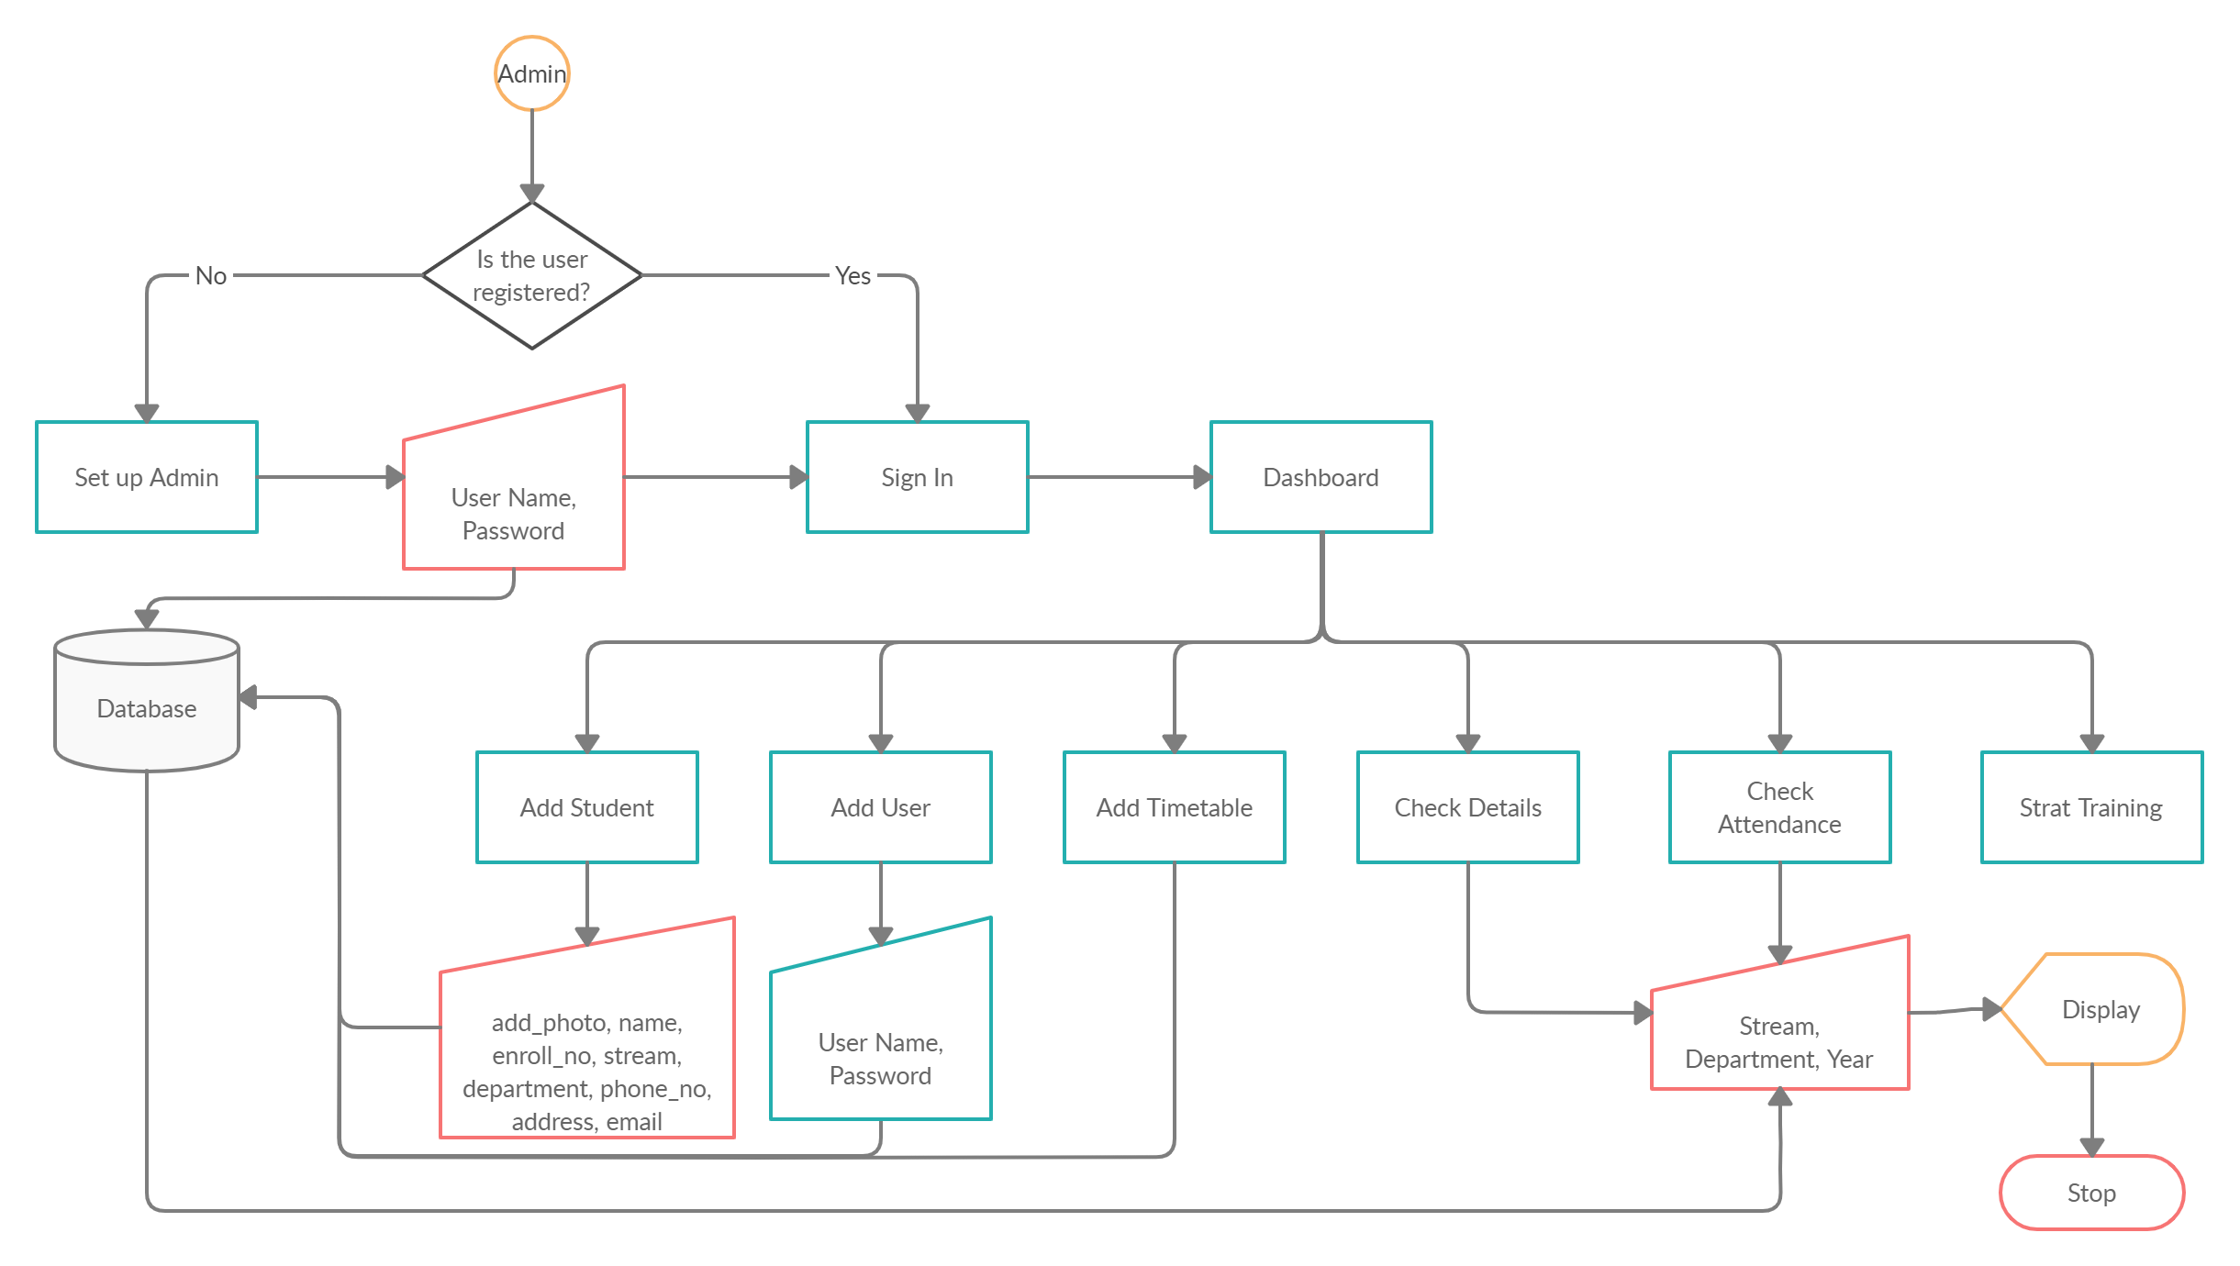
Canvas Summary (Prototype)

Slide 35
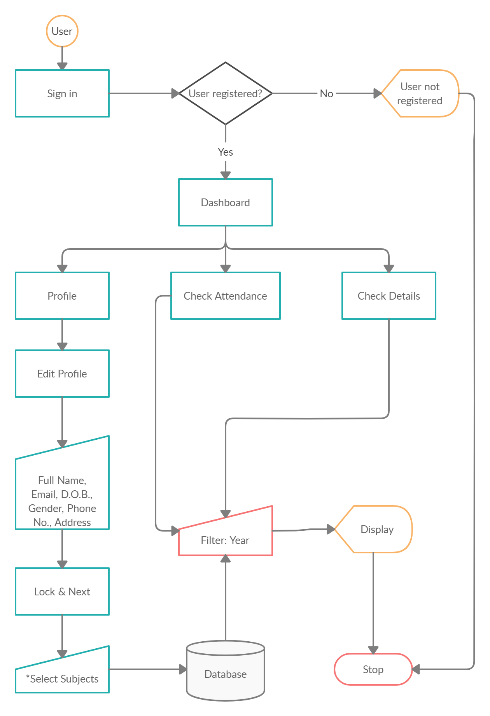
Canvas Summary (Prototype)

Slide 36
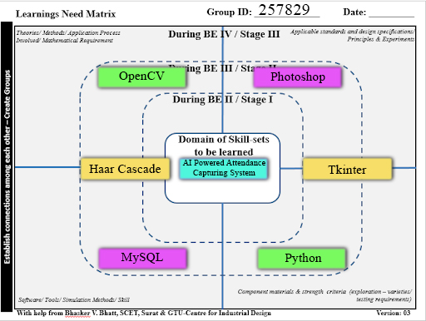
Canvas Summary (Learnings Need Matrix )

Slide 37
Proposed Feature & Specifications
Add timetable:
Admin can add timetable in the database so that the system can capture the face of system and mark present or absent for the respective entity.
Add User:
By adding a user to the system admin gives rights to that particular person to only read the data for his/her respective subject.
Add Student:
Admin can add students’ details to the database.
Train Data:
Admin will train the data set of every student to the system and using machine learning it will learn the faces of every students.

Slide 38
Proposed Feature & Specifications
Check Attendance:
Admin will be able to check and edit the attendance of all the departments and classes in it while the user will only be able to check the attendance of his/her subjects.
Check Details:
This will store the information about students that the admin previously added in the database and will be able to check and edit the details.

Slide 39
References
https://github.com/kmhmubin/Face-Recognition-Attendance-System
https://github.com/thuyngch/Face-Attendance-System
https://github.com/rishabh-karmakar/Facial-Recognition-Based-Attendance-System
https://www.researchgate.net/publication/46189709_Biometric_Authentication_A_Review
https://sites.cs.ucsb.edu/~mturk/Papers/mturk-CVPR91.pdf
https://docs.python.org/3/
https://docs.python.org/3/library/tkinter.html
https://stackoverflow.com/
https://icons8.com/icons/

Slide 40


