Slide 1

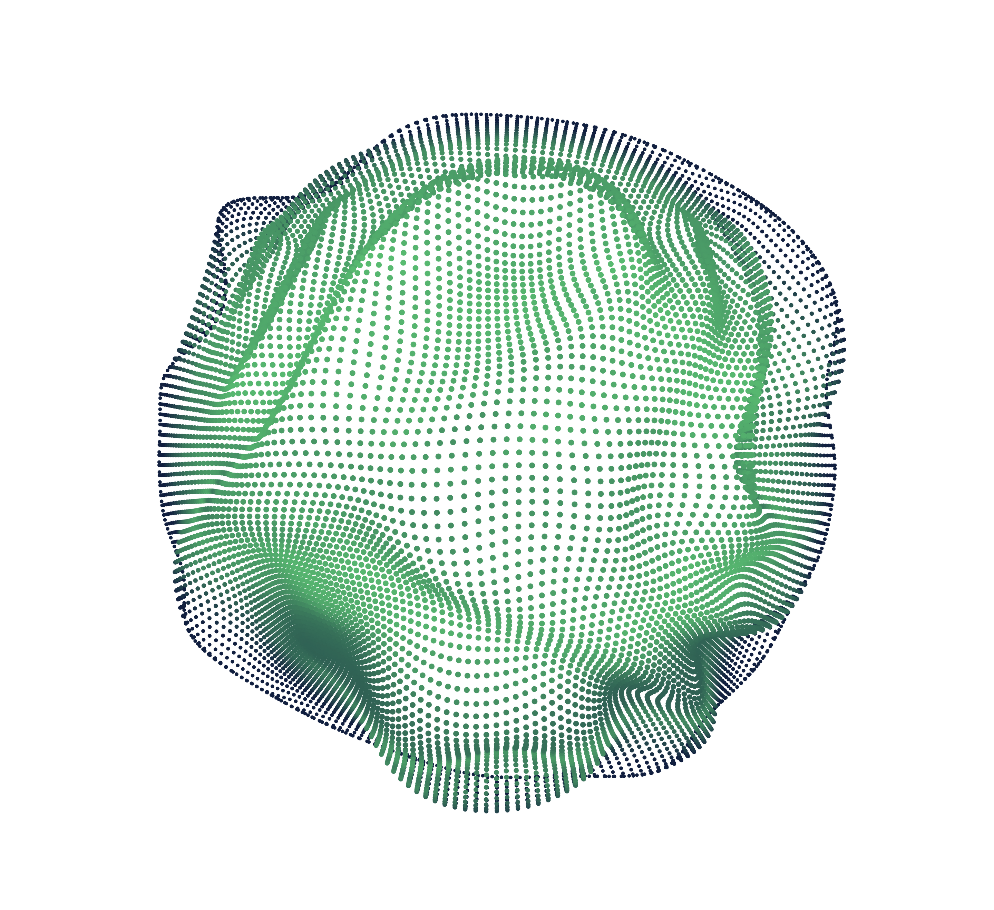

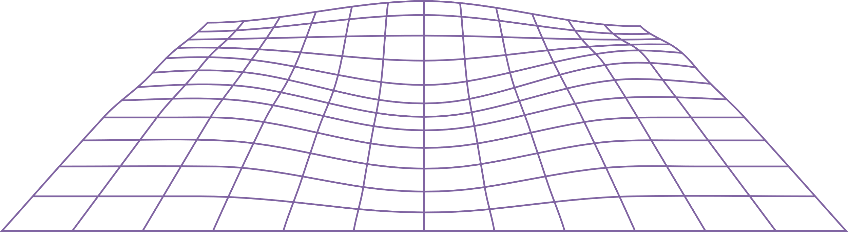
NeuraInk
An Intelligent OCR – System
Presented by: LEGENDS

Slide 2
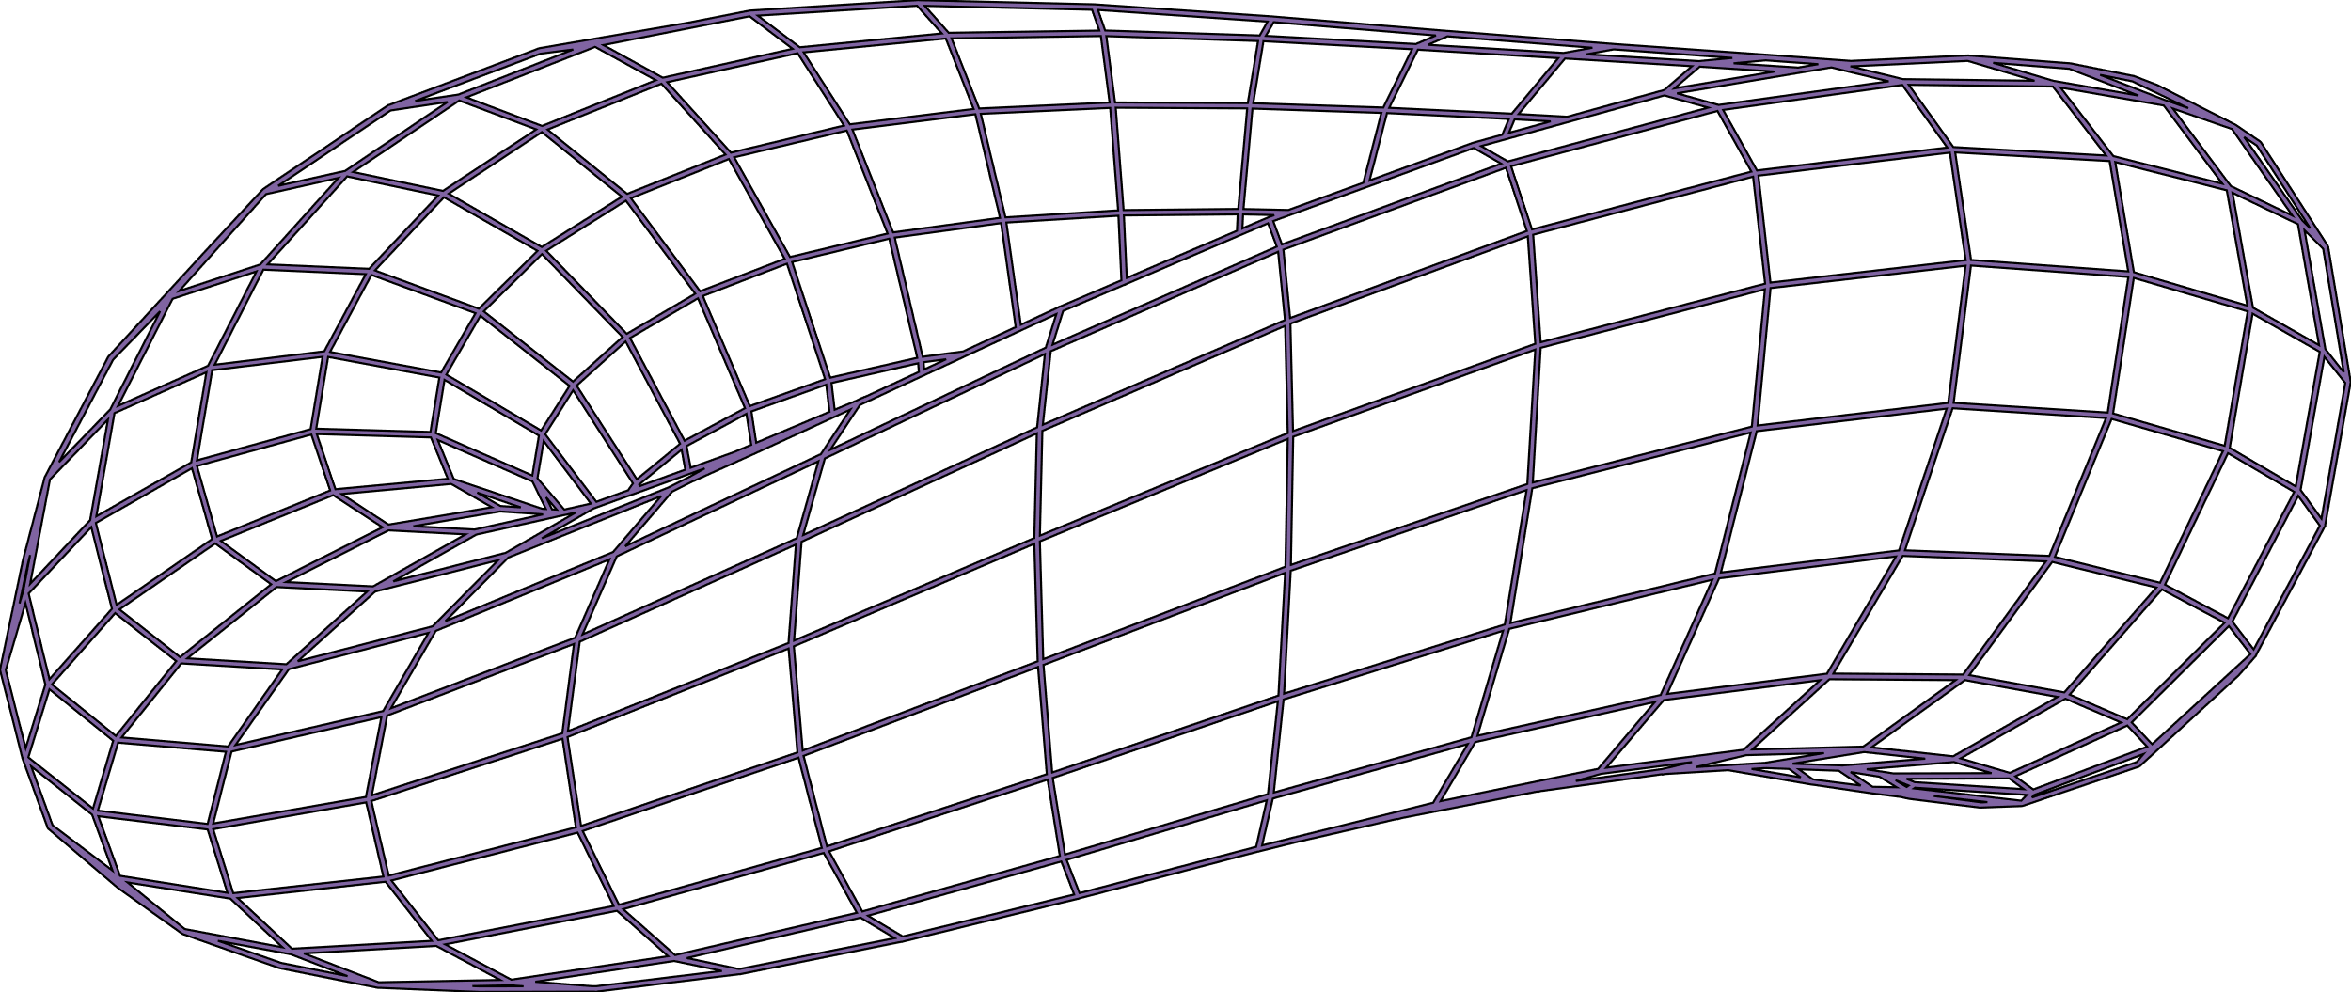
Introduction
What is OCR?
OCR (Optical Character Recognition) converts printed or handwritten text images into machine- readable text.
2. Why handwritten recognition is challenging?
Handwritten recognition is hard due to style variations, distortions, and inconsistent character shapes.
3. How CNNs provide a solution?
CNNs learn features from images automatically, handling handwriting variability with high accuracy.
4. Goals of NeuraInk:
NeuraInk aims to build a CNN-based OCR system for accurate and scalable handwritten text recognition.

Slide 3

Features
🤖 Trained on EMNIST ByClass (62 classes: A-Z, a-z, 0-9)
3
2
4
💾 Save your drawn image
📷 Use your webcam for real-time handwriting recognition
🖌️ Draw handwritten characters using a brush canvas
1
5
⏹️ Seamlessly switch between modes using the GUI and keyboard

Slide 4
Problem Statement
Handwritten characters vary widely in style, size, and shape, making traditional OCR systems inaccurate and inefficient. The challenge is to develop an intelligent model that can accurately recognize and classify handwritten digits and alphabets, even when the input is distorted or non-uniform.
NeuraInk aims to solve this by using a Convolutional Neural Network (CNN) that can learn visual patterns directly from data and handle the variability in handwriting

Slide 5
Database Used
EMNIST (Extended MNIST)Content: Handwritten digits (0–9) and characters (A–Z, a–z)
Classes: [ByClass] Up to 62 classes (10 digits + 26 uppercase + 26 lowercase letters)
Format: Same as MNIST (28×28 grayscale images)
Variants EMNIST 814,255 Characters : ByClass (All Characters and Numbers), ByMerge, Balanced.

Slide 6
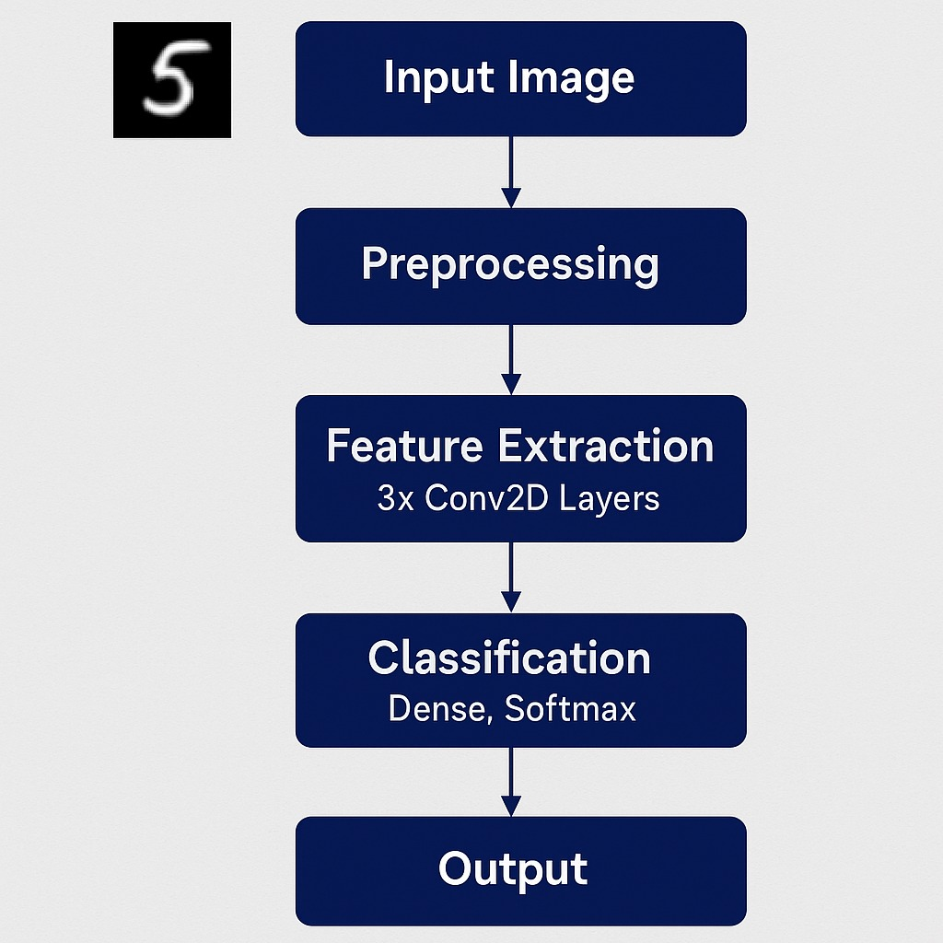
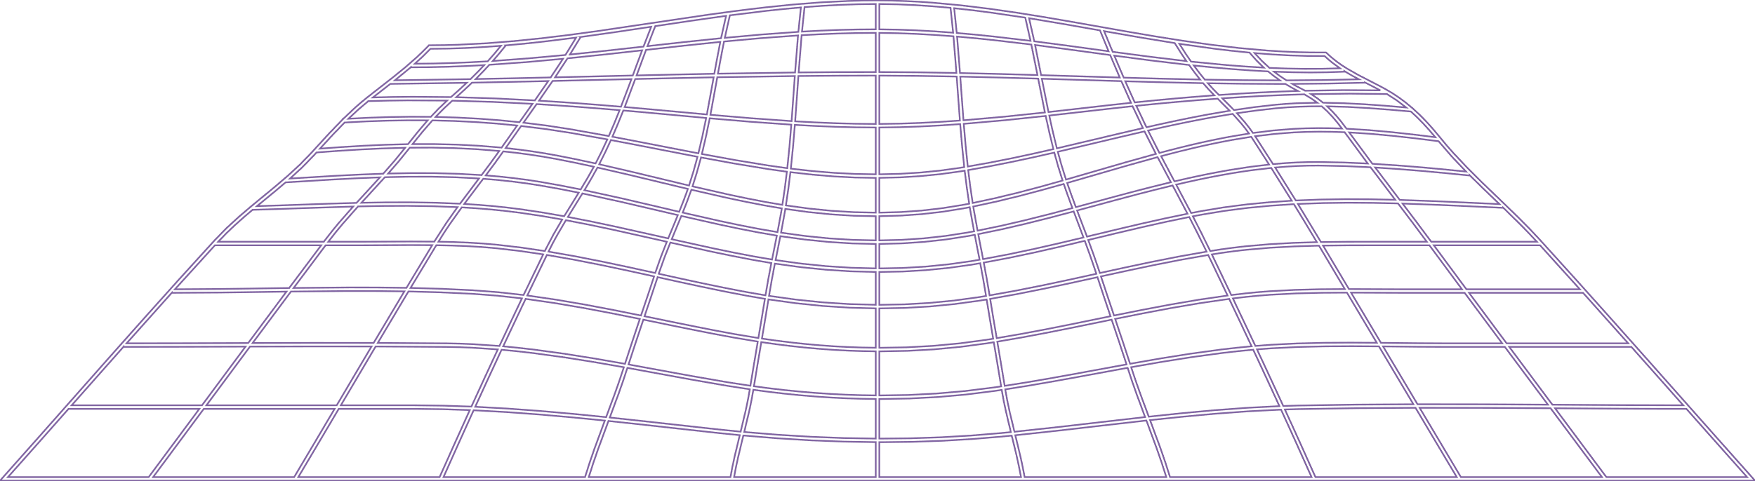
System Architecture / Workflow
Input Image – 28×28 grayscale handwritten digit or letter
Preprocessing – Normalize and resize the image
Feature Extraction – 3x Conv2D layers with ReLU
Regularization – BatchNorm + Dropout to improve training
Flatten + Dense Layer – 512 units with L2 regularization
Output Layer – SoftMax for 62-class prediction
Optimizer – Adam with learning rate scheduling

Slide 7
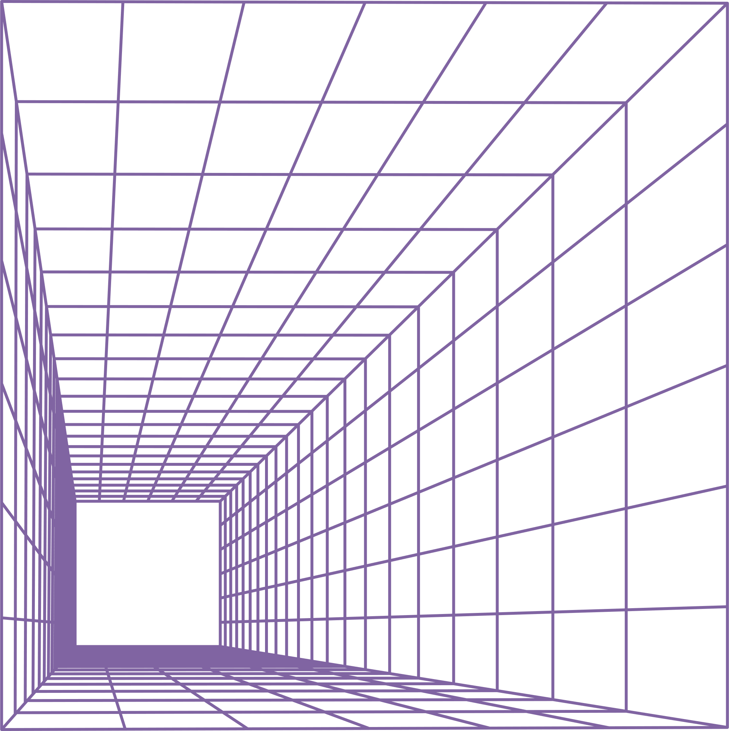
Model Architecture
3x Conv2D Layers: Extract features with increasing filter depth.
BatchNorm & Dropout: Improve stability and reduce overfitting.
Dense (512) + L2: Fully connected layer with regularization.
SoftMax (62 classes): Outputs probabilities for 62 characters.
Adam + LR Scheduler: Optimizes training with adaptive learning rate.

Slide 8
Data Preprocessing
Scale Pixel Values to Standard Range: Image pixels originally range from 0 to 255. Normalization scales them to a standard range like [0, 1] or [-1, 1], which makes the data easier for the model to process.
Improve Model Performance and Stability: Normalized inputs lead to faster convergence during training and help avoid issues like exploding or vanishing gradients.
Ensure Input Consistency Across Dataset: By bringing all input data to the same scale, normalization ensures that the model treats each image uniformly, regardless of lighting or contrast variations.
Apply Common Techniques: A typical approach is dividing pixel values by 255 to get [0, 1]. Alternatively, mean-std normalization ((x - mean) / std) can center data around 0 with unit variance.

Slide 9
Training Setup
Epochs: 30 The model will train over the entire dataset 30 times, allowing it to learn patterns and improve accuracy gradually.
Batch Size: 128 The training data is divided into batches of 128 samples, balancing memory usage and convergence speed.
Loss Function – Sparse Categorical Cross entropy: Used for multi-class classification with integer labels; ideal for recognizing digits or characters from image data.
Callbacks for Optimized Training:
Early Stopping: Stops training early if validation performance stops improving to prevent overfitting.
Reduce LROn Plateau: Reduces learning rate if validation loss stalls, helping the model fine-tune better.
Mode checkpoint: Saves the best model during training based on validation accuracy or loss.

Slide 10
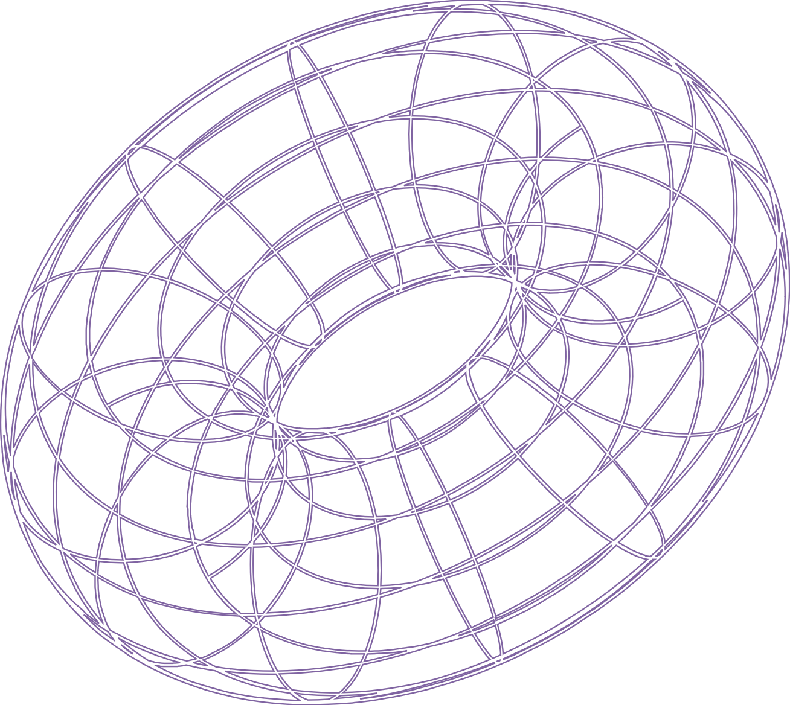
Results and Accuracy
✅ CNN Model Accuracy 90%
✅ Training accuracy 89.30%
✅ Test accuracy 89.30% on Emnist ByClass dataset
📉 Smooth Learning Curve: Confusion Matrix: Minor confusions in look-alike characters
🔍 Confusion Matrix: High precision across most characters, slight confusion in similar shapes (e.g., ‘O’ vs ‘0’, ‘l’ vs ‘1’)

Slide 11
GUI and Real-time Input
🖌 Canvas Mode – Draw and Predict: Users can draw characters directly on a canvas using the mouse or touch input. The model predicts the character in real time based on the drawing.
📷 Camera Mode – Live Recognition via Webcam: Allows real-time character recognition using a webcam feed. The system captures frames, processes them, and displays predictions instantly.
🧩 Mode Switching – GUI Button or Spacebar: Users can easily toggle between Canvas and Camera modes either by clicking a GUI button or pressing the Spacebar key for quick access.

Slide 12
Applications
Banking & Finance: Automatic cheque processing and form digitization
Postal Services:
ZIP code and address recognition
Education: Automated grading of handwritten answer sheets
Document Digitization: Converting handwritten records to editable text
CAPTCHA Solving: Recognizing distorted handwritten characters
Smart Devices: Note-taking and handwriting-to-text apps

Slide 13
Challenges and Limitations
🔷 Challenges and Limitations – NeuraInk (CNN Model)
✍ Variability in Handwriting: Diverse writing styles, sizes, and slants are hard to generalize.
🌫 Noisy or Low-Quality Input: Blurred, smudged, or incomplete characters reduce accuracy.
🔠 Similar-Looking Characters: Confusion between characters like 'O' vs '0', 'l' vs '1', 'S' vs '5’.
🧠 High Training Data Requirement: CNNs need large labeled datasets to perform well.
💻 Computational Load: Training deep networks requires significant time and GPU resources.
📦 Generalization Limitations: Model may perform poorly on data outside the training distribution.

Slide 14
Future Improvements
1
2
3
4
5
6
7
8
Add Eraser tool to brush mode
Integrate region selection for more precise camera predictions
Allow user to correct mispredictions and retrain model incrementally
Deploy as a web app using Flask/Streamlit
Build a mobile version using Kivy or Flutter
Add handwriting stroke animation replay
Add .exe packaging for easy sharing (via PyInstaller)
Visualize CNN layer activations for explainability

Slide 15
Conclusion
NeuraInk successfully demonstrates the power of Convolutional Neural Networks (CNNs) in recognizing handwritten digits and alphabets with real-time accuracy. By combining a deep learning model trained on the EMNIST dataset with a user-friendly interface, it bridges the gap between AI theory and practical application. The system’s dual input modes—canvas and camera—highlight its adaptability, while techniques like Batch Normalization, Dropout, and L2 Regularization ensure stable and generalizable performance. Optimized with the Adam algorithm and learning rate scheduling, NeuraInk serves as an effective prototype for educational tools, assistive tech, and intelligent document processing systems.

Slide 16

THANK YOU

