Slide 1


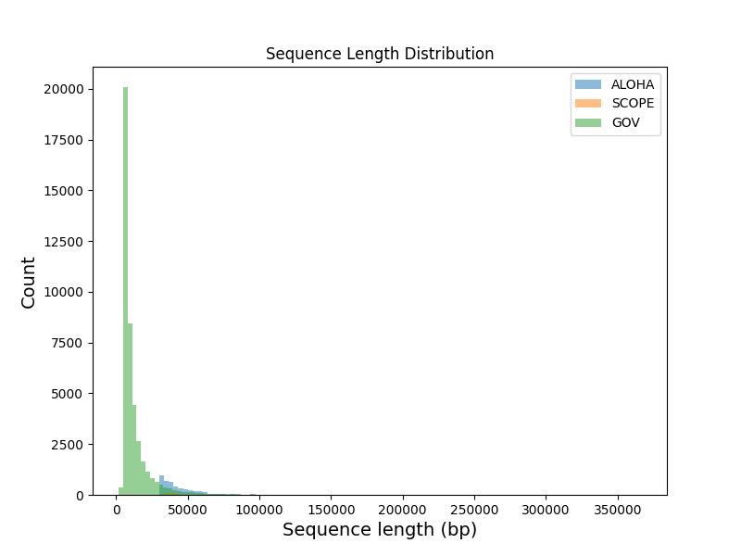
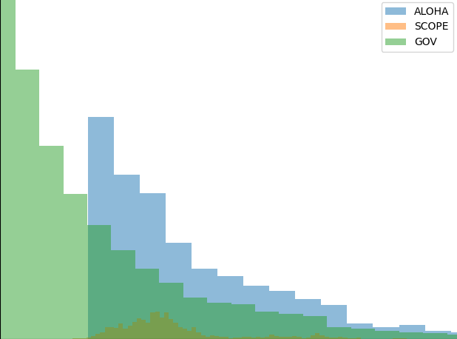
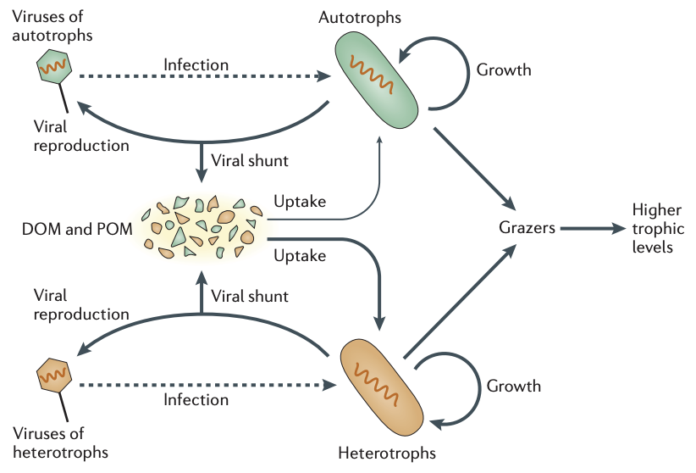
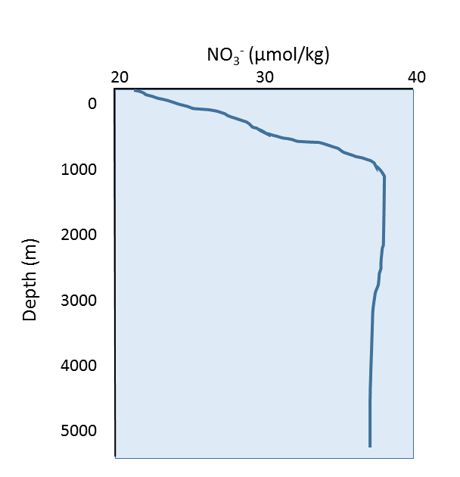
Do viral genomes adapt to nitrogen limitation?
Isimeme Udu^{1,3} , Daniel Muratore² , Joshua Weitz²
¹ ACE- REU Summer 2021, Georgia Institute of Technology, Atlanta GA
² Georgia Institute of Technology, Atlanta GA
³Spelman College, Atlanta, GA
ABSTRACT
RESULTS
Sequence Length Distribution
To survive low nitrogen environments, microbes have pared down their genomes to contain less nitrogen via lower GC content and have encoded proteins with fewer nitrogen atoms (Mende et al. 2017). Marine microbes face pressure via infection from viruses in addition to nutrient limitation. Infection alters biogeochemical cycles through the viral shunt, a mechanism by which viral lysis of hosts released dissolved organic matter (DOM) to the ocean surface (Jover et al. 2014).
Viruses have higher C:N and C:P ratios than their hosts, suggesting viral lysate may be C-rich compared to other host-derived DOM (Jover et al. 2014). However, how host genomic adaptations in nitrogen limitation impact their respective viruses remains unclear. I downloaded marine viral genomes and their respective metadata to study the nitrogen content of marine viruses. Though further analyses, I will be able to determine whether viral genomes adapt to nitrogen limitation.
Sequences were downloaded for most databases except JGI. Most metadata for the sequences were either difficult to obtain or difficult to match. Only GOV metadata were able to matched with their respective sequences.
Table 1: Sequence sample names and steps outlined in materials and methods.
 | FASTA Sequences | Metadata | GC Content Calculation | Prodigal | Nitrogen Content Calculation
JGI | Some | No | No | No | No
ALOHA | Yes | Some | Yes | Yes | No
SCOPE | Yes | Some | Yes | Yes | No
GOV | Yes | Yes | Yes | Yes | No
(a) (b)
When further investigating ALOHA and SCOPE sequences, there was no distinct relationship between sequence length and GC content in both samples. When delving deeper into SCOPE assemblies, sequence lengths were highest at depths of 117 m. Additionally, GC content increased from 25 to 250 m.
Fig 5: Sequence length distribution of ALOHA, SCOPE, and GOV sequences.
Fig 1: (a) Schematic of the viral shunt; (b) nutrient depth profile (Image from Roger Williams University)
DISCUSSIONS AND FUTURE DIRECTIONS
Sequence Length vs. GC content of ALOHA
Sequence Length vs. GC content of SCOPE
The findings in this studies show there is still much work to be done in determining if marine viruses adapt to host nitrogen limitation. JGI proved difficult in retrieving fasta sequences and relevant metadata. We were able to do some limited analysis on the sequences retrieved from NCBI (ALOHA and SCOPE). There were no patterns found between GC content of both ALOHA and SCOPE sequences. When further investigating SCOPE, genome lengths were highest at 117m, potentially indicating that marine viruses thrive in depths where their hosts have enough sunlight for photosynthesis but closer availability to nutrients. However, this result could also be due to the sample size of the viral genomes collected at that depth. Plotting GC content vs. depth showed that deeper depths could indicate more nutrient availability, and consequently, more nitrate availability and higher GC content in genomes. This could indicate that we would expect viruses to contain more nitrogen and more GC content even in a nitrogen limited environment in deeper levels of the ocean. Finally, GOV proved to be the most prospective sequence collection, as metadata and fasta sequences have been compiled together. However, due to time, further analyses have not been completed. This work has implications on the C:N ratios of viral lysate, which is an important consideration for refining our understanding of the Earth’s carbon cycle in the face of climate change. Further directions involve calculating nitrogen contents from Prodigal information and plotting a map of collected viral genomes as a communication effort to the research community to highlight marine environments which are underrepresented in field study.
0.65
0.6
0.60
MATERIALS AND METHODS
0.5
0.55
GC
0.50
Assemblies and relevant metadata were collected and downloaded from different databases (iVirus, NCBI, and JGI). Relevant metadata includes the depth at which the sequences were retrieved, their accession numbers, their location (longitude and latitude), and the nitrate concentrations of the environment the sequences were retrieved from. From the fasta sequences, GC content of sequences were calculated from a pre-developed code in Python. Before proceeding, sequence data should match with the relevant metadata. To calculate nitrogen content of genomes and proteins, sequences first were translated through Prodigal. Furthermore, an approach from Mende et al delineates how to calculate nitrogen content of a viral sequence form data obtained by Prodigal.
0.4
0.45
0.40
0.3
0.35
50000 100000 150000 200000 250000 300000 350000
0.30
30000 40000 50000 60000 70000 80000
Sequence Length (bp)
Fig 3: Scatterplot of ALOHA and SCOPE sequences vs. GC content.
iVirus NCBI JGI
SCOPE Assemblies: Genome and GC% vs. Depth
Sequence Collection
(a) (b)
Global Ocean Viromes
ALOHA SCOPE
25
REFERENCES
FASTA sequences and metadata
Elser, J. J., Acquisti, C., & Kumar, S. (2011). Stoichiogenomics: the evolutionary ecology of macromolecular elemental composition. Trends in ecology & evolution, 26(1), 38-44.
Jover, L. F., Effler, T. C., Buchan, A., Wilhelm, S. W., & Weitz, J. S. (2014). The elemental composition of virus particles: implications for marine biogeochemical cycles. Nature Reviews Microbiology, 12(7), 519-528.
Mende, D. R., Bryant, J. A., Aylward, F. O., Eppley, J. M., Nielsen, T., Karl, D. M., & DeLong, E. F. (2017). Environmental drivers of a microbial genomic transition zone in the ocean’s interior. Nature Microbiology, 2(10), 1367-1373.
117
Organization of Data
Python parsing
Depth [m]
Calculations
GC and Nitrogen
250
ACKNOWLEDGEMENTS
Analysis
Prodigal and Mende et al procedure
30 40 50 60 70 80 90
0.3 0.4 0.5 0.6
Special thanks to the members of Wertz Lab, especially Daniel Muratore and Dr. Joshua S. Weitz for their support and mentorship throughout the project. Thanks to the ACE-REU Summer program for this research opportunity, and the Simons Foundation for support.
Fig 2: Step-by-step process to calculate nitrogen content.
Genome Length (kbp) GC%
Fig 4: Scatterplot of a) Genome length vs depth and b) GC% vs. depth for SCOPE.

