Slide 1
IMAGE → TEXT → EVIDENCE
CAFÉ SUN
Receipt 047
Coffee €3.20
Cake €4.50
Total €7.70
OCR
fundamentals
A practical introduction for students
Turn an image into verifiable evidence.
Notes:
Opening question: Does the application need plain text, exact positions, or structured fields?

Slide 2
PaddleOCR combines pretrained AI models into one OCR pipeline
PaddleOCR is an open-source OCR toolkit. It provides pretrained neural-network models for locating text and converting text images into machine-readable characters.
What does pretrained mean?
• model parameters were learned from training data
• the model can be used without training from scratch
• results still depend on document quality and domain
PRETRAINED OCR PIPELINE
PaddleOCR is not one single model. It orchestrates several specialized models and processing steps.
Text detection
Text recognition
Optional orientation and document preprocessing
In this course, we use the supplied models for inference and evaluate their output against ground truth.
2
Notes:
Introduce the concept before showing commands. A virtual environment keeps this course setup separate from other Python projects. It is a directory, not a service, and deactivation does not delete it.

Slide 3
The smallest OCR experiment needs only one image
RECOGNIZED
HELLO
OCR!
Hello OCR!
>
Check: Is every character correct?
3
Notes:
Start with direct visual inspection before adding complexity.

Slide 4
A virtual environment isolates project packages
A virtual environment is an isolated Python environment for one project. Packages installed there do not change other Python projects.
Why use one?
• avoid package conflicts
• make the interpreter explicit
• repeat the setup on another computer
PADDLEOCR ENVIRONMENT
Activation selects the environment. Deactivation leaves its files intact.
Python interpreter
project packages
package versions
The next slides create and configure this environment step by step.
4
Notes:
Introduce the concept before showing commands. A virtual environment keeps this course setup separate from other Python projects. It is a directory, not a service, and deactivation does not delete it.

Slide 5
Setup 0: install Python
Download the 64-bit Python 3.11 installer for Windows
POWERSHELL
python.org/downloads/windows
python --version
python -c "import platform; print(platform.architecture()[0])"
During installation
• enable Add python.exe to PATH
• complete the installation
• reopen PowerShell
Expected: Python 3.11.x 64bit
PaddlePaddle currently supports Python 3.9–3.13. For pinned version 3.2.0 on Windows, use 3.9–3.12. This course recommends 3.11.
5
Notes:
If python opens the Microsoft Store or is not recognized, disable the Windows App Installer aliases for python.exe and python3.exe, then reopen PowerShell. The general PaddlePaddle installation guide currently lists Python 3.9 through 3.13. The exact PaddlePaddle 3.2.0 release provides Windows x86-64 wheels for Python 3.9 through 3.12, so the course standardizes on Python 3.11.
[Sources]
- Python downloads for Windows: https://www.python.org/downloads/windows/
- PaddlePaddle installation guide: https://www.paddlepaddle.org.cn/documentation/docs/en/install/index_en.html
- PaddlePaddle 3.2.0 files: https://pypi.org/project/paddlepaddle/3.2.0/

Slide 6
Environment creation
Setup 1: check Python, then create the environment.
Expected for this course
POWERSHELL
python --version
python -m venv C:\venvs\paddleocr
Python 3.11.x
The short C:\venvs path reduces the risk of Windows path-length errors during PaddlePaddle installation.
Use python directly. The optional Windows py launcher may not be installed.
6
Notes:
Run these commands in PowerShell. If python is unknown, select or install Python 3.11 before continuing. The environment is placed outside the long project path because PaddlePaddle contains deeply nested files.

Slide 7
Setup 2: activate and verify the environment
POWERSHELL
Both paths must begin with
C:\venvs\paddleocr\Scripts\Activate.ps1
python -c "import sys; print(sys.executable)"
python -m pip --version
C:\venvs\paddleocr
The terminal prompt normally begins with:
(paddleocr)
If PowerShell blocks activation:
Set-ExecutionPolicy -Scope Process -ExecutionPolicy Bypass
C:\venvs\paddleocr\Scripts\Activate.ps1
Or:
Set-ExecutionPolicy -Scope Process -ExecutionPolicy Bypass
& "C:\Users\katha\Nextcloud\2026\BIP\OCR\paddleocr\Scripts\Activate.ps1"
7
Notes:
Verification prevents packages from accidentally being installed into the Microsoft Store Python location or another global interpreter. The execution-policy change applies only to the current PowerShell process.
Der Befehl startet Python und führt direkt den kleinen Code hinter -c aus:
python -c "import sys; print(sys.executable)"
sys.executable zeigt den vollständigen Pfad zu genau dem Python-Interpreter, der gerade verwendet wird.
In deiner aktivierten Umgebung here sollte ungefähr so etwas erscheinen:
C:\Users\katha\Dropbox\06 Programmieren\26_plan_archive-test\here\Scripts\python.exe
Damit kannst du prüfen, ob wirklich das Python aus deiner virtuellen Umgebung verwendet wird und nicht irgendeine globale Python-Installation.

Slide 8
Dependency installation
Download ocr_examples folder
Setup 3: open the terminal in the ocr_examples directory.
requirements.txt installs
POWERSHELL
python -m pip install --upgrade pip setuptools wheel
python -m pip install -r requirements.txt
Pillow
paddlepaddle 3.2
paddleocr
The course uses paddleocr without the optional [all] dependency group.
8
Notes:
Open PowerShell in the ocr_examples directory before installing. requirements.txt selects the CPU package index and the packages required by the three course scripts.

Slide 9
VS Code uses the selected environment
1 Open the command palette with Ctrl + Shift + P
2 Choose Python: Select Interpreter
3 Select C:\venvs\paddleocr\Scripts\python.exe
4 Open a new VS Code terminal
Verify again: python -c "import sys; print(sys.executable)"
9
Notes:
VS Code uses the selected interpreter for running files and debugging. Existing terminals may still point to the previous interpreter, so open a new terminal after the selection.

Slide 10
Setup 4: run the examples in order
POWERSHELL
Step 1
prints the OCR result
Step 2
exports JSON and an overlay
Step 3
creates paddle_evidence.json
python 01_paddleocr_basic.py
python 02_paddleocr_export.py
python 03_paddleocr_evidence.py
deactivate
deactivate leaves the saved environment available for the next session.
10
Notes:
The first run may download model files. Every script locates the included synthetic example.png relative to its own file. Students can reactivate the saved environment later with C:\venvs\paddleocr\Scripts\Activate.ps1.

Slide 11
Python libraries package reusable code
YOUR SCRIPT
PYTHON LIBRARY
OCR PIPELINE
Functions, classes, and defaults
Install, import, call
Example: paddleocr provides the Python interface used by our scripts.
11
Notes:
A library contains reusable code that students import into a script. PaddleOCR provides the Python interface for configuring and running its OCR pipeline.
[Sources]
- PaddleOCR Quick Start: https://www.paddleocr.ai/main/en/quick_start.html

Slide 12
PaddleOCR uses a toolkit and a runtime
paddleocr
paddlepaddle
The OCR toolkit used in the scripts
• configures the pipeline
• detects and recognizes text
• exports results
The computation runtime
• executes the trained models
• supports CPU execution
• installs as a separate Python package
requirements.txt installs both packages into the active virtual environment.
12
Notes:
Students install two related Python packages. PaddleOCR provides the high-level OCR interface. PaddlePaddle supplies the numerical runtime that executes the models on the CPU.
[Sources]
- PaddleOCR installation: https://www.paddleocr.ai/main/en/version3.x/installation.html

Slide 13
Step 1 runs PaddleOCR on one image
PYTHON
1 Import the library
2 Create the OCR pipeline
3 Pass the image path
4 Print the raw result
from paddleocr import PaddleOCR
ocr = PaddleOCR(
use_doc_orientation_classify=False,
use_doc_unwarping=False,
use_textline_orientation=False
)
results = ocr.predict(input="example.png")
for result in results:
result.print()
Script: ocr_examples/01_paddleocr_basic.py
13
Notes:
The first script exposes the smallest working PaddleOCR program. The optional orientation and document preprocessing modules stay disabled to keep the first run focused.
[Sources]
- PaddleOCR Quick Start: https://www.paddleocr.ai/main/en/quick_start.html

Slide 14
Step 2 exports the raw result
PYTHON
The export contains
• detected regions
• recognized text
• confidence scores
• a visual overlay
OUTPUT_DIR.mkdir(exist_ok=True)
for result in results:
result.save_to_json(str(OUTPUT_DIR))
result.save_to_img(str(OUTPUT_DIR))
Script:
ocr_examples/02_paddleocr_export.py
Keep raw exports for debugging and later comparisons.
14
Notes:
The second script keeps PaddleOCR's native result format and visualization. These files help students inspect the pipeline before transforming the output into a course-specific evidence schema.
[Sources]
- PaddleOCR result export: https://www.paddleocr.ai/main/en/version3.x/module_usage/text_recognition.html

Slide 15
Useful OCR evidence includes text, position, and confidence
Text
Coordinates
Confidence
"Total €7.70"
x=118, y=406
w=252, h=31
0.94
Text + location + certainty make the result auditable.
15
Notes:
Preserve original image coordinates. They enable overlays, error analysis, and traceability.

Slide 16
Preprocessing can turn a borderline case into a match
Totol €7.70
Total €7.70
Total €7.70
Original
Grayscale
Threshold
Test only what measurably helps: same images, same metric, documented parameters.
16
Notes:
Preprocessing may help or destroy characters. Measure its effect instead of assuming it is beneficial.

Slide 17
Step 3 creates comparable OCR evidence
JSON
The evidence schema keeps
{
"text": "Total €7.70",
"polygon": [[118,406],[370,406],
[370,437],[118,437]],
"confidence": 0.94,
"source": "example.png",
"engine": "paddleocr"
}
• recognized text
• original polygon coordinates
• confidence and source
• the engine identifier
Script: ocr_examples/03_paddleocr_evidence.py
17
Notes:
The third script converts PaddleOCR's native arrays into a small evidence schema while preserving the original polygon coordinates. Raw output remains separate. Evidence, later interpretation, and final results remain separate stages.
(reduzierte Infos – nur was gebraucht wird)
use_doc_orientation_classify: Erkennt, ob das gesamte Dokument z. B. um 90°, 180° oder 270° gedreht ist, und korrigiert die Orientierung vor der OCR. True ist sinnvoll bei Scans/Fotos, die falsch gedreht sein können.
use_doc_unwarping: Versucht geometrische Verzerrungen des Dokuments zu korrigieren, etwa fotografierte, perspektivisch verzerrte oder gebogene Seiten. Bei einem normalen geraden Scan bringt das meist wenig und kostet zusätzliche Rechenzeit.
use_textline_orientation: Prüft die Orientierung einzelner Textzeilen. Das hilft beispielsweise bei kopfstehendem oder unterschiedlich orientiertem Text.

Slide 18
Data work is a core part of the machine-learning process
COLLECT
PREPARE
RUN
EVALUATE
ITERATE
Synthetic images
and metadata
Clean, normalize,
and split data
Apply the OCR
engine
Compare with
ground truth
Analyze errors
and adjust
Model execution is only one step. Data preparation and analysis determine whether results are trustworthy.
18
Notes:
Frame OCR as a small machine-learning workflow: inputs, preprocessing, inference, ground truth comparison, and error analysis. The exact percentages of effort vary by project, so focus on the principle rather than inventing a fixed ratio.
[Sources]
- OCR-D Quality Assurance: https://ocr-d.de/en/spec/ocrd_eval.html

Slide 19
OCR preprocessing changes pixels before recognition
GOAL
OPERATIONS
RISK
Make relevant characters easier to separate from background and layout noise.
• crop relevant regions
• resize carefully
• grayscale conversion
• denoising
• thresholding / binarization
• deskewing and rotation
Every transformation can also erase strokes, punctuation, or spatial evidence.
Keep the original image. Record parameters. Evaluate every variant against the same ground truth.
19
Notes:
Difficult images may benefit from explicit preprocessing. Examples include rescaling, binarization, noise removal, dilation or erosion, and deskewing. Never overwrite the original image. Store derived variants separately.
[Sources]
- OpenCV Image Thresholding: https://docs.opencv.org/4.12.0/d7/d4d/tutorial_py_thresholding.html

Slide 20
Postprocessing turns raw OCR evidence into usable data
RAW EVIDENCE
NORMALIZE
RESOLVE
RESULT
text
coordinates
confidence
Unicode
whitespace
number formats
merge tokens
match fields
apply rules
validated
structured
data
Do not silently replace the raw OCR output. Keep corrections traceable and reversible.
20
Notes:
Examples of postprocessing include Unicode normalization, whitespace cleanup, locale-aware number parsing, token merging, field matching, dictionaries, and validation rules. Preserve Evidence → Resolver → Result: raw OCR remains immutable evidence; corrections and interpretations create new derived data.
[Sources]
- OCR-D Quality Assurance and normalization: https://ocr-d.de/en/spec/ocrd_eval.html

Slide 21
Ground truth is the answer key for evaluation
SYNTHETIC IMAGE
GROUND TRUTH
PREDICTION
{
"text": "TOTAL €7.70",
"bbox": [88, 300, 252, 70]
}
{
"text": "TOTAI €7.70",
"bbox": [91, 302, 248, 68]
}
TOTAL €7.70
Ground truth is manually verified and kept separate from OCR output.
21
Notes:
Ground truth is the reference annotation used to judge OCR predictions. It may contain text, regions, coordinates, field labels, or all of these. For this course, create only synthetic ground truth inside the repository.
[Sources]
- OCR-D Ground Truth Guidelines: https://ocr-d.de/en/gt-guidelines/trans/
- OCR-D Quality Assurance: https://ocr-d.de/en/spec/ocrd_eval.html

Slide 22
Evaluation turns examples into a repeatable experiment
1 Freeze
2 Run
3 Compare
4 Explain
Fix the synthetic images and ground truth.
Apply every method with documented settings.
Normalize outputs and calculate the same metrics.
Inspect failures by image, field, and error type.
Change one factor at a time. Keep the test set, normalization, and scoring code identical.
22
Notes:
A useful evaluation is repeatable and localizes errors. Normalize ground truth and predictions in the same way before comparing them. Separate a development set used for tuning from a final test set when the exercise grows.
[Sources]
- OCR-D Quality Assurance: https://ocr-d.de/en/spec/ocrd_eval.html
- OCR-D Evaluation Workflow: https://ocr-d.de/en/workflows

Slide 23
F-scores balance false alarms and missed findings
PRECISION
RECALL
F1 SCORE
TP / (TP + FP)
TP / (TP + FN)
2PR / (P + R)
Of everything predicted,
how much was correct?
Of everything present,
how much was found?
Harmonic mean of
precision and recall.
Example: TP = 8, FP = 2, FN = 4
Precision = 0.80 Recall = 0.67 F1 ≈ 0.73
Define the positive class first: a correctly detected field, word, or region.
23
Notes:
TP means true positive, FP false positive, and FN false negative. F1 is the harmonic mean and reaches 1 only when both precision and recall are high. Always state the evaluation unit and matching rule.
[Sources]
- scikit-learn precision, recall and F-score documentation: https://scikit-learn.org/stable/modules/generated/sklearn.metrics.precision_recall_fscore_support.html
- OCR-D Quality Assurance: https://ocr-d.de/en/spec/ocrd_eval.html

Slide 24
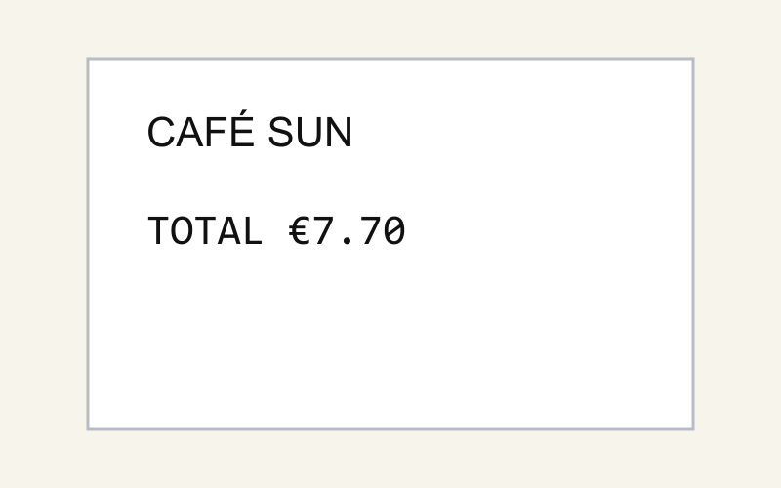
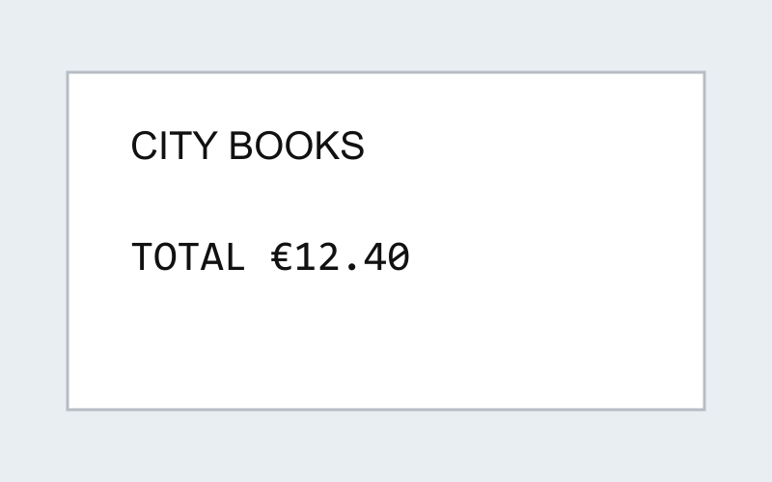
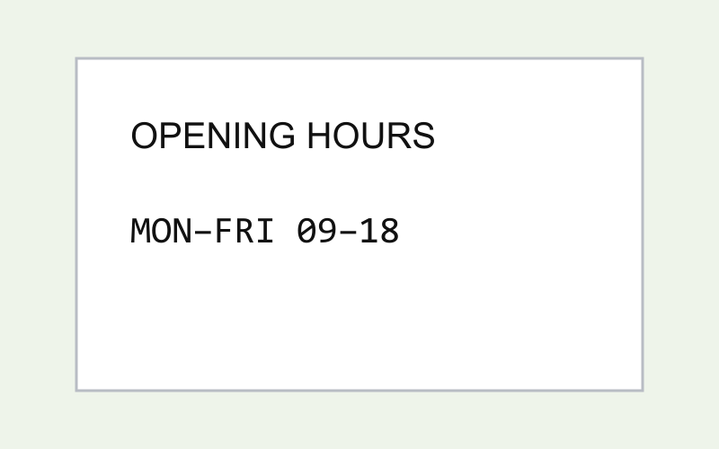
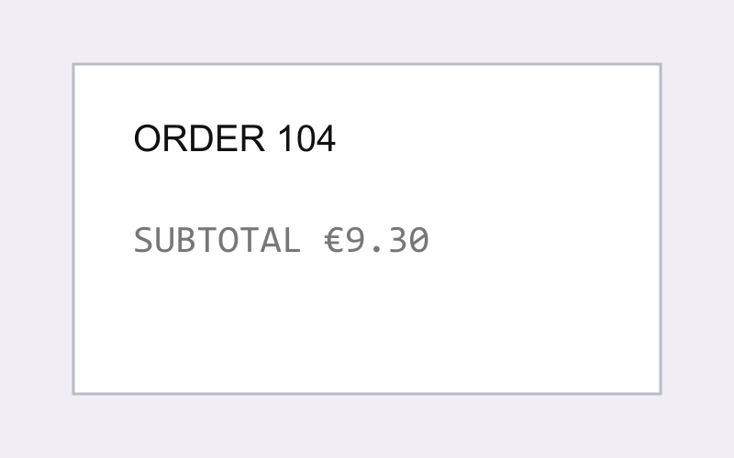
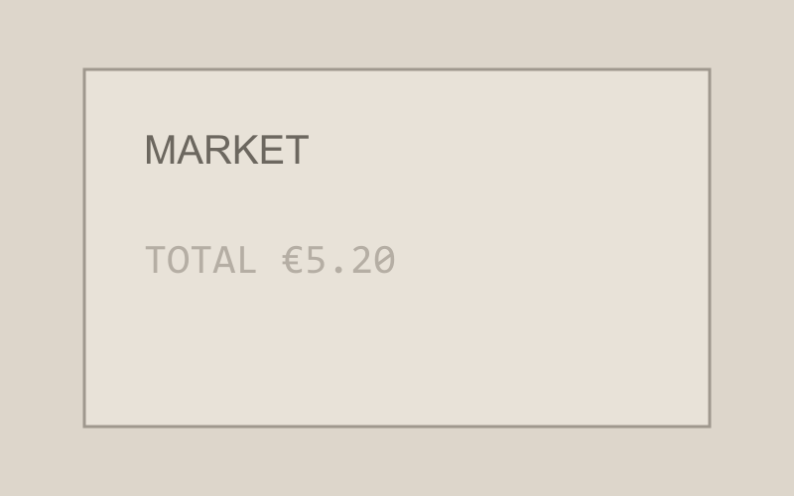
Five images make TP, TN, FP, and FN concrete
IMAGE 1
IMAGE 2
IMAGE 3
IMAGE 4
IMAGE 5
GT: €7.70
GT: €12.40
GT: absent
GT: absent
GT: €5.20
OCR: €7.70
OCR: €12.40
OCR: absent
OCR: €9.30
OCR: absent
TP
TP
TN
FP
FN
Task: detect the field labelled TOTAL and return its exact monetary value.
Exact label + exact value = a match. An absent prediction is correct only when TOTAL is absent.
24
Notes:
Walk through the five cases. Images 1 and 2 are true positives. Image 3 is a true negative because neither ground truth nor OCR contains a TOTAL field. Image 4 is a false positive: SUBTOTAL was incorrectly returned as TOTAL. Image 5 is a false negative: the faint TOTAL field was missed.
[Sources]
- Synthetic course dataset: deliverables/fscore_dataset

Slide 25
The five-image dataset produces an F1 score of 0.67
TP = 5 TN = 3 FP = 2 FN = 4
PRECISION
RECALL
F1 SCORE
Precision = TP / (TP + FP)
= 5 / (5 + 2) = 0.71
Recall = TP / (TP + FN)
= 5 / (5 + 4) = 0.56
F1 = 2 × (Precision × Recall)
/ (Precision + Recall)
= 2 × (.71 × .56) / 1.27 = .63
Five of seven reported TOTAL fields
were correct.
Five of nine real TOTAL fields
were found.
The true negative is useful context, but it is not part of the F1 formula.
25
Notes:
Connect each number directly to the preceding slide. Precision asks how reliable positive predictions are. Recall asks how many real positives were found. F1 balances both. TN is excluded, which is why accuracy and F1 answer different questions.
[Sources]
- scikit-learn precision, recall and F-score documentation: https://scikit-learn.org/stable/modules/generated/sklearn.metrics.precision_recall_fscore_support.html
- Synthetic course dataset: deliverables/fscore_dataset

Slide 26
PaddleOCR is the course starting point
It installs within the Python environment and provides text detection and recognition in one pipeline.
Other local OCR packages and models
Tesseract + pytesseract transparent classical baseline
EasyOCR compact Python interface with pretrained recognition models
docTR modular detection and recognition pipeline
Kraken OCR toolkit with strong support for historical documents
Use the same synthetic images and ground truth when comparing alternatives.
26
Notes:
PaddleOCR provides the common starting point for the exercise. Students do not need to install every alternative. The final section signals that OCR engines remain replaceable and that a fair comparison requires identical inputs, ground truth, preprocessing conditions, and metrics.
[Sources]
- PaddleOCR Quick Start: https://www.paddleocr.ai/main/en/quick_start.html
- Tesseract documentation: https://tesseract-ocr.github.io/tessdoc/
- EasyOCR repository: https://github.com/JaidedAI/EasyOCR
- docTR documentation: https://mindee.github.io/doctr/
- Kraken documentation: https://kraken.re/main/

Slide 27
Tiling preserves small text in large document images
Large scans are often downscaled before detection; overlapping tiles keep small characters readable and retain local detail.
Recommended starting configuration
Tile size 1200 × 1200 px
Overlap 200 px
Stride 1000 px
Export tile JSON + tile visualization
Use tiles large enough for complete text lines and overlap enough to protect words at tile boundaries.
27
Notes:
PaddleOCR provides the common starting point for the exercise. Students do not need to install every alternative. The final section signals that OCR engines remain replaceable and that a fair comparison requires identical inputs, ground truth, preprocessing conditions, and metrics.
[Sources]
- PaddleOCR Quick Start: https://www.paddleocr.ai/main/en/quick_start.html
- Tesseract documentation: https://tesseract-ocr.github.io/tessdoc/
- EasyOCR repository: https://github.com/JaidedAI/EasyOCR
- docTR documentation: https://mindee.github.io/doctr/
- Kraken documentation: https://kraken.re/main/

Slide 28
Orient once, then run OCR tile by tile
Determine orientation on the complete page before cropping; individual tiles often contain too little context for reliable classification.
Processing sequence
1 Load the complete TIFF image
2 Classify page orientation: 0° / 90° / 180° / 270°
3 Rotate the complete image
4 Generate overlapping tiles
5 Run PaddleOCR predict() with orientation disabled
6 Add tile offsets and merge duplicate detections
Merged boxes use the oriented page coordinates; transform them back only if the original TIFF coordinate system is required.
28
Notes:
PaddleOCR provides the common starting point for the exercise. Students do not need to install every alternative. The final section signals that OCR engines remain replaceable and that a fair comparison requires identical inputs, ground truth, preprocessing conditions, and metrics.
[Sources]
- PaddleOCR Quick Start: https://www.paddleocr.ai/main/en/quick_start.html
- Tesseract documentation: https://tesseract-ocr.github.io/tessdoc/
- EasyOCR repository: https://github.com/JaidedAI/EasyOCR
- docTR documentation: https://mindee.github.io/doctr/
- Kraken documentation: https://kraken.re/main/

