Slide 1



Interactive Storytelling for Elderly-Friendly RPG Games
Chan Chi Fai
22063545d

Slide 2
Background and Problem Statement
Nowadays, a lot of games are developed. Different players have different preservatives and needs. But there was no game mainly for the elderly people.
This project is going to design an Elderly-Friendly Word Adventure Game.
This game will have large fonts, simple vocabulary, and calm pacing elements.
This project focuses on the text layer and aims to design Interactive Storytelling for Elderly-Friendly RPG Games

Slide 3
Objectives and Outcome
Write short, clear scenes and meaningful choices for an elderly-friendly, text-first game.
Scenes: 60–150 words, everyday language, short sentences.
Choices: 2–3 clear options; each changes what happens next.
Endings: a few simple, positive-leaning outcomes.
Game language: Chinese, Cantonese for voice function

Slide 4
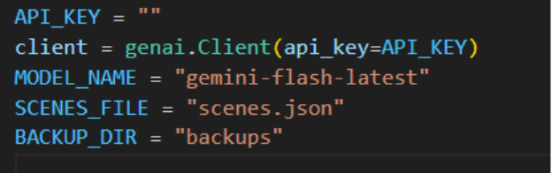
Project Methodology
Program lanuage: Python3.12
LLM: gemini-flash-latest
LLM advantage: Free quote, easy to set up and easy to apply the api key

Slide 5
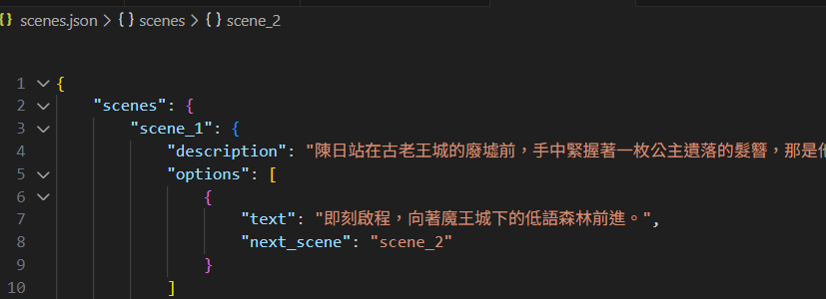
Game scenes
Static scenes: The player saves data in the previous game
Dynamic scenes: Generated by an LLM based on player choices
Scenes structure: JSON file, highly readable and flexible.

Slide 6
Program structure
Dictionary structure: Simple and direct. Allows for a quick lookup of the current scene and options.
Nested dictionaries: allow for direct expression of scene descriptions, options, and the logical relationships between scenes. And it directly corresponds to the JSON file structure. It is easier to apply the scene management function.

Slide 7
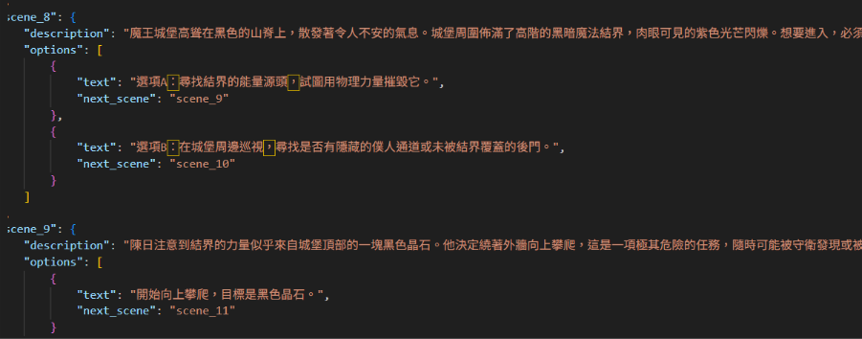
Story generation
Ask the LLM to generate a whole story and options.
More logical. The scene can match the previous scene.
Increase story completeness and logic
So this project chose to let LLM generate the whole story at the beginning.

Slide 8
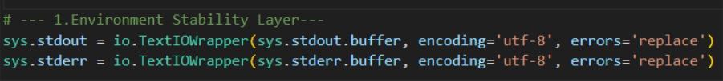
System design
Environment Stability Layer: Handles encoding issues, ensuring the correct display of Chinese characters (UTF-8) across different terminals.

Slide 9
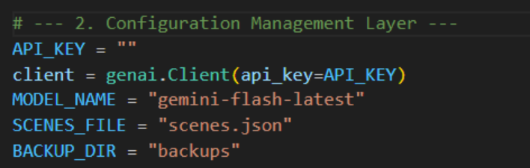
Configuration Management Layer:
Centrally manages API keys, model names, and file paths

Slide 10
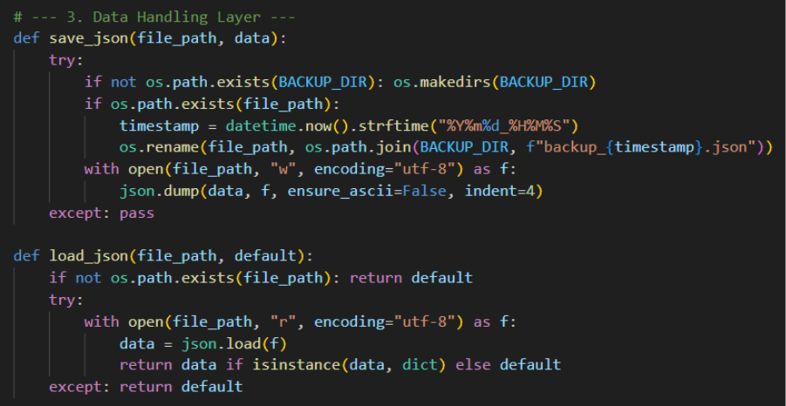
Data Handling Layer
Responsible for reading and writing JSON files and automatic backup

Slide 11
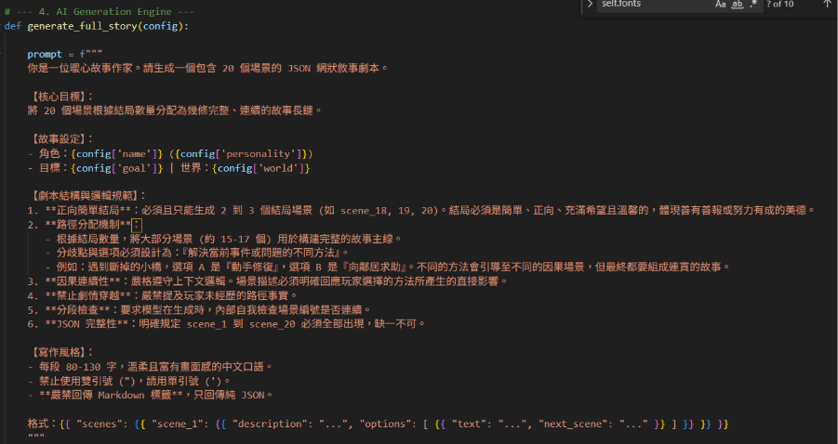
AI Generation Engine
Scale Limitation
Causal Continuity
Safety and Style
Structural Integrity
Positive ending

Slide 12
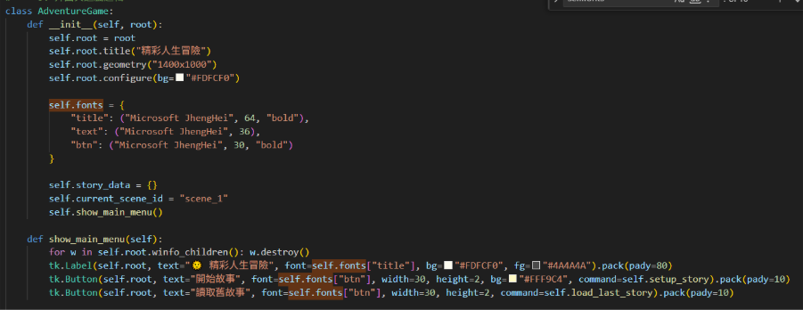
GUI Interaction Layer
Based on tkinter category design, manages view switching (main menu, settings page, game page).

Slide 13

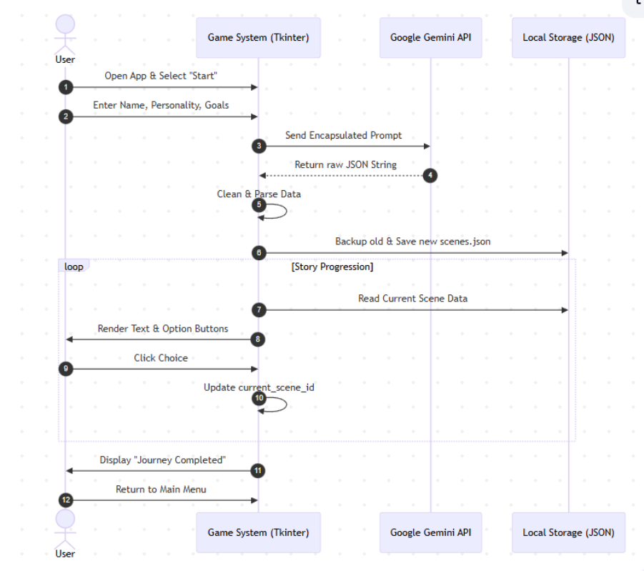

Workload

Slide 14
Elderly-friendly function
The target people of this project are the elderly. So the project has achieved a lot of elderly-friendly functions.
Dynamic Font Scaling System
The Canvas and Scrollbar mechanism
Cantonese Audio Reading (Edge-TTS Integration)
Voice Command Input (Speech Recognition, 語音控制)
Heartwarming AI Script Generation (Gemini AI Engine)
Time travel(時光倒流) and History(查閱往事)
Simplified save and script Management

Slide 15
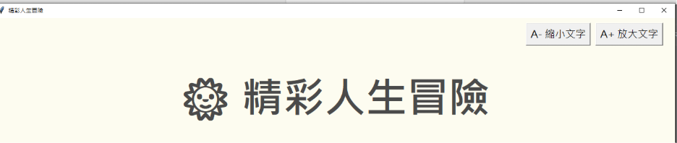
Dynamic Font Scaling System
The elderly can adjust the font to the most comfortable size by clicking the "A+" or "A-" buttons.
It solves common presbyopia or vision deterioration problems among the elderly.

Slide 16
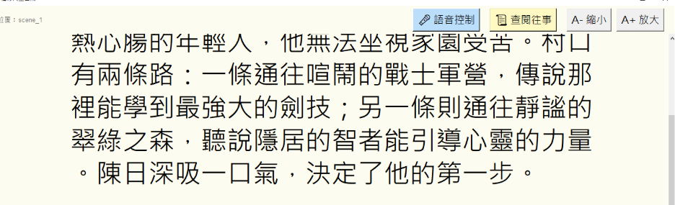
The Canvas and Scrollbar mechanism
For match font scaling system, to avoid the text overlapping the windows.
The Canvas and Scrollbar mechanism allows users to view the full content via scrolling or the mouse wheel, regardless of the font size.
Scroll wheel support

Slide 17

Cantonese Audio Reading
Target user is the Hong Kong local user
Hong Kong female voice (zh-HK-HiuGaaiNeural) was specifically chosen.
Elderly vision may be damaged, reading long texts difficult
Reduces the time elderly people spend staring at the screen, alleviating eye strain

Slide 18
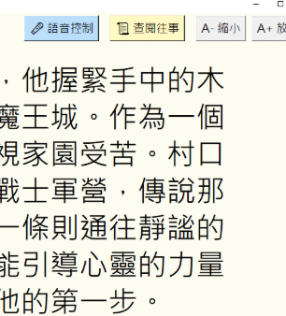
Voice Command Input
"Voice Control" bottom, the program listens to the microphone.
Speech to text using speech recognition and automatically matches options (such as saying "第一項" or "第二項").
Hong Kong users, Cantonese as the input language.
Designed for seniors with arthritis or hand tremors who
have difficulty accurately operating a mouse.

Slide 19
Heartwarming AI Script Generation
Generates a network narrative of 20 scenes using the Gemini API.
Prompts emphasize a "heartwarming writer" style and a "positive ending
Emotional support is crucial for seniors
Ensures the story is gentle, non-oppressive and logically simple

Slide 20
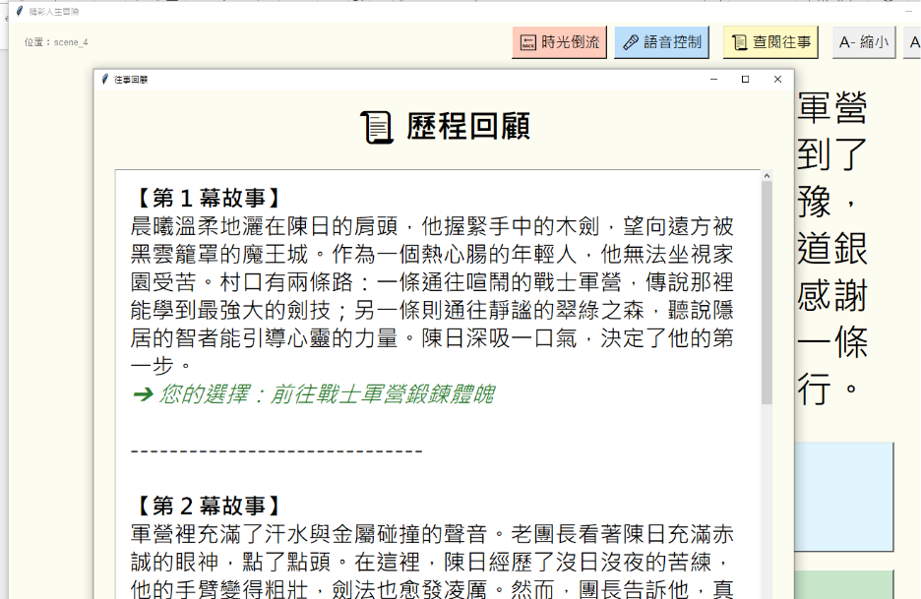
Time travel(時光倒流) and History(查閱往事)
`時光倒流` allows you to go back to the previous step.
`查閱往事` pops up a scrolling window displaying all past scene descriptions and choices.
Short-term memory decline
Forget previous events
Accidentally select the wrong option

Slide 21
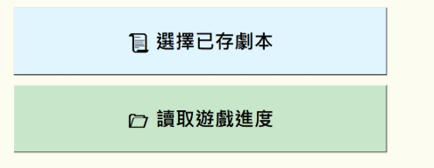
Simplified save and script Management
Provides 4 visual save slot
Simplifies the complex file management

Slide 22
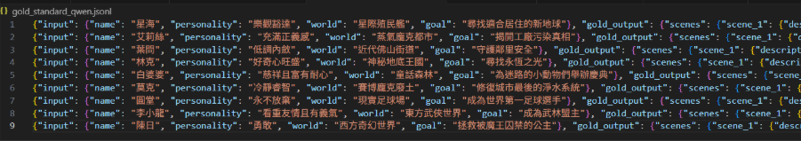
Program evaluation mechanism
Using advanced LLMs GPT-4 and Qwen to draft these "gold standard" responses based on specific input.
Designing an exam: create specific questions (inputs) and an answer key (ground truth) to objectively test my system.
Use to a .jsonl file file to be my dataset

Slide 23
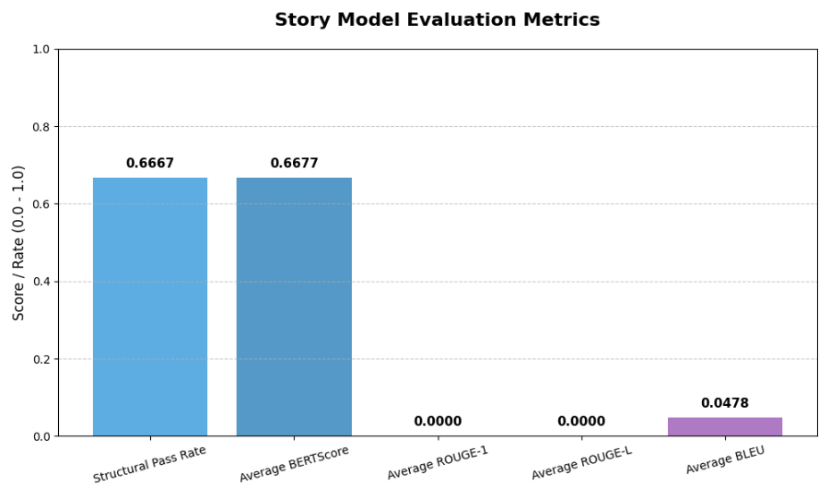
Result

Slide 24
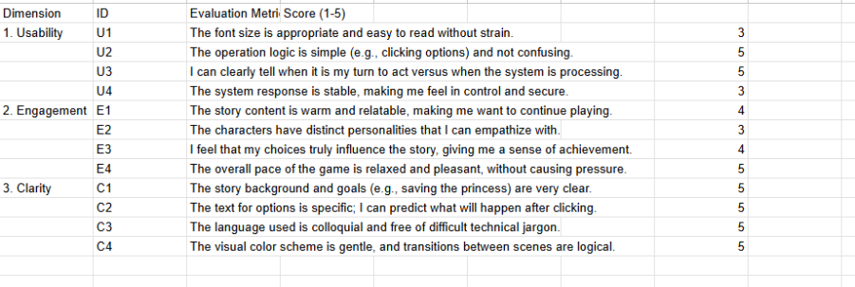
Human Evaluation

Slide 25
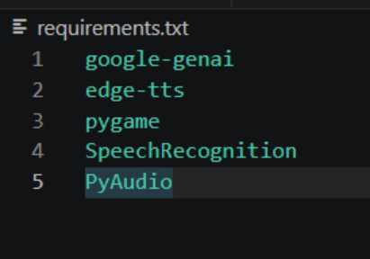
Requirement
Python 3.12 (64bit): The newest version of Python, such as Python 3.14, is too new, some libraries are not supported. Python 3.12 is my develop version, so my program can run successfully in this version.
Geminin API: For create the story
VPN: Because Gemini API is not supported in the Hong Kong area.
requirements.txt: Help for installing all the library

Slide 26
Possible function and future problem
Music and background: Let the user enjoy the story more.
VPN problem: Now the Gemini API can not be called from the Hong Kong area. So need VPN to call and apply. But Google already say that it will open the Hong Kong area limitation. Now we can already use the website version of Gemini. So this problem should be fix very soon in the future. In that time did not need to use VPN anymore.
The voice input may be affected by VPN.

Slide 27
Demo
4月21日.mp4

Slide 28
End

