Slide 1
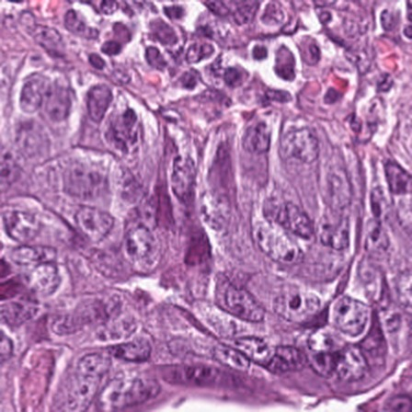
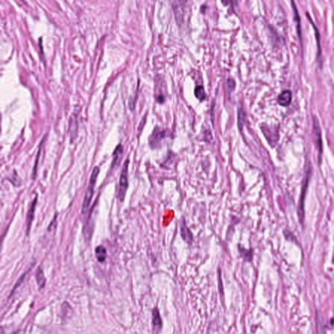
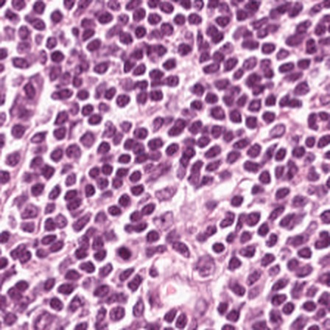
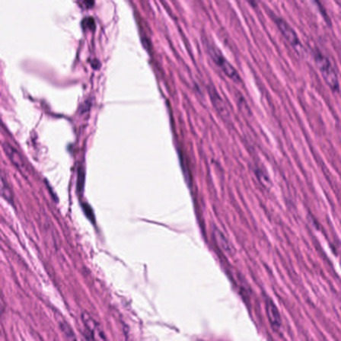
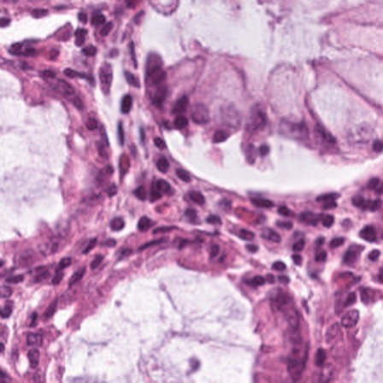
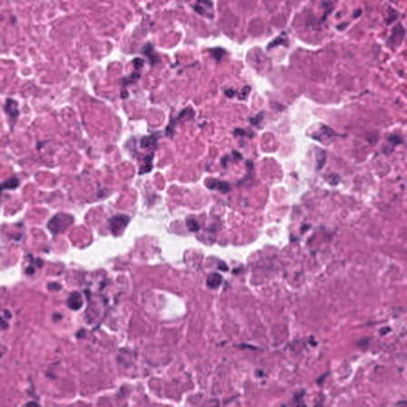
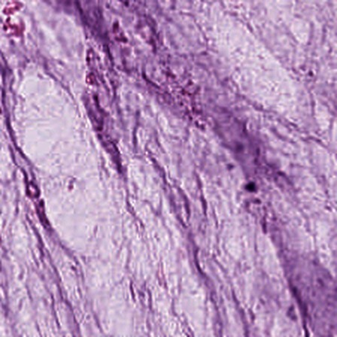
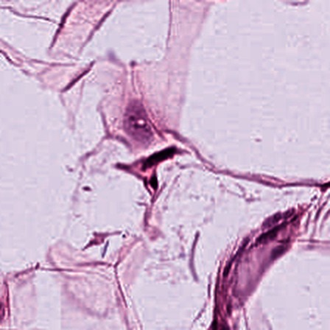
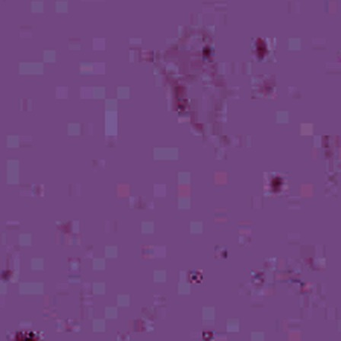
TwinRead
Yubo Wu, Noah Zhang, William Liu, Franklin Liu, Andy Chen
University of Illinois Urbana-Champaign
2026 Ashby Prize in Computational Science Hackathon
Notes:
[0:20] Hello, we are team TwinRead. Our question comes straight from the challenge: can foundation models make pathology more precise, more reproducible and more interpretable? These nine tiles are the nine tissue classes in our test set, all real H&E.

Slide 2
Why a second opinion matters
75.3%
47%
of individual breast-biopsy reads matched the expert panel, and only 48% for atypia
of the world’s population has little or no access to diagnostics
Can two AI models act as independent readers?
And can we make it run offline on a small device?
Notes:
[0:50] Pathology has a safety habit for hard cases: a second, independent read. It exists because reads vary. In Elmore's JAMA study, individual reads of breast biopsies matched the expert panel 75 percent of the time, and only 48 percent for atypia. But a second read needs a second expert, and the Lancet Commission estimates almost half the world has little or no access to diagnostics at all.
So we asked two questions. Can CONCH and MUSK, the two foundation models this hackathon provides, act as two independent readers? And can that second look be made small enough to run offline?
Sources: Elmore et al. doi:10.1001/jama.2015.1405. Fleming et al. doi:10.1016/S0140-6736(21)00673-5.

Slide 3
CONCH and MUSK make different mistakes
CONCH
MUSK
Contrastive: 1.17 M image–caption pairs
Masked: 50 M images and 1 B text tokens
At least one model was wrong on 505 of 7,180 test images
Only CONCH wrong
Both wrong
Only MUSK wrong
Only 110 out of the 505 were misclassified by both models.
Notes:
[0:50] Why would two models behave like two readers? Because they learned differently. CONCH was pretrained contrastively on over 1.17 million histology image and caption pairs. MUSK used masked modelling on 50 million image patches and a billion text tokens, unpaired, before its contrastive stage.
Here is the test of that idea. On the 7,180 colorectal test tiles, CONCH misses 329 and MUSK misses 286, but only 110 are missed by both. So each reader gets most of the other's errors right: 219 of CONCH's, 176 of MUSK's. That is the gap a second reader can cover.
Source: results/cm_local/CM/crc/reader_error_overlap.json.

Slide 4
System Architecture
1 Read twice
CONCH
2 Combine Predictions
Review flag
Least certain tiles go to a pathologist
Fused call
MUSK
H&E tile
Linear probes on frozen features
3 Distill
Student model
5.65 M parameters, 6.0 MB int8
Arduino UNO Q
Offline, no GPU, USB-powered
Train: 17,349 NCT-CRC-HE-100K tiles. Test: 7,180 CRC-VAL-HE-7K tiles (9 classes) and 1,500 Camelyon17 tiles from an unseen hospital.
Notes:
[1:00] The system has three parts. One: each tile is read twice, by a linear probe on frozen CONCH features and one on frozen MUSK features. Two: the readers are fused into one call, and the fused reader's uncertainty raises a review flag for a pathologist. Three: a small student network learns from both readers and is exported to int8, so it runs on an Arduino UNO Q.
The key discipline: the fusion rule and the review thresholds were chosen on validation and pre-registered before any test label was read. Every test number you see was computed once, after that.
The open-model pair, PathGen-CLIP and QuiltNet, went through the same protocol as a negative control.

Slide 5
CUDA kernels: ×202 preprocessing, ×10.6 augmentation
×202
K1: dual-reader preprocessing
×10.6
K2: training augmentation
One tile in, CONCH 448 px and MUSK 384 px out, bit-exact to the official transforms
Nine dependent stages plus JPEG, each within one grey level of a float64 reference
×1.11
whole embedding run: the model forward is 89% of the time
×2.49
whole student training step: 1,559 to 3,880 images/s
RTX 5060; compile-checked for Delta A100 and DeltaAI GH200; compute-sanitizer clean. Tiles/s (K1), images/s (K2). K2 simulates a USB camera filming a screen.
Notes:
[0:45] We wrote two custom CUDA kernels. K1 prepares both readers' inputs from one tile, and its fixed-point math makes the output bit-exact to each model's official transform. It is ×202 faster than PIL inside the embedding run. We show the honest number next to it: the whole run gains only ×1.11, because the model forward dominates in this batched setup.
K2 simulates what a camera filming a screen does to a tile. It augments ×10.6 faster than torch, which makes the full student training step ×2.49 faster, close to training with no augmentation at all (4,507 images/s). Next, how they get this fast.
If asked: the kernel bench with input already on the GPU gives 90,131 tiles/s, and K2 gives 46,315 images/s standalone. See the backup slide.
Sources: results/kernels/*.json, results/student/*/throughput.json.

Slide 6
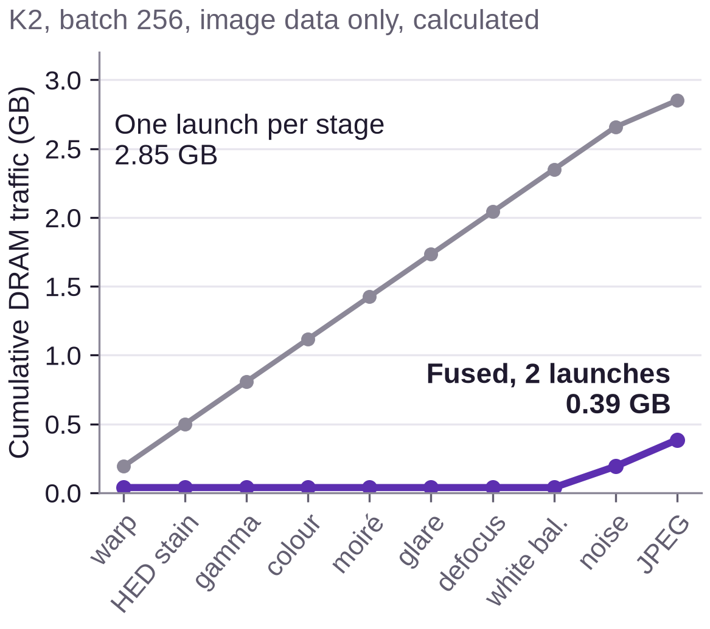
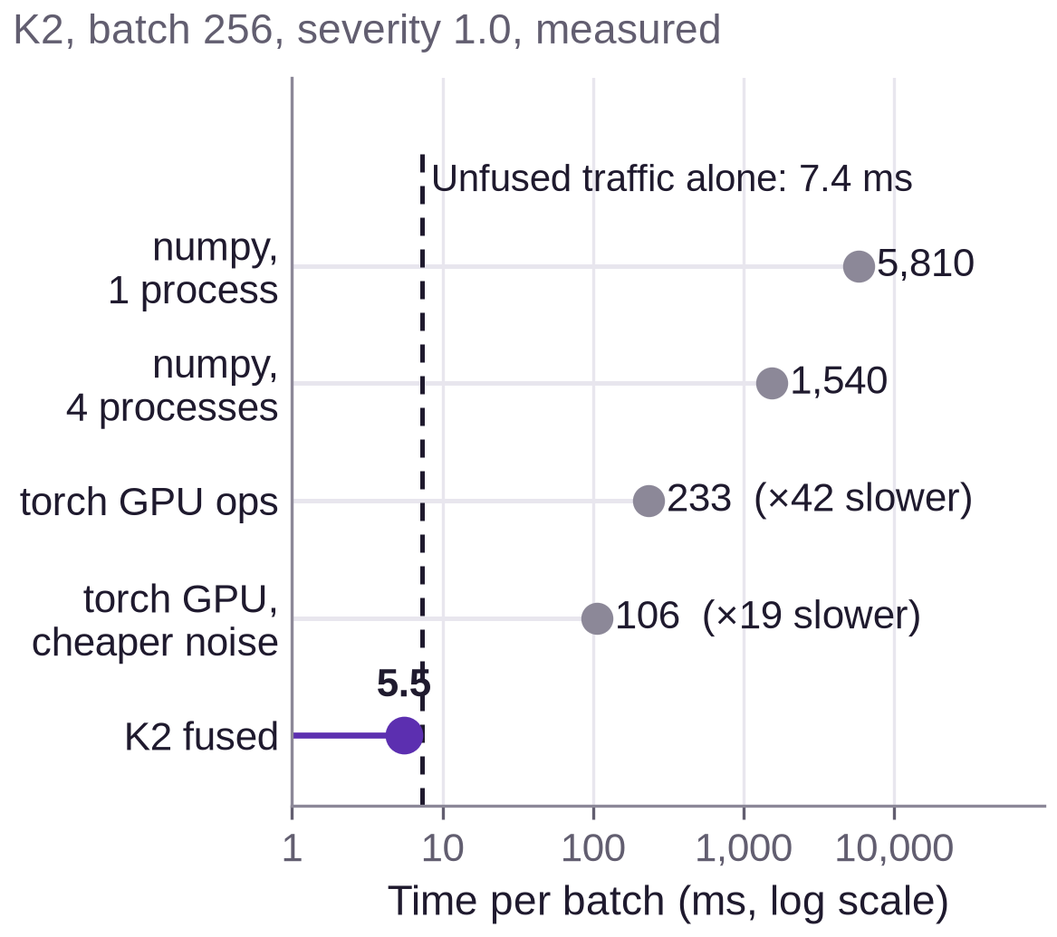
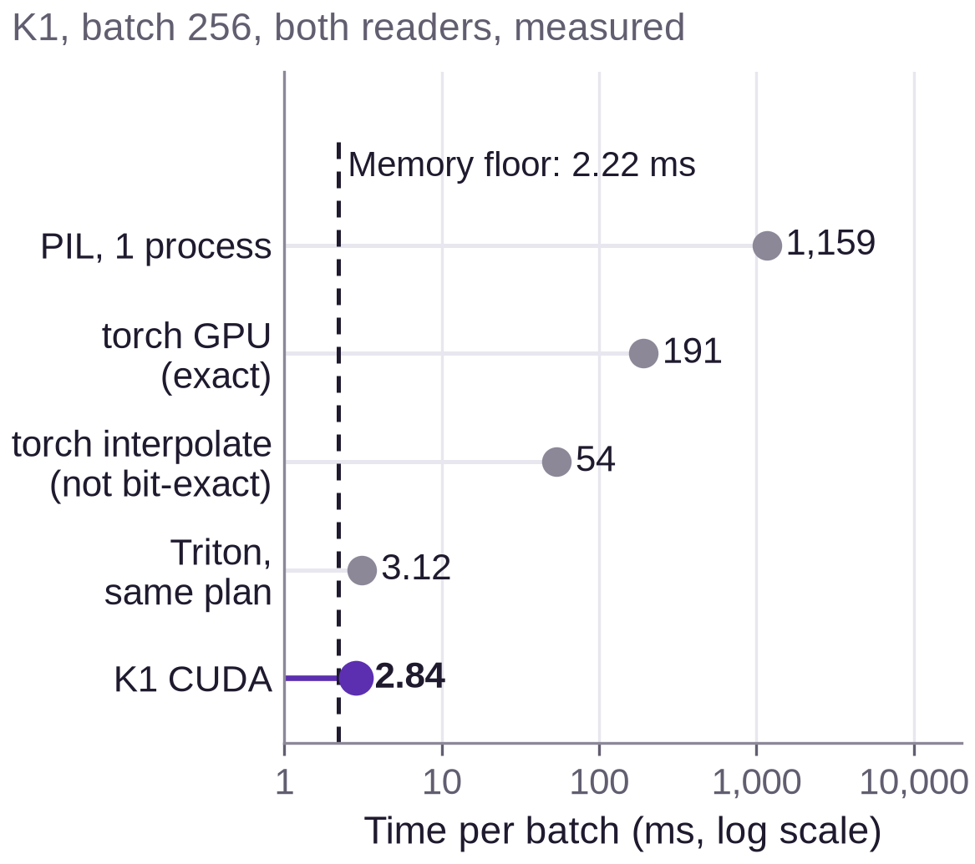
Fusing dependent stages avoids DRAM round trips
A dependent kernel chains stages where each one needs the previous stage’s output. Fusing runs the chain in one launch, with intermediates in on-chip shared memory.
Why fuse
What it accomplishes
Why it’s cool
One launch per stage sends every intermediate through DRAM: ×7.4 the traffic.
K2 takes 5.5 ms per batch, less than the unfused chain’s memory traffic alone.
K1 runs within 28% of the memory-bandwidth floor and stays bit-exact.
DRAM traffic and floors are calculated from tensor sizes and the measured memcpy rate (388 GB/s), not hardware counters. Times are CUDA events on a shared RTX 5060. No hand-written unfused CUDA version was measured.
Notes:
[1:15] Here is how they get this fast. K2 is a dependent chain: warp, stain jitter, gamma, colour, moire, glare, defocus, white balance, noise, JPEG. Each stage needs the previous stage's output, so they cannot run as independent jobs. The usual way is one launch per stage, which writes every intermediate to GPU memory and reads it straight back. For one batch that is 2.85 gigabytes of traffic, by calculation.
We fuse the chain instead. One launch works through 32-by-16 pixel tiles, keeping intermediates in on-chip shared memory, with a halo of extra pixels so the blur can see its neighbours. Barriers between stages keep them in order. Traffic falls to 0.39 gigabytes.
The result: 5.5 milliseconds per batch, less than the unfused chain's memory traffic alone would take. Torch GPU ops take 233.
The part we like most: K1 runs within 28 percent of the floor set by GPU memory bandwidth, and matches the official transforms bit for bit. torch interpolate, the quick alternative, is 19 times slower and up to 21 grey levels off.
If asked: fusing alone does not explain the whole ×42. We did not measure a hand-written unfused CUDA version. The memory floor shows one would take at least 7.4 ms plus compute, so fusing is worth at least ×1.33, and the rest is torch overhead. Our Triton version of K1's plan is within 10% of K1, so most of K1's gain comes from the design, not the language. ×42 is the standalone bench at batch 256 and severity 1.0; ×10.6 on the previous slide is inside the training loop at batch 128 and severity 0.5. K2's launch 1 takes 3.27 ms and JPEG 2.17 ms. compute-sanitizer memcheck, racecheck and synccheck are clean.
Sources: results/kernels/k1_bench.json, k1_parity.json, k2_bench.json, k2_sanitizer.json, src/twinread/csrc/k2_camera_aug.cu.

Slide 7
Fusion adds +0.74 points on colorectal tiles only
Balanced accuracy, colorectal test set
Fused minus best single reader, 95% CI
94.13%
CONCH + MUSK
Colorectal
+0.74
[+0.18, +1.29]
CONCH alone
94.80%
CONCH + MUSK
Camelyon17
−0.40
[−3.70, +0.76]
MUSK alone
Open control pair
Colorectal
+0.08
[−0.52, +0.66]
95.55%
CONCH + MUSK fused
Open control pair
Camelyon17
0.00
[−1.22, +1.65]
+3.6 points of tumour recall: most of the net gain
CIs: tile-level on colorectal (anti-conservative, no slide IDs), slide-clustered on Camelyon17. Test sets: 7,180 and 1,500 tiles.
Notes:
[1:00] First result. Fusing CONCH and MUSK gives 95.55% balanced accuracy against 94.80% for MUSK alone, a gain of 0.74 points. Most of the net gain is tumour recall, up 3.6 points. Fusion leaves 239 errors, fewer than either reader alone.
But look at the forest plot. Only the top row clears zero. On Camelyon17, an unseen hospital, fusion gives no gain, and the open control pair gains nothing on either dataset. So the gain is real but small and dataset-dependent.
If asked: the colorectal CI is tile-level and therefore optimistic because this dataset has no slide IDs. Validation picked the fusion rule by one or two tiles (2641 vs 2640 vs 2639 of 2658). Muscle and stroma recall swing by about 13 points in opposite directions and cancel. Backup slide has the per-class view.
Sources: results/cm_local/CM/*/fusion.json, results/open/OPEN/*/fusion.json, results/headline.json.

Slide 8
Reviewing the least certain 10% catches 80% of errors
Errors caught at a 10% review budget
80.3%
Fused reader’s uncertainty
74.1%
MUSK alone
66.0%
CONCH alone
59.0%
Readers disagree
The signal is the fused reader’s doubt, not disagreement.
CRC-VAL-HE-7K, 7,180 tiles. Single readers flag their own errors by their own confidence.
Notes:
[1:10] Second result, and the one that surprised us. We expected disagreement between the readers to be the best signal for sending a tile to a pathologist. It is not.
The chart ranks tiles by each score and sends the top ones for review. At a 10% budget, the fused reader's own uncertainty catches 80.3% of its errors. MUSK flagging itself catches 74.1%, CONCH 66.0%. Disagreement alone stalls at 59.0%, because the readers disagree on only 5.6% of tiles.
A learned flag that adds disagreement to uncertainty ranks tiles almost identically, Spearman 0.9999, so it adds nothing. Two readers help because they make a better-calibrated reader, not because their disagreement is informative.
If asked: on Camelyon17 fused uncertainty catches 81.1%, while the pre-registered flag reaches 75.5% against CONCH alone at 74.5%, and it does not beat CONCH alone on cleared-tile accuracy. Backup slide.
Sources: results/cm_local/CM/crc/review.json, triage_curves.json.

Slide 9
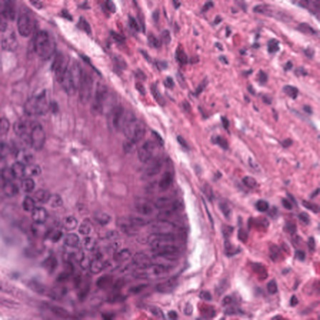
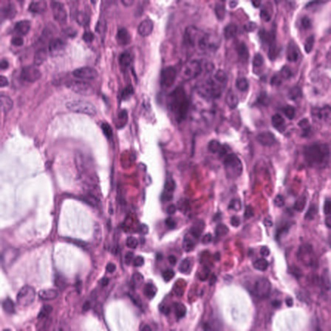
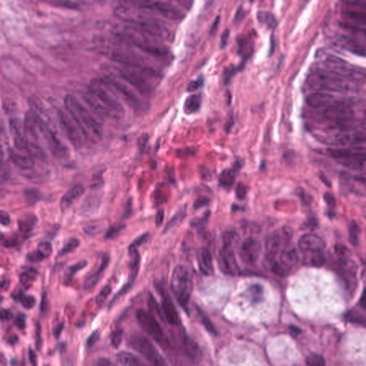
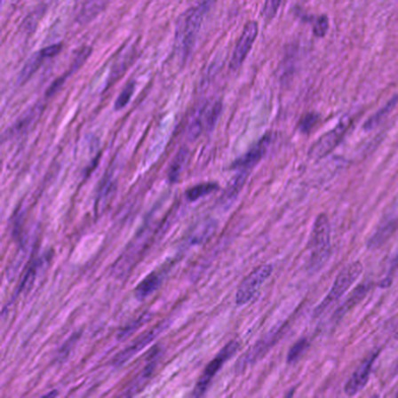
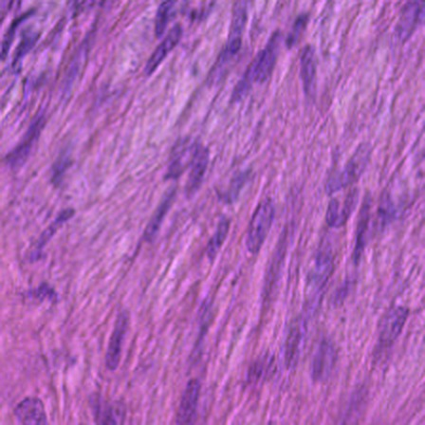
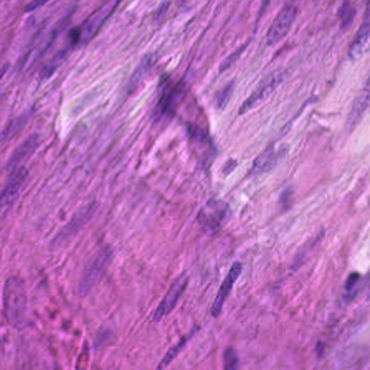
53 tiles fooled both readers; six also escaped the flag
Truth: tumour. Both readers: normal.
53
tiles (0.74%): both wrong (>80% confidence)
47
caught by the pre-registered flag, which reviews 25.1% of tiles
6
escaped it (shown): both readers at least 0.98 confident
Truth: stroma. Both readers: muscle.
Two models agreeing is not proof. A pathologist stays in the loop.
CRC-VAL-HE-7K, truth as labelled in the dataset. 36 of the 53 are muscle vs stroma; 11 are tumour called normal.
Notes:
[0:50] Now the limit of the whole idea. These are shared blind spots: tiles where both readers make the same wrong call, both with high confidence. There are 53 on the colorectal test set, 0.74% of tiles. Most are muscle versus stroma, but 11 are tumour called normal.
No disagreement signal can catch these, because the readers agree. The fused uncertainty flag still catches 47 of them, at the cost of reviewing a quarter of tiles. The 6 on this slide escaped even that.
Pathologists in the room may disagree with some of these labels, and we would welcome that. The point stands: when two models agree, that is not proof.
If asked: on Camelyon17 the flag catches only 1 of 12 such tiles.
Sources: results/cm_local/CM/crc/review.json, triage_curves.json, tile_preds.npz.

Slide 10
Why shrink it: AI that works without a network
Model size (MB)
Why quantise to int8
Why run on a small device
Smaller: 22.6 MB down to 6.0 MB, ×3.8
Faster and lighter: ×1.5 faster and ×1.8 less RAM on x86
Small cost: 94.15% to 93.05% balanced accuracy; 96.8% of calls unchanged
Low-access clinics: no GPU, server or network
Disaster relief: Hurricane Maria knocked out 95.6% of Puerto Rico’s cell sites
Mars: up to 22 minutes each way to Earth, so decisions must be local
Privacy and cost: images stay local; $79 list price
Checkpoints include text encoders. Speed and RAM: MobileNetV4 backbone, 4 threads, x86; fp32 not timed on the board. Sources: Wilson et al., Lancet 2018; FCC 2017; McBrayer et al., NASA, 2022; Arduino 2026.
Notes:
[1:00] So far this takes two large models and a GPU: over two gigabytes of checkpoints. Distilling gives us one small student. Quantising it to 8-bit integers then makes it ×3.8 smaller, at 6 megabytes. On x86 it is also about ×1.5 faster. The cost is about one point of balanced accuracy, and 96.8% of calls do not change.
Why run on a small device? A clinic with no GPU and no second pathologist. A disaster zone: after Hurricane Maria, 95.6 percent of Puerto Rico's cell sites were down. And an extreme case, not pathology but the same principle: Mars is up to 22 minutes from Earth each way. You cannot wait for a server, which is why NASA's Perseverance rover already picks some science targets by itself. Local, lightweight AI keeps working when the connection does not.
If asked: these are reasons to build this way, not deployments. TwinRead has not been field-tested in a clinic or disaster zone, and this board is not space-rated. The Lancet series by Wilson et al. names workforce and infrastructure among the barriers to pathology access in low- and middle-income countries. The 95.6% is the FCC snapshot of 23 September 2017; some providers had not reported. AEGIS on Perseverance targeted rocks without direction from Earth from May 2022. The speed and RAM numbers are for the MobileNetV4 backbone alone on x86 at 4 threads (1.85 vs 1.24 ms, 54 vs 30 MB). We did not time fp32 on the UNO Q, so we quote no board speed-up, and we did not measure power. MinMax and Entropy calibration collapsed, so we used percentile calibration. $79 is the 4 GB list price since 6 July 2026; the 2 GB board is $59.
Sources: results/student/model_sizes.json, results/uno_q/backbone_latency_x86_sim.json, results/uno_q/onboard/int8_kernel_check.json, device/uno_q_app.py, FCC report DOC-346860A1, Wilson et al. Lancet 2018, NASA NTRS 20220013418, NASA Science on AEGIS (Sol 442), Arduino blog 26 June 2026.

Slide 11
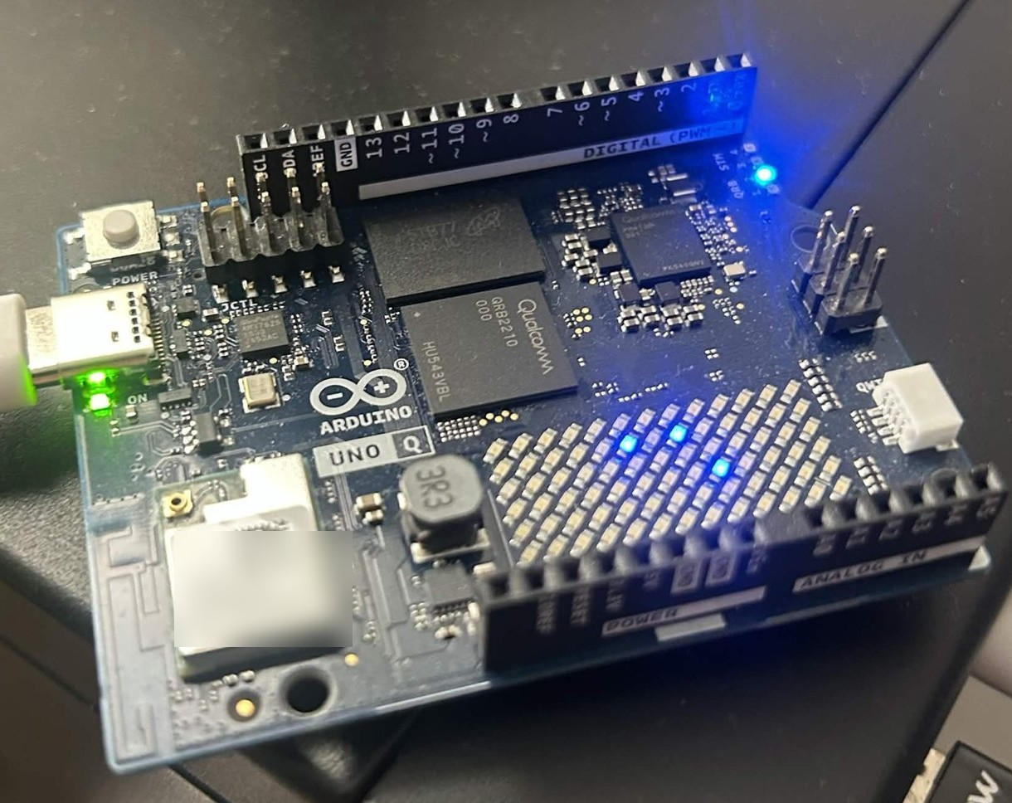
Implementation on Arduino UNO Q
18.7 ms
per tile, model inference: int8, 4 threads, offline
93.05%
balanced accuracy on all 7,180 test tiles, below every teacher (94.13–95.55%)
6.0 MB
5.65 M parameters: 1.4% of the two teachers’ vision towers
All measured on the Arduino UNO Q: Qualcomm QRB2210, 4× Cortex-A53, 3.6 GiB RAM, onnxruntime on CPU. Stored test tiles; no camera captures yet.
Notes:
[0:50] Hold up the board now, if you brought it.
This is the third part. A student network, 1.4 percent of the parameters of the two teachers' vision towers, exported to a 6.0 megabyte int8 model. It runs on this Arduino UNO Q over USB power, with no network.
Everything on this slide was measured on the board: 18.7 milliseconds of model inference per tile, and 93.05% balanced accuracy across all 7,180 test tiles, which took 282 seconds. That is below every teacher. The value here is small, offline and low-cost, not beating the foundation models.
If asked: a full app frame takes about 90 ms, mostly the numpy tissue check, and the full loop runs at 25.4 tiles/s. The x86 int8 score of 92.19% was an onnxruntime kernel artefact. Backup slide.
Sources: results/uno_q/onboard/*.json, results/student/model_sizes.json.

Slide 12
Future Directions
What remains
Next step
The fusion gain is fragile: validation chose the rule by 1–2 tiles
Rerun on all 100k training tiles on NCSA Delta (kit ready)
The pre-registered threshold flagged 25.1% of tiles, not 10%
Calibrate per site; add slide IDs for clustered CIs
The board’s flag tracks the teachers weakly (κ 0.32), on stored tiles only
Real camera captures on the board, then clinical validation
Notes:
[0:50] What is not solved. The fusion gain is fragile, so next is a full-data run on NCSA Delta with all 100 thousand training tiles. Our Slurm kit is tested locally but has not run there yet. The pre-registered threshold over-flagged the test set, 25.1% of tiles for a 10 percent target, so thresholds must be calibrated per site. And the board's flag tracks the teachers only weakly, kappa 0.32, because its two readers are two heads on one backbone. It has only seen stored tiles, so real camera captures come next.
If asked: the board flag covers 10.2% of tiles and catches 57.2% of its own errors. The low x86 scores only showed up as an artefact because we ran on the actual board.

Slide 13
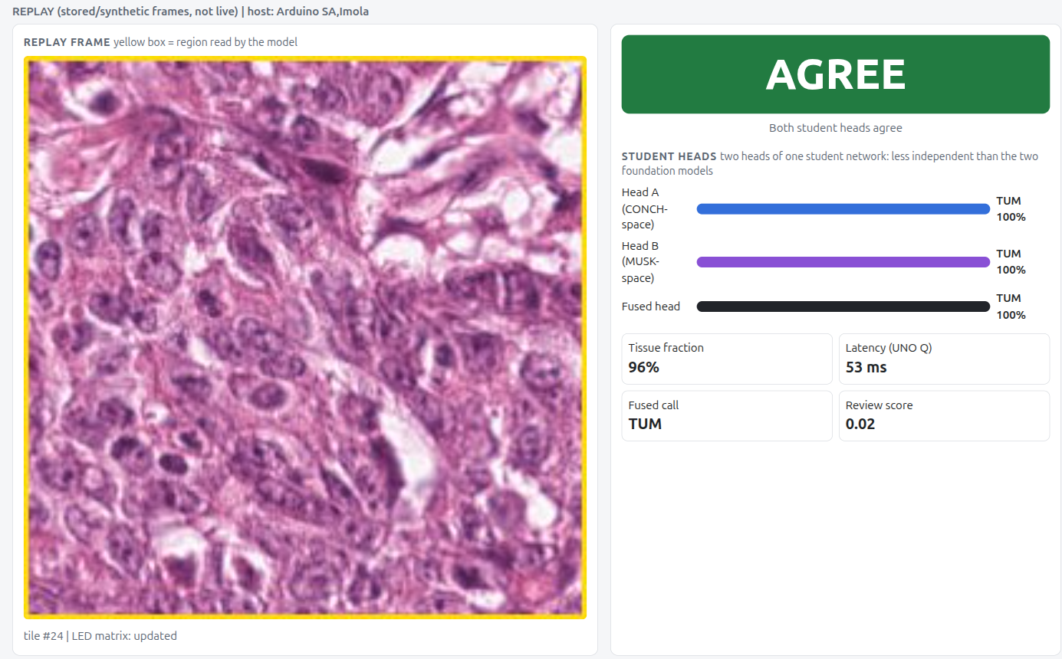
Why it matters to pathologists and patients
For pathologists
A short list of tiles worth re-checking, with each reader’s call shown.
For patients
A low-cost offline second look could help where no second pathologist is available.
For the field
Two readers help by making a better-calibrated reader, not through disagreement.
The app on the UNO Q, replaying a stored test tile. Its two heads share one student network.
Notes:
[0:40] Why it matters. For pathologists: a short list of tiles worth a second look, with each reader's call shown rather than one black-box score. For patients: a low-cost, offline second look could help where no second pathologist is available, pending real-world validation. For the field: a measured, pre-registered finding about why two readers help.
This is a second-read aid, not a diagnosis, and nothing here is clinically validated.
If asked about the 53 ms in the screenshot: that timer covers the whole step, meaning frame read, crop, tissue check and network, about 50 ms by stage medians. 18.7 ms is the network alone at 4 threads.

Slide 14
TwinRead in three numbers
+0.74 pts
80.3%
18.7 ms
balanced accuracy from fusion on colorectal tiles
of errors caught by reviewing the least certain 10% of tiles
per tile on an offline board: a 6.0 MB model, 93.05% accurate
Thank you. Questions?
Yubo Wu, Noah Zhang, William Liu, Franklin Liu, Andy Chen
github.com/iujab/twinread-conch-musk-edge
Notes:
[0:20] Three numbers to remember: a small fusion gain on one dataset, 80.3% of errors caught with 10 percent review, and 18.7 milliseconds per tile on a board. Thank you. We would welcome your questions.
Leave this slide up during questions. Backup slides follow the references. Spoken total is about 11:40.

Slide 15
References
Elmore JG, et al. Diagnostic concordance among pathologists interpreting breast biopsy specimens. JAMA 2015. doi:10.1001/jama.2015.1405
Fleming KA, et al. The Lancet Commission on diagnostics: transforming access to diagnostics. Lancet 2021. doi:10.1016/S0140-6736(21)00673-5
Wilson ML, et al. Access to pathology and laboratory medicine services: a crucial gap. Lancet 2018. doi:10.1016/S0140-6736(18)30459-8
Lu MY, et al. A visual-language foundation model for computational pathology (CONCH). Nat Med 2024. doi:10.1038/s41591-024-02856-4
Xiang J, et al. A vision–language foundation model for precision oncology (MUSK). Nature 2025. doi:10.1038/s41586-024-08378-w
Ikezogwo WO, et al. Quilt-1M: one million image-text pairs for histopathology (QuiltNet). NeurIPS 2023. arXiv:2306.11207
Li et al. Multi-modal foundation models for computational pathology: a survey. TMLR 2025. PMC13081565
Muneer A, et al. Review on multimodal data integration for cancer research. Artif Intell Rev 2026. doi:10.1007/s10462-026-11522-9
Kather JN, et al. NCT-CRC-HE-100K and CRC-VAL-HE-7K (CC-BY-4.0). Bandi P, et al. Camelyon17; Koh PW, et al. WILDS (Camelyon17-WILDS, CC0).
Open models: PathGen-CLIP (CC-BY-4.0), QuiltNet-B-16 (MIT), timm mobilenetv4_conv_small.
FCC. Communications Status Report for Areas Impacted by Hurricane Maria. 23 September 2017.
McBrayer KT, Chai PR, Judd EL. Communication Delays, Disruptions, and Blackouts for Crewed Mars Missions. NASA, ASCEND 2022. NTRS 20220013418.
NASA Science. Perseverance’s SuperCam uses AEGIS for the first time. 2022.
Arduino. A heads-up on the Arduino UNO Q board pricing. Arduino blog, 26 June 2026.
Code, results JSON and this deck’s generator: github.com/iujab/twinread-conch-musk-edge. Every TwinRead number here is read from results/*.json at build time.
Notes:
Not presented. Leave out of the talk unless asked.

Slide 16
Backup: data, splits and statistics
Split | Data | Tiles | Used for
Train | NCT-CRC-HE-100K subset | 17,349 | Probes and student
Validation | Same source, group-disjoint | 2,658 | Fusion rule, thresholds
Test | CRC-VAL-HE-7K, 9 classes | 7,180 | Evaluated once, after pre-registration
Test | Camelyon17-WILDS, hospital 2 | 1,500 | Unseen hospital; trained on hospitals 0, 3, 4
Statistics. Percentile bootstrap, 1,000 resamples. Colorectal CIs and McNemar tests are tile-level and anti-conservative because the dataset has no slide IDs; Camelyon17 CIs are clustered by slide.
Licences. CONCH and MUSK are CC-BY-NC-ND, so their student is never distributed. PathGen-CLIP + QuiltNet-B-16 is the control pair and the shareable bundle.
Scale. Teacher numbers are from a local 20k-tile subset on one RTX 5060. The Delta kit is written and tested locally and has not run on Delta.
Sources: results/cm_local/CM/*/preregistration.json, results/student/cm_crc/metrics.json, ncsa/README.md.
Notes:
Backup for questions on data, leakage, statistics or licensing.

Slide 17
Backup: why the colorectal gain is fragile
+0.40 of the +0.74
points of balanced accuracy come from tumour recall. Muscle and stroma cancel.
2,641 / 2,640 / 2,639
of 2,658 validation tiles correct for the average, gated MLP and concat rules. Validation is near ceiling.
−0.40
test points for the runner-up rule, the gated MLP, against MUSK.
Post hoc and descriptive. Balanced accuracy is the mean of 9 class recalls, so each class contributes its recall change divided by 9. Source: results/headline.json.
Notes:
Backup for 'how robust is the fusion gain?'. Answer: not very. This is why the next step is the full-data run on Delta.

Slide 18
Backup: where the review flag falls short
At a 10% budget | Fused uncertainty | Learned flag | Best single reader | Flag: cleared-tile accuracy | Best single: cleared-tile accuracy
Colorectal | 80.3% | 80.3% | 74.1% | 99.27% | 98.85%
Camelyon17 | 81.1% | 75.5% | 74.5% | 99.04% | 99.11%
Pre-registered threshold on test | Target flagged | Actually flagged | Errors caught
Colorectal | 10% | 25.1% | 97.5%
Camelyon17 | 10% | 5.3% | 58.5%
Validation sits near ceiling (99.36%), and validation to test is a distribution shift, so a threshold calibrated on it does not transfer. Recalibrate on the target site.
Single readers flag their own errors by their own confidence. Source: results/cm_local/CM/*/review.json, results/headline.json.
Notes:
Backup for 'does the flag generalise?'. On Camelyon17 the pre-registered flag clears tiles no better than CONCH alone, and the threshold over-flags colorectal.

Slide 19
Backup: kernel throughput
K1: tiles/s, both readers, 224 px | Rate
PIL, 1 CPU process | 221
PIL DataLoader, 8 workers | 538
torch GPU ops (exact) | 1,340
Triton (our baseline) | 82,058
K1 CUDA, including host copy | 46,157
K1 CUDA, input on GPU | 90,131
K2: images/s, severity 1.0 | Rate
numpy, 1 process | 44
numpy, 4 processes | 166
torch GPU ops | 1,097
K2 CUDA | 46,315
K1 cosine to the official transforms: at least 0.999997. The ×1.11 end-to-end figure is for a batched, GPU-forward-bound run, where preprocessing is 9.5% of the time. Per-image serving and faster GPUs are a different regime, not measured here.
CUDA-event timing (warmup 3, median of 10) on a shared GPU, so throughput is an estimate. Source: results/kernels/*.json.
Notes:
Backup for compute questions. Kernel bench uses batch 256 with both readers' outputs.

Slide 20
Backup: a 90 ms app frame and int8 fidelity
Median time per stage (ms)
CONCH + MUSK student, int8 | Balanced accuracy
On the board | 93.05%
x86, fused int8 kernels off | 93.01%
x86, onnxruntime defaults | 92.19%
fp32 student | 94.15%
Board vs x86 kernels off: 13 of 7,180 calls differ.
Board flag: 10.2% of tiles, catches 57.2% of its own errors, agreement with the teacher flag 79.6% (κ 0.32).
The device’s two readers are two heads on one shared backbone.
Full app loop 25.4 tiles/s. Each Bridge RPC call to the MCU costs about 8 ms. Source: results/uno_q/onboard/*.json.
Notes:
Backup for edge-device questions. The largest cost in a frame is the numpy tissue check, not the network.

