Slide 1
WS - Security
HP SOFTWARE
Mahmoud Agbareya February 2013

Slide 2
Contents
What is Security?
Two levels of Security:
Transport Level Security
Message Level Security
Security Tokens
Timestamp
Message Signature
Data Encryption

Slide 3
What is Security?
Confidentiality: keeping message secret from unintended listeners during the transit.
Integrity: the message was not corrupted in the way.
Authentication(&Authorization): solves questions as "Who is the other party?" and "How does he prove his identity?"
Notes:
Message Confidentiality: we will use Encryption
Message Integrity: we will use signature
Client Authentication: this is the first part – followed by Authorization.

Slide 4
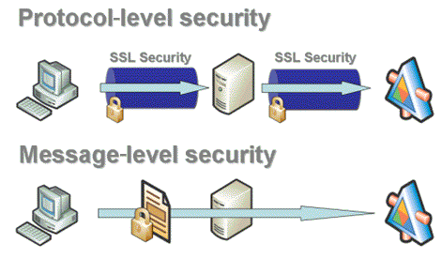
Two Levels of Security

Slide 5
Transport Level Security
Based on SSL and TLS.
Provides authentication, integrity and confidentiality.
Transits over https.
Notes:
The integrity and confidentiality are confirmed when we use SSL and TLS

Slide 6
Transport vs Message Security
Transport Level Security | Message Level Security
Uses SSL | Doesn’t use SSL
Point-to-Point: protects the pipe | The data itself is protected
All or nothing | Can secure parts and parts not
Will repeat with intermediaries | End-to-End: once and for all
More effective | More features

Slide 7
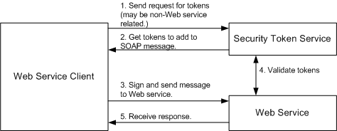
Message Level Security

Slide 8
Message Level Security
Before Security
<?xml version="1.0" encoding="utf-8"?>
<soap:Envelope xmlns:soap="http://schemas.xmlsoap.org/soap/envelope/">
<soap:Body>
<EchoString xmlns="http://tempuri.org/">
<s>abcde</s>
</EchoString>
</soap:Body>
</soap:Envelope>

Slide 9
Message Level Security
After Security
<?xml version="1.0" encoding="utf-8"?>
<soap:Envelope xmlns:soap="http://schemas.xmlsoap.org/soap/envelope/" xmlns:wsse="http://docs.oasis-open.org/wss/2004/01/oasis-200401-wss-wssecurity-secext-1.0.xsd" >
<soap:Header>
<wsse:Security soap:mustUnderstand="1">
………
</wsse:Security>
</soap:Header>
<soap:Body>
<EchoString xmlns="http://tempuri.org/">
<s>abcde</s>
</EchoString>
</soap:Body>
</soap:Envelope>
Notes:
All security configuration in Message Level Security will be under the Security header

Slide 10
Message Level Security
Four basic elements:
Security Tokens
Timestamp Element
Message Signature
Data Encryption

Slide 11
Security Tokens UserName Token
Syntax
<wsse:UsernameToken>
<wsse:Username>…</wsse:Username>
<wsse:Password type=“…”>…</wsse:Password>
<wsse:Nonce EncodingType=“…”>…</wsse:Nonce>
<wsu:Created>…</wsu:Created>
</wsse:UsernameToken>
Notes:
<Password> (Optional): contains the password.
Type: the type is a URL that implies the type of the password: Text or Digest (hashed)Nonce
<Nonce> (Optional): unique random number, it is used to ban replay attacks – no two requests have the same nonce value.
EncodingType: default is Base64
<Created> (Optional): specifies the creation time.
Nonce and created are used to create the hash function when sending the password in 64 encoding.
An additional way used to prevent replay attacks is to save the nonces used latest in the server

Slide 12
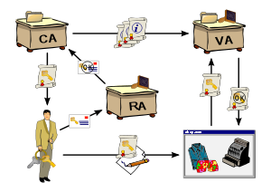
Security Tokens X509
X509 is a PKI
Long lasting certificates
Computationally intensive
Private keys must bee saved securely
Notes:
PKI stands for Public Key Infrastructure
CA: certificate authority
RA: Registration authority
VA: Validation authority
SSO: single sign on : if you sign to one service you are signed to all

Slide 13
Security Tokens X509 Certificate
Syntax
<wsse:BinarySecurityToken
ValueType="http://docs.oasis-open.org/wss/2004/01/oasis-200401-wss-x509-token-profile-1.0#X509v3"
EncodingType="http://docs.oasis-open.org/wss/2004/01/oasis-200401-wss-soap-message-security-1.0#Base64Binary"
xmlns:wsu="http://docs.oasis-open.org/wss/2004/01/oasis-200401-wss-wssecurity-utility-1.0.xsd"
wsu:Id="SecurityToken-778caab2-d295-4a1b-92ad-907d339b77de">
…………
</wsse:BinarySecurityToken>
Notes:
We know that this is a X509 certificate from the ValueType attribute.
ValueType attribute: tells the types of this Security Token, for X509 it can be:
X509v3: single certificate
X509PKIPathv1: list of X509 certificates
PKCS7
EncodingType: the type of the encoding, default: base64
Id: ID reference (~address) of the token.

Slide 14
Security Tokens Other types
Kerberos 1
Kerberos 2
SAML

Slide 15
Timestamp Element
Out of date messages
Contradicting messages
syntax
<wsu:Timestamp>
<wsu:Created> 2002-08-19T16:15:31Z </wsu:Created>
<wsu:Expires> 2002-08-19T16:20:31Z </wsu:Expires>
<wsu:Received> 2002-08-19T16:17:28Z </wsu:Received>
</wsu:Timestamp>
Notes:
Each element can be added alone to any other element

Slide 16
Let’s try it

Slide 17
Message Signature
Based on Security Token
Integrity
Authentication (sometimes)
May sign some parts and some not.
Will add ID attribute to signed parts.

Slide 18
Message Signature
Syntax
<Envelope> <Headers> <Security>
<Signature>
<SignedInfo>
(CanonicalizationMethod)
(SignatureMethod)
(<Reference (URI=)? >
(Transforms)?
(DigestMethod)
(DigestValue)
(</Reference>)+
</SignedInfo>
(SignatureValue)
(KeyInfo)?
(Object)*
</Signature>
…</Security>…</Headers>…</Envelope>
Notes:
‘*’ = zero or more, ‘+’ = one or more, ‘?’ = zero or one
<signedInfo>: the information actually assigned.
<Transforms>: a list of <Transform>, each transform defines a processing step
<KeyInfo>: contains the key details by <SecurityTokenReference> element

Slide 19
Let’s try it

Slide 20
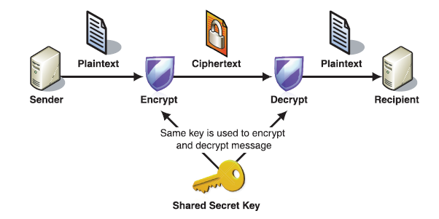
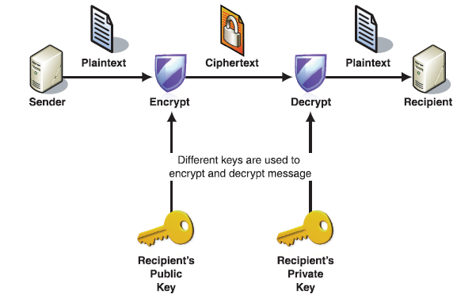
Data Encryption
Encrypt the message Symmetrically
Encrypt the message Asymmetrically
Notes:
Confidentiality
Based on Security Token
May Encrypt some parts and some not

Slide 21
Data Encryption
Syntax – under Security header
<Envelope> <Headers> <Security>
<xenc:EncryptedKey xmlns:xenc="http://www.w3.org/2001/04/xmlenc#">
<xenc:EncryptionMethod Algorithm=“” />
<KeyInfo xmlns="http://www.w3.org/2000/09/xmldsig#">
……
</KeyInfo>
<xenc:CipherData>
<xenc:CipherValue>...</xenc:CipherValue>
</xenc:CipherData>
<xenc:ReferenceList>
<xenc:DataReference URI="EncryptedContent-c51cdf0e-c12b-4643-a150-29f259fd9862"/>
</xenc:ReferenceList>
</xenc:EncryptedKey>
…</Security>…</Headers>…</Envelope>

Slide 22
Data Encryption
Syntax – Encrypted element
<EncryptedElement wsu:Id=“myId”>
<xenc:EncryptedData
Id="EncryptedContent-c51cdf0e-c12b-4643-a150-29f259fd9862" Type="http://www.w3.org/2001/04/xmlenc#Content" xmlns:xenc="http://www.w3.org/2001/04/xmlenc#">
<xenc:EncryptionMethod Algorithm="" />
<xenc:CipherData>
<xenc:CipherValue>...</xenc:CipherValue>
</xenc:CipherData>
</xenc:EncryptedData>
</EncryptedElement>

Slide 23
Let’s try it

Slide 24

Thank You
For Listening

