Slide 1
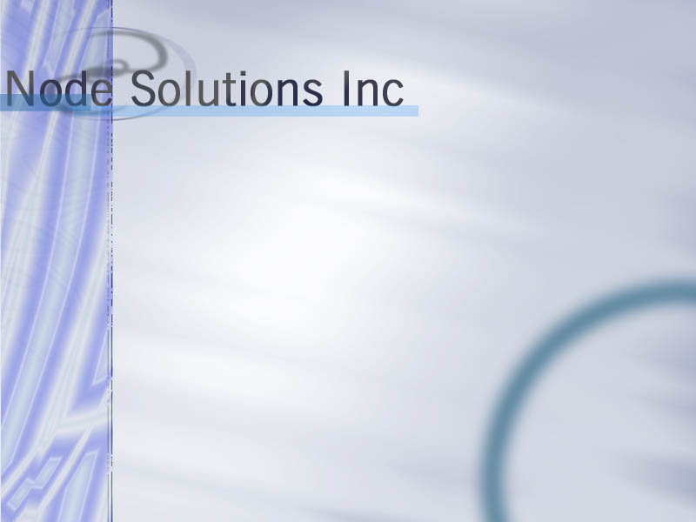
Network Security:
Threats and Solutions

Slide 2

It’s About Time To Prepare Your Network for the Unknown
Part One
First Questions You Should Ask: IS IT SAFE?
Why is There a Threat?
Statistics
What can We do to Help You?
Designing a Secure Network
Example: A Secure e-Business Network
Security Considerations
What Needs to Change?
Are You Really Ready?
Part Two
Notes:
Check spelling.. And “questions” ?
Sick background intro
Ok.. Questions… need to be changed. This is index site. Outline… will work

Slide 3

The Threat Exists
Part One

Slide 4
Why is there a Threat?
· Computer Threats are on the rise
  o Information Theft
  o Intrusion
  o Vandalism
  o Virus Infection
  o Denial of Service
· Misplaced / Poorly Configured Security Systems:
  o DNS Server is not properly configured.
  o HTTP Server’s Security is not up to date.
  o Firewall Server’s rules don’t mirror your Security Policy.
  o Email Server is susceptible to SPAM attacks.
  o Intrusion Detection System is misplaced.
  o Out of box SNMP devices are NOT Secure.
· Problems may be too complex to solve
· Lack of Trained Personnel
· A “security standard” like C2 doesn’t ensure your
e-Business Security
Notes:
Threat stuff in bg

Slide 5
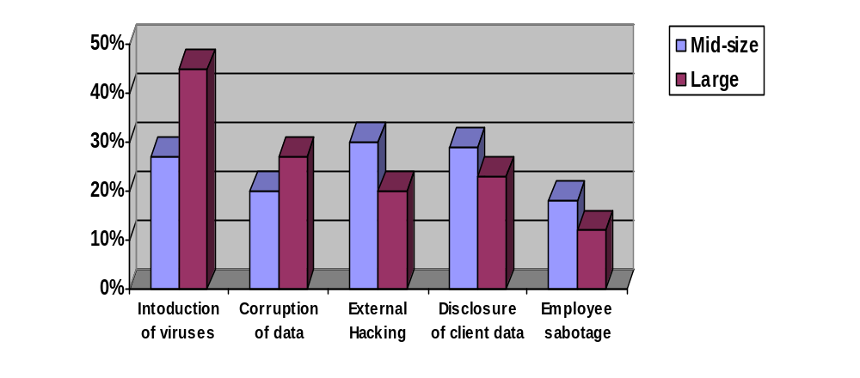
Security Threats to Mid- and Large-Sized Companies
Notes:
This does not go with next.
Check title.
Maybe some money or broken files in background

Slide 6
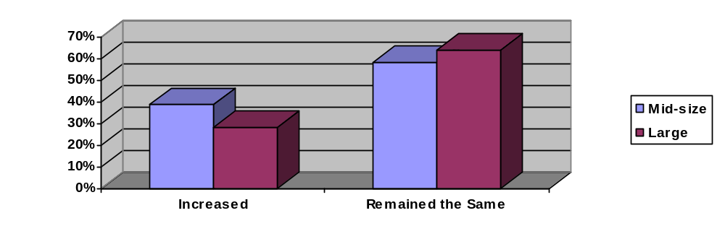
Computer Threats on the Rise
8,268*
Number of reported Cyber
Vandalism incidents in 1999
Number of sites on the Internet that
provide hacking tools for free download
The percentage of intrusions that
come from within the enterprise
The percentage of intrusions that
remain undetected
2,000
70%
* Reported by Computer Emergency Team (CERT)
85%
Notes:
MM… fill up space on right side

Slide 7
SANS Top 10 Network Security Vulnerabilities
1. BIND weaknesses: nxt, qinv and in.named allow immediate root compromise.
2. Vulnerable CGI programs and application extensions (e.g., ColdFusion) installed on web servers.
3. Remote Procedure Call (RPC) weaknesses in rpc.ttdbserverd (ToolTalk), rpc.cmsd (Calendar Manager), and rpc.statd that allow immediate root compromise
4. RDS security hole in the Microsoft Internet Information Server (IIS).
5. Sendmail buffer overflow weaknesses, pipe attacks and MIMEbo that allow immediate root compromise.
6. Buffer overflow attacks on sadmind and mountd
7. Global file sharing and inappropriate information sharing
8. User IDs, especially root/administrator with no passwords or weak passwords.
9. IMAP and POP buffer overflow vulnerabilities or incorrect configuration.
10. Default SNMP community strings set to 'public' and 'private.'

Slide 8
Eliminating the Threat
Part Two

Slide 9
Questions to ask yourself:
1. Is my network vulnerable to these popular vulnerabilities?
2. Is my IT personnel aware of these vulnerabilities?
3. Is my IT staff trained to deal with these vulnerabilities?
4. How can I be sure that my network is not vulnerable to these threats?
5. What is the impact of these IT security risks?
6. What plans exist if an incident does happen?
Notes:
Question marks in the background

Slide 10
What Can We Do to Help You?
The Node Solutions security team will help you:
· Design and Integrate Security Systems into Your Network
· Create and Implement Security Policies
· Maintain / Update your Network’s Security
· Test your current Network Security
· Network and Systems Installation Review
We will make sure that we meet your needs by providing you with sophisticated solutions and working closely with your IT staff.
Notes:
I don’t know…
Fix that button stuff.
Maybe change font… a bit too crowded.
Make happy bg.

Slide 11
Designing a Secure Network
Node Solutions staff would gladly design or assist you in designing a Secure Network.
By using state of the art tools and network mapping software Node Solutions can build network architectures for you that will meet your e-Business needs.
Our approach to solving this problem allows your business to maximize its network's efficiency without compromising its needs for privacy and security.
Notes:
Something dealing with networking on right and bg… maybe hex and bin
Take small snapshots of next page and put here

Slide 12
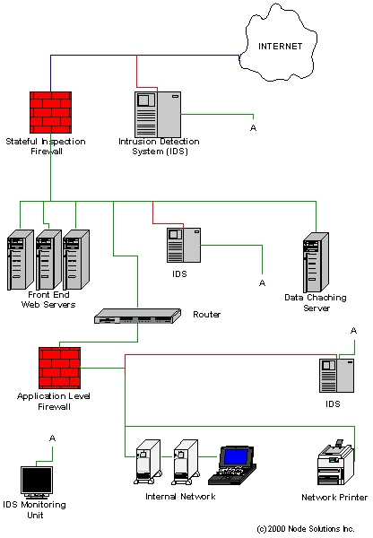
Example: A Secure e-Business Network
Notes:
Background nice and simple. Don’t want to distract from main point of slide.

Slide 13
Security Considerations
· Take into consideration the cost of downtime your Systems might suffer after an intrusion or virus attack occurred
· Implement Comprehensive Security Systems
· Perform Regular Penetration Tests on Your Network to spot possible weaknesses
· Keep up to date your Networks’ Security by applying patches or upgrading your software
· Update annually your Security Policies
· Allocate the desired budget for your e-Business Security
Notes:
Damn it fix that last button !!.
Looks shitty. Fix page layout. Too crowded in middle.

Slide 14
What Needs to be Done
· Dispel the myth “it won’t happen to me”
· Senior business management must pay attention to what IT has to say.
· Allocate the necessary budget for maintaining the integrity of your e-Business.
· Get Serious about Security!
Notes:
Buttons really screwed up. Will get them fixed.
Questions and answers in back, needs to be good since this is last page.
Text needs to be revised a lot.

Slide 15

Initializing Network Interface...
=> Decoding Ethernet on interface \Device\Packet_{2F44DAF5-76E9-4D6D-A7B3-F23F386F22B6}
-*> Snort! <*-
Version 1.6.3-WIN32
By Martin Roesch (roesch@clark.net)
WIN32 Port By Michael Davis (mike@datanerds.net, www.datanerds.net/~mike)
12/24-02:25:33.063101 0.0.0.0:68 -> 255.255.255.255:67
UDP TTL:128 TOS:0x0 ID:6436
Len: 308
=+=+=+=+=+=+=+=+=+=+=+=+=+=+=+=+=+=+=+=+=+=+=+=+=+=+=+=+=+=+=+=+=+
12/24-02:25:33.073241 ARP who-has 192.168.1.140 (FF:FF:0:43:0:44) tell 192.168.1.1
12/24-02:25:33.080536 ARP who-has 24.113.56.1 tell 24.113.57.49
12/24-02:25:33.087351 0.0.0.0:68 -> 255.255.255.255:67
UDP TTL:128 TOS:0x0 ID:6437
Len: 323
=+=+=+=+=+=+=+=+=+=+=+=+=+=+=+=+=+=+=+=+=+=+=+=+=+=+=+=+=+=+=+=+=+
12/24-02:25:33.197228 ARP who-has 24.113.82.1 tell 24.113.82.250
12/24-02:25:33.219490 0.0.0.0:68 -> 255.255.255.255:67
UDP TTL:128 TOS:0x0 ID:6438
Len: 308
=+=+=+=+=+=+=+=+=+=+=+=+=+=+=+=+=+=+=+=+=+=+=+=+=+=+=+=+=+=+=+=+=+
12/24-02:25:33.340112 24.113.99.13:12851 -> 224.0.1.37:8089
UDP TTL:1 TOS:0x0 ID:22010
Len: 548
=+=+=+=+=+=+=+=+=+=+=+=+=+=+=+=+=+=+=+=+=+=+=+=+=+=+=+=+=+=+=+=+=+
12/24-02:25:33.340227 24.113.99.13:12851 -> 224.0.1.37:8089
UDP TTL:1 TOS:0x0 ID:22011
Len: 91
=+=+=+=+=+=+=+=+=+=+=+=+=+=+=+=+=+=+=+=+=+=+=+=+=+=+=+=+=+=+=+=+=+
12/24-02:25:33.342119 24.113.99.13 -> 224.0.1.37
UDP TTL:1 TOS:0x0 ID:22013 MF
Frag Offset: 0x0 Frag Size: 0x5C8
=+=+=+=+=+=+=+=+=+=+=+=+=+=+=+=+=+=+=+=+=+=+=+=+=+=+=+=+=+=+=+=+=+
12/24-02:25:33.342863 24.113.99.13 -> 224.0.1.37
UDP TTL:1 TOS:0x0 ID:22013
Frag Offset: 0xB9 Frag Size: 0x379
=+=+=+=+=+=+=+=+=+=+=+=+=+=+=+=+=+=+=+=+=+=+=+=+=+=+=+=+=+=+=+=+=+
It`s not enough to monitor your network.
You need to look into its Soul.
Registers:
EAX=7fff0377 CS=001b
EIP=004013f4 EFLGS=00000206
EBX=0012fbdc SS=0023
ESP=0012d19c EBP=0012d1c4
ECX=00000008 DS=0023
ESI=00000000 FS=0038
EDX=003b17e8 ES=0023
EDI=00000008 GS=0000
Bytes at CS:EIP:
db 55 f8 33 c0 50 50 50 ff 34 8d 38 90 40 00 ff
Stack dump:
00000008 00000000 0012fbdc 00000000 0012fbdc 77e30def 0085063a 000000f0 7fff0377 00000000 0012fbdc 00401257 00000008 00000111 00000001 004ce8b0
they are watching
_

Slide 16
Initializing Network Interface...
=> Decoding Ethernet on interface \Device\Packet_{2F44DAF5-76E9-4D6D-A7B3-F23F386F22B6}
-*> Snort! <*-
Version 1.6.3-WIN32
By Martin Roesch (roesch@clark.net, www.snort.org)
WIN32 Port By Michael Davis (mike@datanerds.net, www.datanerds.net/~mike)
12/24-02:25:33.063101 0.0.0.0:68 -> 255.255.255.255:67
UDP TTL:128 TOS:0x0 ID:6436
Len: 308
=+=+=+=+=+=+=+=+=+=+=+=+=+=+=+=+=+=+=+=+=+=+=+=+=+=+=+=+=+=+=+=+=+
12/24-02:25:33.073241 ARP who-has 192.168.1.140 (FF:FF:0:43:0:44) tell 192.168.1.1
12/24-02:25:33.080536 ARP who-has 24.113.56.1 tell 24.113.57.49
12/24-02:25:33.087351 0.0.0.0:68 -> 255.255.255.255:67
UDP TTL:128 TOS:0x0 ID:6437
Len: 323
=+=+=+=+=+=+=+=+=+=+=+=+=+=+=+=+=+=+=+=+=+=+=+=+=+=+=+=+=+=+=+=+=+
12/24-02:25:33.197228 ARP who-has 24.113.82.1 tell 24.113.82.250
12/24-02:25:33.219490 0.0.0.0:68 -> 255.255.255.255:67
UDP TTL:128 TOS:0x0 ID:6438
Len: 308
=+=+=+=+=+=+=+=+=+=+=+=+=+=+=+=+=+=+=+=+=+=+=+=+=+=+=+=+=+=+=+=+=+
12/24-02:25:33.340112 24.113.99.13:12851 -> 224.0.1.37:8089
UDP TTL:1 TOS:0x0 ID:22010
Len: 548
=+=+=+=+=+=+=+=+=+=+=+=+=+=+=+=+=+=+=+=+=+=+=+=+=+=+=+=+=+=+=+=+=+
12/24-02:25:33.340112 24.113.99.13:12851 -> 224.0.1.37:8089
UDP TTL:1 Toí-GYSn- _b%_²,/%S Network Interface “\Device\Packet_{2F44DAF5-76E9-4D6D-A7B3-F23F386F22B6}“ access violates new security policy. (50129).
Proess %92æ§\sñ (PID 592991) will be terminated.
Process data dump.
Registers:
EAX=7fff0377 CS=001b
EIP=004013f4 EFLGS=00000206
EBX=0012fbdc SS=0023
ESP=0012d19c EBP=0012d1c4
ECX=00000008 DS=0023
ESI=00000000 FS=0038
EDX=003b17e8 ES=0023
EDI=00000008 GS=0000
Bytes at CS:EIP:
db 55 f8 33 c0 50 50 50 ff 34 8d 38 90 40 00 ff
Stack dump:
00000008 00000000 0012fbdc 00000000 0012fbdc 77e30def 0085063a 000000f0 7fff0377 00000000 0012fbdc 00401257 00000008 00000111 00000001 004ce8b0

