Slide 1

Redundant & Secure
Networks
Notes:
Title page

Slide 2

O v e r v i e w
Part I: The Security Threat is Real
Costly Breaches
Reasons To Have Policies & Procedures
Document and Enforce Policies & Procedures
Part II: Eliminating The Threat
Design and Implement a Secure & Redundant
Network
Covering Current Network Topology
What needs to be done…
Credits
Notes:
Part I

Slide 3

The Security Threat Exists
Notes:
Part I

Slide 4

Why Is There a Threat?
· Computer Threats are on the rise
  o Information Theft
  o Intrusion
  o Vandalism
  o Virus Infection
  o Distributed Denial of Service
· Misplaced / Poorly Configured Security Systems:
  o DNS Server is not properly configured.
  o HTTP Server’s Security is not up to date.
  o Firewall Server’s rules don’t mirror your Security Policy.
  o Email Server is susceptible to SPAM attacks.
  o Intrusion Detection System is misplaced.
  o Out of box SNMP devices are NOT Secure.
Notes:
Explanation to the Affirmation “The Security Threat Exists”

Slide 5
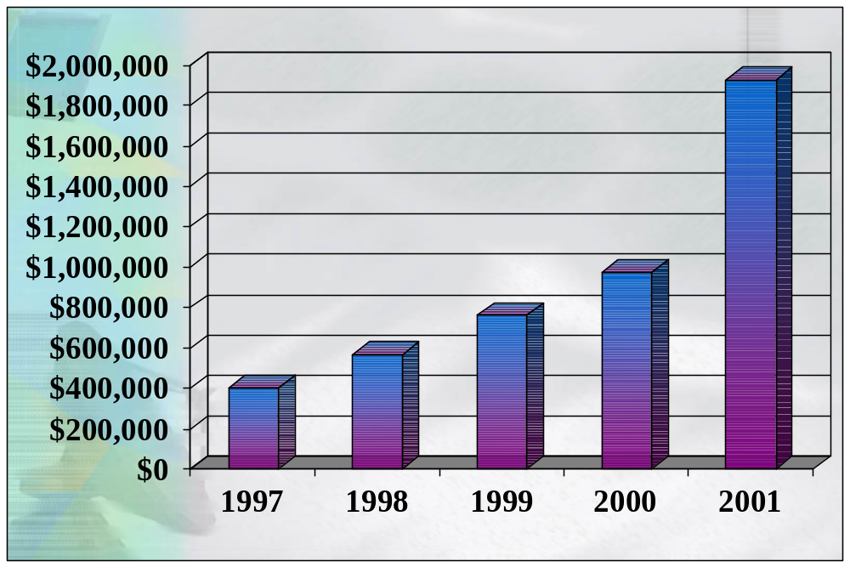
Costly Breaches
What network intrusions cost the average company:
Source: Computer Security Institute
Notes:
Current Statistics

Slide 6
Reasons To Have Policies
Minimize cost of security incidents
Educate, train, and motivate staff
Maintain trade secret protection for information assets
Organize and maintain the network infrastructure in an easier manner
Clarify appropriate responses to security incidents
Notes:
Why it’s good to have policies

Slide 7
Documentation & Enforcement
Lalalallalalaldkdkdkdkdkkdkdkdkdkdkdkkddkdkdkdkkdkdkdkdkdkdkkdkdkdkdkdkdk
Kdkdkdkdkdkdkdkdkkdkdkdkdkkdkdkdkdkkdkdkdkdkdkkdkdkdkkdkdkkdkdkkdkdkdkdkkdkdkdkdkkdkdkdkkdkdkkdkdkdkkdkdk

Slide 8

Eliminating the Threat
Notes:
Part II

Slide 9
Designing & Implementing
Map of a Secure & Redundant Network

Slide 10
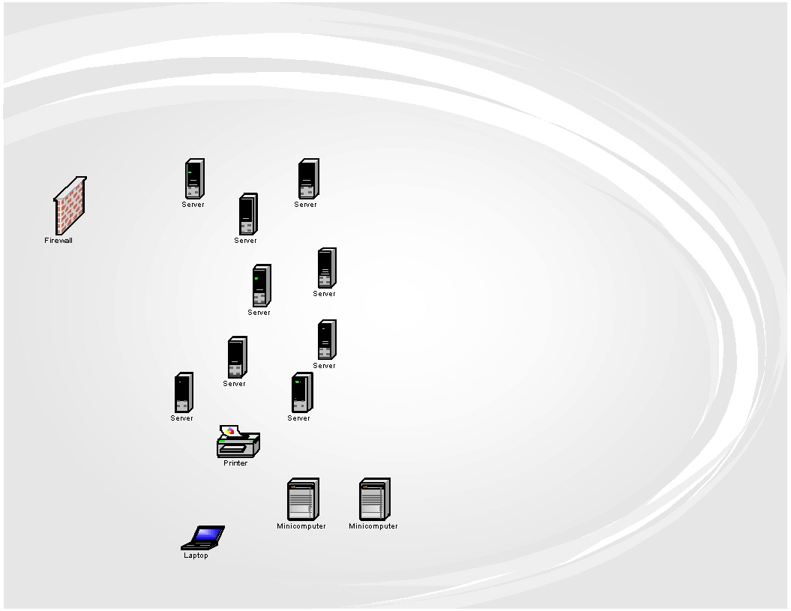
Current Network Architecture

Slide 11
What Needs to Be Done…
Describe what needs to be done and why it needs to be done!
Talk only about pros here ;)

Slide 12

C r e d i t s
Irene Garrett
Iulian Radu
Richard Haisinger
Adrian Lazar
Notes:
Asta cred ca va fii last slide unless u wanna do some kinky last slide….

