Slide 1
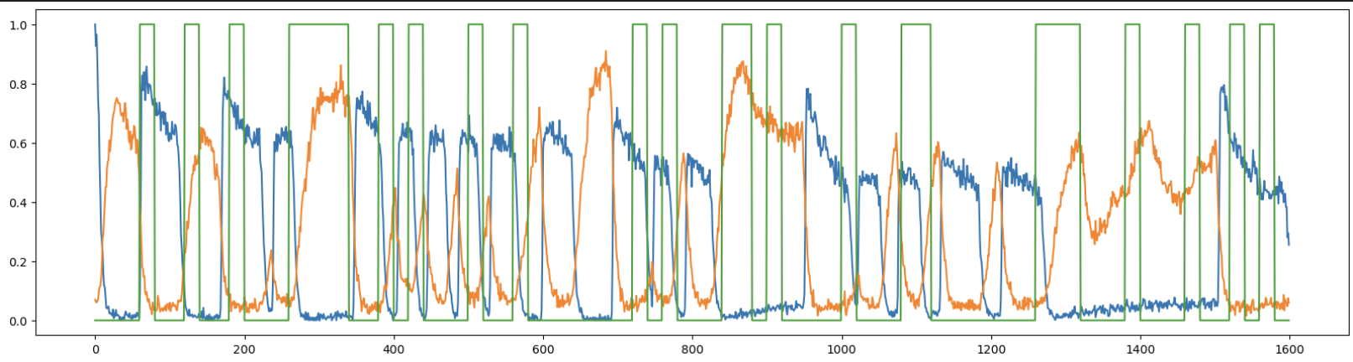

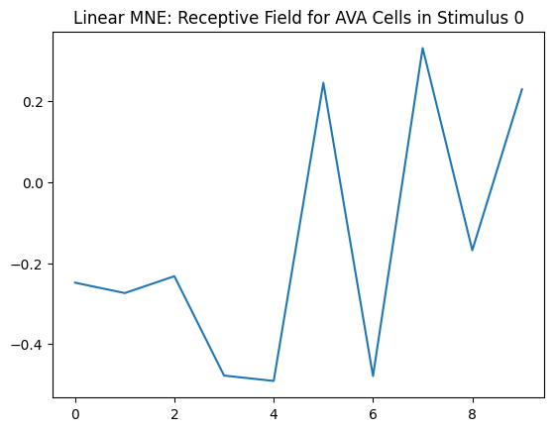
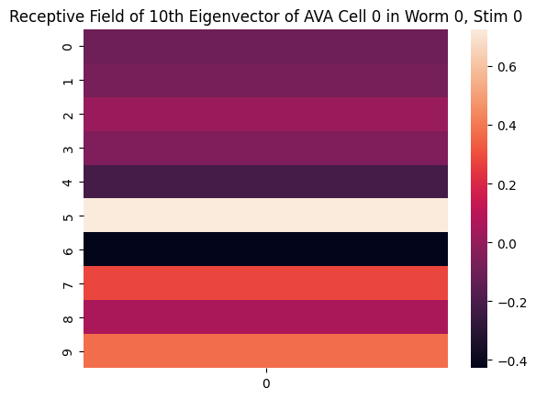
MNE Finds Neuronal Receptive Fields
The Data
The Method: Maximum Noise Entropy
The Results
a, h, and J are determined by
minimizing the negative log-likelihood
Unconstrained optimization finds local/global min
Train CNN model → extract weights = receptive field!

