Slide 1
State-dependent network interactions differentially gate sensory input at the motor and command neuron level in Caenorhabditis elegans Revisions
4/23/24

Slide 2
File System
All data: /nadata/mnlsc/home/ztcecere/ProcAiryData2
All bacteria stimuli cells:
Yfull_op50_SF.npz
Stimulus Sequence:
inpfull_op50_SF.npz
Clustered:
Yanno_op50_SF.npz
Same stim
ProcAiryData

Slide 3
Misc. Notes
Figure creation
Font: ariel
Clustering Algorithm

Slide 4
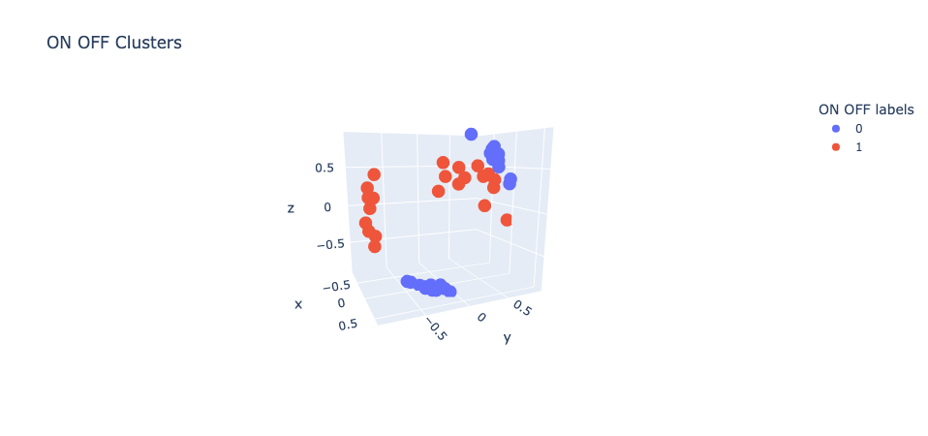
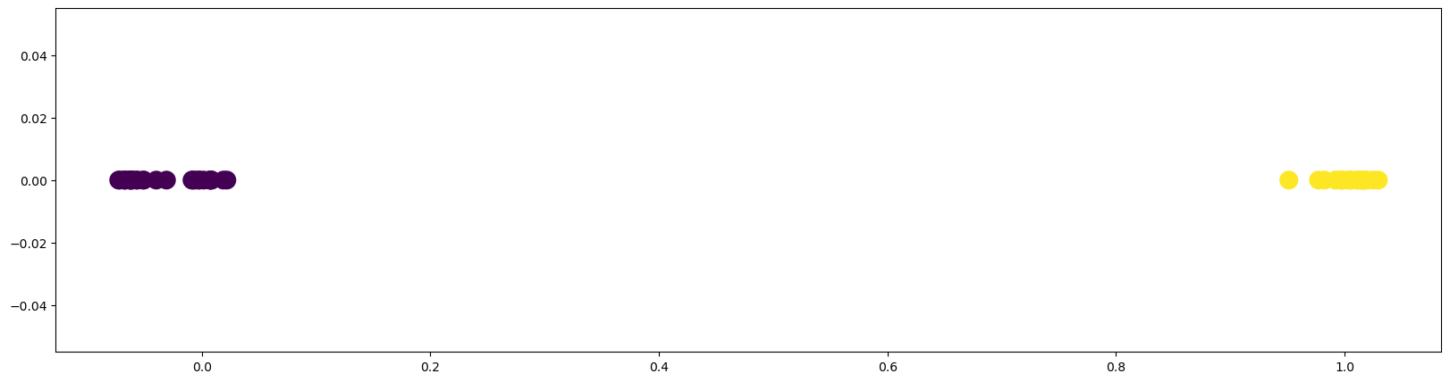
ON/OFF Clusters

Slide 5
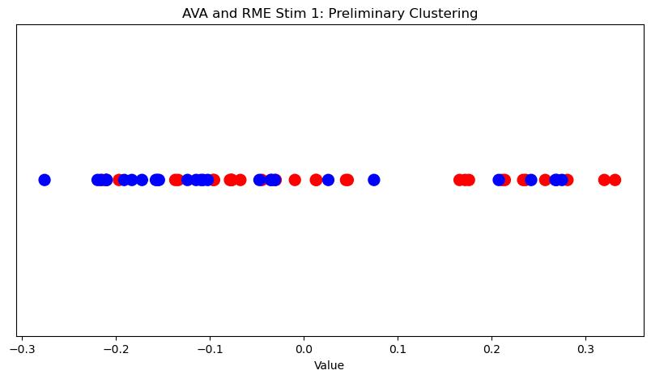
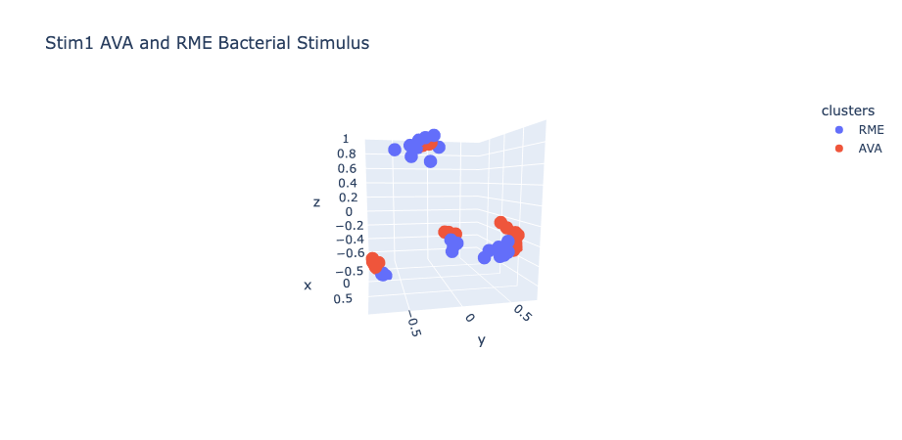
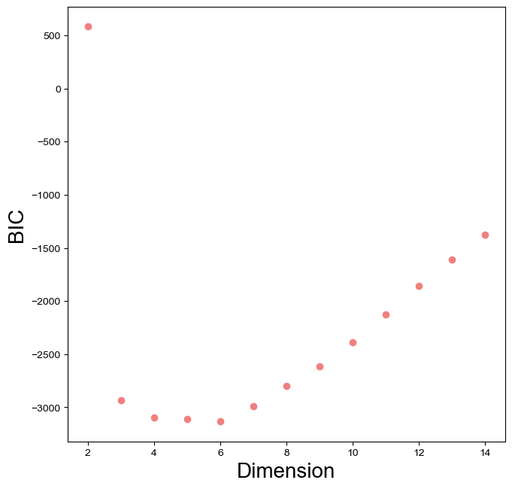
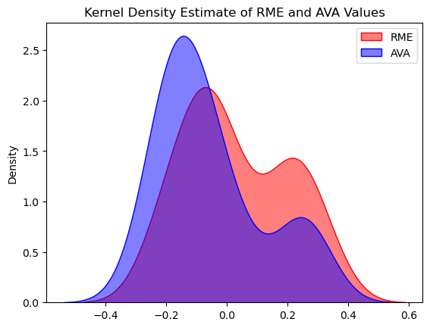
Testing AVA/RME Clusters

Slide 6
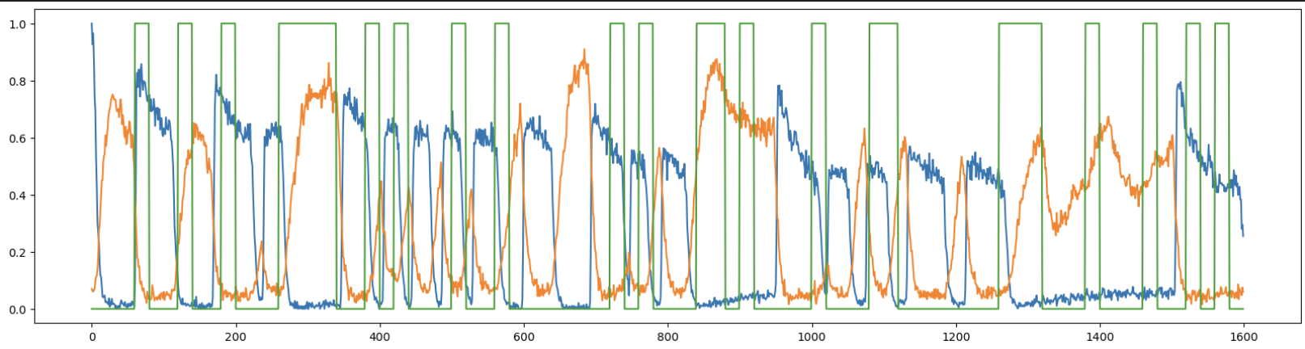
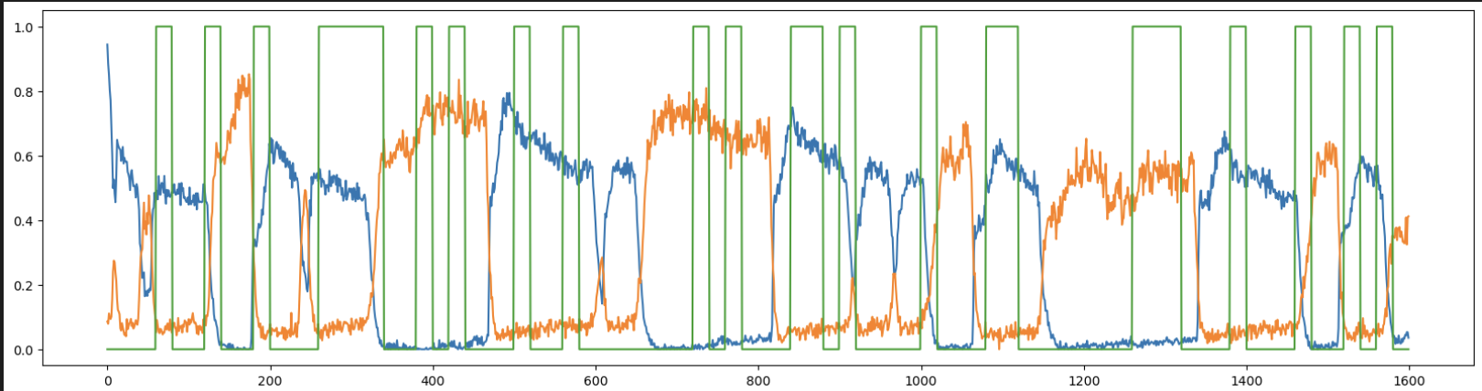
RME/AVA suspected clusters
Yanno[‘arr_2’] cell 0, cell 1
Yanno[‘arr_4’] cell 0, cell 1

Slide 7
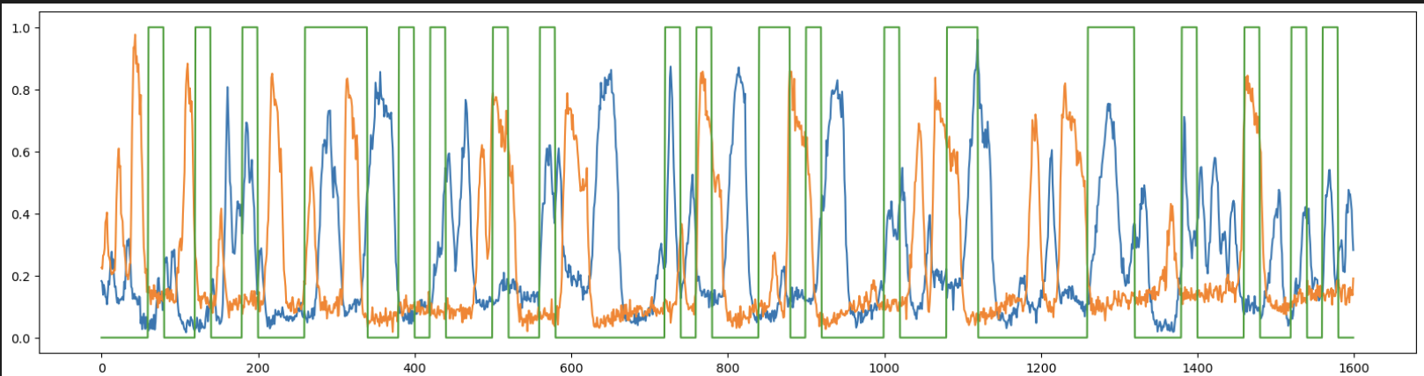
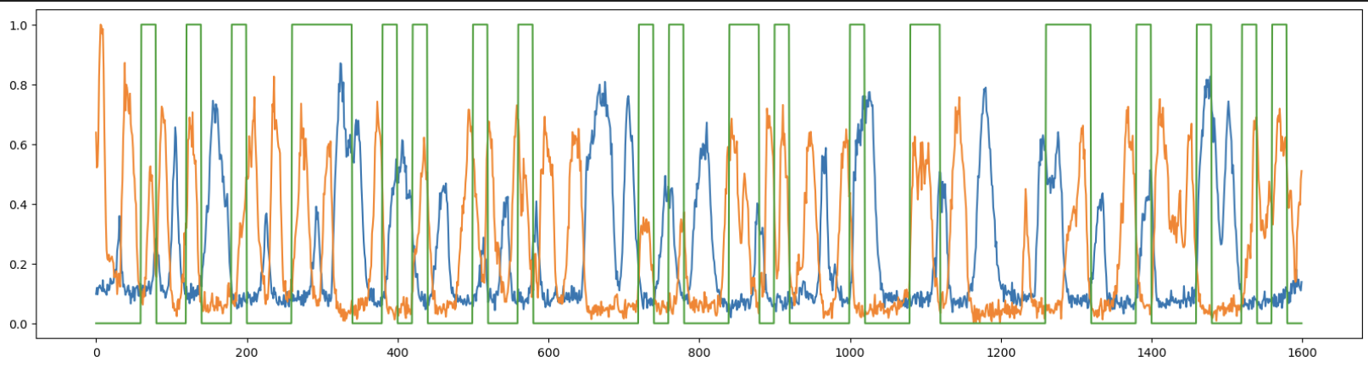
SMDD/SMDV
yanno['arr_3'][:, 2]
yanno['arr_3'][:, 3] ) #orange
yanno['arr_4'][:, 2] ) #blue
yanno['arr_4'][:, 3] ) #orange

Slide 8
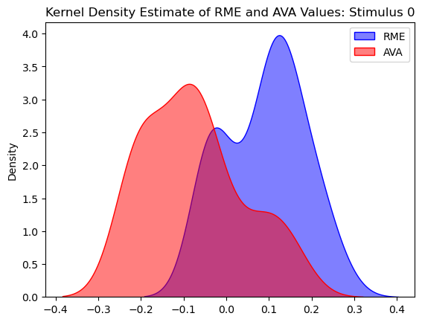
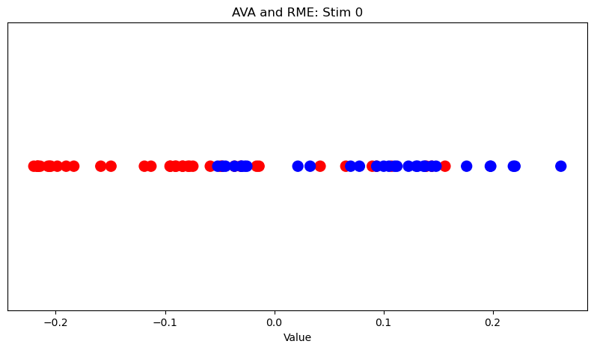
Single Axis Cluster Separation
AVA and RME stimulus_0
Hyperbolic embedding coordinates from HMDS, used 6 dimensions
Calculated mean of each dimension, within each cluster
Subtracted one from the other
Took dot product of each cell vector with the normalized average

Slide 9
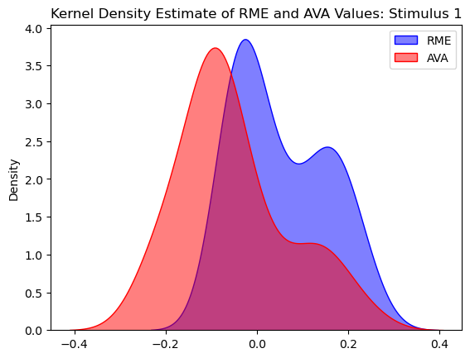
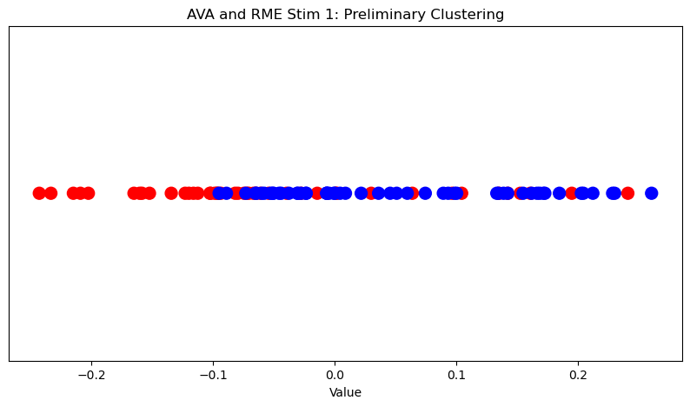
BIC: 6 for both

Slide 10
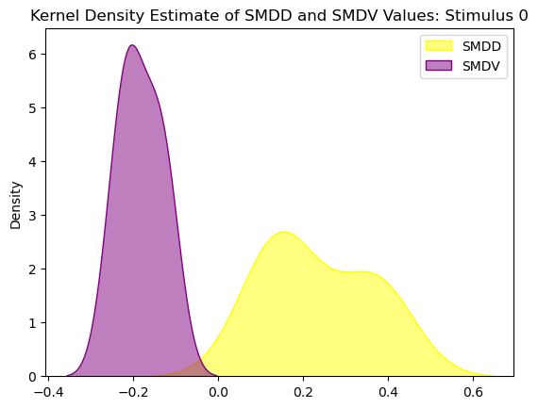
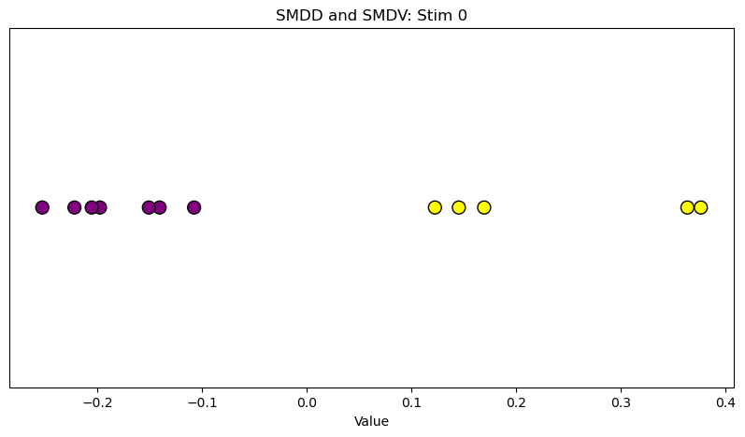
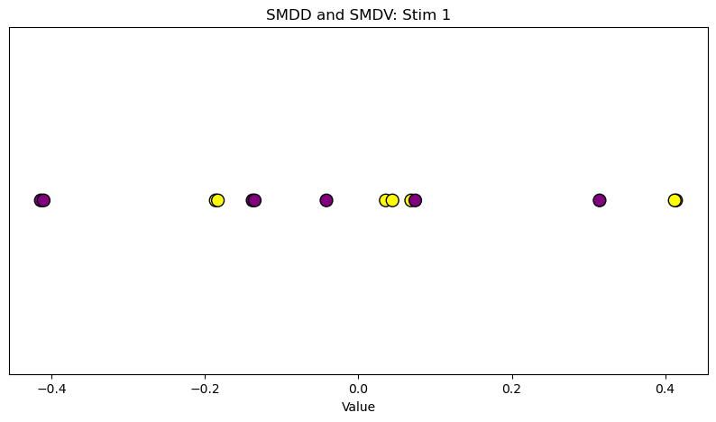
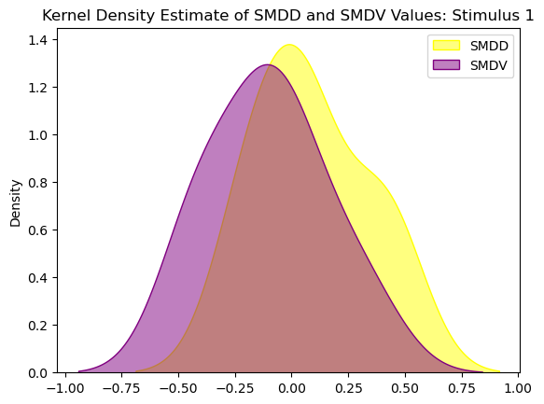
BIC: 3 for both

Slide 11
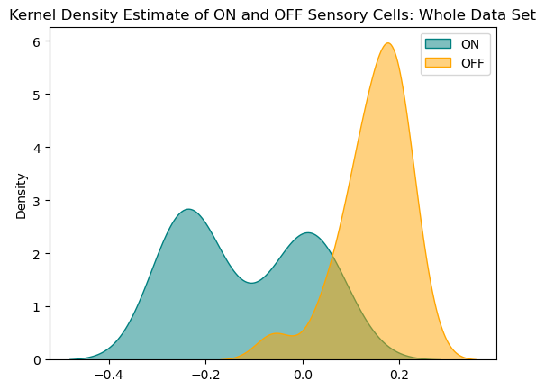
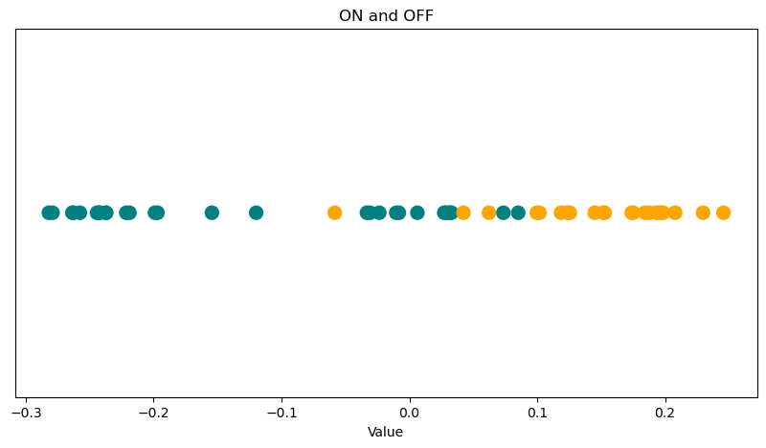
ON and OFF cells, both stimuli

Slide 12
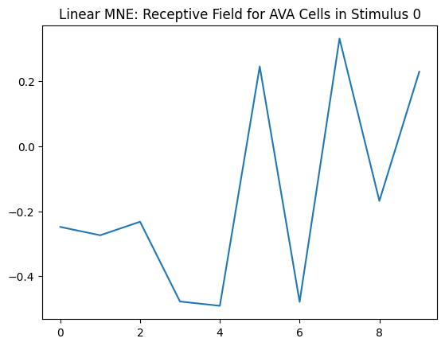
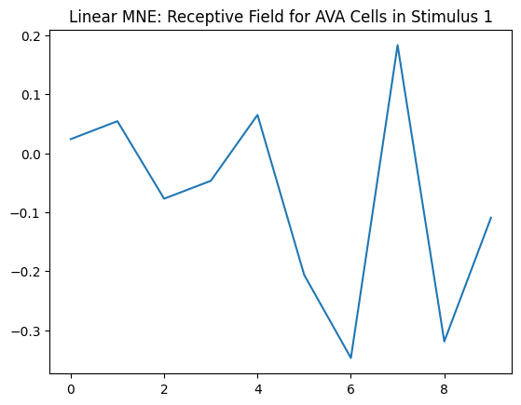
MNE Linear- before convergence
Example cell: AVA Cells under stimulus 0 and 1

Slide 13
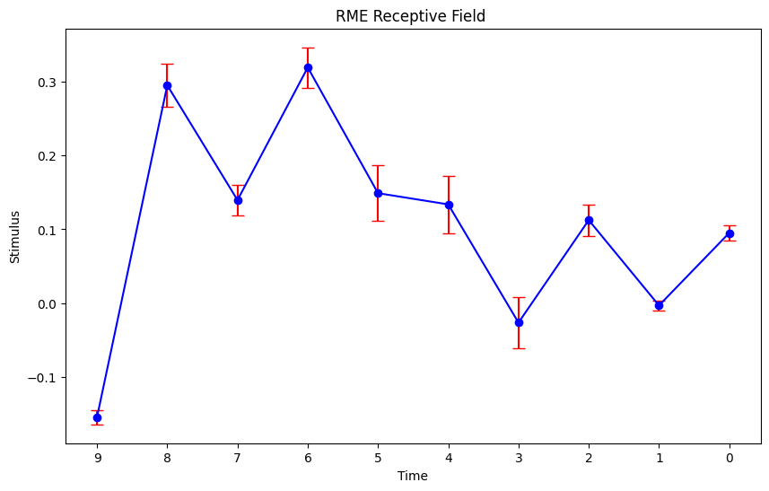
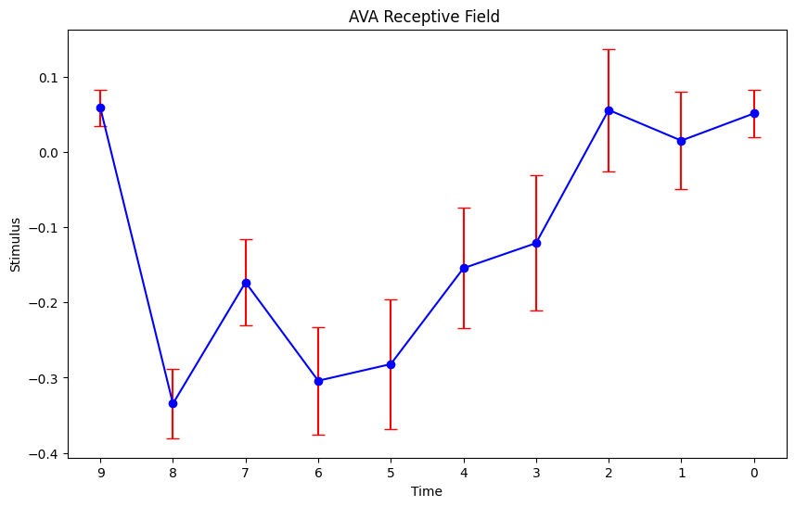
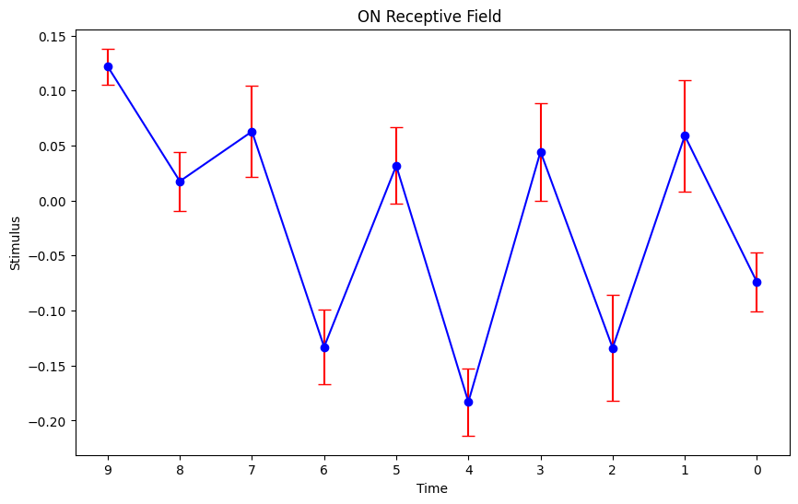
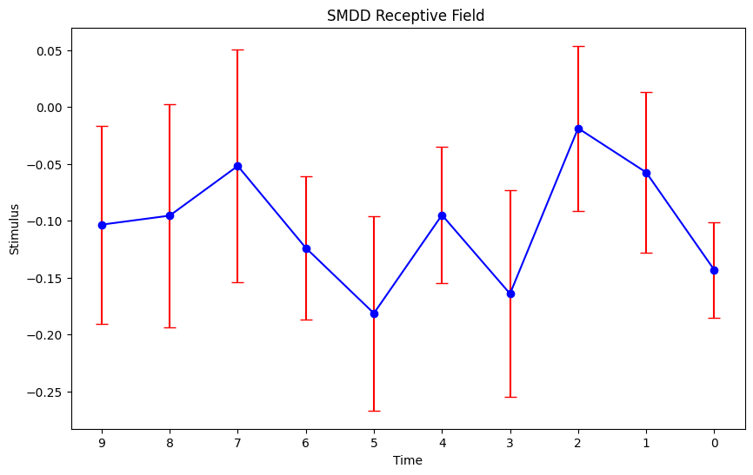
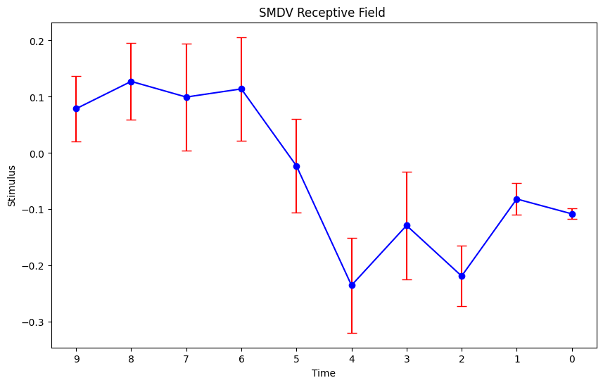
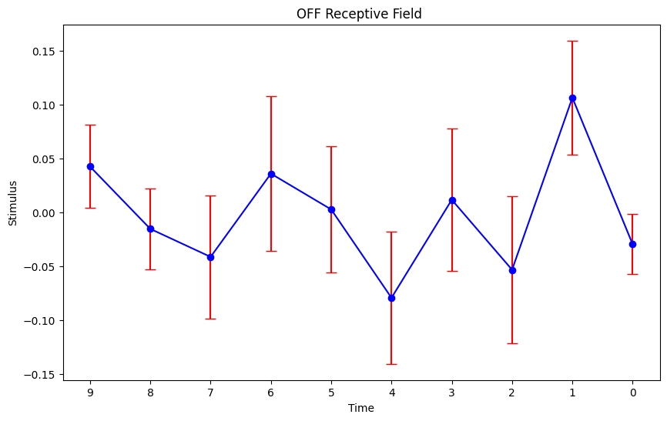
MNE Linear

Slide 14
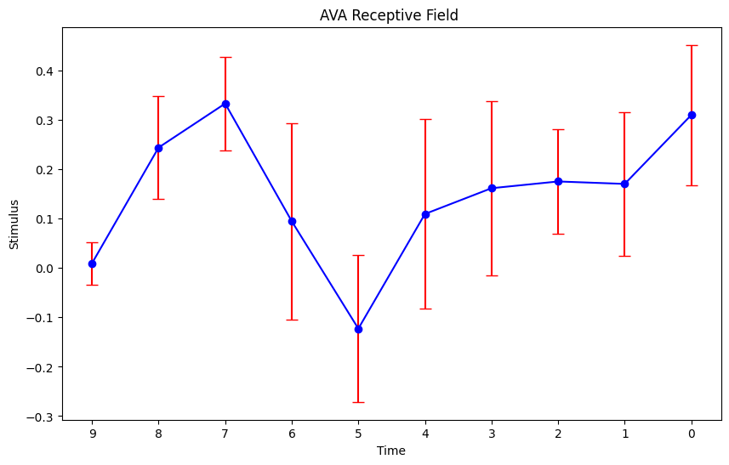
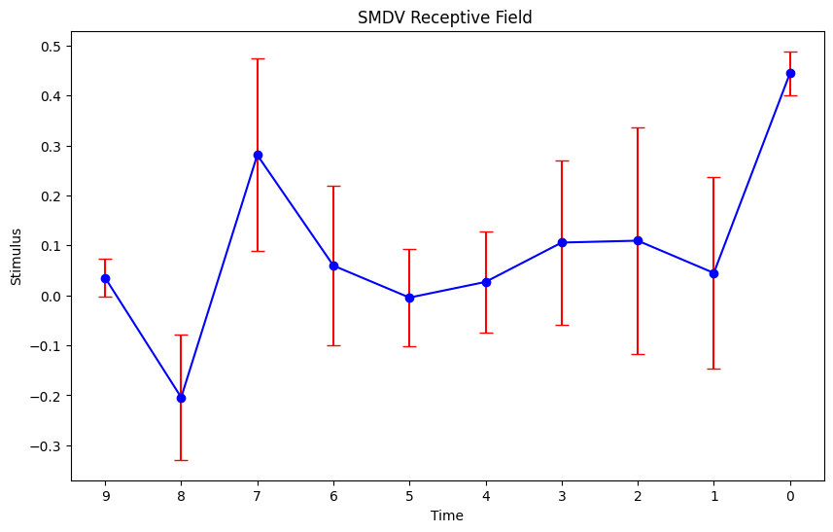
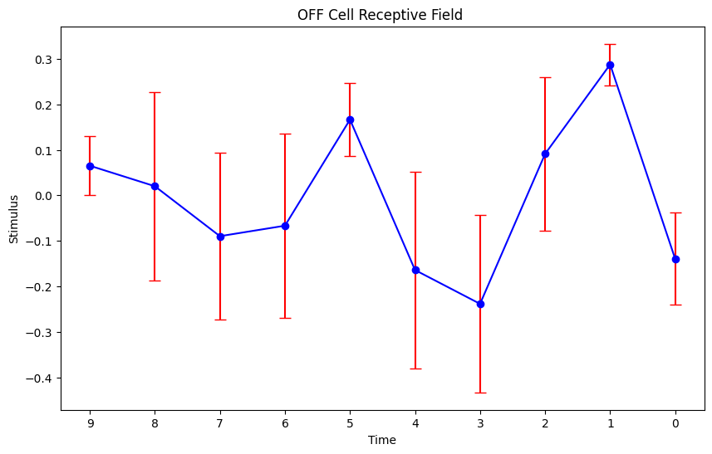
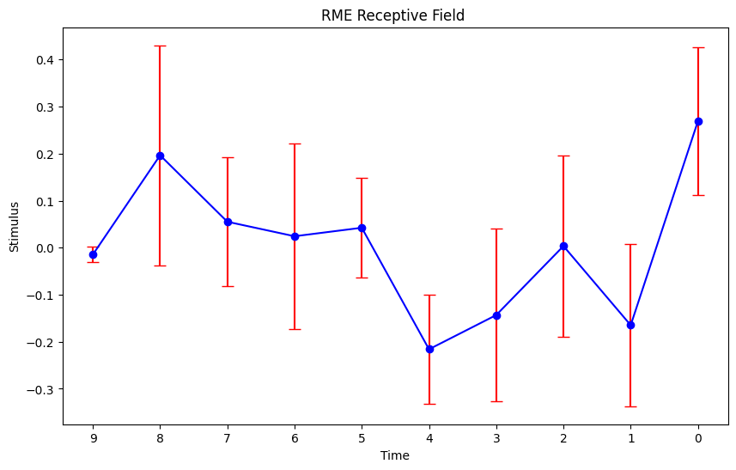
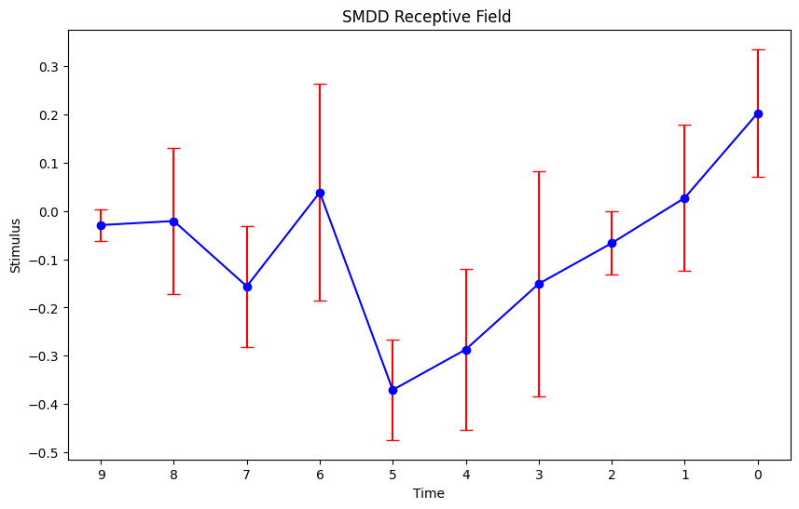
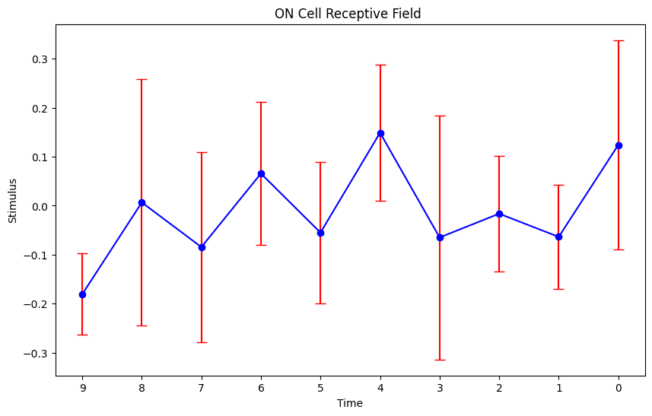
MNE Quadratic

Slide 15
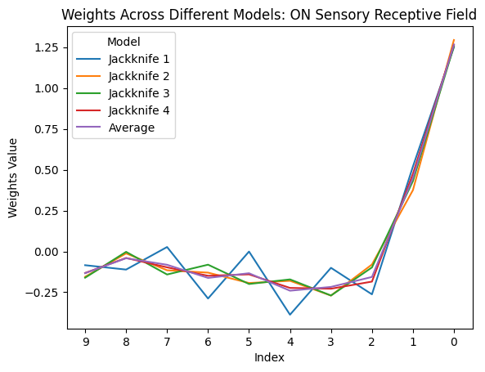
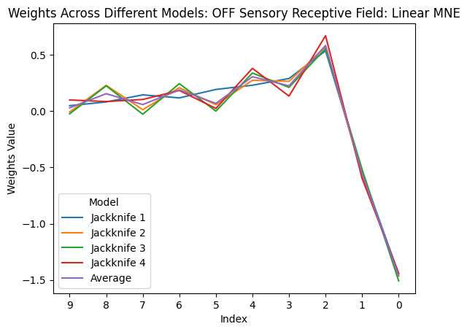
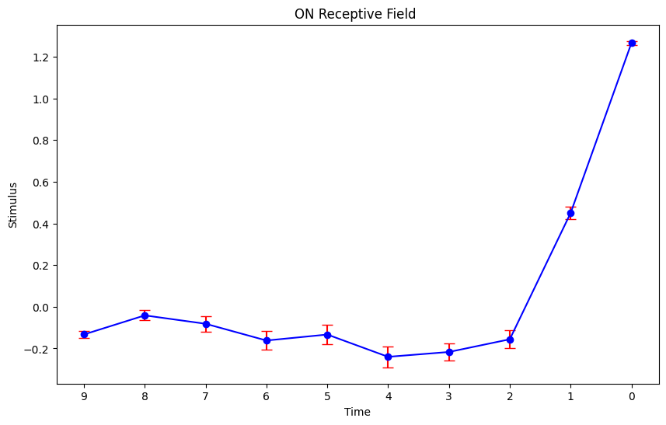
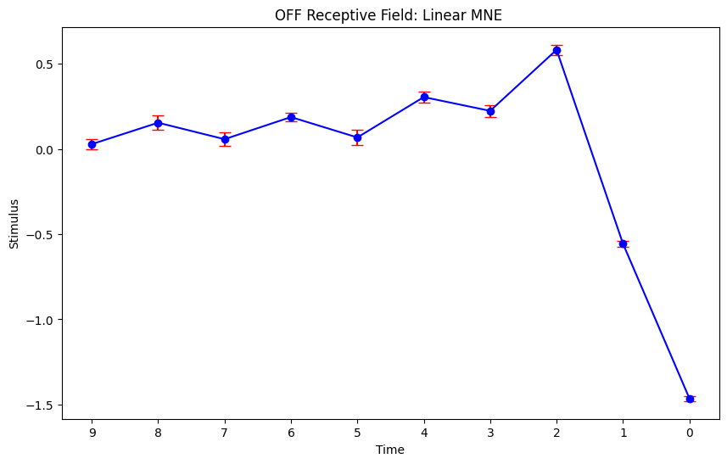
MNE Linear ON/OFF
Reclustered ON/OFF, added more data

Slide 16
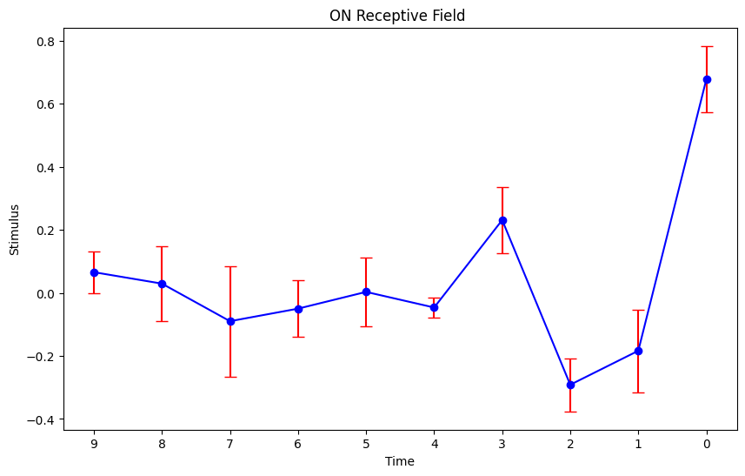
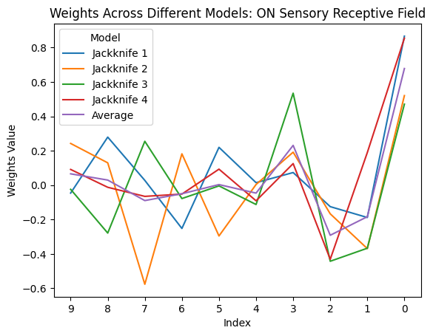
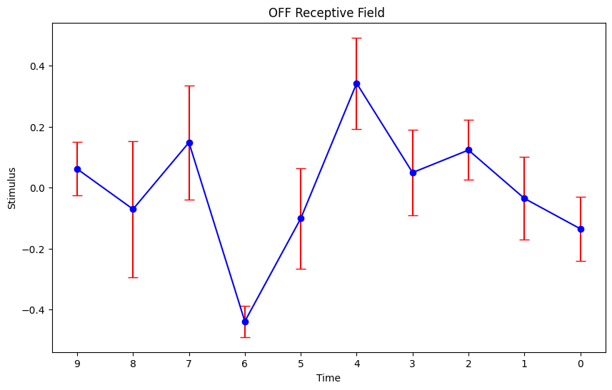
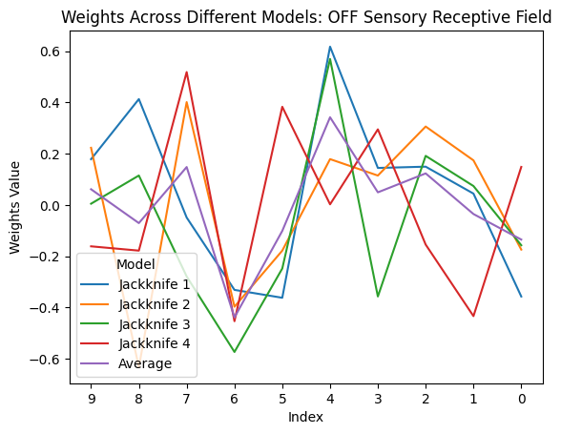
MNE Quadratic ON/OFF
Notes:
OFF with bin size 5

Slide 17
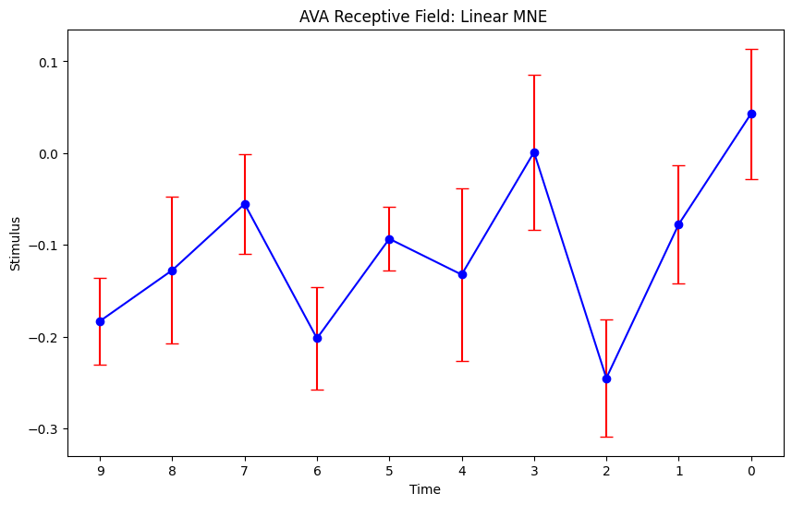
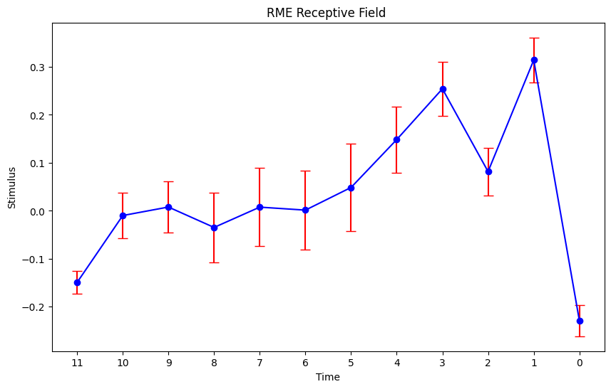
AVA/RME Linear
Notes:
RME – 12 bins, 10 size
AVA – 10 bins, bin size 5

Slide 18
SMDD/SMDV Linear

Slide 19
Fig 1, keep, make a table for each cell type abundance
biphasic response, sensory stimulus is changing the state
Quadratic for ava can be greater, ryan’s quadratic index ( relative contribution of linear vs quad to neural response)
Low rank MNE

Slide 20
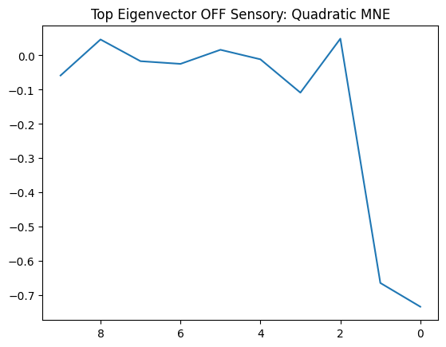
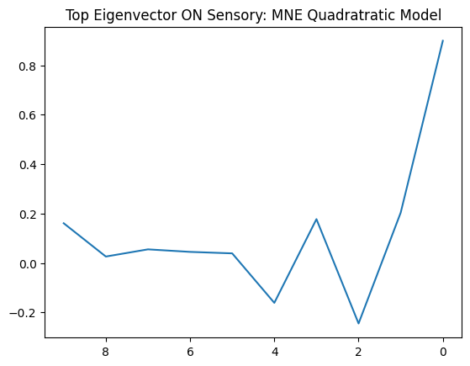
Quadratic MNE

Slide 21
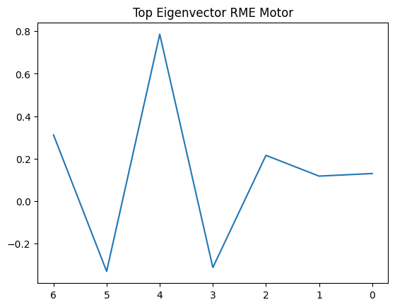
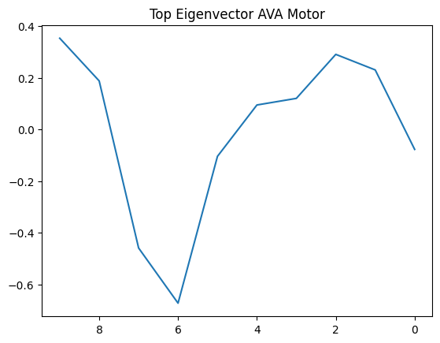

Slide 22
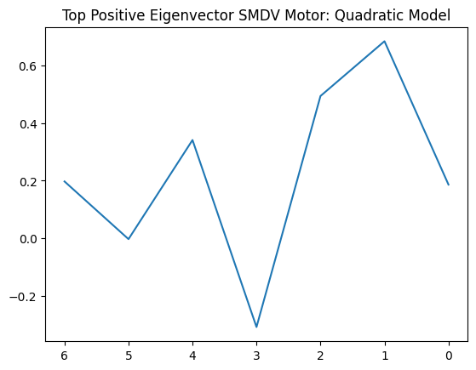
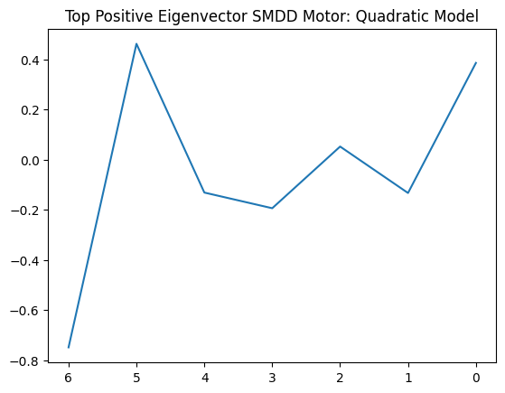

Slide 23


40s timescale

