Slide 1
Zooming and shrinking in digital images Study and implementation of the zoom and shrink techniques (at any scale) applied for digital images (grayscale with 8 bits/pixel)
Image Processing Project
Chereji Iulia

Slide 2
Nearest neighbor interpolation
We have the original images of dimensions lets say 3x4. And we want to make it 2.5 times larger. This mans a new image of 7.5x10 rounded => 8x10. After we read the image (src) and the scale (s) we create the output image (dest) and iterate on it:
For i=0:dest.y
For j:dest:x
dest(i,j)=src(round(i/s),round(j/s))
This also works for making an image smaller (scale < 0).

Slide 3
Bilinear interpolation
It uses linear interpolation to calculate the values between the neighboring pixels’ colors.
For i=0:dest.y
For j:dest:x
isrc=i/s, jsrc=j/s
ifloor=floor(isrc), iceil=ceil(isrc), jfloor=floor(jsrc), jceil=ceil(jsrc)
ul=src(iceil,jceil), ur=src(ifloor,jceil), dl=src(iceil,jfloor),
dr=src(iceil,jceil); //u-up,d-down,l-left,r-right

Slide 4
Calculate the interpolated values on the horizontal lines first:
u=ul*(jceil-jsrc) + ur*(jsrc-jfloor)
d=dl*(jceil-jsrc) + dr*(jsrc-jfloor)
val=u*(iceil-isrc)+d*(isrc-ifloor)
dest(i,j)=val
We also need to check if the values for isrc and jsrc are integers, in which case we don’t need to interpolate, we just assign the value.
This algorithm uses 4 nearest neighbors to determine the output. Bicubic uses 16 neighbors and weights distribution is done differently.

Slide 5
Bicubic interpolation
For example we take an image of height 241 and width 218 and the scale 1.5 => height 362, width 327
We iterate on the new bigger image and reach i=8, j=242. We compute the x and y equivalent in the original image x= 161.33 y=5.33.
We take 16 points around the point; their x values will be: 160,161,162,163 and their y values: 4,5,6,7.
We compute the distances between our projected point (real nr) coordinates and the 16 points’ coordinates.
So x1 = 161.33-160 = 1.33, x2= 0.33, x3=0.66, x4=1.66
Y1=1.33, y2=0.33,y3=0.66,y4=1.66. We need these distances to compute the weights of the 16 points.

Slide 6
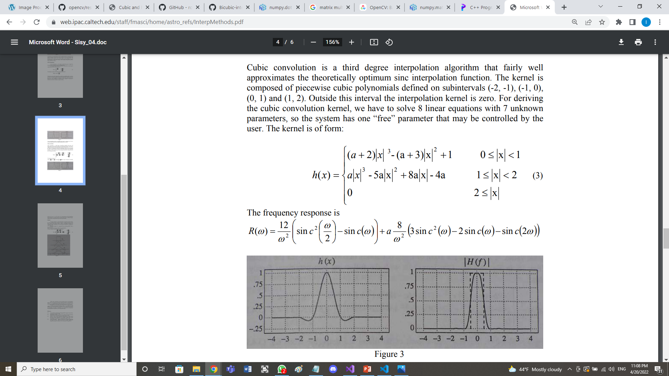
We use this formula to compute the weights:
a is a chosen value (-0.5, -0.75, -1) we choose it -0.5.
So we get h(x1)=-0.07, h(x2)=0.77, h(x3)=0.33, h(x4)=-0.03
h(y1)=-0.07, h(y2)=0.77, h(y3)=0.33, h(y4)=-0.03
Then we use these values to interpolate first horizontally (on 4 lines) then vertically the previous results to get the final value.

Slide 7
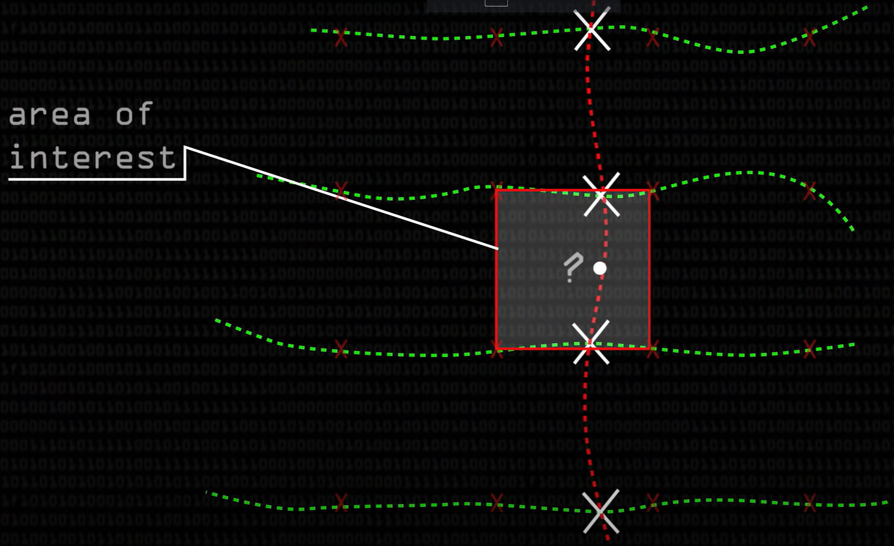

Slide 8
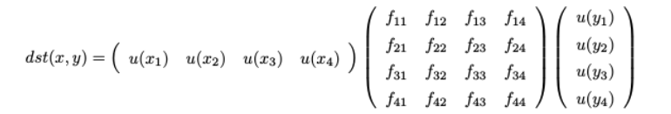
Doing this computation is exactly this matrix multiplications:
Where f are the pixel colors (level of grays) in the source image.

