Slide 1

Research methods for online and social media data
Dr. Iulia Cioroianu
Institute for Policy Research
University of Bath
i.cioroianu.bath.ac.uk

Slide 2
Today’s workshop
What is big data and why is it useful for research?
Examples of research questions addressed in the social sciences using big data
Collecting Twitter data (theory and applications)
Collecting Facebook data (theory and applications)
Analysing social media data (theory and applications)
Methodological concerns and challenges in the use of social media and online data

Slide 3
What is big data?
No single definition.
Characteristics (Lazer and Radford, 2017):
Large, heterogeneous, complex, constantly changing.
Hard to process with existing software.
New tools needed to collect, process and analyse it.
Intersection between computer science and social sciences.
Examples:
Social media posts, images, videos, blog posts, digital books, location and space, networks, streaming, campaign contributions, CDR (call detail record), sensor data.

Slide 4
Types of big data
Lazer and Radford (2017) classification:
Digital life – behaviours are all online - Twitter, Facebook, and Wikipedia.
Digital traces – records of the actions taken (metadata, but not the action itself). CDR, voter records, campaign contributions.
Digitalized life - capture of non-digital life in digital form. Street video recording, Google Books.

Slide 5
Advantages of big data
Allows us to directly observe behaviours, expressed opinions, social networks.
Study complex social systems.
Social monitoring at a reduced cost but high scale – more efficient. Avoid self-reporting biases (such as recency, salience biases).
Fine-grained, real time data can be used in forecasting.
The data is already there!

Slide 6
Advantages of big data
Natural and/or field experiments
Access to data on traditionally underrepresented populations
Generate robust population estimates from the narrow sub-samples within.
Estimate interaction effects.
Huge potential for linking data across sources.

Slide 7
Examples of big data social science research
Political mobilization and protest (Barbera et al. 2015, 2018)
Political polarization, information filters, echo-chambers (Lazer 2015, Williams et al. 2017)
Public opinion (Beauchamp 2016, Hopkins & King 2010)
Ethnic interaction (Toomet et al. 2015)
Social inequality (Edelman & Luca 2014, Greenberg & Mollick 2016), inflation (Cavallo & Rigobon 2016)
Campaign finance (Bonica, 2014)
Conflict (Zeitzoff 2017)
Censorship (King et al. 2016)
Turnout and social influence (Bond et al. 2012)

Slide 8
Collecting Twitter data

Slide 9
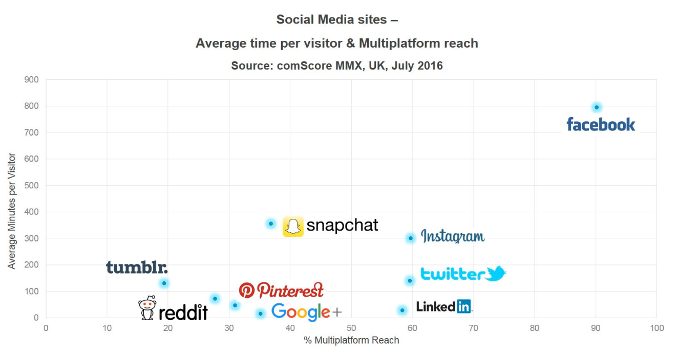
Why use Twitter data for research?
Disadvantages:
Not the most popular social media platform.
Not representative of the population.
Short text.
Fake accounts and automation.
Failure to meet expectations.
Advantages:
Unique infrastructure:
Access to almost all the data through well structured APIs.
Openness:
Can observe direct user interactions, conversations, social networks and expressed opinions at unrivalled scale.

Slide 10
Collecting Twitter data The method you choose depends on:
Your programming skills or willingness to develop these skills
The characteristics of the data you want to collect
Your budget
Twitter APIs
Some programming skills required
Many available packages in Python (tweepy) and R (twitteR)
Flexible but constraints on data collected.
Web scraping
More advanced programming
More flexible, you can get more data
Still have to follow Twitter rules of service
Commercial or free software
Chorus, NodeXL, Voson, etc.
Easy access
Some include data analysis options
Less flexible
Same constraints as the API
Purchasing data from Twitter
Convenient but expensive
Free scripts and tutorials: ExpoNET tools
Notes:
API stands for Application Programming Interface. They allow developers to build tools and applications based on the data stored. And they give researchers interested in data collection an easy way to access the data.

Slide 11
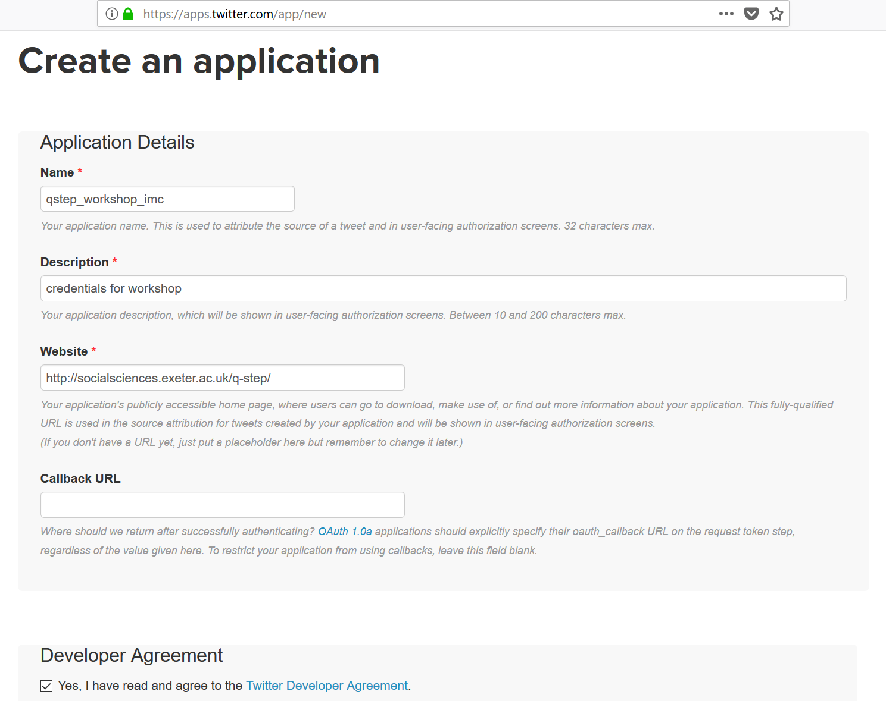
Accessing the Twitter APIs
Become a Twitter developer.
Get a Twitter account.
Create a new app by visiting: https://apps.twitter.com/
The app needs a unique name.
You can fill in anything as the website and description.
Accept the terms and conditions.

Slide 12
Getting the access credentials
Once you become a developer, you will find your access credentials under the Keys and Access Tokens tab of your new app.
You will need to save the following fields to be used later in your script:
Consumer Key (API Key)
Consumer Secret (API Secret)
Access Token
Access Token Secret

Slide 13
Which programming language?
There are Twitter API libraries for almost any programming language.
R and Python most commonly used by social science researchers.
Libraries available for both:
Python (tweepy)
R (twitteR)
Each has some advantages:
Python – better text processing and analysis and machine learning libraries.
R – better statistical analysis packages.
Both catching up fast, less differences.

Slide 14
Tweepy
Tweepy is a Python library for accessing the Twitter API.
Provides a convenient front-end for the Twitter API, giving us easy access in Python.
Install it by typing the following command in your Anaconda Prompt:
conda install tweepy
Now ready to start a Python script/Jupyter notebook with a Python kernel and collect data.

Slide 15
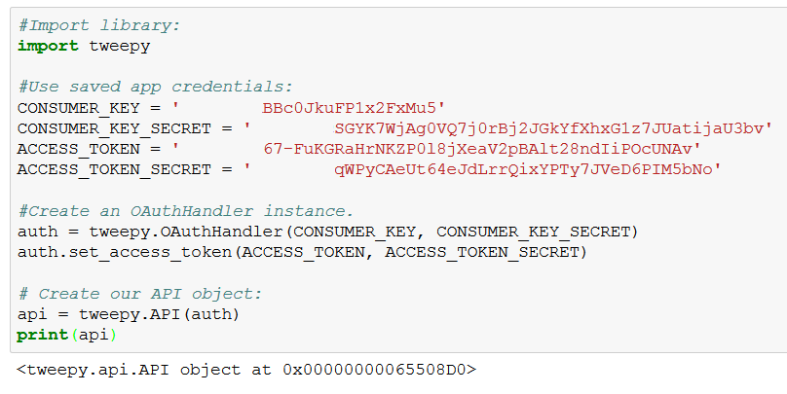
Connect to the Twitter API with tweepy:
Range of different requests we can make.
Use GET to retrieve information about public users or tweets.
Use POST to make changes to the account we used to authorize, such as following accounts and posting tweets.
All functions of the API are thoroughly documented.
Here we focus on most common data collection for research tasks.

Slide 16
Collecting user timeline tweets
Statuses posted by a specified user can be collected with a GET statuses/user_timeline request.
Need to specify either the user_id or screen_name of the user.
Can include other options such as:
the number of statuses to retrieve;
the first and last status to be collected;
whether retweets should be included or not;
count limits for number of results returned from the search.
Otherwise you will reach the API rate limit or the end of the user's timeline.
Note that retweets are counted towards your app rate limit.
See the last sections on Rate limits; Pagination and the cursor to learn how to handle rate limits and get more tweets using the cursor.

Slide 17
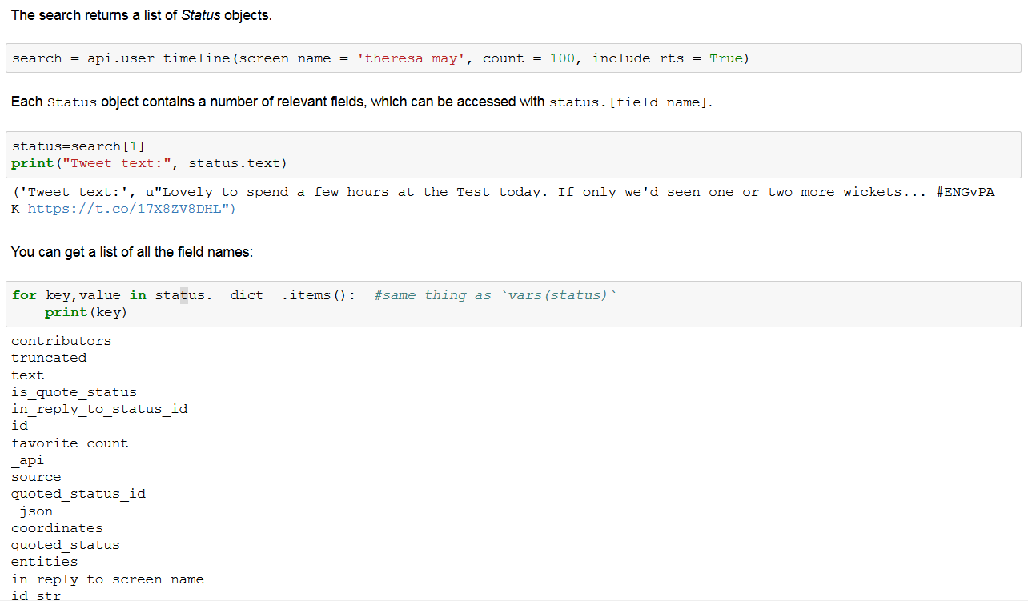
Collecting user timeline tweets

Slide 18
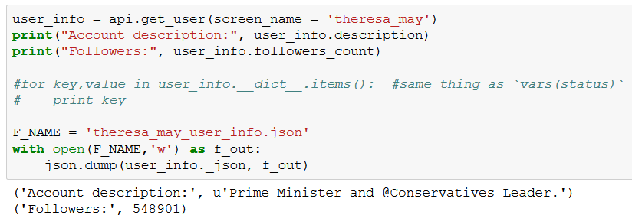
Getting information about a user account
Detailed information about an account
account description, number of followers, number of users followed, the date the account was created, location, number of tweets, a link to the profile image, number of favorites, etc.
The argument needed is either user_id or screen_name.
The output is a User object.
We again save the output object as a .json file.

Slide 19
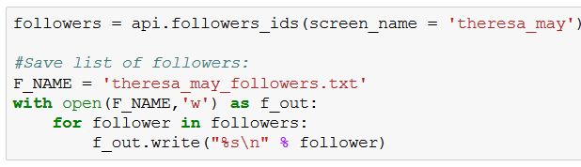
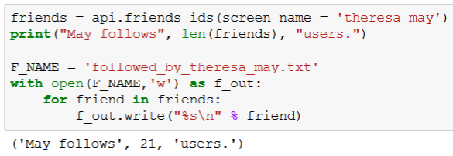
Getting follower/friend IDs
Get a list of the IDs of the first 100 users following a certain account, or those which the user follows.
See the Rate limits; Pagination and cursor sections at the end to find out how to get more than the first 100 users.

Slide 20
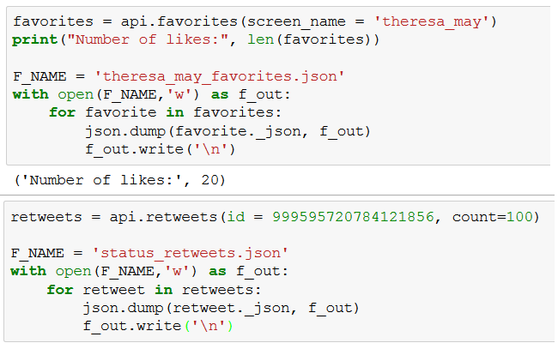
Getting tweets favorited by a certain user and retweets of a certain status

Slide 21
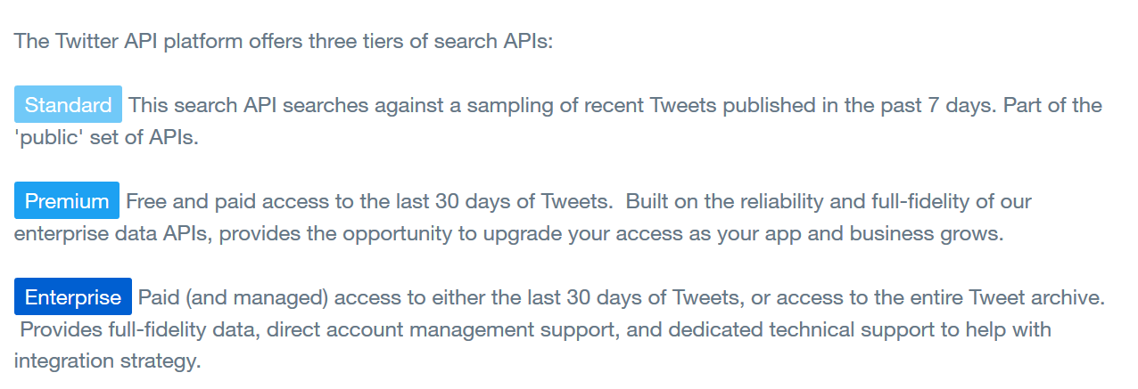
Search API options
"Standard" means free (and incomplete).
This is what we get unless we contact Twitter/Gnip sales and get a paid account.

Slide 22
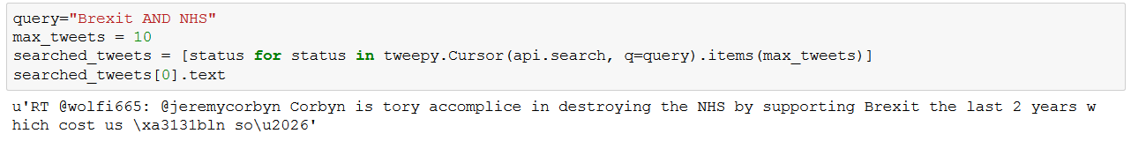
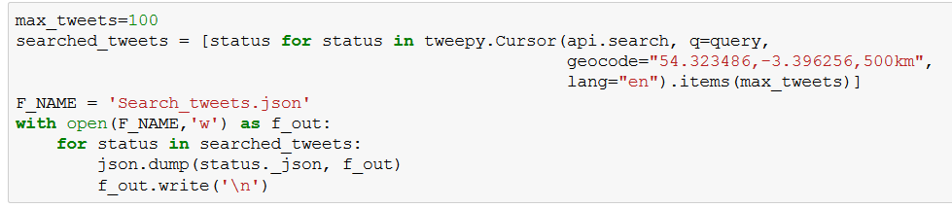
Example search:
Find 10 tweets that mention "Brexit" and "NHS" and see what the text of the first one looks like:
Now restrict our search to tweets that are in English;
which are from the UK.
Get up to 100 tweets;
write the results out to a file:

Slide 23
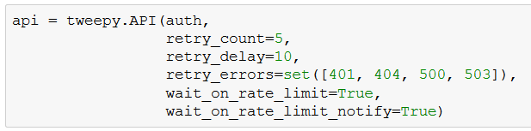
Rate limits
To protect Twitter from abuse, API usage is rate limited, with additional account-based fair use limits.
There is a limited number of requests you can make in a certain time frame.
Tweepy can help handle these limitations.
You can set a number of additional parameters in the tweepy.api class:
retry_count – default number of retries to attempt when error occurs.
retry_delay – number of seconds to wait between retries.
retry_errors – which HTTP status codes to retry.
wait_on_rate_limit – automatically wait for rate limits to replenish.
wait_on_rate_limit_notify – print a notification when limit reachd.

Slide 24
Collecting Facebook data

Slide 25
Why use Facebook data for research?
Advantages:
Most popular social media platform - 2.19 billion monthly active users; 40 million in UK, 60% of population.
It allows users to like, share, and comment on pictures, videos, websites, articles, and more.
Allows researchers to analyse the content shared and generated by users, and study the user to user and user-content networks, although recently with limitations.
Intense political activity takes place on Facebook,
praised as a great tool for promoting democracy and political participation
criticized as a tool which can lead to the demise of it.

Slide 26
Why use Facebook data for research?!
Disadvantages:
Collecting Facebook data is difficult.
Complicated, poorly-documented privacy settings.
Poorly documented API - data incomplete, unreliable. In contrast with Twitter’s complex and reliable architecture.
Ethical concerns - confusion among users about the level of privacy provided by the platform, and a tendency among users to expect their Fb activity , even on public pages, to not be used for other purposes.

Slide 27
Facebook Graph API
FB uses a graph API whose primary unit is a node which may be of different types (users, pages, images).
Nodes of different types have different fields and edges.
An edge is a connection to another node, or to another set of nodes.
Researcher have to parse this complex structure
decide which nodes and edges to collect
do so in a sequential fashion
looping through multiple nodes and
collecting all of their connected nodes of interest
This requires medium to advanced programming skills.

Slide 28
Tools for collecting Facebook data
Open source:
F(b)arc - A command line tool and Python library for retrieving parts of the graph and archiving it.
Netvizz extracts data from different sections of the Facebook platform - in particular groups and pages - for research purposes.
fb_scrape_public - This script can download posts and comments from public Facebook pages and groups (but not users).
Rfacebook: Allow R users to access Facebook’s API to get information about users and posts, and collect public status updates that mention specific keywords
‘SocialMediaMineR retrieves the number of shares, likes, pins, and hits on FB
Purchase tools:
DataSift – download data subject to API limitations.
Nvivo – download and analysis.

Slide 29
How do you access data directly?
Graph API requests require an access token which you get by following a set of simple authentication steps:
Register as a developer at: http://developers.facebook.com
Accept the terms and conditions
Asked to verify your account
Provide some information about yourself
Register a new application.
Need the App ID and App Secret
These values are your application’s credentials to Facebook, and we will use them in our code.

Slide 30
Which programming language?
HTTP based – any language.
Some useful FB API libraries for the programming languages most commonly used by social science researchers R and Python.
Python (Fbarc)
R (Rfacebook)
Write your own functions for parsing the graph.
Choice of language depends on next. Each has advantages:
Python – better text processing and analysis and machine learning libraries.
R – better statistical analysis packages.

Slide 31
Rate limits
Just like other social media platforms, Facebook does have rate limits in place
There are limits on:
the amount of data that can be returned in a single request
Deal with these by imposinf limits for maximum number of edges and nodes to retrieve.
the number of requests within a time period
You can set the number of requests to make per second or minute.

Slide 32
Recent changes to Facebook privacy policy and developer access
April 2015, Facebook removed all friendship connections from all of its APIs.
Spring 2018 major API changes
Following Cambridge Analytica scandal.
Removed features related to ability to collect data on individual users, as well as all user info; privacy increased
This means users can no longer be distinguished in comment files.
User-post bipartite graphs can no longer be generated.

Slide 33
Fb recently announced a new Social Data Initiative
To help provide independent, credible research about the role of social media in elections, as well as democracy more generally.
Create a commission made of social science senior scholars who will:
Define and Prioritization of research agenda.
Solicit proposals of independent research
Manage a peer review process to select scholars who will receive funding for their research, as well as access to privacy-protected datasets from Facebook which they can analyze.

Slide 34
Respect privacy restrictions!
Not allowed to scrape Facebook or Twitter data without going through the APIs
Not allowed to collect non-public data
Fb user nodes restricted, public comments visible, but can’t be linked to individual users
Follow the University’s ethics and human subjects review board guidelines!

Slide 35
Analysing social media data

Slide 36
R or Python.
Choice of language depends on your goals. Each has advantages:
Python – slightly better text processing and analysis libraries and machine learning libraries scikit-learn
R – better statistical analysis packages
Both catching up fast – Python has pandas and statsmodels, R has the newly developed Quanteda for political scientists

Slide 37
Jupyter or Markdown.
Both environments that allows you to create and share documents that contain code, results, graphs, explanatory text and equations.
Jupyter which was initially called IPython notebook is the standard choice for Python users
R Notebook R Notebook is an R Markdown document with chunks that can be executed independently and interactively, with output visible immediately beneath the input.

Slide 38
R and RStudio
Using R Notebook in an RStudio environment is preferred by R users.
Both supports both types of programming languages, and others
Both allow you to have the code and results on the screen inline.
Both integrate well with Github.
Rmarkdown slightly better for version control.
Jupyter slight advantage in number of languages implemented.

Slide 39
Storing data
As raw files
More flexible, but can be slower as you need to write all functions for querying and processing the data
Or need to be able to read in large volumes of data
In a database
Relational databases
MySQL – fast, efficient, less storage, but less flexible
Non-relational databases
NoSQL - MongoDB –a document database very flexible, scalable, but also querying and indexing features that make if easier to wor with than raw json.
Visualizing with RoboMongo.

Slide 40
Python also has packages for processing and analysing text data
Textbolob
Stanford Core NLP
Gensim
NLTK – most popular - includes graphical demonstrations and sample data.
It is accompanied by a book that explains the underlying concepts behind the language processing tasks supported by the toolkit, plus a cookbook.

Slide 41
First step - Processing and cleaning data, dealing with encodings
Combination of Pandas – great encoding functions – deal with strange characters or foreign – common on social media
And NLTK – common tasks include removing most common words (stopwords and, to for, from), tokenizing the corpus.
Corpus - Body of text, multiple text are called corpora.
Token – A single "entity“ in text, based on what rule you use for splitting the text. Most commonly words, but you can also tokenized the sentences out of a paragraph.
Different tokenizers functions used – word tokenizer, punkt tokenizer.

Slide 42
Other useful functions
Stemming algorithms work by cutting off the end or the beginning of the word, taking into account a list of common prefixes and suffixes that can be found in an inflected word.
Studies - studi, studying – study
Lemmatization, on the other hand, is based on detailed dictionaries which the algorithm can look through to link the form back to its lemma.
Both studies and studying turned to study.
Both take time, lemmatization more complex.

Slide 43
Counts and searches
Count Word Frequency – FreqDist
Searches with: Keywords Regular expressions
Search for keywords and show where they appear in the corpus.
Use more complex searcher based on regular expressions
You often need to do this to identify specific search patterns and capturing what you want and not more than you want
In this example count how many times reference to the UK appear in the text, but making sure we don’t capture Ukraine as well.

Slide 44
Measuring similarity between documents
Cosine similarity.
Evaluate how similar texts are based on the words included, regardless of word order.
We tokenize the texts, take the vector of counts and calculate the cosine of the angle between them.
So for any two pairs of texts we can calculate the cosine similarity and then identify in a large collection the documents that are most similar.

Slide 45
Machine learning methods for the analysis of social media data include
Supervised methods - Such as supervised classifiers which allow us to label posts and put them into categories.
For example, we have posts that are related to Brexit and posts which are not. We can core a sample of our data on these two categories. We then train a supervised classifier to predict if the rest of the posts are about Brexit or not.
Unsupervised methods - Such as clustering algorithms, which aims to group together similar social media posts based on the language, but without human coding.

Slide 46
What does the text of the posts talk about?
Relative word frequencies
Plot the using word clouds, although not the most informative method.
If we already know the categories we can used supervised classification.
If not, clustering.
But we can also use another popular unsupervised method –
Topic modelling.

Slide 47
Topic models
Latent Dirichlet Allocation (LDA)
Documents are a mixture of topics.
Topics generate words based on their probability distribution.
Algorithm:
Determine number of words in document.
Determine mixture of topics in document.
Based on the topics' multinomial distribution, assign words to documents.
Mallet, Python Gensim, R Quanteda.

Slide 48
Analysing network data
What is a network?
Mathematical construct of nodes and edges.
•Information (attributes) on the nodes as well as the edges.
•News domains are nodes
•Edges are formed between two domains if a user shares/reads an article on both domains.
Explicitly model interdependencies between observations.
•Patterns of information exposure
•Detect communities/echo chambers

Slide 49
Network analysis in R and Python
Python packages include: Network X and Igraph.
R packages include: network, igraph and sna
Gensim self-standing software which is very popular in the network analsyis research community.

Slide 50
Methodological concerns and challenges in the use of social media and online data
Incidental data – based on what is available
Convenience sample
Representativeness
Generalizability
System artefacts
Ideal user assumption
Vs. bots, manipulation
Divided across platforms, hard to join
“Big data hubris” (Lazer et al. 2014)
More caution when interpreting measures of statistical precision.
Sampling error driven toward zero
Other errors associated with inferences drawn from a sample not reduced.

