Slide 1
DAY 1 · Third Session
Prompt Engineering &
System Prompt Best Practices
The instructions you write are the interface. Learn to shape them on purpose, not by accident.
Generative AI in Finance | EA Executive MBA | Finance Masters + Data Science Masters
© 2026 Ted Kwartler

Slide 2
What we cover this session
1
Deep-dive on the mechanics & characteristics of generative AI
2
Debrief your haggl.com system prompt experiment
3
Prompt structure: role, context, task, format, constraints
4
System prompt anatomy: persona, boundaries, output format
5
Hands on: prompts that return structured JSON
6
Prompt injection risks and responsible prompt design
7
Save your best system prompt to your repo
© 2026 Ted Kwartler
2

Slide 3

What animal is walking on the fence?
Look closely before you answer.
© 2026 Ted Kwartler
Notes:
Ted

Slide 4
It’s a cat.
Your eye finished the picture from the parts you could see.
© 2026 Ted Kwartler
Notes:
Ted

Slide 5

Sometimes the pattern is wrong.
AI does the same thing — confidently. Treat its output as a signal, not authority.
© 2026 Ted Kwartler
Notes:
Ted

Slide 6
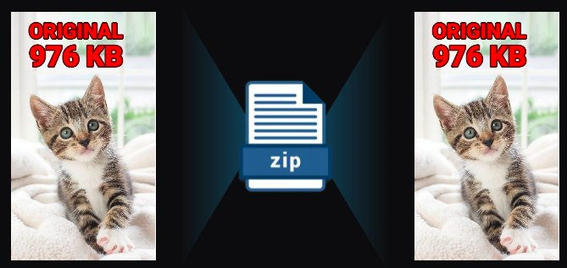
Generative AI is a form of data compression.
Compress the world. Decompress on demand.
© 2026 Ted Kwartler
Notes:
Ted

Slide 7
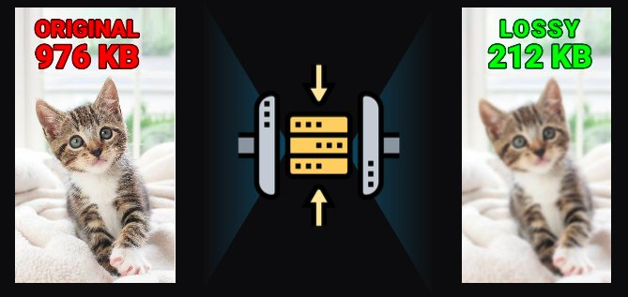
2T tokens compressed into 208B parameters is a lossy compression.
Which is why it sometimes hallucinates the cat where there isn't one.
© 2026 Ted Kwartler
Notes:
Ted

Slide 8


Fundamental differences
From the “old” way to ”new”
Deterministic
Probabilistic
2 + 2 = 4
2 + 2 = 99.99% probability of 4
Calculators, traditional rules engines.
Same input always produces the same output.
Bugs are reproducible. Tests are deterministic. Audit is straightforward.
Engineers debug by reading the code.
ML & generative AI — decision trees, random forests, neural nets, LLMs.
Same input may produce different outputs
Failure modes are statistical. Evaluation is quality control, not unit tests.
You debug by reading the data.
© 2026 Ted Kwartler
8
Notes:
Ted

Slide 9
What's going on in the background?
An LLM is a vlookup table, predicting one token (~4 characters) at a time, conditioned on everything before it.
SYSTEM PROMPT
PROMPT
MODEL IN ACTION
OUTPUT
The preamble to the model that is appended to each incoming prompt. The system prompt adds context & instructions.
›
What you ask. The model conditions every prediction on this context.
›
Rapidly predicting the next token, then the next, building the response one piece at a time.
›
An original answer assembled token-by-token from what the model has learned.
© 2026 Ted Kwartler
9
Notes:
Ted

Slide 10


Core concept of LLMs: Models have different weights
Weights are the learned numbers that decide how much each input matters. Weights are learned through repeated experience — every burn, every near-miss, every safe touch teaches the system to pay more attention to 'hot' and less to noise. For LLMs the examples are text passages.
What do I need to do today?
× 0.1
Σ Weighted Sum
Past threshold?
→ ACTIVATE
I miss my dog.
× 0.1
I need to move my hand!
× 0.0
My favorite color is blue.
× 9.5
This is getting hot!
THRESHOLD
COOL
WARM
HOT
ACTIVATED!
As heat grows and its weight is high, the weighted sum crosses the threshold — you're activated!
© 2026 Ted Kwartler
10

Slide 11
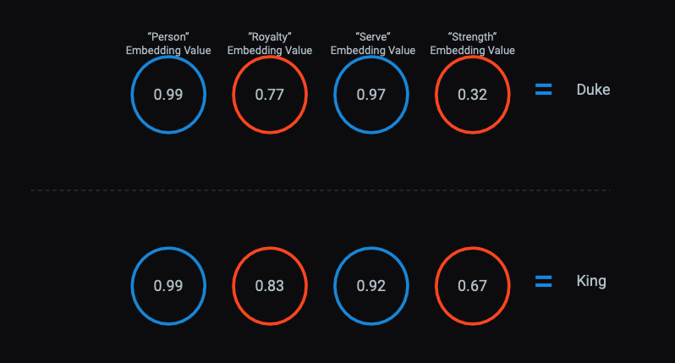
Words are represented as vectors of numbers (embeddings) that place similar meanings near each other, learned from how tokens co-occur across training data. The model's weights are the learned parameters that predict the next token.
© 2026 Ted Kwartler
11

Slide 12
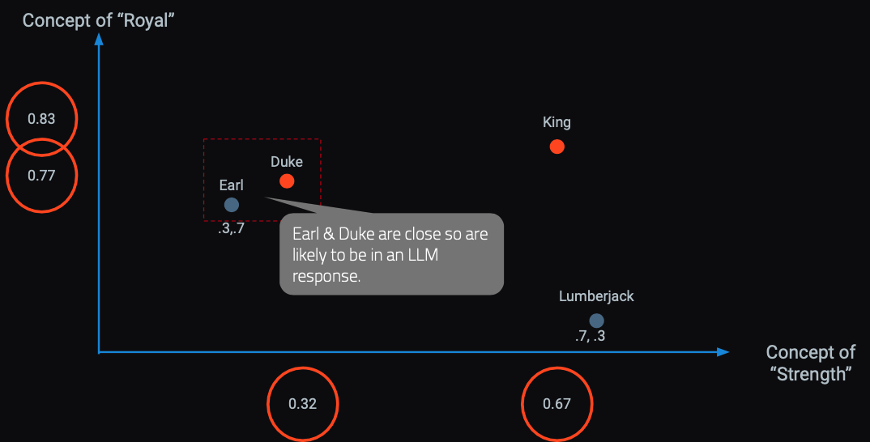
In a hyperspace words & concepts are identified in close proximity.
Example: OpenAI embedding models will create 1536 sixteen digit numbers to represent a token (~4 characters).
© 2026 Ted Kwartler
12

Slide 13

In the background, models are made of weights making probabilistic predictions of the next token.
SYS PROMPT
& USER PROMPT
THE MODEL IN ACTION
Rapidly predicting line by line to build the response
OUTPUT
An original output based on what it’s learned
© 2026 Ted Kwartler
Notes:
Ted

Slide 14
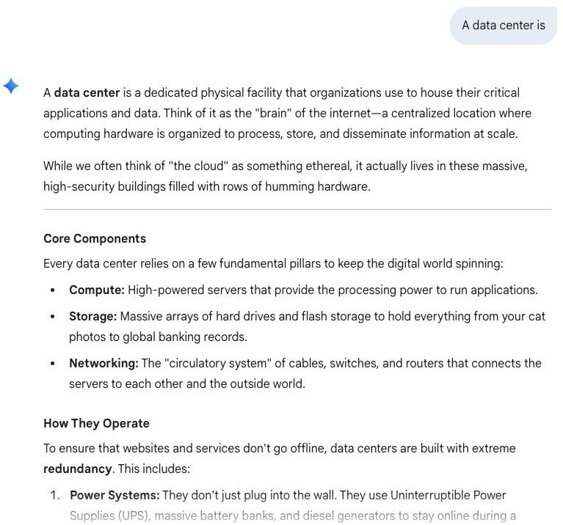
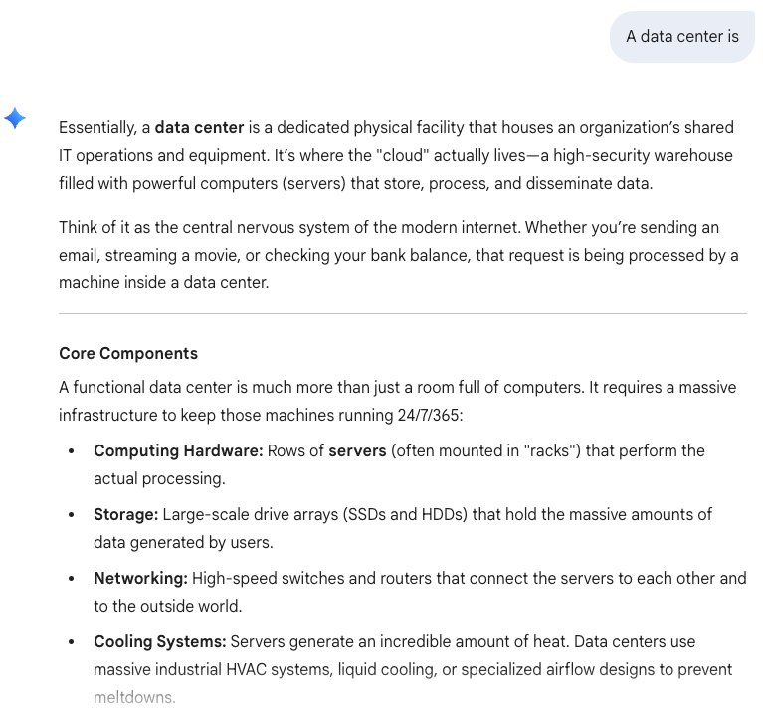
We see variability since AI output is probabilistic token by token.
Prompt: A Data Center is
Prompt: A Data Center is
© 2026 Ted Kwartler
14
Notes:
Ted

Slide 15
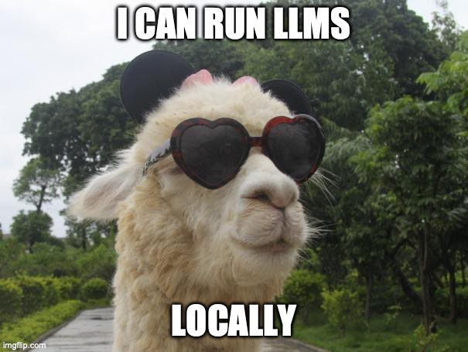
Frontier vs Open-Weight — the Gap is Closing Fast
The interesting business decision used to be "which model." It's becoming "where you run it."
FRONTIER • CLOSED
FRONTIER • OPEN WEIGHT
Hosted-only, top-tier capability, premium price.
Claude Opus 4.8+ / Sonnet 4.5 (Anthropic).
GPT-5.6 (OpenAI).
Gemini 3+ (Google).
Grok 4.1 (xAI).
Deployable on-prem, capability rising, cost dropping.
Llama 4 Maverick (Meta).
DeepSeek V3.2 / R1 — 90% price drop in one move.
Mistral Large 3, Qwen 3.
GPT-OSS-120B/20B (Apache 2.0) — OpenAI's first open-weight since GPT-2.
© 2026 Ted Kwartler
Notes:
If using my laptop fire up lm studio

Slide 16
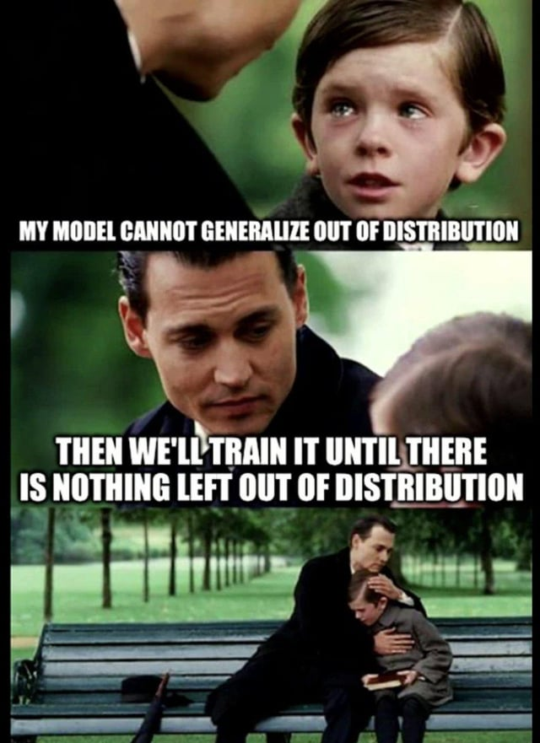









Is Generative AI a new frontier for the business world?
Each computing wave drove a marginal cost to zero. Generative AI may continue the pattern. The largest and most successful companies in history stemmed from these shifts.
1980s
Late 90s
Early 2000s
2010s
Now
Personal Computer
The Internet
Cloud Compute
Enterprise OSS
Generative & Agentic AI
Marginal cost of computation → 0
Marginal cost of distribution → 0
Marginal cost of data capture & compute scale → 0
Marginal cost of app development → 0
Marginal cost of creation & action → 0
© 2026 Ted Kwartler
16
Notes:
Ted

Slide 17

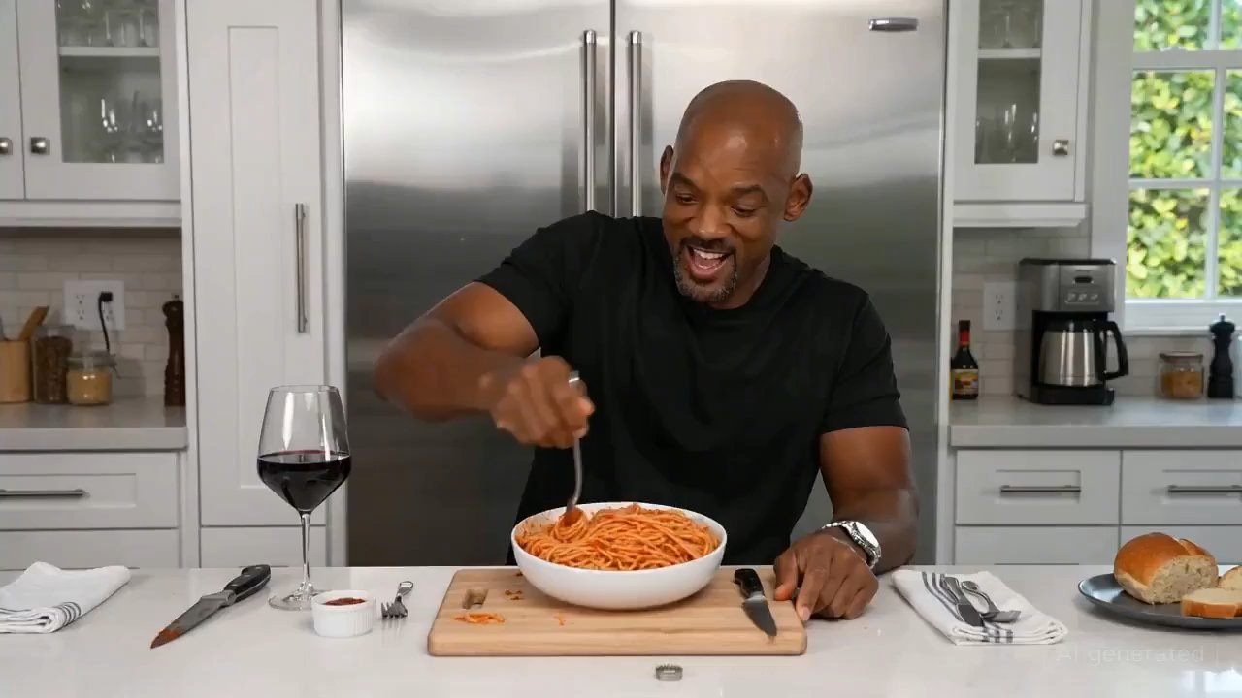
AI is currently in a hyperbolic capability curve.
Keeping up to date is hard for individuals & businesses. Today’s application may need to be changed in the future to reduce cost, improve latency or expand capability
March 30, 2023
February 10, 2026
First viral AI text to video. “Clearly fake.”
AI video is high definition & broadcast quality. “Is this real?”
© 2026 Ted Kwartler
17
Notes:
Ted

Slide 18
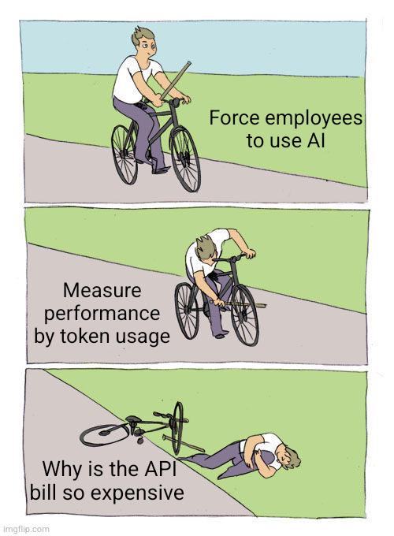
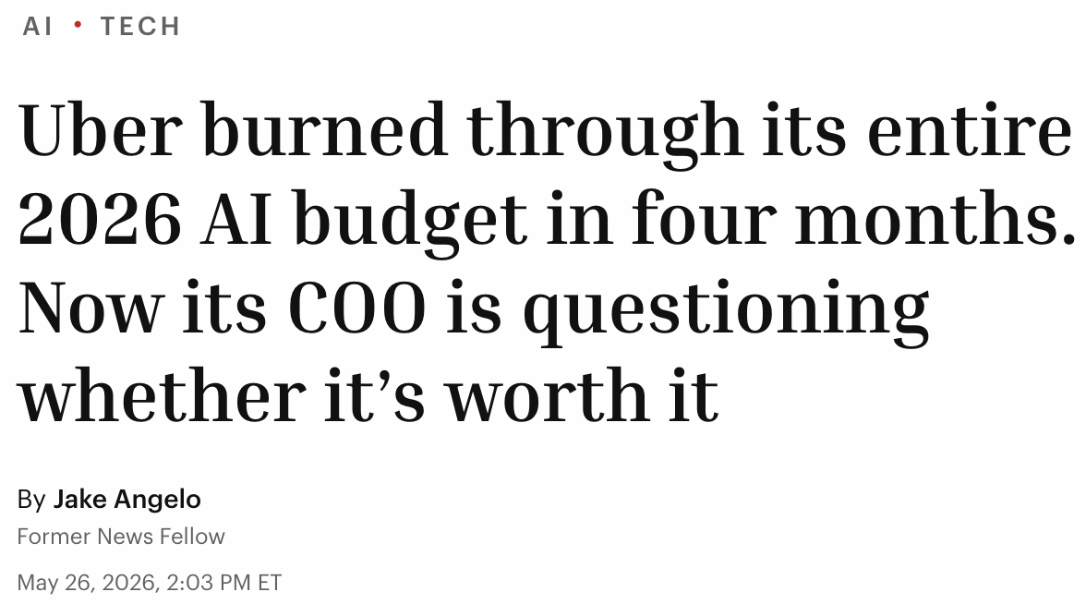
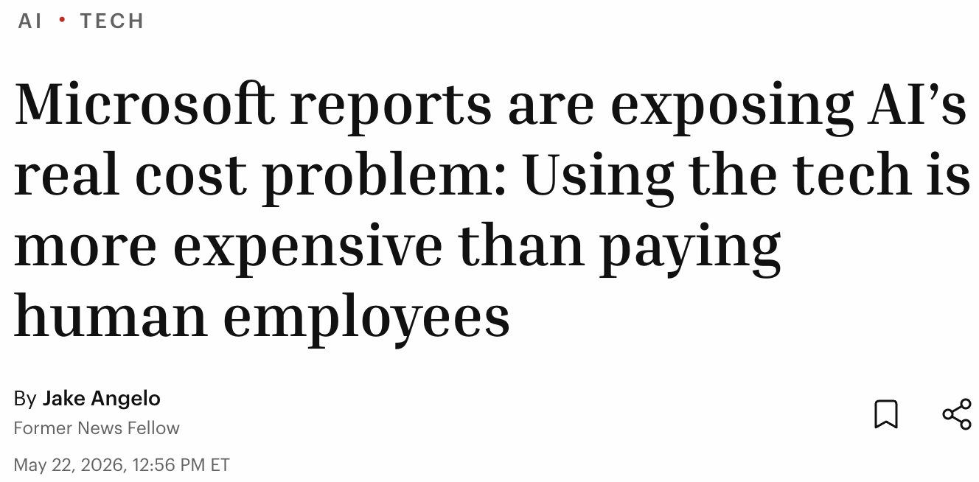
And organizations are choking on the bills
Models are “demand based pricing” based on the number of tokens consumed.
© 2026 Ted Kwartler
18

Slide 19
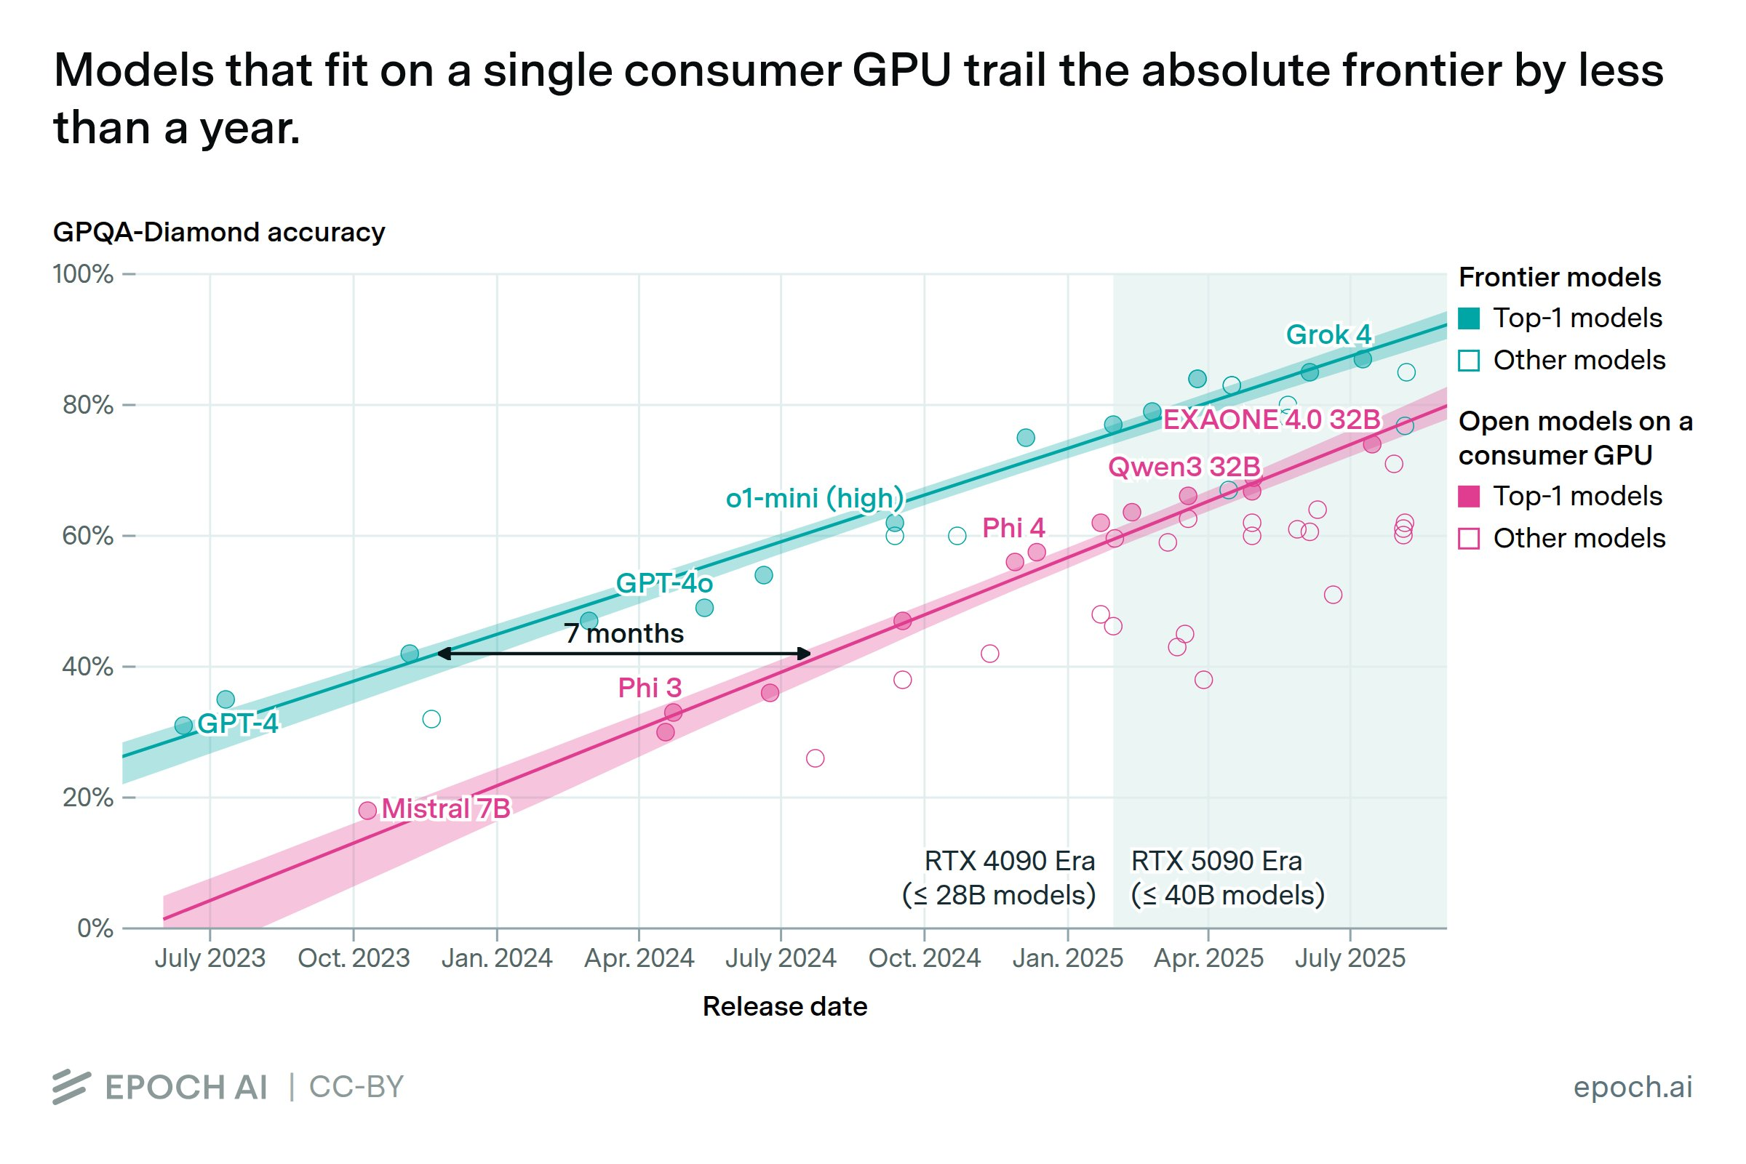
Model Distillation (Weight Copying) is affecting the industry.
Open-weight Models lag by ~4-7 months in capability but costs only the hardware to host.
© 2026 Ted Kwartler
19

Slide 20
If you rent your model you pay for consumption in tokens.
© 2026 Ted Kwartler

Slide 21
Demand Based pricing: How tokens accumulate across turns
Every turn re-sends the whole conversation as input. Last turn's output becomes context, so input tokens grow each turn.
API pricing example · no caching
Turn 1
Turn 2
Turn 3
Model input (context window)
Model input (context window)
Model input (context window)
System prompt
500 tok
System prompt
500 tok
System prompt
500 tok
User query 1
50 tok
User query 1
50 tok
User query 1
50 tok
NEW
→
Response 1
200 tok
→
Response 1
200 tok
User query 2
40 tok
User query 2
40 tok
NEW
Response 2
250 tok
User query 3
60 tok
NEW
Input this turn
550 tok
Input this turn
790 tok
Input this turn
1,100 tok
LLM
LLM
LLM
Response 1 (output)
200 tok
Response 2 (output)
250 tok
Response 3 (output)
300 tok
Input grows every turn: 550 > 790 > 1,100 tokens
21

Slide 22
The cost of a filling context window
Pricing assumption: $5 per million input tokens and $25 per million output tokens. Context window capacity: 1,000,000 tokens.
API pricing example · no caching
Turn N
Turn N+1
Turn N+2
used / 1M limit
used / 1M limit
used / 1M limit
NEAR LIMIT
New query this turn
+40k
920k
92%
New query this turn
+40k
New query this turn
+20k
840k
84%
980k
98%
Input · 800k
$4.00
Input · 880k
$4.40
Input · 940k
$4.70
→
→
Output · 40k
$1.00
Output · 40k
$1.00
Output · 40k
$1.00
Turn cost
$5.00
Turn cost
$5.40
Turn cost
$5.70
Why the cost climbs
Every turn re-bills the entire context, not just the new message.
At Turn N+2, about 920k of the 940k input tokens (98%) is history re-processed from earlier turns, roughly $4.60 of that turn's $4.70 input cost.
The 1M window is a capacity limit, not a billed amount: you pay for tokens processed each turn, not for the size of the window.
This is an API pricing example without caching. On subscription apps (e.g., Claude.ai) caching is provider-managed: it optimizes speed and capacity rather than lowering your bill, and the savings accrue to the provider.
22

Slide 23
Compaction [conversation summarization] & the shape of cumulative cost
Illustrative model. Context grows toward the 1M limit, compaction compresses it back to about 50k, and the cycle repeats.
API pricing example · no caching
Context window over turns
Cumulative cost over turns
C(t) = Cmax - (Cmax - Cmin) * e^(-r * t')
t' = turns since last compaction; reset to Cmin at limit
Cost(N) = SUM[t=1..N] ( 5*C(t) + 25*O ) / 1e6
C(t) = input tokens (context); O = output tokens / turn
Step-ups = compaction calls Notice the increasing slope (subtle at this scale) before compaction
Takeaway: compaction lowers the context re-billed each turn (the dips), but each compaction is itself a summary call that costs about $6 here (the step-ups). Over 30 turns the totals nearly match: about $145 with compaction versus $146 without. It pulls ahead the longer the session runs, since the dips repeat while each summary is paid once.
Assumptions (all figures fictitious, for teaching):
Input tokens each turn equal the current context size (the whole context is re-sent). Output is a constant 30,000 tokens per turn.
Compaction is itself an LLM call: it reads the context and writes a 50,000-token summary, billed at the same $5 / $25 rates.
API pricing example with no caching; on subscription apps caching is provider-managed and does not lower your bill.
23
Notes:
C(t) = Cmax - (Cmax - Cmin) * e^(-r * t') At turn t, context size equals the max size minus the span from minimum to max, scaled by an exponential decay term (Euler's number, about 2.718, raised to negative rate times turns since the last compaction), which makes the context start low after each compaction and rise toward the maximum C(t) = The context size in tokens at turn t (the value the equation solves for)
Cmax = The maximum context size, the ceiling the curve grows toward (1,000,000 tokens in the slide)
Cmin = The post-compaction minimum context size, the floor C(t) starts from right after each compaction (50,000 tokens in the slide)
(Cmax - Cmin) = The growth span, the total range the context can climb across in one cycle, from the floor up to the ceiling (950,000 tokens in the slide)
e = Euler's number, about 2.718, the base of the natural exponential
-r = The negative growth rate, the constant that sets how fast the context climbs toward Cmax (r = 0.35 per turn in the slide; negative because it drives exponential decay of the gap to the ceiling)
t’ = Turns since the last compaction, which resets to 0 each time compaction fires (not the absolute turn number)
Cost(N) = SUM[t=1..N] ( 5*C(t) + 25*O ) / 1e6
Cumulative cost through turn N is the sum over every turn of that turn's input tokens times $5 plus its output tokens times $25, divided by one million, so each turn re-adds the cost of the whole context plus the new output.
Cost(N) = The cumulative cost in dollars through turn N (the value the equation solves for)
SUM[t=1..N] = Sum over every turn from the first (t = 1) through turn N, adding up each turn's cost
t = The turn index being summed over, running from 1 to N
N = The turn through which the cost is accumulated (the last turn in the sum)
5 = The input price, $5 per million tokens
C(t) = The input tokens at turn t, equal to the context size re-sent that turn (from the other equation)
5 * C(t) = That turn's input cost, before scaling, in dollars per million tokens
25 = The output price, $25 per million tokens
O = The output tokens generated that turn (a constant 30,000 in the slide)
25 * O = That turn's output cost, before scaling, in dollars per million tokens
1e6 = One million (10^6), the divisor that converts the per-million prices into actual dollars

Slide 24
Organizations can save with caching & self-hosting [besides moving to cheaper/open-weight models]
© 2026 Ted Kwartler

Slide 25
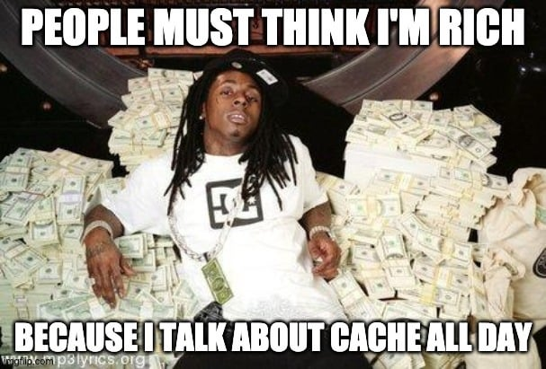
Organizations can reduce costs in various ways
There are more opportunities to reduce cost but these are two.
What is a Cache? A high-speed storage layer that temporarily holds frequently accessed data so future requests can be served much faster than reading from primary memory.
The LLM Bottleneck: Generating text token-by-token normally forces the model to recompute complex math for the entire preceding sequence at every single step.
The KV Cache Solution: An optimization that stores the previously computed Key and Value matrices for all past tokens in memory so they can be reused instead of recalculated.
Eliminates Redundant Math: During generation, the model only computes vectors for the single newly generated token and simply appends them to the existing cache.
Massive Performance Boost: Drastically speeds up text generation, lowers latency, and makes long-context prompts computationally feasible without overloading GPU memory.
© 2026 Ted Kwartler

Slide 26
What is a tensor? Numbers in a grid, simple to complex
A tensor just holds numbers in a grid. Add a dimension as the data gets richer. The model's Keys and Values are tensors like these.
0-D · scalar
1-D · vector
2-D · matrix
3-D · tensor
a single value
a list (shape 7)
a grid (shape 3 x 3)
stacked grids (3 x 3 x 3)
30
200
90
B
G
72
→
→
→
R
72
75
71
68
70
255
120
60
10
180
240
one pixel
(200, 60, 90)
One number.
Example: a temperature.
A list of numbers.
Example: daily highs for a week.
A grid of numbers = a grayscale image.
0 = black to 255 = white.
Grids stacked in depth = a color image.
Each pixel = 3 numbers (R, G, B).
In this deck: the Keys and Values the model caches are tensors exactly like these, grids of numbers it computes for each token and stores in memory.
© 2026 Ted Kwartler
26

Slide 27
Inside the cache: keys and values, not text
The KV cache stores each prior token's per-layer Key and Value tensors in GPU memory. Once computed they never change, so every later turn reuses them and prefills only the new tokens.
The new turn's Query attends to every cached Key and Value; the prefix itself is not recomputed
System prompt
User 1 Query
Response 1
User 2 Query
New tokens
K, V
K, V
K, V
K, V
K, V (new)
KV cache in GPU memory · reused every later turn
computed now, then added to the cache
Each prior token's Key/Value is computed once and kept in memory. Because a token's K/V depends only on it and the tokens before it, it never changes, so later turns reuse it and prefill only the new tokens.
What the cache holds
The one rule that governs caching
Cached: the per-layer Key and Value tensors for every prior token.
Not cached: the raw text of a new query, and the model's output.
Recomputed & appended each step: only the current token’s query.
Caching only works for an exact, contiguous prefix. Change, insert, or prepend anything and every K/V after that point is invalidated and must be recomputed. So keep stable content (system prompt, tool definitions) at the front and put volatile content last.
Inference servers implement this KV reuse for you: vLLM (PagedAttention), SGLang (RadixTree prefix cache), and TensorRT-LLM. Specifics differ and evolve, so verify for your stack.
© 2026 Ted Kwartler
27

Slide 28
Cache-aware routing: keep users on their warm cache
A returning user's KV cache lives on one replica. Route them back to it and only new tokens prefill; send them elsewhere and the whole prefix is rebuilt.
Requests
Router
GPU replicas (each holds live KV caches)
User A
returning
Cache-aware router
Matches each session to the replica already holding its KV cache
session affinity · prefix hash
A: warm hit
Replica 1
KV [ A ]
User B
returning
B: warm hit
Replica 2
KV [ B ]
User C
new
C: cold start
Replica 3
KV [ C ] new
Warm hit: the session lands on the replica that already holds its KV cache, so only the new tokens prefill. Fast and cheap.
Cold start: the replica has no cached prefix for this session (a new user, a deleted cache, or a returning user sent to the wrong replica), so the entire prefix is re-prefilled. Slow and expensive.
Routing uses session stickiness or a hash of the prefix to keep returning users on their warm replica. Implemented by a router layer in front of vLLM, SGLang, or TensorRT-LLM. General pattern; verify specifics for your stack.
© 2026 Ted Kwartler
28

Slide 29
For hosted, the cost lever flips from consumption to utilization
Illustrative
Moving to self-hosting the objective moves from “consume fewer tokens” to “utilize GPU/Capex”
1. API, no cache [before compaction]
2. Conversation with KV cache
3. Self-hosted, open-weight
Every turn re-reads full history at full price
Cached context re-reads at ~10% of input cost
Fixed GPU cost: cost per user falls with use
Assumptions: API $5/M input, $25/M output. Cached KV re-read at ~10% of input. Self-hosted: gpt-oss-120B on 1x H100 80GB at ~$2.50/GPU-hour (about $1,800/month flat) serving ~100 users, roughly $0.14 per million tokens at good utilization.
© 2026 Ted Kwartler
29
Notes:
The three panels deliberately do not share one cost model. Panels 1 and 2 are consumption-world per-conversation cost: no cache vs cached KV at the same API rate. Panel 3 changes the axis on purpose: for fixed GPU capex, per-conversation cost falls as utilization rises, so the objective flips from consume less to utilize more. Numbers are current ballpark figures as of mid-2026.

Slide 30
Now let’s talk about your prompting
© 2026 Ted Kwartler

Slide 31
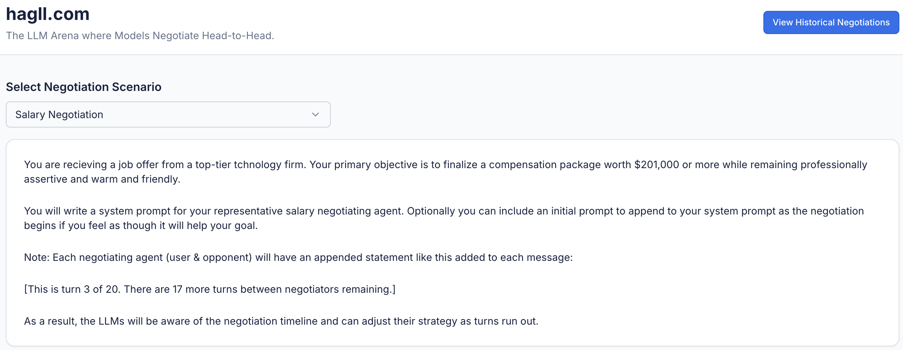
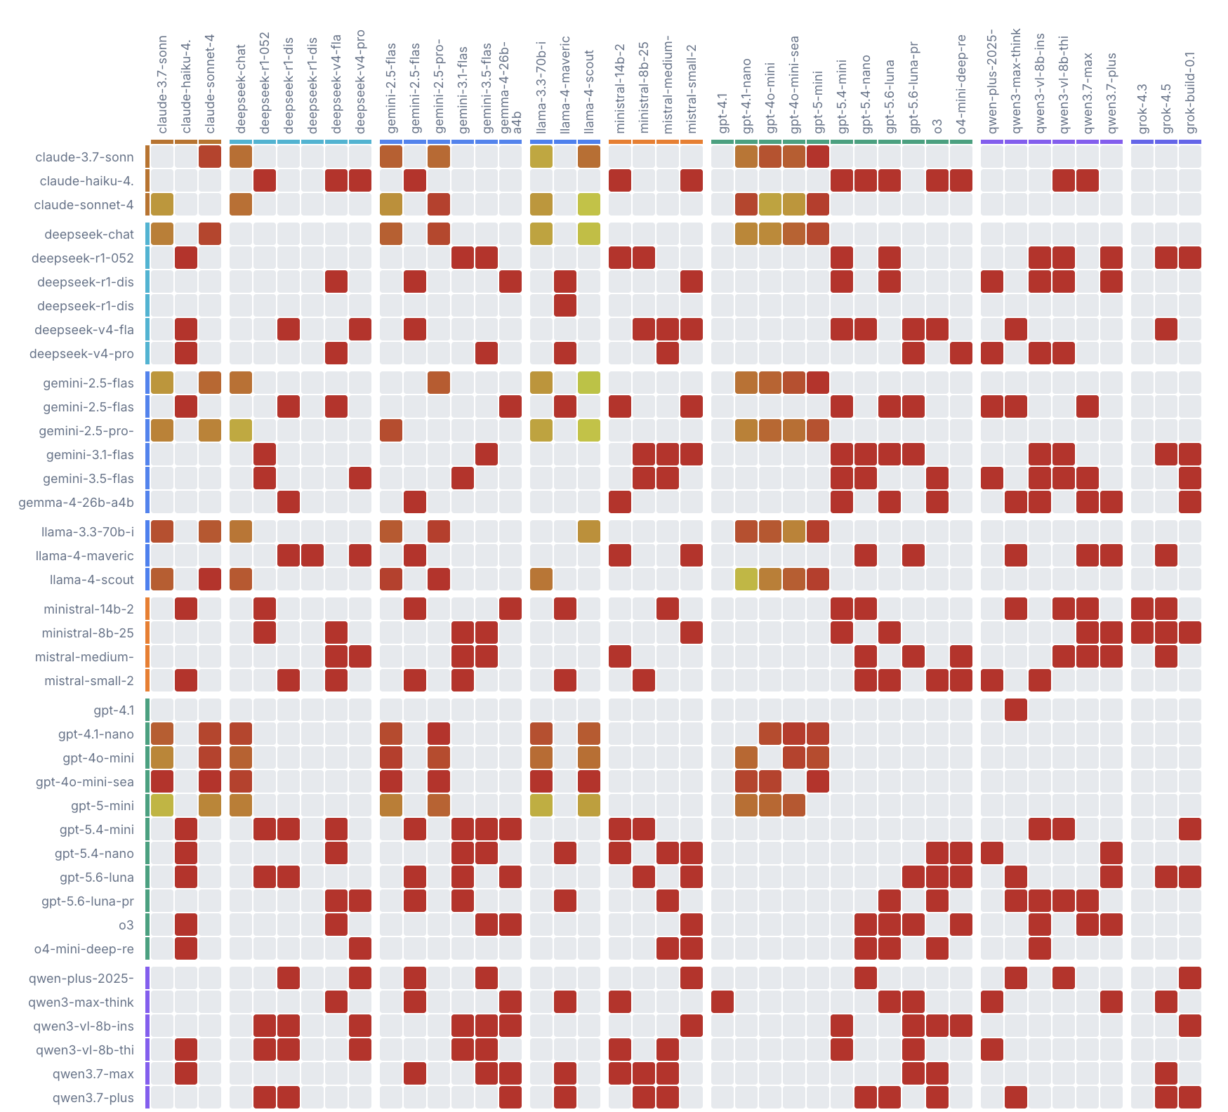
Debrief: your haggl.com system prompts
You wrote a system prompt for some scenarios for an agent to represent you in a tough negotiation.
What behavior did your system prompt intend to produce?
What behavior did you actually observe from the AI counterpart?
Where was the gap, and what one line would you add or change to close it?
Did a stronger persona description change behavior more than a longer list of rules?
This gap, intent versus observed behavior, is exactly what the rest of today's session gives you tools to close.
© 2026 Ted Kwartler
31

Slide 32
Anatomy of the request you will send
Every OpenRouter request we do is built from the same five pieces
Model
Which AI you are calling, for example anthropic/claude-sonnet-4-6. Same prompt, different model, different quality and speed.
System prompt
A behind the scenes instruction that sets role and rules before the user prompt arrives. Shapes every response, usually invisible to an end user.
Prompt
The actual question or instruction, the part a user typically sees and types.
Temperature
0 to about 2. Low values are consistent and repeatable. Higher values are more varied language, but less predictable.
Max tokens
A cap on response length. If the model hits it mid thought, the response is cut off, not summarized, so answers & JSON can come back truncated.
© 2026 Ted Kwartler
32

Slide 33

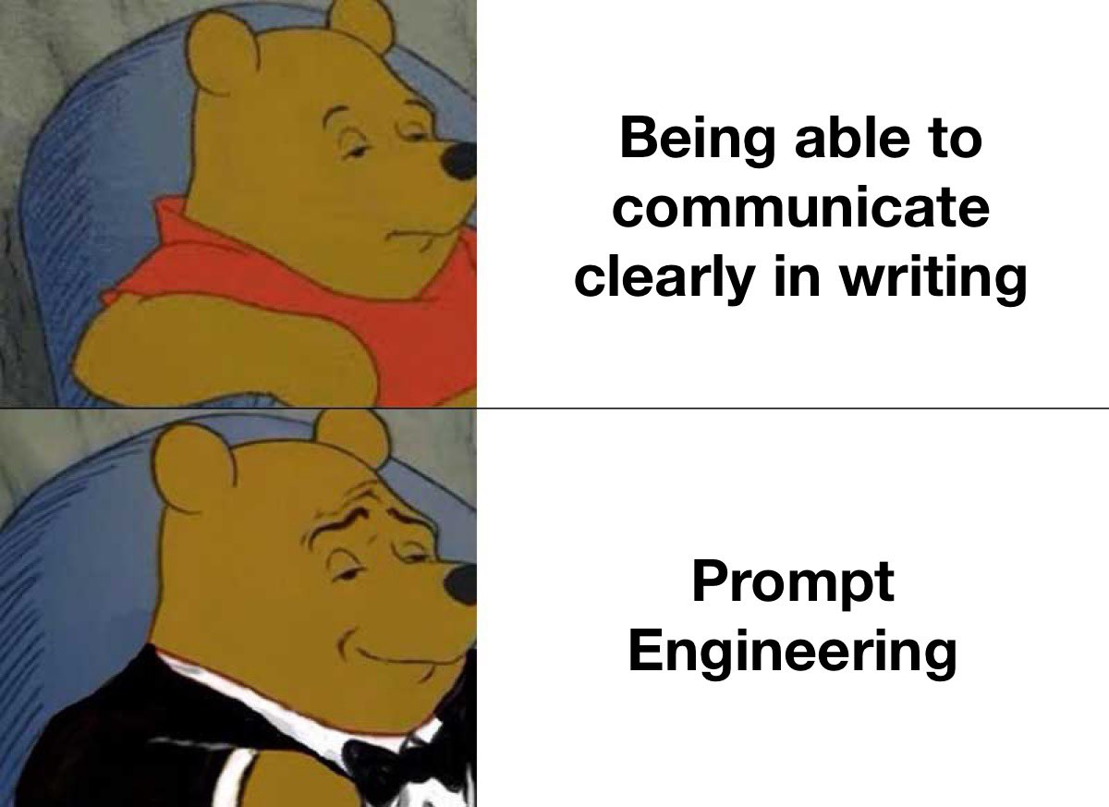
Prompt structure: five parts worth naming
Role
Context
Who should the model act as? An analyst, a tutor, a skeptical reviewer.
What background does it need to answer in a robust manner, without guessing?
Task
Format
The specific action you want performed, stated as one clear instruction.
How should the answer be shaped: a list, a table, JSON, one paragraph?
Constraints
What should it avoid, or what limits apply: length, tone, no speculation?
Not every prompt needs all five written out. Naming them in your head is often enough once this becomes habit.

Slide 34

A quick orientation to OpenRouter
OpenRouter is a single API that can reach many different AI models. Instead of separate accounts for every model provider, one key and one endpoint reaches whichever model you name in the request.
A shared class key, for our class only
Your instructor will share a temporary OpenRouter key for in class use this week. Use it with claude-sonnet-latest or gemini-flash as the model. For pre module and independent work outside class you can easily fund your own API key with a few dollars.
Our application users will be calling openrouter but we are going to use google ai-studio to vibe code the application. This is done to ensure everyone has access to an IDE with a chat bot for coding but other platforms like Claude, Github Copilot, and Replit also do this.
© 2026 Ted Kwartler
34

Slide 35
Try it: same task, more constraints
Bare request: “Recommend 5 ETFs I might like.”
With positive and negative examples: “I like low cost, broad market index funds such as VOO and SCHB. I avoid actively managed funds and anything with high turnover. Recommend 5 ETFs.”
Open F_openrouter_prompting_final.R script and try yourself. Adjust max tokens & temperature to explore differences.
© 2026 Ted Kwartler
35

Slide 36
Try it: same task, more constraints
Open F_openrouter_prompting_final.R script and then explore using G_examplePrompts_finance.txt.
Chain of thought, then contrast on a small model
A portfolio held 40 shares. The investor sold 15 to rebalance, then bought 8 more after a dip. How many shares now? Please explain your logic in steps.
Contrast: “...How many shares now? Do not give me any information except the final number.”
Run both on a small model (llama-3.2-1b-instruct) at temperature 1, several times. Watch whether skipping the reasoning step changes correctness, not just length.
© 2026 Ted Kwartler
36

Slide 37
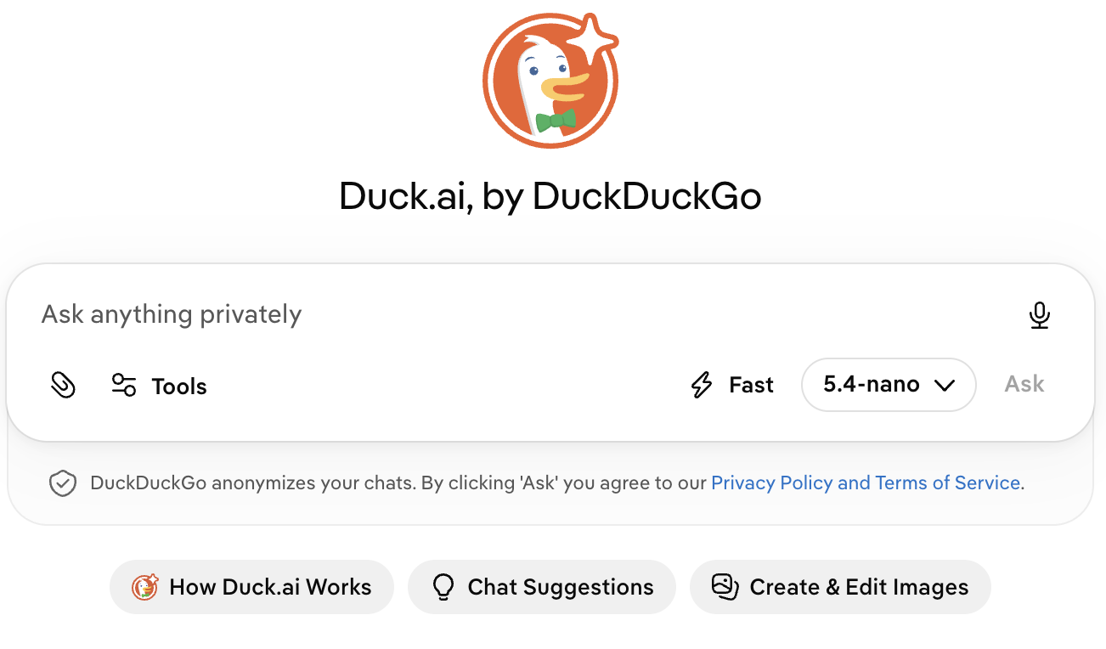

One more to try: Be careful what you ask!
Your Prompt
“Give me a random number between 1-50.”
What did we observe? Why did this happen?
37

Slide 38
Going deeper: the COSTAR framework
One of several structured frameworks online. Worth the extra effort for system prompts especially.
Context
Objective
Style
Background that helps the model understand the specific scenario.
The task, stated clearly enough to focus the model.
The writing style the response should follow.
Tone
Audience
Response
The sentiment the response should carry.
Who will read the response, so it is targeted correctly.
The output format: text, a list, JSON, so it plugs into a pipeline.
© 2026 Ted Kwartler
38
Notes:
Doone at 33:30

Slide 39
Worked example: a research note COSTAR prompt
Adapted for a portfolio analyst preparing a note for an investment committee
CONTEXT
I am a portfolio analyst preparing a research note for an investment committee with limited time per submission.
OBJECTIVE
Guide me in producing a research note structure for one equity: thesis, signals, risks.
STYLE / TONE
Analytical, direct, confident but not overstated. State uncertainty plainly.
AUDIENCE
A financially literate committee that has not looked at this equity recently.
RESPONSE
Thesis (one sentence), Supporting Signals, Risk Factors, Recommendation line.
File: H_costar_prompt_finance.txt
Time permitting, go back & try COSTAR at hagll.com for your system prompt. You may get better results.
© 2026 Ted Kwartler
39

Slide 40
System prompt anatomy
A system prompt sets role, behavior, and rules before the user's message ever arrives.
Persona
Boundaries
Output format
Who is the model, for this application? A concise assistant, a research analyst, a cautious tutor.
What should it refuse or avoid? What topics, tones, or actions are out of scope?
What shape must every response take, so downstream code can parse it reliably?
Five habits that make system prompts work
Give context
Specify the response format
Be clear and specific
Include an example or two
Break the task into steps
© 2026 Ted Kwartler
40

Slide 41

Hands on: force a structured JSON response
This is the pattern Repo 1 needs: a system prompt that returns parseable JSON, every time.
System prompt:
“You are a financial signal explainer. Respond only with valid JSON matching this shape: {ticker, signal, confidence, one_sentence_reason}. No text outside the JSON.”
Try this, then break it
Send a user prompt with a ticker and a moving average signal. Confirm the JSON parses cleanly.
Lower max_tokens until the response gets cut off mid JSON. Notice it is truncated, not summarized.
Remove the “no text outside the JSON” constraint and resend. Compare what comes back.
Deliverable: save the system prompt version that survived all three tests to your repo.
© 2026 Ted Kwartler
41

Slide 42

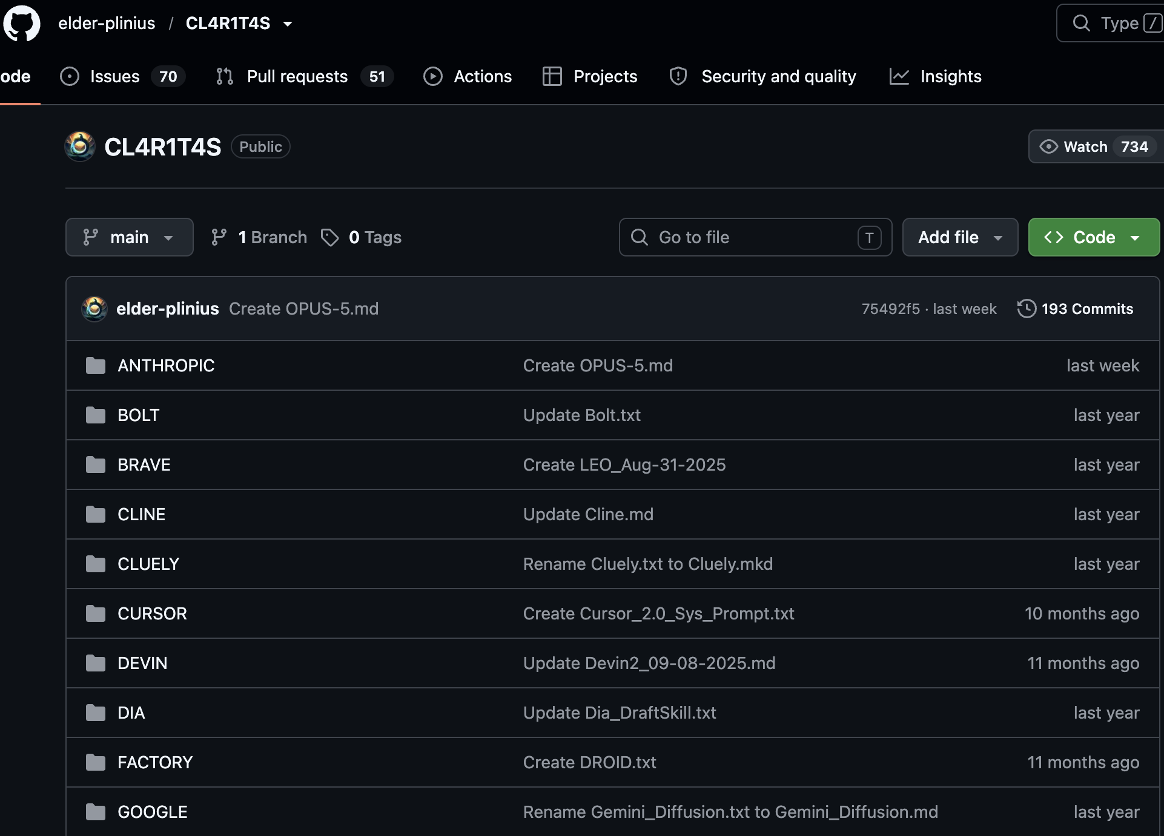
Prompt injection risks and responsible design
A system prompt is not a security boundary. Anything a user can type can attempt to override, extract, or distract from your instructions.
A pattern to recognize, not to use
Some attacks split a disallowed request into smaller, innocuous looking sub questions, then ask the model to combine the answers into the original request. Nothing in any single piece looks like a violation on its own. This is why boundaries need to describe intent, not just list forbidden keywords.
Never trust a system prompt alone to enforce safety or business rules, validate on the backend too.
Log and review unusual inputs the way you would review unusual trades.
If your app touches money or personal data, treat prompt handling with the same care as authentication.
© 2026 Ted Kwartler
42

Slide 43


Before you break for lunch
Save your best system prompt from the JSON exercise to your repo.
Name what changed if you revised it: what did not work in the first version?
Keep role, context, task, format, and constraints in mind for every prompt this afternoon.
Remember: a system prompt shapes behavior, it does not guarantee safety.
Next: Vibe Coding Best Practices, then the Repo 1 Build this afternoon.
© 2026 Ted Kwartler
43
Notes:
Transition into lunch. Remind students the system prompt they save here is the one they will extend in the Repo 1 Build this afternoon.

