Slide 1
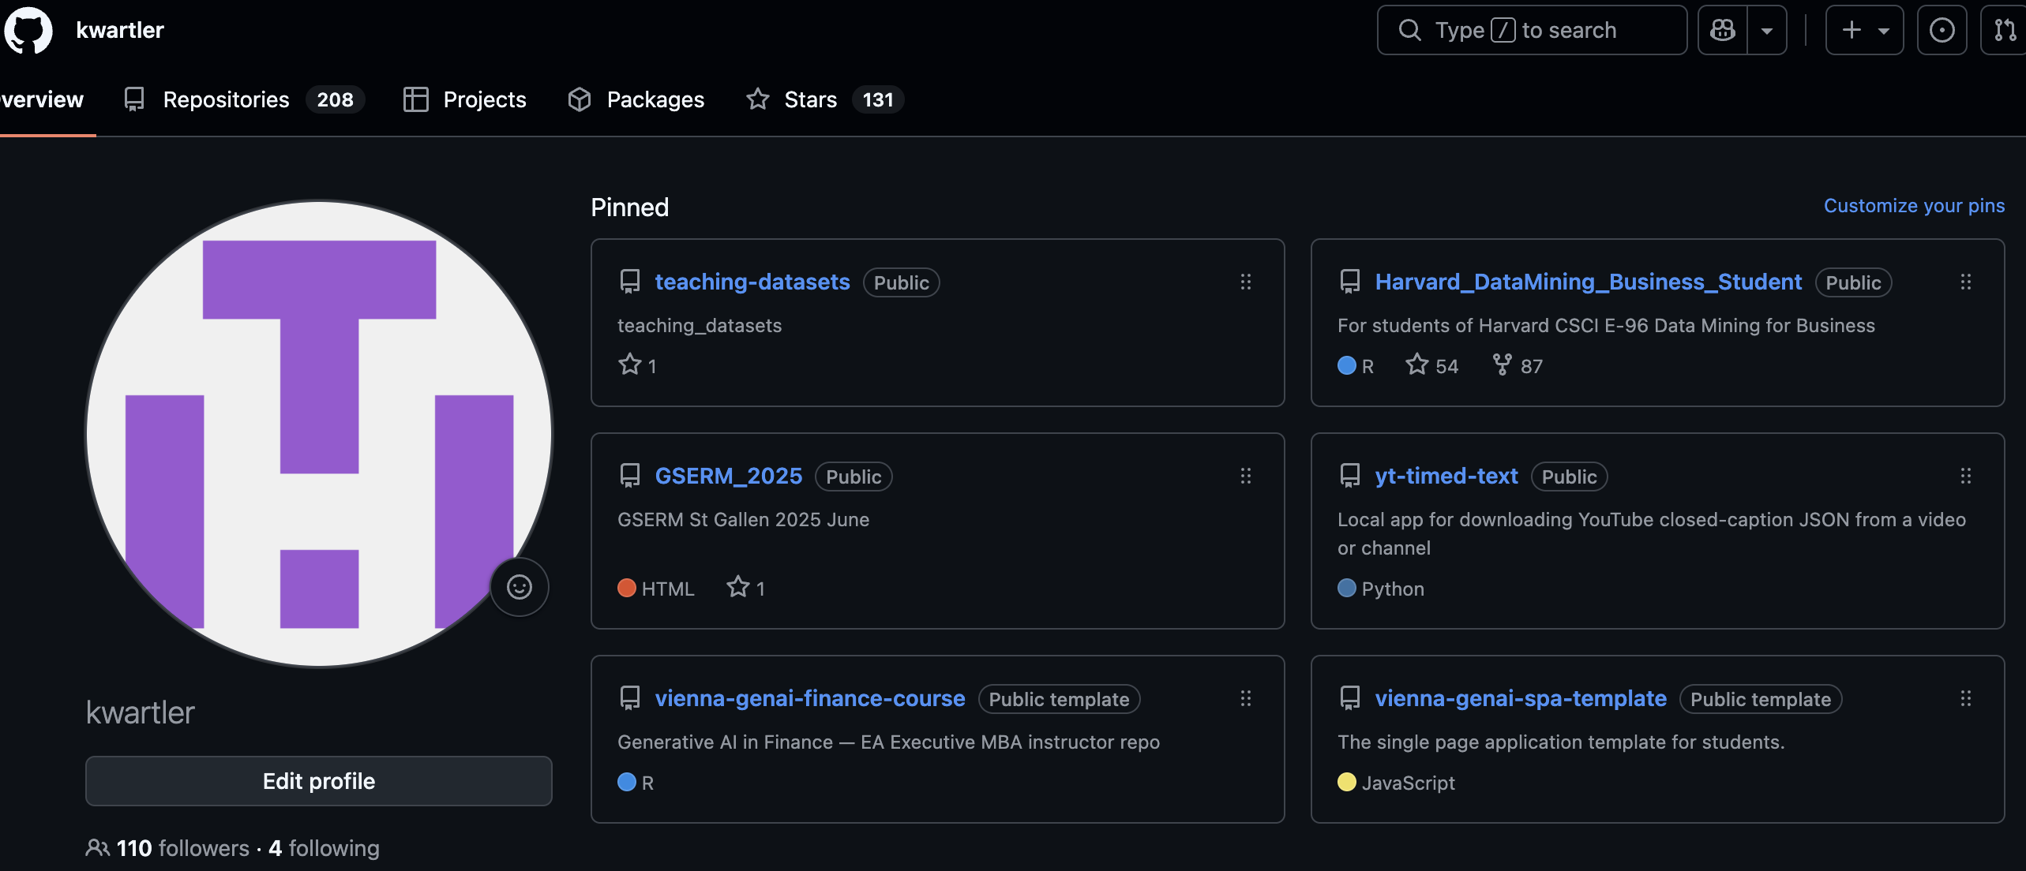
https://github.com/kwartler/
Click on the Vienna-genai-spa-template repository
© 2026 Ted Kwartler
1

Slide 2
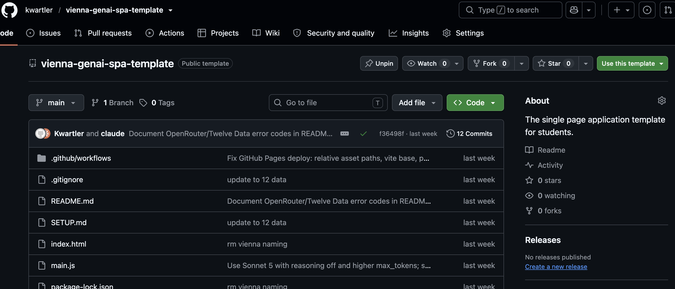
The single page application has been scaffolded for you.
Click “Use this template” then “Create a new repository”
The scaffolded application is live here:
https://kwartler.github.io/vienna-genai-spa-template/
2

Slide 3
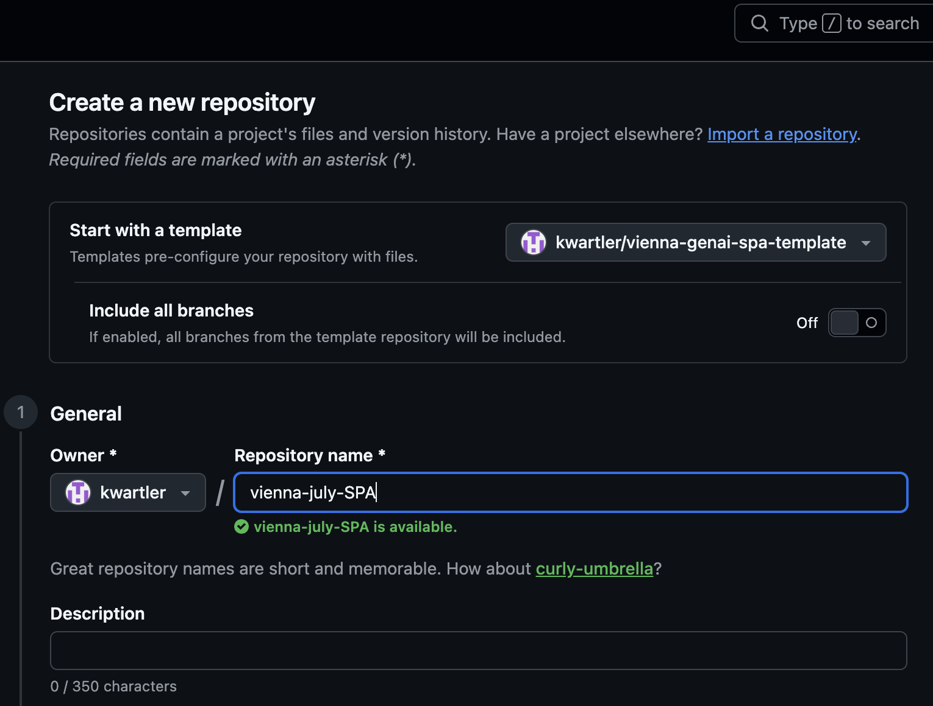
Name your template & add a description
© 2026 Ted Kwartler
3

Slide 4
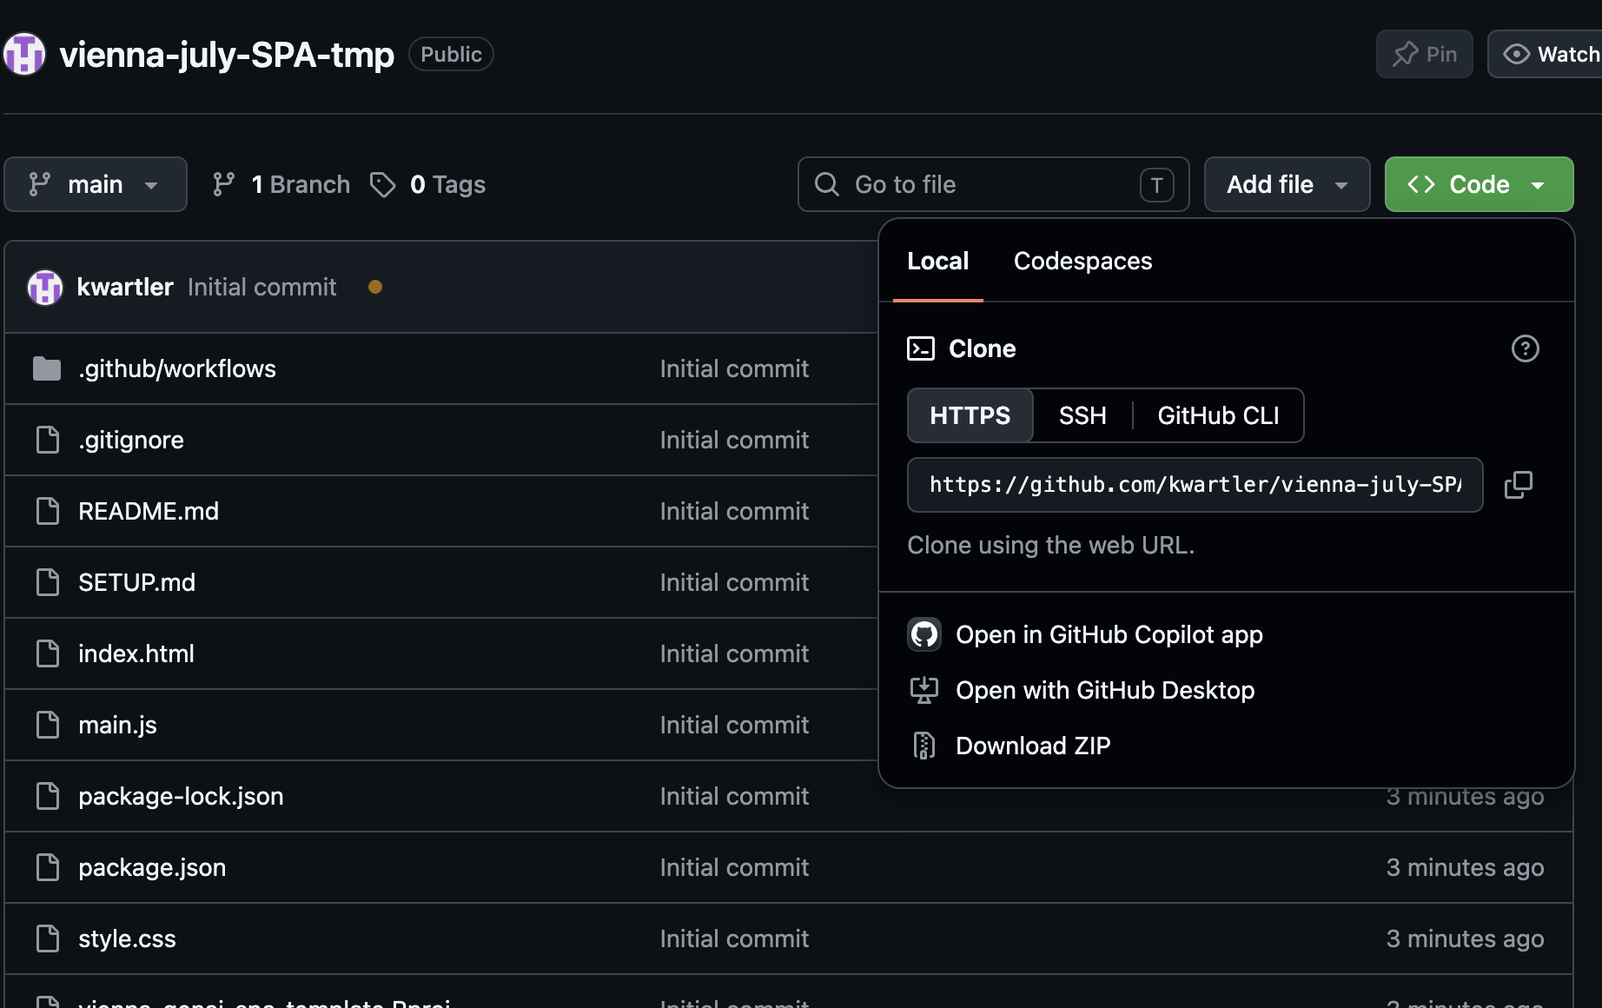
Now you have your own SPA template. Clone it for your first working application.
We clone this so we have a clean template you can use over and over.
© 2026 Ted Kwartler
4

Slide 5
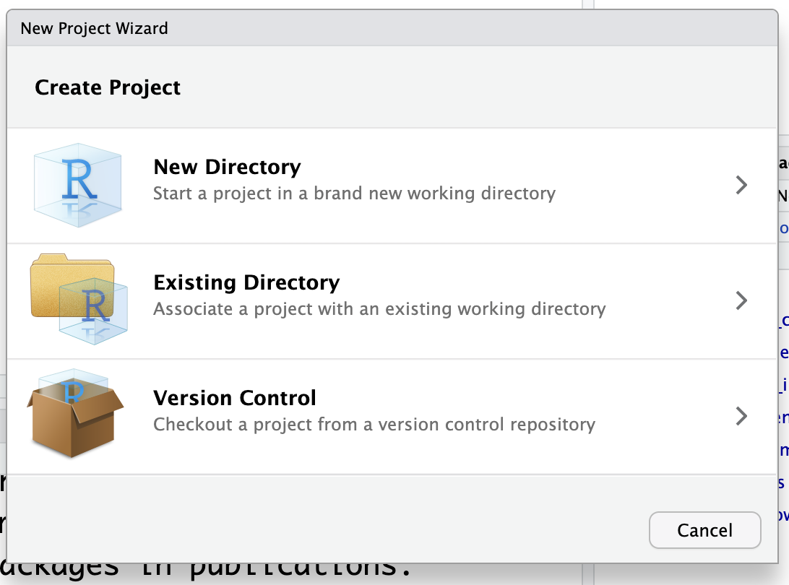
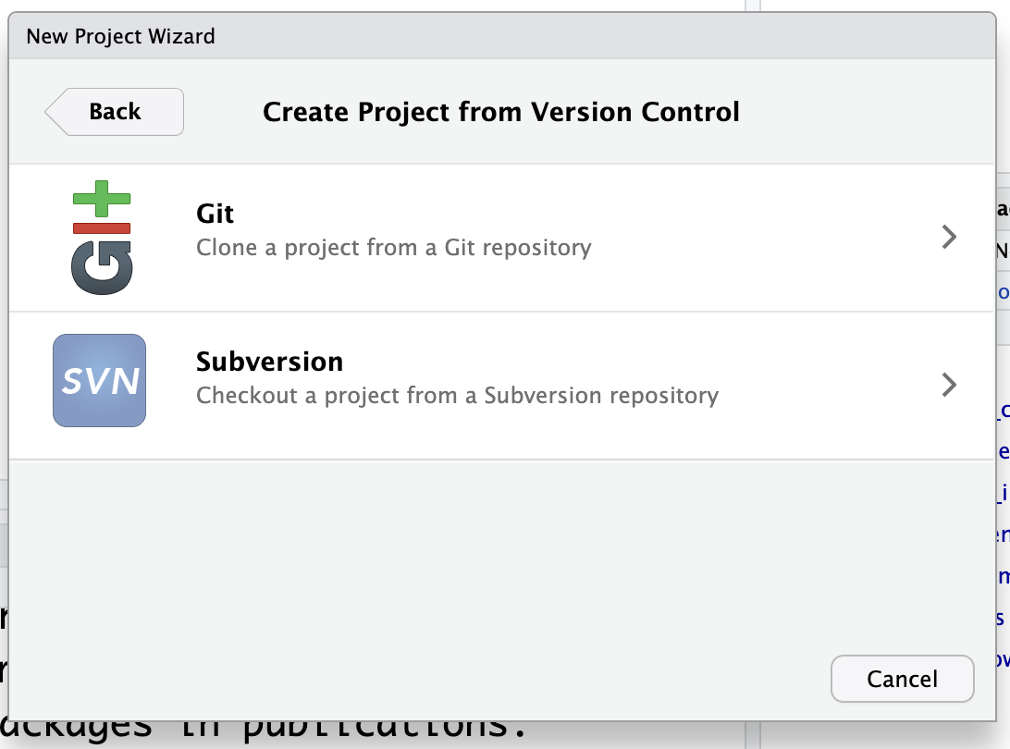
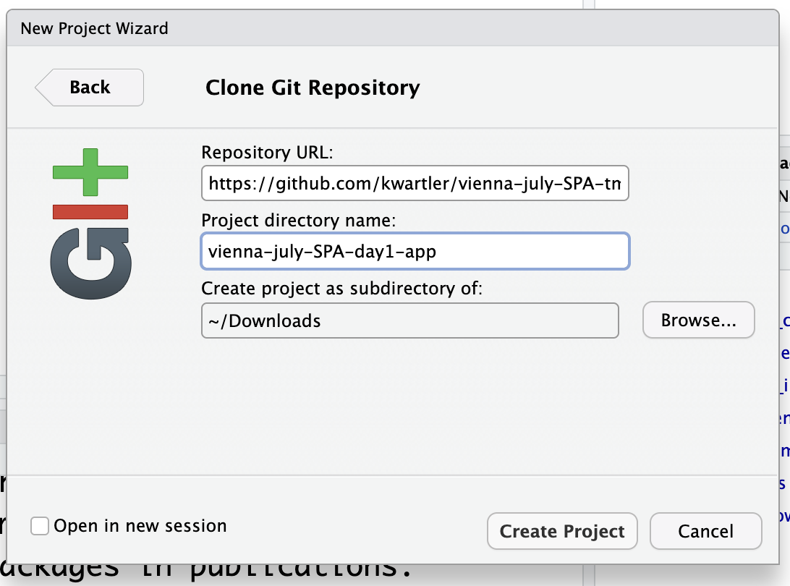
Many ways to clone, but R studio may be easiest for newbies.
Enter the URL from your template. Then create an application folder name & know where you saved it.
© 2026 Ted Kwartler
5

Slide 6
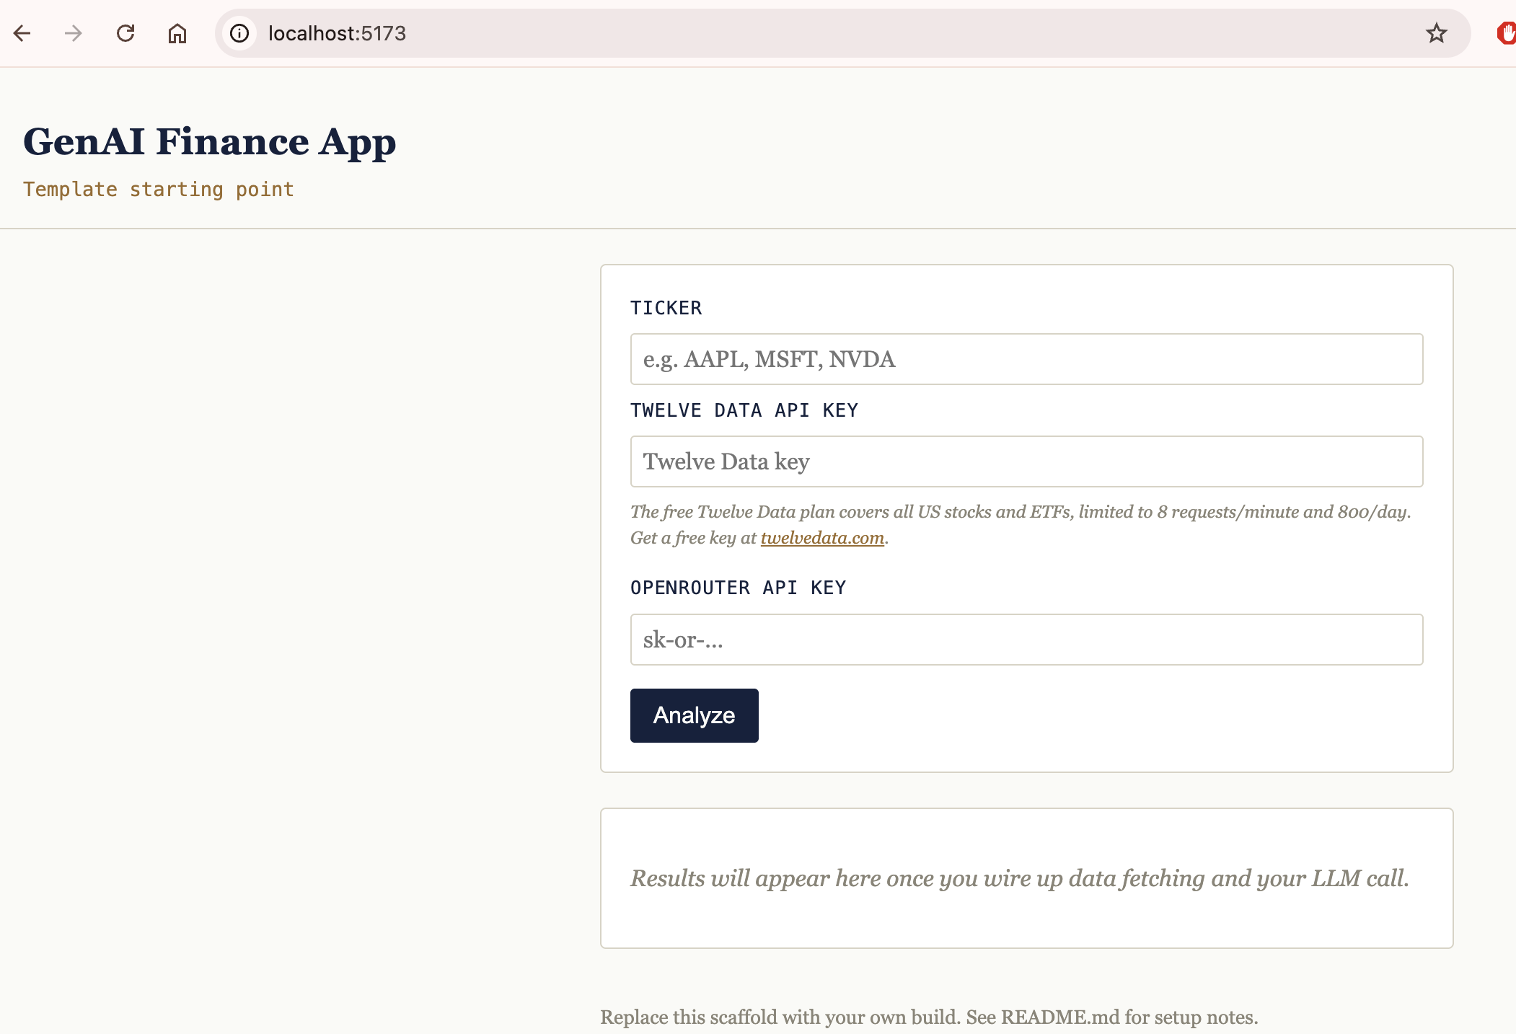
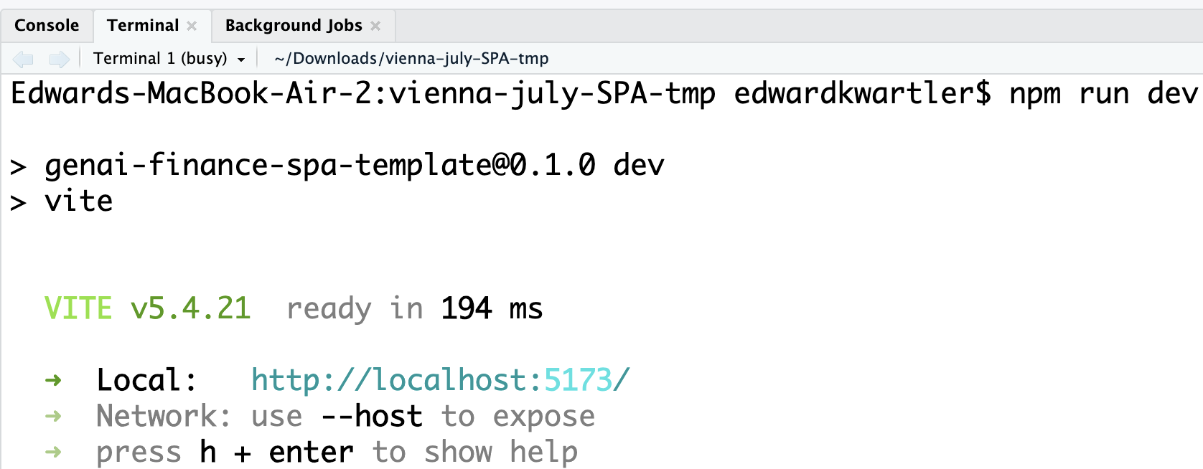
Back on github.com you can now see your new specific application codebase locally.
You could use another vibe coding application like cursor or claude to change your code base. But we will be showing AI studio since it is free, and we want everyone to have access immediately.
© 2026 Ted Kwartler
6

Slide 7
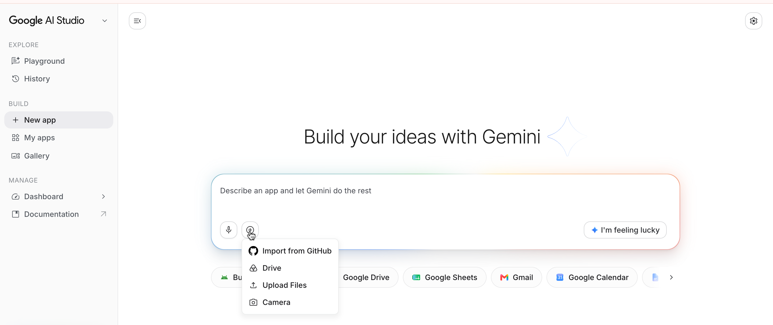
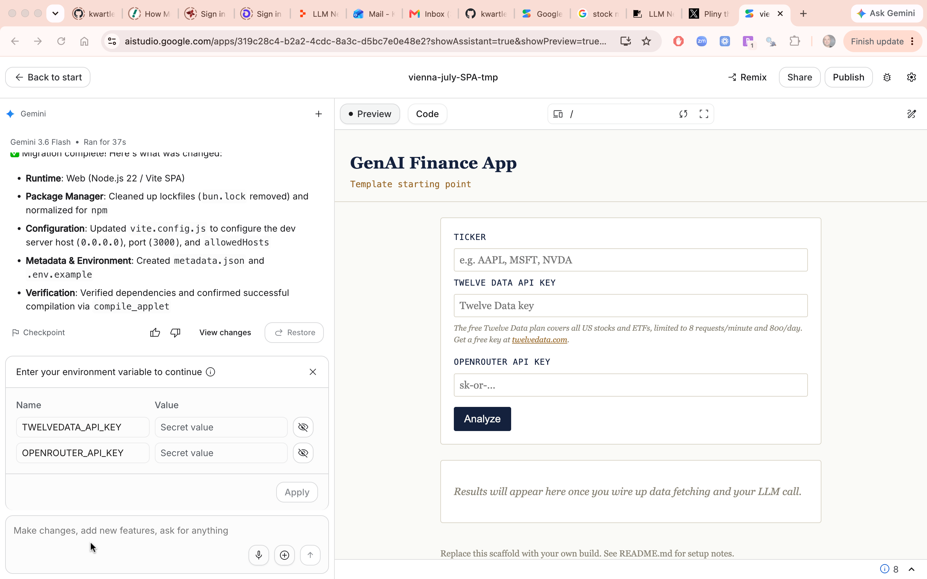
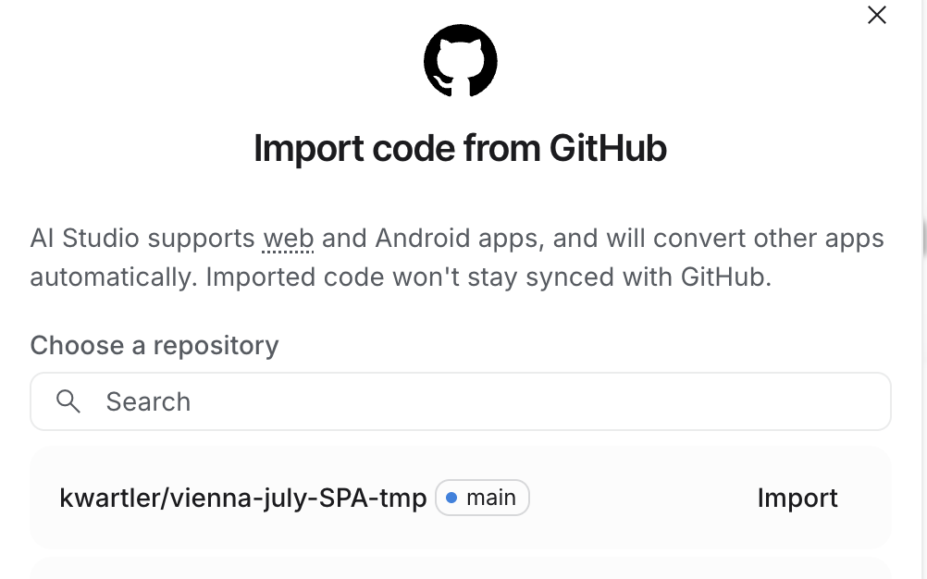
Click “+” to import from Github…then wait a moment.
We can describe what we want to change here.
Our application is a webform where users input API keys. So we do not need to store them in our AI Studio Environment so we can test the real user experience.
7

Slide 8
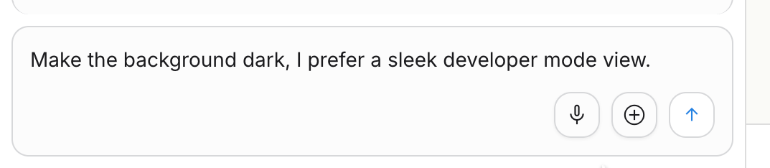
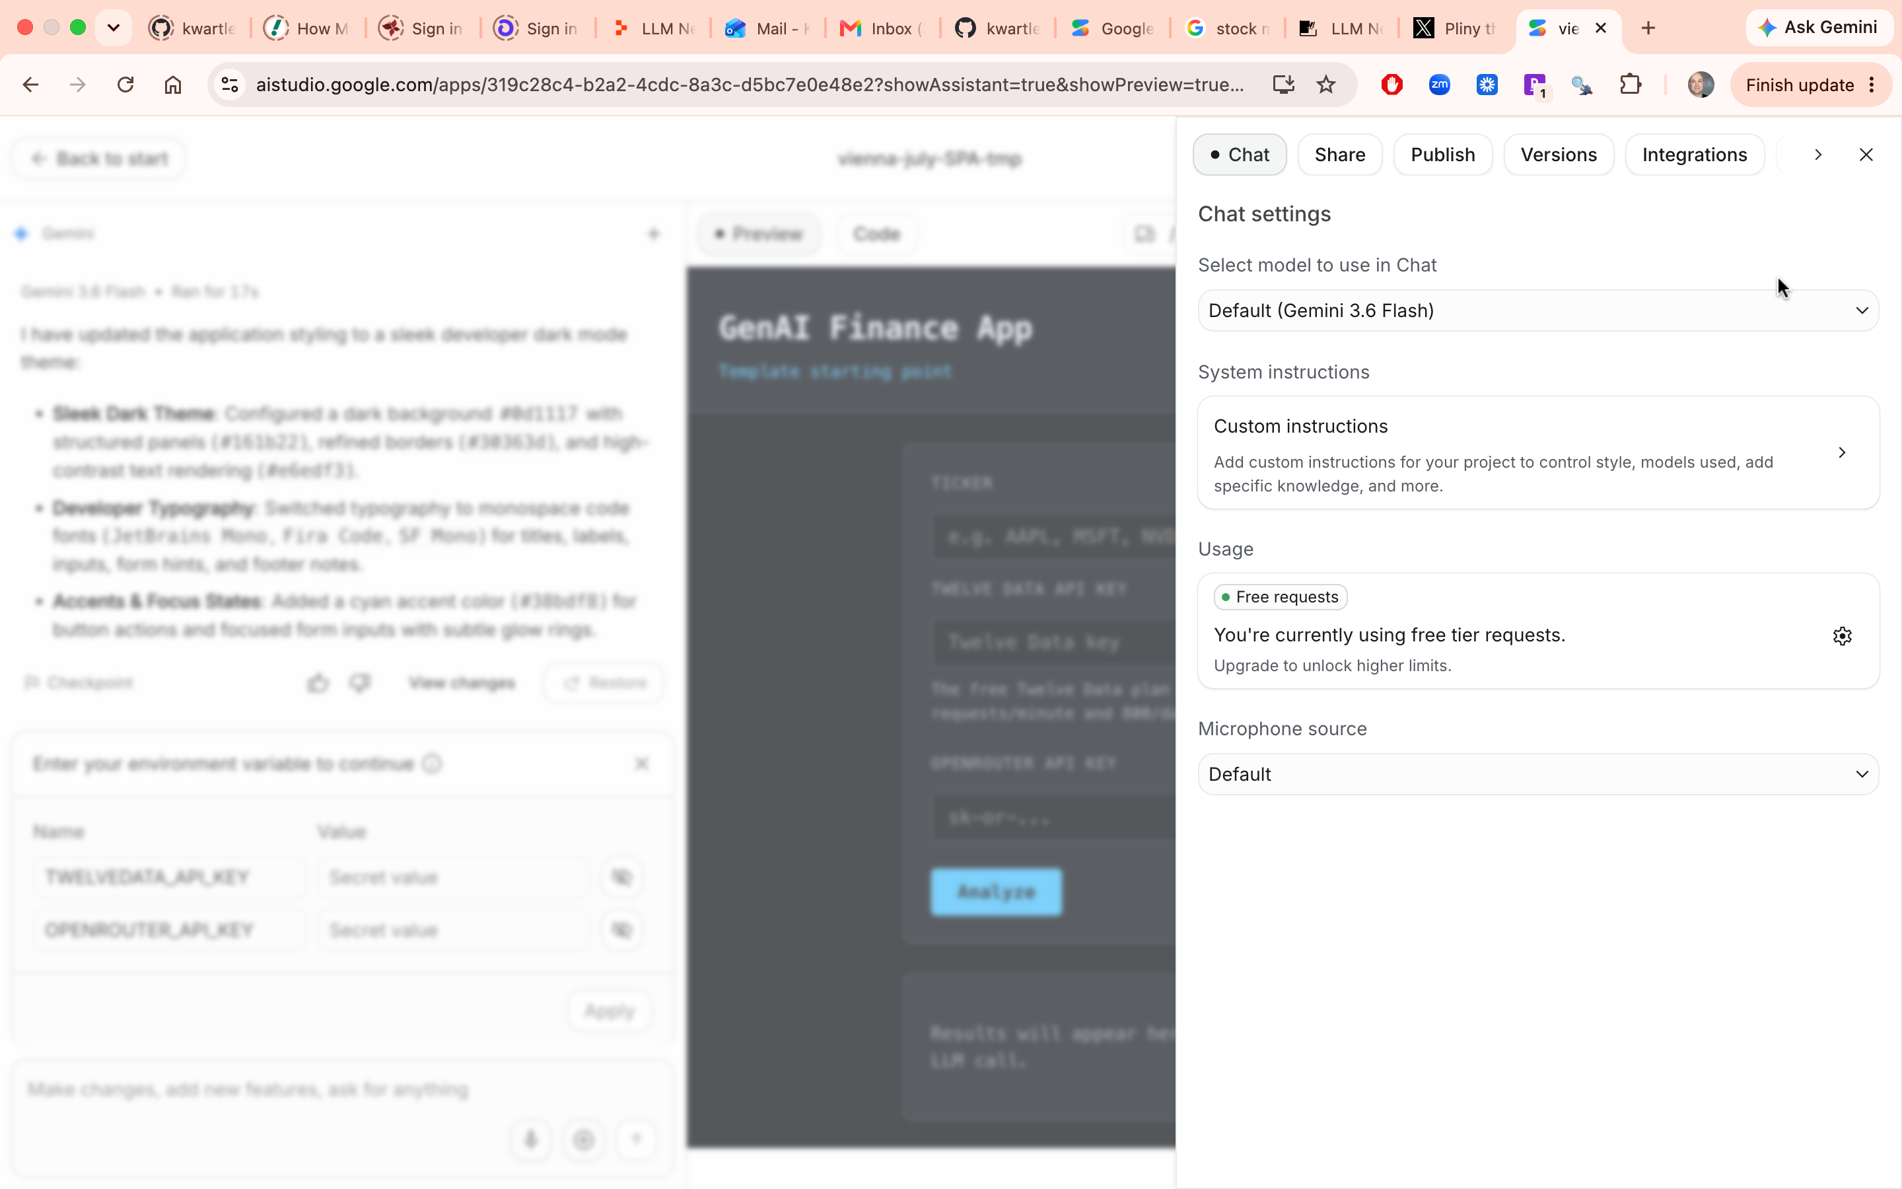
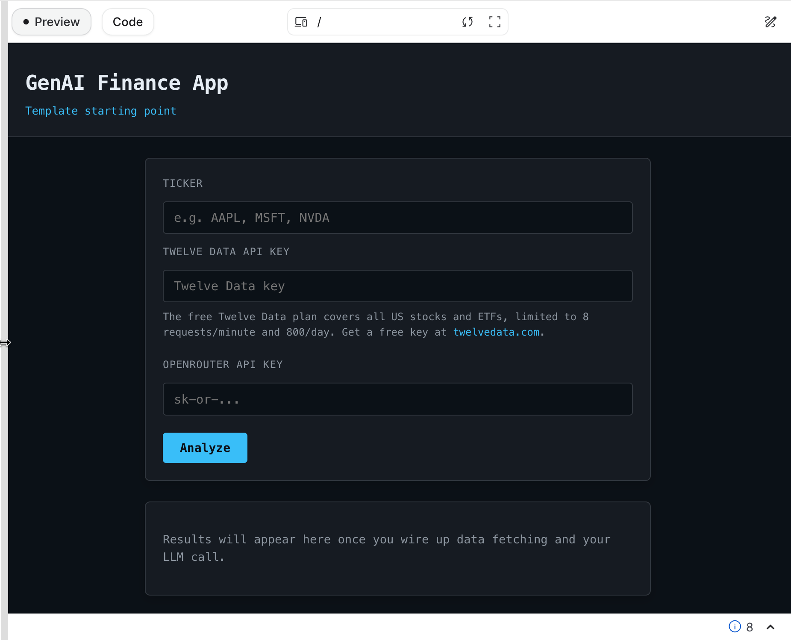
Let’s vibe code our first change! These changes are ONLY inside AI Studio for now.
© 2026 Ted Kwartler
8

Slide 9
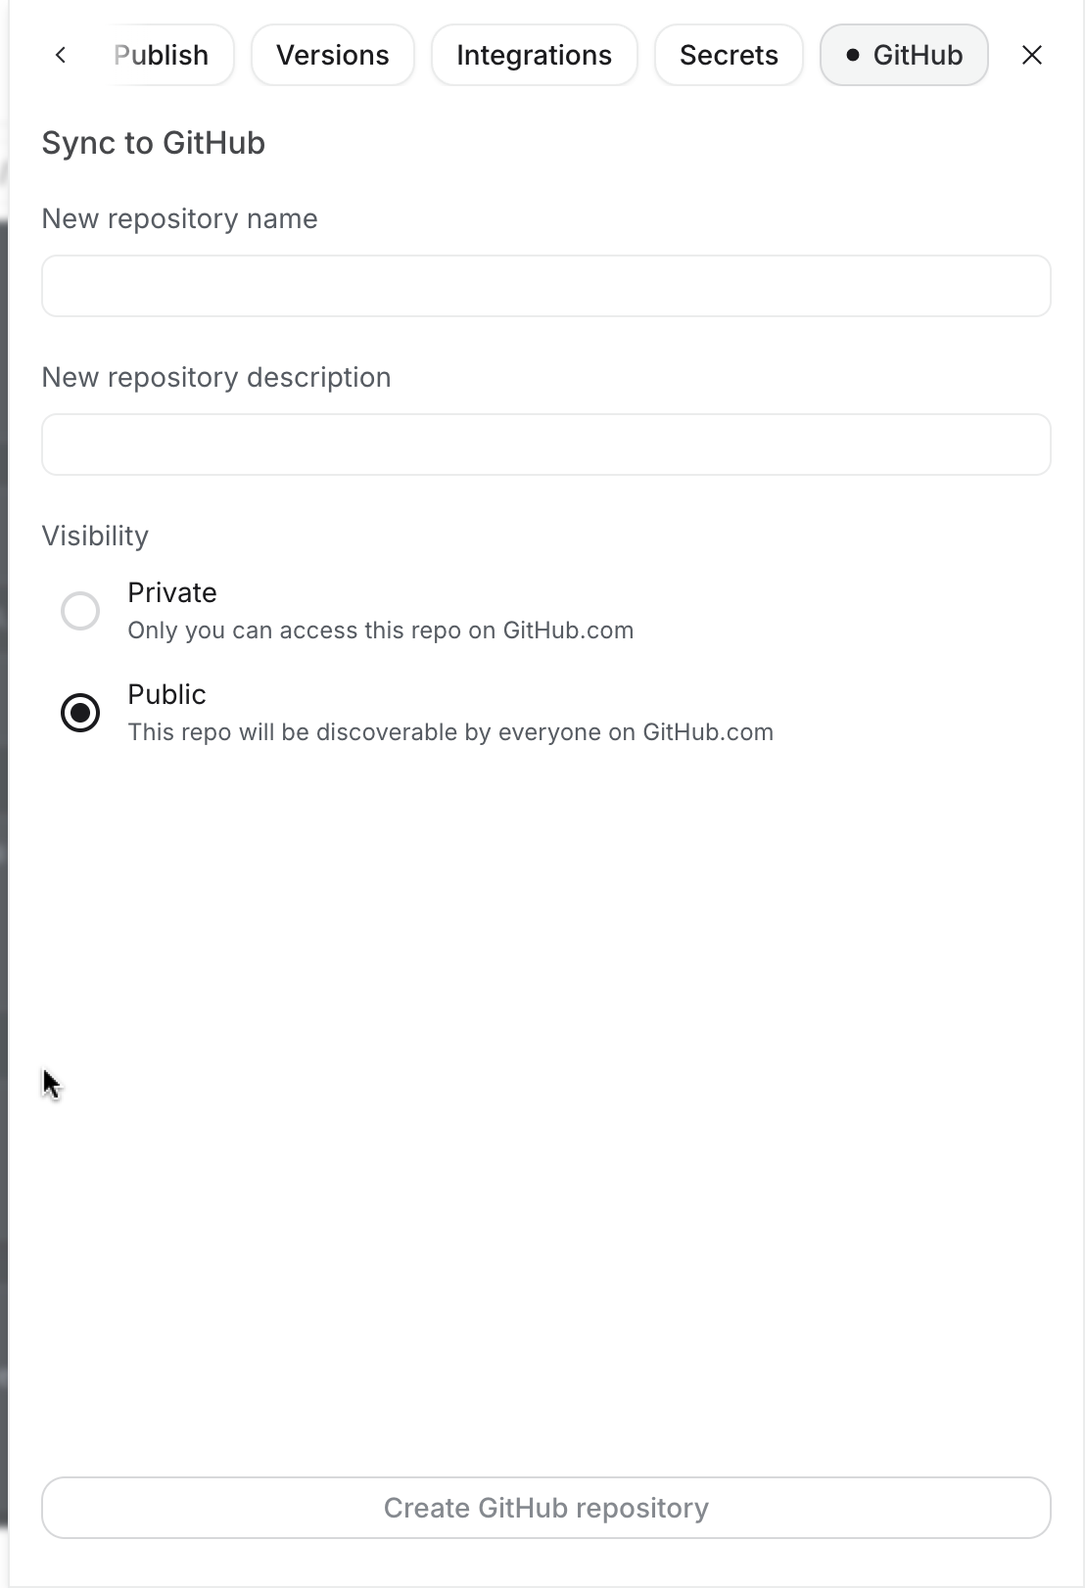
Time to push our new changes to a new repository.
1. Add the rep name
2. Add a short description
3. Mark it as Public 4. Click Create Github repository
2. Click Stage and commit all changes
© 2026 Ted Kwartler
9

Slide 10
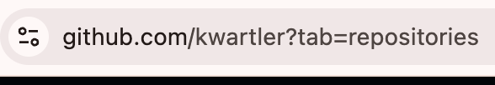
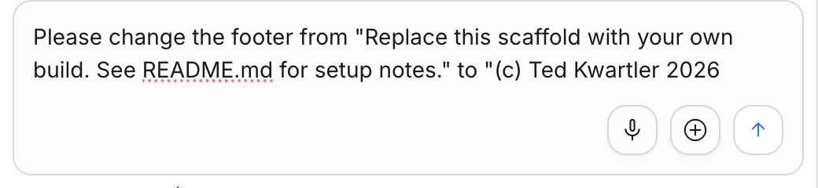

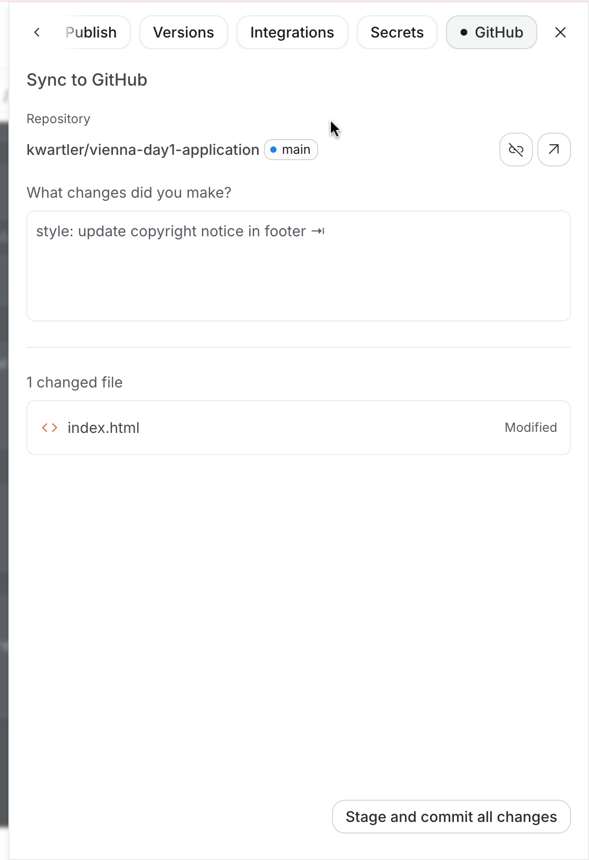
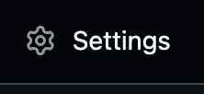
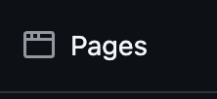
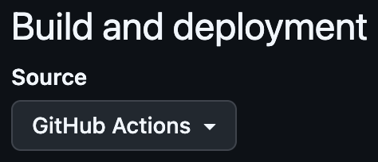
Find your new edited repository on github.com
Make a small additional change to the app.
1
2
Stage & Commit your changes back to github.
Remember it’s the “gear” then scroll to the right.
Back on your github repo, “settings”, then “pages”. Refresh that page to see the new deployed application!
3
https://github.com/kwartler/vienna-day1-application/settings/pages
4
5
© 2026 Ted Kwartler
10

Slide 11
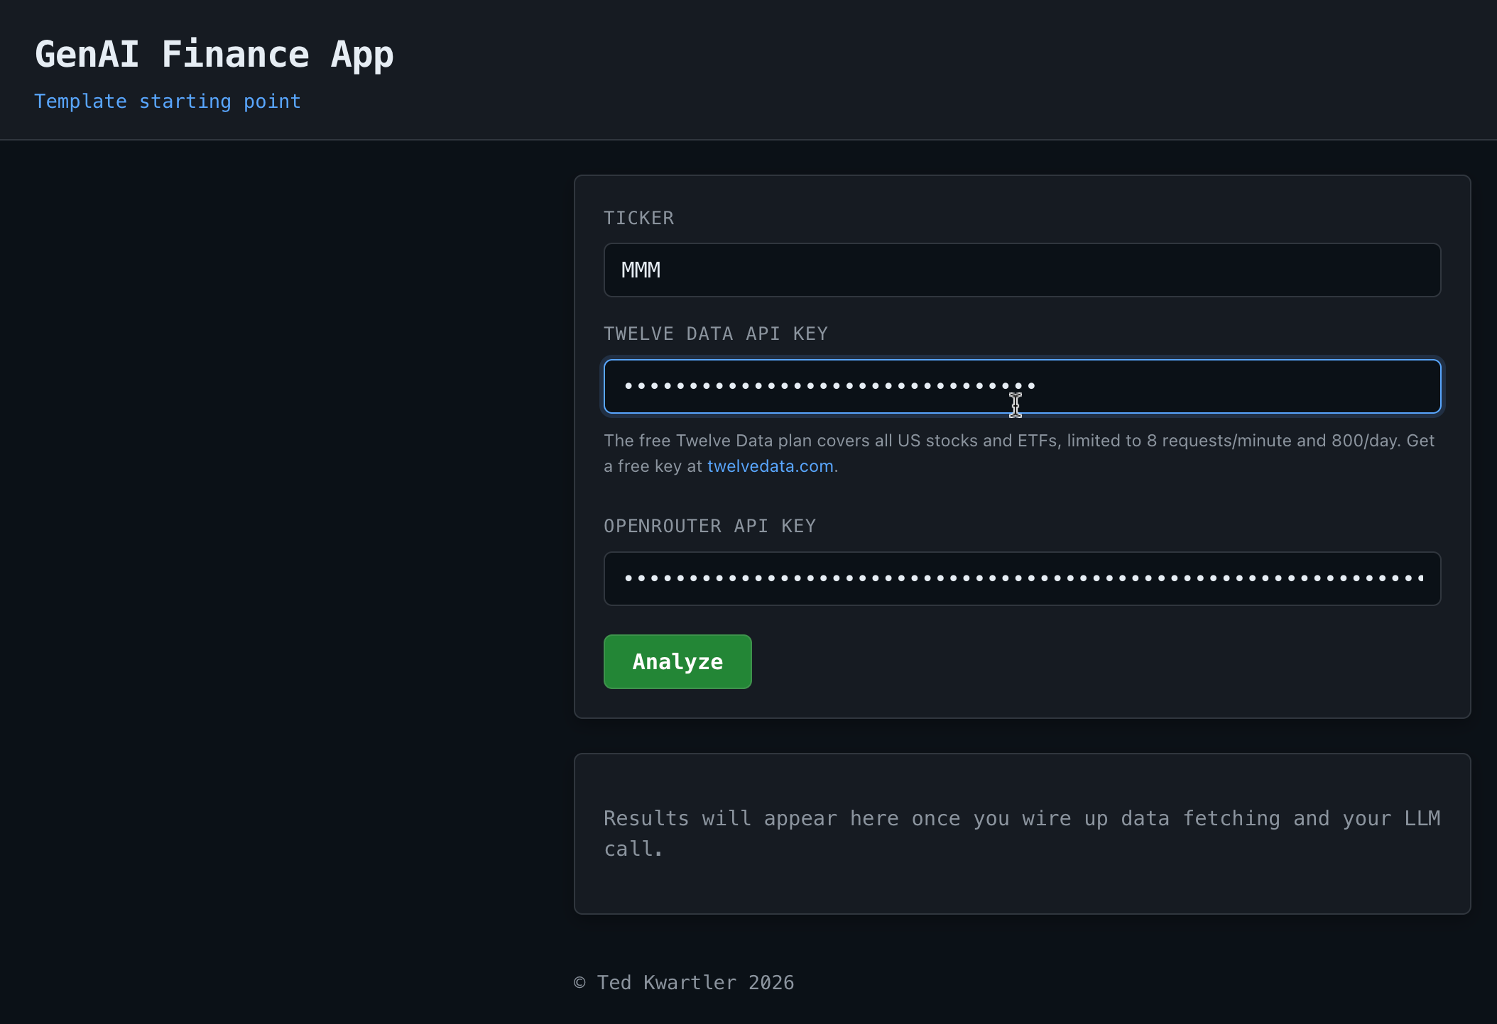
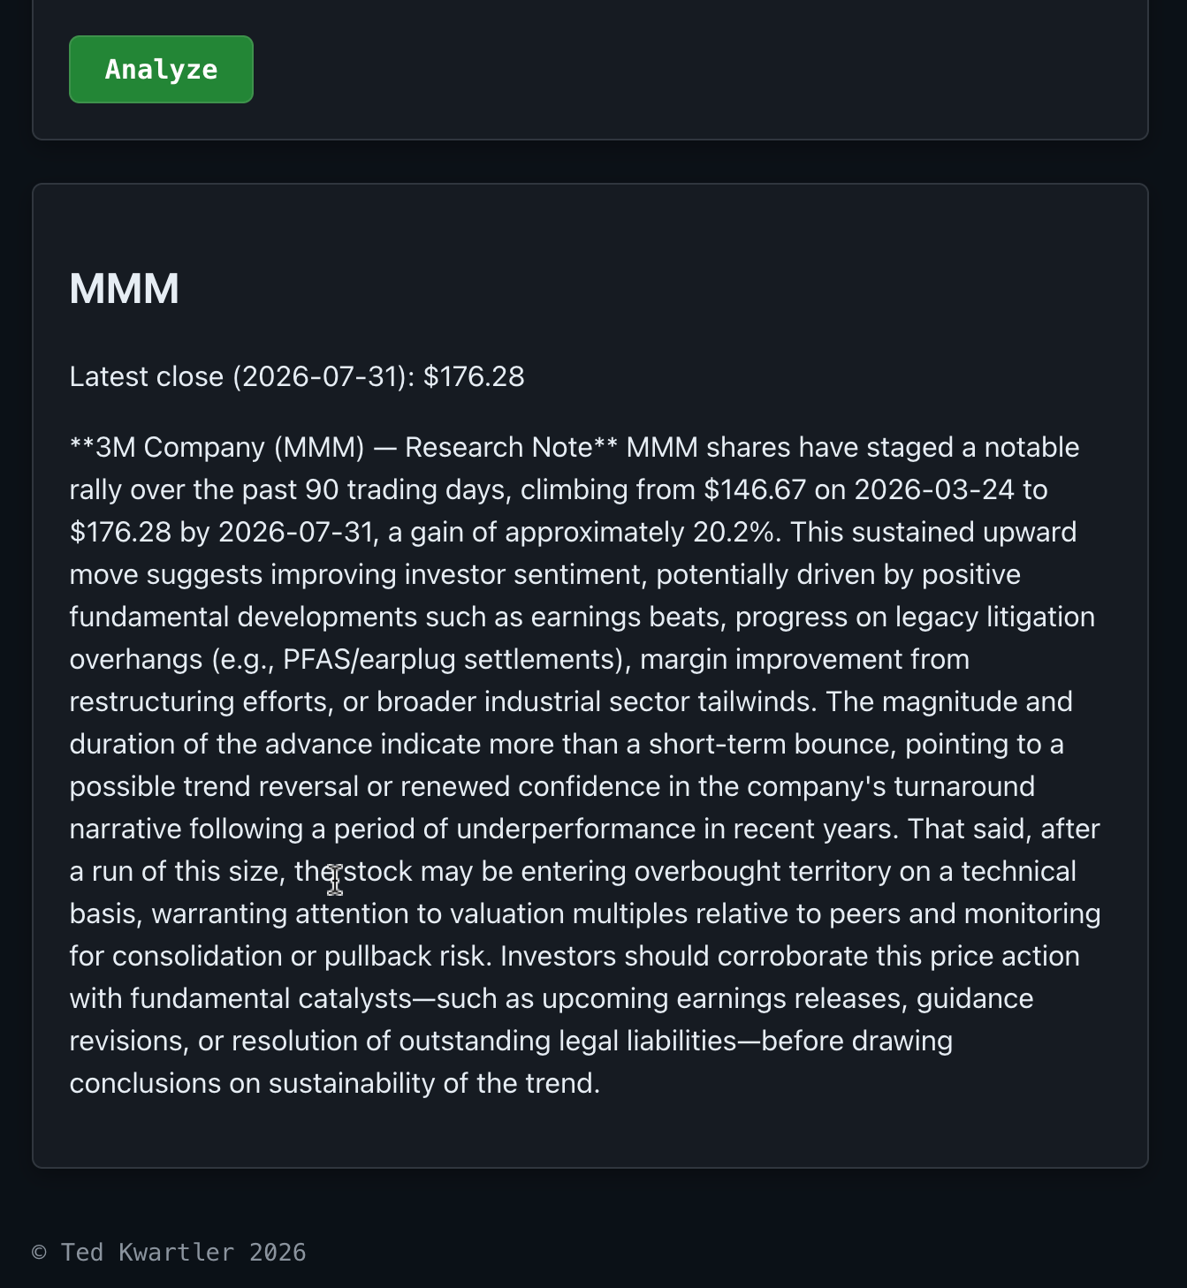
Test your application, make sure we didn’t break anything (yet)!
© 2026 Ted Kwartler
11

Slide 12
Strict JSON Output
Goal: the model returns parseable JSON every time, with no markdown fences or prose around it
Request: response_format = { type: "json_schema", strict: true }
Schema: { explanation, research_note, risks[3] }, additionalProperties: false
Routing: provider.require_parameters = true, so OpenRouter only picks endpoints that enforce the schema
Model matters: Claude Sonnet 5 supports strict structured outputs; the older sonnet-4-6 did not
Defense in depth: schema enforcement first, then a "{" prefill retry, then a fence-stripping JSON parse
Payoff: the research note and its three risk factors render reliably in the UI, no guesswork
© 2026 Ted Kwartler
12

Slide 13
Data Flow
Charts
candlestick, MACD, RSI CALCULATED IN JAVASCRIPT
User inputs
ticker, MACD/RSI Inputs & API keys
Twelve Data
daily OHLC, 120 bars
Indicators
(JS Calculated)
MACD, RSI, EMA
Research note
OpenRouter, Sonnet 5, strict JSON
All in the browser: keys stay in the tab, indicators computed client-side, one Twelve Data call feeds both the charts and the model.
© 2026 Ted Kwartler
13

Slide 14
Signal Explainer: Component Checklist
✓ Inputs form: ticker, MACD fast/slow, RSI period, Twelve Data key, OpenRouter key
✓ Price data: Twelve Data daily OHLC (120 bars), fetched directly in-browser via CORS
✓ Indicators in JavaScript: EMA, MACD (fast / slow / 9 signal), RSI (14)
✓ Charts (Chart.js. echarts): candlestick from OHLC, MACD plot, RSI plot with 70 / 30 bands
✓ Linked zoom: dual-handle range slider drives all three charts together, plus Reset
✓ Clean re-runs: charts, slider, and note all cleared on each Analyze (no frozen state)
✓ AI research note: OpenRouter call to Claude Sonnet 5
✓ Strict JSON output: schema-enforced response, safe to parse and render
✓ Security and deploy: keys entered at runtime, never committed; Vite build to GitHub Pages
© 2026 Ted Kwartler
14

