Slide 1
Generative AI in Finance
Day 2, Data Science Masters Track
Portfolio optimization, rolling risk metrics, and a live investment thesis app
© 2026 Ted Kwartler

Slide 2
Session 1
Portfolio Optimization in R
From raw prices to two optimized portfolios, then a plain English read
© 2026 Ted Kwartler

Slide 3




SCRIPTS A TO D
The session as one pipeline
A Prepare
→
B Min variance
→
C Max Sharpe
→
D Compare
Prices to returns, five stocks plus SPY
The calmest mix of holdings
Best return per unit of risk
Benchmark, then export for the LLM
Course principle throughout: R does the math examples, then SPA uses javascript to calculate and the LLM only interprets.
© 2026 Ted Kwartler
3

Slide 4



DATA PREPARATION
Script A: from prices to returns
The basket AAPL, JPM, JNJ, PG, XOM. Five sectors, so diversification has something real to work with.
Prices become returns
SPY benchmark Fetched as the market reference for rolling beta in Hour 2, kept out of the optimization.
Returns are comparable across stocks and are exactly what the optimizer needs.
Simple returns, saved once Weights times returns equals portfolio return. A saves clean data so nothing re-fetches.
Discrete Returns
Formula: (Today's Price - Yesterday's Price) / Yesterday's Price
Example: Going from $100 to $105 is a 5% simple return.
*Another way to calculate is “log” returns which is often used outside of portfolio optimization log(105/100) = .0488 or 4.88%
© 2026 Ted Kwartler
4

Slide 5
LIVE IN RSTUDIO
Script A: run it
LIVE CODE STEP THROUGH
> Fetch from Yahoo, inspect one raw ticker object, extract adjusted close.
> Run the missing data check, build the returns matrix, preview the correlation matrix.
> Point out the saved .rds files that every downstream script reads.
© 2026 Ted Kwartler
5

Slide 6




THE CALMEST PORTFOLIO
Script B: minimum variance
The goal
Covariance is key
The calmest portfolio, not the highest return. Variance is our stand in for risk.
The single most important input. Correlation between holdings matters more than any one stock's own risk.
Two rules
Solved with quadprog
Weights sum to 1, and no short selling (every weight at or above zero).
We hand the solver the covariance matrix and the two constraints.
© 2026 Ted Kwartler
6

Slide 7
PORTFOLIO RISK · DAILY TO ANNUAL
Portfolio Volatility: From Daily Variance to Annual Risk
Three moves turn a covariance matrix into one comparable, annualized volatility number.
annualized volatility = √( w′ Σ w ) × √252
1 Collapse the matrix
2 Take the square root
3 Scale to a year
t(weights) %*% cov_daily %*% weights
sqrt( ... )
* sqrt(252)
Weights times the covariance matrix Σ and back turns the whole multi-asset table into one number: the portfolio's daily variance.
Variance is in squared units, hard to read. The square root converts it back to a daily standard deviation, which is daily volatility.
Markets trade about 252 days a year. Volatility grows with the square root of time (the random-walk rule), so multiply by √252 to annualize.
daily variance → daily volatility → annualized volatility
© 2026 Ted Kwartler
7

Slide 8
MARKOWITZ MEAN-VARIANCE OPTIMIZATION
Minimizing Portfolio Risk as a Quadratic Program
Find the mix of asset weights that gives the lowest possible variance, then hand that risk formula to a math solver that only speaks matrices.
minimize ½ w′ Σ w = total portfolio variance (the number to make as small as possible)
The math in plain English
Handing it to R’s quadprog solver
w the weights: what percent of your money goes into each asset
w′ the transpose of w, lined up for matrix multiplication
Σ the covariance matrix: how every asset moves relative to every other
w′ Σ w the total portfolio variance the solver drives down
Dmat <- cov_matrix
the quadratic matrix is Σ, your risk-and-relationship table
dvec <- rep(0, n_assets)
the linear vector is all zeros, one per asset
Zeros because this step minimizes risk only, with no expected-return term yet
© 2026 Ted Kwartler
8

Slide 9
LIVE IN RSTUDIO
Script B: run it
LIVE CODE STEP THROUGH
> Build the covariance matrix, set up the quadprog inputs, solve.
> Read out the weights, run the sanity check that they sum to 1.
> Compare portfolio volatility to each stock alone: the diversification payoff.
© 2026 Ted Kwartler
9

Slide 10
RISK-ADJUSTED RETURN
The Sharpe Ratio: Return per Unit of Risk
One number that says how much reward a portfolio earned for the amount of risk it took, so you can compare very different portfolios fairly.
Sharpe ratio = (Rp - Rf) / σp = excess return ÷ volatility
The pieces in plain English
Why it matters
Rp the portfolio's return, what you actually earned
Rf the risk-free rate, what a no-risk T-bill would pay
Rp - Rf excess return: the reward for taking any risk at all
σp volatility (standard deviation): how bumpy the ride was
• Higher Sharpe means more return for each unit of risk taken.
• It puts risky and safe portfolios on the same level playing field.
• Maximizing it seeks the best return-for-risk trade-off, not just the biggest raw return.
• A negative Sharpe means you would have done better holding the risk-free asset.
© 2026 Ted Kwartler
10

Slide 11
PORTFOLIOANALYTICS · MAX SHARPE VIA ROI
Building the Max-Sharpe Portfolio, Step by Step
What the R script does, without the matrix math: describe the goal, let the solver find the mix, then check its work.
Goal: the maximum-Sharpe portfolio (the mix with the most return for the risk it takes)
Set up the problem
Solve, verify, report
1. Pick a risk-free rate.
3.5% a year, divided by 252 trading days for a daily figure. The no-risk benchmark (a 3-month T-bill).
2. Switch to excess returns.
Subtract that daily rate from every return. The max-Sharpe shortcut assumes a zero rate, so this bakes in your 3.5%.
3. Refuse pointless cases.
If not one asset beats the risk-free rate, stop: a best-Sharpe mix would not be meaningful.
4. Describe the goal, not the math.
Tell the wrapper the rules: deploy all capital (weights sum to 1), no short selling (weights not negative), and chase return and low risk together, which is the Sharpe trade-off.
5. Solve and read the weights.
The optimizer returns how much to hold in each asset; round the percentages.
6. Never trust it blindly.
Check the weights add to 100% and none came back negative before using them.
7. Report the scorecard.
On the real (not excess) returns, show the annualized return, the volatility, and the Sharpe ratio.
© 2026 Ted Kwartler
11

Slide 12



RETURN PER UNIT OF RISK
Script C: maximum Sharpe
The tangency portfolio
PortfolioAnalytics wrapper
Best return per unit of risk, not lowest risk. The contrast with B.
Describe the portfolio, let it solve. The quadprog reformulation is optional depth.
Why not maximize directly
Risk free rate: 3.5%
Sharpe is a ratio of two functions of the weights, which the solver cannot take head on.
A single input. Real value: the 3 month T bill (FRED series DTB3).
© 2026 Ted Kwartler
12

Slide 13
LIVE IN RSTUDIO
Script C: run it
LIVE CODE STEP THROUGH
> Set the rate, build the portfolio spec, run optimize.portfolio.
> Read out weights and the annualized return, volatility, and Sharpe.
> Note the concentration into a few names, which sets up the comparison in D.
⏱ about 8 minutes
© 2026 Ted Kwartler
13

Slide 14




THREE PORTFOLIOS, ONE READ
Script D: compare and export
Three way comparison
What to expect
Equal weight (1/N) as an honest benchmark alongside minimum variance and maximum Sharpe.
Min variance wins volatility, max Sharpe wins Sharpe, equal weight lands in the middle.
JSON export
Interpret, not recalculate
R produced the numbers. The export is the interpretation step for an LLM.
The chatbot prompt says it plainly: read the numbers, do not recompute them.
© 2026 Ted Kwartler
14

Slide 15
LIVE IN RSTUDIO
Script D: run it
LIVE CODE STEP THROUGH
> Run the comparison table and the side by side weights barplot.
> Write portfolio_summary.json, open it, walk the structure.
> Live: paste the JSON into a chatbot and read the plain English response aloud.
© 2026 Ted Kwartler
15

Slide 16




THE ACCEPTED STAND IN [easier to vibe code but you can do more later]
Inverse volatility weighting
What it is Weight each survivor in proportion to 1 over its volatility, then normalize so weights sum to 1.
Weight by 1 over volatility
Why not minimum variance here True min variance needs a quadratic program (matrix inverse plus solver), heavy in a browser (but possible). As you learn more intensive optimization you will need to build a proper back end.
1 / σ
calmer stocks get more capital, then normalize
Why it is acceptable A real, widely used heuristic. Same lean toward lower risk, no solver, all in plain JavaScript.
© 2026 Ted Kwartler
16

Slide 17
Notes:
Missing worked example slide!

Slide 18
LIVE IN RSTUDIO
Script D Part 2: run it
LIVE CODE STEP THROUGH
> Run the comparison table and the side by side weights barplot.
> Write portfolio_summary.json, open it, walk the structure.
> Live: paste the JSON into a chatbot and read the plain English response aloud.

Slide 19
WHY ANY OF THIS MATTERS
The human review surface
All three portfolios are drafts, built from two years of history. Before any of them touches real capital, a human reviews the weights, questions the inputs, and makes the call. The JSON export is exactly where that review happens.
45 min
is how long Knight Capital's automated logic ran without a human, before it cost them the firm.
© 2026 Ted Kwartler
19

Slide 20
Session 2
How Relationships Change Over Time
The optimizer used one average correlation. What did that single number hide?
© 2026 Ted Kwartler

Slide 21

SCRIPTS E AND F
The session as one pipeline
E Rolling correlation
→
F Rolling diagnostics
→
Export
Every pair, at two window lengths
Rolling Sharpe and rolling beta
The monitoring surface, for a person or an LLM
The same split as Session 1, and the bridge to the live SPA app
© 2026 Ted Kwartler
21

Slide 22


CO-MOVEMENT, OVER TIME
Script E: rolling correlation
Watch the stress point Correlations drift toward 1 in a sell-off, the failure mode a single average number cannot show.
The same idea, now moving
Two windows 30 day is reactive but noisy; 90 day is smooth but slow to reveal a real change. Compare both.
Correlation between holdings, the key input to Script B, now tracked through time instead of as one static number.
All pairs at once Five stocks make ten pairs. When the whole band rises together, diversification is weak.
© 2026 Ted Kwartler
22

Slide 23



TWO WINDOWS, TEN PAIRS
Script E: rolling correlation
30 day vs 90 day
Metrics start late
Short is reactive but noisy. Long is smooth but slow to reveal a real change.
A rolling window needs a full window of data before its first value. Expected, not a bug.
All pairs at once
The stress point
Five stocks make ten pairs. When the whole band rises together, diversification is weak.
Correlations drift toward 1 in stress, the failure mode a single number cannot show.
© 2026 Ted Kwartler
23

Slide 24
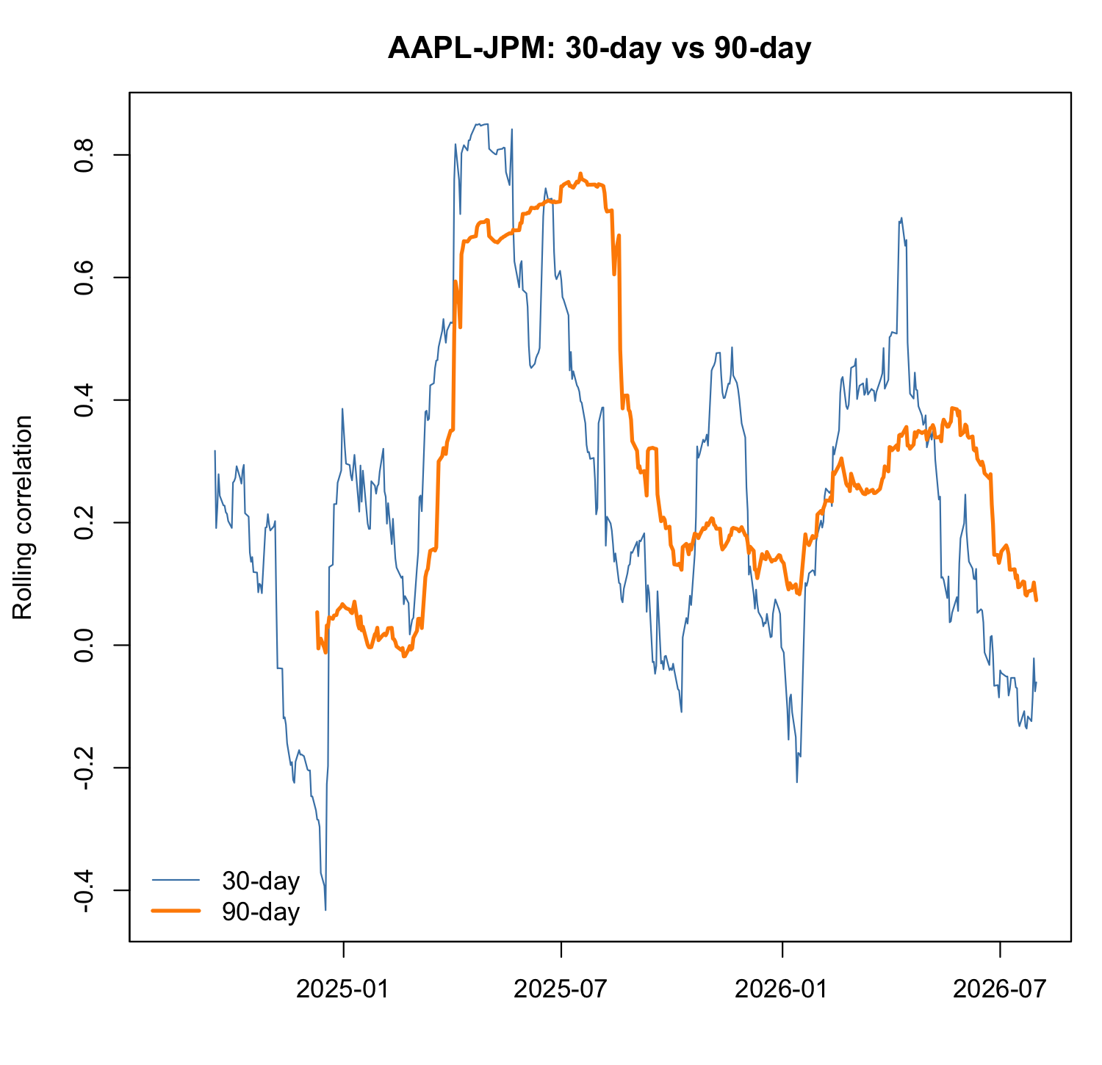
ONE PAIR, TWO WINDOWS
Reading a Rolling Correlation: AAPL vs JPM
How to read it
• Two lines, two speeds. The thin blue line is the 30-day correlation (fast and reactive, but noisy); the thick orange line is the 90-day (smooth, slower to turn).
• It is never one number. Over two years the pair swings from about
-0.2 to +0.85. A single average correlation would hide all of this.
• Watch the peaks. Around mid-2025 both lines climb together toward 0.8: AAPL and JPM move almost as one, so holding both adds little diversification just then.
• Blue warns, orange confirms. The blue line spikes early; the orange only shifts once a move persists, so it carries the calmer underlying story.
• Orange starts late. The 90-day line begins about three months after the blue: a 90-day window needs 90 days of data before its first value.
Neither window is right: watch the short one for early warnings, the long one to avoid overreacting to noise.
© 2026 Ted Kwartler
24

Slide 25
LIVE IN RSTUDIO
Script E: run it
LIVE CODE STEP THROUGH
> Build all ten pairs, compute both windows in the loop.
> Plot 1: all pairs at the short window, read the moving band.
> Plot 2: one pair at both windows, the reactive versus smooth tradeoff.
© 2026 Ted Kwartler
25

Slide 26
RETURN PER RISK, OVER TIME
Script F: rolling Sharpe
Watch for the dip A rolling Sharpe near zero means the portfolio stopped paying for the risk it carried.
The same idea, now moving still moving!
Built from parts A rolling mean, a rolling standard deviation, then annualized. Each piece stays visible.
The return per risk measure from Session 1, tracked through time instead of as one number.
Movement over a single figure We watch it change rather than trust one all in Sharpe number.
© 2026 Ted Kwartler
26

Slide 27
MARKET SENSITIVITY
Script F: rolling beta versus SPY
SPY stands in for the market An S&P 500 ETF used only as a reference series, never inside the optimization.
Beta = market sensitivity
Why it matters Your risk profile can drift even when your holdings do not change.
1.0
moves with the market · >1 more volatile · <1 calmer
How it is computed A small regression style function inside a moving window.
© 2026 Ted Kwartler
27

Slide 28
LIVE IN RSTUDIO
Script F: run it
LIVE CODE STEP THROUGH
> Build the equal weight portfolio return series.
> Compute rolling Sharpe from parts, then rolling beta with the small regression function.
> Plot both, read the story in each.
© 2026 Ted Kwartler
28

Slide 29

THE MONITORING SURFACE
Export and the live chatbot read
rolling_metrics.json
Live chatbot interpretation
Latest Sharpe, latest beta, latest pairwise correlations, in one readable file.
Paste the JSON and show the plain English response. A live demo, not just the prompt.
Could feed a dashboard
The surface Knight lacked
Think about the calculations and descriptions needed to create the JSON for your upcoming vibe-coded application.
Metrics exist so a person can see trouble & step in before it compounds. Don’t fully automate everything without careful understanding of the code’s actions.
© 2026 Ted Kwartler
29

Slide 30
FROM R TO THE BROWSER
Bridge to the app
R
SPA
→
Taught us the math and gave us a live fetchable abstraction.
Fetches its own live data and does the same calculations in JavaScript. Numbers computed, the model explains.
© 2026 Ted Kwartler
30

Slide 31
Session 3
From R to a Running App
The same analysis, now in the browser, fetching live
© 2026 Ted Kwartler

Slide 32
THE SPINE OF THE WHOLE BUILD
The investment thesis
RSI below overbought and a positive MACD represent quality individual stocks that can be optimized as a portfolio with inverse volatility weighting.
RSI < 70
MACD > 0
Optimization
not overbought
positive histogram
Pick a portfolio optimization technique
Every user story that follows traces back to this one sentence.
© 2026 Ted Kwartler
32

Slide 33


WHY THE APP IS TRUSTWORTHY
The rule for the build
Calculations
Language
RSI, MACD, and the weighting all run in JavaScript.
The LLM only writes the plain English research note.
Arithmetic from the code, language from the model. That is the whole trust argument.
© 2026 Ted Kwartler
33

Slide 34
WHAT STUDENTS NEED ACCESS TO
API tools for the build
API | Auth | Used for | Required?
Twelve Data | Your key | OHLCV feeding RSI, MACD, volatility | Yes, only data source
OpenRouter | Shared class key | Plain English research note | Yes, language only
Core build needs just Twelve Data plus the OpenRouter key you should already have.
© 2026 Ted Kwartler
34

Slide 35
THE REPO 2 STARTING POINT
Clone the template
Clone the SPA template repo (vienna-genai-spa-template) into a new personal repository.
1
This becomes Repo 2, the build target for this session.
2
Confirm npm run dev serves the app locally before building.
3
© 2026 Ted Kwartler
35

Slide 36
INSTRUCTOR DEMO, SETS THE GOAL
Target application
Enter several tickers and the indicator settings.
1
See per ticker RSI and MACD calculated in the browser.
2
Watch the app keep only the thesis qualifying names.
3
Show inverse volatility weights and an LLM interpretation.
4
© 2026 Ted Kwartler
36

Slide 37


1
Enter the candidate universe
USER STORY As an investor, I need to enter a set of candidate tickers so I can screen them against my thesis.
FUNCTIONAL REQUIREMENT Build a browser form that accepts a comma separated list of tickers plus indicator settings (RSI period, MACD fast/slow/signal) and an OpenRouter key field.
© 2026 Ted Kwartler
37

Slide 38
2
Get price history
USER STORY As an investor, I need recent price history for each ticker so I have something to calculate signals from.
FUNCTIONAL REQUIREMENT Fetch OHLCV per ticker from the Twelve Data
© 2026 Ted Kwartler
38

Slide 39
3
Calculate RSI and MACD
USER STORY As an investor, I need to calculate RSI to check for overbought conditions and MACD to confirm momentum.
FUNCTIONAL REQUIREMENT Build browser based RSI and MACD calculation from the ticker inputs. Render a per ticker signal summary.
Remember the numbers come from JavaScript, not the model.
© 2026 Ted Kwartler
39

Slide 40
4
Keep only the quality names
USER STORY As an investor, I need to keep only stocks that fit my thesis so the portfolio reflects the idea.
FUNCTIONAL REQUIREMENT Filter the candidate list to names that pass both conditions: RSI below 70 and MACD > 0. Make input the thresholds visible and adjustable.
© 2026 Ted Kwartler
40

Slide 41
5
Weight the survivors by risk
USER STORY As an investor, I need to weight the surviving stocks so calmer names carry more of the portfolio.
FUNCTIONAL REQUIREMENT Compute inverse volatility weights across the survivors, entirely in JavaScript, then normalize.
Callback: this is the accepted stand in for minimum variance.
© 2026 Ted Kwartler
41

Slide 42
6
Show the portfolio and explain it
USER STORY As an investor, I need a plain English read of the portfolio so I can explain it to an investment committee.
FUNCTIONAL REQUIREMENT Render the weights as a chart, then call OpenRouter to interpret the weights and the screening in plain English.
The model receives finished numbers and explains them, matching D and F.
© 2026 Ted Kwartler
42

Slide 43
SHIP REPO 2
Commit, push, and wrap
Commit and push Repo 2 to GitHub.
1
It’s the same pipeline done in R. Assuming you enabled settings>git pages and on github actions the app is now live and shareable.
2
The calculation and language split stays intact, and every feature traces back to the thesis.
3
© 2026 Ted Kwartler
43

Slide 44

Extra credit: macro risk overlay
USER STORY As an investor, I am worried the lagging indicators (RSI and MACD look backward) may miss near term risk to a selected stock.
FUNCTIONAL REQUIREMENT Once the tickers are selected, pull the current macro risk from the Riskline API and use an additional LLM call to determine whether any of it would affect the selected portfolio companies.
Riskline is the unauthenticated macro alerts feed. No key required.
The split holds: the app fetches alerts, the LLM only reasons about relevance. It flags exposure, it never changes a weight.
An overlay, not a gate: the technical thesis still selects and weights; this is a forward looking sanity check on top.
© 2026 Ted Kwartler
44

