Slide 1
Generative AI in Finance
Day 2, Finance Masters Track
LLM context: earnings calls, macro risk, company news, and one assembled prompt
© 2026 Ted Kwartler

Slide 2
HOUR 1 · 8:00 TO 9:00
Building a Context Window on Purpose
Four scripts, three sources, one call
© 2026 Ted Kwartler

Slide 3
A NOTE ON THIS TRACK
The difference in the tracks…
∑
Data Science track
“ ”
Finance track
R does the math. The LLM never touches arithmetic, it only explains the result.
The LLM does the core work. Reading text, judging tone and pulling out names ARE language tasks.
IN PRACTICE
quadprog solves for the quant, the model writes the paragraph.
IN PRACTICE
the LLM reads the call and reports what management emphasized.
Same principle, opposite side of the capability divide: use the model only for what it is actually good at.
© 2026 Ted Kwartler
3

Slide 4
SCRIPTS A TO D
The hour as one pipeline
A
B
C
D
Read
→
Macro risk
→
Company news
→
Assemble
One earnings call, and how big it really is
Live geopolitical alerts, no API key at all
Headlines, then a search model that cites
Three sources, one system prompt, one call
A is local and free. B costs nothing. C needs a key. D spends the tokens, once, on purpose.
© 2026 Ted Kwartler
4

Slide 5
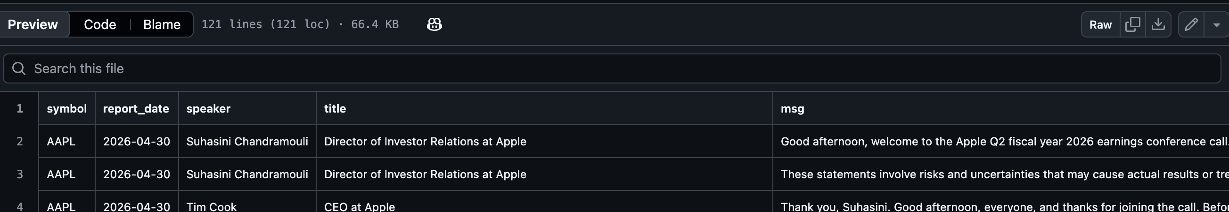
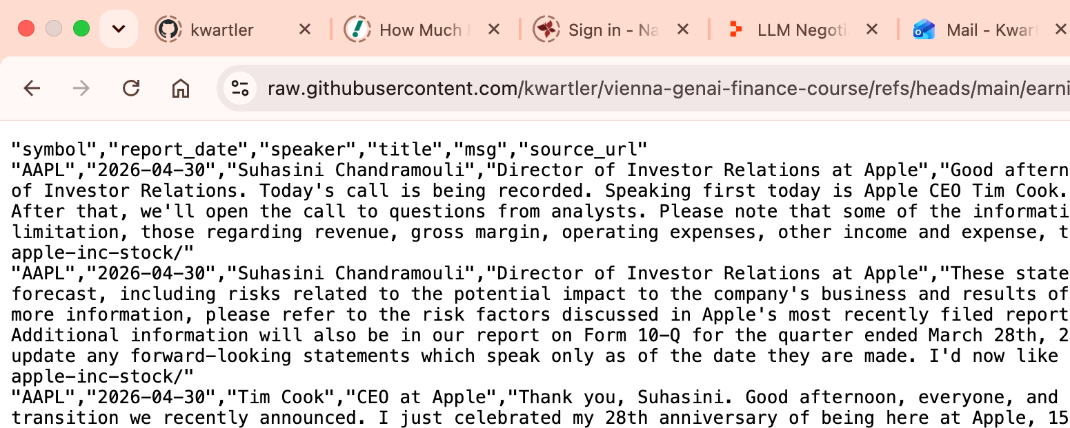
The class repo has SP500 Earnings Calls as CSV files
A
Read
Click “RAW” to open a CSV in your browser. We can add this link to your SPA.
One earnings call, and how big it really is

Slide 6
SCRIPT A · FITTING INSIDE THE WINDOW w/EARNINGS CALLS
A transcript is not a blob of text
symbol report_date speaker title msg source_url
One row per speaker turn. That structure is useful all morning.
1
Who is in the room
2
An imperfect rule
3
Hold on to the split
The title column names each speaker's role. A call has two halves: prepared remarks and analyst questions.
grepl("analyst|research") splits the two groups. Look at where it gets people wrong. That is the lesson.
Management is almost always positive about their own quarter. The interesting question is whether analysts agree.
© 2026 Ted Kwartler
6

Slide 7
STOP AND LOOK AT THAT NUMBER
One call does not fit
4 chars ≈ 1 token
Our pretend budget: 8,000 tokens
Real models allow far more. But every model has a ceiling, and every token costs money. Run the script and read the multiple out loud: a single call is several times the budget, before we have added anything else.
A rough rule, but accurate enough to reason about limits.
Now imagine four quarters of calls, plus recent news, plus a macro feed, and still room for the answer.
This is the whole reason “context engineering” is a phrase. We cannot paste it in. We have to choose the “context” that is most relevant.
© 2026 Ted Kwartler
7

Slide 8
THE TRICK WORTH STEALING
Sorting text that happens to be a date
available_dates <- sort(unique(this_call$report_date), decreasing = TRUE)
chosen_date <- available_dates[1] # the newest call
Sort descending, take the first item, and you have the newest call. With no date class parsing issues at all.
①
Largest unit first
②
Fixed width, zero padded
③
Text order is time order
YYYY, then MM, then DD. The most significant field is also the leftmost one.
Every field is always the same number of characters, so nothing shifts position.
A character by character comparison settles the year, then the month, then the day.
© 2026 Ted Kwartler
8

Slide 9
WHY IT ONLY WORKS FOR ISO 8601 DATES
Nearly every other format breaks this
SORTED AS PLAIN TEXT
WHAT WENT WRONG
"12/01/2024" lands before "02/01/2025"
✗
The year is never considered first
"Dec 16 2024" lands before "Jan 5 2025"
✗
Alphabetical, not chronological
"2024-1-5" lands after "2024-12-16"
✗
No zero padding, so widths shift
AND IT REMOVES AN AMBIGUITY THAT CAUSES REAL ERRORS IN FINANCE
03/04/2025 reads as March 4th in the US and 3 April across most of Europe. 2025-03-04 can only mean one thing.
When you control how data is named or stored, this is the format to insist on.
© 2026 Ted Kwartler
9

Slide 10
SCRIPT A · FITTING INSIDE THE WINDOW w/EARNINGS CALLS
Two strategies, and what each one costs
1
Select, do not summarize
2
Chunk on speaker boundaries
The data is already split by speaker, so keep only management remarks. Cheapest possible reduction.
Pack whole turns into chunks. The naive cut every N characters slices sentences and speakers in half.
THE COST
You just threw away every analyst question. Fine for “what did management claim?”. Fatal for “did anyone push back?”
THE COST
A model reading chunk 3 has no memory of chunk 1. An analyst referring back forty minutes later loses the connection.
Every context strategy trades away something. Knowing what you traded is the skill.
© 2026 Ted Kwartler
10

Slide 11
LIVE IN RSTUDIO
Script A: run it
LIVE CODE STEP THROUGH
> Stack every CSV, print the column names, and point out the shape: rows, not a blob.
> Print the participants, run the Analyst / Company split, and find one it gets wrong.
> Print total characters and estimated tokens, then compare to the 8,000 token budget.
> Show the chunk table, then read one management turn and one analyst turn out loud.
© 2026 Ted Kwartler
11

Slide 12
SCRIPT B · FIN_B_macro_risk.R
Your first API call, and it needs no key
○
Nothing to authenticate
!
Check the status first
Riskline publishes these alerts openly, so nothing can go wrong with a key. Script C adds one.
A failed request still returns an object, just with no useful data. Skip the check and it breaks later, somewhere confusing.
?
Read the shape, then write code
▤
Do not assume the wrapper
Print names(alerts) before anything else. Real APIs rarely return what you assumed they would.
The API nests its results. Loop the fields, find the data frame, and report which one it was.
© 2026 Ted Kwartler
12

Slide 13
Riskline API
Filtering is context engineering
THE FEED
dozens of countries
THE FILTER
COUNTRIES_OF_INTEREST
THE CONTEXT
Usually about ten lines of text
If you send it all to the LLM you pay twice…
A model cannot read a data frame
Compare the size & information to Script A
You pay tokens for the irrelevant alerts, & they bury the relevant signal where the model may miss it.
Context has to be text. Structured data must be rendered into prose lines before it can go in a prompt.
The API JSON is tiny, and it tells the model something no earnings call could contain because it very contemporary information.
High value, low cost. That combination is exactly what earns a place in a context window.
© 2026 Ted Kwartler
13

Slide 14
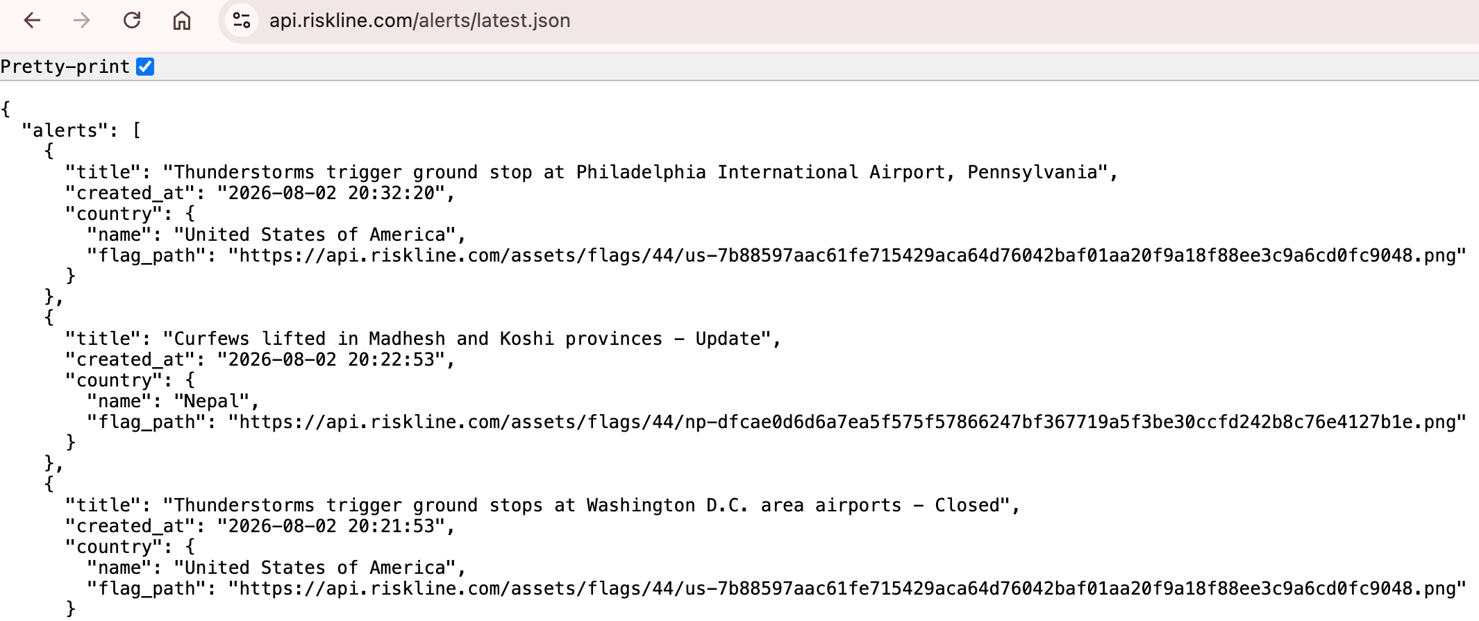
Riskline is a service covering natural disaster, political and other impactful events
https://api.riskline.com/alerts/latest.json`
B
Macro risk
Live geopolitical alerts, no API key at all
Since it is not authenticated, you can go to the site in your browser & see it.

Slide 15
LIVE IN RSTUDIO
Script B: run it
LIVE CODE STEP THROUGH
> Make the request, check the status code, and print the field names before anything else.
> Filter to the countries of interest and read out how much was kept.
> Build the context block, print it, and measure it in characters and tokens.
> Save macro_context.rds. API results are worth caching, local files are not.
© 2026 Ted Kwartler
15

Slide 16
SCRIPT C · FIN_C_newsdataIO_company_news.R
A key is a password. Treat it like one.
# In the CONSOLE, never in the file:
Sys.setenv(NEWS_DATA_IO_API_KEY = "your_key_here")
api_key <- Sys.getenv("NEWS_DATA_IO_API_KEY")
⚠
The most common real mistake
●
Print the length, not the key
↺
Let the API explain itself
A key typed into a script that goes into a shared repo is a published password. People who know better do this constantly.
When debugging, print enough to confirm something loaded and nothing more. Never cat() a secret to a projector or recorded lesson!
401 the key was rejected. 429 you hit the daily limit. 422 a parameter your plan does not allow.
© 2026 Ted Kwartler
16

Slide 17
SCRIPT C · ASKING A PRECISE QUESTION
A search API answers exactly what you ask
AAPL
✗
Few results. A ticker rarely appears in prose.
Apple
✗
The fruit, Apple Records, apple pie recipes.
"Apple" AND (earnings OR revenue OR stock OR shares OR analyst)
✓
The company, in a financial context.
Quotation marks force an exact phrase. AND requires both terms. Together they make the story be about the business.
THEN FILTER FOR RELEVANCE, AND READ WHAT YOU DROPPED
Even a careful query returns strays. Sometimes the filter caught junk.
© 2026 Ted Kwartler
17

Slide 18
SCRIPT C · THE LIMITATION YOU MUST KNOW ABOUT
Know what your newsdata.io plan actually returns
0
That is the API telling you exactly how much it withheld.
So per article you have a headline and a one line description. Enough to know WHAT happened. Not enough to analyse HOW it was reported.
characters of article text on the free plan. The content field is just a paid-plan placeholder.
News gives you breadth & depth
Many sources, current events, dated and attributed.
© 2026 Ted Kwartler
18

Slide 19
SCRIPT C · THE PATTERN WORTH LEARNING
So we extend the pipeline from the newsdata.io API to know what to search and use another to get more information.
→
→
→
newsdata.io
Your headlines
perplexity/sonar
Briefing + sources
Structured & cheap. What happened, and who reported it.
Real stories identified, named in the prompt, so the model searches specifically.
Searches the web, reads the actual pages, & summarizes them.
Facts, figures, what is disputed, and a numbered citation list are all returned.
Still a language task
Cited, so checkable
Provenance, not just facts
It is reading and summarizing. It is not being asked to invent facts or compute anything.
An ungrounded model answers from a training cutoff and gives you no way to verify. Perplexity will search the web similar to google’s AI Overview
Every line carries its source & date. The model cannot judge Reuters against a blog unless you tell it.
Cost of the search model: roughly $1 per million tokens, search included.
© 2026 Ted Kwartler
19

Slide 20
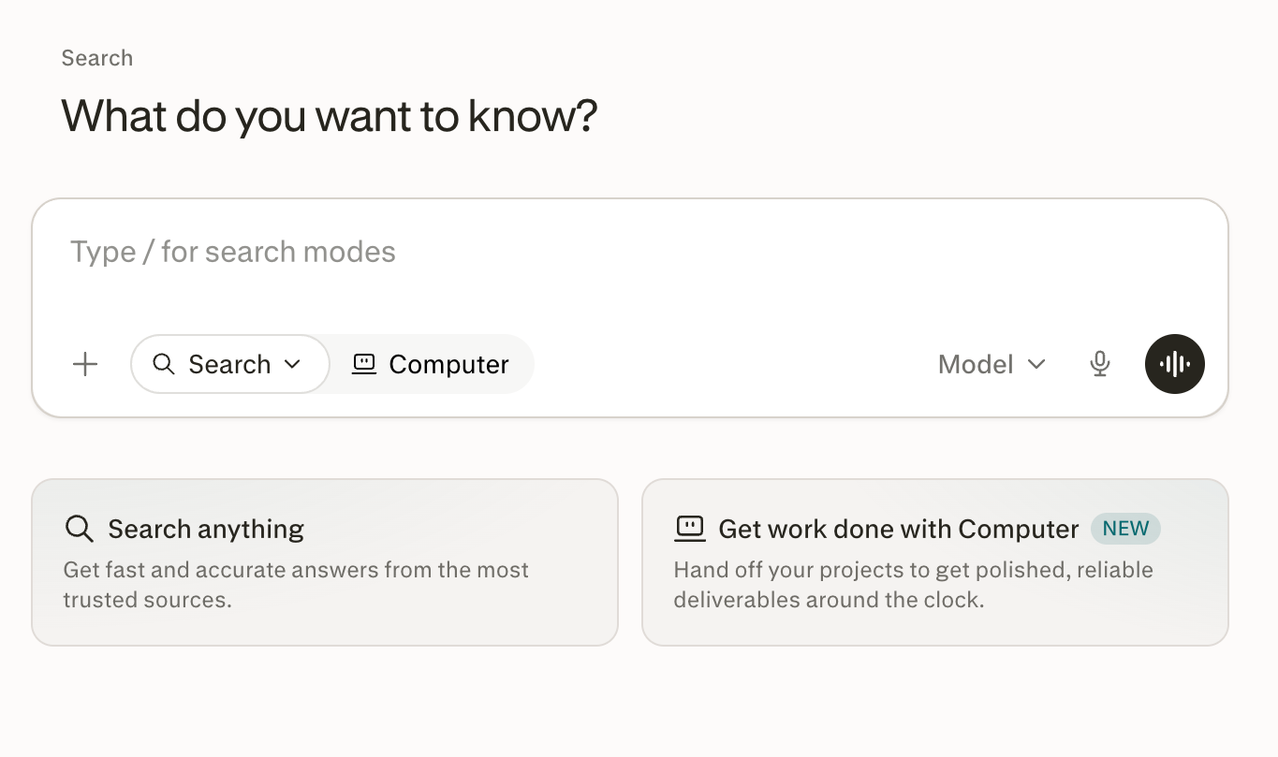
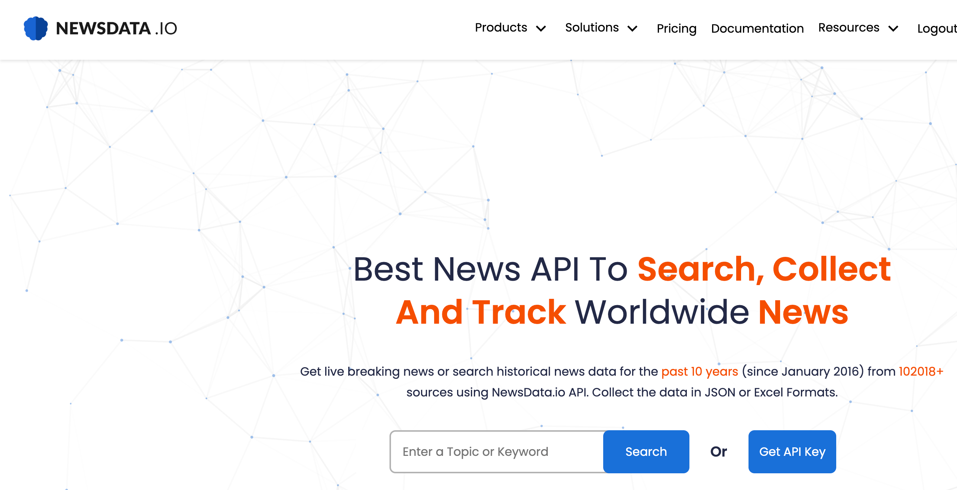
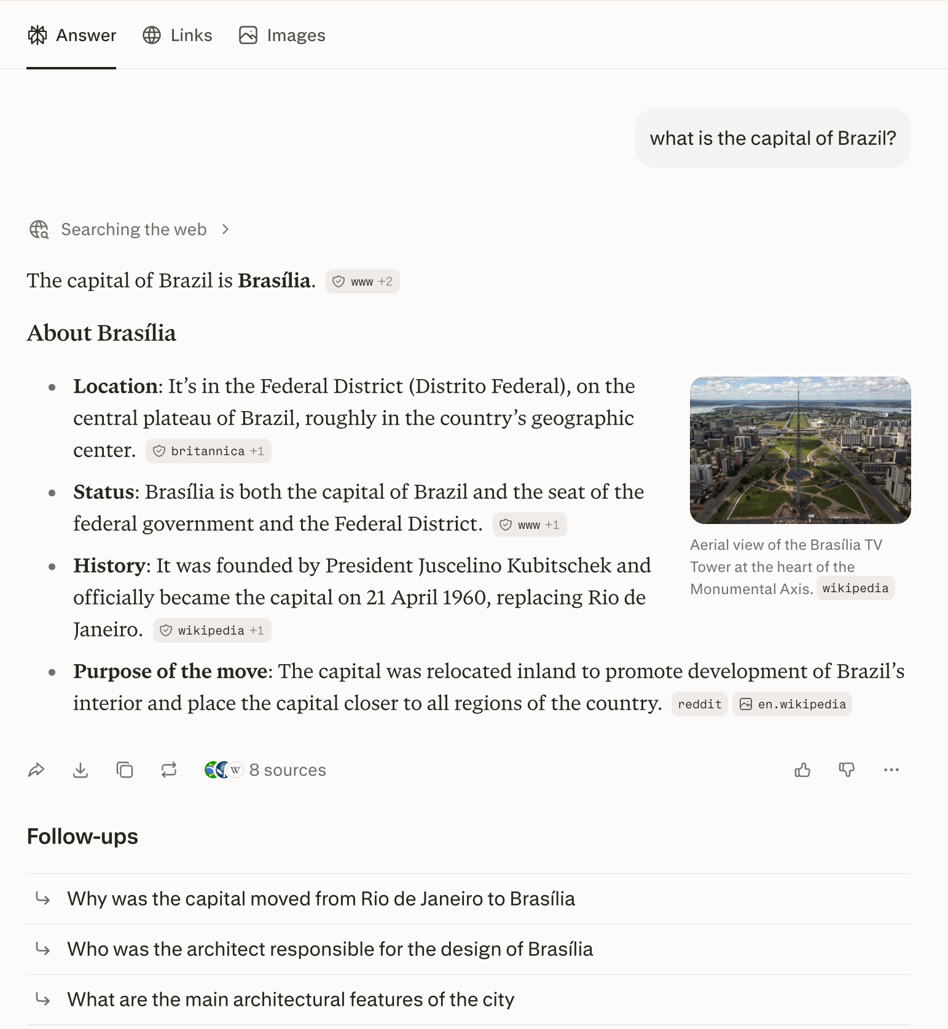
Make sure you sign up at newsdata.io & have explored perplexity.
C
Company news
Headlines, then a search model that cites
News headline API points us in a specific direction to focus on newsworthy stories from reputable sources, thereby avoiding blogs & slop. Then we use that information to perform a search & summary with perplexity.

Slide 21
LIVE IN RSTUDIO
Script C: run it
LIVE CODE STEP THROUGH
> Confirm the key loaded by printing its length, then show the assembled query string.
> Print the headline table, then print one content field and see it is a paid-plan placeholder, not the article text.
> Run the relevance filter and read the dropped headlines out loud. Was it right?
> Send six headlines to perplexity/sonar, read the briefing, then read the citation list.
© 2026 Ted Kwartler
21

Slide 22
SCRIPT D · THE SAME TRICK, ON FILE NAMES
Find the right earnings call without opening a file
AAPL_2026-05-01.csv MSFT_2025-10-29.csv BRK.B_2026-02-24.csv
newest_idx <- order(file_dates, decreasing = TRUE)[1] # ISO again
①
Everything is in the name
②
Prefix match, not regex
③
Sort the dates as text
④
Open one file, not hundreds
Symbol and date both live in the file name, so we can list every available call without reading anything.
Tickers like BRK.B contain regex wildcards. The underscore also stops “A” matching AAPL_ and “ALL” matching ALLY_.
Strip the prefix and the .csv and you have a plain ISO string. Descending order gives you the newest.
We never read a file we are not going to use. The archive can grow without the script getting slower.
Name your files in ISO 8601 and the file system sorts your history for you, for free.
© 2026 Ted Kwartler
22

Slide 23
SCRIPT D · FIN_D_build_context.R
Context Enginering: Order & labels do real work
=== PRIMARY SOURCE: COMPANY STATEMENTS ===
Earnings call excerpt, management turns only
=== SECONDARY SOURCE: PRESS COVERAGE ===
Headlines plus the enriched briefing
=== ENVIRONMENT: MACRO RISK ===
Filtered Riskline alerts
=== QUESTION ===
Four things we want the model to address
Beginnings and ends get the most weight
Without headers, sources blur together
Look at the proportions
Models attend unevenly across a long input, so the primary source goes first and the question goes last.
The model cannot tell where a company's own claims end and a journalist's summary begins unless you say so.
Which source is eating your window? Is it the one you trust most? Those two answers often do not match.
© 2026 Ted Kwartler
23

Slide 24
SCRIPT D · THE SYSTEM PROMPT
The context is the material. This is the instruction.
1
Use only the provided sources
Rule 4 is the one
2
Attribute every claim to its source
Most people leave it out, and it is the one doing the real work. A model asked a question it cannot answer from the context will usually answer anyway. Delete this line, re-run, and watch it start filling gaps. It does not work 100% of the time but it will help.
3
Separate what the company asserts from what others report
4
If the sources do not answer, say so plainly
5
No investment advice, no buy or sell view
6
Be concise
It still does not always work. Models are trained to be helpful and will state a fabricated fact confidently.
© 2026 Ted Kwartler
24

Slide 25
SCRIPT D · NOW CHANGE SOMETHING
Three experiments worth running in the room
A
Cut the transcript
B
Add the analysts back
C
Remove rule 4
Set TRANSCRIPT_TURNS to 3 and re-run. Less context is cheaper. Is the research note meaningfully worse?
Include analyst turns as well as management. Does the model's read of the call change?
Delete the instruction to admit gaps. Watch whether the model starts filling them in for you.
AND CHECK OUR ARITHMETIC AGAINST THEIRS
The response carries a usage field with the real prompt, completion and total token counts. Compare it to our characters divided by four. Dividing by 4 is a rough rule, not a precise one.
© 2026 Ted Kwartler
25

Slide 26
LIVE IN RSTUDIO
Script D: run it
LIVE CODE STEP THROUGH
> Find the newest file by sorting names, read exactly one CSV, and build the excerpt.
> Load the saved macro and news blocks, then print the size of each of the three pieces.
> Assemble, print the labelled context, and send one call to the model.
> Read the research note, then the usage field, then change TRANSCRIPT_TURNS and re-run.
© 2026 Ted Kwartler
26

Slide 27
BEFORE YOU TRUST THE ANSWER
What we traded away, on purpose
Kept management remarks only
→
Deleted every question and every pushback
Chunked the call by speaker
→
Chunk three has no memory of chunk one
Filtered the risk feed by country
→
Assumed our country list was the right one
Took the first 12 turns
→
Assumed the prepared statement is the story
If the model reports that the call was positive, remember we only showed it the part where management describes its own quarter. We built that bias in ourselves.
© 2026 Ted Kwartler
27

Slide 28
HOUR 1 CLOSE
What you should take away
Context is built by choosing, not by pasting everything in.
Give the model the source and the date, not just the claim.
1
4
Structure you already have (speakers, dates, file names) is free leverage.
Order and labels matter. Primary source first, question last.
2
5
Filtering is context engineering. Noise costs tokens and hides signal.
What you leave out shapes the answer as much as what you include.
3
6
Sentiment analysis & named entity recognition. We stop asking the model to summarize the text and start asking it to score and label it, one sentence at a time.
© 2026 Ted Kwartler
28

