Slide 1
Evolution of brain and body
Group 6B
Iulia-Alexandra Lungu, Enrique Fernández Rodicio, Mathias Schmerling

Slide 2
Outline
Motivation
Platforms - ludobots, webots; shortcomings
Robogen - what is it, references, how does it work- controller, body tree, config files
Explain parameters, scenarios
Body part examples
Body-brain coevolution, racing scenario
explain terrains, method, etc
videos
Body-brain coevolution, chasing scenario
explain terrains, method, etc
videos
Brain evolution
chasing scenario
racing scenario
Conclusion

Slide 3
Motivation
biologically realistic
outsourcing computation to morphology/environment
reducing designer bias
emergence of interesting features
better body-environment-controller compatibility

Slide 4
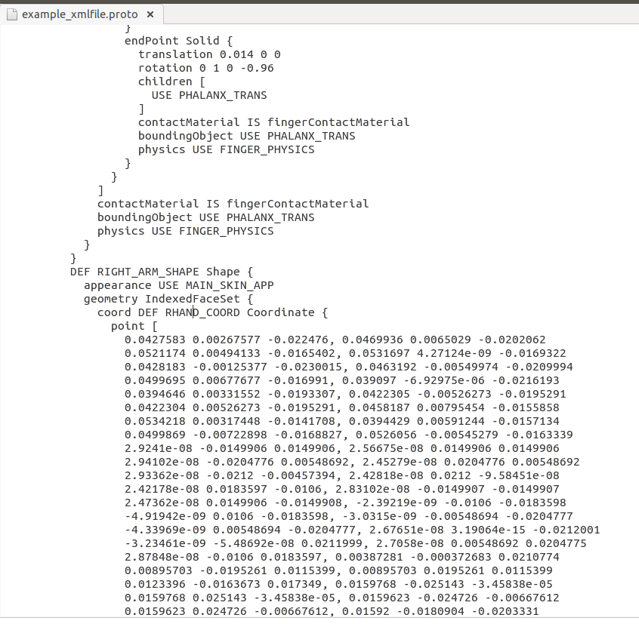
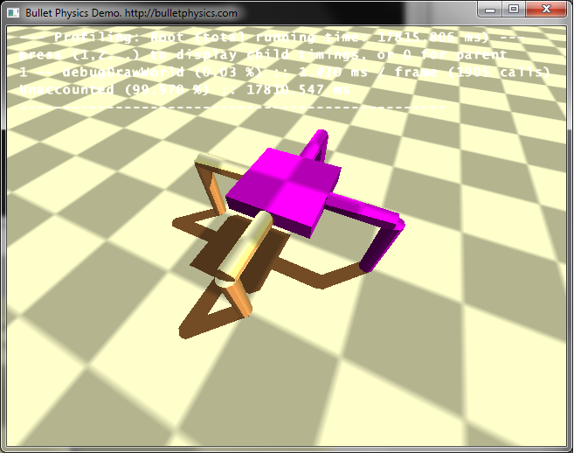
Software
Ludobots
Webots
difficult to customise - only few body part types
impossible to evolve the body
morphology was specified in XML files

Slide 5
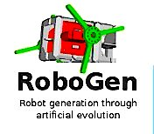
Robogen
developed by J. Auerbach, D. Aydin, A. Maesani, P. Kornatowski, T. Cieslewski, G. Heitz, P. Fernando, I. Loshchilov, L. Daler and D. Floreano.
two core components
simulator - ODE
evolution engine

Slide 6
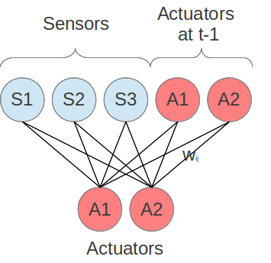
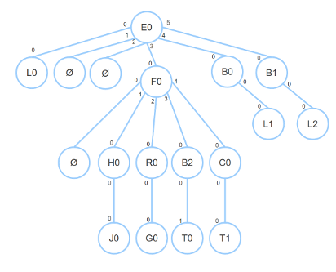
Robogen
controller - fully connected recurrent neural network
body- represented by a body tree

Slide 7
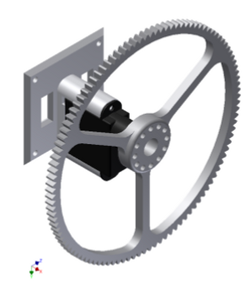
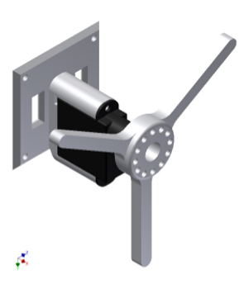
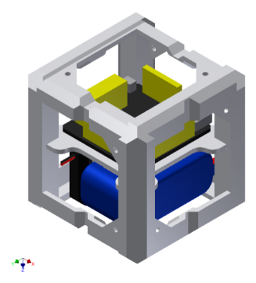
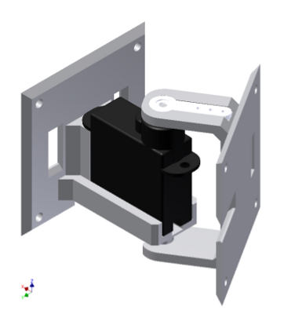
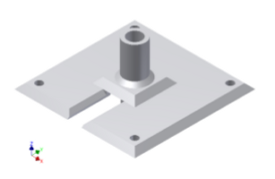
Body parts
wheels
whegs
core module
joints
light sensors
touch sensors

Slide 8
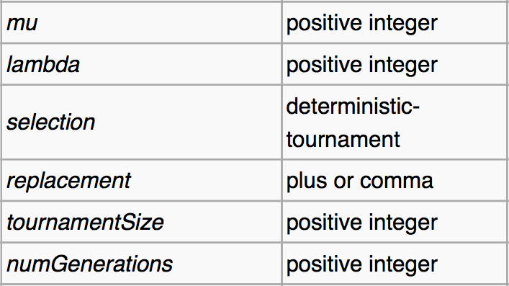
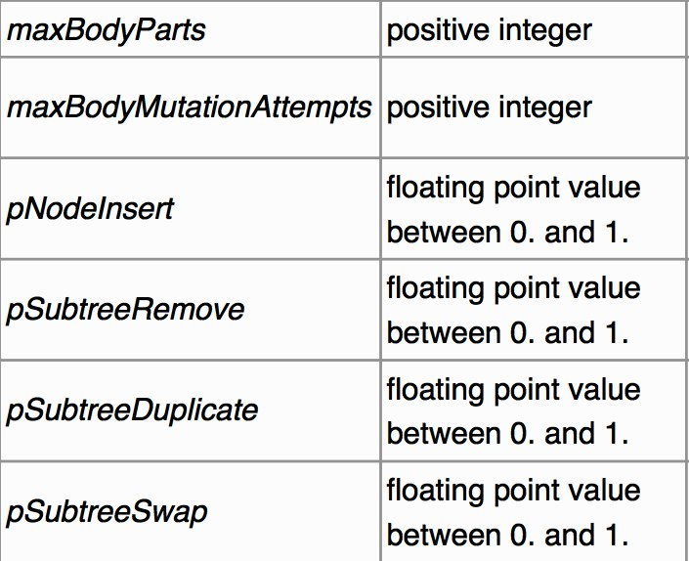
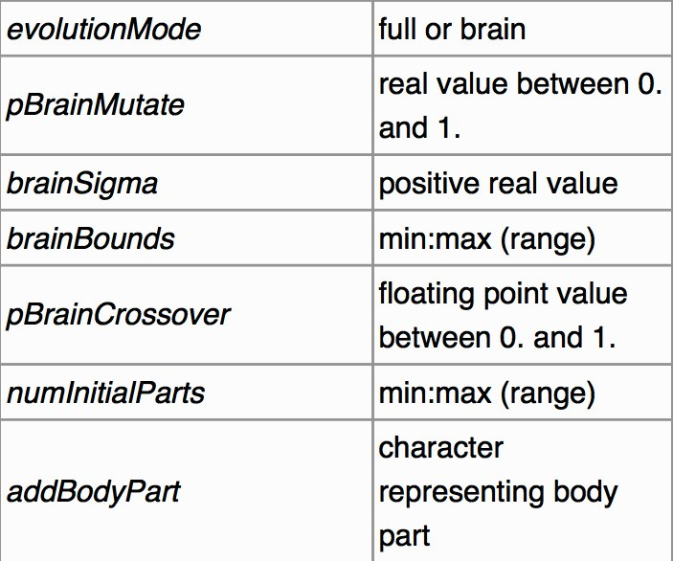
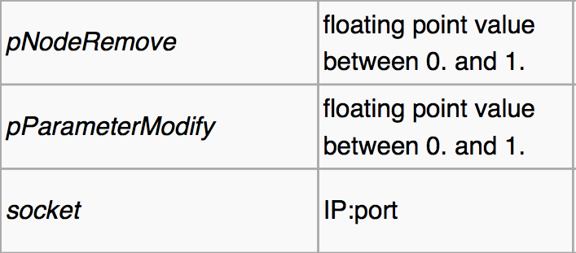
Parameters evolution

Slide 9
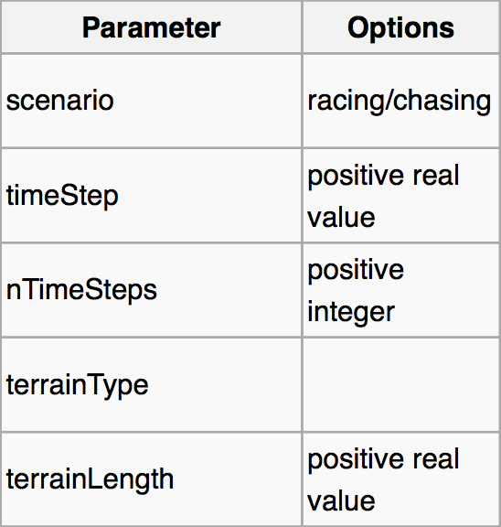
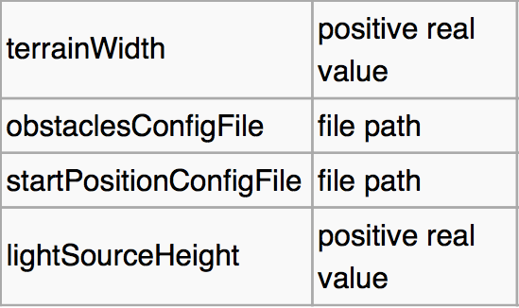
Parameters simulator

Slide 10
Brain-body coevolution
- racing scenario-
Goal: The robot has to cover the maximal distance within a given time, in this case 8 seconds.
Brain and body will be evolved together.
Random initial robot.
Three test environments, three seed values.

Slide 11
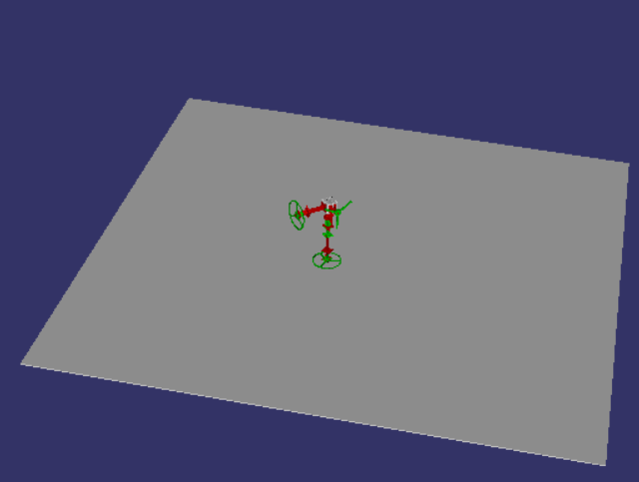
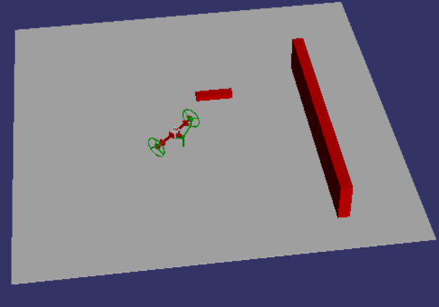
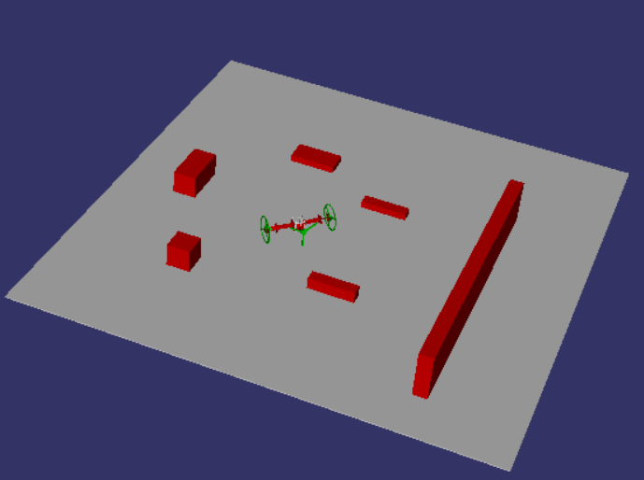
Brain-body coevolution
- racing scenario-
Three different environments:
Plain surface Light density of obstacles High density of obstacles

Slide 12
Brain-body coevolution
- racing scenario-
For each environment, three tests were performed, with three different values for the seed.
Fitness-value obtained for 100 iterations:
 | 1 | 2 | 3
No obstacles | 0,543 | 0,794 | 1,389
Light density | 2,62 | 0,63 | 0,508
High Density | 2,32 | 0,794

Slide 13
Brain-body coevolution
- racing scenario-
Conclusions for this scenario:
The best results were obtained at the environment with a light density of obstacles.
The presence of a challenging element (as obstacles) improves the results of the evolution. However, the results will be worse if the challenge is too hard.
Increasing the number of iterations usually means getting better results.
Increasing the seed improves the results on the environment without obstacles, but worsens the results in the other environments.

Slide 14
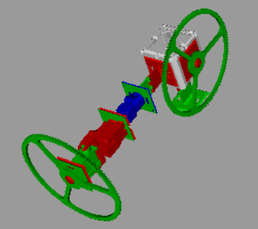
Brain-body coevolution
- racing scenario-
The best robot generated had a fitness value of 6.94,and was obtained for 10000 iterations.

Slide 15
Brain-body coevolution
-chasing scenario-

Slide 16
Brain evolution
-racing scenario-

Slide 17
Brain evolution
- chasing scenario-

Slide 18
Conclusion
We evolved 2 types of robots - only body, body and brain
We explored different parameters - scenario, brain mutation rate
Most robots are primitive - body evolution is hard
Exploring the parameters is time-consuming
Solution :
design complex bodies by hand and evolve the controller
evolve the brain for simple bodies

Slide 19
Thank you!

Slide 20
References
http://imgur.com/ZgaBuu7,Xq2dUtm,Z9Ykkg1,q5MmWAO#3
RoboGen: Robot Generation through Artificial Evolution. J. Auerbach, D. Aydin, A. Maesani, P. Kornatowski, T. Cieslewski, G. Heitz, P. Fernando, I. Loshchilov, L. Daler and D. Floreano. Artificial Life 14: International Conference on the Synthesis and Simulation of Living Systems, New York, NY, USA, July 30-August 2, 2014.

