Slide 1
Group 6B
Evolution of brain and body
Iulia-Alexandra Lungu, Enrique Fernández Rodicio, Mathias Schmerling

Slide 2
Outline
Motivation
Platforms - ludobots, webots; shortcomings
Robogen - what is it, references, how does it work- controller, body tree, config files
Explain parameters, scenarios
Body part examples
Body-brain coevolution, racing scenario
explain terrains, method, etc
videos
Body-brain coevolution, chasing scenario
explain terrains, method, etc
videos
Brain evolution
chasing scenario
racing scenario
Conclusion
<Nummer>

Slide 3
Motivation
biologically realistic
outsourcing computation to morphology/environment
reducing designer bias
emergence of interesting features
better body-environment-controller compatibility
<Nummer>

Slide 4

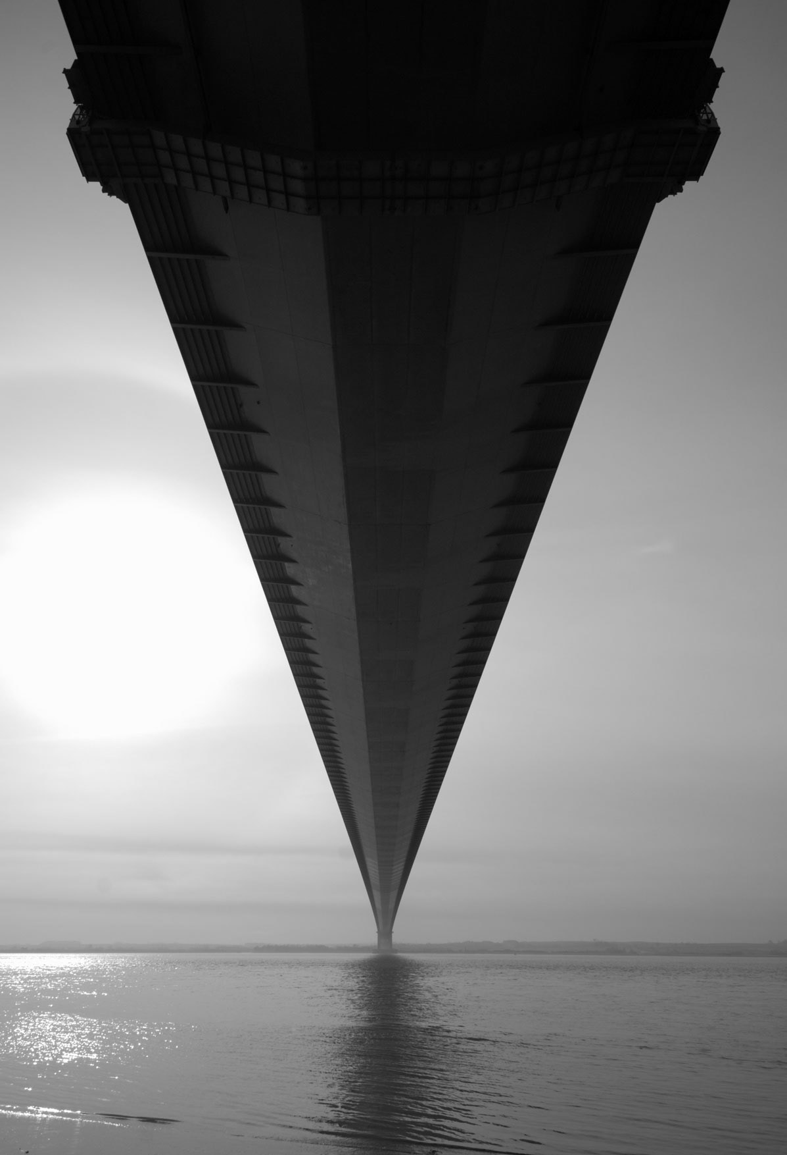
Software
Ludobots
Webots
difficult to customise - only few body part types
impossible to evolve the body
morphology was specified in XML files
<Nummer>

Slide 5

Webots
<Nummer>

Slide 6
Robogen
developed by J. Auerbach, D. Aydin, A. Maesani, P. Kornatowski, T. Cieslewski, G. Heitz, P. Fernando, I. Loshchilov, L. Daler and D. Floreano.
two core components
simulator - ODE
evolution engine
controller - fully connected recurrent neural network
body- represented by a body tree

Slide 7
Body parts
wheels
whegs
core module
light sensors
joints
<Nummer>

Slide 8
Robogen parameters
add photo, highlight explored parameters for the evolution engine and for the simulator separately
<Nummer>

Slide 9
Brain-body coevolution - racing scenario-
<Nummer>

Slide 10
Brain-body coevolution -chasing scenario-
Expected result: braitenberg vehicle - type lover
Actual result: see video
<Nummer>

Slide 11
Brain evolution -racing scenario-
<Nummer>

Slide 12
Brain evolution - chasing scenario-
<Nummer>

Slide 13
Summary and conclusion
We evolved 2 types of robots - only body, body and brain
We explored different parameters - scenario, brain mutation rate
Most robots are primitive - body evolution is hard
Exploring the parameters is time-consuming
Solution :
design complex bodies by hand and evolve the controller
evolve the brain for simple bodies
<Nummer>

Slide 14
Thank you!

Slide 15
References

