Slide 1

Introducing: Maven 4 & Java 21
Iuliana Cosmina, Oct 2023

Slide 2
Agenda
Maven 4 - what’s new
Java 21 – goodies
Play time

Slide 3
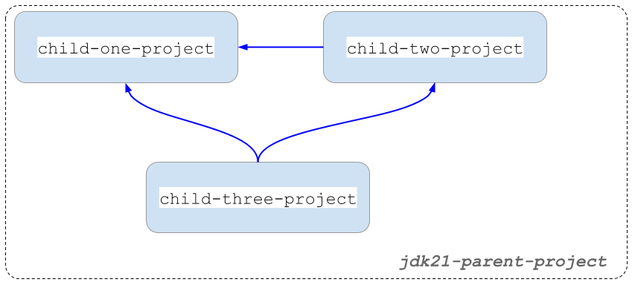
Project Structure
Notes:
Multi-module with inter-module dependencies.

Slide 4
Maven 4 - what’s new (1)
Automatic parent/dependency versioning
Checksum mismatches fail the build
Project specific settings.xml
Comments in .mvn/maven.config
New CLI options
-fos WARN/ -fail-on-severity WARN
-r / --resume #resume build from last failure point
Compatible with Maven 3 dependencies, not with Maven 2 though.

Slide 5
Maven 4 - what’s new (2)
Improvements of build times
automatically detect modules that can be built in parallel
better & faster recovery from failures during parallel builds
Under development: remote caching, keep build results remote, use them speed up things locally.
No official release date for a GA.

Slide 6
Java 21 - Projects
Amber - evolution of the Java language
Leyden - improvement of start-up time
Panama – performance improvement of I/O operations (Java-Native platform changes GraalVM)
Valhalla – improvement of the Java object model to use of memory more efficiently
Loom - massively scale lightweight threads
ZGC - scalable low latency garbage collector
Notes:
Long Term Commercial Support
Valhala: augmenting the Java object model with value objects – value-based objects - The @ValueBased annotations is used for classes, whos instances can be flattened and treated as primitives.
Loom: the reactive model will become redundant in Java.

Slide 7
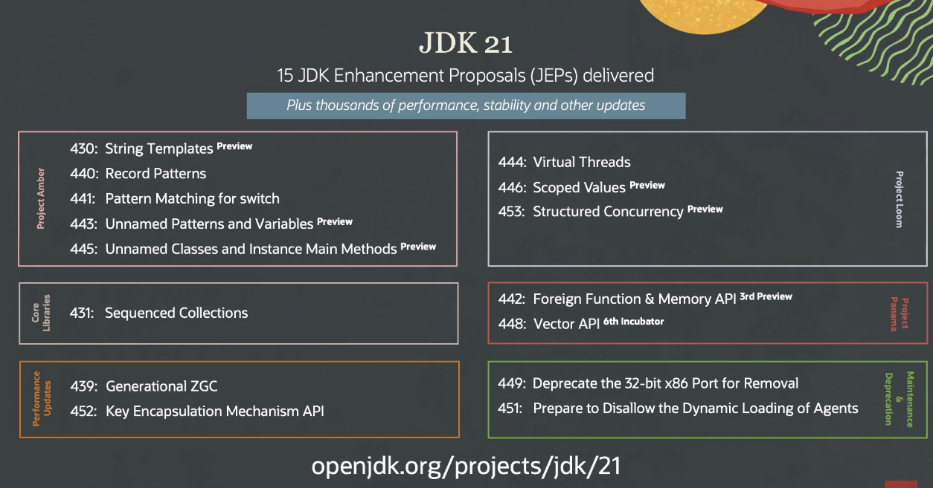
Java 21 - JEPS
Notes:
33.3 % - Preview
13.3 % - Deprecations
56.6% - Valuable deliveries

Slide 8
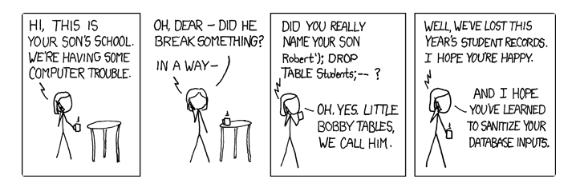
Amber: String Templates (preview)
String interpolation in other languages
Evaluate expression/variable
Convert to String if needed
Insert resulted String into the original String literal

Slide 9
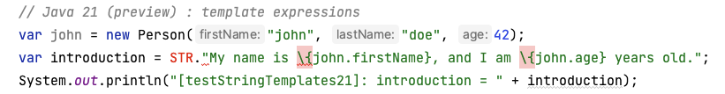
Amber: String Templates (preview)
template expression: a programmable way of safely interpolating expressions in String literals.
[A template processor].[A template containing wrapped expressions like \{varName}]
STR - The Java compiler automatically imports it in any Java class. It is called a template processor.
Developers can create their own processors by implementing java.lang.StringTemplate.Processor functional interface

Slide 10
Amber: Everything Else
Pattern Matching for instanceof with Records (Java 19)
Pattern Matching for switch
Unnamed Pattern & Unnamed Variables (preview)
The return of the underscore
Unnamed Classes & Instance main Methods (preview)

Slide 11
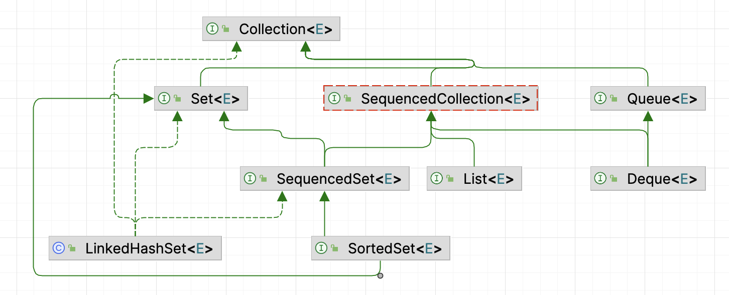
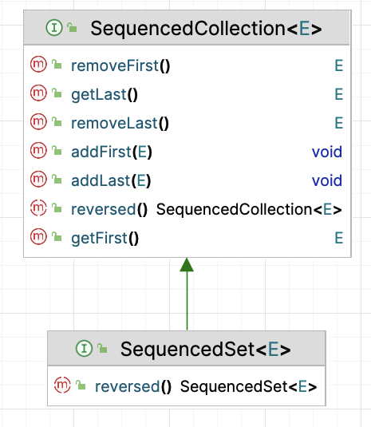
Sequenced Collections
Notes:
new interfaces to represent collections with a defined encounter order.

Slide 12
ZGC
Java 11 introduced the Z Garbage Collector (ZGC) as an experimental garbage collector (GC) implementation designed to keep low pause times on even multi-terabyte heaps.
ZGC intends to provide stop-the-world phases as short as possible. (1 ms)
ZGC a good fit for server applications
where large heaps are common
and fast application response times are a requirement
To avoid memory fragmentation without pausing the application, it does most of the relocating in parallel with the application.
To avoid references being accessed during relocations uses something called a load barrier.
Uses a dynamic number of threads, and the max can be configured explicitly.
Uses a dynamic number of ZPages (memory regions of various size)
To enable it: java -XX:+UseZGC <java_application>
Notes:
NUMA= Non-Uniform Memory Access
"Zettabyte File System”
(Non-generational ZGC uses multi-mapped memory to reduce the overhead of load barriers.)

Slide 13
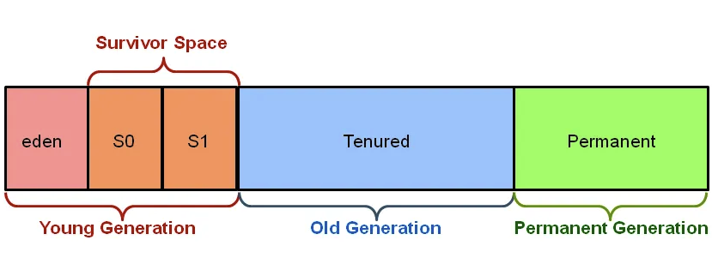
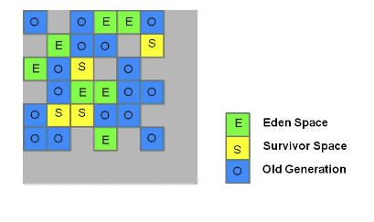
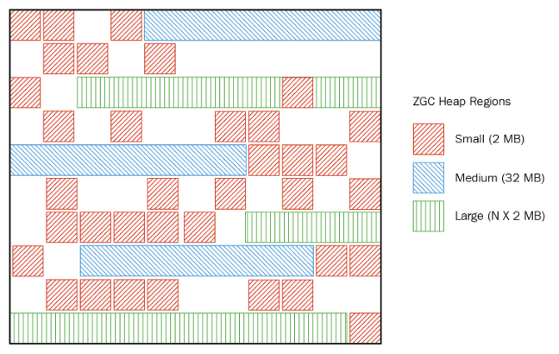
ZGC
Old style GC heap allocation (before Java 8)
G1GC heap allocation (starting with Java 8)
ZGC heap allocation (starting with Java 11)
Notes:
NUMA= Non-Uniform Memory Access
"Zettabyte File System”
(Non-generational ZGC uses multi-mapped memory to reduce the overhead of load barriers.)

Slide 14
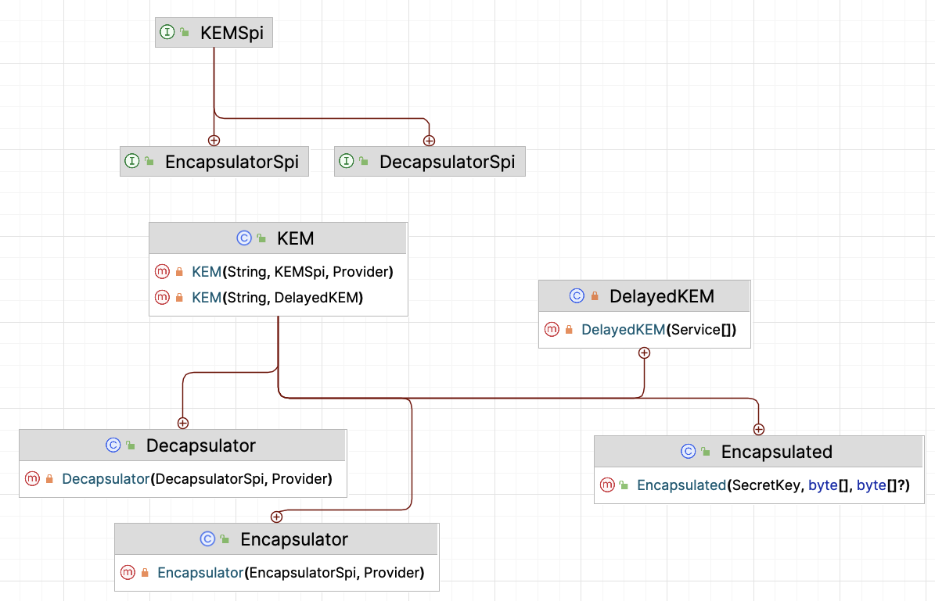
Key Encapsulation Mechanism API
It is expected to play a crucial role in defending against quantum attacks and enhancing the security of higher-level protocols and cryptographic schemes.

Slide 15
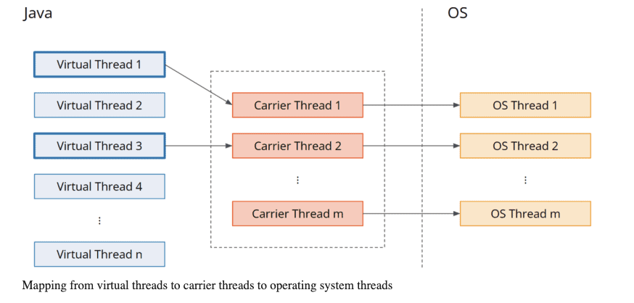
Virtual threads

Slide 16
Scoped Values
Scoped Values are a modern alternative to ThreadLocal variables that can be used well in the context of Virtual Threads.
Scoped values have the following advantage over ThreadLocal variables:
They are only valid for a defined period (“scope”).
They are immutable.
And therefore, they can be inherited without having to be copied (as is the case with InheritableThreadLocal).

Slide 17
Foreign Function & Memory API
Replacement for JNI, to invoke code from outside the JVM (e.g. C Libraries)
To be continued …

Slide 18
Vector API
To be continued …

Slide 19
Play Time (aka. demo)

Slide 20
References
https://openjdk.org/projects/jdk/21
https://www.infoworld.com/article/3689880/jdk-21-the-new-features-in-java-21.html
https://maarten.mulders.it/2020/11/whats-new-in-maven-4
https://www.happycoders.eu/java/virtual-threads/
https://www.happycoders.eu/java/java-21-features/#Scoped_Values_Preview_-_JEP_446
https://github.com/iuliana/jdk21-parent-project
https://maven.apache.org/docs/history.html

