Slide 1

Introducing: Java 21 & Maven 4
Iuliana Cosmina, Oct 2023

Slide 2
Agenda
Maven 4 - what’s new
Java 21 – goodies
Play time

Slide 3
Maven 4 - what’s new (general)
Automatic parent/dependency versioning
Checksum mismatches fail the build
Project specific settings.xml
Comments in .mvn/maven.config
New CLI options
-fos WARN/ -fail-on-severity WARN
-r / --resume #resume build from last failure point
Compatible with Maven 3
Root-reactor aware subfolder builds

Slide 4
Maven 4 - what’s new (multi-module)
Identifier for root pom:
<project root ="true" …/>
Improvements of build times
automatically detect modules that can be built in parallel
better & faster recovery from failures during parallel builds

Slide 5
Java 21 - Projects
Amber - evolution of the Java language
Leyden - improvement of start-up time
Panama – performance improvement of I/O operations (Java-Native platform changes GraalVM)
Valhalla – improvement of the Java object model to use of memory more efficiently
Loom - massively scale lightweight threads
ZGC - scalable low latency garbage collector
Notes:
Long Term Commercial Support

Slide 6
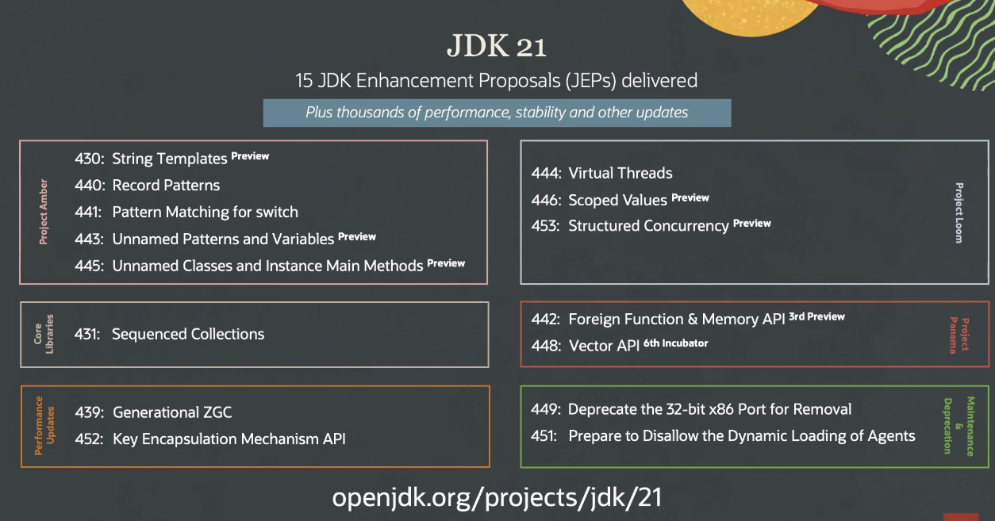
Java 21 - JEPS
Notes:
33.3 % - Preview
13.3 % - Deprecations
56.6% - Valuable deliveries

Slide 7
Play Time (aka. demo)

Slide 8
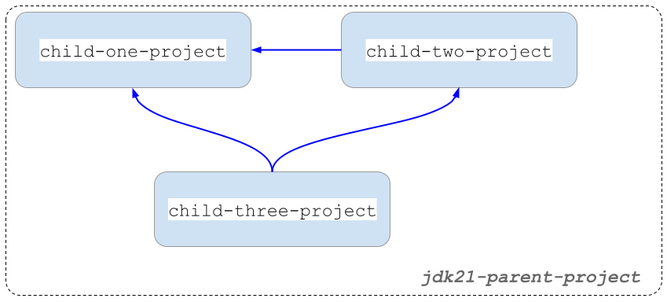
Project Structure
Notes:
Multi-module with inter-module dependencies.

Slide 9
References
https://openjdk.org/projects/jdk/21
https://www.infoworld.com/article/3689880/jdk-21-the-new-features-in-java-21.html
https://maarten.mulders.it/2020/11/whats-new-in-maven-4

