Slide 1

Introducing: Maven 4 & Java 21
Iuliana Cosmina, Oct 2023

Slide 2
Agenda
Maven 4 - what’s new
Java 21 – goodies
Play time

Slide 3
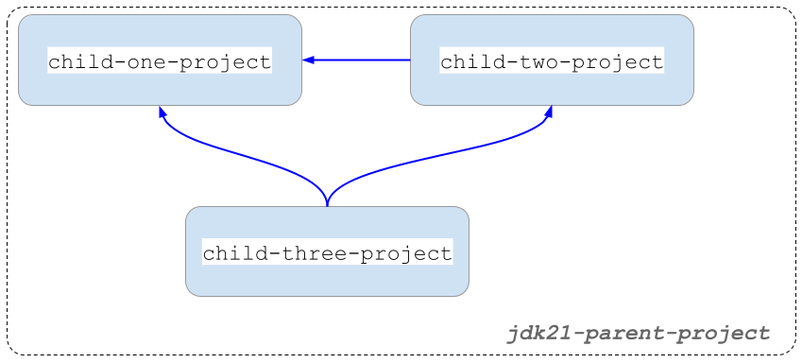
Project Structure
Notes:
Multi-module with inter-module dependencies.

Slide 4
Maven 4 - what’s new (1)
Automatic parent/dependency versioning
Checksum mismatches fail the build
Project specific settings.xml
Comments in .mvn/maven.config
New CLI options
-fos WARN/ -fail-on-severity WARN
-r / --resume #resume build from last failure point
Compatible with Maven 3 dependencies, not with Maven 2 though.

Slide 5
Maven 4 - what’s new (2)
Improvements of build times
automatically detect modules that can be built in parallel
better & faster recovery from failures during parallel builds
Under development: remote caching, keep build results remote, use them speed up things locally.
No official release date for a GA.

Slide 6
Java 21 - Projects
Amber - evolution of the Java language
Leyden - improvement of start-up time
Panama – performance improvement of I/O operations (Java-Native platform changes GraalVM)
Valhalla – improvement of the Java object model to use of memory more efficiently
Loom - massively scale lightweight threads
ZGC - scalable low latency garbage collector
Notes:
Long Term Commercial Support

Slide 7
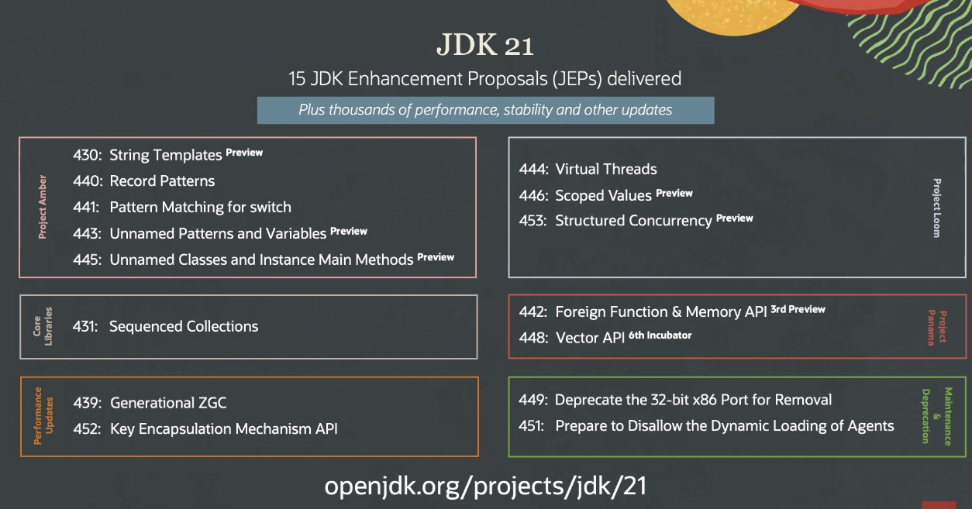
Java 21 - JEPS
Notes:
33.3 % - Preview
13.3 % - Deprecations
56.6% - Valuable deliveries

Slide 8
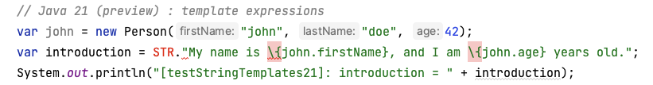
String Templates
template expression: a programmable way of safely interpolating expressions in String literals.
[A template processor].[A template containing wrapped expressions like \{varName}]
STR - The Java compiler automatically imports it in any Java class. It is called a template processor.
Developers can create their own processors by implementing java.lang.StringTemplate.Processor
Notes:
The Java compiler automatically imports STR in any Java class.
STR is a processor, similar to a Function(String) -> String
To create

Slide 9
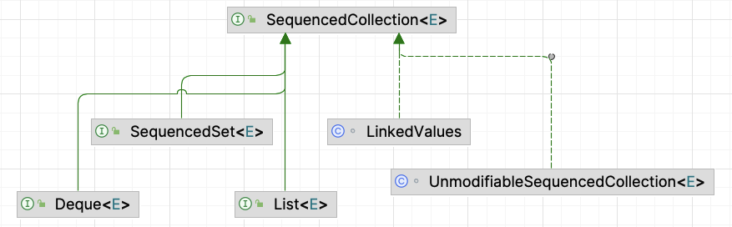
Sequenced Collections

Slide 10
ZGC
Java 11 introduced the Z Garbage Collector (ZGC) as an experimental garbage collector (GC) implementation designed to keep low pause times on even multi-terabyte heaps.
ZGC intends to provide stop-the-world phases as short as possible.
ZGC a good fit for server applications
where large heaps are common
and fast application response times are a requirement.
To avoid memory fragmentation without pausing the application, it does most of the relocating in parallel with the application.
To avoid references being accessed during relocations uses something called a load barrier.
Used a dynamic number of threads , and the max can be configured explicitly.
To enable it: java -XX:+UseZGC <java_application>

Slide 11
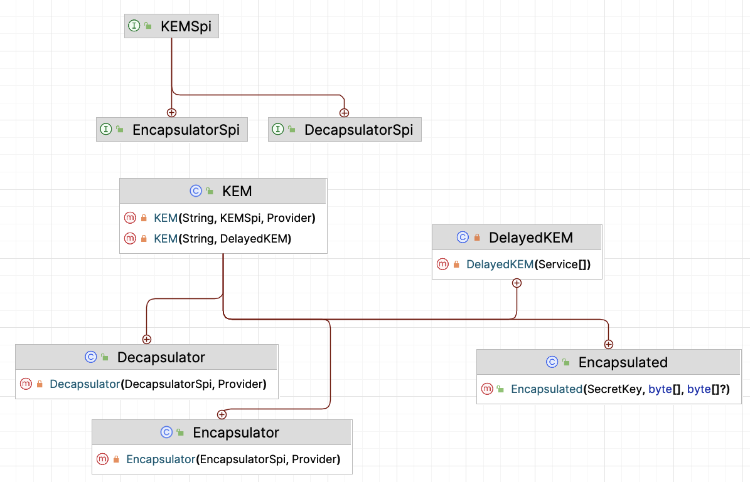
Key Encapsulation Mechanism API
It is expected to play a crucial role in defending against quantum attacks and enhancing the security of higher-level protocols and cryptographic schemes.

Slide 12
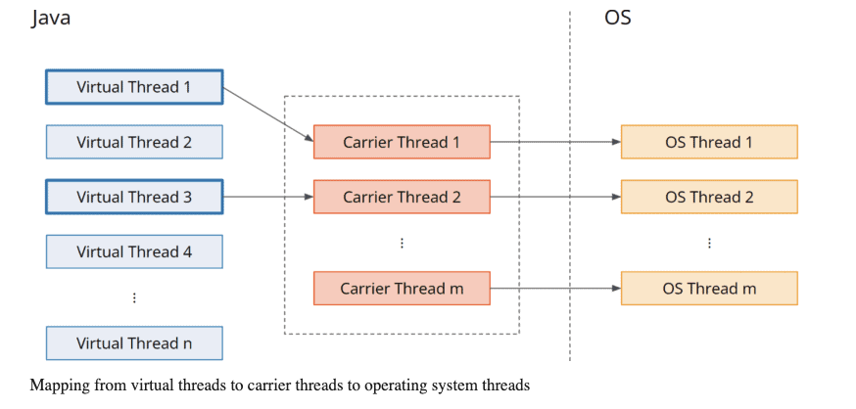
Virtual threads

Slide 13
Scoped Values
Scoped Values are a modern alternative to ThreadLocal variables that can be used well in the context of Virtual Threads.
Scoped values have the following advantage over ThreadLocal variables:
They are only valid for a defined period (“scope”).
They are immutable.
And therefore, they can be inherited without having to be copied (as is the case with InheritableThreadLocal).

Slide 14
Foreign Function & Memory API
Replacement for JNI, to invoke code from outside the JVM (e.g. C Libraries)
To be continued …

Slide 15
Vector API
To be continued …

Slide 16
Play Time (aka. demo)

Slide 17
References
https://openjdk.org/projects/jdk/21
https://www.infoworld.com/article/3689880/jdk-21-the-new-features-in-java-21.html
https://maarten.mulders.it/2020/11/whats-new-in-maven-4
https://www.happycoders.eu/java/virtual-threads/
https://www.happycoders.eu/java/java-21-features/#Scoped_Values_Preview_-_JEP_446
https://github.com/iuliana/jdk21-parent-project
https://maven.apache.org/docs/history.html

