Slide 1

Introducing: Maven 4 & Java 21
Iuliana Cosmina, Oct 2023

Slide 2
Agenda
Maven 4 - what’s new
Java 21 – goodies
Play time

Slide 3
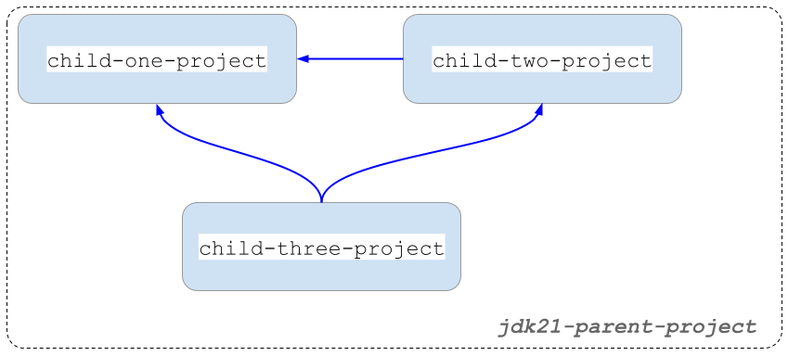
Project Structure
Notes:
Multi-module with inter-module dependencies.

Slide 4
Maven 4 - what’s new (1)
Automatic parent/dependency versioning
Checksum mismatches fail the build
Project specific settings.xml
Comments in .mvn/maven.config
New CLI options
-fos WARN/ -fail-on-severity WARN
-r / --resume #resume build from last failure point
Compatible with Maven 3 dependencies, not with Maven 2 though.

Slide 5
Maven 4 - what’s new (2)
Improvements of build times
automatically detect modules that can be built in parallel
better & faster recovery from failures during parallel builds
Under development: remote caching, keep build results remote, use them speed up things locally.
No official release date for a GA.

Slide 6
Java 21 - Projects
Amber - evolution of the Java language
Leyden - improvement of start-up time
Panama – safety and performance improvement of I/O operations (Java-Native platform changes, GraalVM)
Valhalla – improvement of the Java object model to use of memory more efficiently
Loom - massively scale lightweight threads
ZGC - scalable low latency garbage collector
Notes:
Long Term Commercial Support
Valhala: augmenting the Java object model with value objects – value-based objects - The @ValueBased annotations is used for classes, whos instances can be flattened and treated as primitives.
Loom: the reactive model will become redundant in Java.
Leyden: historically Java prioritised performance over faster startups.

Slide 7
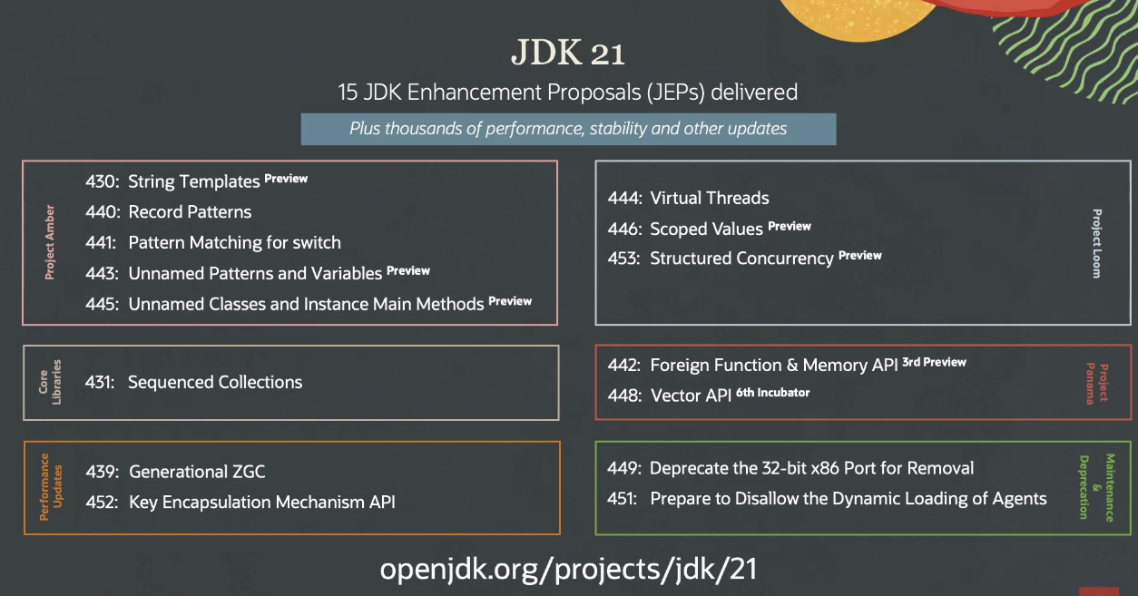
Java 21 - JEPS
Notes:
33.3 % - Preview
13.3 % - Deprecations
56.6% - Valuable deliveries
Backward compatibility – is out the window.

Slide 8
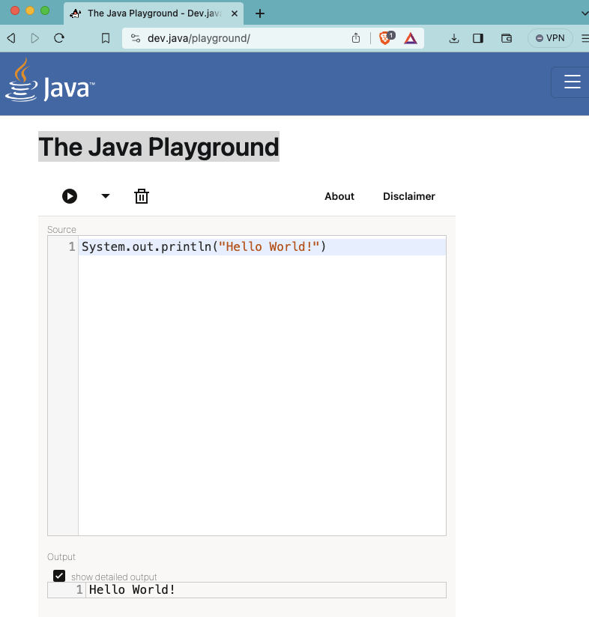
Others
The Java Playground
Various methods added to existing classes( e.g. String)
Flattened Heap Storage ( bringing benefits of primitives to objects)
JVM Design changes
Pseudo Random Number Generator Improvements
etc
Notes:
33.3 % - Preview
13.3 % - Deprecations
56.6% - Valuable deliveries

Slide 9
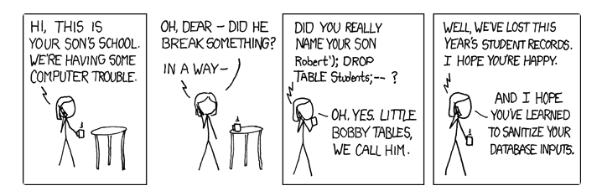
JEP 430. String Templates (preview)
String interpolation in other languages
Evaluate expression/variable
Convert to String if needed
Insert resulted String into the original String literal

Slide 10
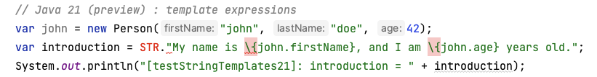
String Templates (preview)
template expression: a programmable way of safely interpolating expressions in String literals.
[A template processor].[A template containing wrapped expressions like \{varName}]
STR - The Java compiler automatically imports it in any Java class. It is called a template processor.
Developers can create their own processors by implementing java.lang.StringTemplate.Processor functional interface

Slide 11
Everything Else in Amber
JEP 440. Pattern Matching for instanceof with Records
JEP 441. Pattern Matching for switch
JEP 443. Unnamed Pattern & Unnamed Variables (preview)
The return of the underscore
JEP 445. Unnamed Classes & Instance main Methods (preview)

Slide 12
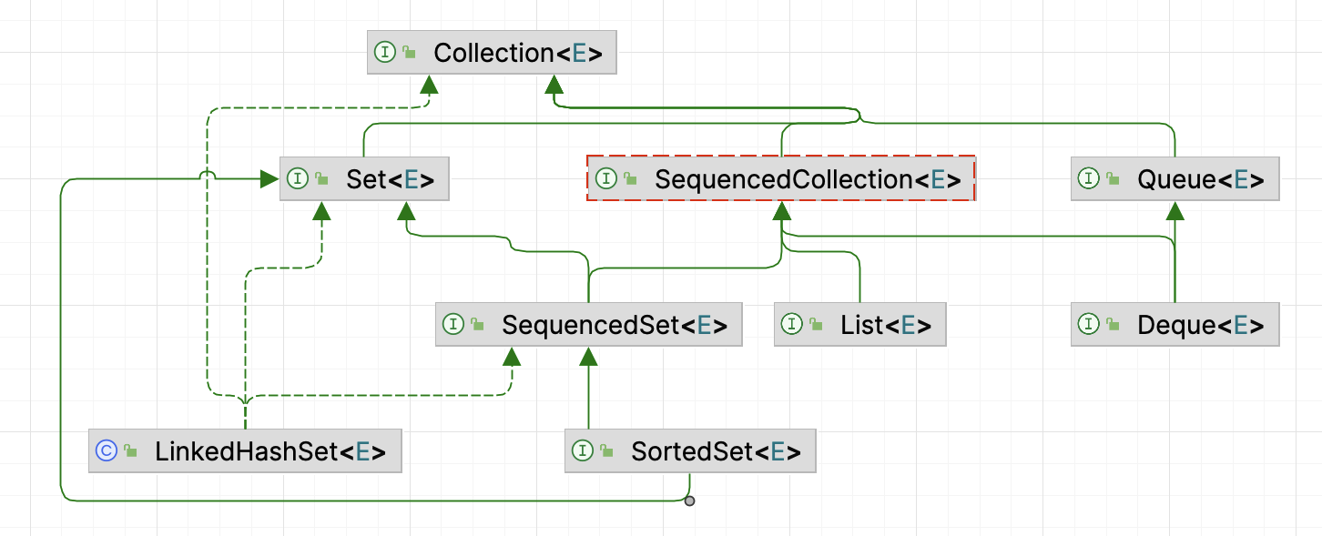
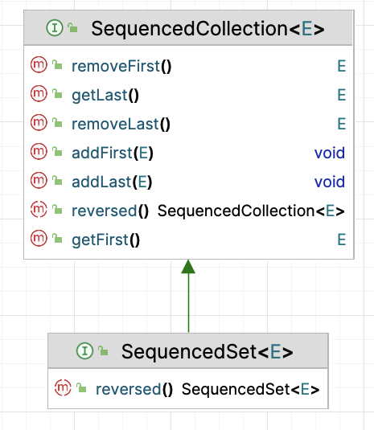
JEP 431. Sequenced Collections
java.util
Notes:
new interfaces to represent collections with a defined encounter order.

Slide 13
JEP 439. ZGC
Java 11 introduced the Z Garbage Collector (ZGC) as an experimental garbage collector (GC) implementation designed to keep low pause times on even multi-terabyte heaps.
ZGC intends to provide stop-the-world phases as short as possible. (1 ms)
ZGC a good fit for server applications
where large heaps are common
and fast application response times are a requirement
To avoid memory fragmentation without pausing the application, it does most of the relocating in parallel with the application.
To avoid references being accessed during relocations uses something called a load barrier.
Uses a dynamic number of threads, and the max can be configured explicitly.
To enable it: java -XX:+UseZGC <java_application>
Generational ZGC will become the default in future releases, with non-generational ZGC eventually being removed.
Notes:
NUMA= Non-Uniform Memory Access
"Zettabyte File System”
(Non-generational ZGC uses multi-mapped memory to reduce the overhead of load barriers.)

Slide 14
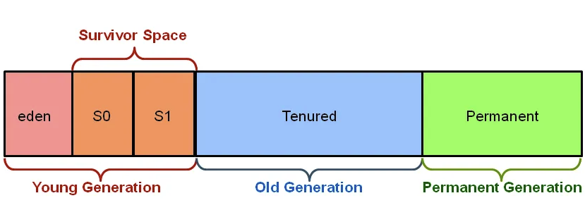
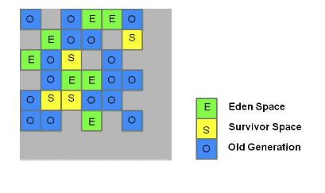
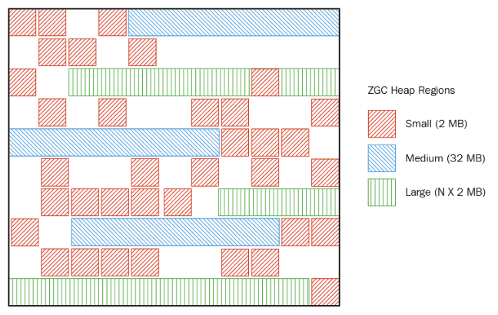
ZGC
Old style GC heap allocation (before Java 8)
G1GC heap allocation (starting with Java 8)
ZGC heap allocation (in Java 11)
Notes:
NUMA= Non-Uniform Memory Access
"Zettabyte File System”
(Non-generational ZGC uses multi-mapped memory to reduce the overhead of load barriers.)

Slide 15
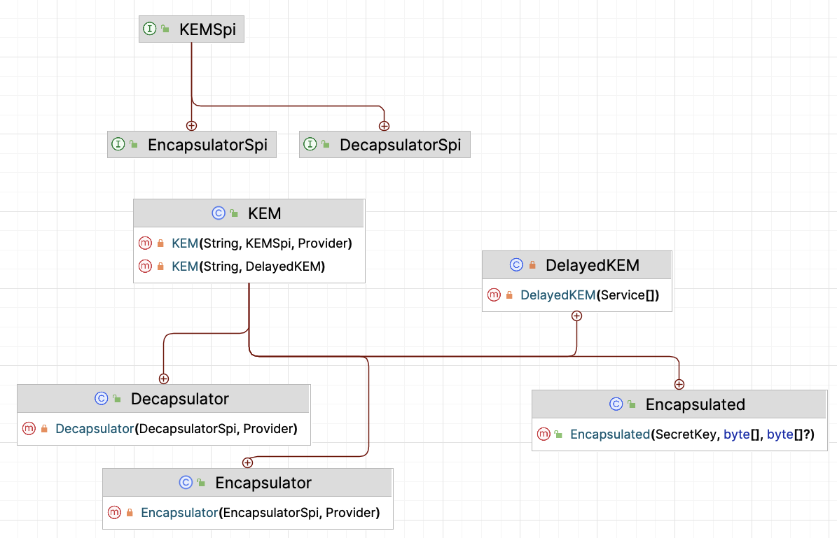
JEP 452. Key Encapsulation Mechanism API
It is expected to play a crucial role in defending against quantum attacks and enhancing the security of higher-level protocols and cryptographic schemes.
javax.crypto

Slide 16
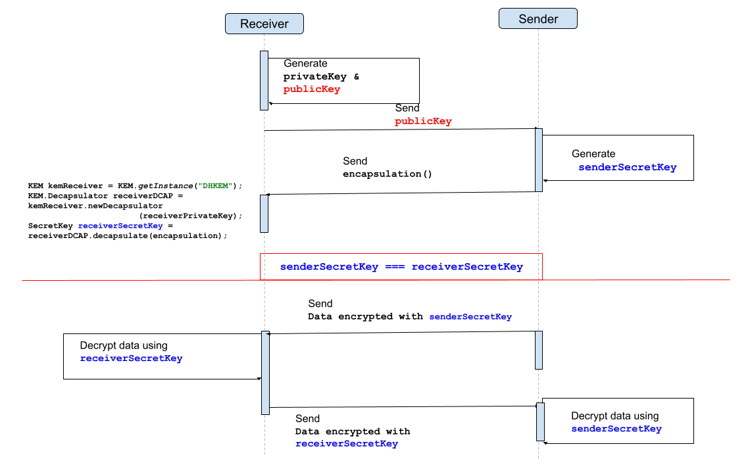
Key Encapsulation Mechanism API

Slide 17
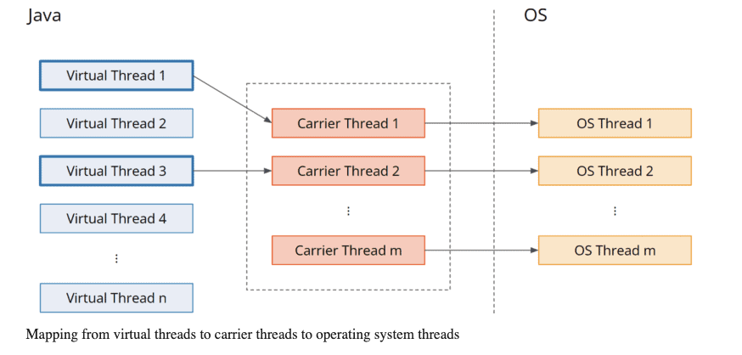
JEP 444. Virtual threads

Slide 18
JEP 446. Scoped Values (preview)
ThreadLocal<T> variables are connected to a specific thread and remove the need for sincronization.
InheritableThreadLocal<T> variables that are shared between a thread and its child threads.
These work with Virtual Threads as well, but the downsides multiply proportionally with the number of threads.
ScopedValue<T> represents a new way to store and share immutable data with a bounded lifetime within a thread and its child threads.

Slide 19
Scoped Values (preview)
private static final ThreadLocal<String> USER = ThreadLocal.withInitial(“Jimmy);
private static final ScopedValue<String> USER =
ScopedValue.newInstance();
ScopedValue.where(USER,"Jimmy") .run(() -> System.out.println(STR."Welcome to \{USER.get()}"));

Slide 20
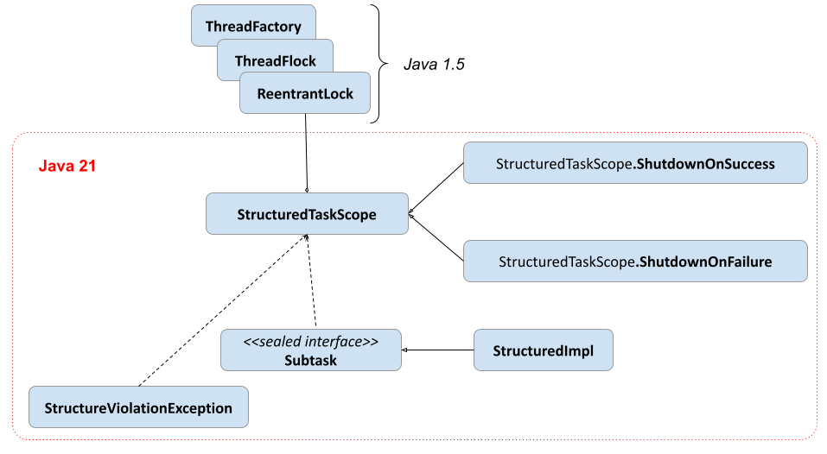
JEP 453. Structured Concurrency (preview)
Structured concurrency treats groups of related tasks running in different threads as a single unit of work, thereby streamlining error handling and cancellation, improving reliability, and enhancing observability.

Slide 21
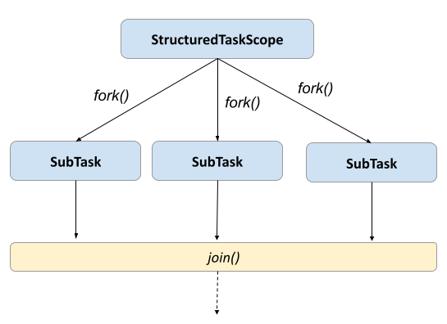
Structured Concurrency (preview) - simple

Slide 22
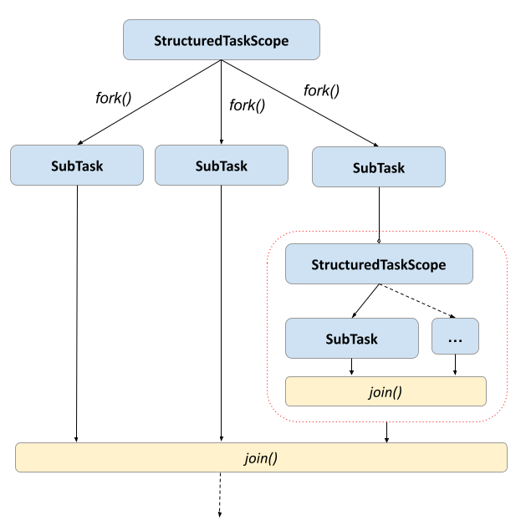
Structured Concurrency (preview) - nested

Slide 23
Structured Concurrency (preview)
Advantages
Hierarchical organization of tasks
Reduced resource leaks
No orphaned tasks
Easier error handling
Disadvantages
In case of successful tasks, there is no way to figure out what kind of service is task is specific to (ATM)

Slide 24
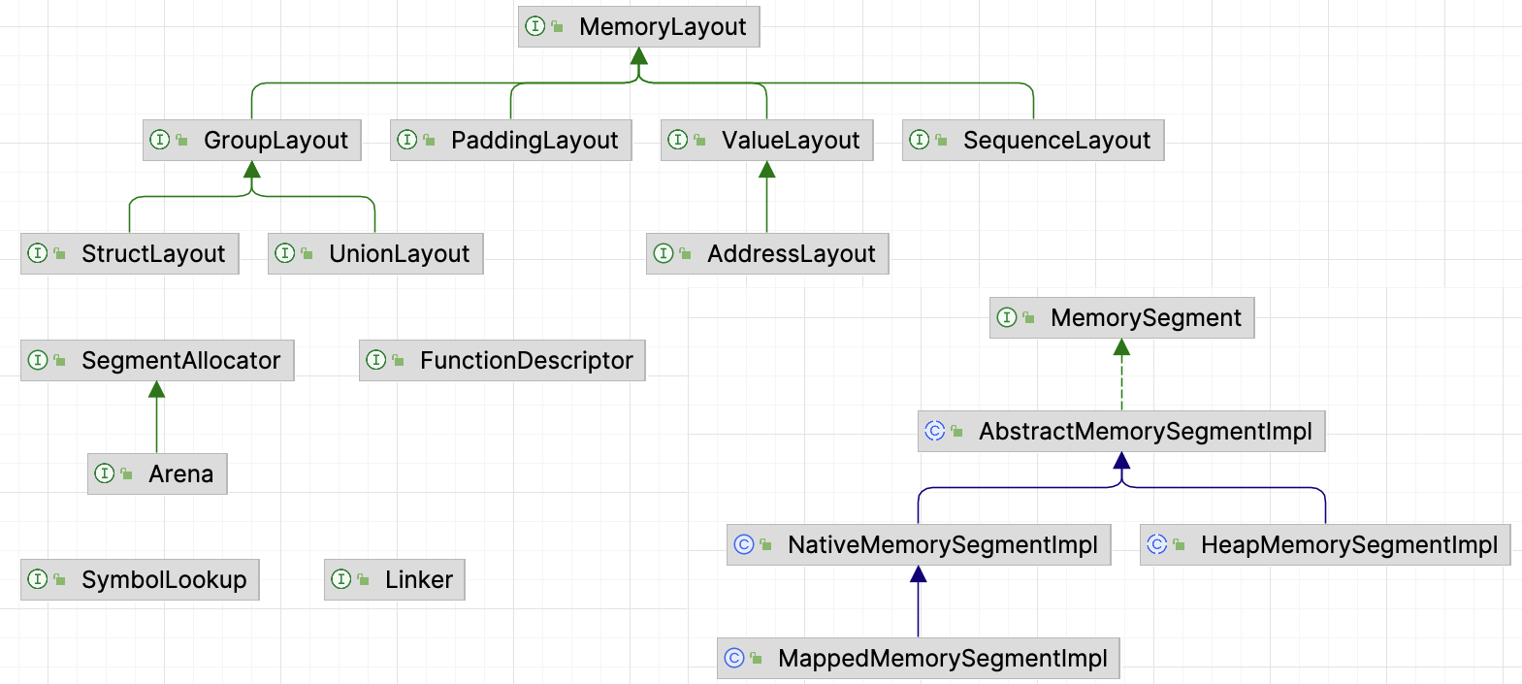
JEP 442.Foreign Function & Memory API
Replacement for JNI, to invoke code from outside the JVM (e.g. C Libraries)
java.lang.foreign

Slide 25
Vector API
To be continued … we’ll see I guess

Slide 26
Play Time (aka. demo)

Slide 27
References
https://openjdk.org/projects/jdk/21
https://www.infoworld.com/article/3689880/jdk-21-the-new-features-in-java-21.html
https://maarten.mulders.it/2020/11/whats-new-in-maven-4
https://www.happycoders.eu/java/virtual-threads/
https://www.happycoders.eu/java/java-21-features/#Scoped_Values_Preview_-_JEP_446
https://github.com/iuliana/jdk21-parent-project
https://maven.apache.org/docs/history.html

