Slide 1


Introducing:
Maven 4,
Java 25 &
Spring 7
Iuliana Cosmina, Oct 2025
https://github.com/iuliana/jdk25-parent-project

Slide 2
Agenda
Maven 4 - what’s new
Java 25 – what’s awesome
Spring 7 – what’s cool

Slide 3





Maven 4 - what’s new

Slide 4
Maven – General things
Very capable and versatile project and build management tool
Relies on pom.xml (Project Object Model )
XML
  Consistent
  Verbose
  Redundant (e.g. DependencyManagement, PluginManagement, and multiple pom.xml)
Introduced standardized project structure, versioning system, artifact identity and idea of a remote repository
Config looks different than code

Slide 5
Maven 4 – JDK changes
Maven 4 requires Java 17 to run, but can still compile against older Java versions by using the Toolchains Plugin
Let me show you…
Notes:
file:///Users/iulianacosmina/Downloads/jdk25-parent-project/toolchains-demo/README.adoc

Slide 6
Maven 4 – POM changes
The information in a pom.xml can be split in 2 categories
  all information and configuration needed to build the artifact (build POM)
  and dependencies needed to build the artifact (consumer POM)
Projects using an artifact (“consumers”) need the second bit, not the first bit
Maven 4 generates a stripped-down consumer POM that removes build information not needed by consumers, and deploys this to the remote repository
Notes:
Maven 4 consume pom – does not contain plugin configuration and POM properties. Maven 4 has declared war on boilerplate configurations.

Slide 7
Maven 4 - Extensions
Consumer POM syntax is still set in stone
Build POM is allowed to evolve. Alternate syntaxes can be supported via a ModelParser SPI
Extensions Under Development
  Mason: https://github.com/maveniverse/mason
  Apache Hocon: https://github.com/apache/maven-hocon-extension
Notes:
Exit and open page

Slide 8
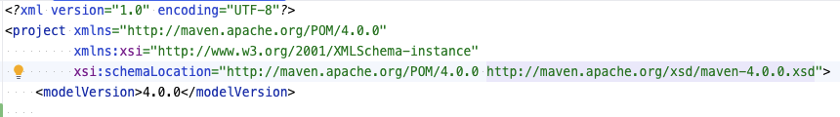
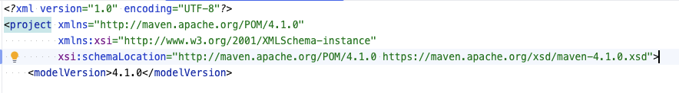
Maven 4 – Schema Updates (1)
Model Version Schema
  Maven 3 is based on POM v4.0.0
  Maven 4 is based on POM v4.1.0
Notes:
file:///Users/iulianacosmina/Downloads/jdk25-parent-project/demos/fancy_pom.xml

Slide 9
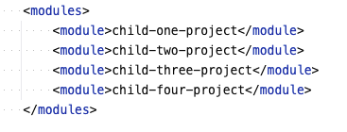
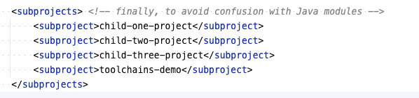
Maven 4 – Schema Updates (2)
modules are now subprojects
Notes:
<modules> can still be used but it is now deprecated.
file:///Users/iulianacosmina/Downloads/jdk25-parent-project/demos/fancy_pom.xml

Slide 10
Maven 4 – Schema Updates (3)
New artifact types
  jar (default): on the class path or on the module path
  classpath-jar: on the class path
  modular-jar: on the module path
  processor: on the annotation processor class path or module path
  classpath-processor: on the annotation processor class path
  modular-processor: on the annotation processor module path
  List of artifact types:
  https://maven.apache.org/maven-core/artifact-handlers.html (currently redirects to 3.9.11)
Notes:
Limitation: As of October 2025, only Maven Compiler Plugin (version 4.0.0-beta-3 and newer) complies with the new types. Other plugins will be updated progressively.

Slide 11
Maven 4 – Schema Updates (4)
New packaging type: bom
  Bill of Materials POM
There is a clear differentiation between build POM and Consumer POM
  Build POM contains plugin configuration and properties
  Consumer POM, the one generated and packed with your artifact does not, which makes it more concise and smaller in size.
Notes:
BOM: This now differentiates between parent POMs and dependency-managing BOMs.

Slide 12
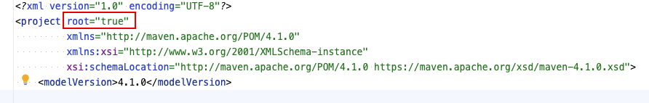
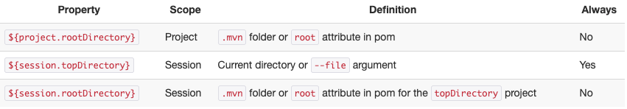
Maven 4 – Schema Updates (5)
Declaring the root directory
  In Maven 3 you would create a .mvn directory and add configuration for subprojects there
  In Maven 4, it is done via POM
  New directory properties
Notes:
file:///Users/iulianacosmina/Downloads/jdk25-parent-project/demos/fancy_pom.xml

Slide 13
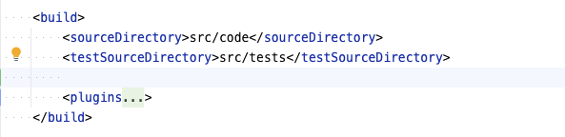
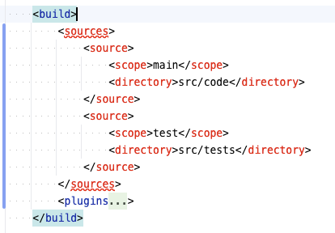
Maven 4 - Schema Updates (6)
New way to declare source directories
Notes:
This does not work yet.
file:///Users/iulianacosmina/Downloads/jdk25-parent-project/child-one-project/pom.xml

Slide 14
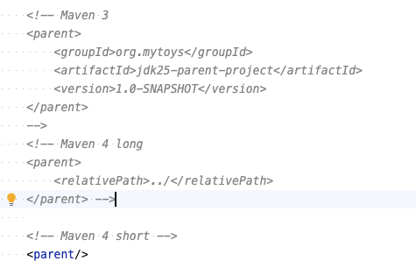
Maven 4 – Automatic Versioning & Parent inference
Notes:
file:///Users/iulianacosmina/Downloads/jdk25-parent-project/child-one-project/pom.xml

Slide 15
Maven 4 – Subprojects discovery
Yeap … <modules .. /> and <subprojects ../> are not always needed anymore
Subprojects are automatically discovered when:
  The parent POM has pom packaging
  No <subprojects ../> or <modules ../> section is explicitly defined
  Direct subdirectories contain a pom.xml file
Notes:
file:///Users/iulianacosmina/Downloads/jdk25-parent-project/pom.xml

Slide 16
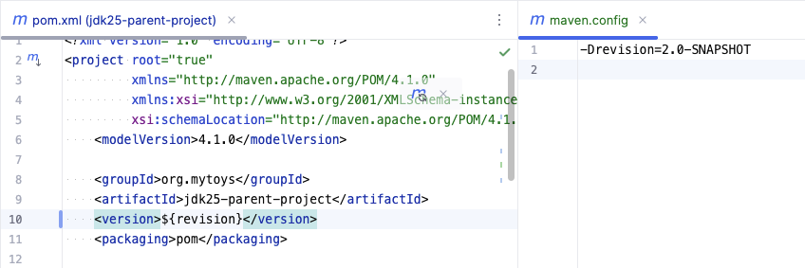
Maven 4 - Full support of CI-friendly variables
Notes:
I mentioned this in my previous Maven presentation too
file:///Users/iulianacosmina/sandbox/jdk25-parent-project/demos/fancy_pom.xml

Slide 17
Maven 4 - Reactor improvements and fixes
Resuming failed builds using
  M3: --resume-from (-rf) :<nameOfTheFailingSubproject>
  M4: --resume (-r) (resume a build from the subproject that last failed)
  --also-make :<nameOfTheDependentSubproject> (fix for bug MNG-6863)

Slide 18
Maven 4 – Deployment Improvements
In Maven 3 deploying a project with multiple subprojects, could end up in a partial-deployed project if any subproject build failed
In Maven 4 all subprojects
  Will be deployed is all builds pass (default value of the deployAtEnd parameter is now true)
  will have consistent timestamps in their packaged archives
Notes:
I haven’t tested this

Slide 19
Maven 4 – Workflow, lifecycle & runtime changes (1)
--fail-on-severity (-fos) parameter - break the build when at least one log message matches the severity of the given argument
  mvn clean install --fail-on-severity=ERROR
  mvn clean install -fos ERROR
Profiles improvements
  Maven 3 – run a build with a non-existent profile fails
    mvn compile "-Pnope"
  Maven 4 – introduces support for non-existent profiles
    mvn compile "-P?nope"
Notes:
-fos does not work yet, does not even appear in the CLI doc
Test profiles:
cd /Users/iulianacosmina/Downloads/jdk25-parent-project/child-three-project

Slide 20
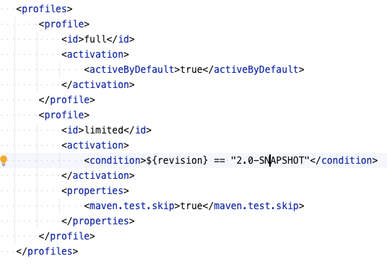
Maven 4 – Workflow, lifecycle & runtime changes (2)
Condition-based profile activation

Slide 21
Maven 4 – Workflow, lifecycle & runtime changes (3)
In Maven 3 the lifecycle is a list of phases
In Maven 4
  the lifecycle is a tree of phases, can be enabled during execution with –b concurrent
  we can skip phases, e.g. artifacts can be deployed (deploy) without being installed (install) to the local repository
  every lifecycle phase now has a before: and an after: phase
  pre-* and post-* phases, are now deprecated
Notes:
The three of phases lifecycle allows for more fine-grained execution of dependent phases.
This is suitable for big projects with intricate dependencies.
file:///Users/iulianacosmina/Downloads/jdk25-parent-project/demos/01-Maven.adoc
before and after are called minor phases, the ones wrapped in them are major phases

Slide 22
Maven 4 – Workflow, lifecycle & runtime changes (4)
In Maven 3 plugins that bind to post-* phases do not execute when the major phase is executed
In Maven 4 plugins that bind to after-* phases do execute, because the executing the major phase includes the after-*
Introduction of new phases
  all - wraps the standard lifecycle phases (validate, compile, test, etc.)
  each - encompasses the entire build of a project
Thus, we can have before:all, after:all, before:each and after:each

Slide 23
Maven 4 – Performance Boosts
Faster build times especially for large multi-module projects
  Improved dependency resolution
  Parallel build enhancements (better use of multi-core processors)
  Reduced memory consumption
  Incremental build improvements
Notes:
Improved dependency resolution – resolution algorithm has been tuned, leading to faster resolution and reduced overhead
Reduced memory consumption – makes it more efficient especially in resource-constrained environments
Incremental build improvements – smarter about detecting changes and rebuilding necessary modules, reducing build times

Slide 24
Maven 4 – API changes
Significant code and API updates, make really old plugins incompatible
Improved encryption through the mvenc CLI
Maven Artifact Resolver is now based on the Java HTTP client
mvnd manages a pool of resident Maven processes, to speed up Maven builds
mvnsh keeps a single Maven process running for as long as the shell remains open
Maven Upgrade Tool : helps automate the migration to Maven 4 process
A lot of bugfixes
Notes:
Build plugin with 3.9 and -Dmaven.plugin.validation=verbose to get all the help to upgrade a plugin
The Maven Artifact Resolver is a library for working with artifact repositories and dependency resolution.
M
mvnd – v. 2.0.0-rc-3

Slide 25
Maven Daemon 2.0.0-rc3
Every mvn command triggers the following:
  Booting Java
  Starting Maven
  Perform the task (execute the goals)
  Tear down
  Exit
Enter mvnd which manages a pool of resident Maven processes
  Improve performance
  Reduces build times

Slide 26

Java 25 – What’s awesome

Slide 27
Java 25
Released on 16th of September 2025
  12 finalized features (1 deprecation)
  4 previews
  1 incubator (the 10!! for Vector API)
  1 experimental (JDK Flight Recorder Improvements for CPU-time profiling on Linux )

Slide 28

Syntax Sugar (mostly)
  JEP506: Scoped Values
  JEP511: Module Import Declarations
  JEP512: Compact Source Files and Instance Main Methods
  JEP513: Flexible Constructor Bodies
  JEP502: Stable Values(Preview)
  JEP507: Primitive Types in Patterns, instanceOf and switch(3rd Preview)
  JEP505: Structured Concurrency (5th Preview)

Slide 29
Scoped Values
  # TODO

Slide 30
Module Import Declarations
  # TODO

Slide 31
Compact Source Files and Instance Main Methods
  # TODO

Slide 32
Flexible Constructor Bodies
  # TODO

Slide 33
Stable Values (Preview)
  # TODO

Slide 34
Primitive Types in patterns, instanceOf and switch (3d Preview)
  # TODO

Slide 35
Structured Concurrency(5th Preview)
  # TODO

Slide 36

Optimizations & Monitoring
  JEP514: Ahead-of-Time Command-Line Ergonomics
  JEP515: Ahead-of-Time Method Profiling
  JEP519: Compact Object Headers
  JEP521: Generational Shenandoah
  JEP518: JFR Cooperative Sampling
  JEP520: JFR Method Timing & Tracing
  JEP509: JFR CPU-Time Profiling (Experimental)

Slide 37

Cryptography and Computations
  JEP508: Vector API (10th Incubator)
  JEP470: PEM Encodings of Cryptographic Objects (Preview)
  JEP510: Key Derivation Function API

Slide 38

Spring 7 – What’s cool

Slide 39
Spring 7
#TODO

Slide 40
References - Maven 4
https://maven.apache.org/whatsnewinmaven4.html
https://maarten.mulders.it/2021/03/introduction-to-maven-toolchains
https://ant.apache.org
https://gradle.org
https://github.com/bazelbuild
https://cstamas.org/blog/2024/09/handling-sensitive-data-in-maven
https://github.com/apache/maven-mvnd
https://maven.apache.org/tools/mvnsh.html

Slide 41
References – Java 25
#TODO

Slide 42
References – Spring 7
#TODO

