Slide 1
Threads and Rabbit Holes
Because sometimes you need to go all the way down
Iuliana Cosmina, January 2026

Slide 2
Agenda
01 | The why
02 | The Threads
03 | The rabbit hole
04 | Conclusions

Slide 3

How did I get Myself into this ?

Slide 4
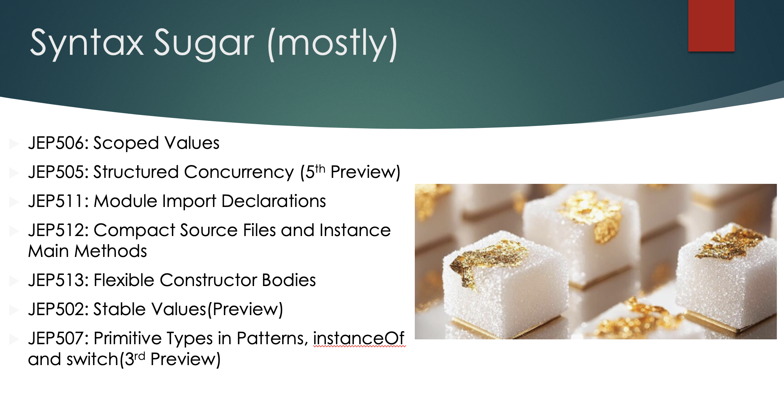
The why

Slide 5
…The why
To explain Scoped Variables I needed to explain 3 things
Platform Threads
Virtual Threads (also Structured Concurrency)
Thread Local

Slide 6
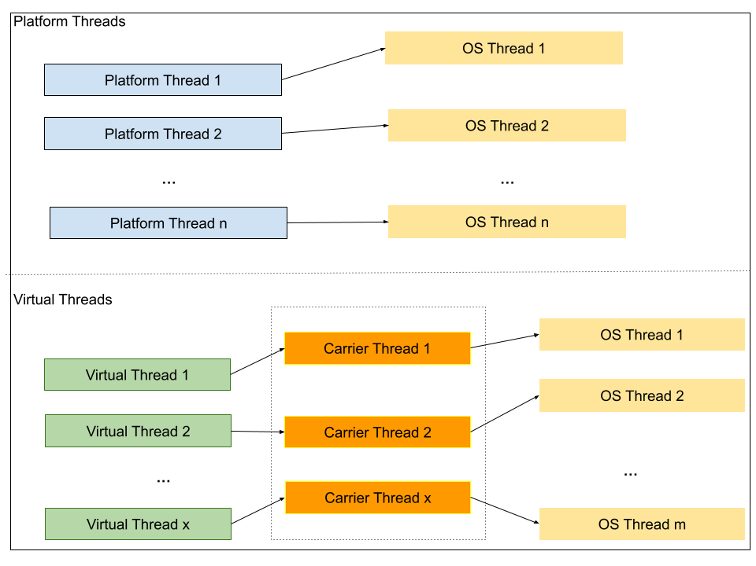
The threads

Slide 7

The Rabbit Hole
Two years ago, Alex asked – How many Virtual threads can you have in a Java application?

Slide 8
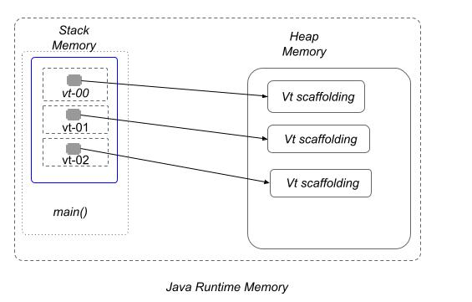
…Down the Rabbit hole I go….
Stack Size
java -XX:+PrintFlagsFinal -version | grep -i threadstack
> ThreadStackSize = 2048 KB = 2 MB
Heap Size
-XX:+PrintCommandLineFlags
> InitialHeapSize=603979776 ~576 MB
> MaxHeapSize=9663676416 ~ 9216MB = 9 GB

Slide 9
…And I go….
Based on thread stack size of 2MB
- Assuming the Vts executions won’t finish instantly, and the GC does not get them, references are implemented as pointers, so 8 bytes per Vt =>
2048 KB = 2048 * 1024 B = 2097152B => ~262144 Vt references before StackOverflowError is thrown.
But wait… do I have CompressedOops enabled?
> java StackOverflow -verbose:gc -Xlog:gc*
> [0.004s][info][gc,init] Compressed Oops: Enabled (Zero based)
This means references can be 4 bytes…
2048 KB = 2048 * 1024 B = 2097152B => ~524288 Vt references before StackOverflowError is thrown.
What this means is that in my main method I had to declare 524288 variables.

Slide 10
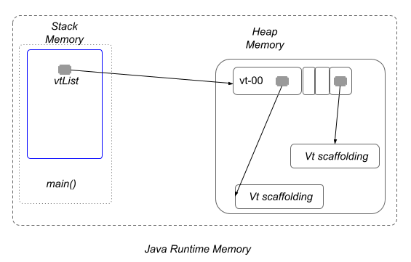
…And I go DEEPER….
No, I cannot put those references in a List, and this I why.

Slide 11
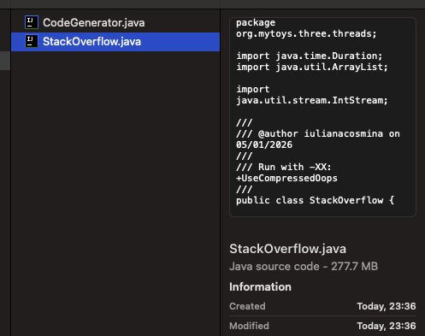
… And Deeper ….
So, I wrote some code to generate this humongous class, I tried to run It and…
Notes:
And I found out that you can have a class too big for the compiler to handle… why?

Slide 12
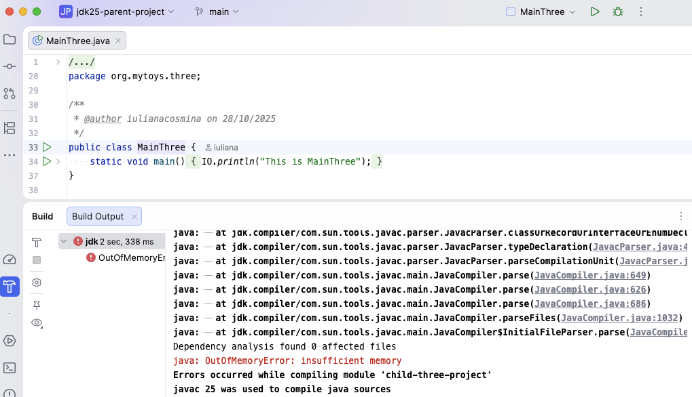
… And bOOM ….
So, I wrote some code to generate this humongous class, I tried to run it … and I annoyed my IntelliJ.
Apparently… a java method must not exceed 65535B = 64MB
Notes:
My main method is clearly bigger than that. That is information I never needed, because I am not a psychopath. Also, I am an adept of hacking my code into pieces that can be read and understood in one glance (sometimes a 30s one, but oh well, what can you do, complex minds can birth complex ideas)
IntelliJ tries to compile the entire project before executing something so yeah … dies every time.

Slide 13

…So, this is Where I stopped ….

Slide 14
…BuT I go DEEPER….
I could make my StackOverflow implementation recursive, write a method to create a Vt, slap a local variable on it, and invoke itself.
Would that do it? …
BUUUUUUUUUUT …
Vt Scaffolding – the virtual thread stack – does not have a fixed size, but …
We know that to execute a Vt its thread stack gets copied onto the platform thread, so technically, if I were to devise a Runnable implementation that when instantiated is exactly 2MB in size
This means I could fit in my heap 9216 /2 = ~4608 Vts
But with a minimal Runnable (Thread.sleep()) - on my mac – 36GB , 14Cores -- I was able to run around 100_000_000 before OutOfMEmeoryError appeared.
And this is where I stopped…
NO.
Notes:
Would that do it? … Well, no, the virtual thread stack is dynamic in size, but probably it is not gonna be smaller than a reference on the stack memory, so you might end up filing your heap, before you fill your stack memory.

Slide 15
…Conclusion….
How many Virtual threads can you run in a Java application ?
On your hardware, your code and VM configurations. Still A LOT more than platform threads though.
Notes:
What is the chorus of this presentation? … say it with me guys… It depends.

Slide 16

Notes:
What is the chorus of this presentation? … say it with me guys… It depends.

