Slide 1
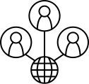

Iulian-Valeriu Cioată and Franca Maria Kiefinger
Social Network Analysis
analysing the effects of the policy intervention on a network cluster

Slide 2
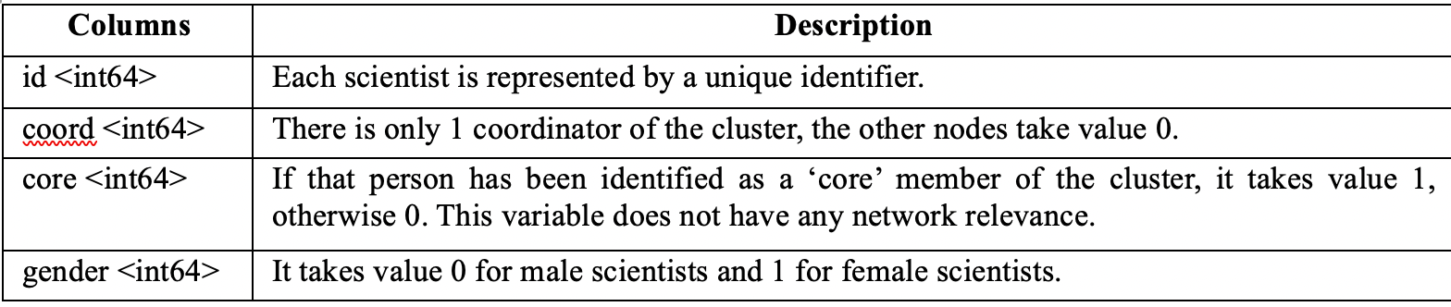

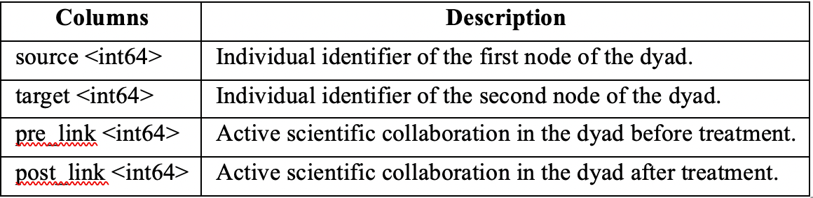
Iulian-Valeriu Cioată and Franca Maria Kiefinger
Data set description
Nodes of the network cluster
Edges of the network cluster
1

Slide 3
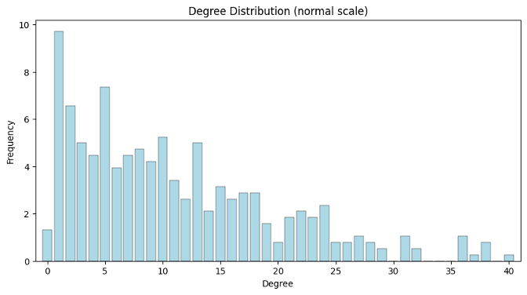

Iulian-Valeriu Cioată and Franca Maria Kiefinger
Basic graph information with NetworkX
Graph G contains:
rapid drop can be observed
381 nodes
2098 edges
disconnected
undirected
graph density of 0,029
most nodes have a low degree; only few nodes have a very high degree
average degree
of 11,013
medium level of connectivity between its nodes
2

Slide 4
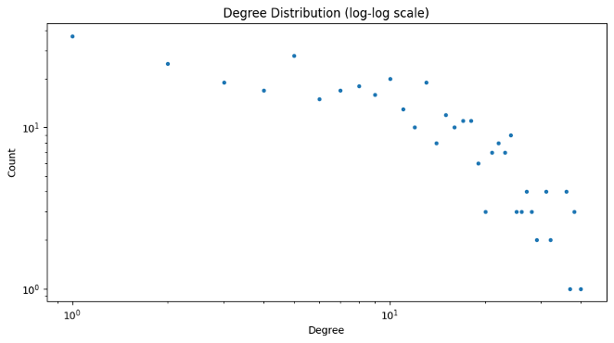
Iulian-Valeriu Cioată and Franca Maria Kiefinger
Basic graph information with NetworkX
Comparison with a theoretical
Erdős-Rényi random network
suggests a social network with random topology, rather than an uniform hierarchy
not high enough to form evident sub-clusters between nodes, but noticeable
degree of scientists’ cluster follows an
heterogenous degree distribution
3

Slide 5
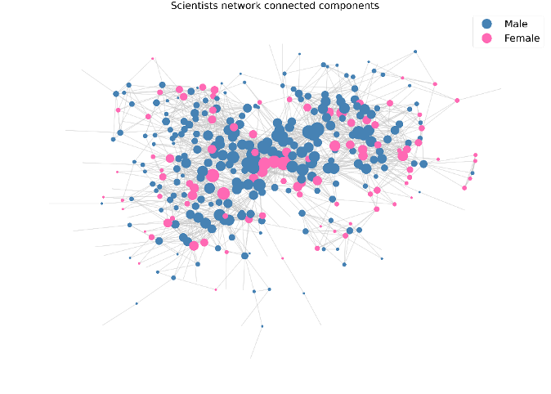
Iulian-Valeriu Cioată and Franca Maria Kiefinger
Basic graph information with NetworkX
nodes’ centrality, meaning the few high degree nodes are more central and influential in the cluster,
11 isolated nodes, connected by 3 edges, from which 6 male and 5 female scientists
average shortest path length of 3,814, nodes are relatively closely connected
information flow is still moderately quick and efficient
4

Slide 6
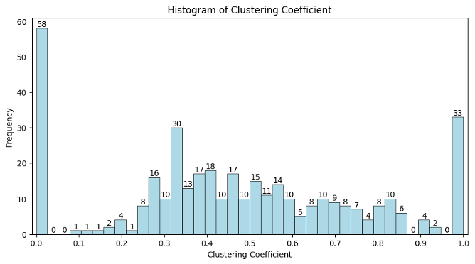
Iulian-Valeriu Cioată and Franca Maria Kiefinger
Basic graph information with NetworkX
Histogram of local clustering coefficient distribution
confirms
approximately 3 levels of hierarchy, around 0, between 0,3 and 0,6 and around 1
average clustering coefficient
of 0,467
moderate tendency of nodes to form clusters or groups with near neighbours
transitivity
(global clustering coefficient) of 0,41
nodes in the network tend to form triangles
5

Slide 7
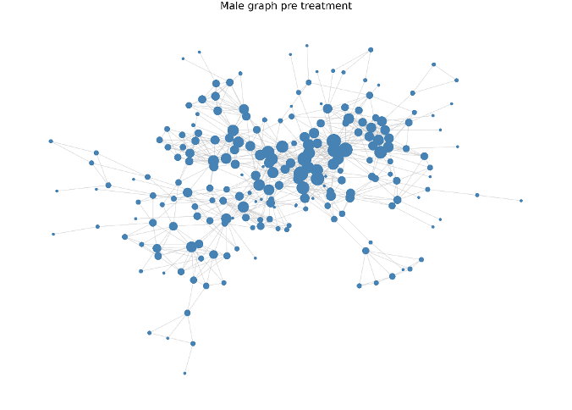
Iulian-Valeriu Cioată and Franca Maria Kiefinger
Time analysis based on gender
Male graph before treatment:
disconnected graph with 271 nodes and 746 edges
Moderate average degree of 5,506
Relatively low average clustering coefficient of 0,35
Moderate transitivity of 0,442
Relatively low average closeness centrality of 0,143
Very low average eigenvector centrality of 0,029
Very low average betweenness centrality of 0,007
post treatment
local clustering coefficient went from relatively low to moderate, neighbours of each male node became moderately well connected to each other
6

Slide 8
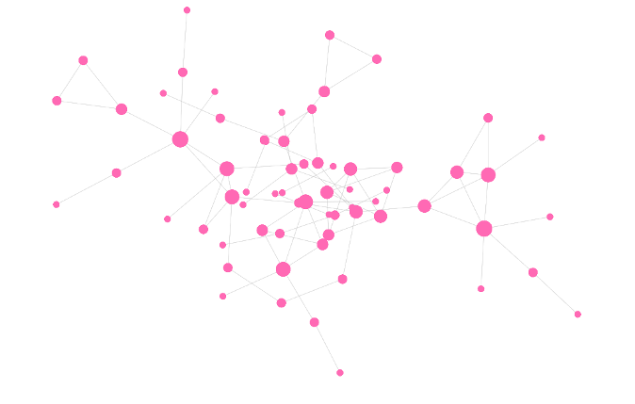
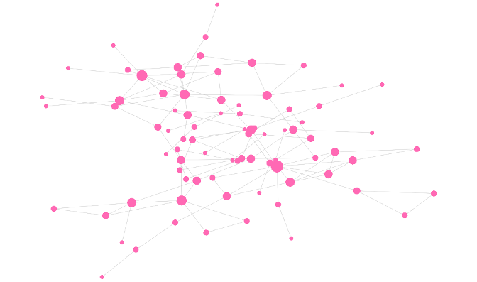
Iulian-Valeriu Cioată and Franca Maria Kiefinger
Time analysis based on gender
female pre treatment
female post treatment
Before: very low graph metrics in all characteristcs
After: better - increased density by strengthening connections -, but still low, 2,8 times less connected than males
7

Slide 9
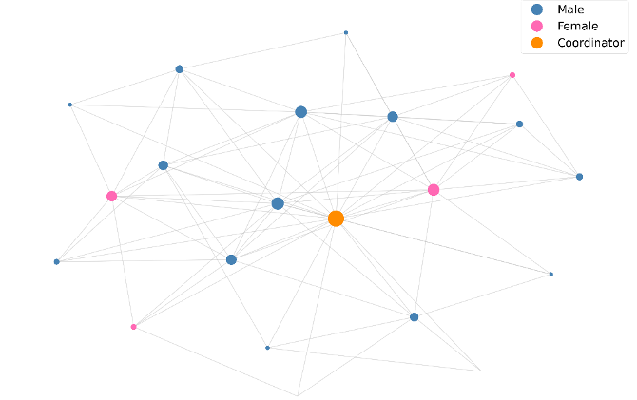
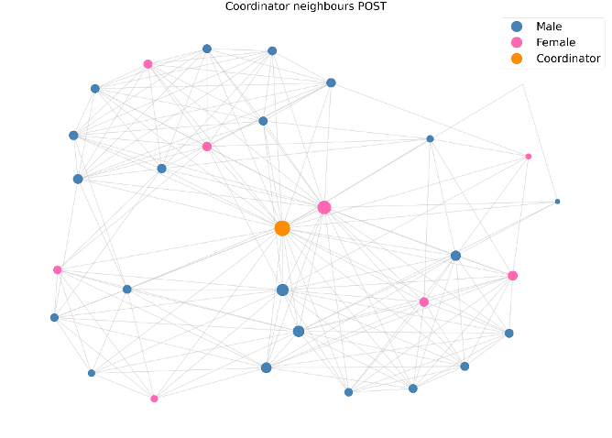
Iulian-Valeriu Cioată and Franca Maria Kiefinger
Time analysis based on gender
coordinator pre treatment
coordinator post treatment
centrality measures improve overall with the degree and eigenvector centrality by more than 1,5 times
gender distribution has improved (71%male, 29% female), still gender imbalance
8

Slide 10
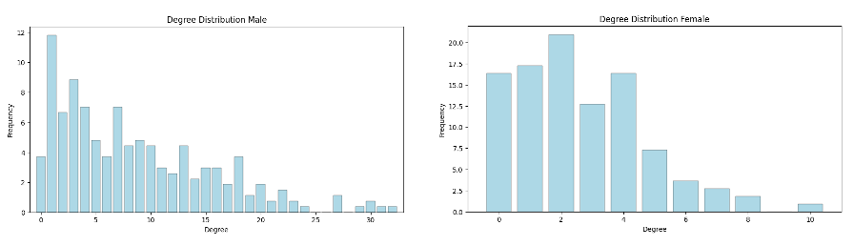
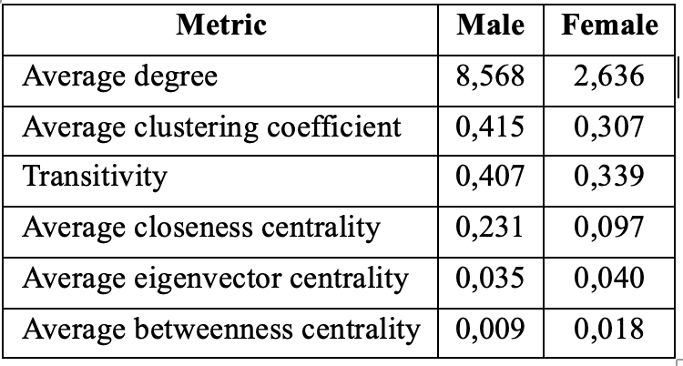
Iulian-Valeriu Cioată and Franca Maria Kiefinger
Gender information for both periods
female degree distribution is more homogenous, meaning that the nodes’ connections are more evenly distributed
male nodes have 3,25 times more connections
male nodes’ neighbours tend to be more connected to each other
female nodes lie on more shortest paths between other nodes in the graph
9

Slide 11
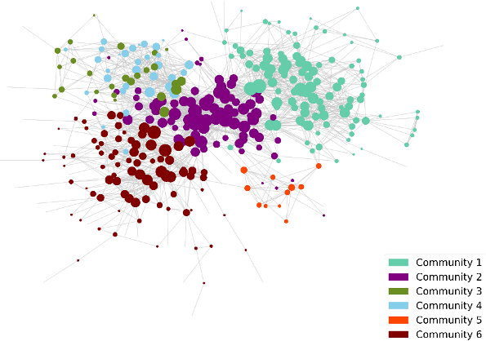
Iulian-Valeriu Cioată and Franca Maria Kiefinger
Community detection
high degree modularity = tight-knit communities
low hierarchical structure = communities overlapping, no strict boarders
Louvain Communities
10

Slide 12
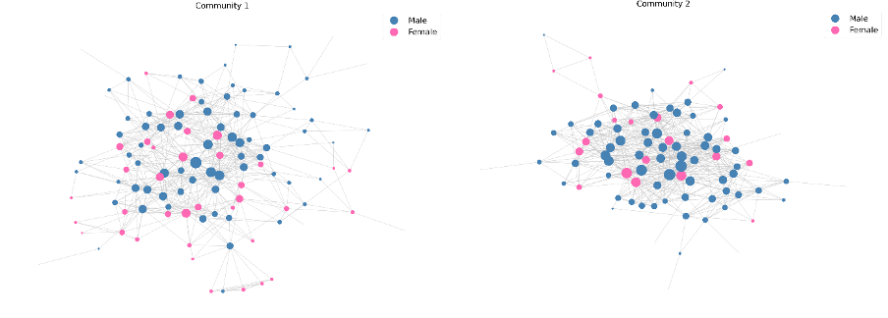
Iulian-Valeriu Cioată and Franca Maria Kiefinger
Community detection
111 nodes
552 edges
low density of 0,09
most balanced gender distribution with 71 males (64.55%) and 39 females (35.45%)
Community 1
Community 2
89 nodes
624 edges
(low) density of 0,159
gender distribution of 65 males (73.86%) and 23 females (26.14%)
degree of 14,022
Cluster Coordinator
11

Slide 13
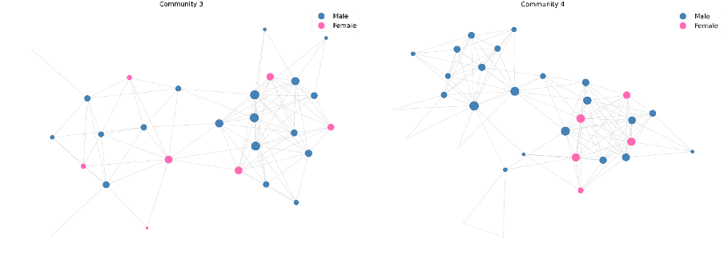
Iulian-Valeriu Cioată and Franca Maria Kiefinger
Community detection
27 nodes
97 edges
moderate density of 0,28
gender distribution with 20 males (74,07%) and 7 females (25,93%)
Community 3
Community 4
31 nodes
126 edges
similar density of 0,27
gender distribution of 25 males (80,65%) and 6 females (19,35%)
maximum local clustering coefficient of 0,765
12

Slide 14
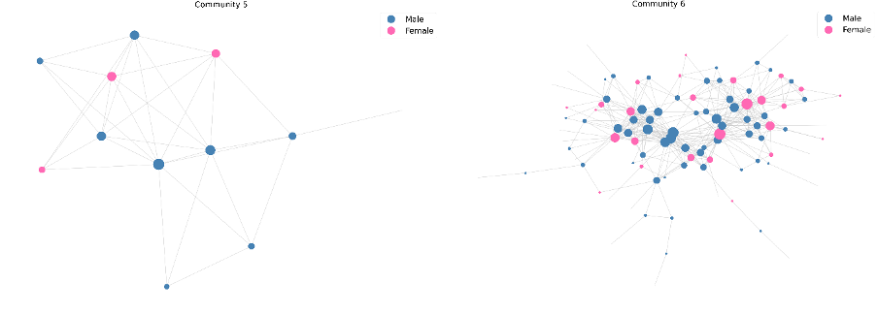
Iulian-Valeriu Cioată and Franca Maria Kiefinger
Community detection
12 nodes
33 edges
high density of 0,5
gender distribution with 71 males (64.55%) and 39 females (35.45%)
degree of 5,5
Community 5
Community 6
100 nodes
396 edges
low density of 0,08
gender distribution of 65 males (73.86%) and 23 females (26.14%)
13

Slide 15
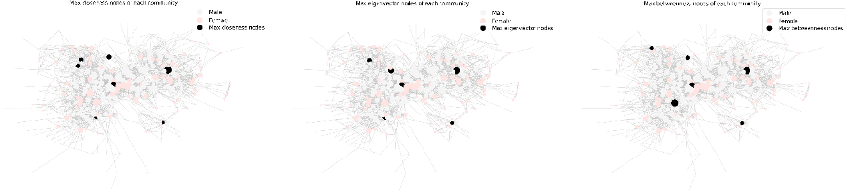
Iulian-Valeriu Cioată and Franca Maria Kiefinger
Community detection
Highest centrality measures on communities
Communities 1, 2, and 5 have one single male central node each.
Communities 4 and 6 have two central nodes, both males, respectively 1 male and 1 female.
Community 3 has three different central nodes, based on each centrality measure, 2 males and 1 female.
14

Slide 16
Iulian-Valeriu Cioată and Franca Maria Kiefinger
Conclusions
Women are significantly underrepresented in the network, coordinator cluster, and each Louvain community, with an approximate 7:2 male-to-female ratio, in both periods.
Results
A slight improvement in women's representation can be observed over time, the major increase seen in their connectivity (degree) and betweenness centrality.
Limitations
Small sample, not to be generalized, and also lack of data information.
15

