Slide 1
Beyond Worst-Case Analysis

Slide 2
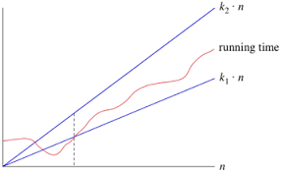

INTRODUCERE

Slide 3
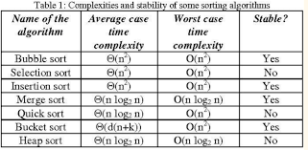
Complexitati algoritmi de sortare

Slide 4
METODA SIMPLEX PENTRU PROBLEME DE PROGRAMARE LINIARA
Simplex Algorithm (Dantzig 1948)
A series of combinations is tried to increase the objective function
Number of iterations less than O(max(M,N))
Worst case complexity is exponential ( in number of variables ) ;
Yet has polynomial “smoothed complexity” ( and works well in practice )

Slide 5
CLUSTERINCA SI PROBLEME NP-DIFICILE DE OPTIMIZARE
Cluster analysis or clustering is the task of grouping a set of objects in such a way that objects in the same group (called a cluster) are more similar (in some sense) to each other than to those in other groups (clusters).

Slide 6
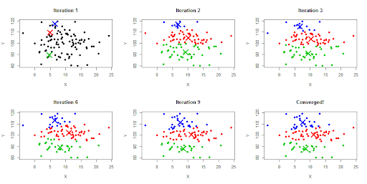
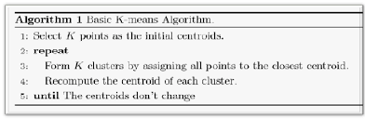
K-Means

Slide 7
POLITICI DE INLOCUIRE CACHE
In computing, cache algorithms (also frequently called cache replacement algorithms or cache replacement policies) are optimizing instructions, or algorithms, that a computer program or a hardware-maintained structure can utilize in order to manage a cache of information stored on the computer. Caching improves performance by keeping recent or often-used data items in memory locations that are faster or computationally cheaper to access than normal memory stores. When the cache is full, the algorithm must choose which items to discard to make room for the new ones.

Slide 8
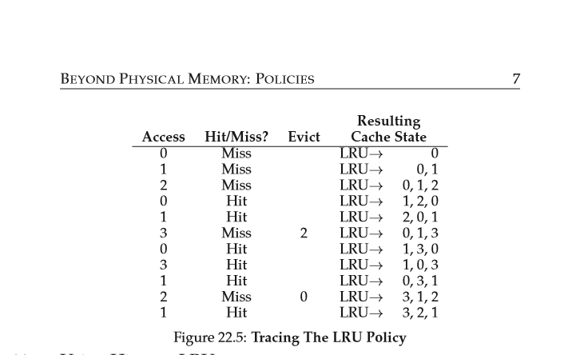
LRU (Least recently used) - example

Slide 9
cONCLUZII
With algorithms, silver bullets are few and far between. No one design technique leads to good algorithms for all computational problems. Nor is any single analysis framework—worstcase analysis or otherwise—suitable for all occasions.

