Slide 1
Dynamical Processes and Graph Transformations
Rumi Ghosh, Shang-Hua Teng, Kristina Lerman & Xiaoran Yan
Xiaoran@isi.edu
Notes:
Hello everyone. Welcome to my very first pecha kucha presentation. The topic is about dynamics on networks, might be a bit too technical for this format. But luckily, we network scientists never run out of pretty pictures to show,

Slide 2
Notes:
Such as this one! The road network of the city of Washington DC, with both the local roads, high ways and their connections. I love networks because they provide intuitive presentations like this , and humans are visual animals after all.

Slide 3
Modeling complex systems
Graph
Advantages
Vertices
Edges
Adjacency Matrix
Visual
Flexible
Mathematical
node id | 1 | 2 | ... | n
1 | A11 | A12 | ... | A1n
2 | A21 | A22 | ... | A2n
... | ... | ... | ... | ...
n | An1 | An2 | ... | Ann
Notes:
They are also very flexible, capable of modeling a lot of different things. Here I am showing a toy wireless network where two nodes are connected if they are within the communication range. Last but not least, networks are mathematically well defined for theoretical derivations, using things like the adjacency matrices.

Slide 4
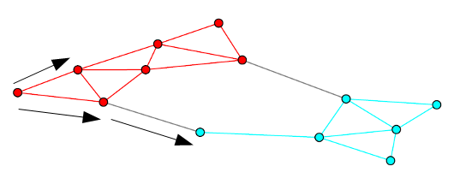


Dynamics on networks
Dynamical processes
Traffic flows
Graph transformations
Epidemics
Propagation of information
Notes:
Similarly, we can also define dynamics on a given network, using the matrices and vectors. Here M is an n by n operator which is related with the adjacency matrix, and \theta is the vector of variables associated with each node. This simple equation could model traffics on road networks, packets on communication networks, and epedemics in populations.

Slide 5
Dynamics on networks
Dynamical processes
Traffic flows
Graph transformations
Epidemics
Propagation of information
node id | 1 | 2 | ... | n
1 | W11 | W12 | ... | W1n
2 | W21 | W22 | ... | W2n
... | ... | ... | ... | ...
n | Wn1 | Wn2 | ... | Wnn
Notes:
Naturally, with different dynamics our perceptions of the structure is changed even for the same topology. Different roads are congested at different time of the day and we can alter communication structures by changing the protocols. That is why we think it is important to consider not just the network topology, but the dynamics as well.

Slide 6


Unbiased random walk
Discrete equations
Notes:
Let us start with the simplest dynamics of all, the unbiased random walk. At each time, the walker simply jumps to a neighbor uniformly at random. Although it might seems extremely simple, unbiased random walk actually connects many important aspects of network structure under a single framework.

Slide 7
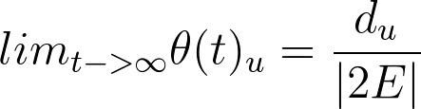
Vertex Centrality
Notes:
For example, the random walk converge to a stationary distribution which is proportional to node degrees. Degree centrality is one of the most basic measures of how important a node is in the system.

Slide 8
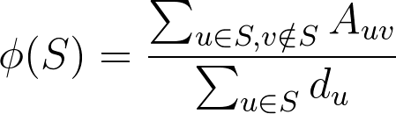
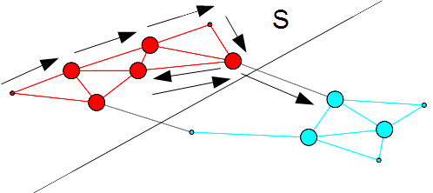
Community Structure
Notes:
Random walk is also related to communities which is defined as groups of nodes with a lot of internal connections. The random walker will stay in a community for a long time before it jump to the other side. A mathematical definition of this idea is the conductance, which is the standard measure for graph partitioning.

Slide 9
Generalizing the URW
L=(D-A)D⁻¹
L=(D_{W}-BAB)D_{W}⁻¹
Biases
Parameterized by B
Equivalent to a UBW on W=BAB
Consider the Biased walk
Notes:
So this is a good start for connecting structures to dynamics. How do we generalize the simple unbiased random walk? Introduce the biases using the B matrix ! They can be routing strategies in communications, could be navigation directions in road networks.

Slide 10
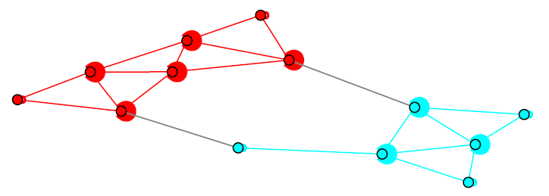
Generalizing the URW
L=(D-A)D⁻¹
L=(D-A)D⁻¹T⁻¹
Delays
Parameterized by T
Waiting time at vertex i is exponentially distributed as
Model the random jumps as a Poisson process
Notes:
We can also specify different time delays or how fast the random walk jumps at each node, This is done using the matrix T. It could represent waiting queues, congestions or susceptibilities to epidemic.

Slide 11
Reweighing transformation
Scaling transformation
Parameterized by B (diagonal)
Parameterized by T (diagonal)
Similarity transformation
Parameterized by ρ
Biases
Change of basis
Local delay time
T : delay matrix
W : interaction matrix
D_{w} : degree matrix of W
ρ = 1/2 :
consensus
ρ = -1/2 :
random walk
Notes:
Biases change the spatial trajectory of the random walk, and delays controlls the temporal pace. and we also have the change of basis parameter rho. Combined, we have the parameterized Laplacian family

Slide 12
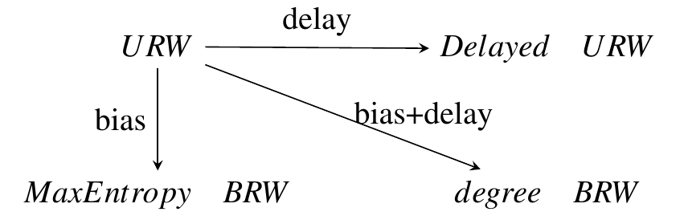
Parameterized Laplacian
Notes:
Under this family, different dynamics are related with each other with linear transformations. And since we consider the structure as a composite function of both topology and dynamics, these transformation of the dynamics can be realized by a equivalent transformation of the topology.

Slide 13
Generalizing the URW
L=(D_{W}-BAB)D_{W}⁻¹
L=(D-A)D⁻¹
L=(D-A)D⁻¹T⁻¹
L=(D-A)D⁻¹
Notes:
For example, the random walk on top left is biased towards high degree node. It is equivalent to an unbiased one with heavier edges connecting the high degree nodes on top right. The delayed random walk on bottom left is equivalent to a simple random walk with the delayed nodes augmented with self-loops, which I showed on bottom right.

Slide 14
Parameterized Laplacian
Reweighing transformation
Scaling transformation
Parameterized by B
Parameterized by T
W = BAB
Node delays
Notes:
And we can composite such equivalent transformations to cover the whole family of parameterized Lapalcian. This allows us to employ many existing tools and algorithms built for simple random walks. This also means I can can simply show the pretty pictures instead of mathematical equations

Slide 15
Parameterized Centrality
Special cases
Degree centrality
Eigenvector centrality
Page rank
…
Notes:
Here is a simple example. On top we have the unbiased random walk which converges to the degree centrality. The maximum entropy random walk at the bottom converges to the eigenvector centrality. We can visually see that now nodes closer to center of mass is weighted even higher.

Slide 16
Parameterized Conductance
Special cases
Notes:
For community structures, the maximum entropy random walk puts the boundary node to the opposite side because the bias has lead to a cheaper cut. Notice here it is important to keep the structural measures consistent, as it does not make much sense to use eigenvector centrality with the standard conductance as they imply different dynamics .

Slide 17
Local clustering
Notes:
The idea of random walk dynamics can also be used to do local graph partitioning. By controlling the where the random walk starts and the size of target communities, we can discover local structures at certain part of the network.

Slide 18
Multi-layer structures
Notes:
We can also apply the transformations to different parts of the graph, where different dynamics are unfolding at the same time. This is especially suitable for multilayer structures where each layer naturally represents a different type of interaction.

Slide 19
The road network example
Notes:
That is what I did in this multilayer road network of Warshington DC. I have done some basic transformations, like give higher way edges heavier weights and intersections of local roads longer delays. And the graph partition here is the result of me playing around seed node and biases by making very simple assumptions about how people navigate.

Slide 20
With real data
Traffic dynamics
Transformed graph: Origin-destination matrix
Original graph: Road network
Dynamics: local navigation rules
Efficient navigation
Road network design
Notes:
Now imagine what we can do with the real data set and the domain expertise you guys have here at Senseable City Lab. For example, we can actually empirically measure transformed graph with the origin-destination matrix​, which allows us to reason about the navigation patterns with more complicated dynamics. We can explore better routing strategies or efficient road network designs by studying their interactions with each other. The potential is limitless, and that is why I am so excited about this opportunity. Thank you.

